Slide 1
Jerusalem, My Happy Home
GOING HOME
CM
Words: | from text by Augustine Aureilus (353-430)
Music: | A. D. Fillmore
3/4
A^{b}/C - MI
Verses: 3
Lead - | MI
Alto - | SOL
Tenor - | DO
Bass - | DO
PDHymns.com

Slide 2
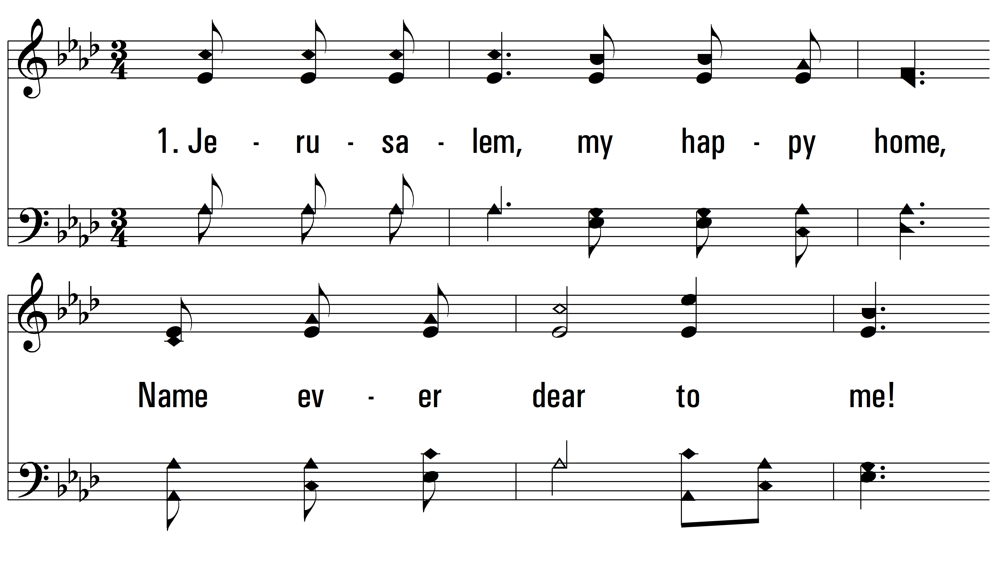
vs. 1 ~ Jerusalem, My Happy Home

Slide 3
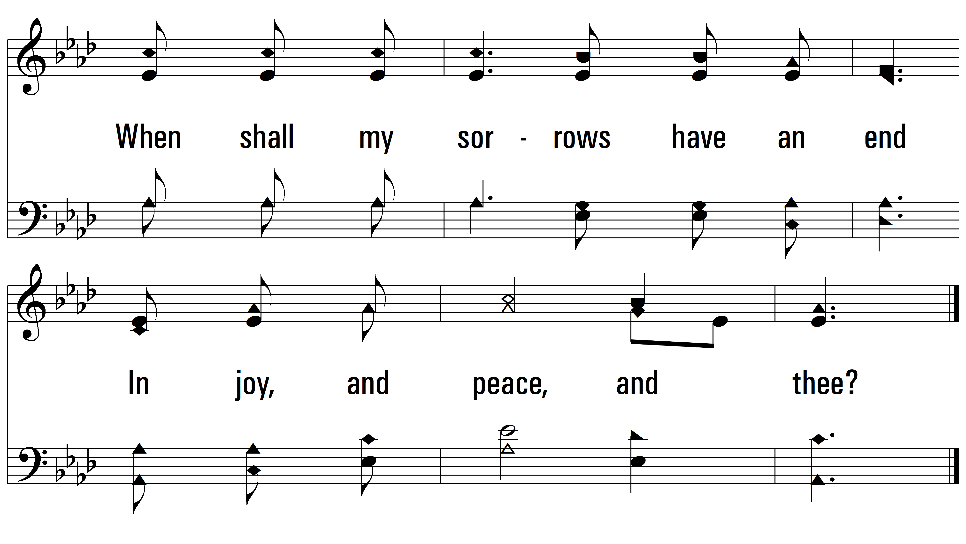
vs. 1

Slide 4
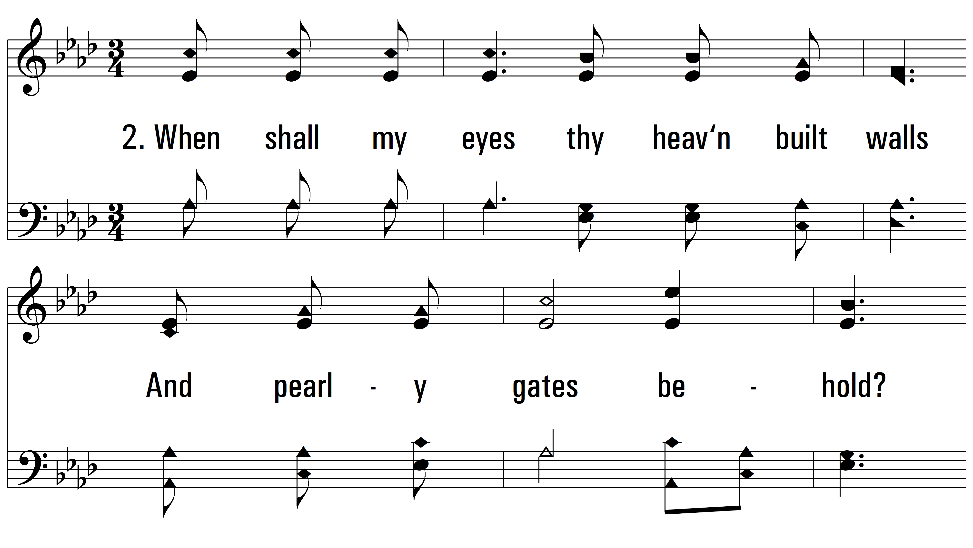
vs. 2 ~ Jerusalem, My Happy Home

Slide 5
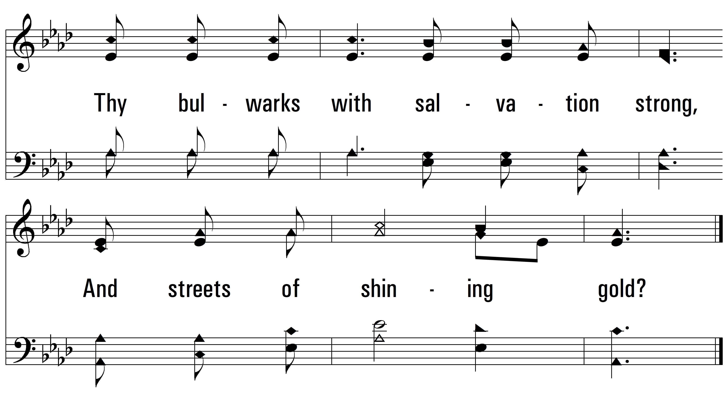
vs. 2

Slide 6
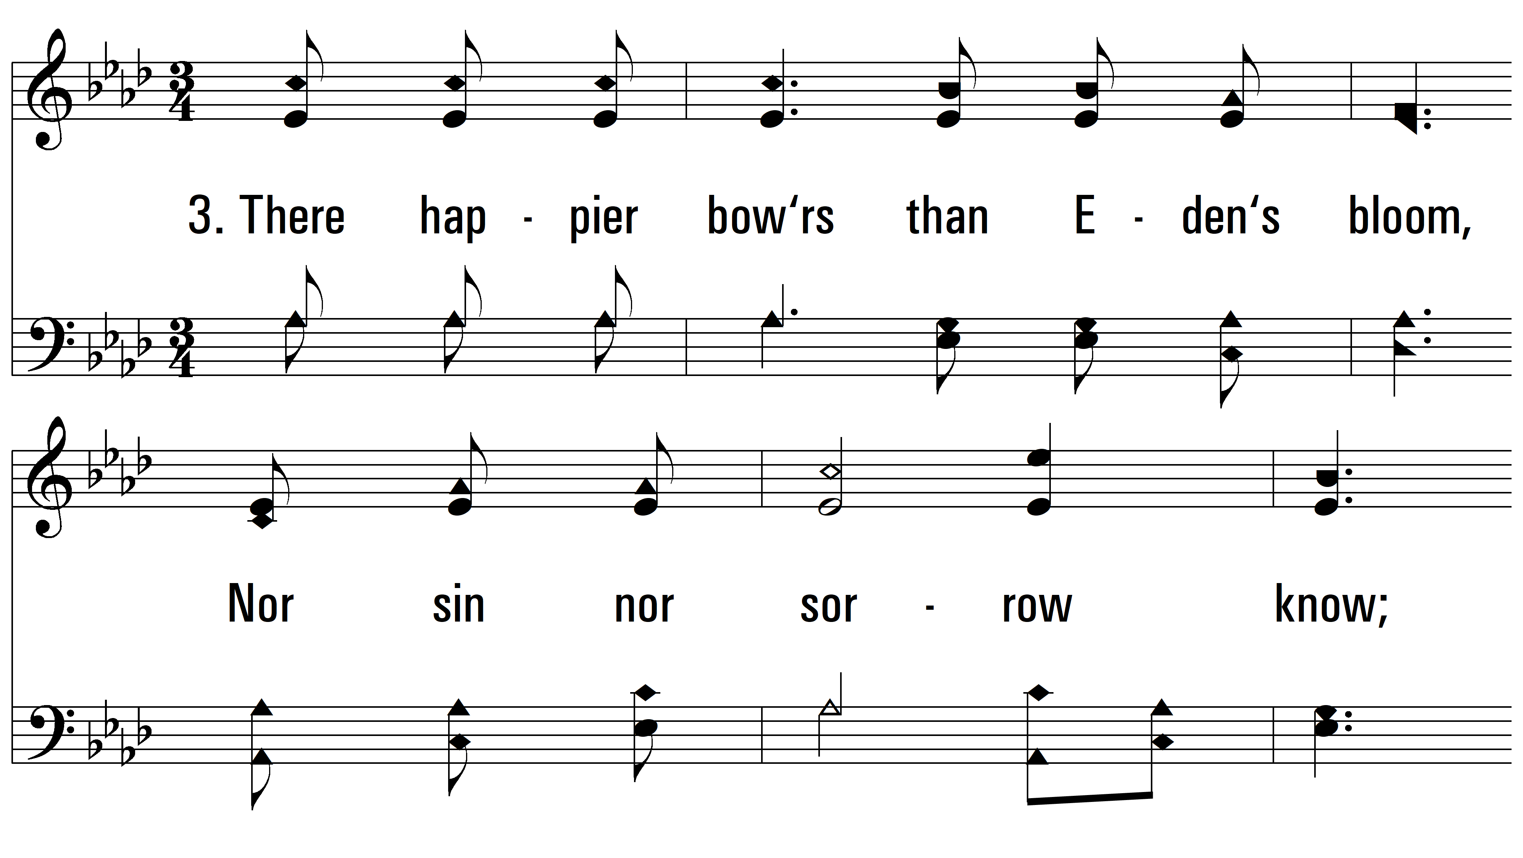
vs. 3 ~ Jerusalem, My Happy Home

Slide 7
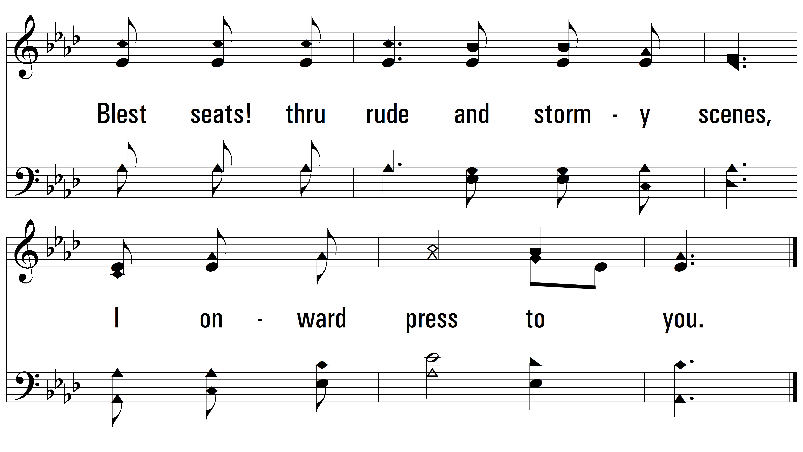
vs. 3
PDHymns.com
END

