Slide 1
Ivory Palaces
Words: | Henry Barraclough (1915)
Music: | Henry Barraclough (1915)
6/4
E/B - SOL
Verses: 4/Chorus
Lead - | SOL
Alto - | SOL
Tenor - | SOL
Bass - | SOL
PDHymns.com

Slide 2
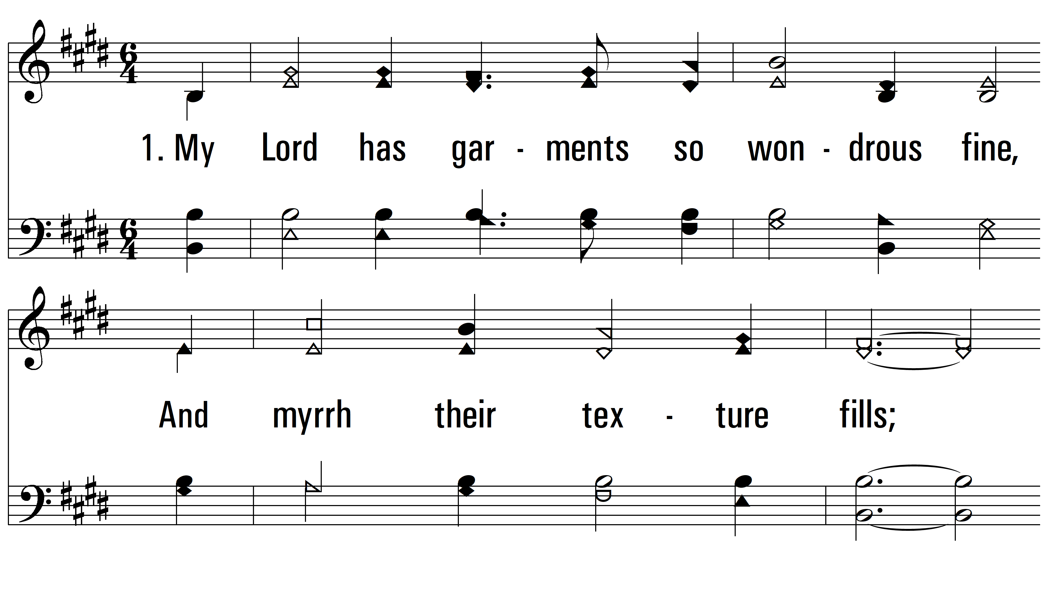
vs. 1 ~ Ivory Palaces

Slide 3
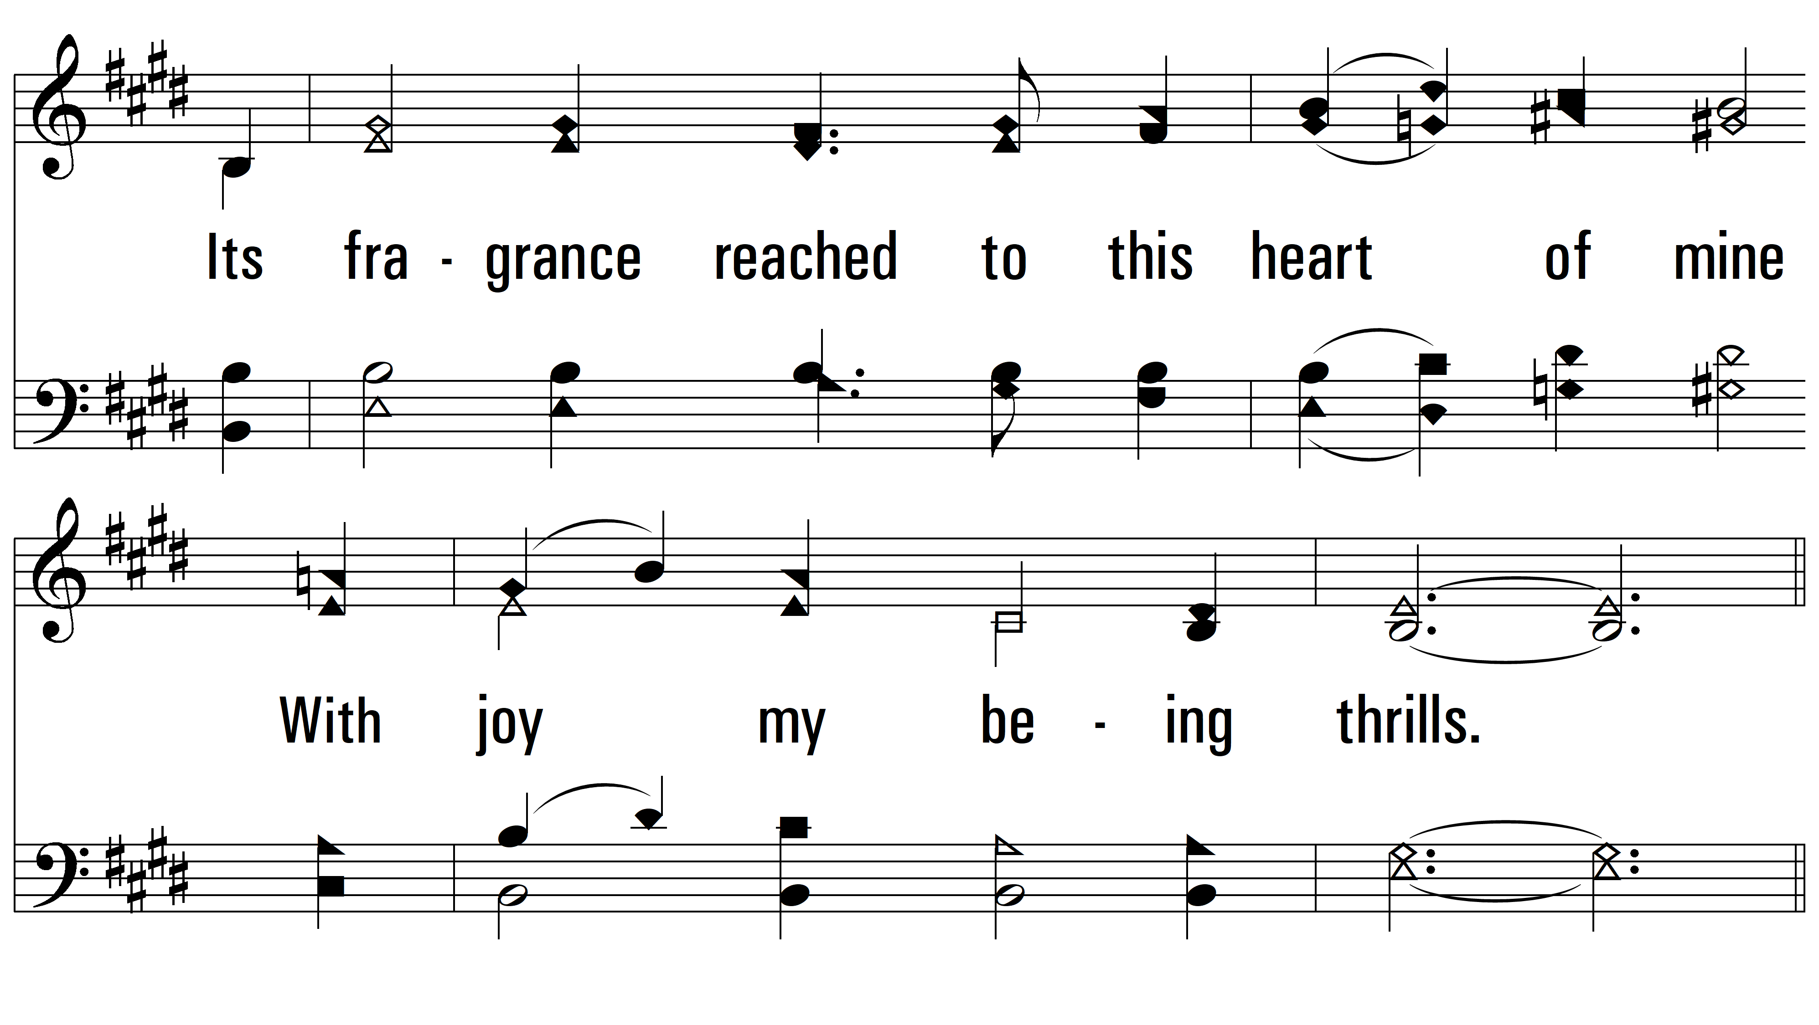
vs. 1

Slide 4
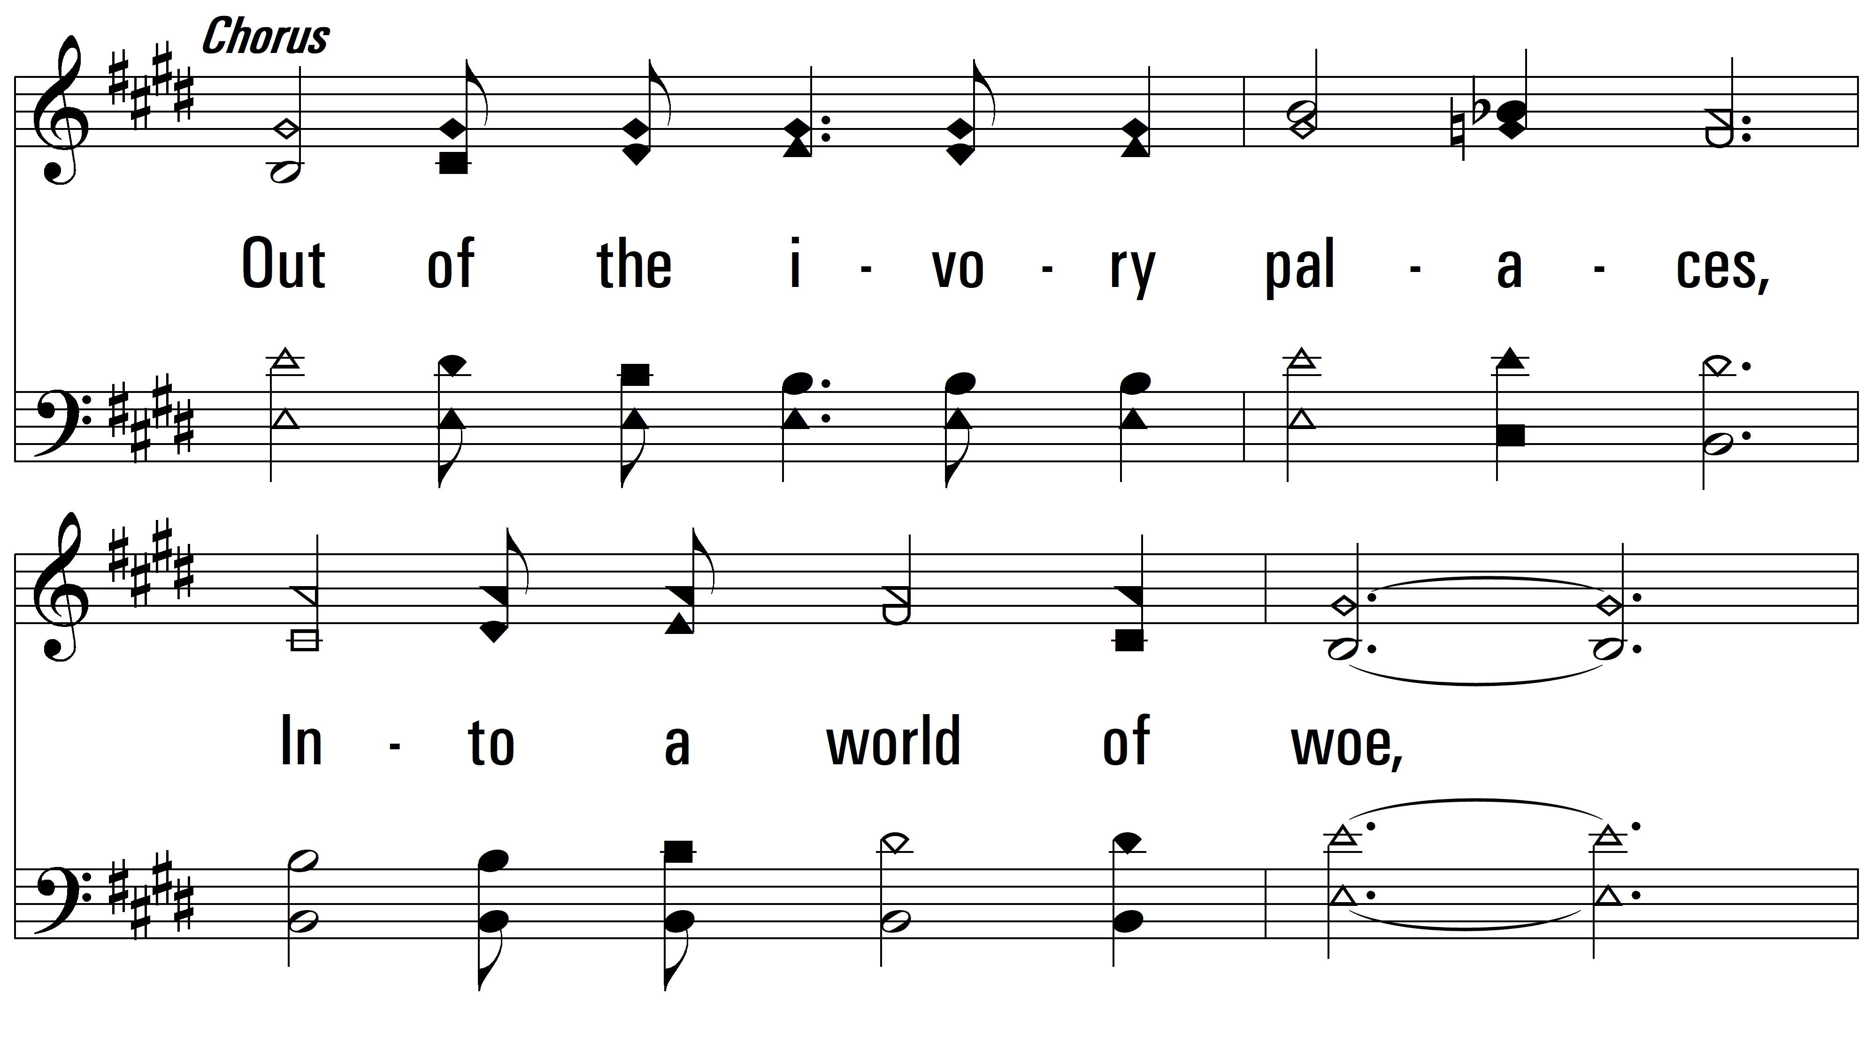
vs. 1

Slide 5
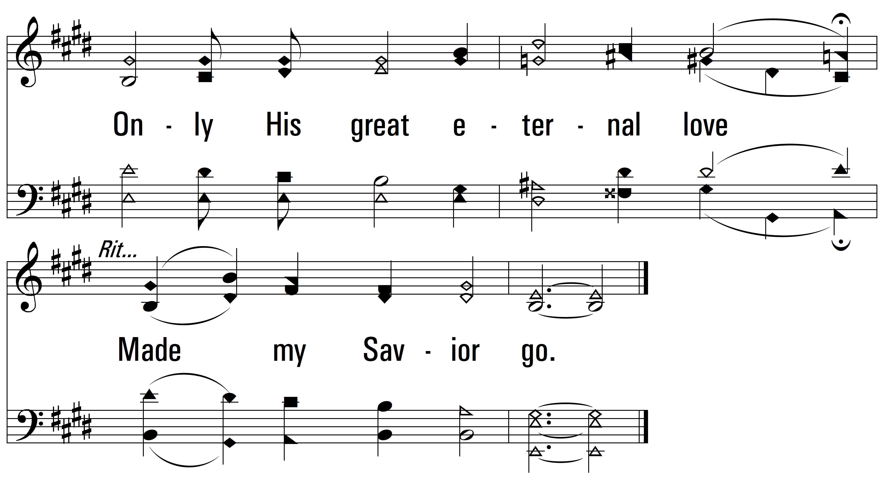
vs. 1

Slide 6
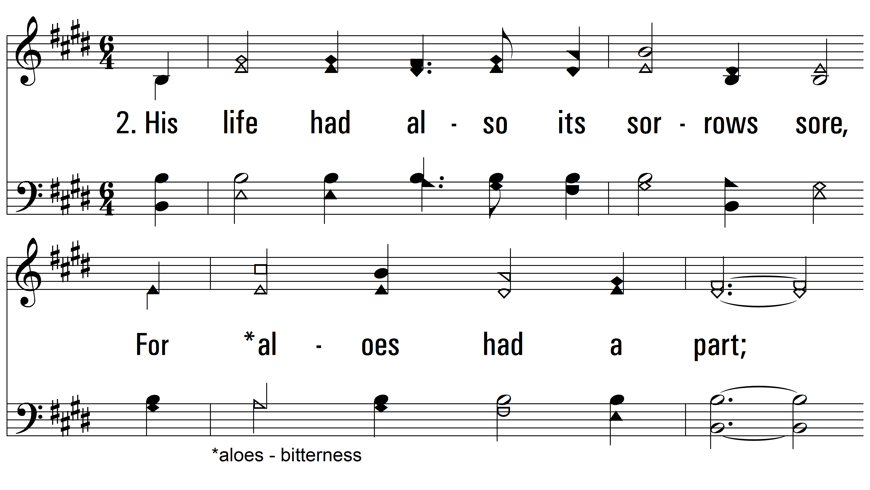
vs. 2 ~ Ivory Palaces

Slide 7
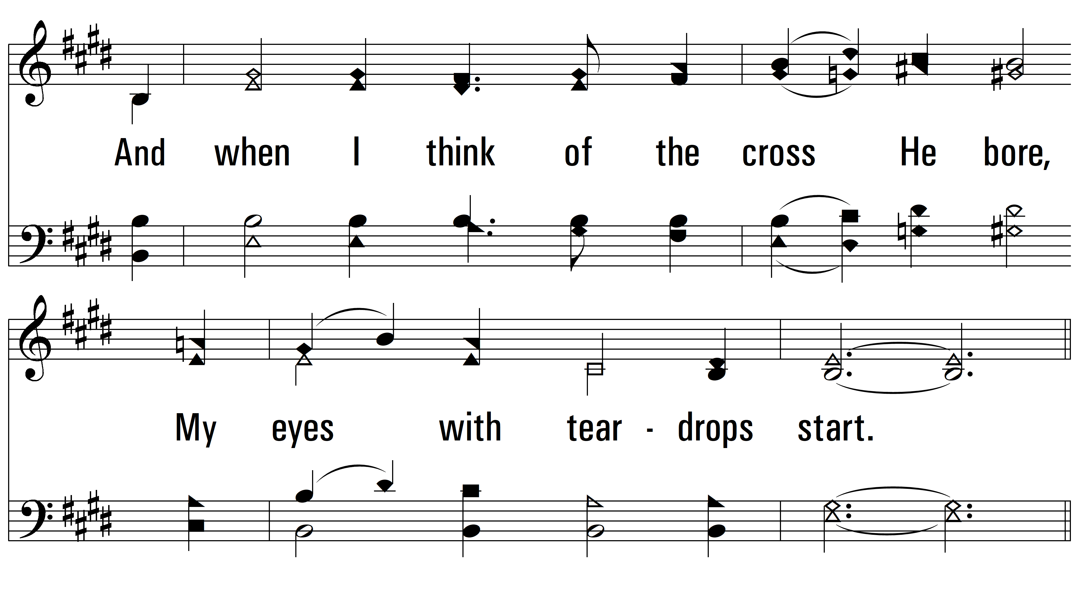
vs. 2

Slide 8
vs. 2

Slide 9
vs. 2

Slide 10
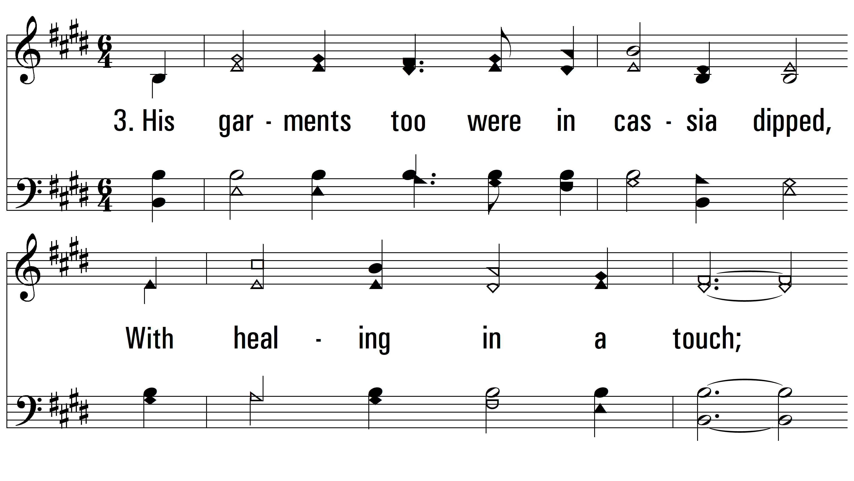
vs. 3 ~ Ivory Palaces

Slide 11
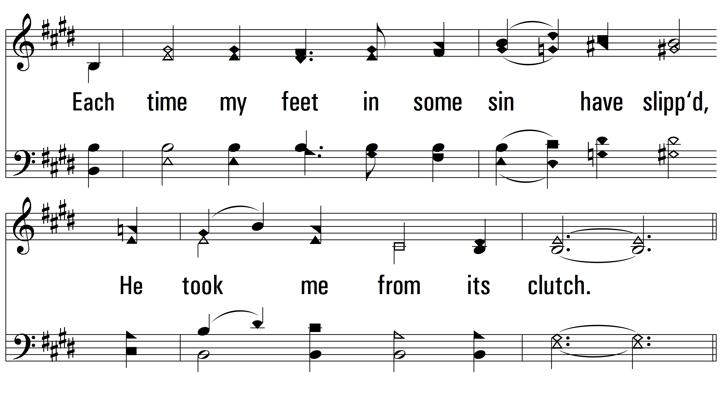
vs. 3

Slide 12
vs. 3

Slide 13
vs. 3

Slide 14
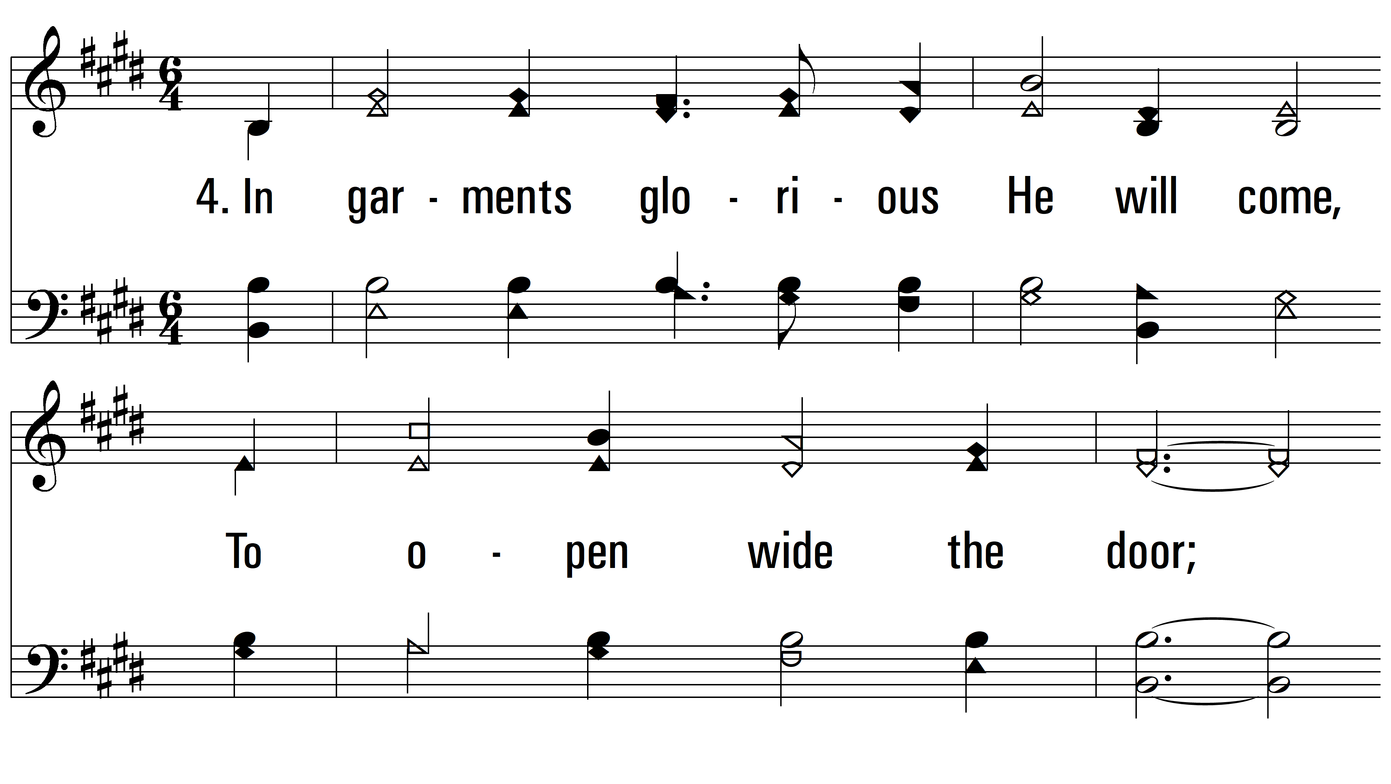
vs. 4 ~ Ivory Palaces

Slide 15
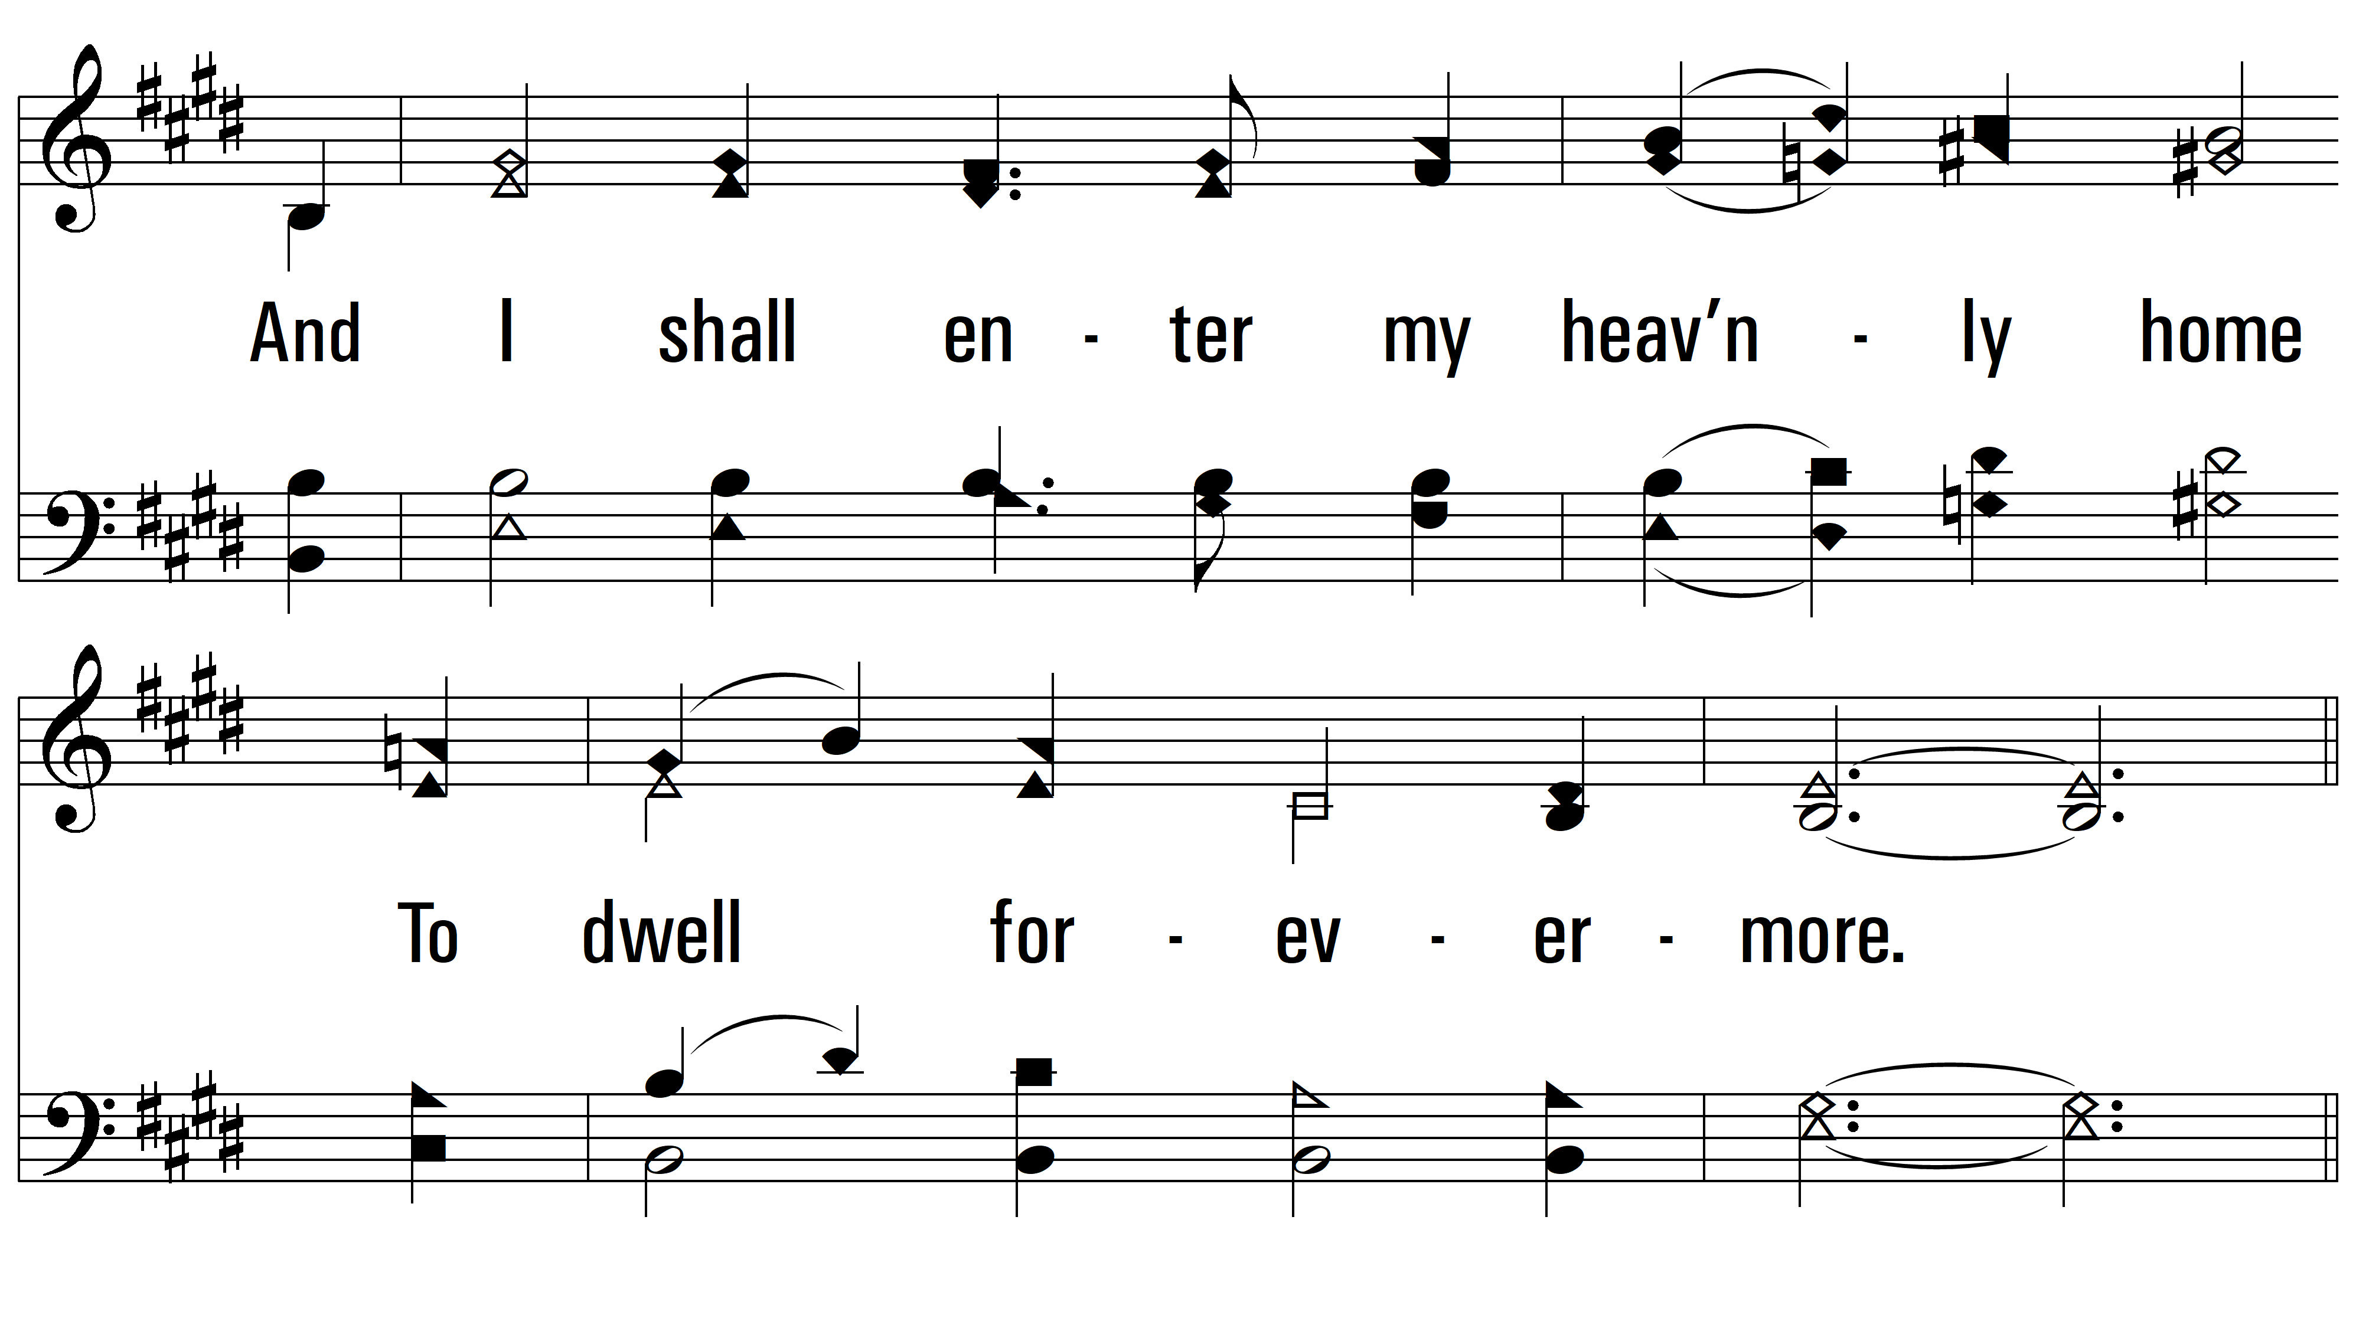
vs. 4

Slide 16
vs. 4

Slide 17
vs. 4
PDHymns.com
END

