Slide 1
It’s Me
Words: | Traditional Spiritual
Music: | Traditional Spiritual
4/4
G/B - MI
Verses: 4/Chorus
Lead - | MI
Alto - | DO
Tenor - | SOL
Bass - | DO
PDHymns.com

Slide 2
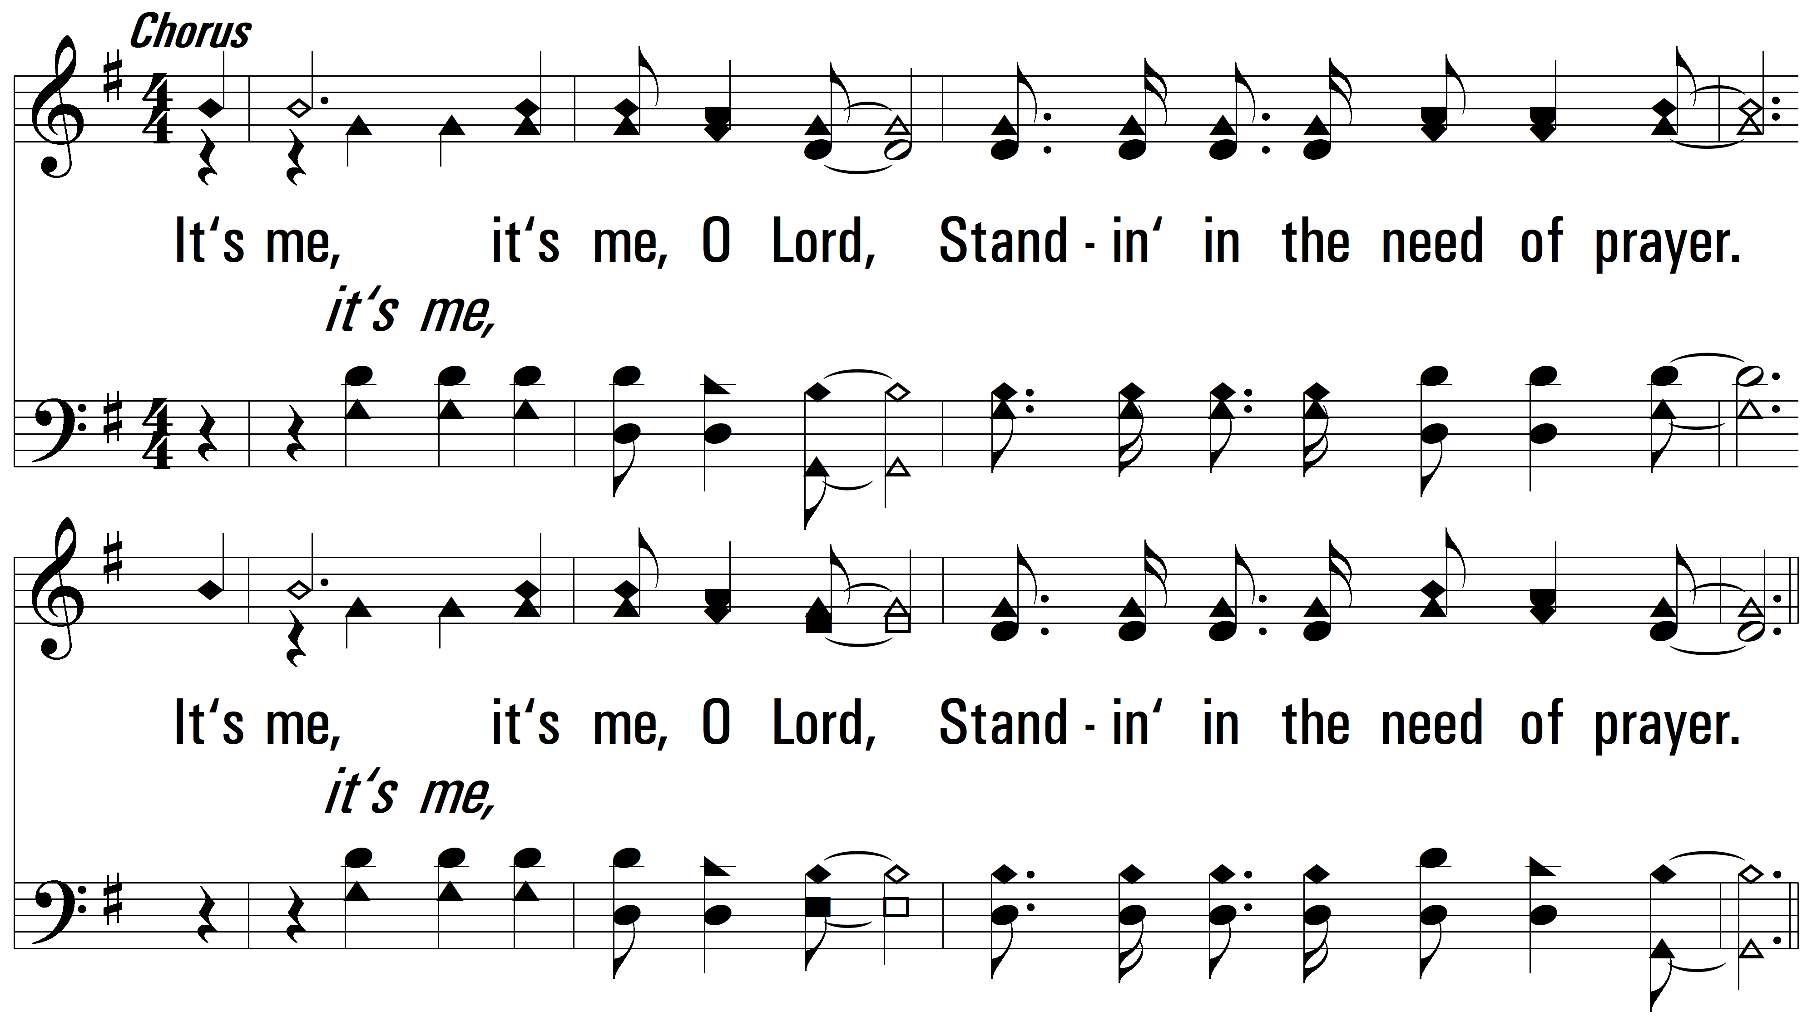
Chorus

Slide 3
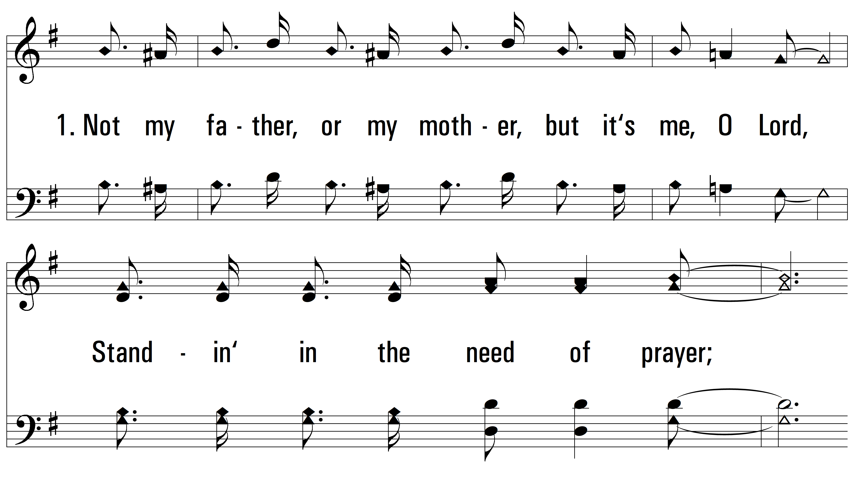
vs. 1 ~ It’s Me

Slide 4
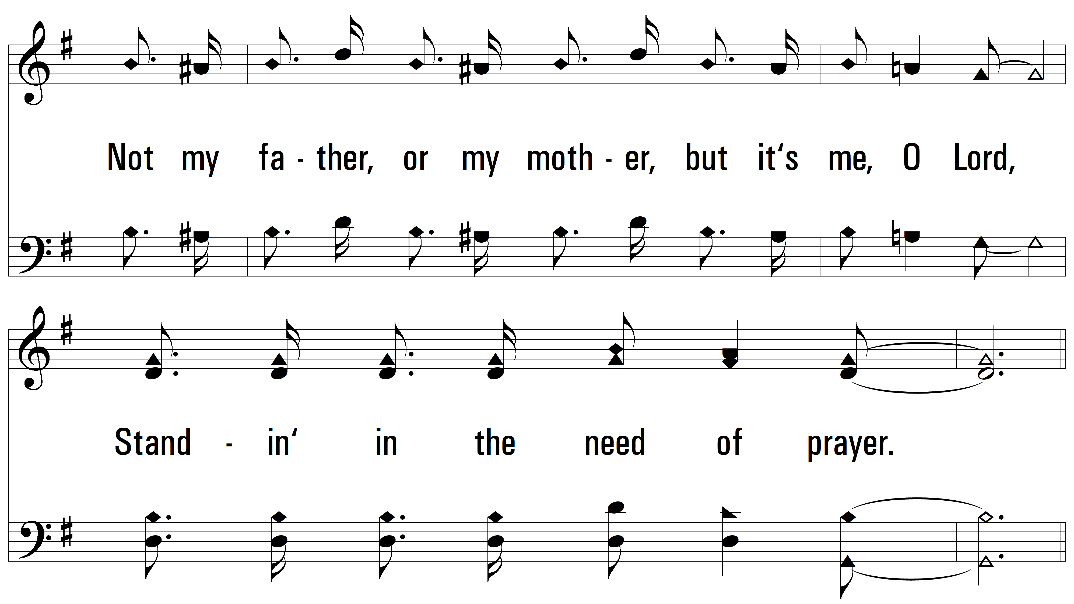
vs. 1

Slide 5
vs. 1

Slide 6
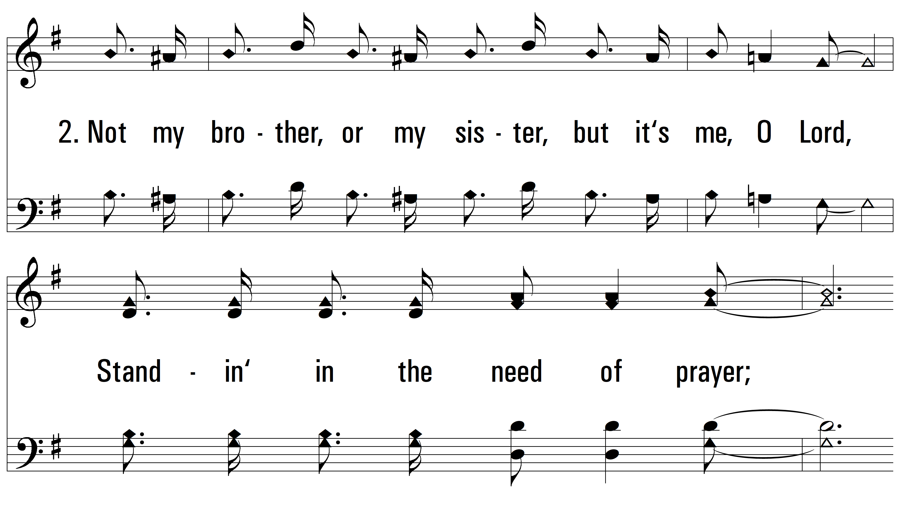
vs. 2 ~ It’s Me

Slide 7
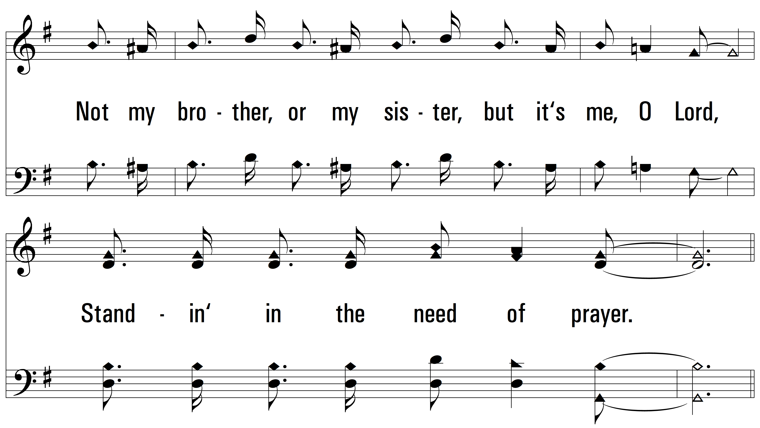
vs. 2

Slide 8
vs. 2

Slide 9
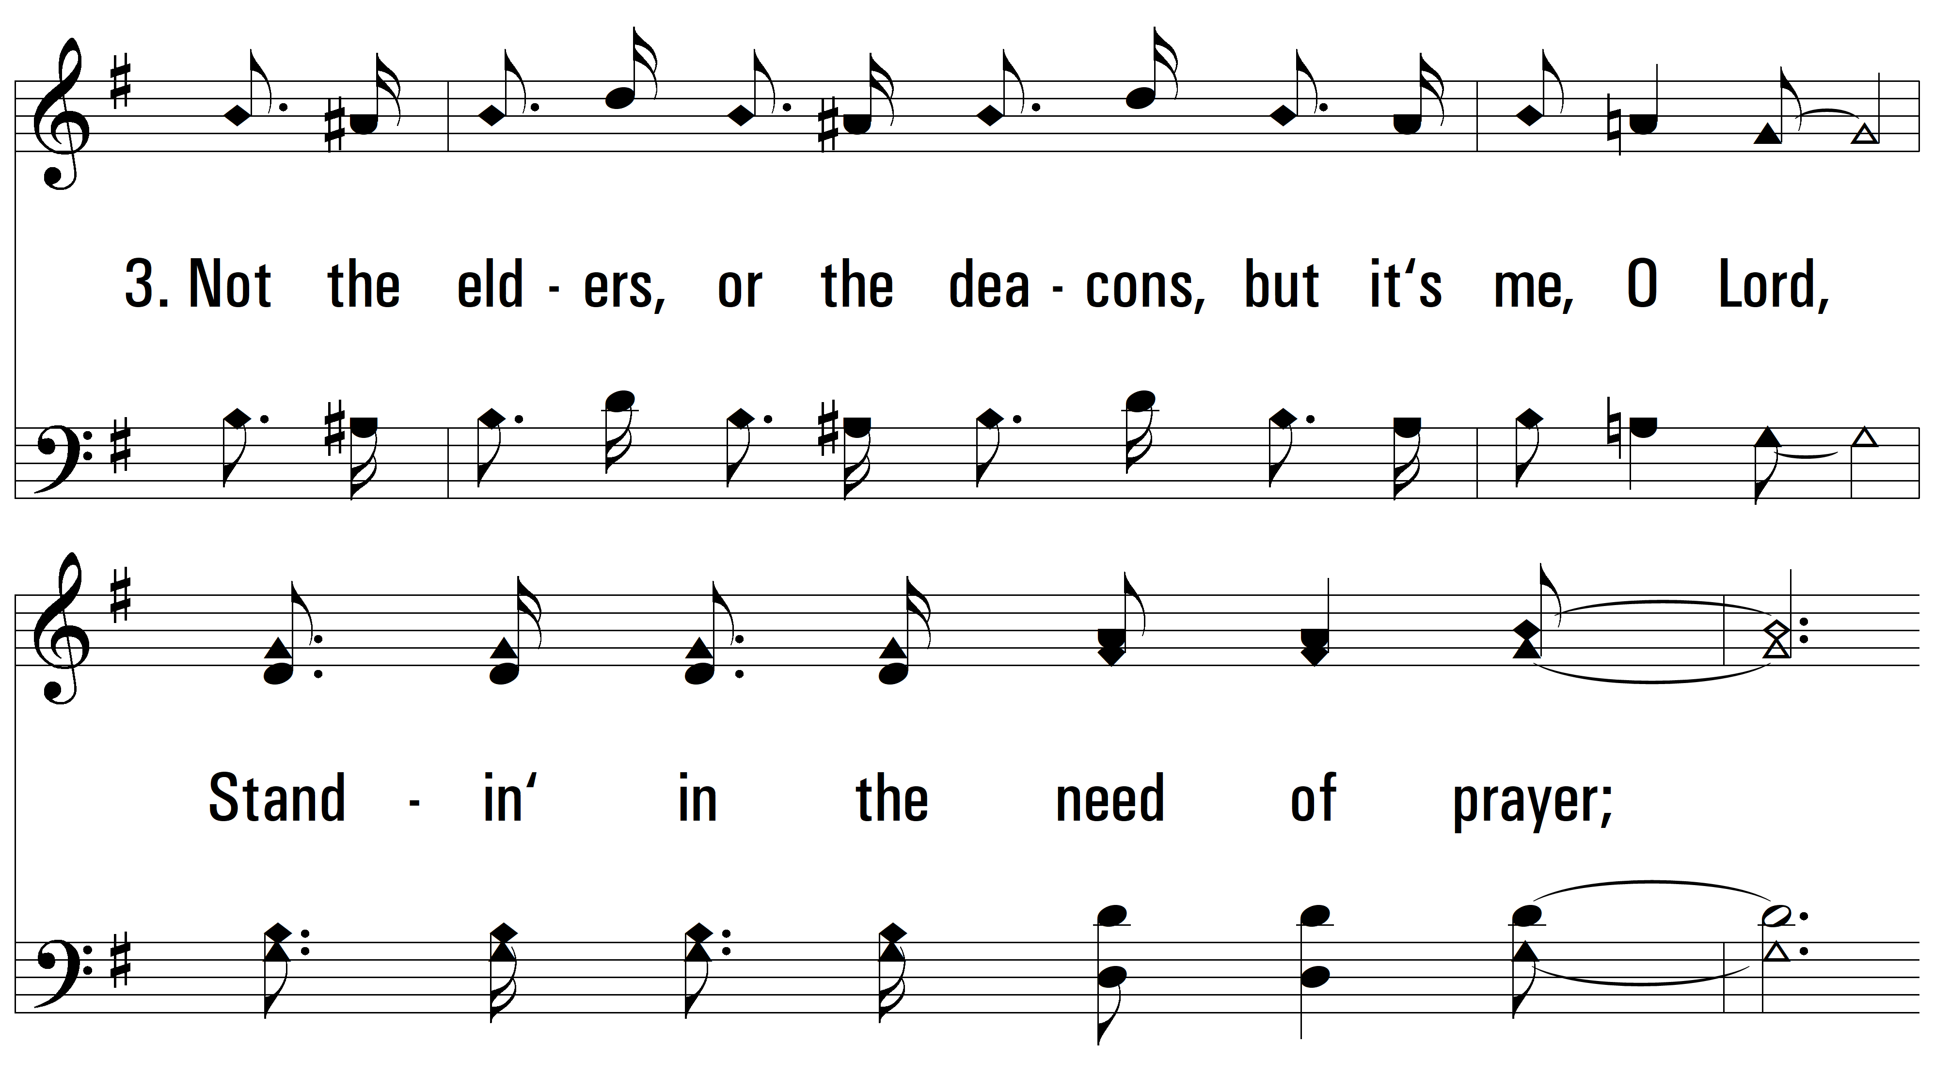
vs. 3 ~ It’s Me

Slide 10

vs. 3

Slide 11
vs. 3

Slide 12
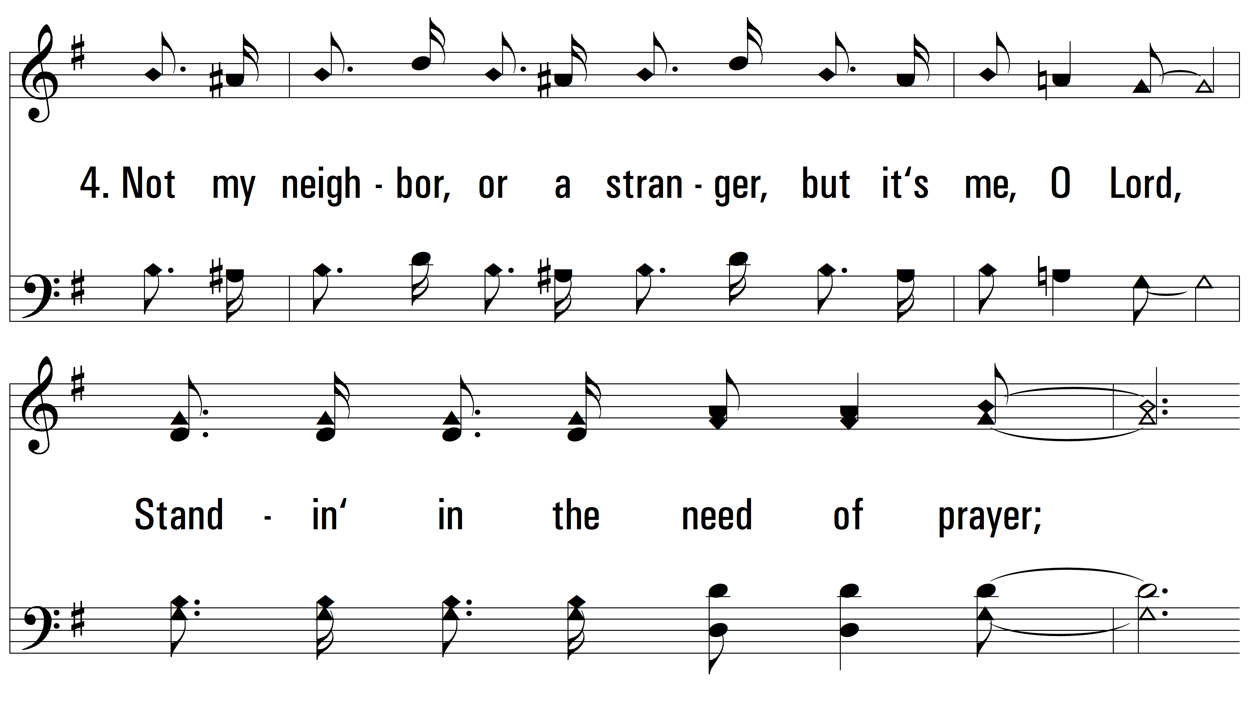
vs. 4 ~ It’s Me

Slide 13
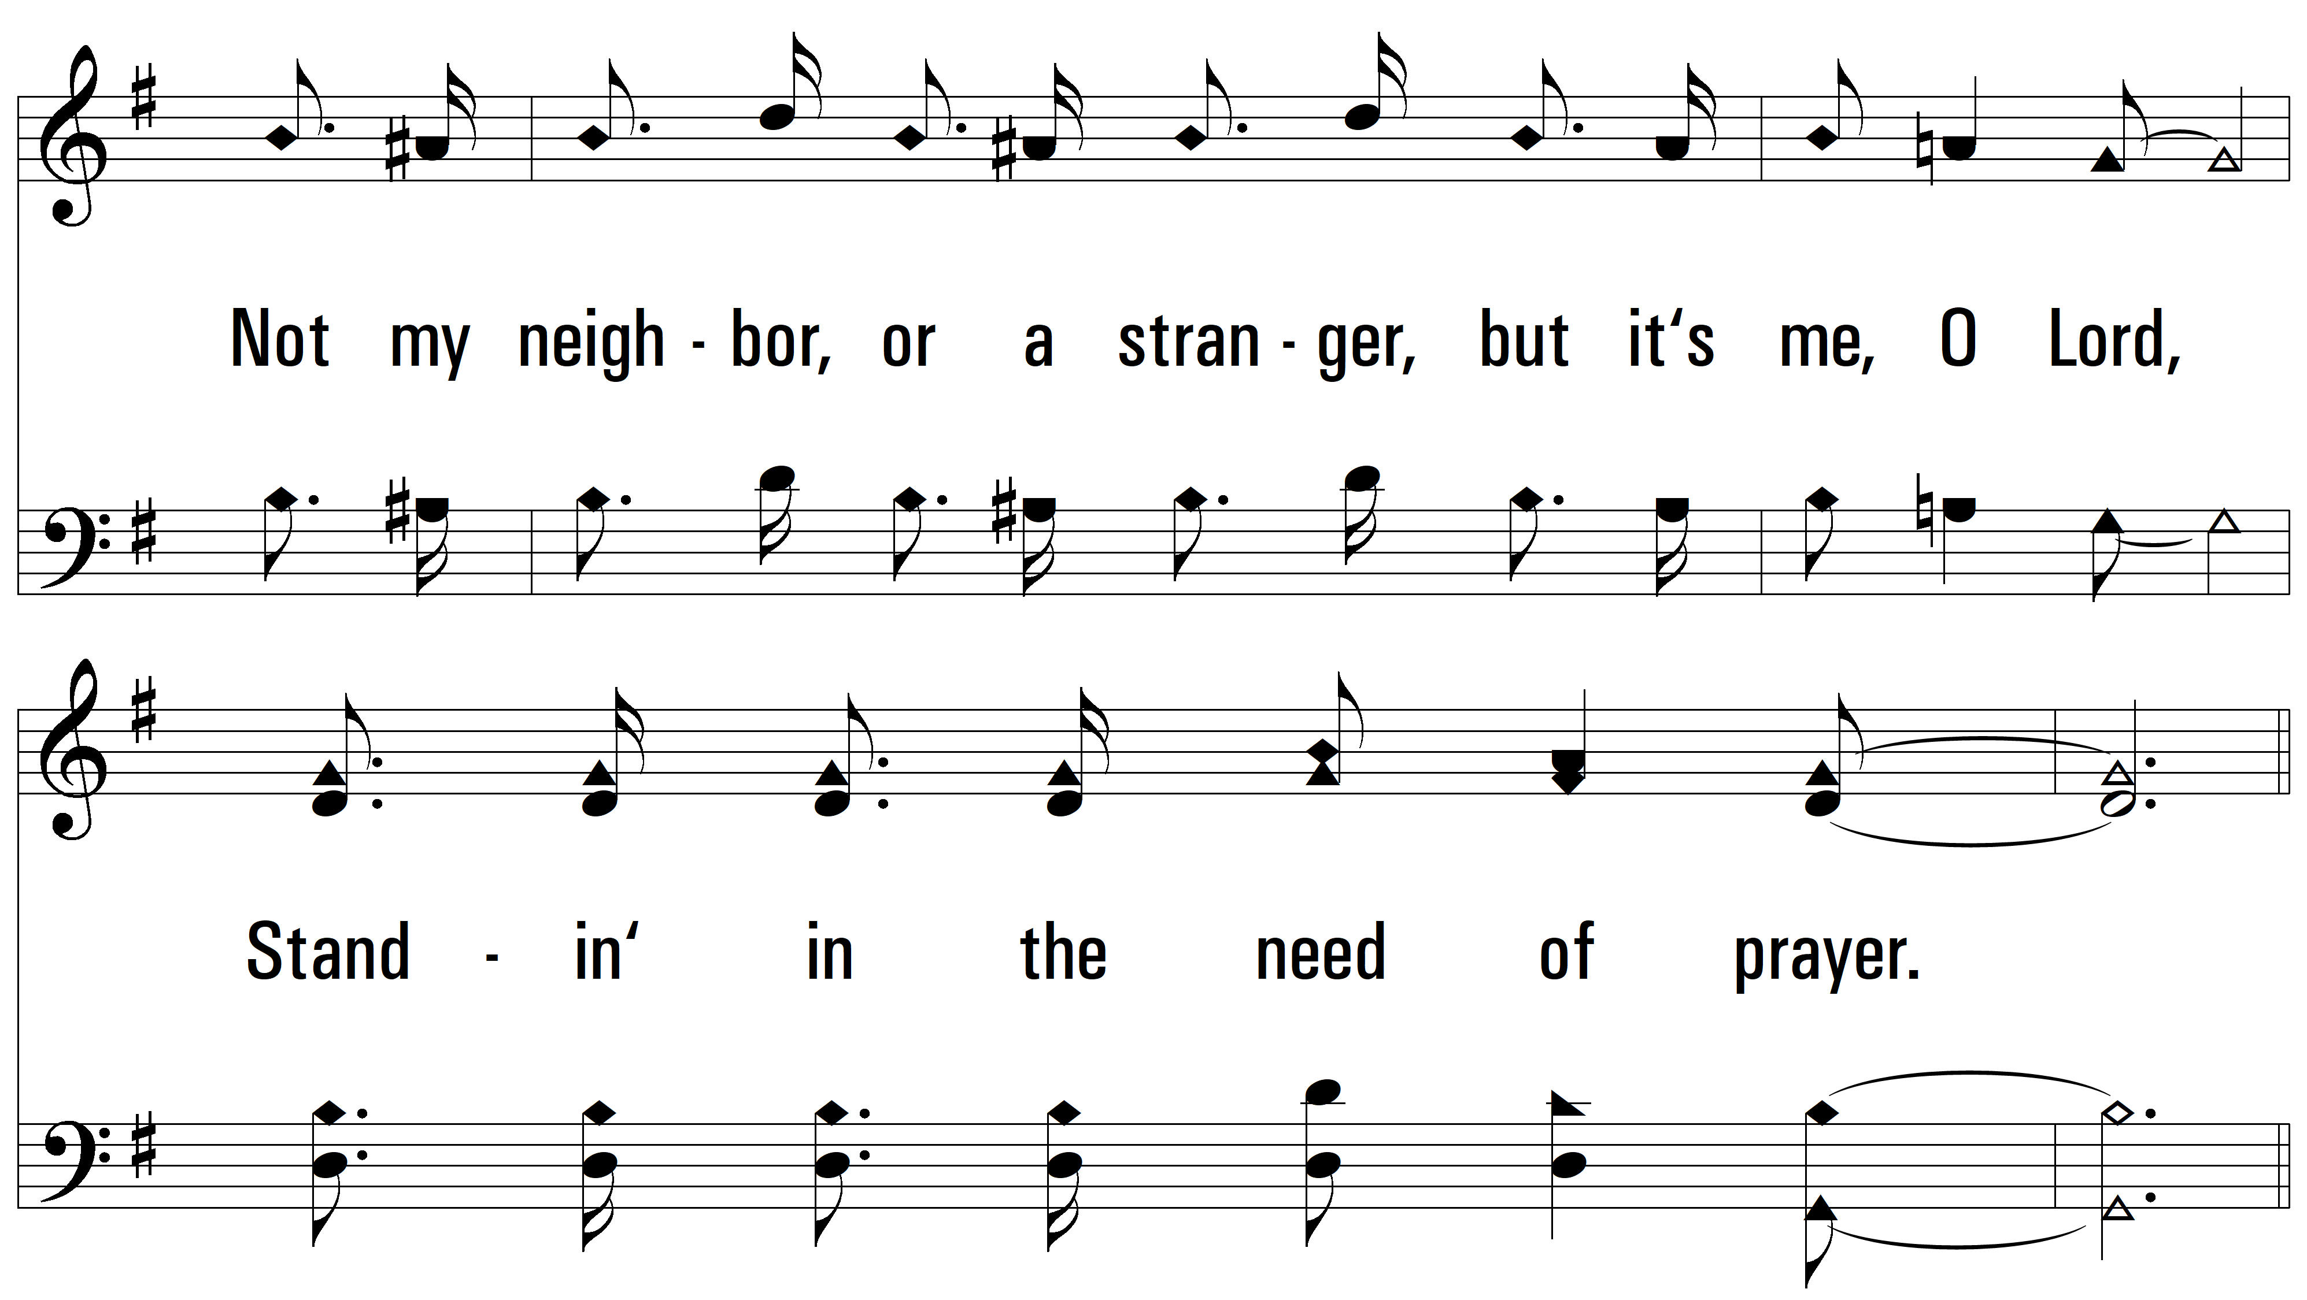
vs. 4

Slide 14
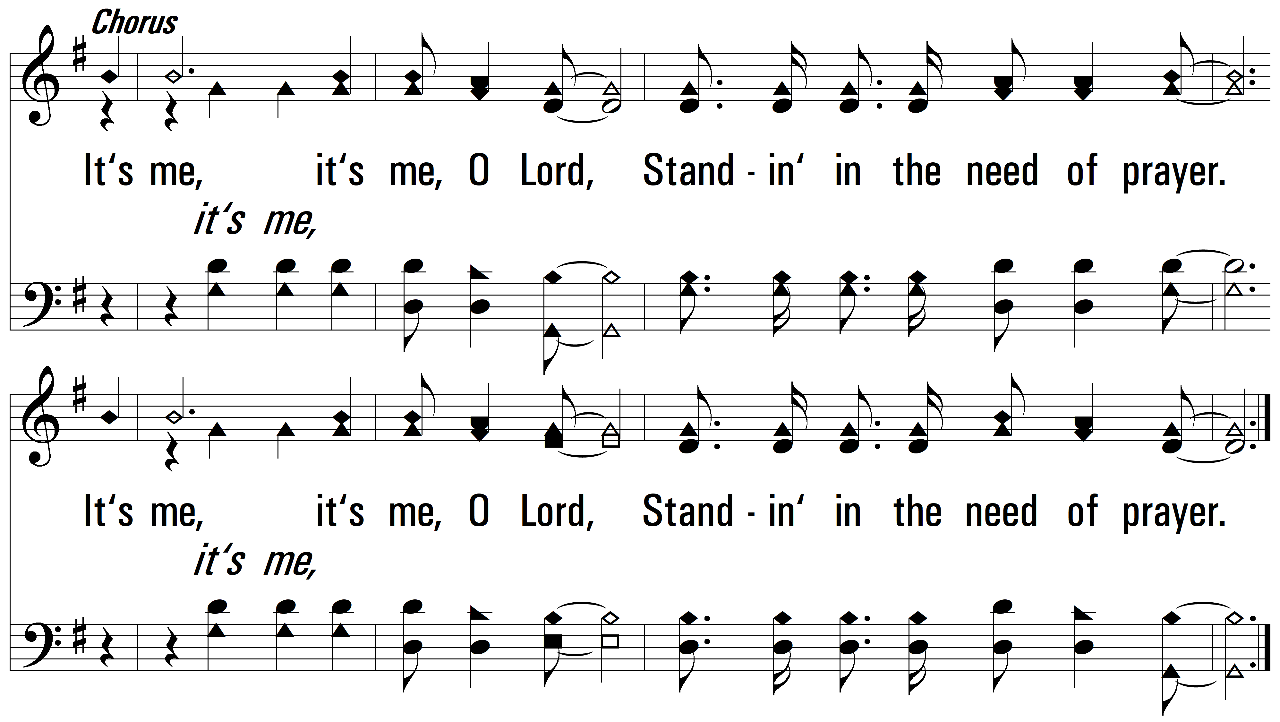
vs. 4
PDHymns.com
END

