Slide 1
It Is Well With My Soul
Words: | Horatio G. Spafford (1873)
Music: | Phillip P. Bliss (1876)
4/4
D/A - SOL
Verses: 4/Chorus
Lead - | SOL
Alto - | MI
Tenor - | SOL
Bass - | DO
PDHymns.com

Slide 2
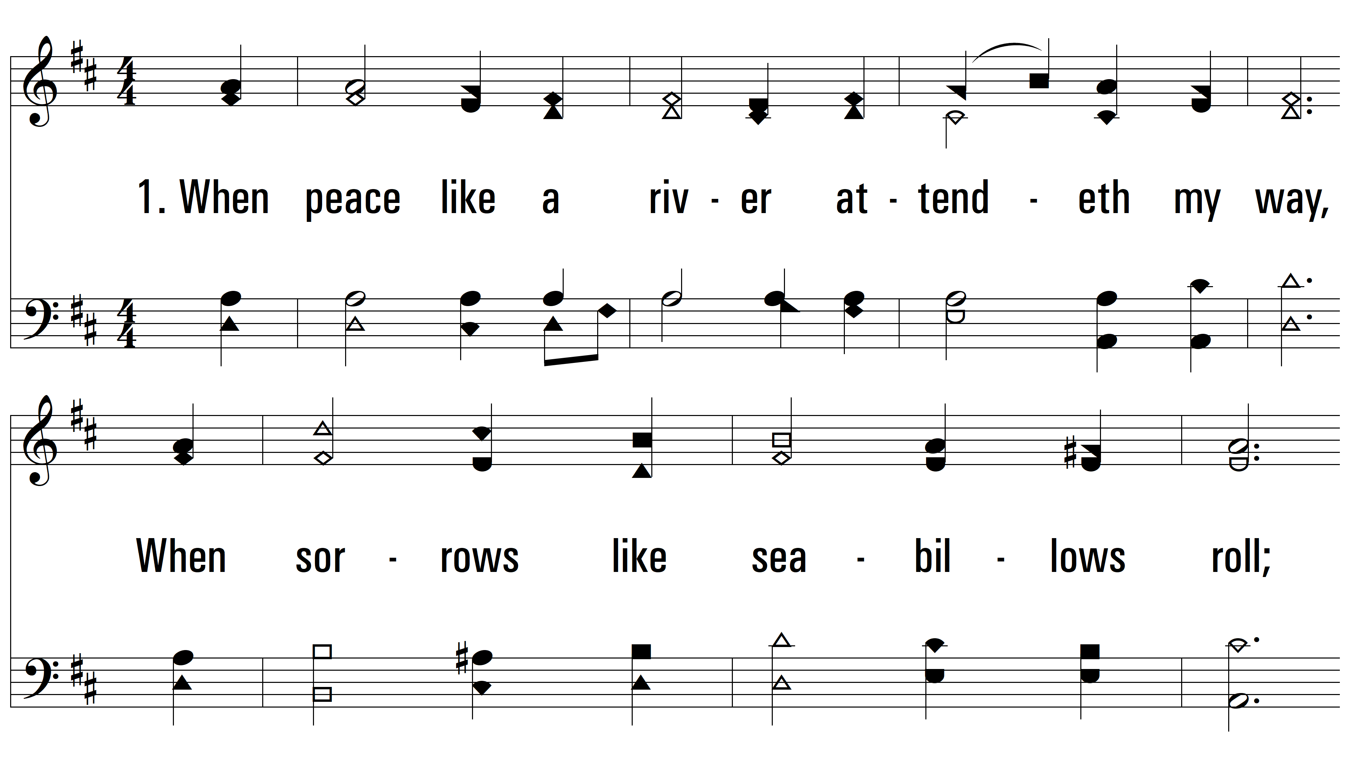
vs. 1 ~ It Is Well With My Soul

Slide 3
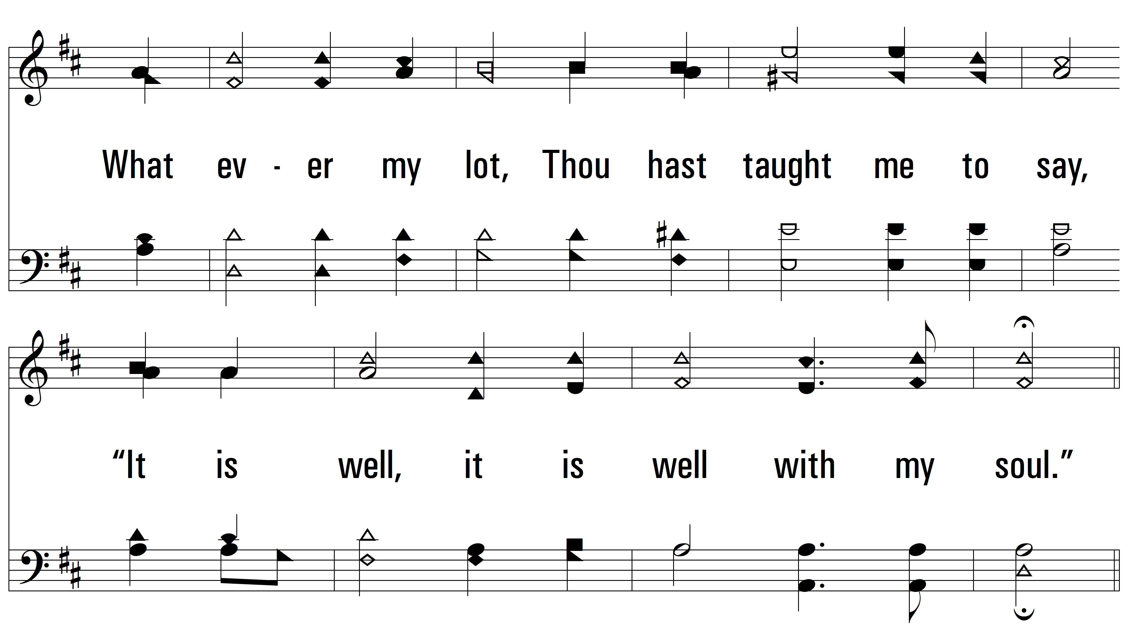
vs. 1

Slide 4
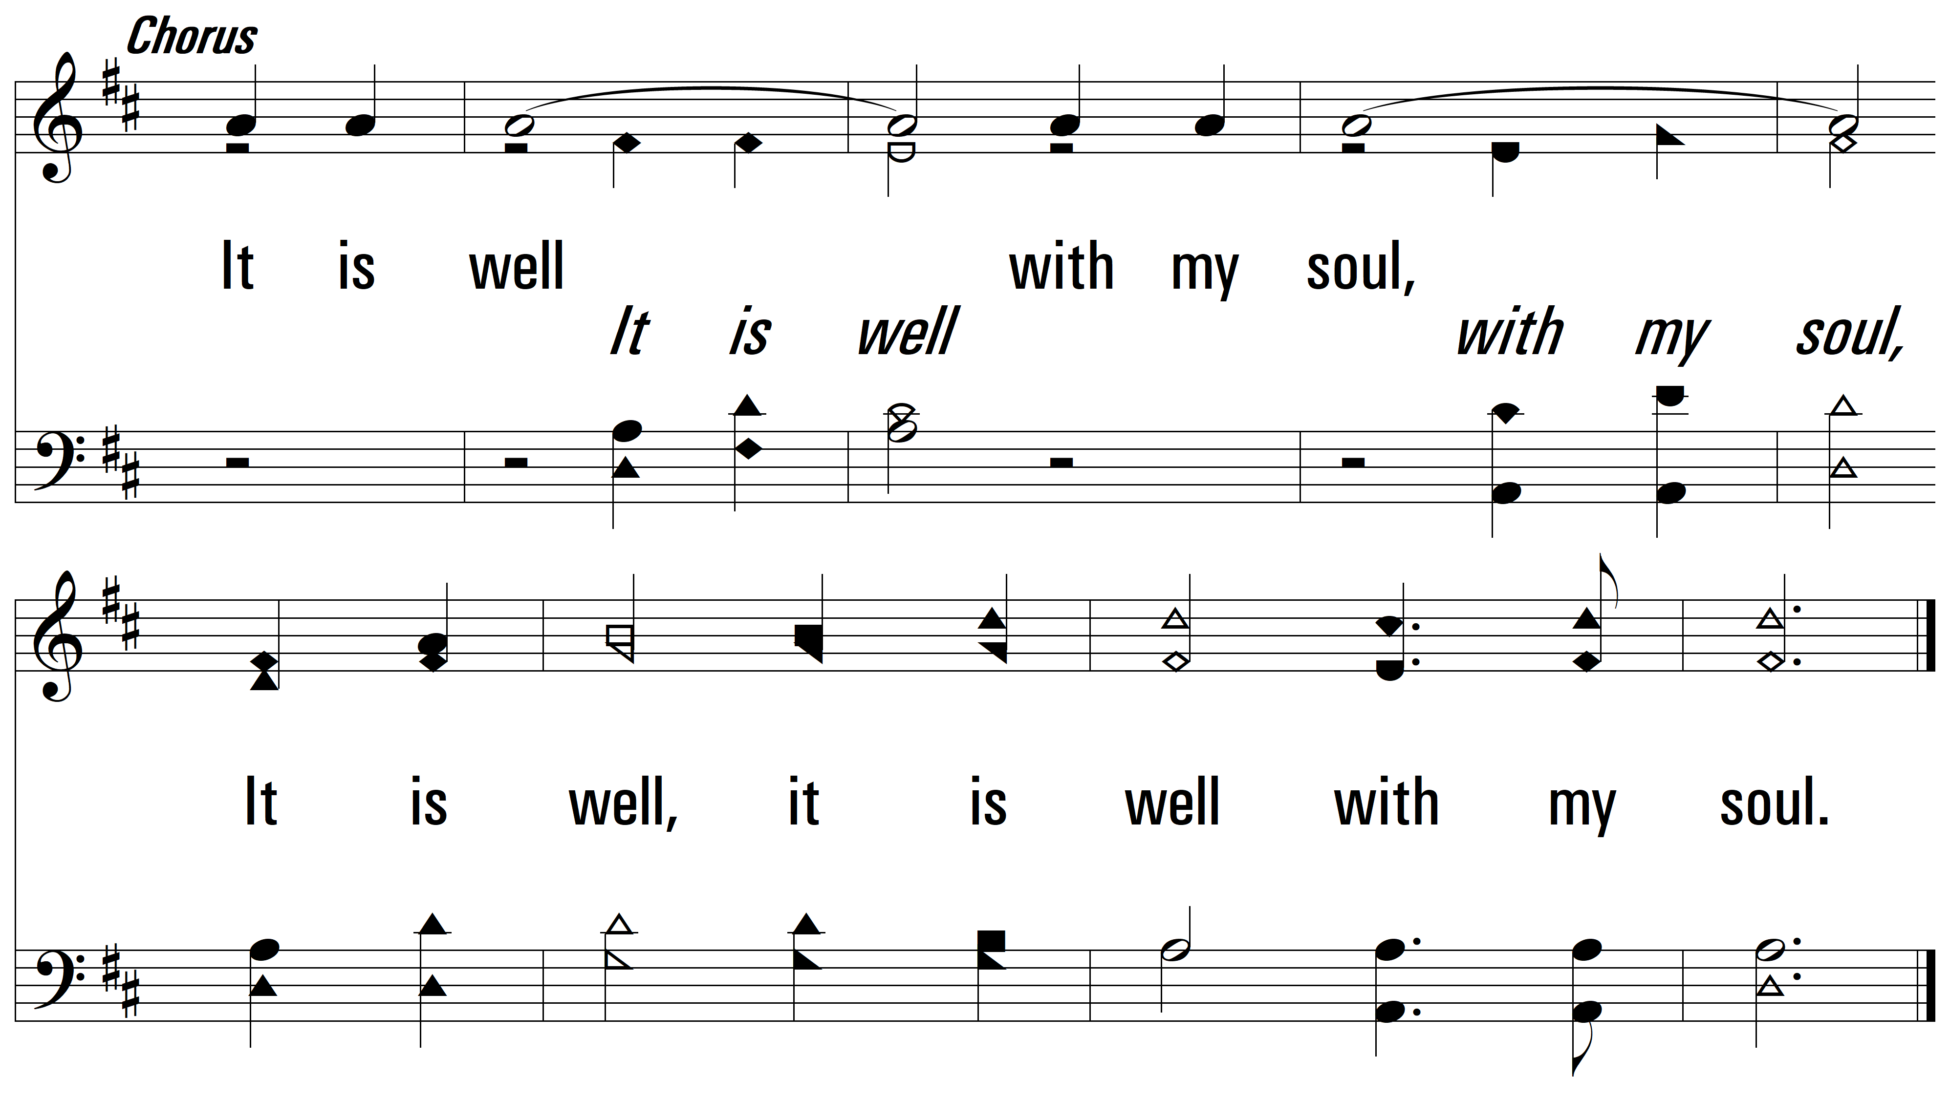
vs. 1

Slide 5
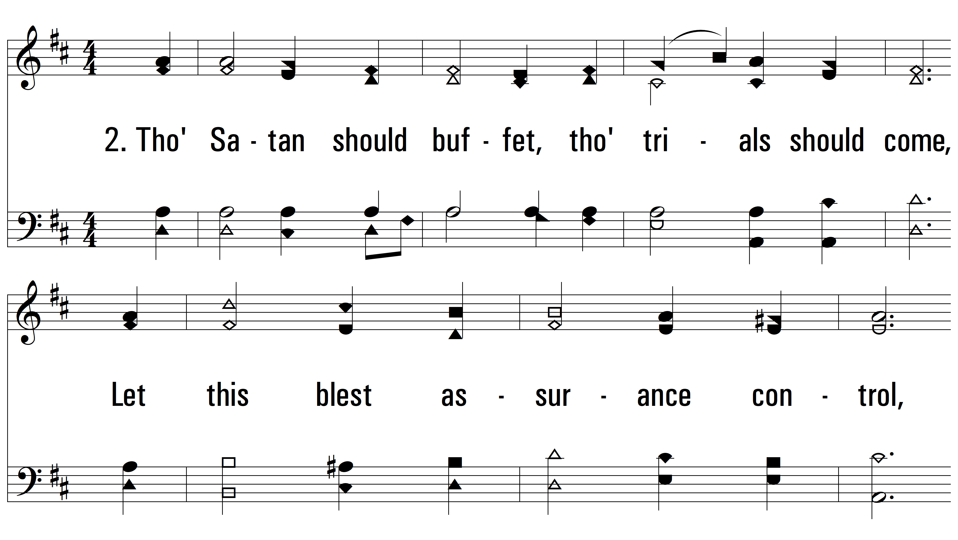
vs. 2 ~ It Is Well With My Soul

Slide 6
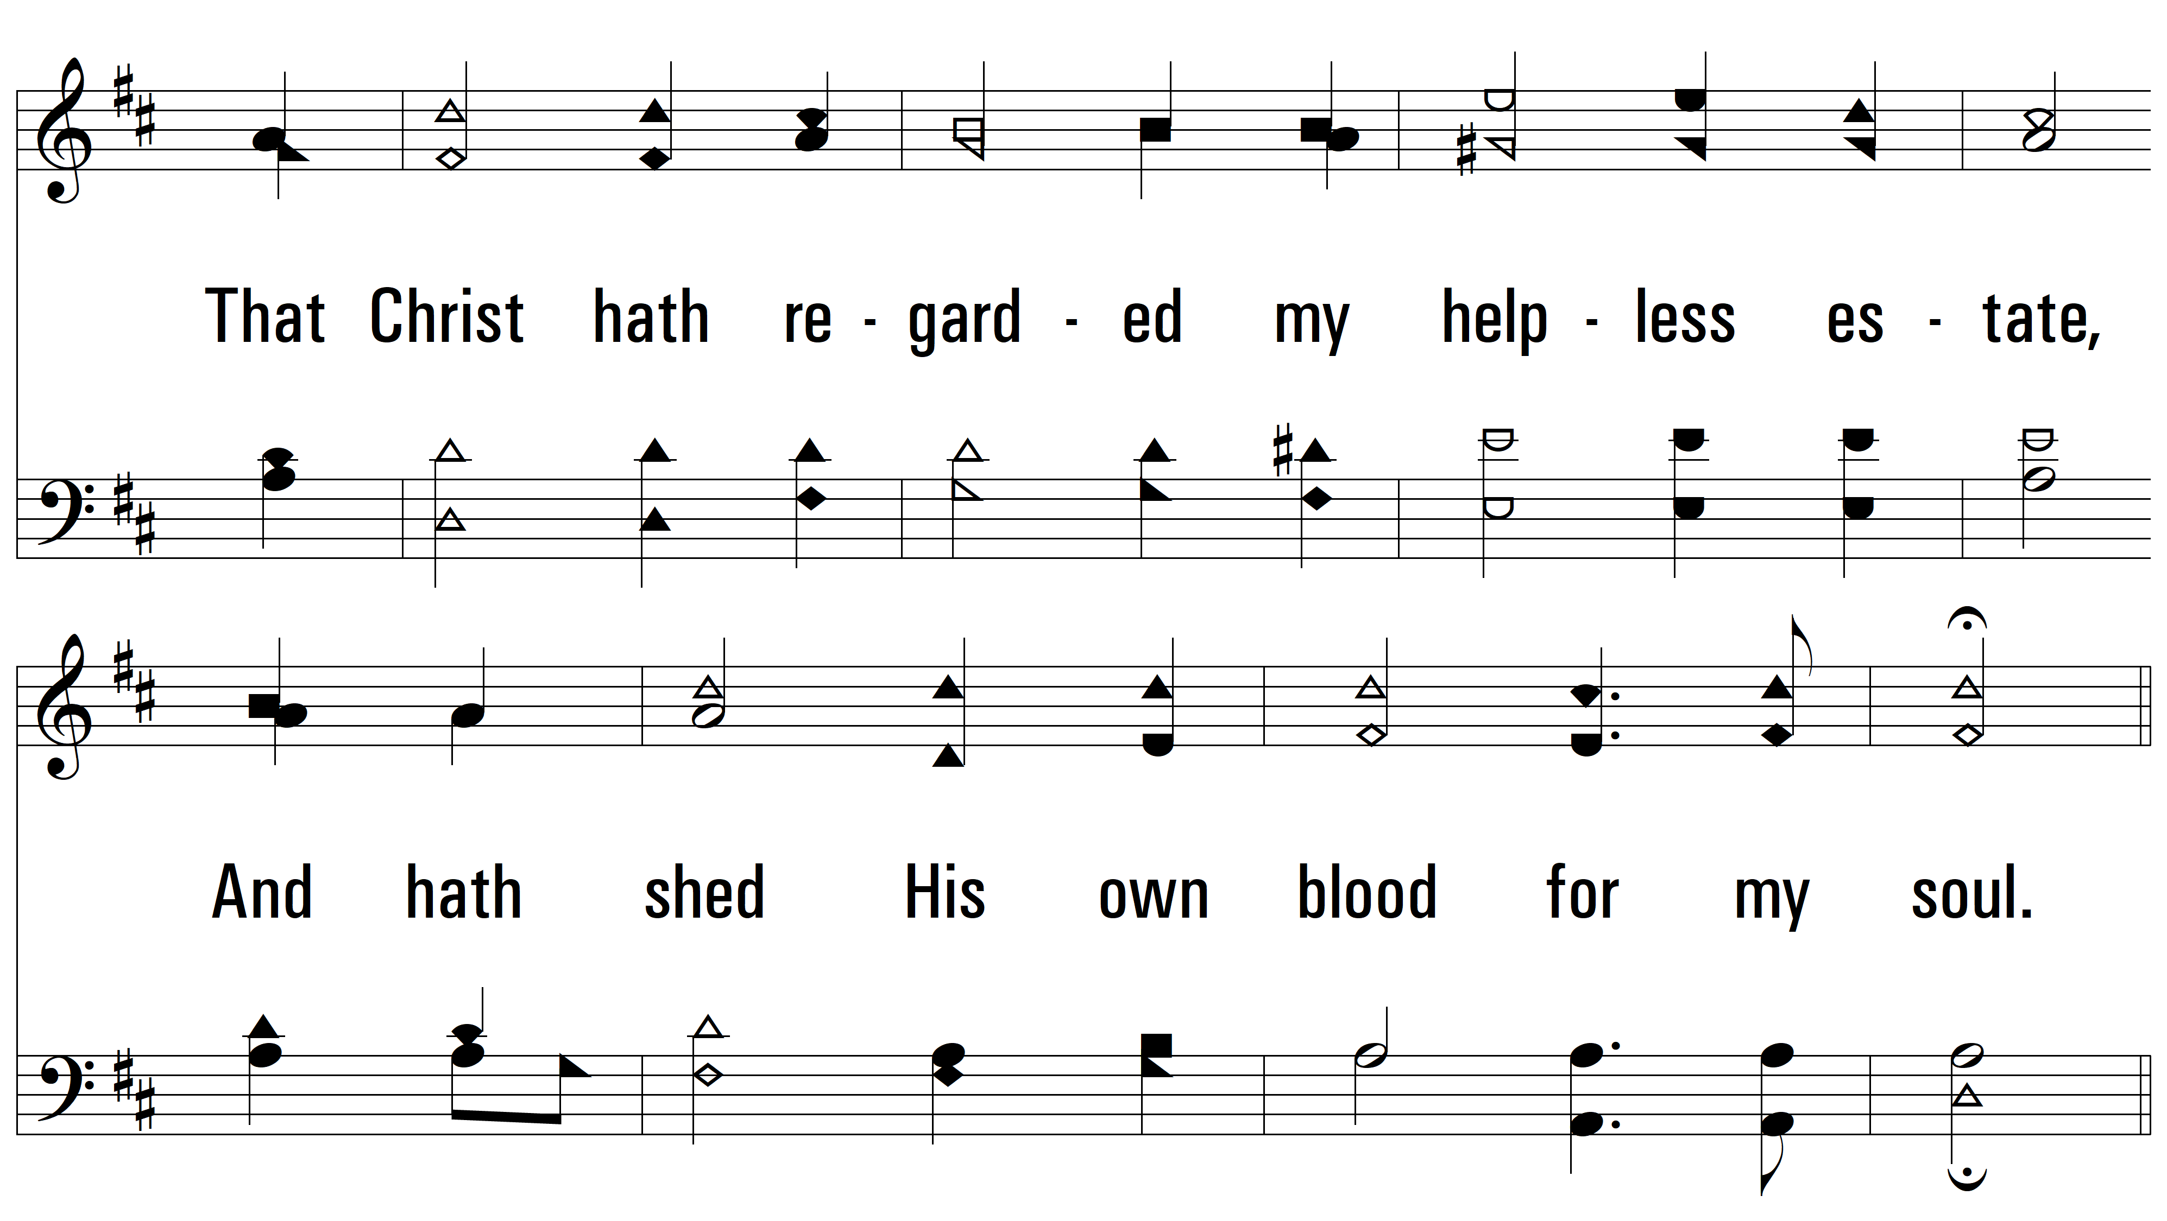
vs. 2

Slide 7
vs. 2

Slide 8
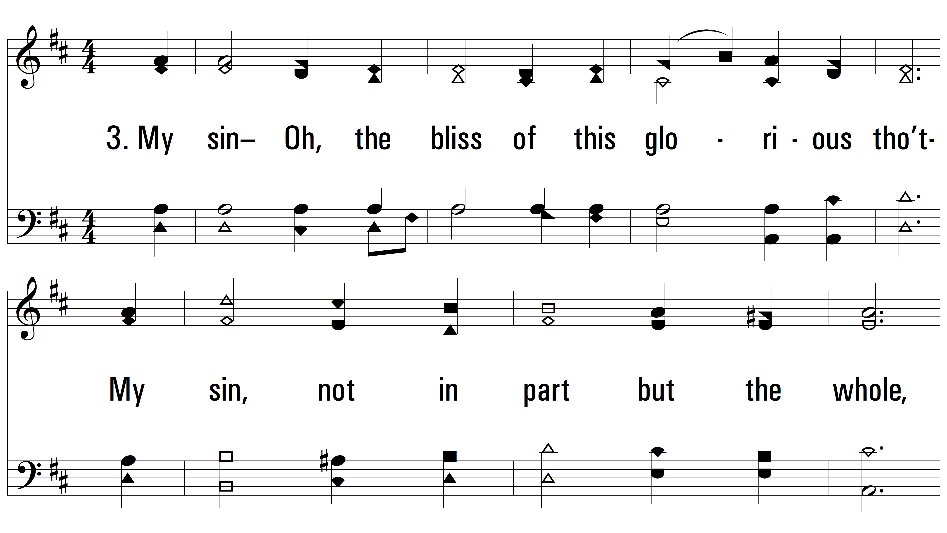
vs. 3 ~ It Is Well With My Soul

Slide 9
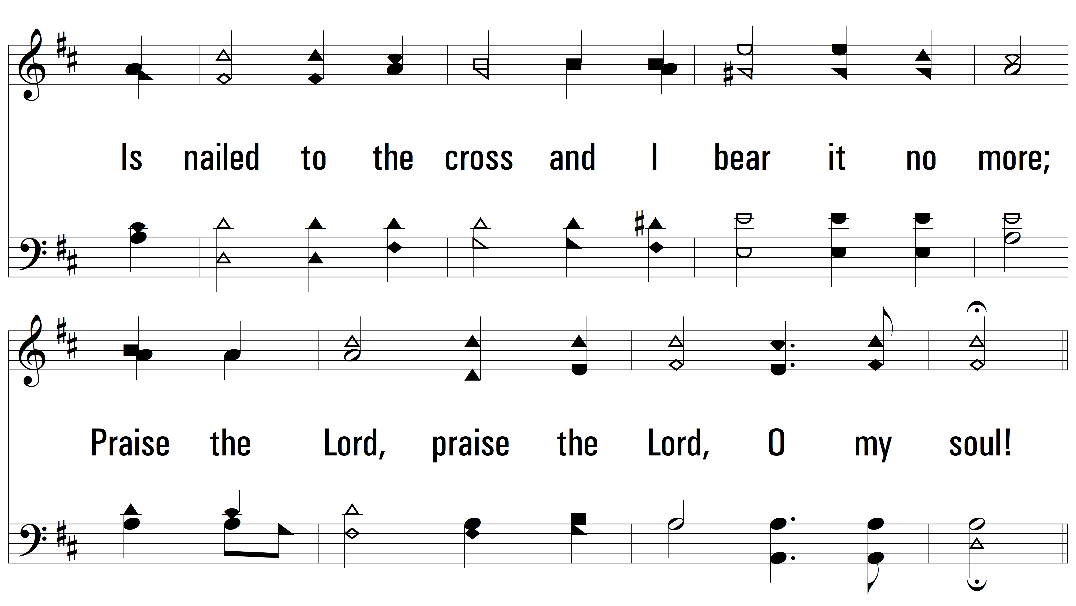
vs. 3

Slide 10
vs. 3

Slide 11
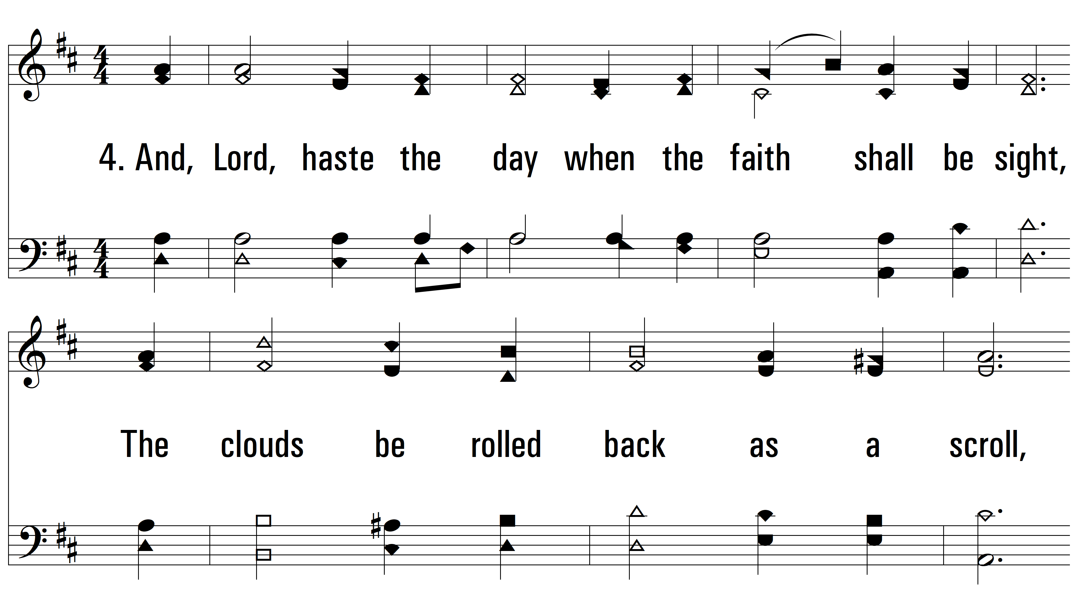
vs. 4 ~ It Is Well With My Soul

Slide 12
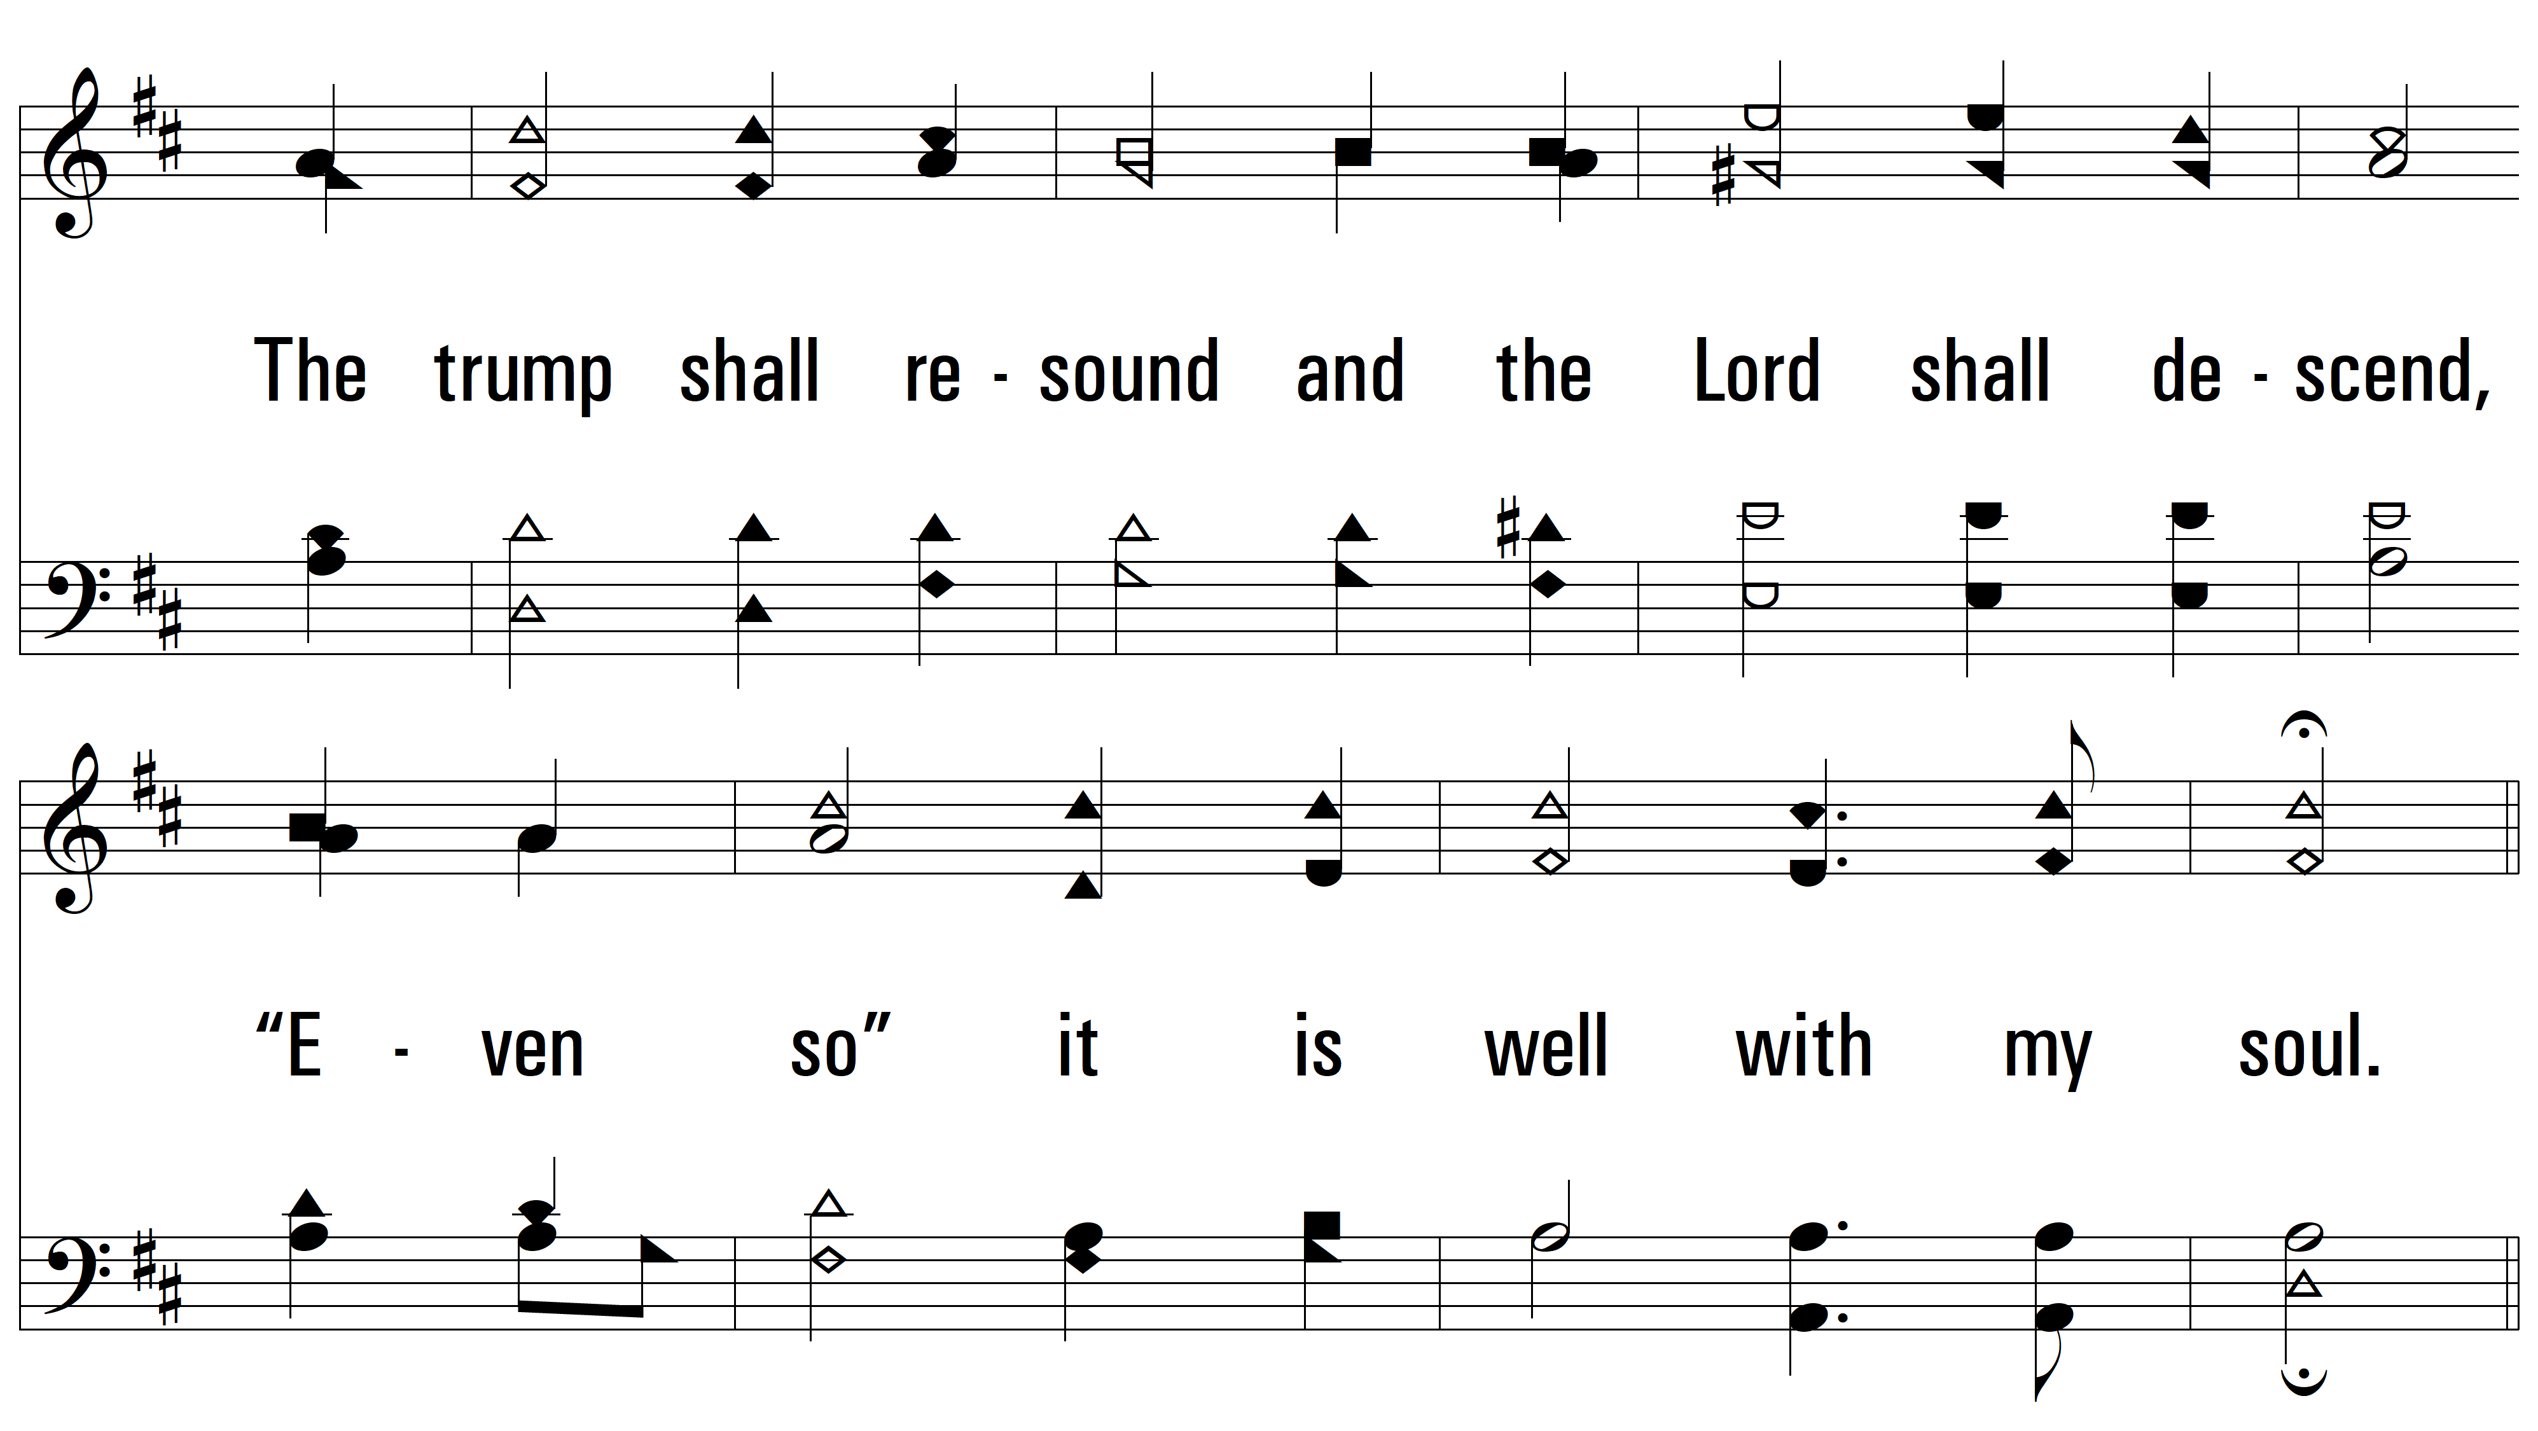
vs. 4

Slide 13
vs. 4
PDHymns.com
END

