Slide 1
Into My Heart
Words: | Harry D. Clarke (1924), vs. 2: American Folk Hymn
Music: | Harry D. Clarke (1924)
6/4
F/A - MI
Verses: 2
Lead - | MI
Alto - | DO
Tenor - | SOL
Bass - | DO
PDHymns.com

Slide 2
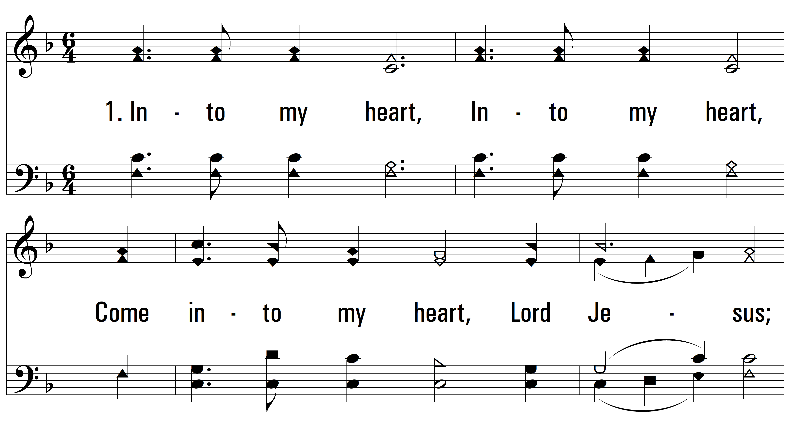
vs. 1 ~ Into My Heart

Slide 3
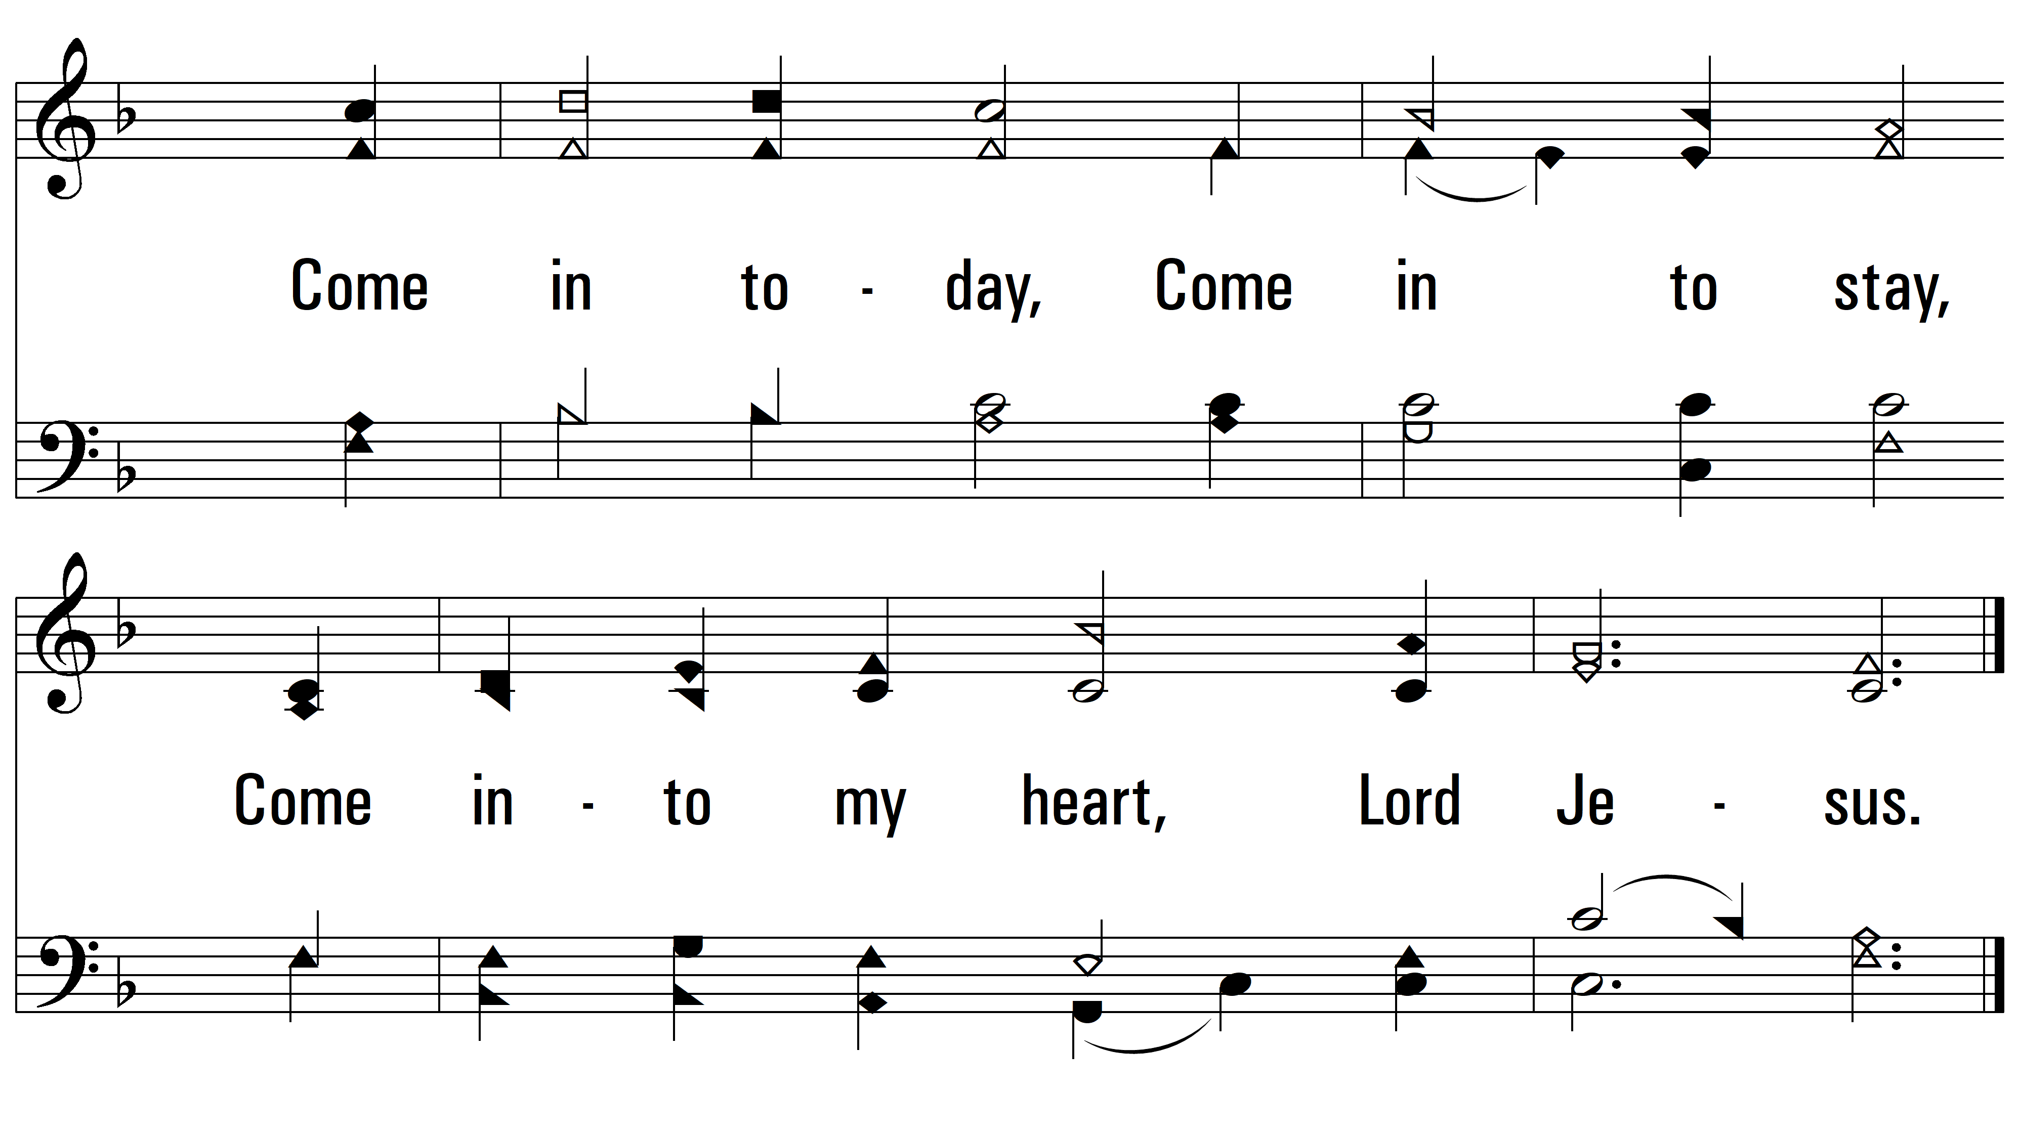
vs. 1
PDHymns.com
END

Slide 4
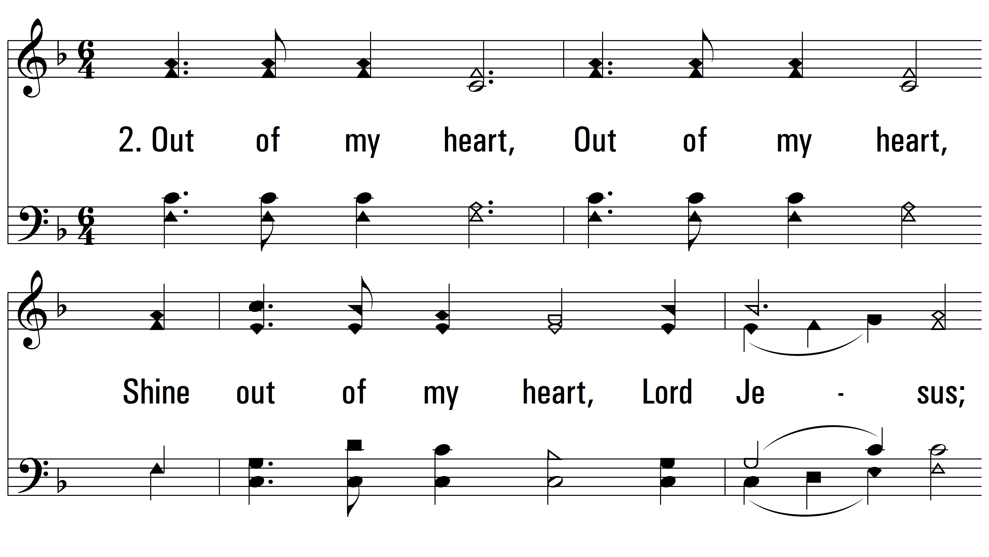
vs. 2 ~ Into My Heart

Slide 5
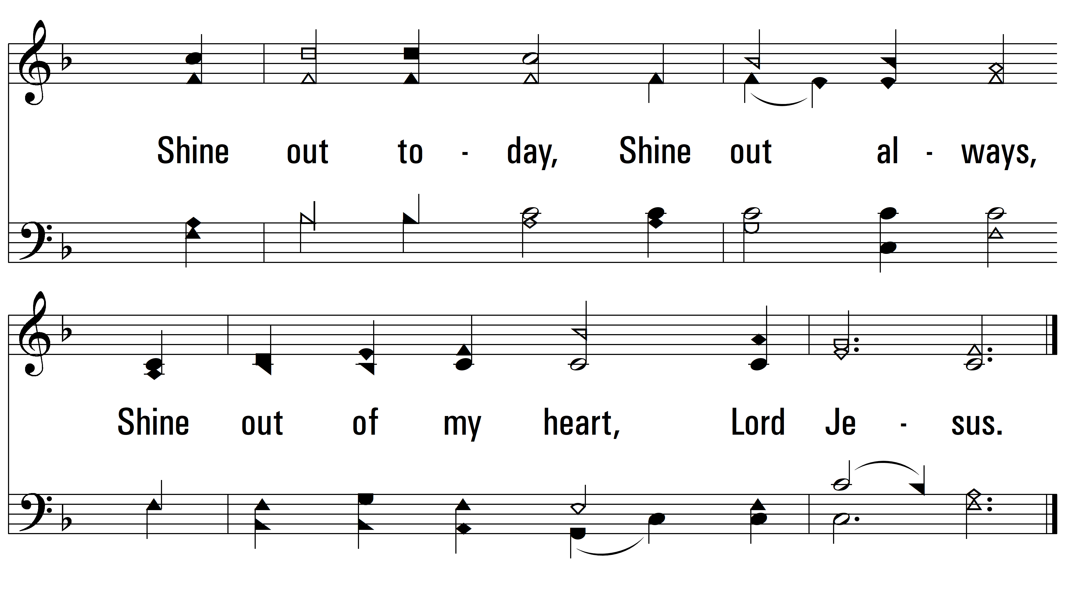
vs. 2
PDHymns.com
END

