Slide 1
In The Hush Of Early Morning
PROIOS
8.7.8.7.D
Words: | Mrs. R. N. Turner (1890)
Music: | William J. Kirkpatrick (1890)
4/4
F/A - MI
Verses: 3
Lead - | MI
Alto - | DO
Tenor - | SOL
Bass - | DO
PDHymns.com

Slide 2
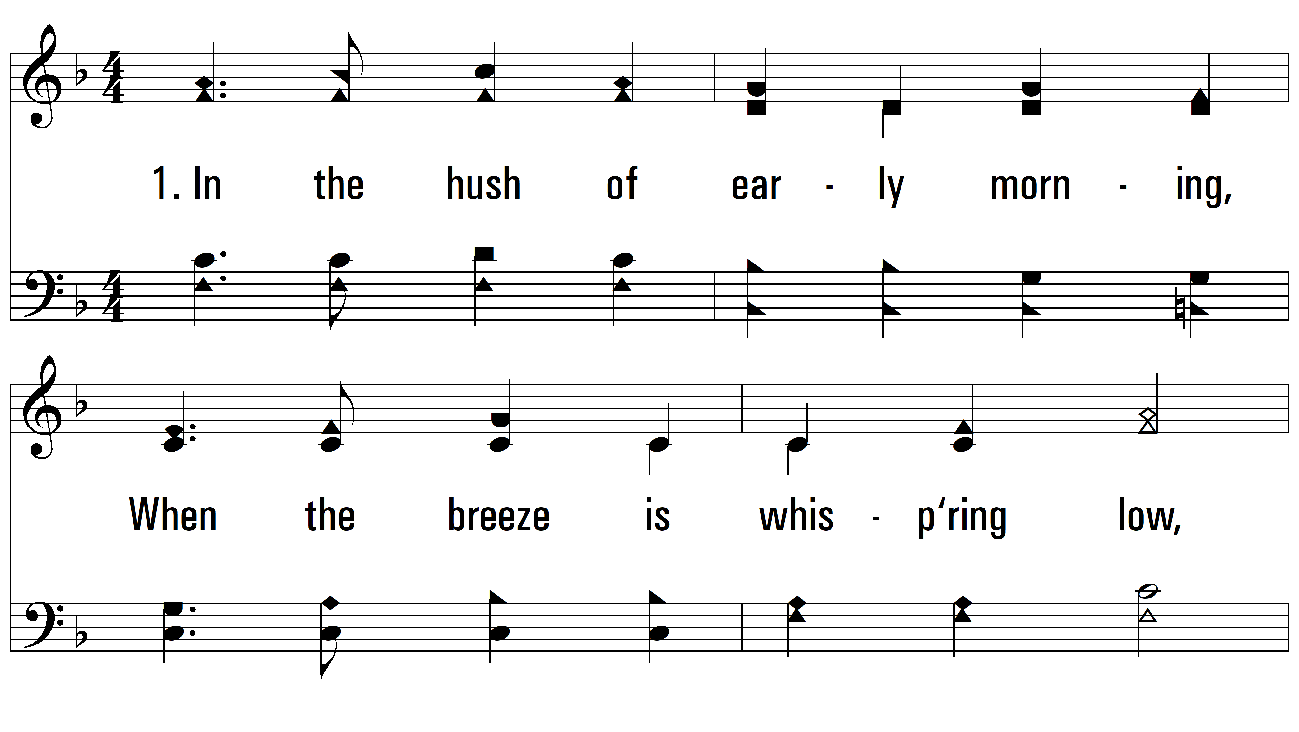
vs. 1 ~ In The Hush Of Early Morning

Slide 3
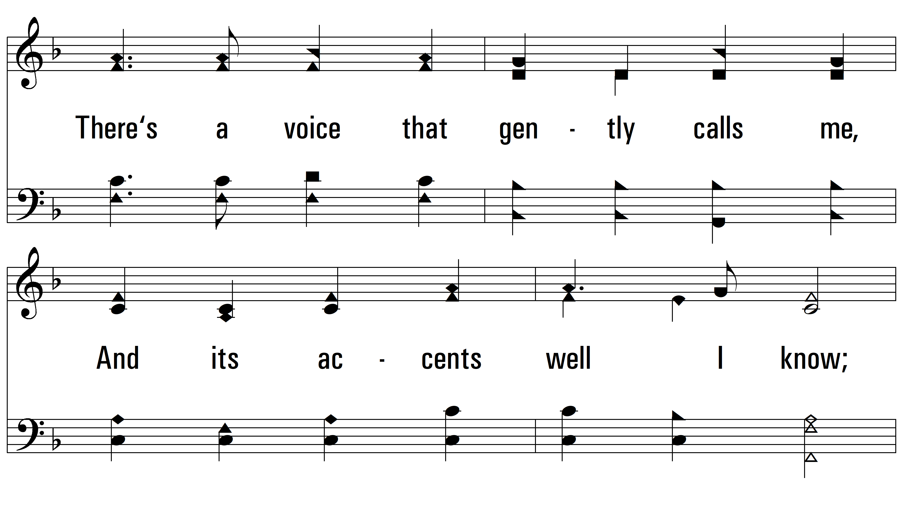
vs. 1

Slide 4
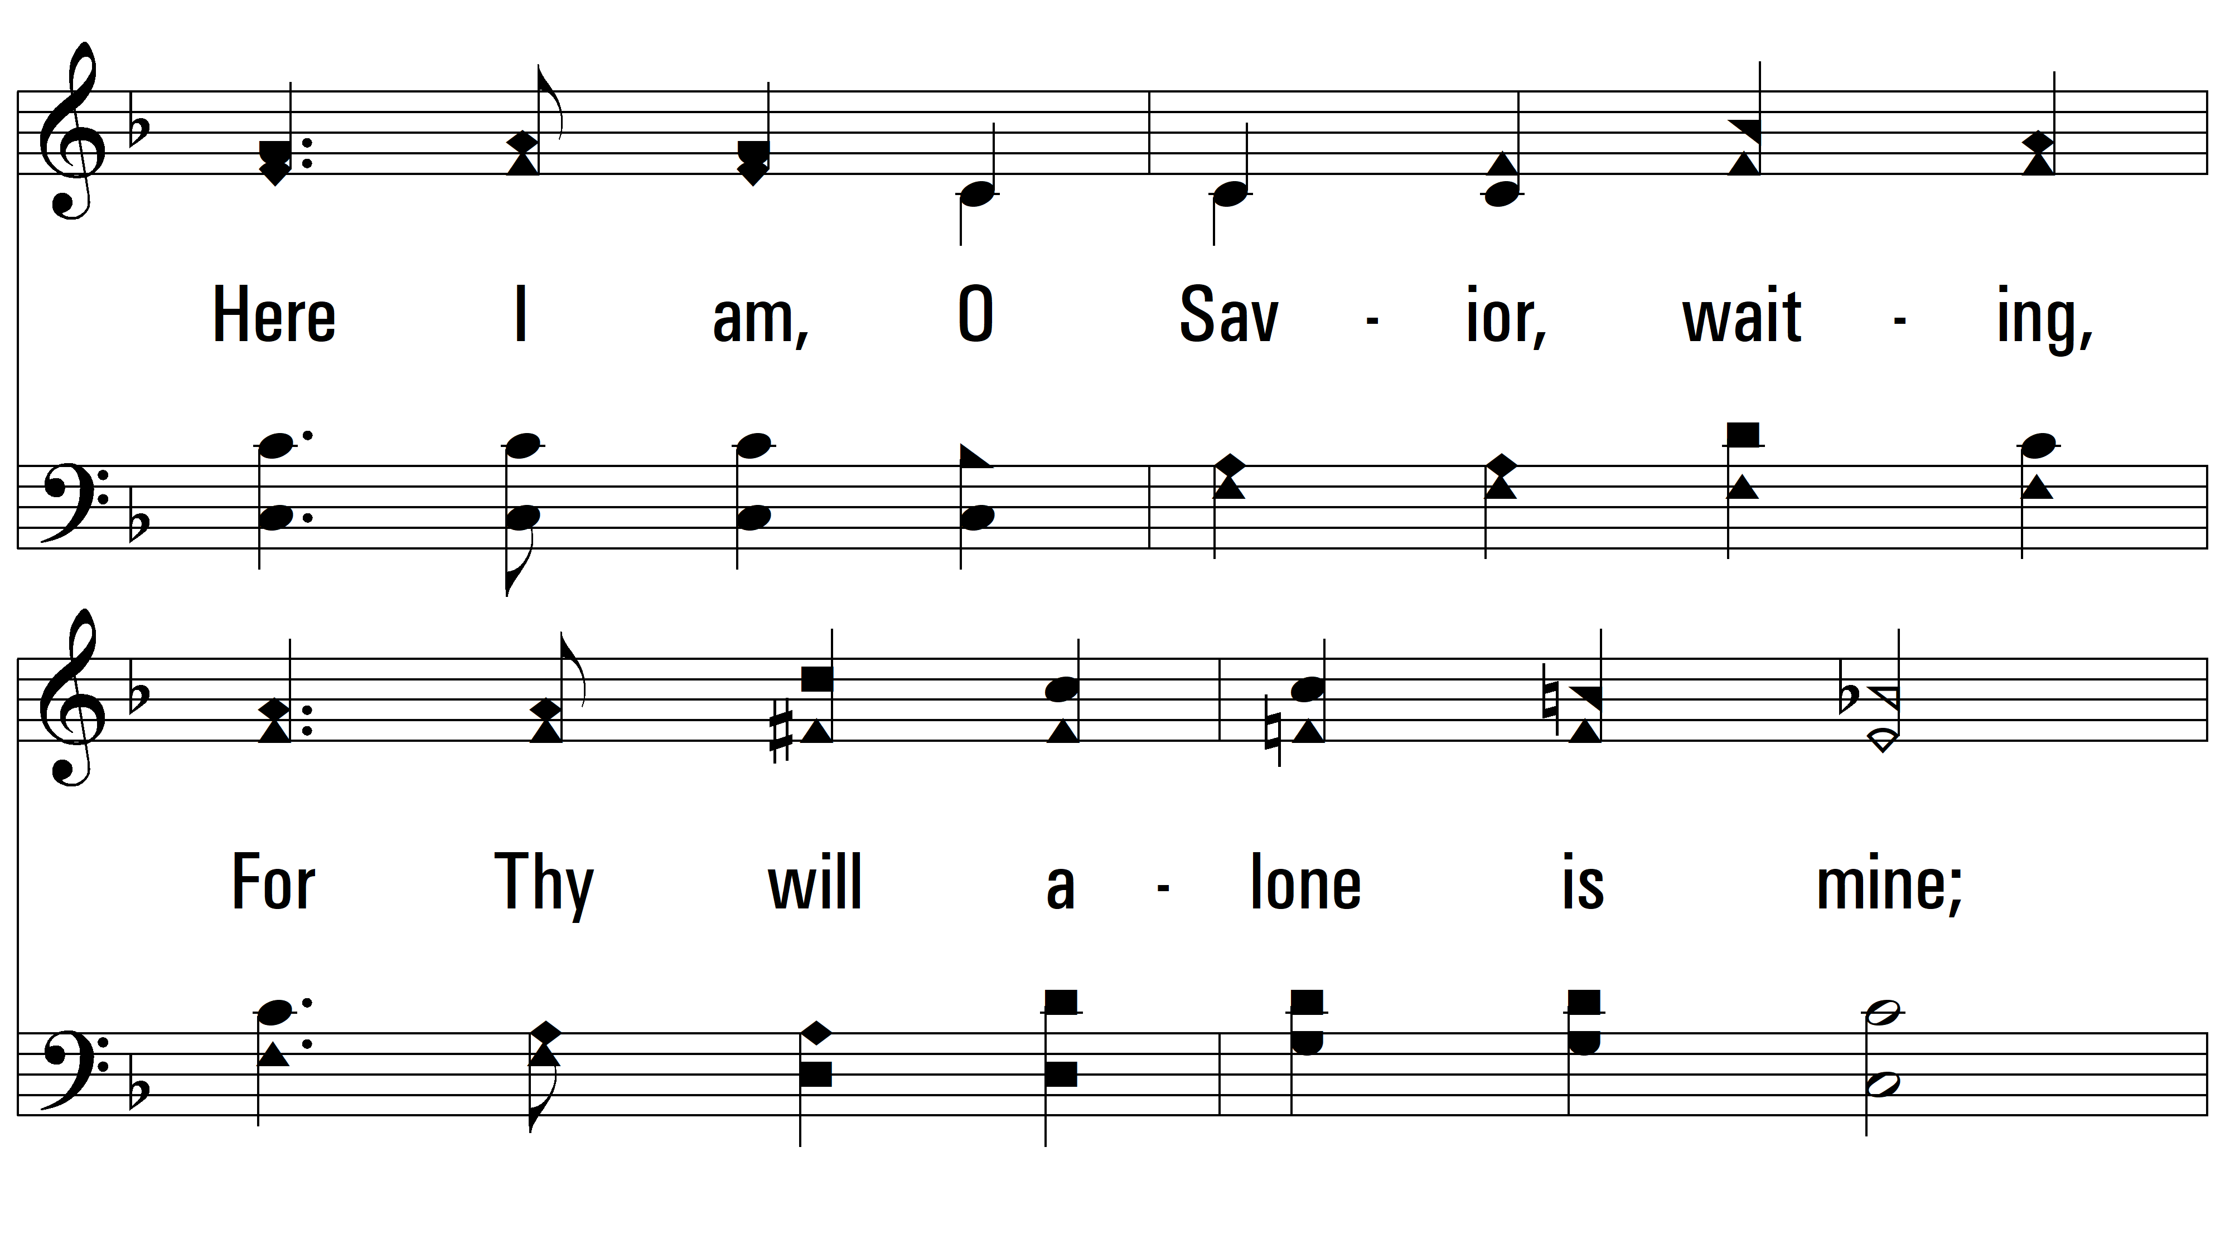
vs. 1

Slide 5
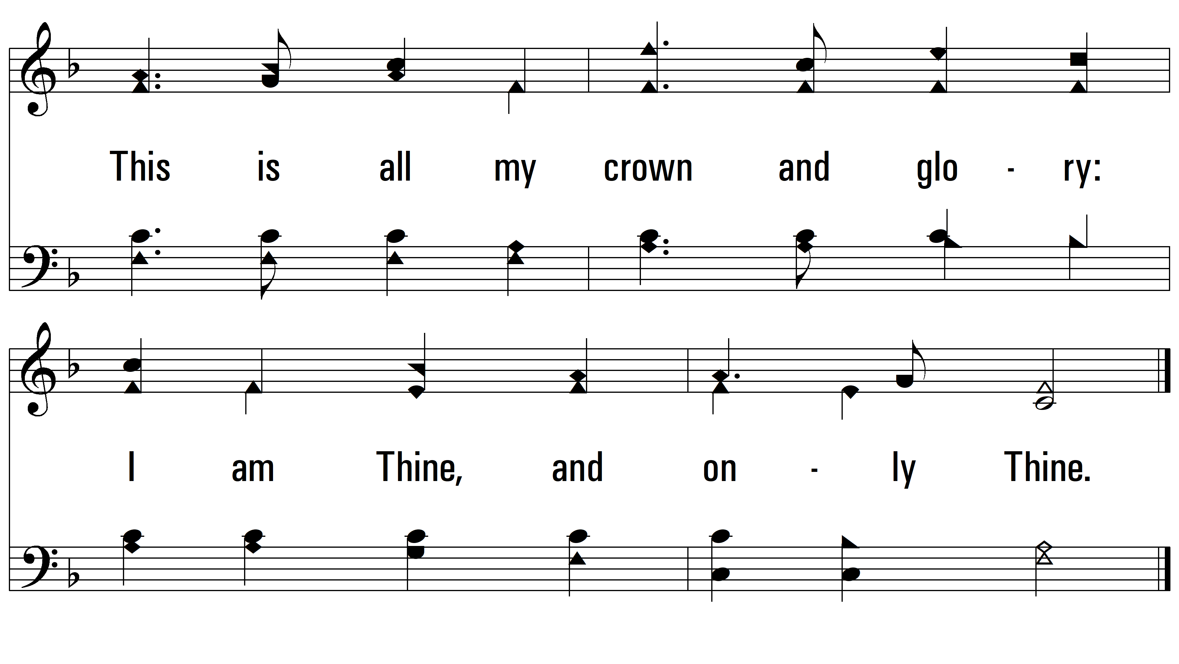
vs. 1

Slide 6
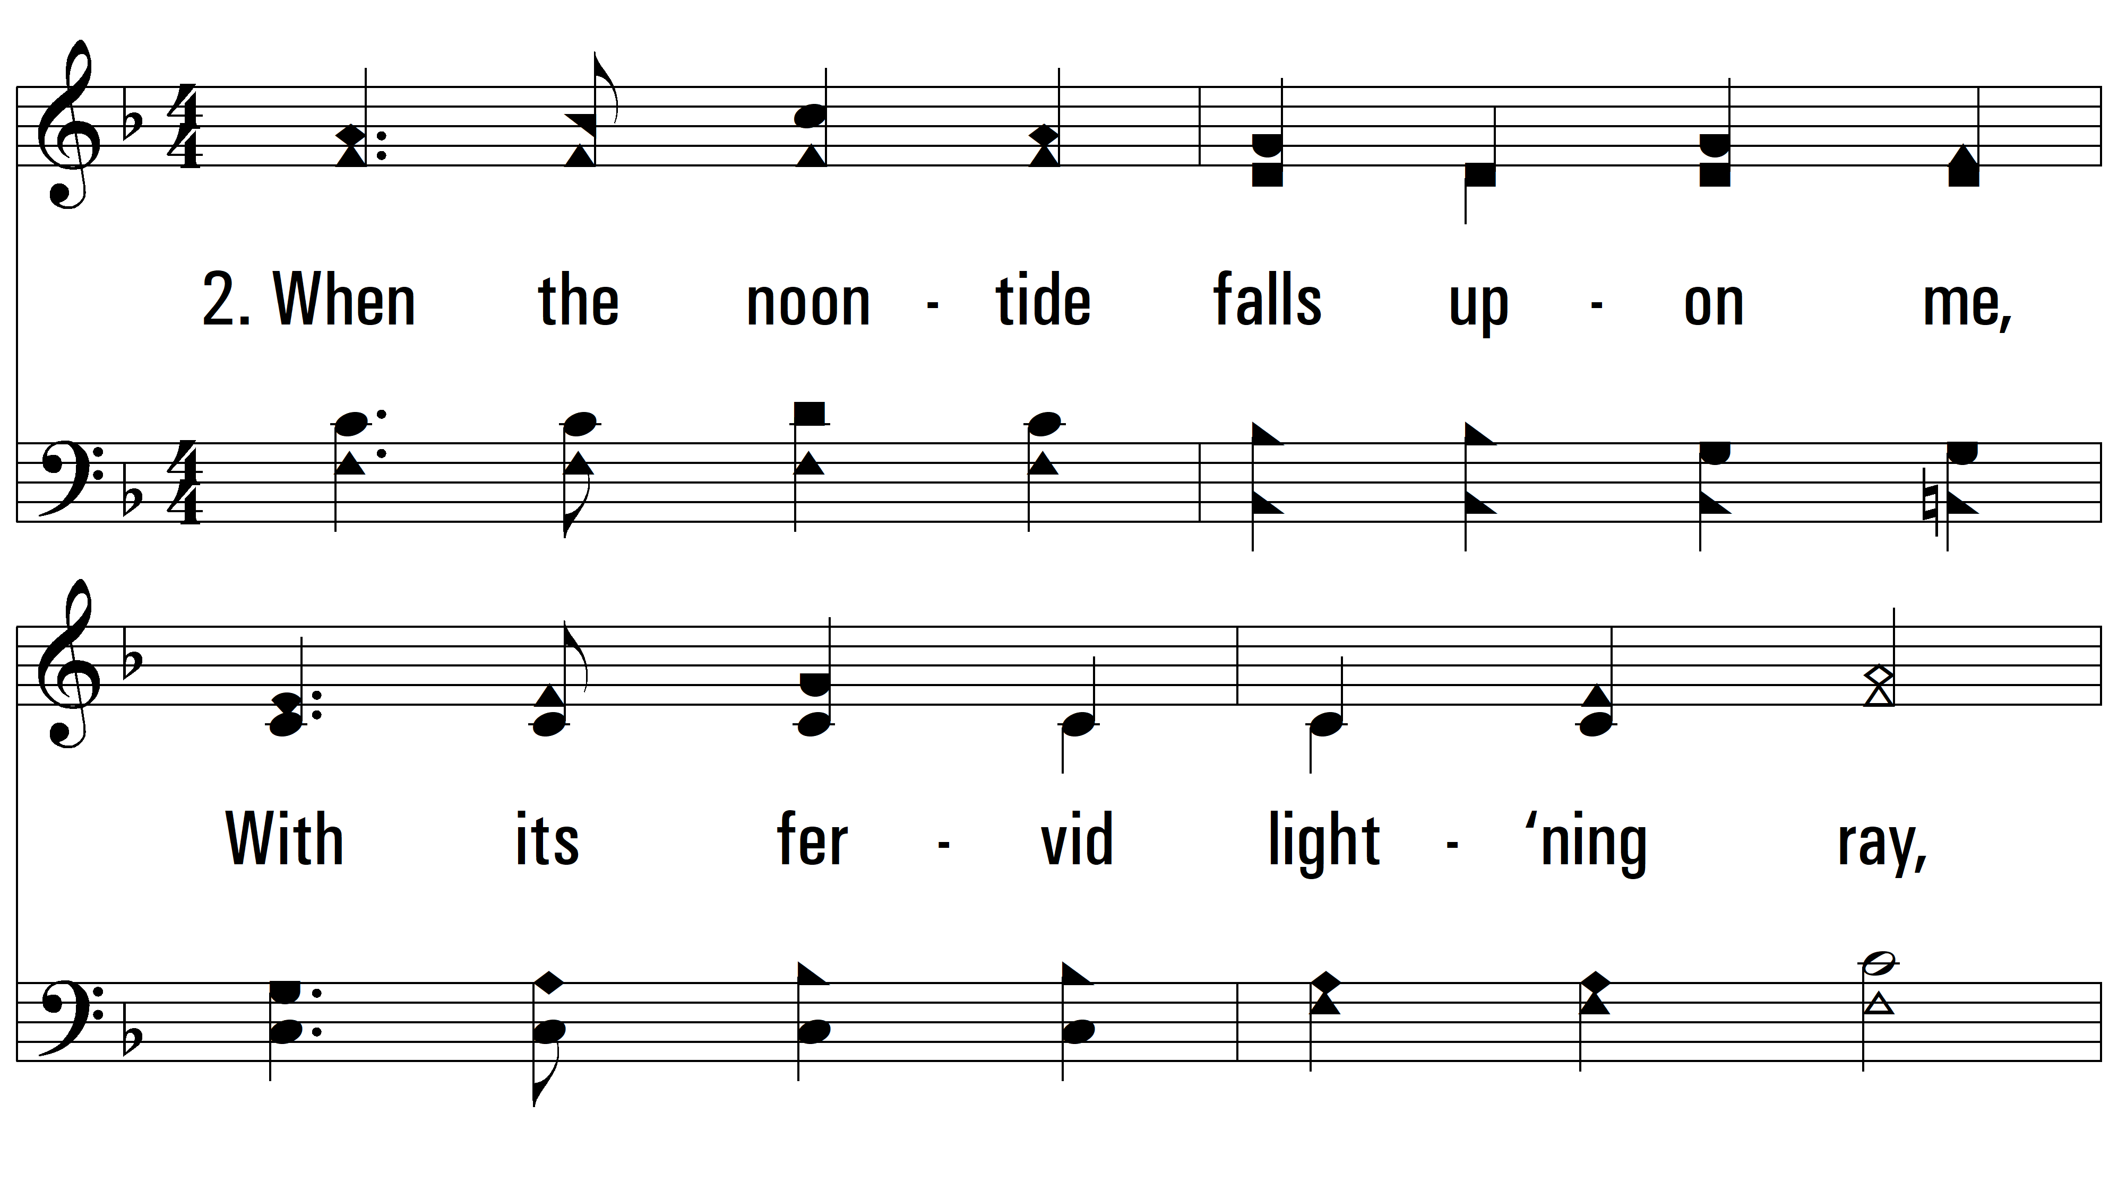
vs. 2 ~ In The Hush Of Early Morning

Slide 7
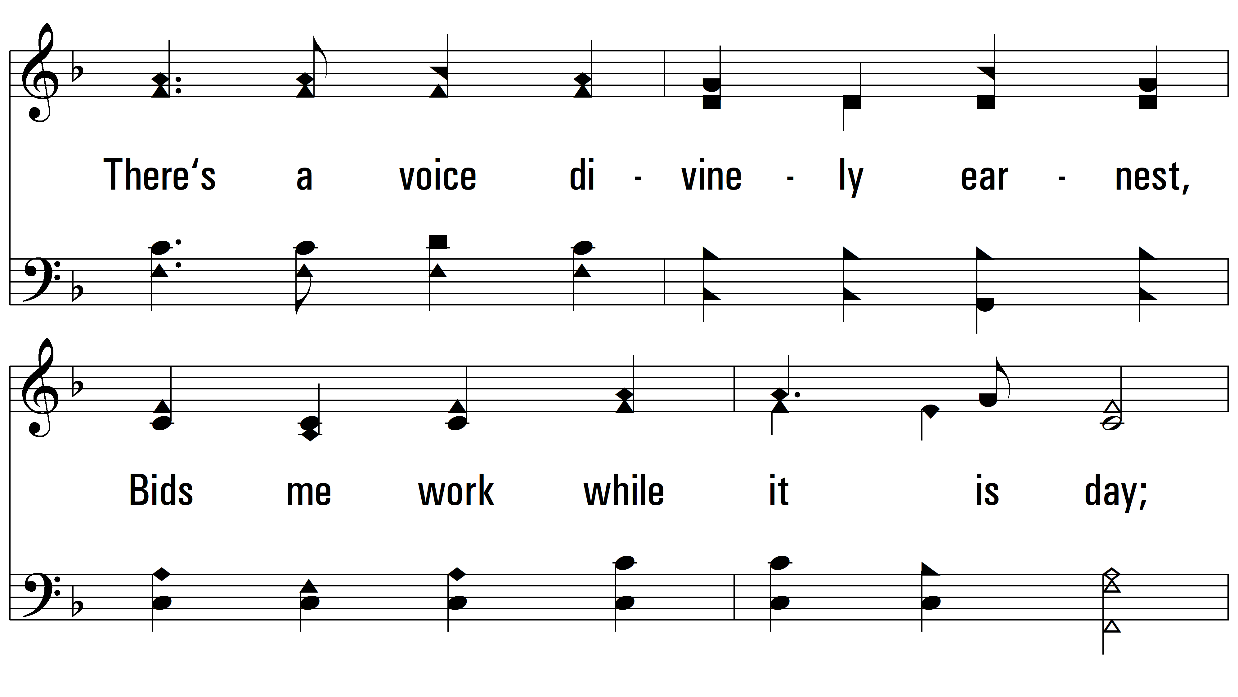
vs. 2

Slide 8
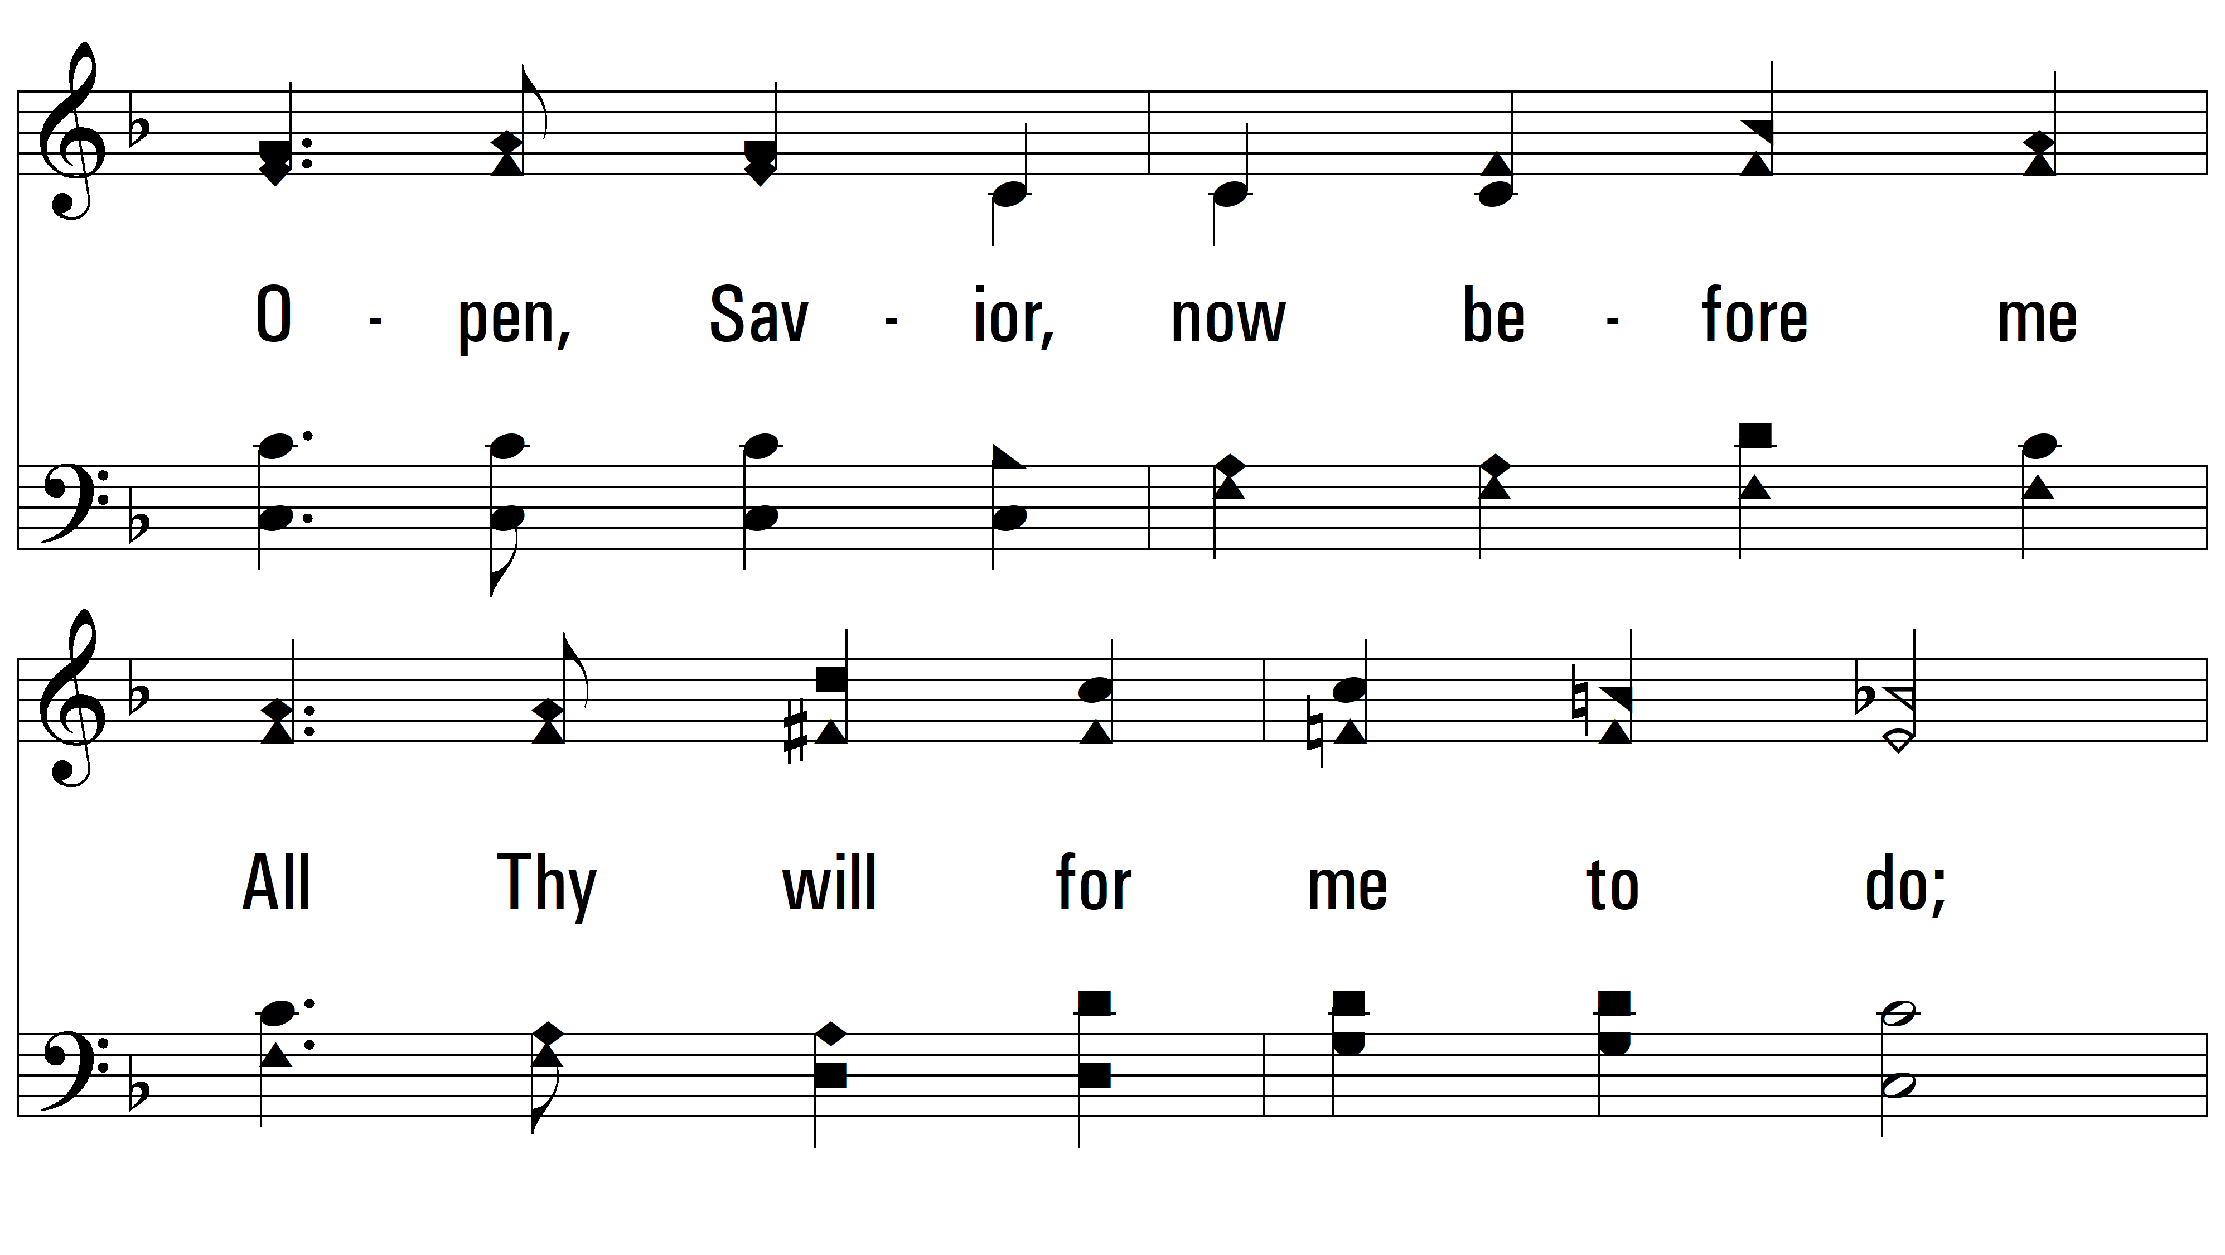
vs. 2

Slide 9
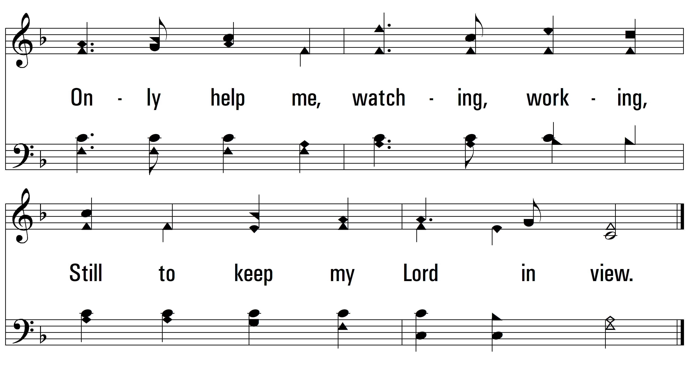
vs. 2

Slide 10
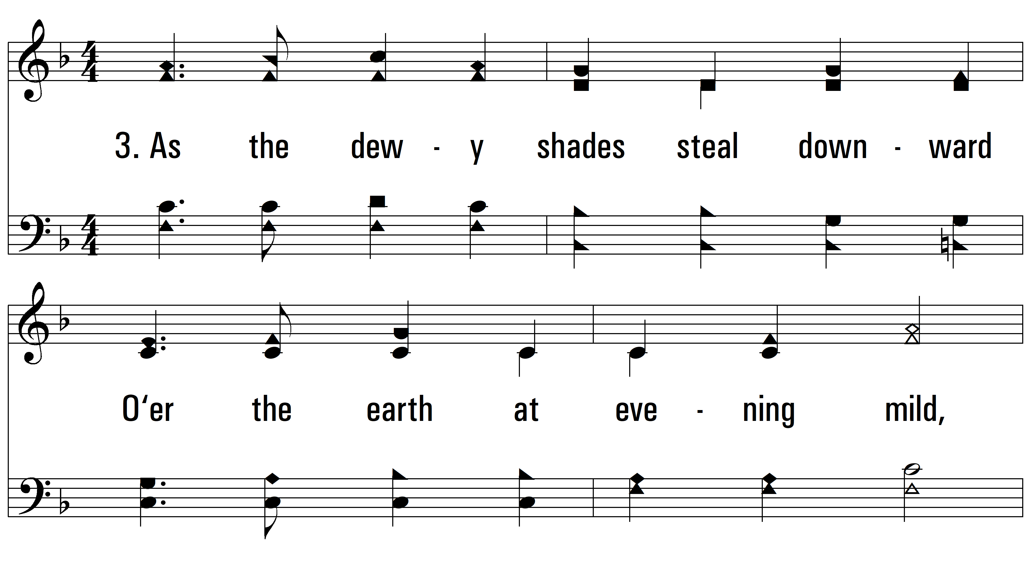
vs. 3 ~ In The Hush Of Early Morning

Slide 11
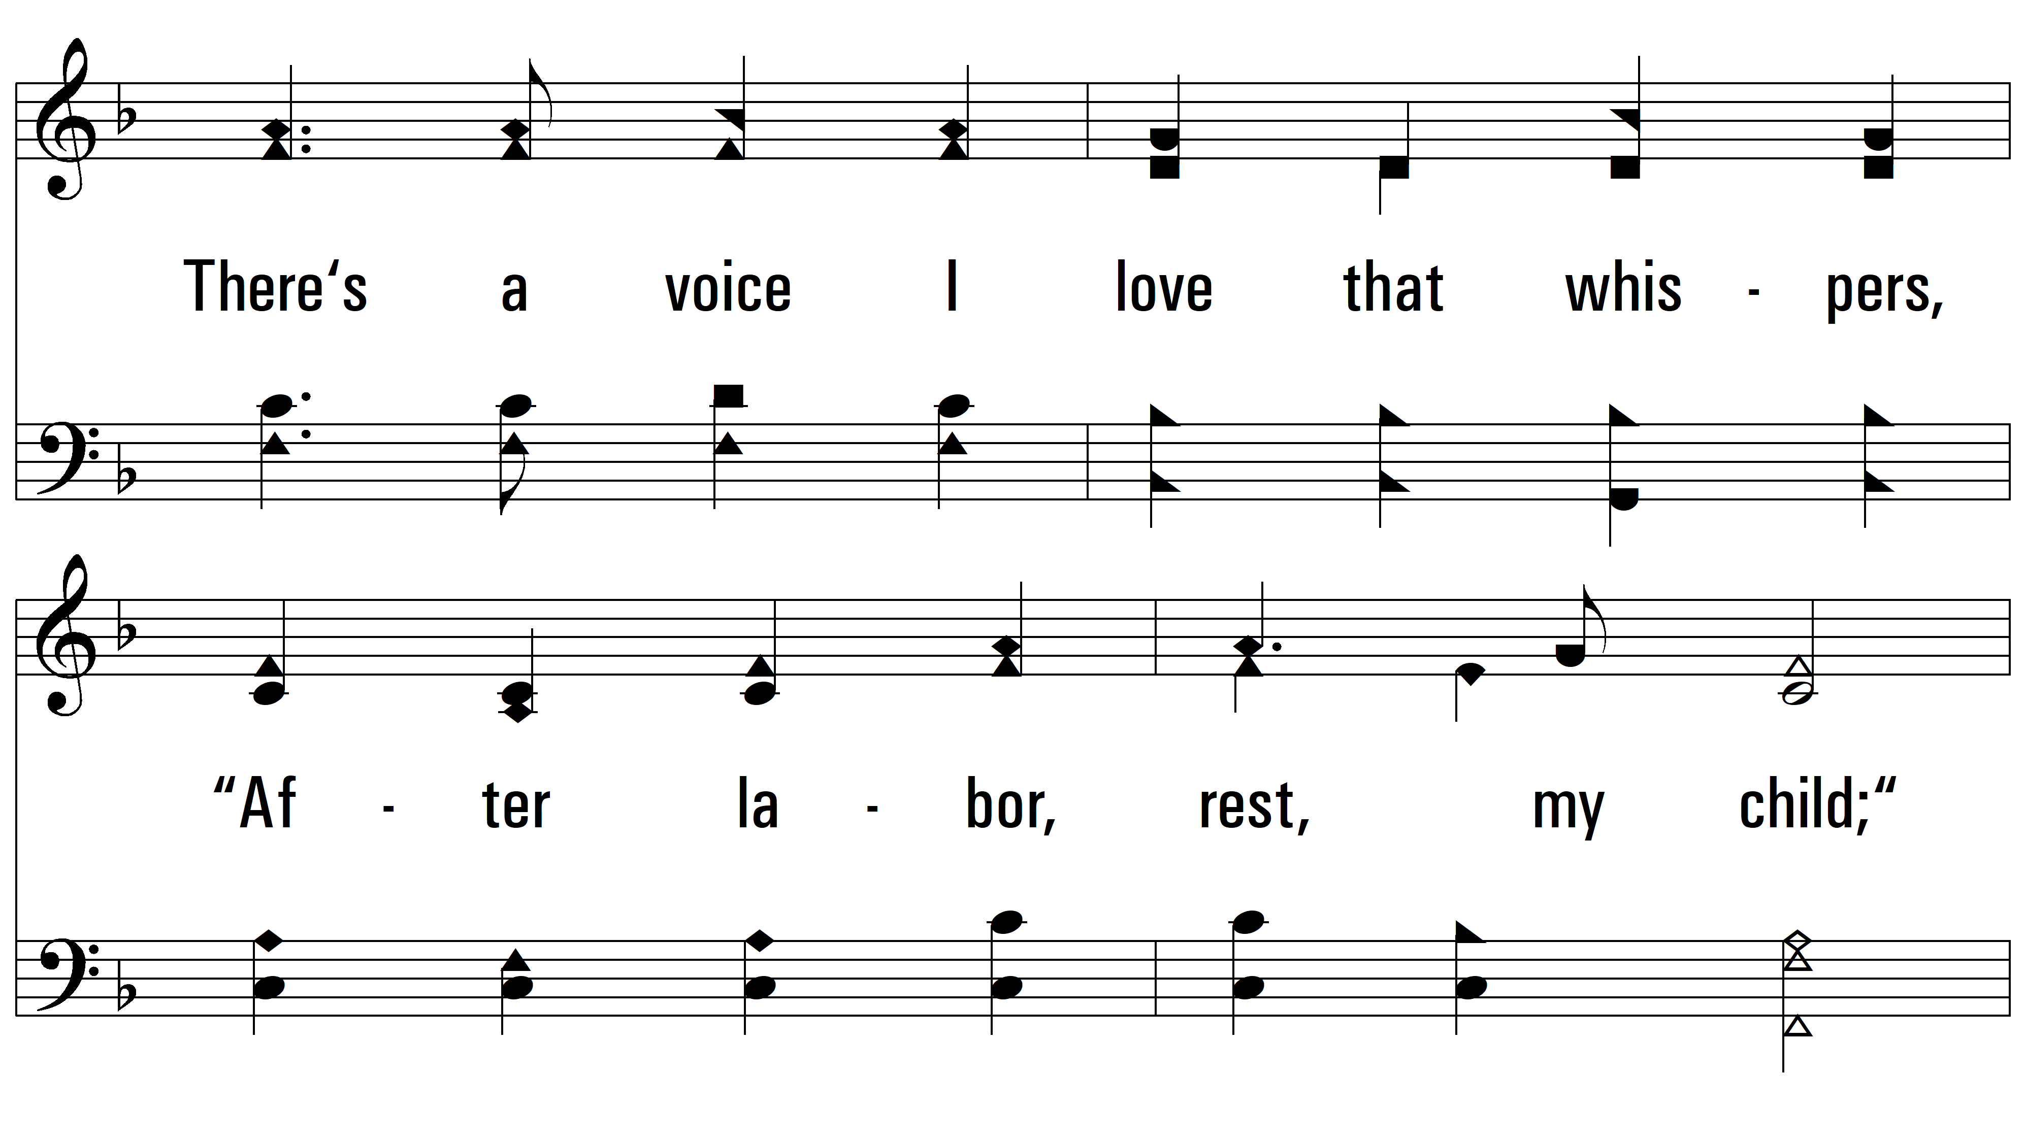
vs. 3

Slide 12
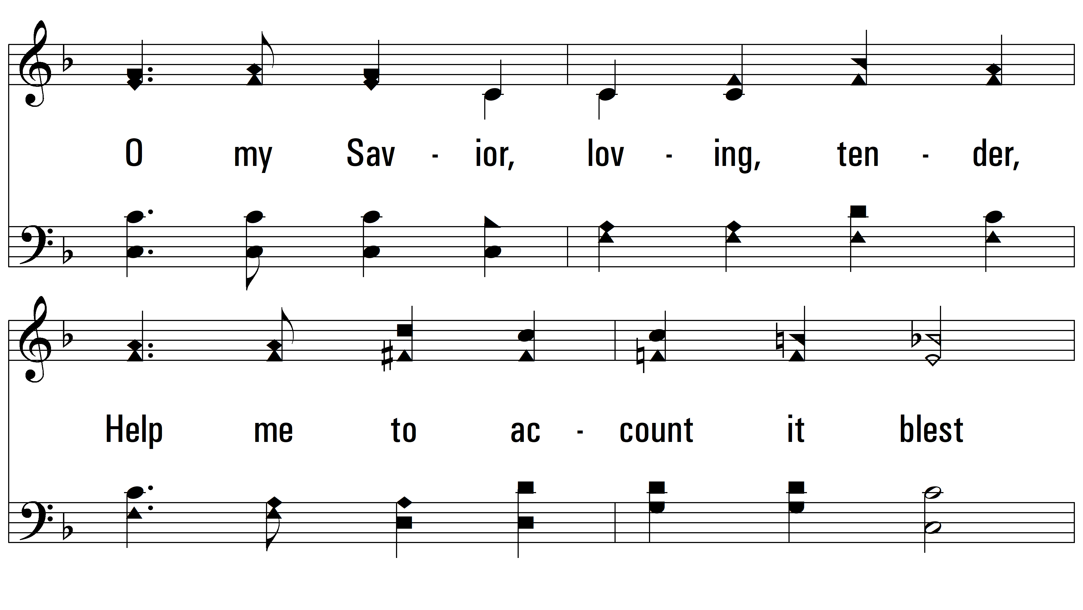
vs. 3

Slide 13
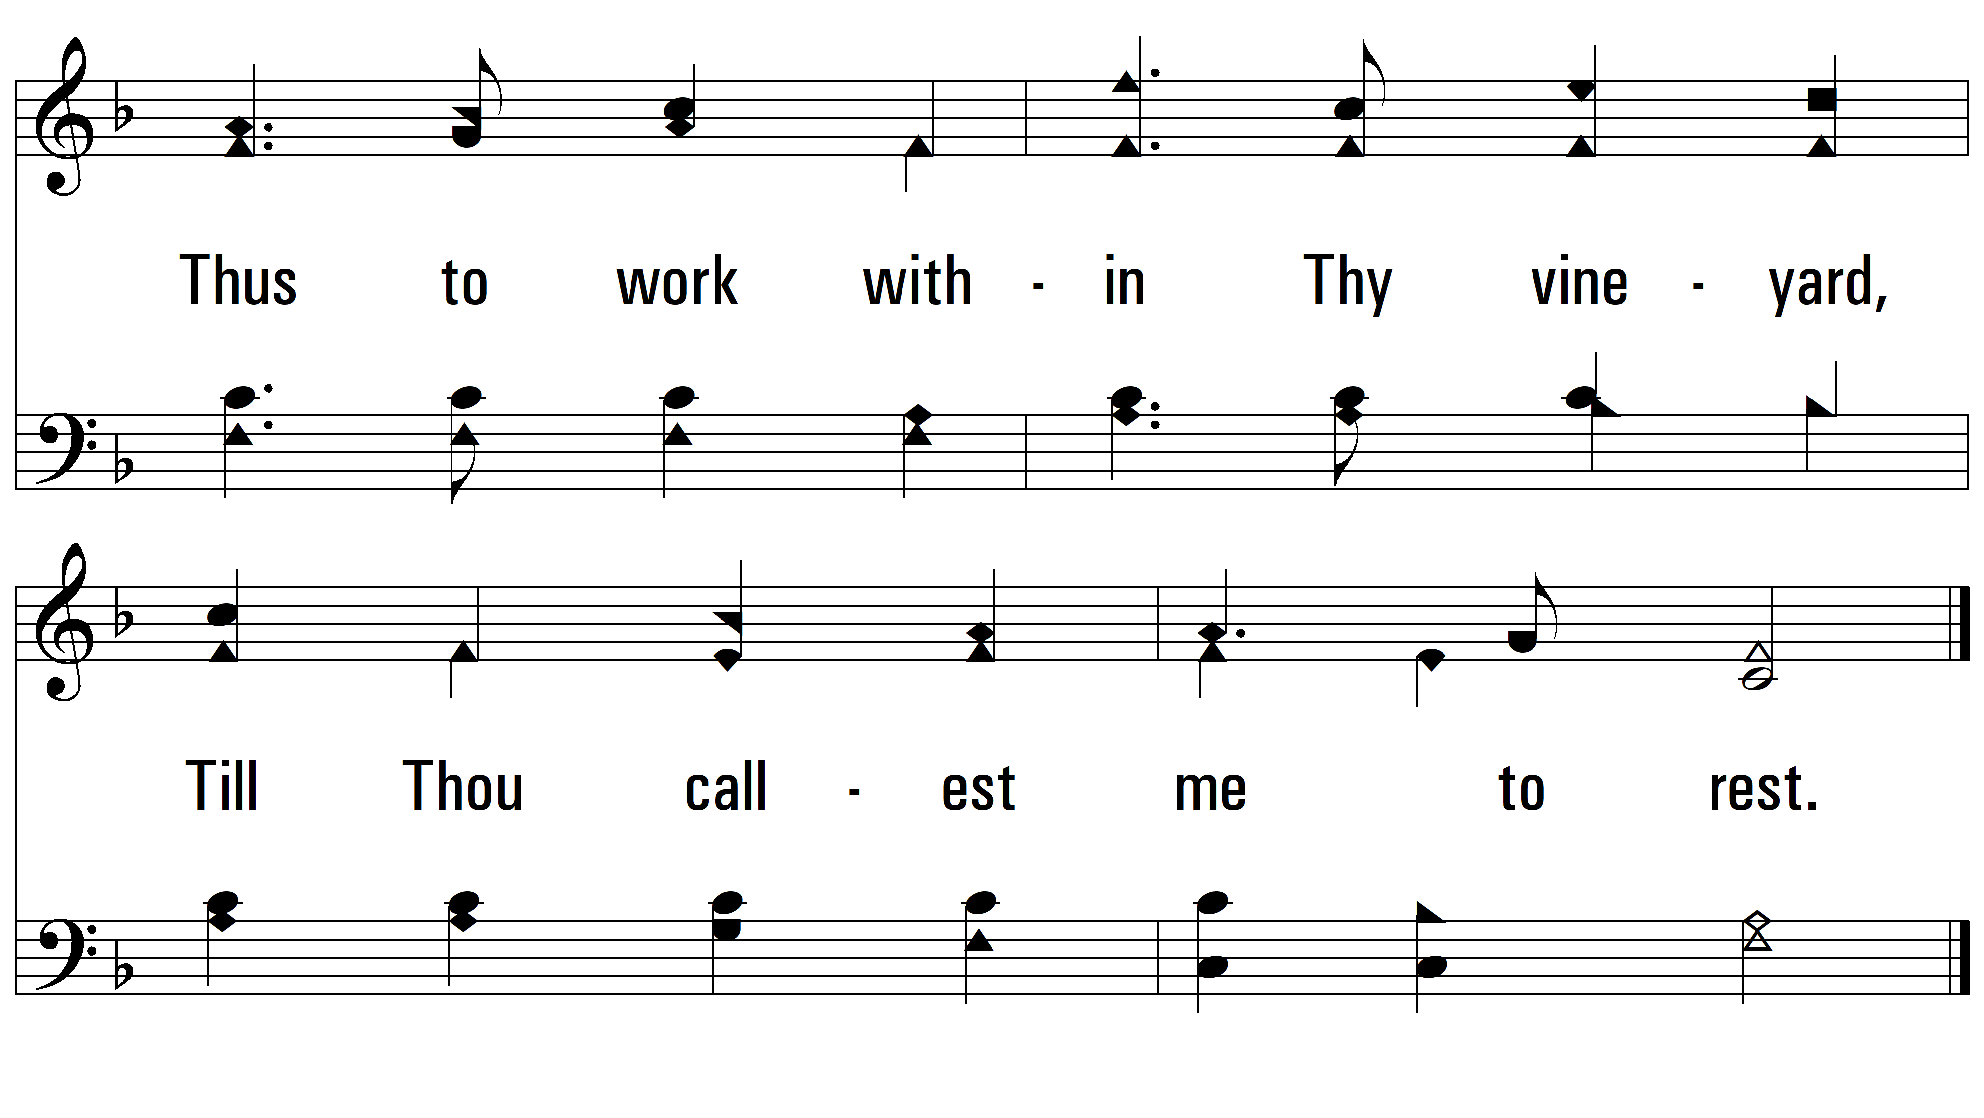
vs. 3
PDHymns.com
END

