Slide 1
In The Shadow Of His Wings
Words: | J. B. Atchinson (1810)
Music: | E. O. Excel (1810)
4/4
F/A - MI
Verses: 3/Chorus
Lead - | MI
Alto - | DO
Tenor - | SOL
Bass - | DO
PDHymns.com

Slide 2
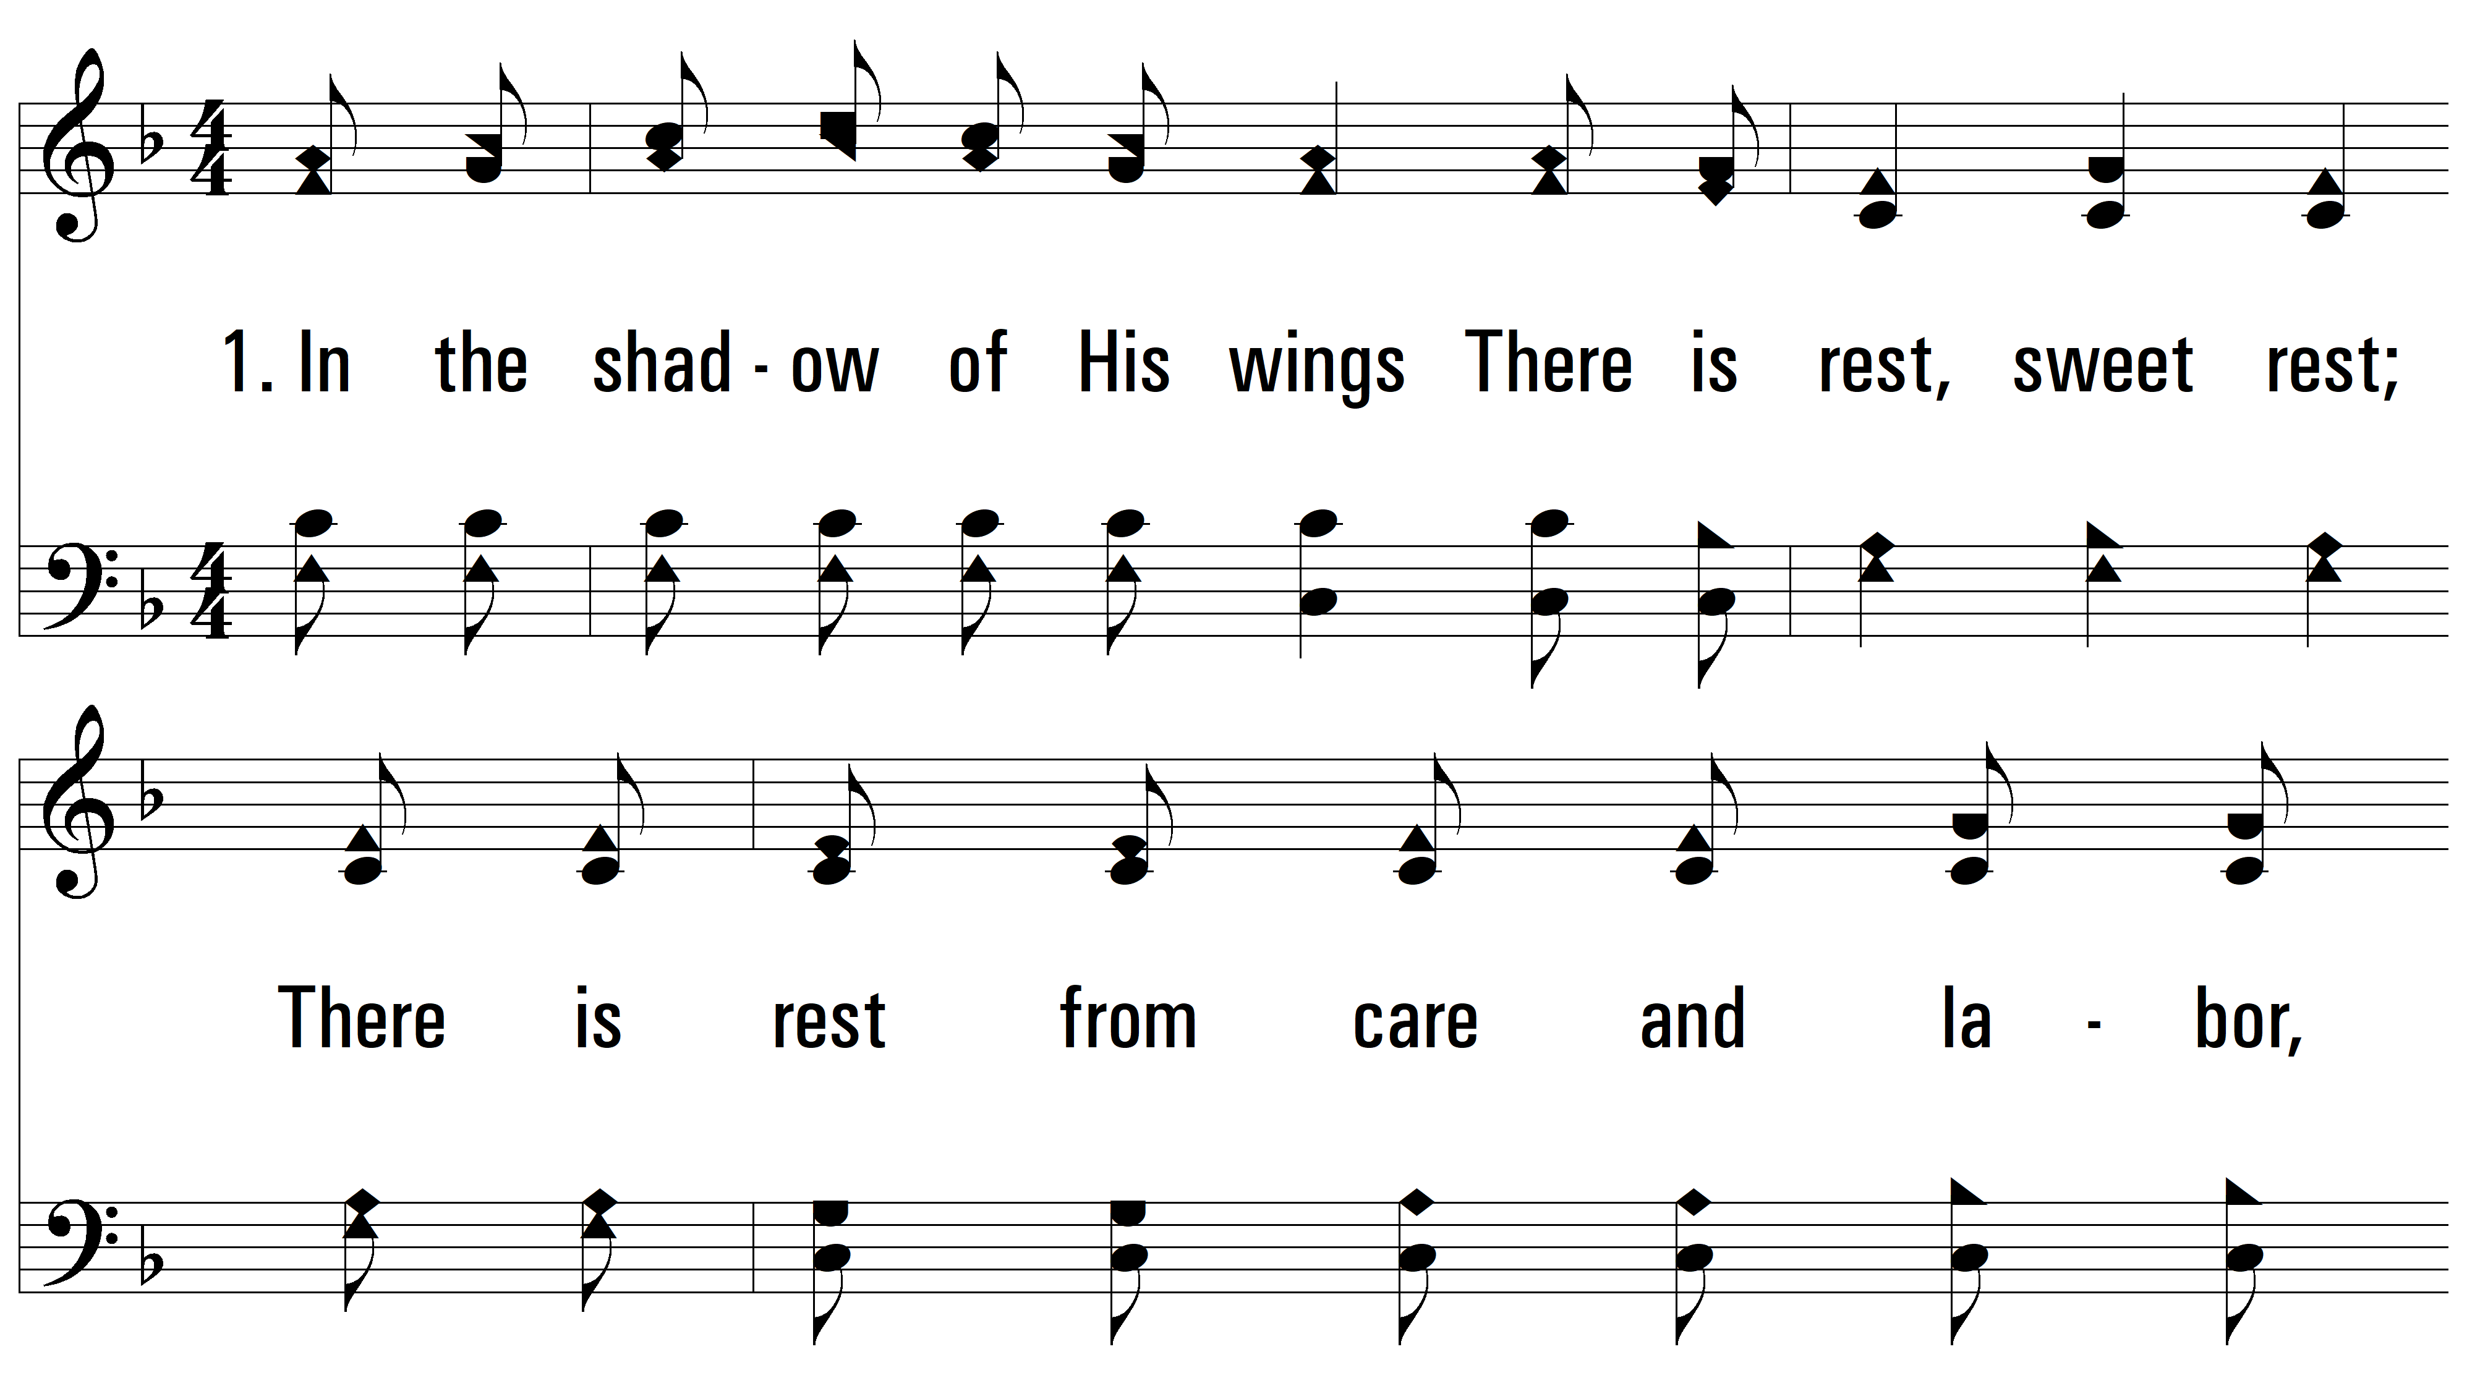
vs. 1 ~ In The Shadow Of His Wings

Slide 3
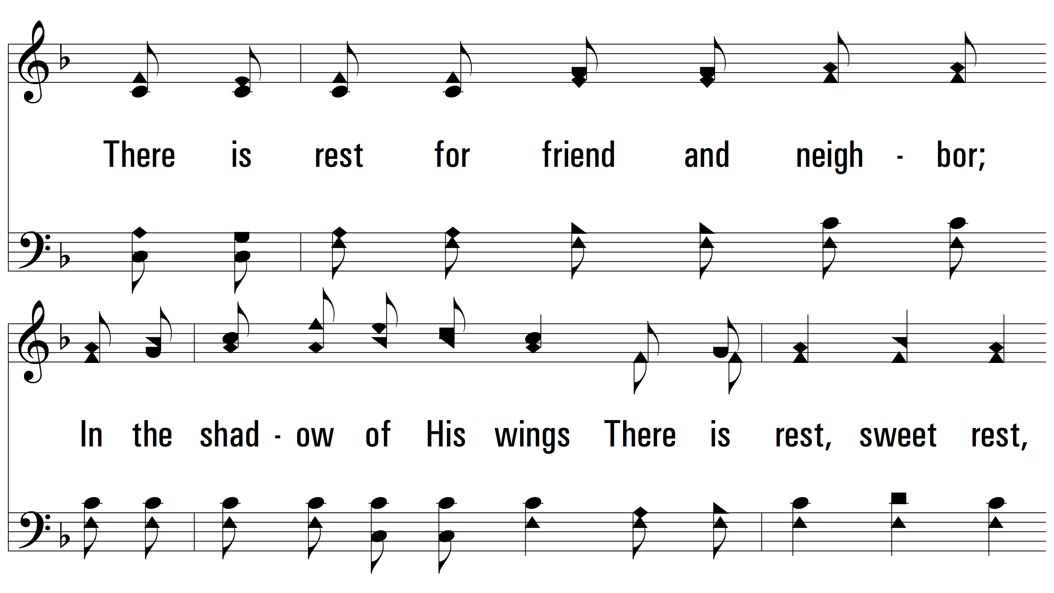
vs. 1

Slide 4
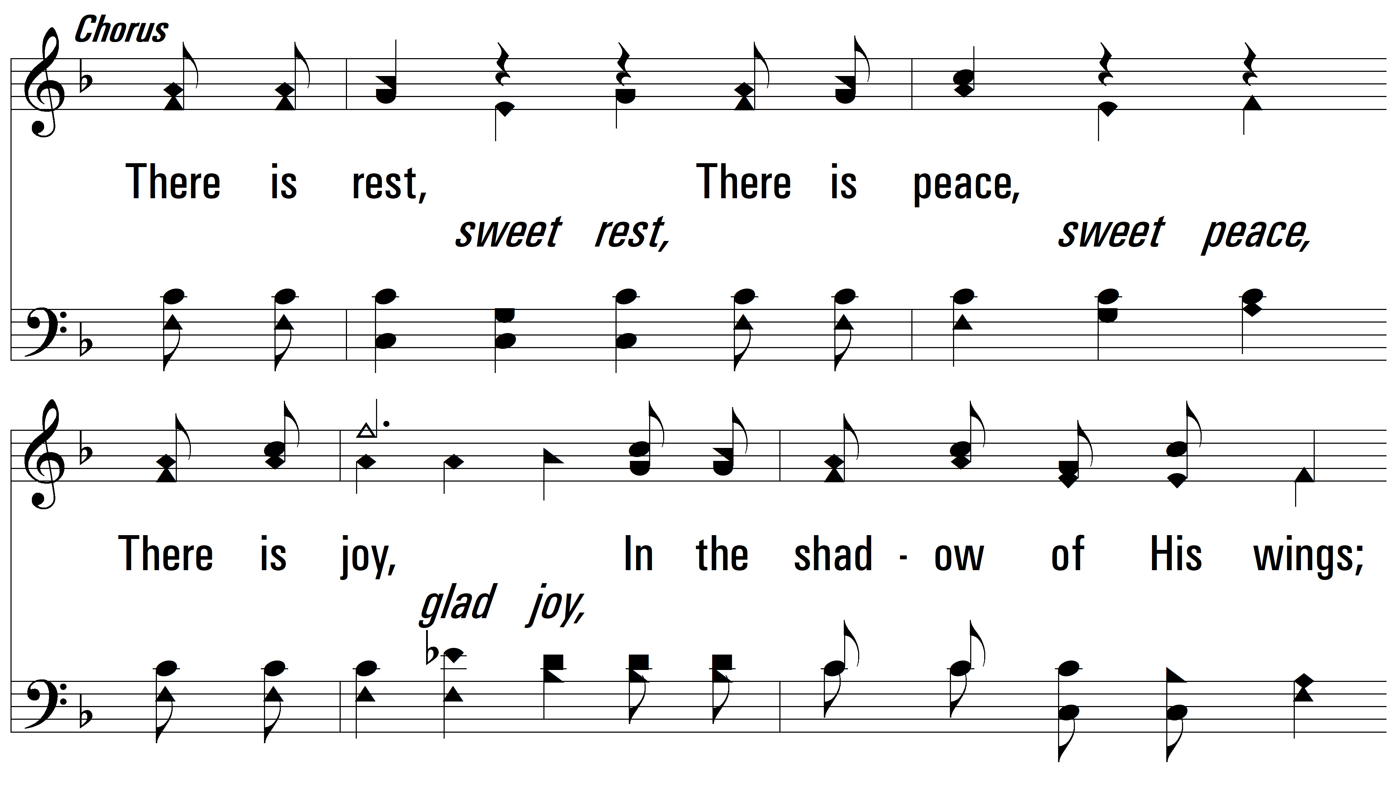
vs. 1

Slide 5
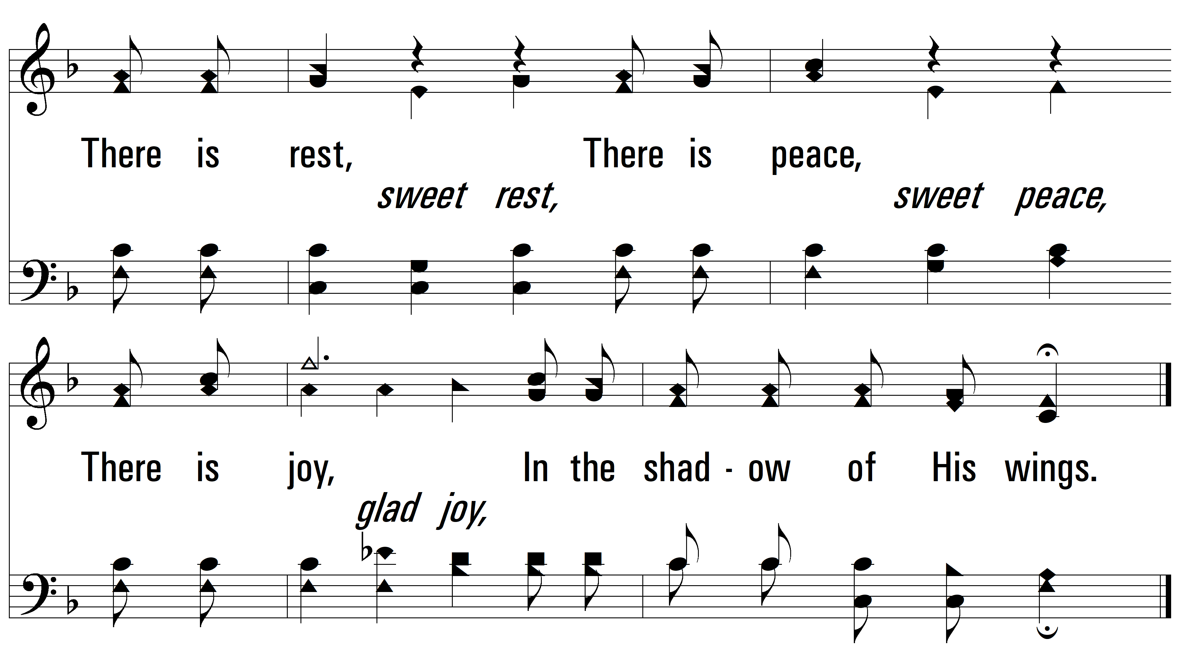
vs. 1

Slide 6
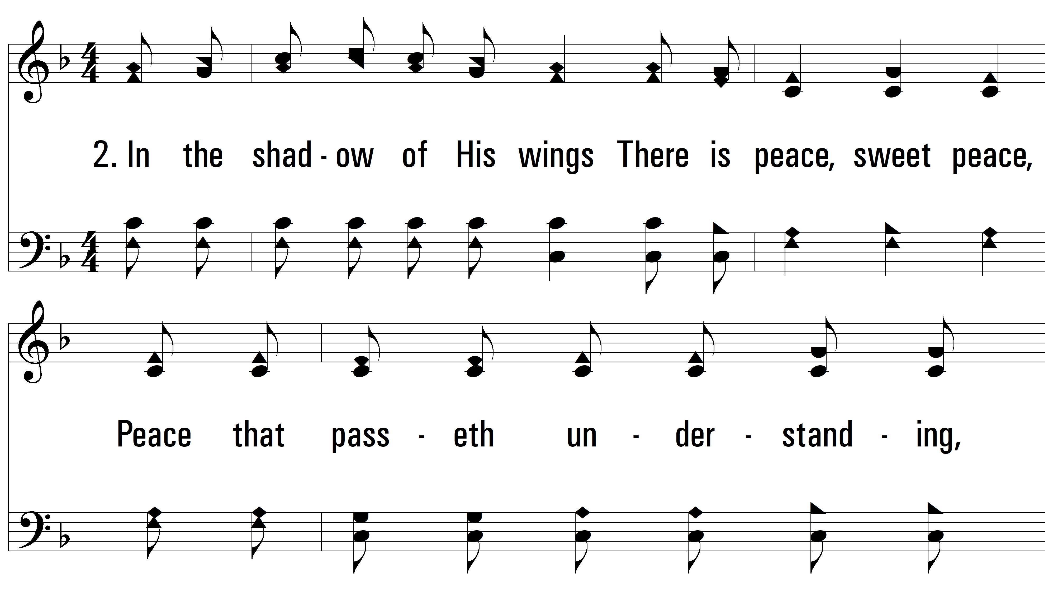
vs. 2 ~ In The Shadow Of His Wings

Slide 7
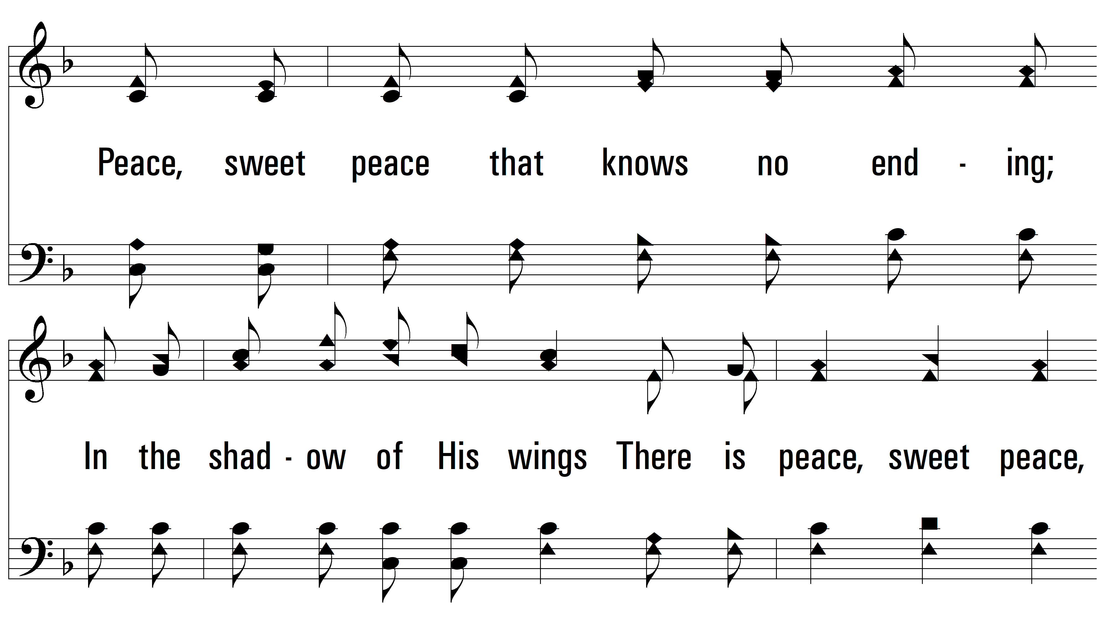
vs. 2

Slide 8
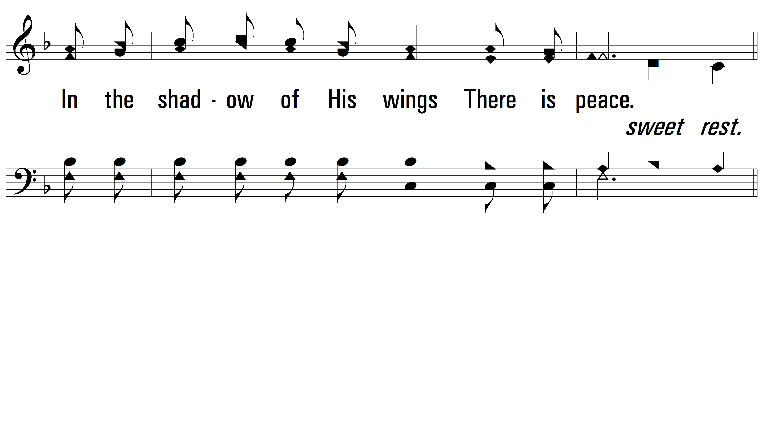
vs. 2

Slide 9
vs. 2

Slide 10
vs. 2

Slide 11
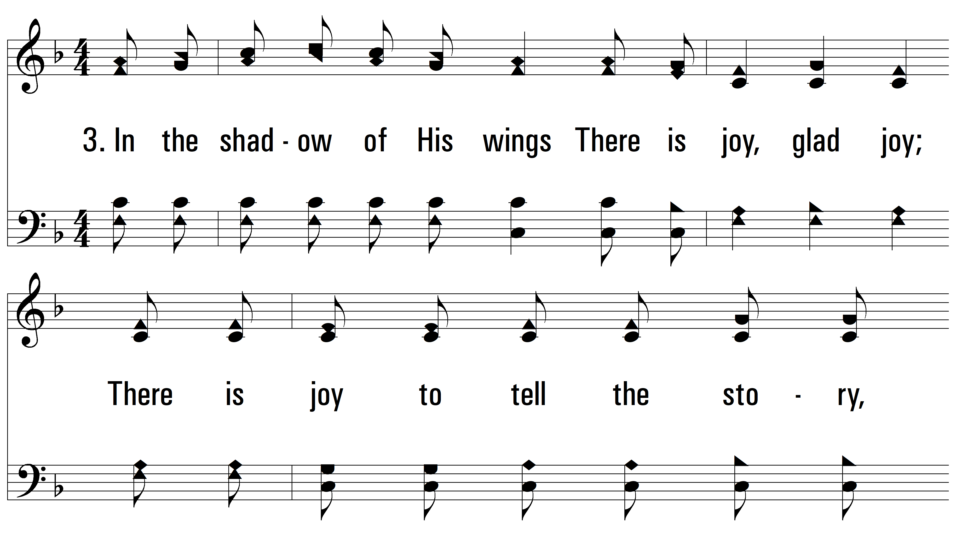
vs. 3 ~ In The Shadow Of His Wings

Slide 12
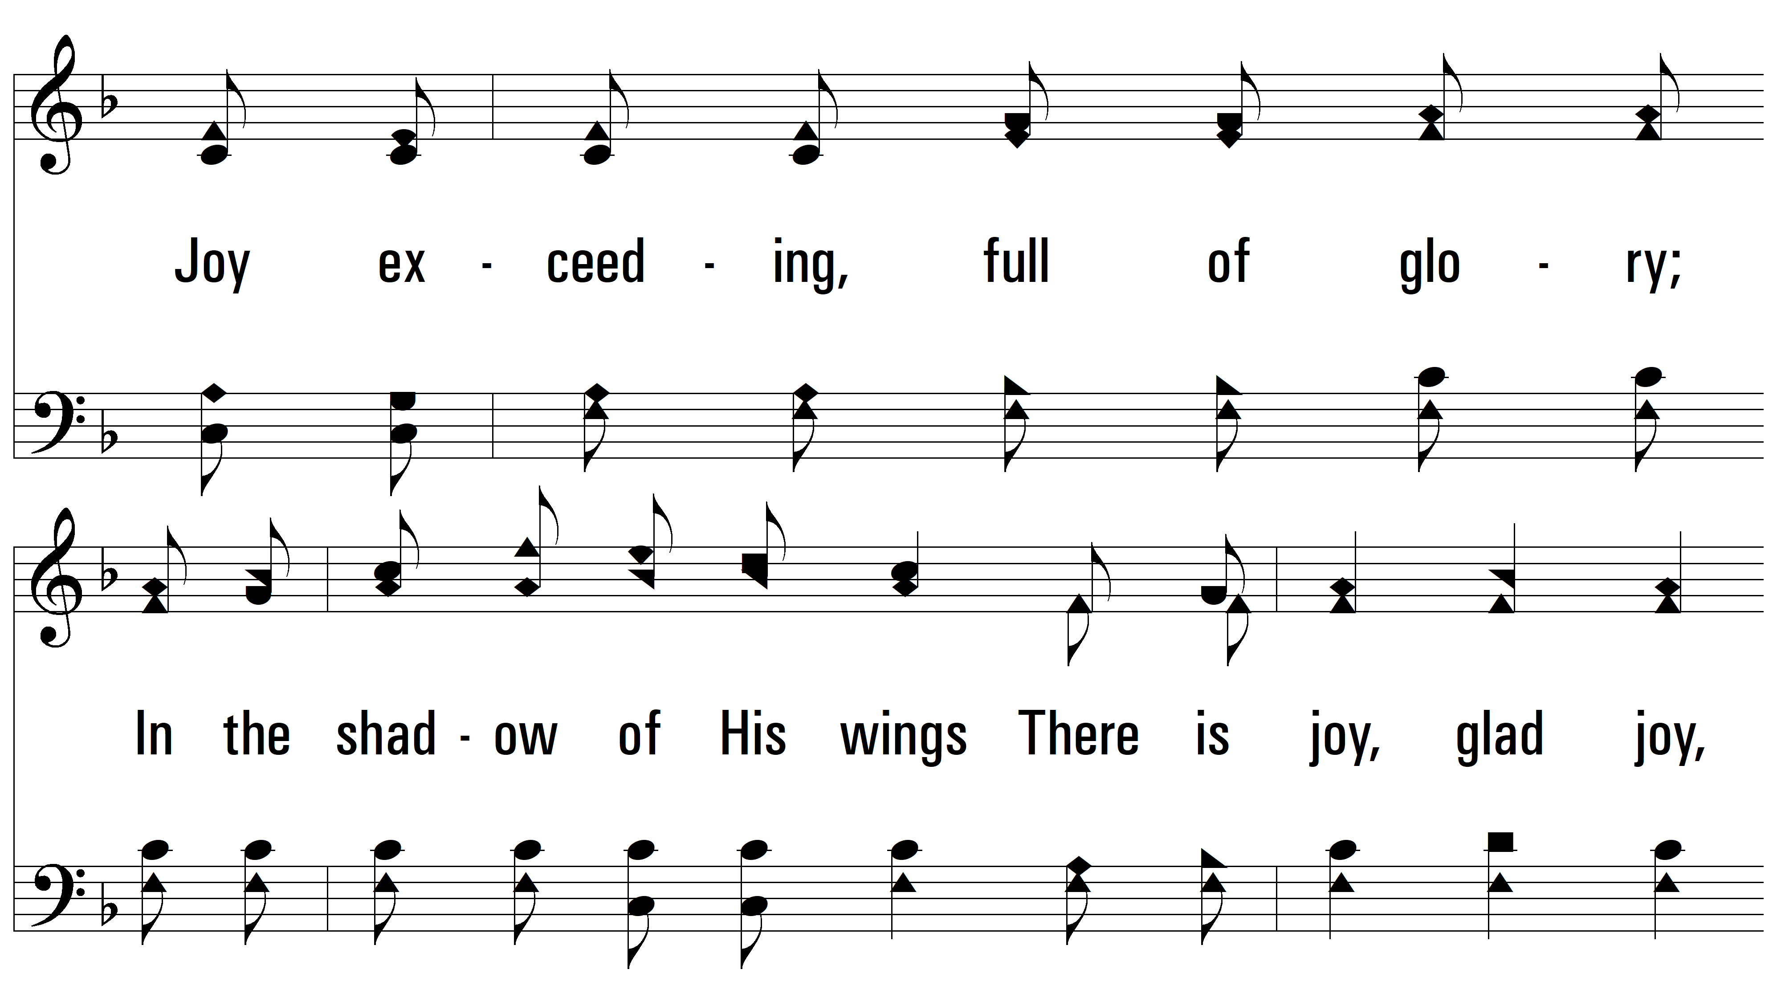
vs. 3

Slide 13
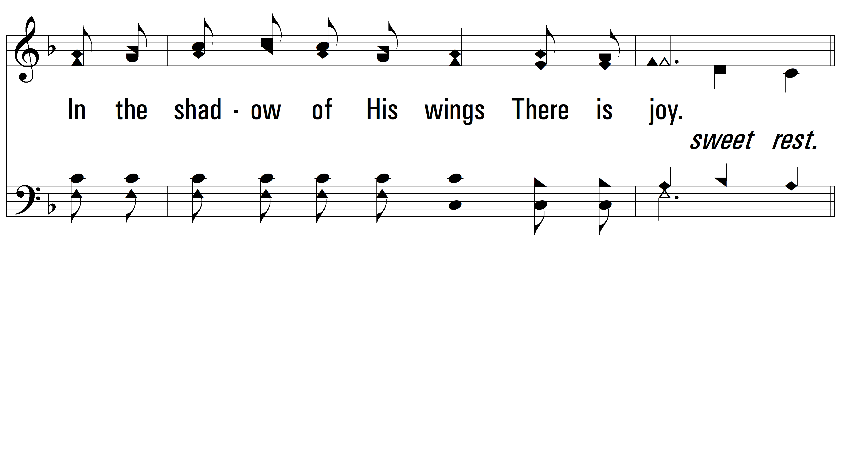
vs. 3

Slide 14
vs. 3

Slide 15
vs. 3
PDHymns.com
END

