Slide 1
In The Service Of The King
Words: | Alfred H. Ackley (1912)
Music: | Bentley D. Ackley
4/4
B^{b}/D - MI
Verses: 4/Chorus
Lead - | MI
Alto - | DO
Tenor - | SOL
Bass - | DO
PDHymns.com

Slide 2
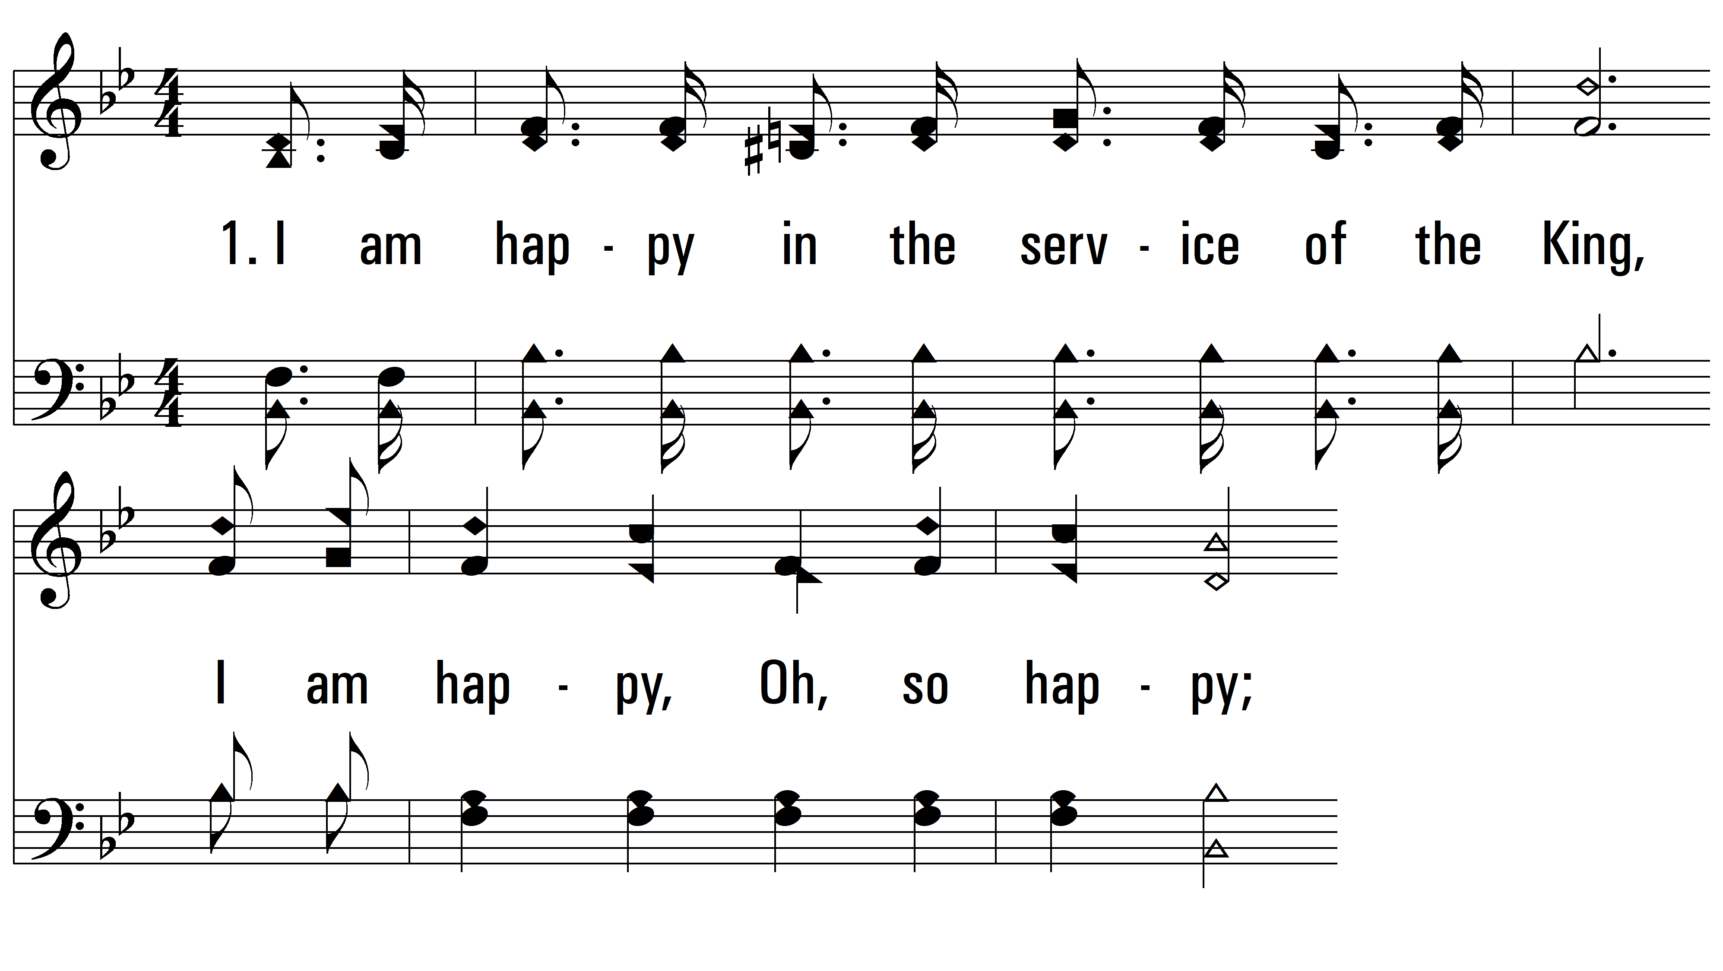
vs. 1 ~ In The Service Of The King

Slide 3
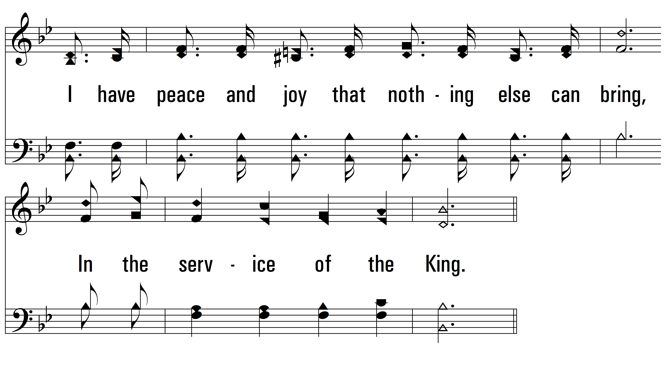
vs. 1

Slide 4
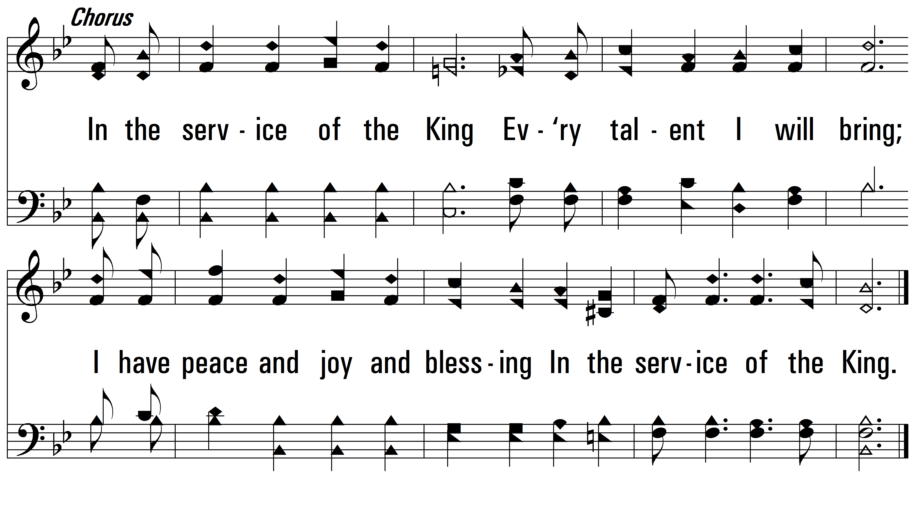
vs. 1

Slide 5

vs. 2 ~ In The Service Of The King

Slide 6
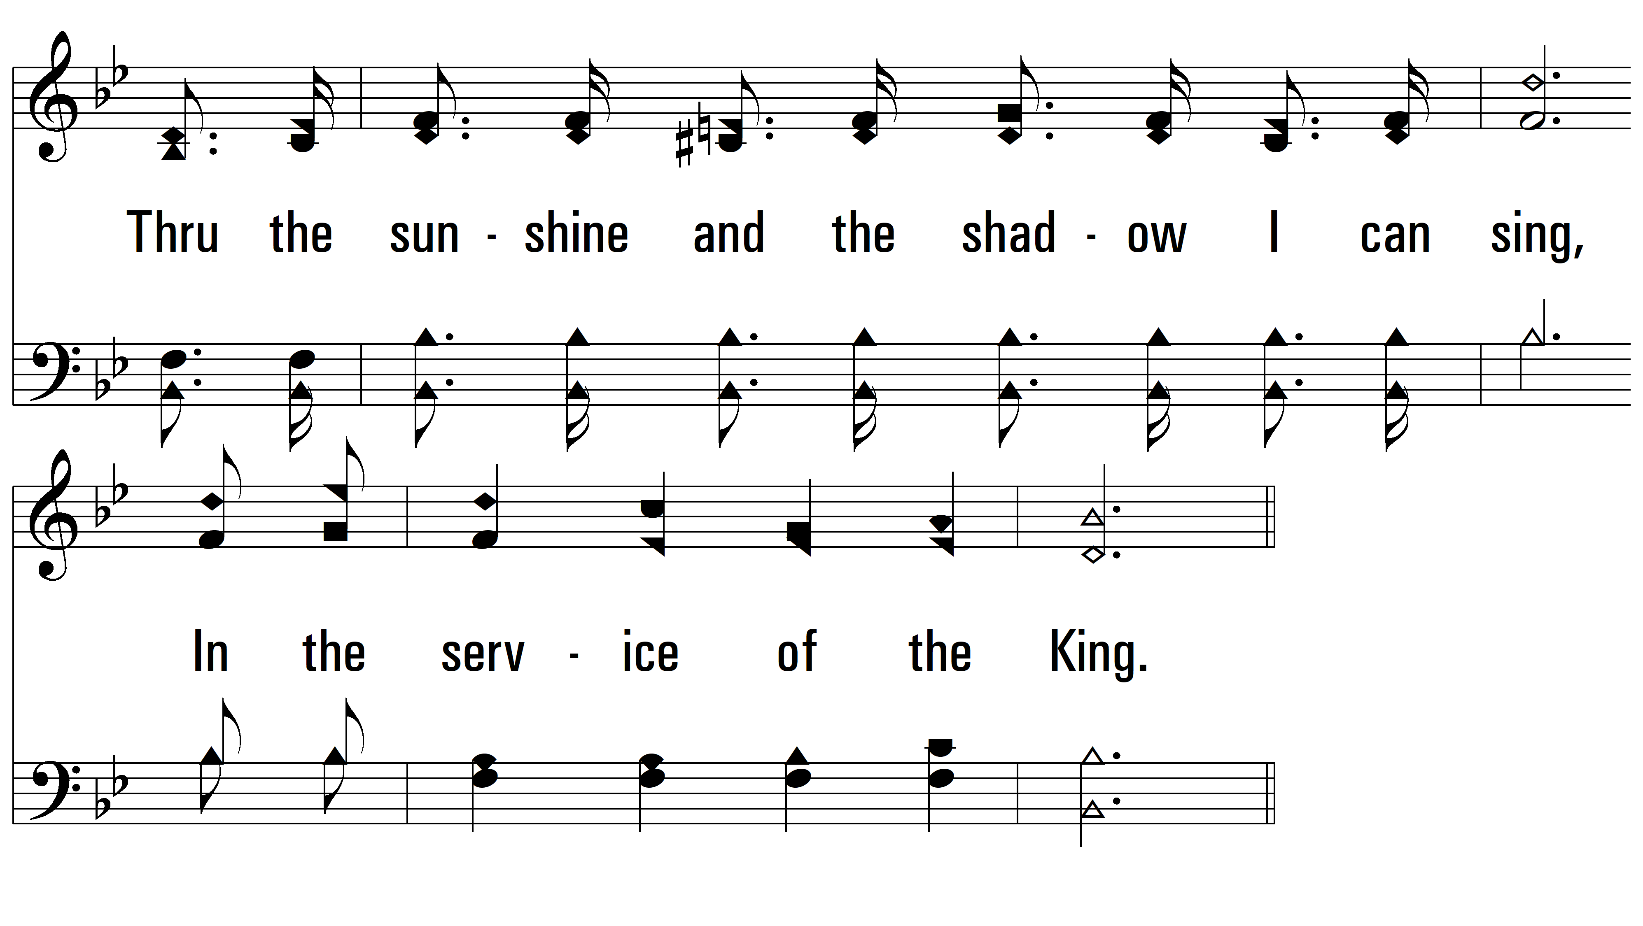
vs. 2

Slide 7
vs. 2

Slide 8

vs. 3 ~ In The Service Of The King

Slide 9
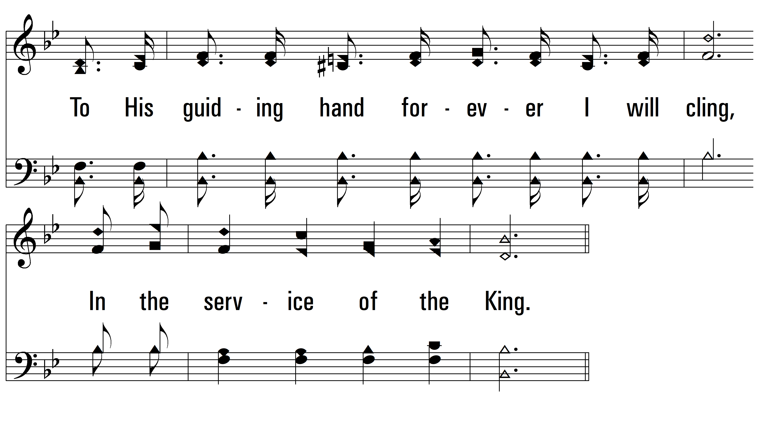
vs. 3

Slide 10
vs. 3

Slide 11

vs. 4 ~ In The Service Of The King

Slide 12
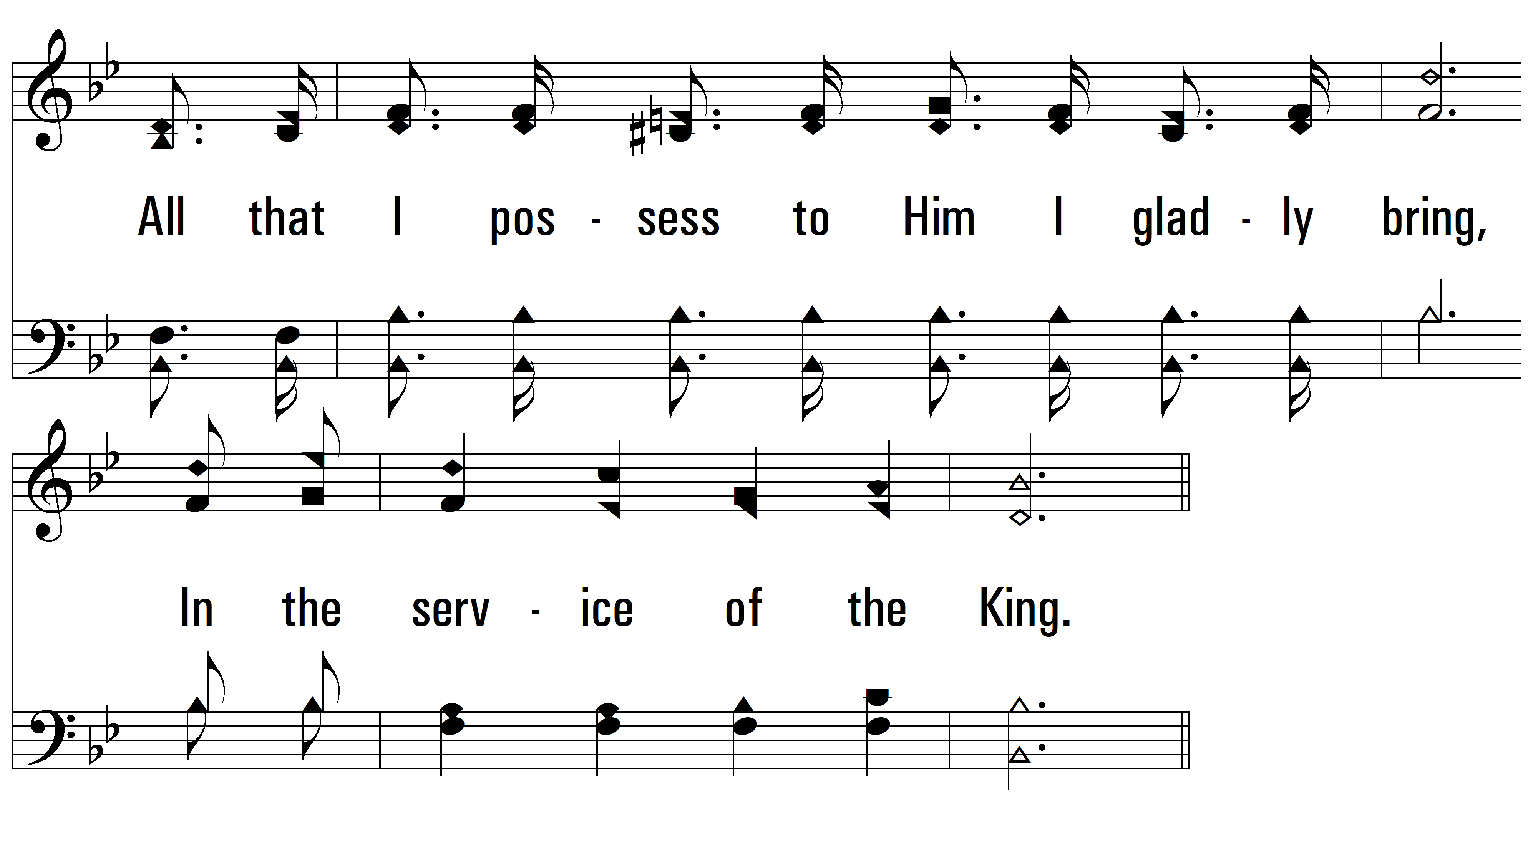
vs. 4

Slide 13
vs. 4
PDHymns.com
END

