Slide 1
In The Morning Of Joy
Words: | Mrs. R. A. Evilsizer (1895)
Music: | A. J. Showalter (1895)
3/4
E/E - DO
Verses: 3/Chorus
Lead - | DO
Alto - | SOL
Tenor - | MI
Bass - | DO
PDHymns.com

Slide 2
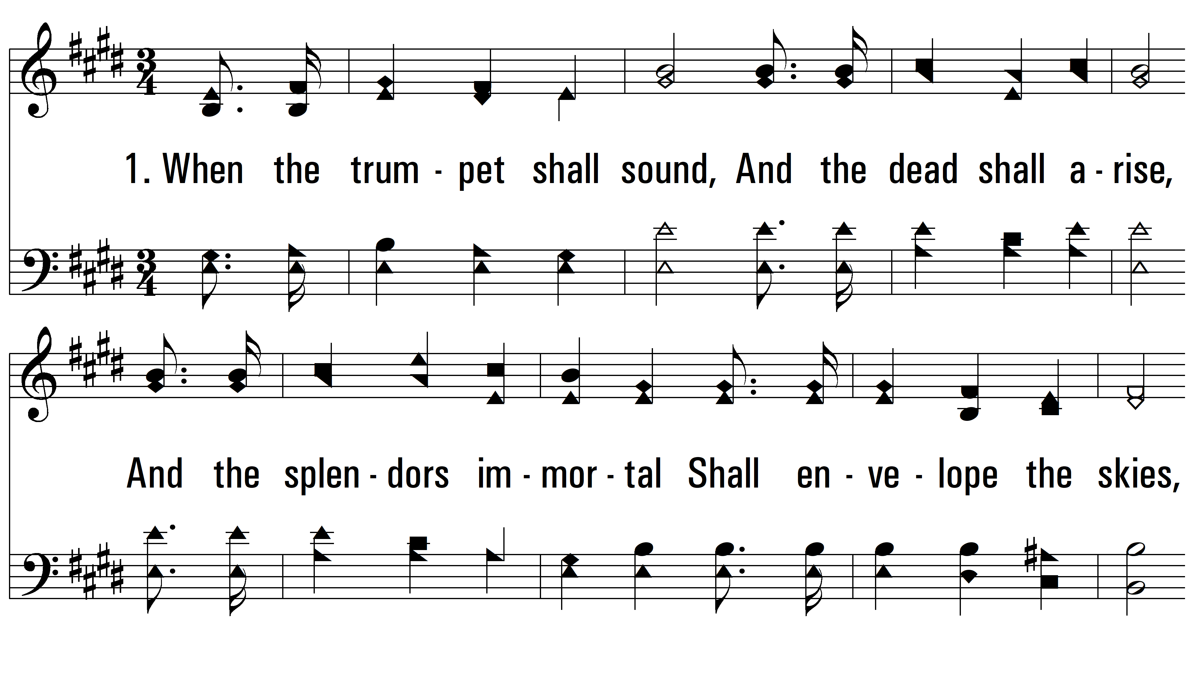
vs. 1 ~ In The Morning Of Joy

Slide 3
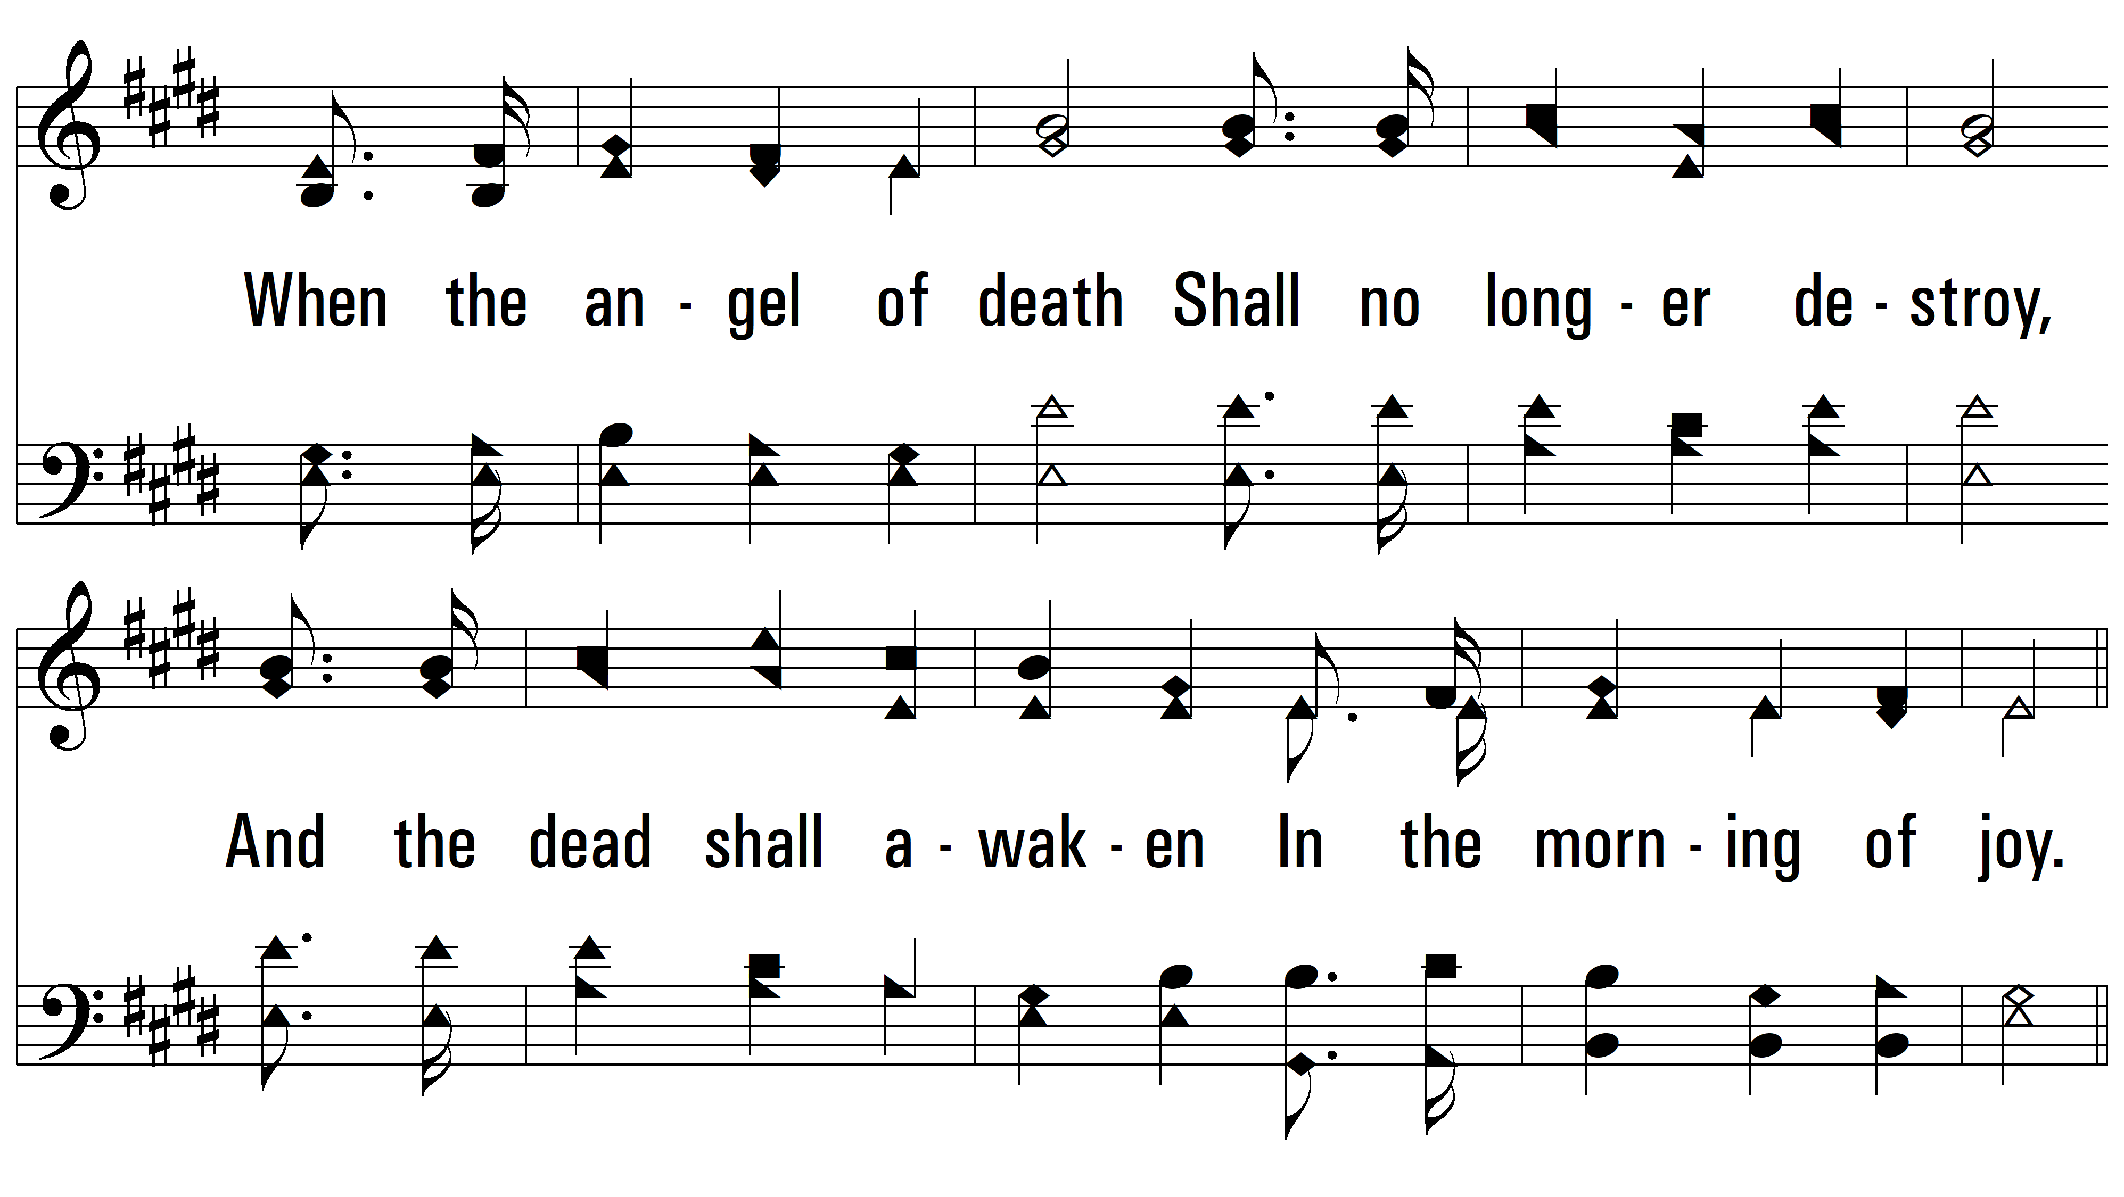
vs. 1

Slide 4
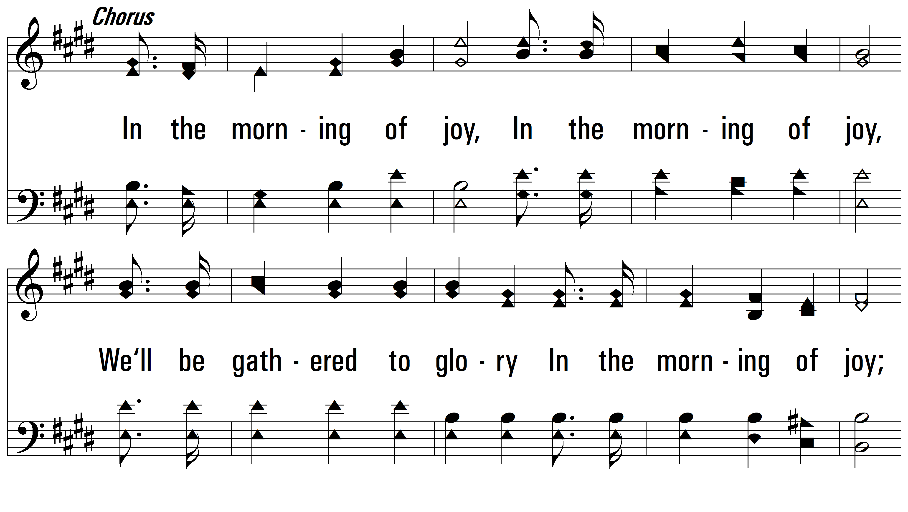
vs. 1

Slide 5
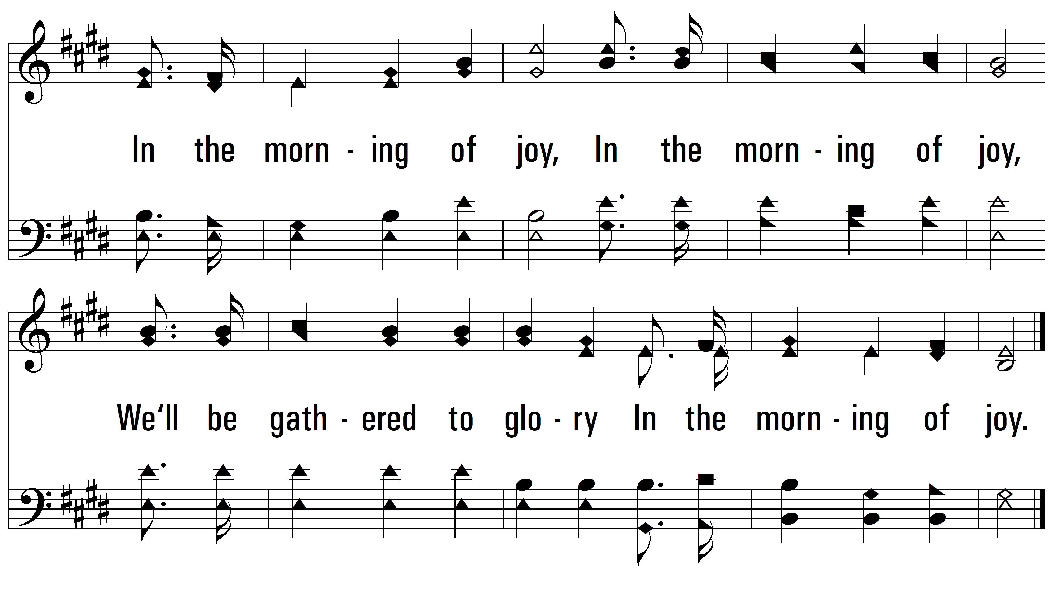
vs. 1

Slide 6
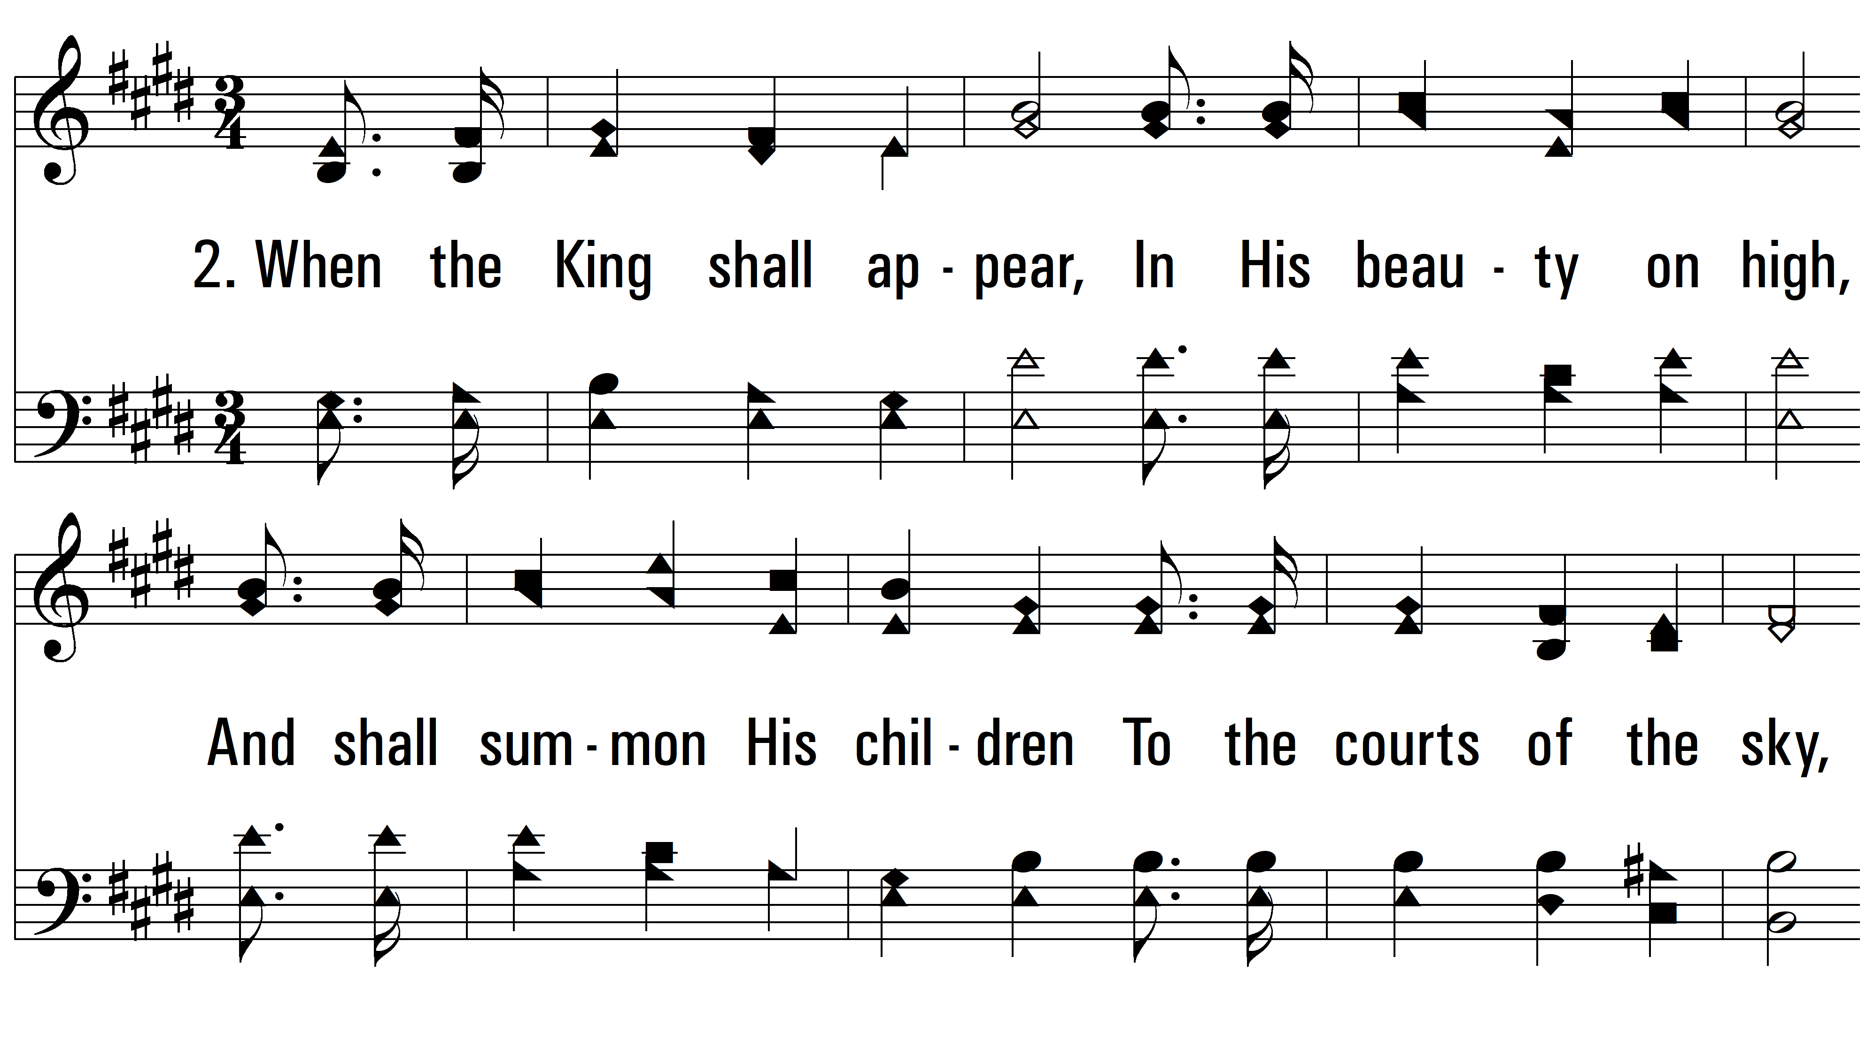
vs. 2 ~ In The Morning Of Joy

Slide 7
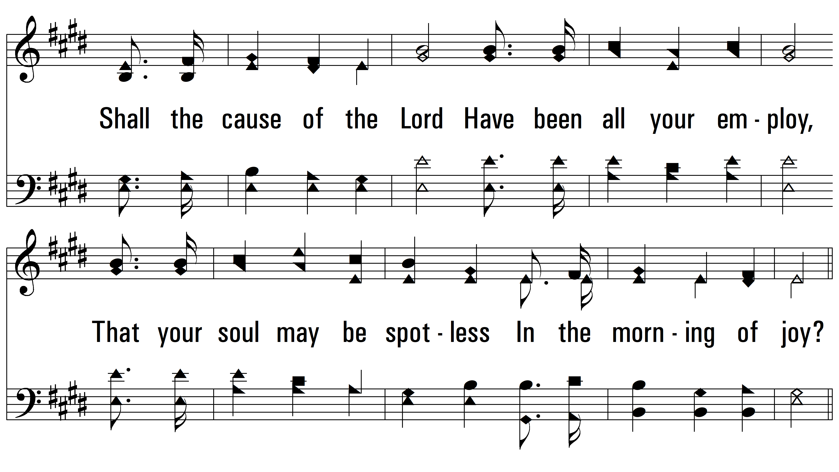
vs. 2

Slide 8
vs. 2

Slide 9
vs. 2

Slide 10
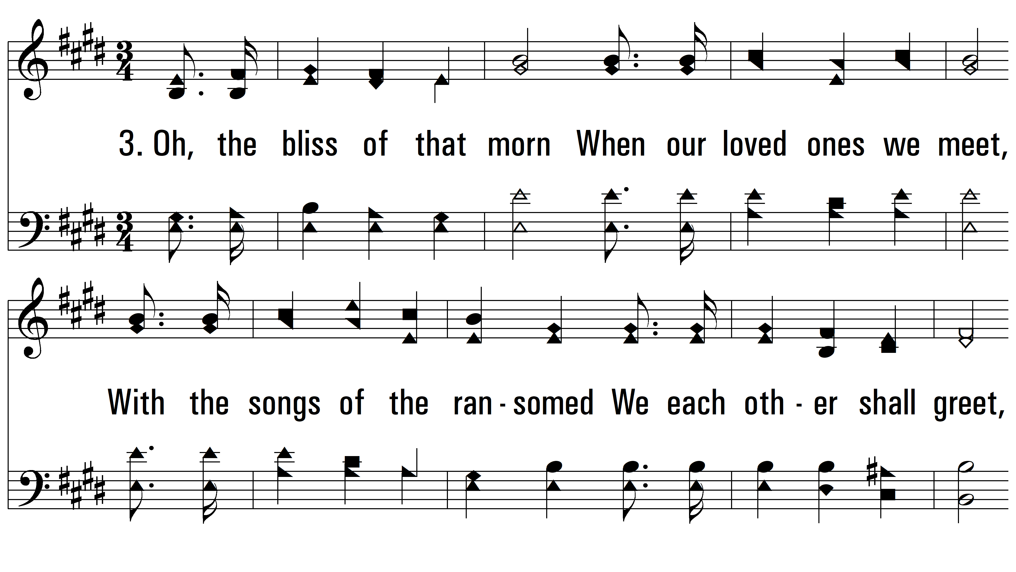
vs. 3 ~ In The Morning Of Joy

Slide 11
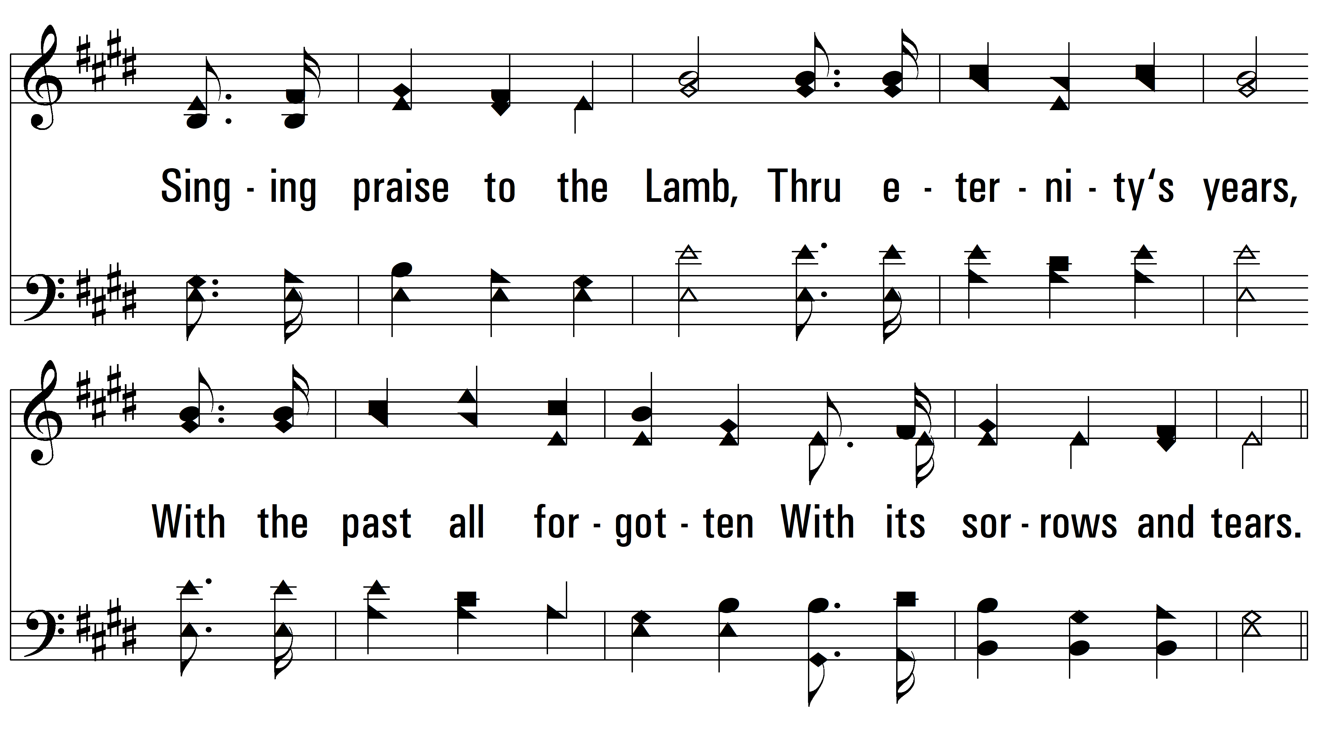
vs. 3

Slide 12
vs. 3

Slide 13
vs. 3
PDHymns.com
END

