Slide 1
In The Land Of Fadeless Day
(No Night There)
Words: | John R. Clements (1899)
Music: | Hart P. Danks (1899)
3/4
E^{b}/E^{b} - DO
Verses: 4/Chorus
Lead - | DO
Alto - | DO
Tenor - | MI
Bass - | DO
PDHymns.com

Slide 2
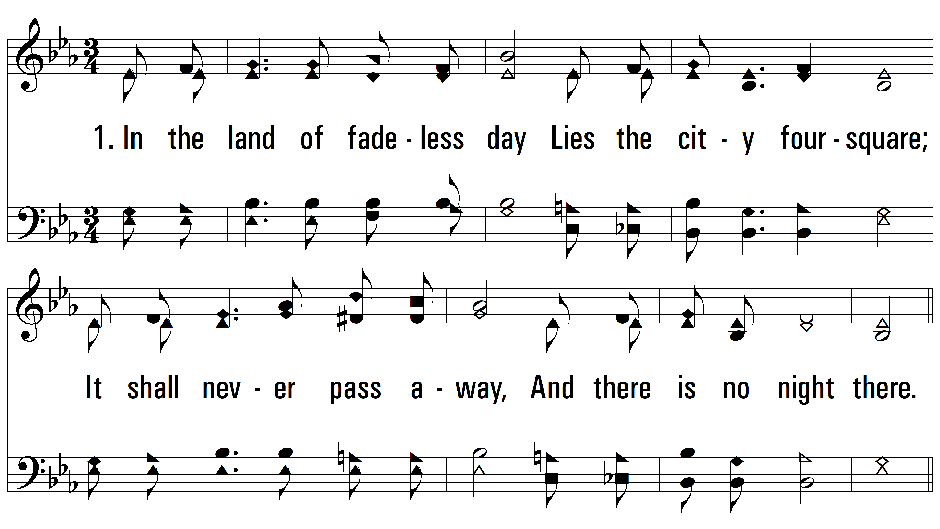
vs. 1 ~ In The Land Of Fadeless Day

Slide 3
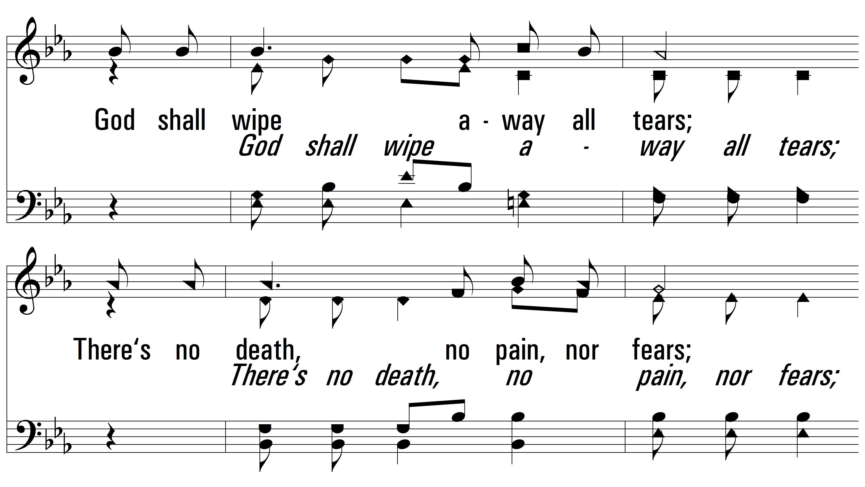
vs. 1

Slide 4
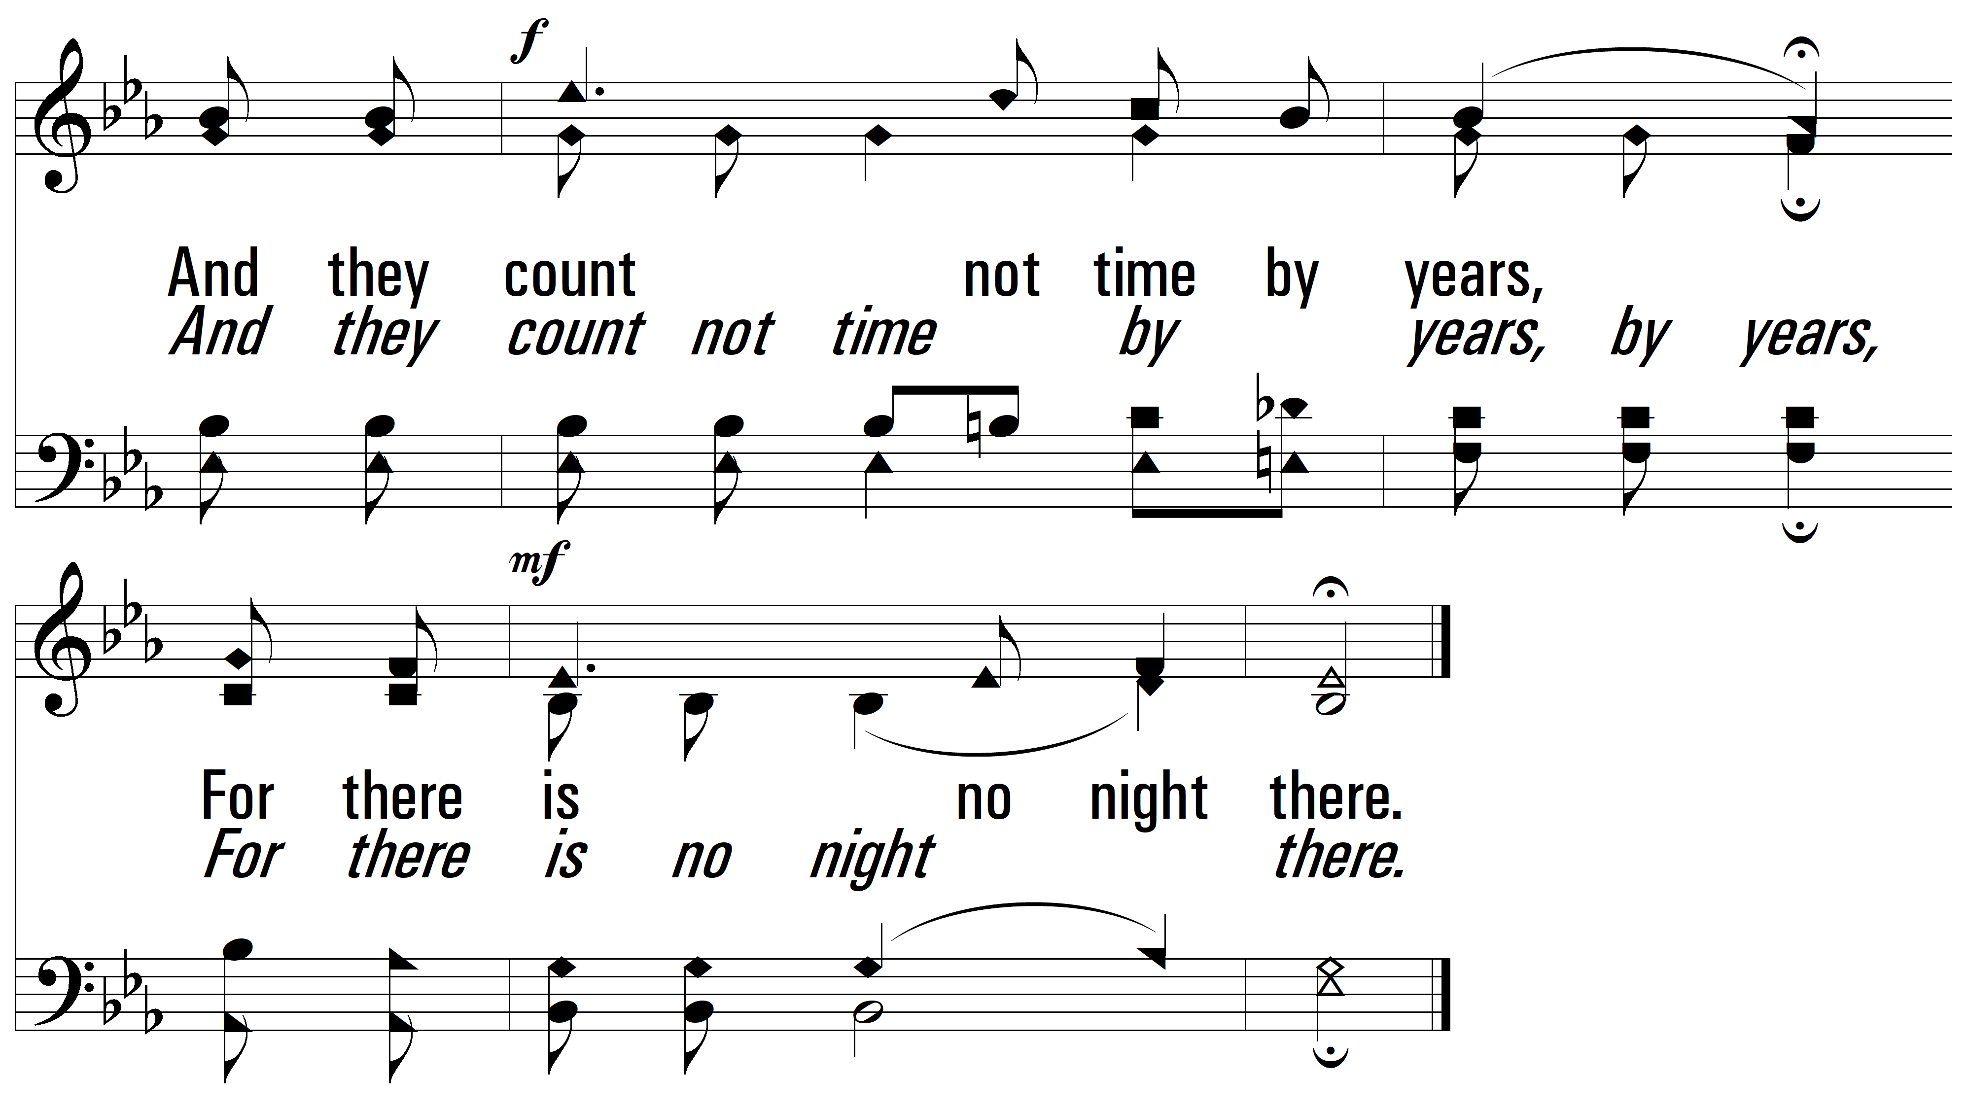
vs. 1

Slide 5
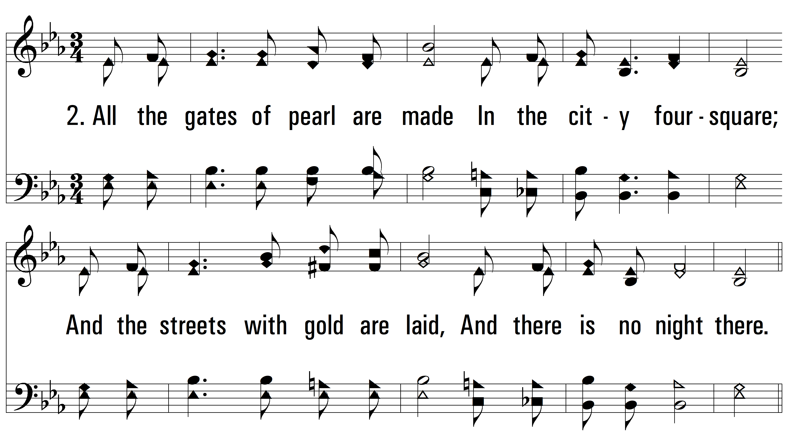
vs. 2 ~ In The Land Of Fadeless Day

Slide 6
vs. 2

Slide 7
vs. 2

Slide 8
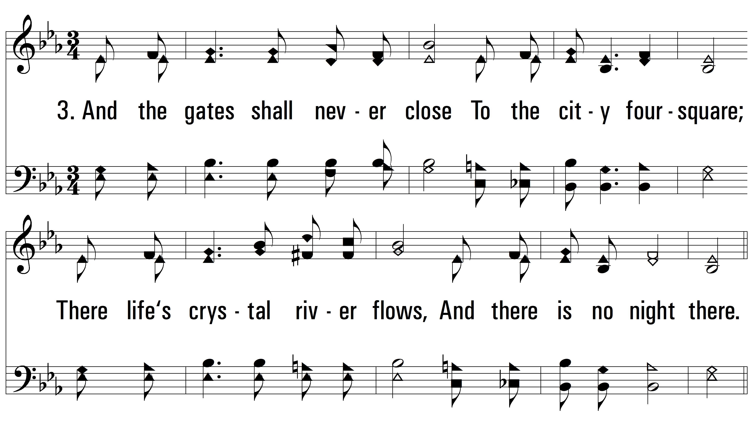
vs. 3 ~ In The Land Of Fadeless Day

Slide 9
vs. 3

Slide 10
vs. 3

Slide 11
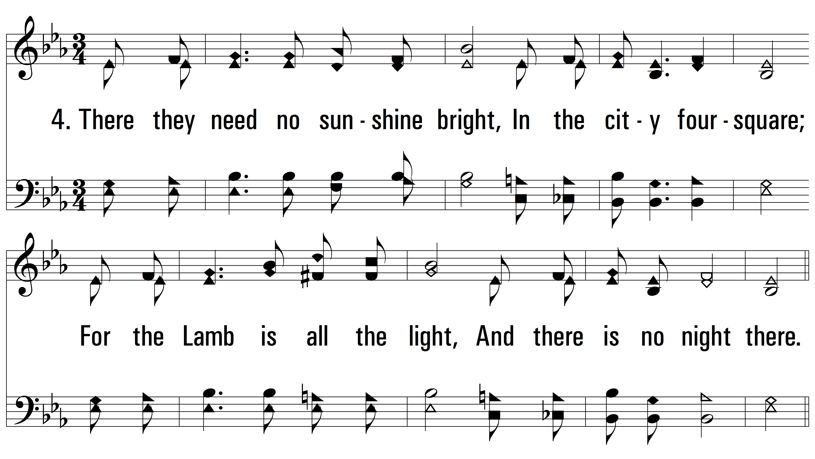
vs. 4 ~ In The Land Of Fadeless Day

Slide 12
vs. 4

Slide 13
vs. 4
PDHymns.com
END

