Slide 1
In The Hour Of Trial
PENITENCE
6.5.6.5.D
Words: | James Montgomery (1834)
Music: | Spencer Lane (1835)
4/4
D^{b}/F - MI
Verses: 4
Lead - | MI
Alto - | DO
Tenor - | SOL
Bass - | DO
PDHymns.com

Slide 2
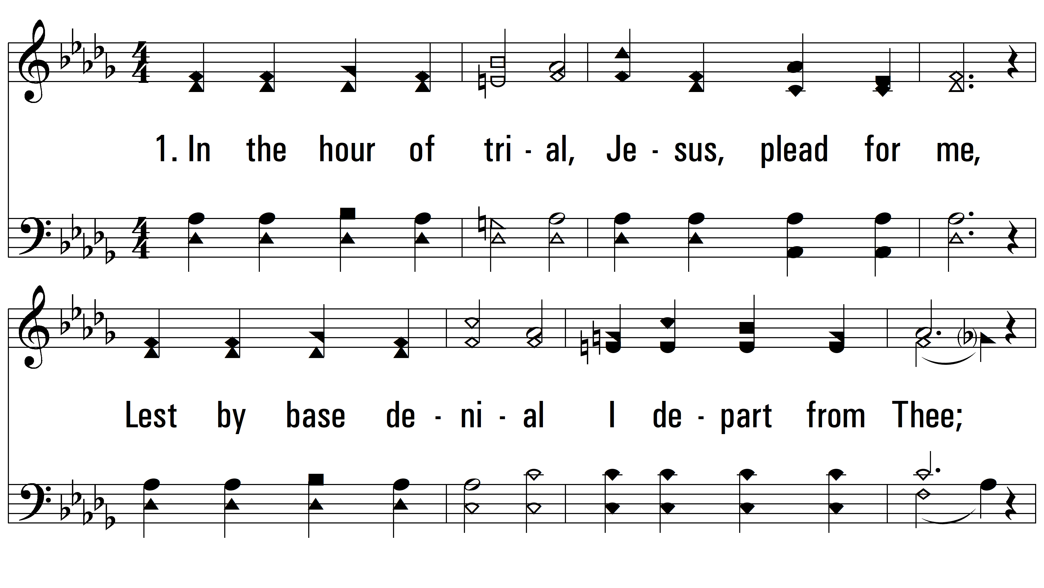
vs. 1 ~ In The Hour Of Trial

Slide 3
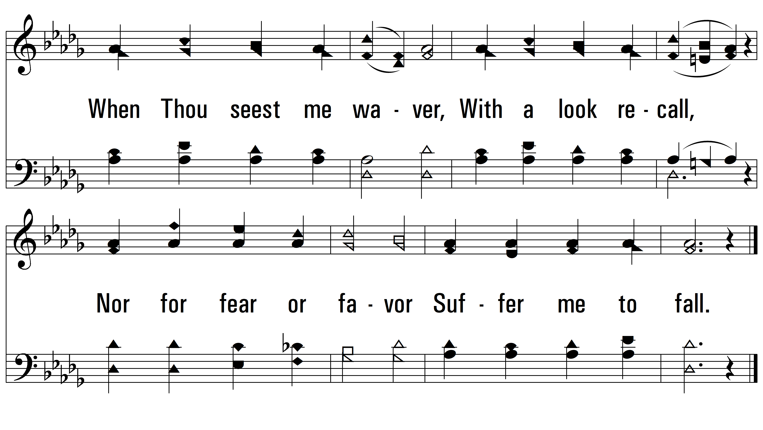
vs. 1

Slide 4
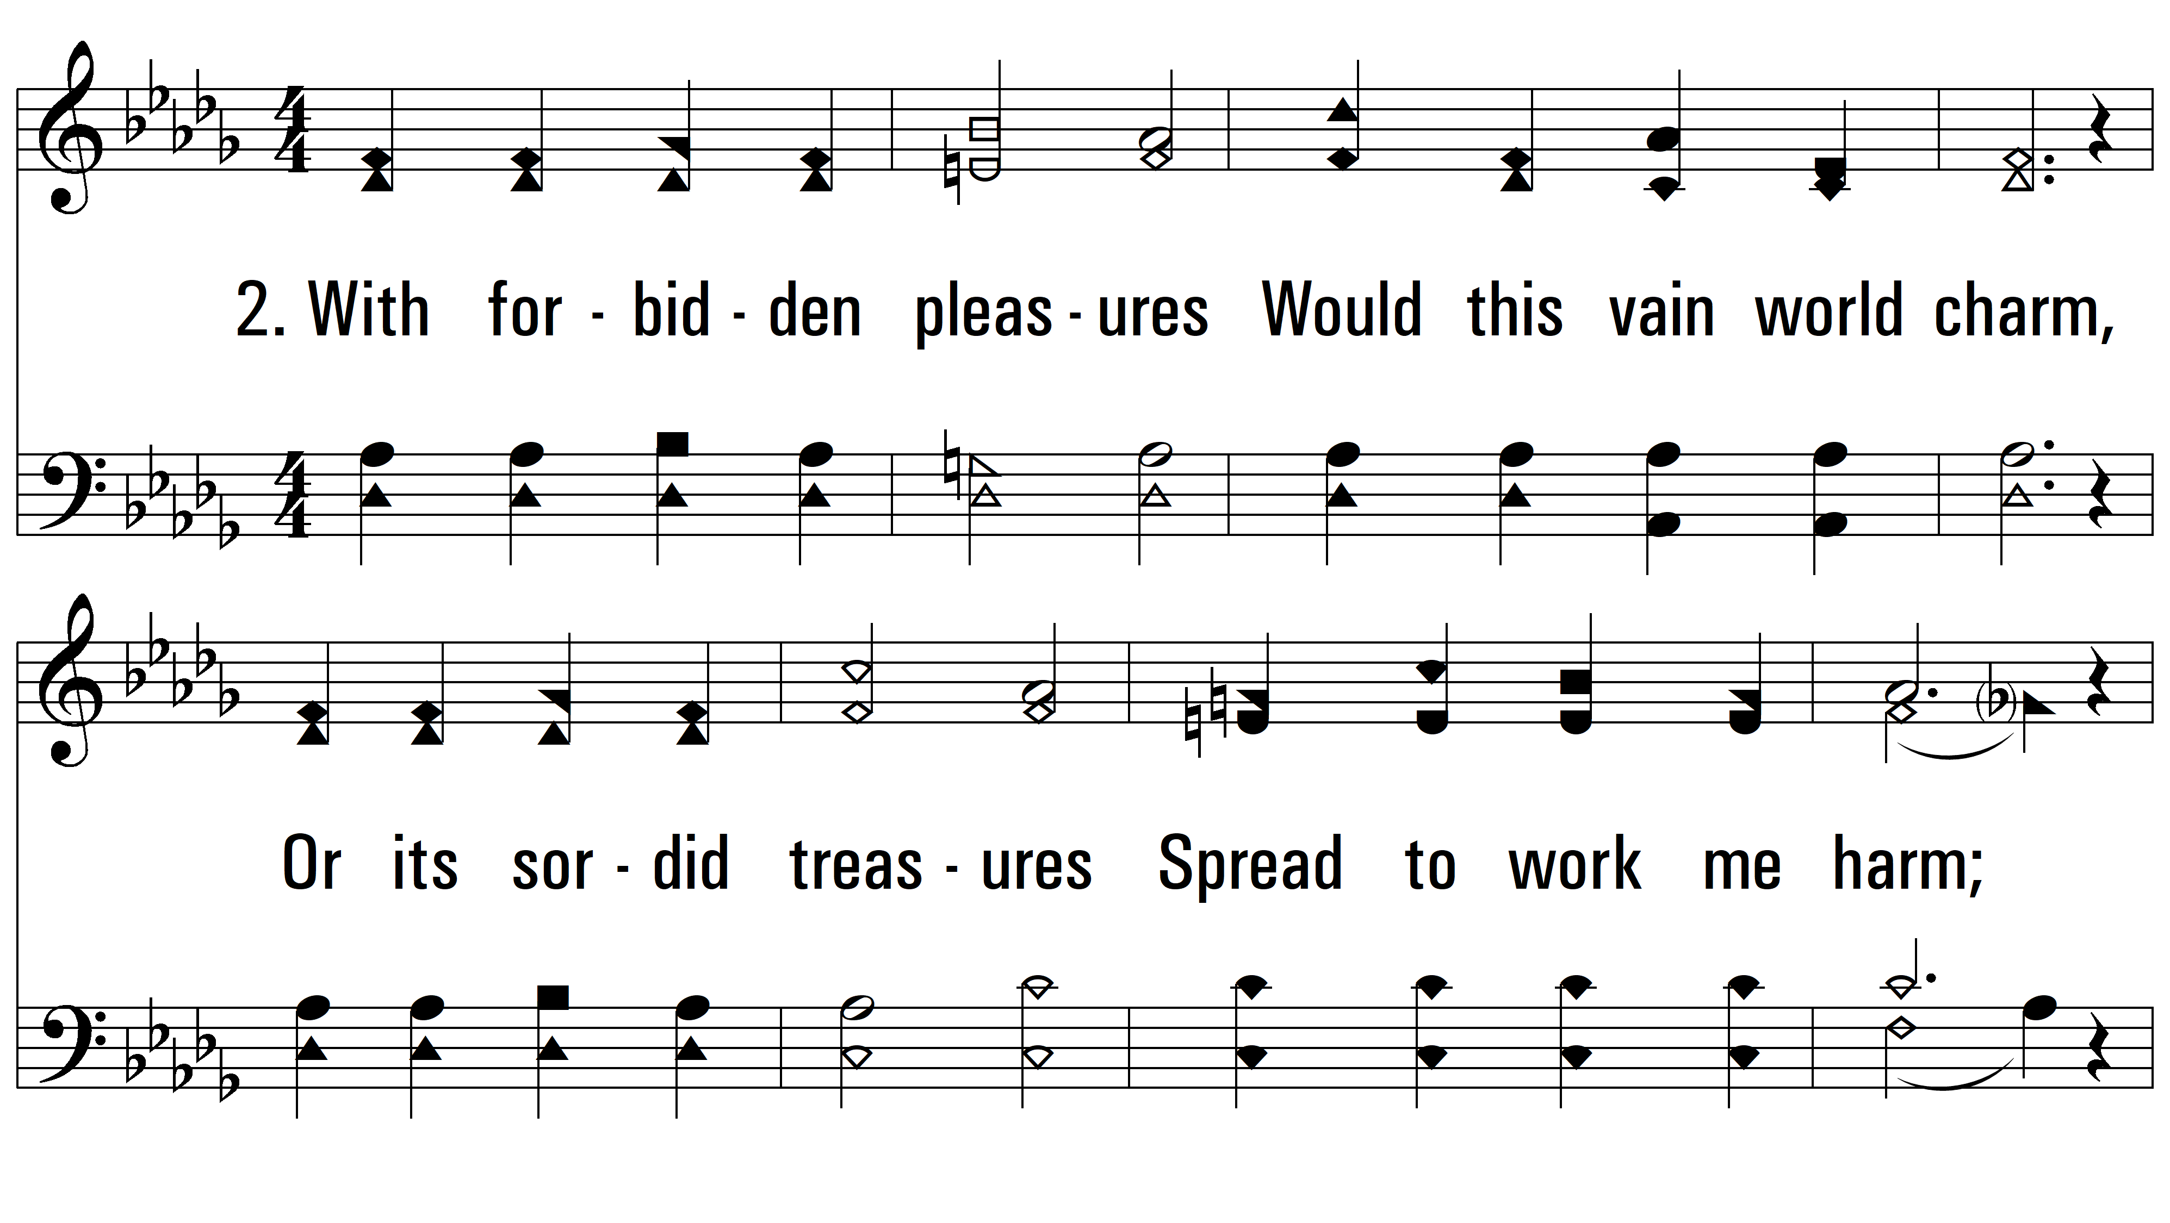
vs. 2 ~ In The Hour Of Trial

Slide 5
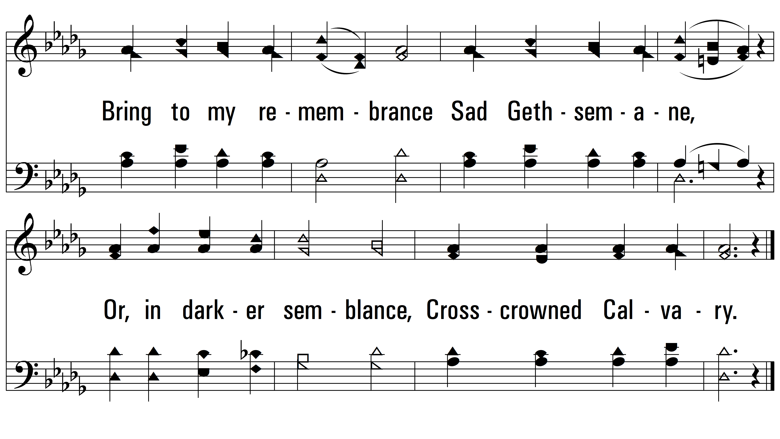
vs. 2

Slide 6
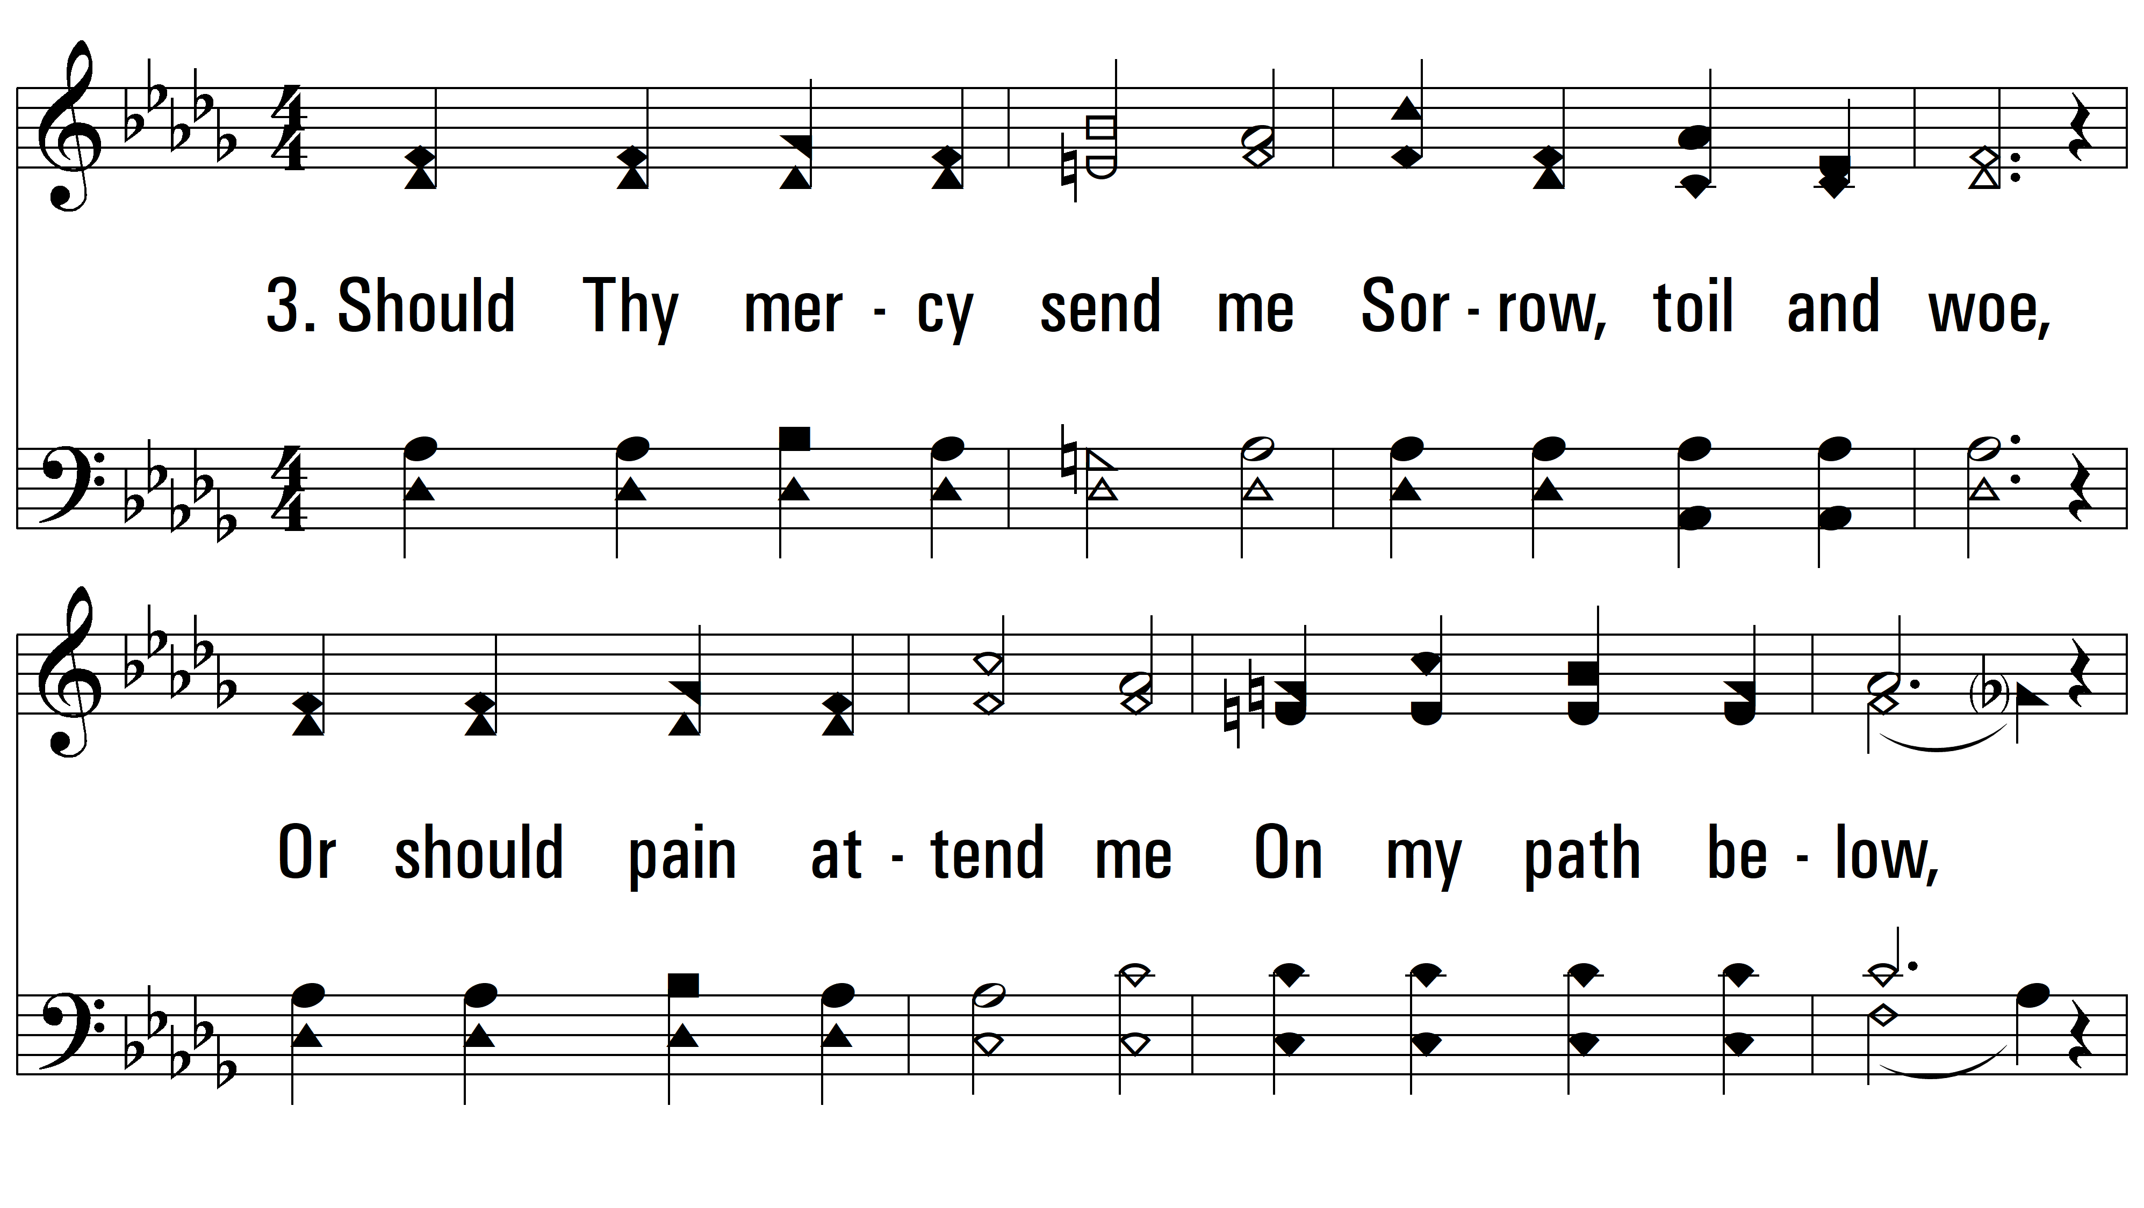
vs. 3 ~ In The Hour Of Trial

Slide 7
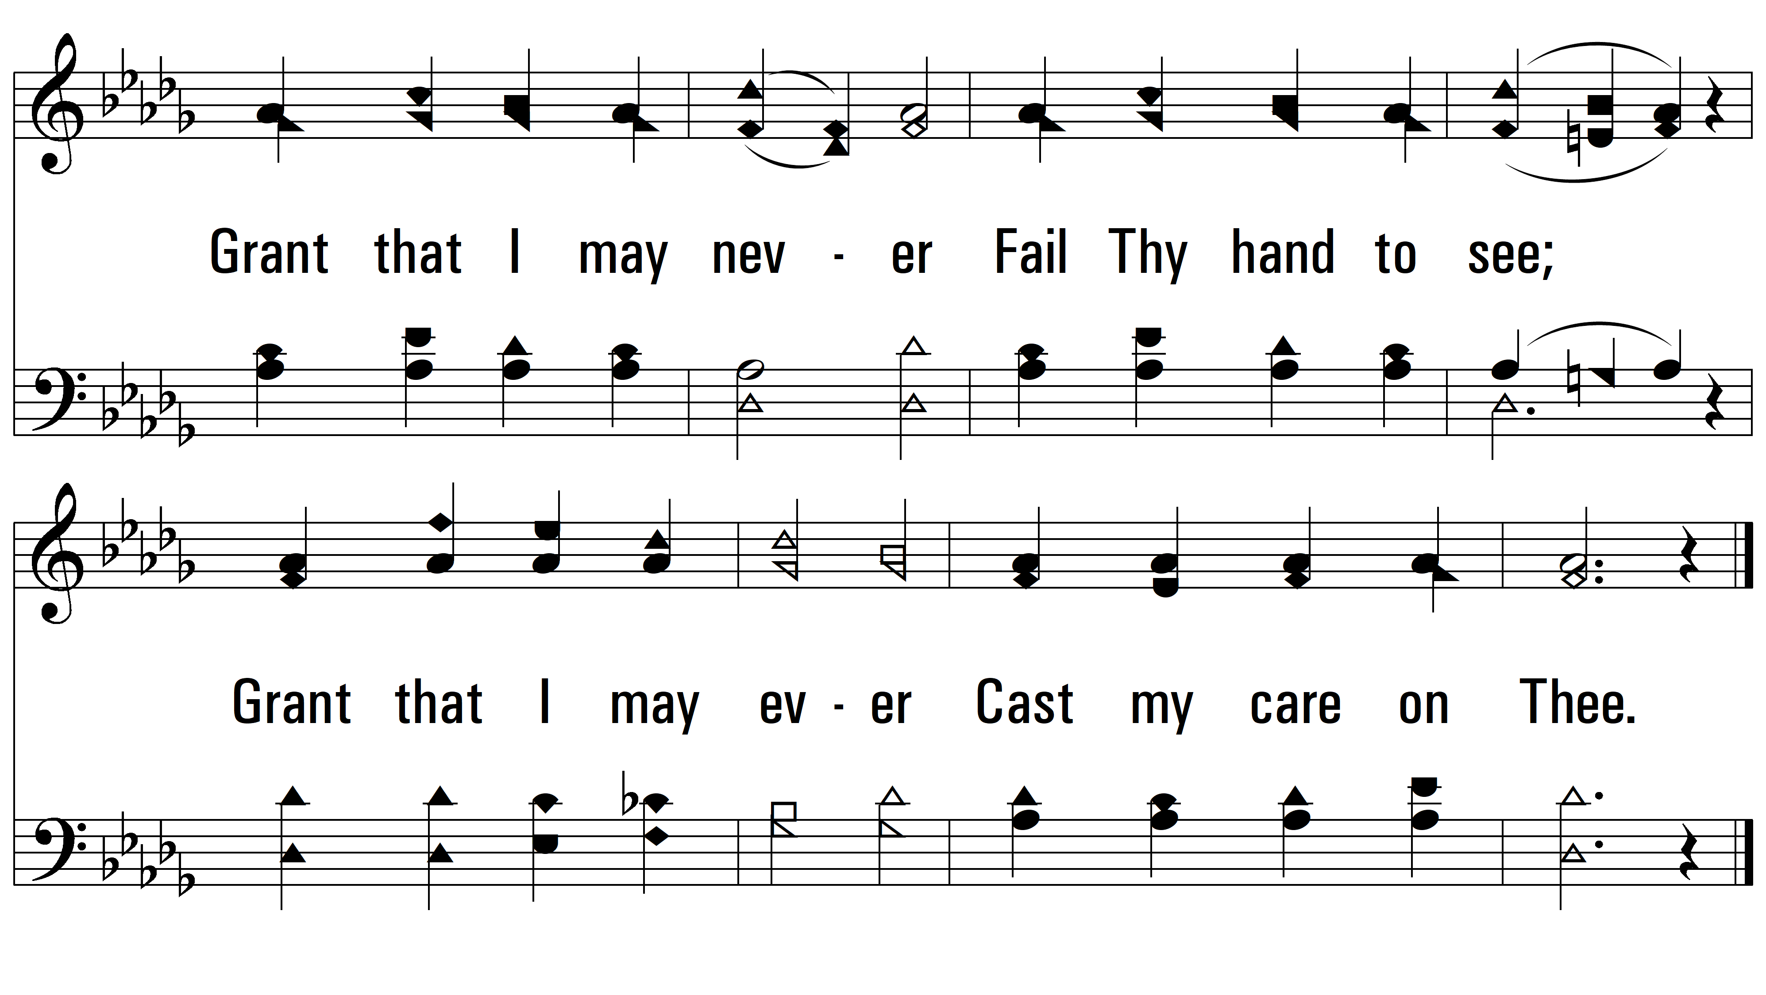
vs. 3

Slide 8
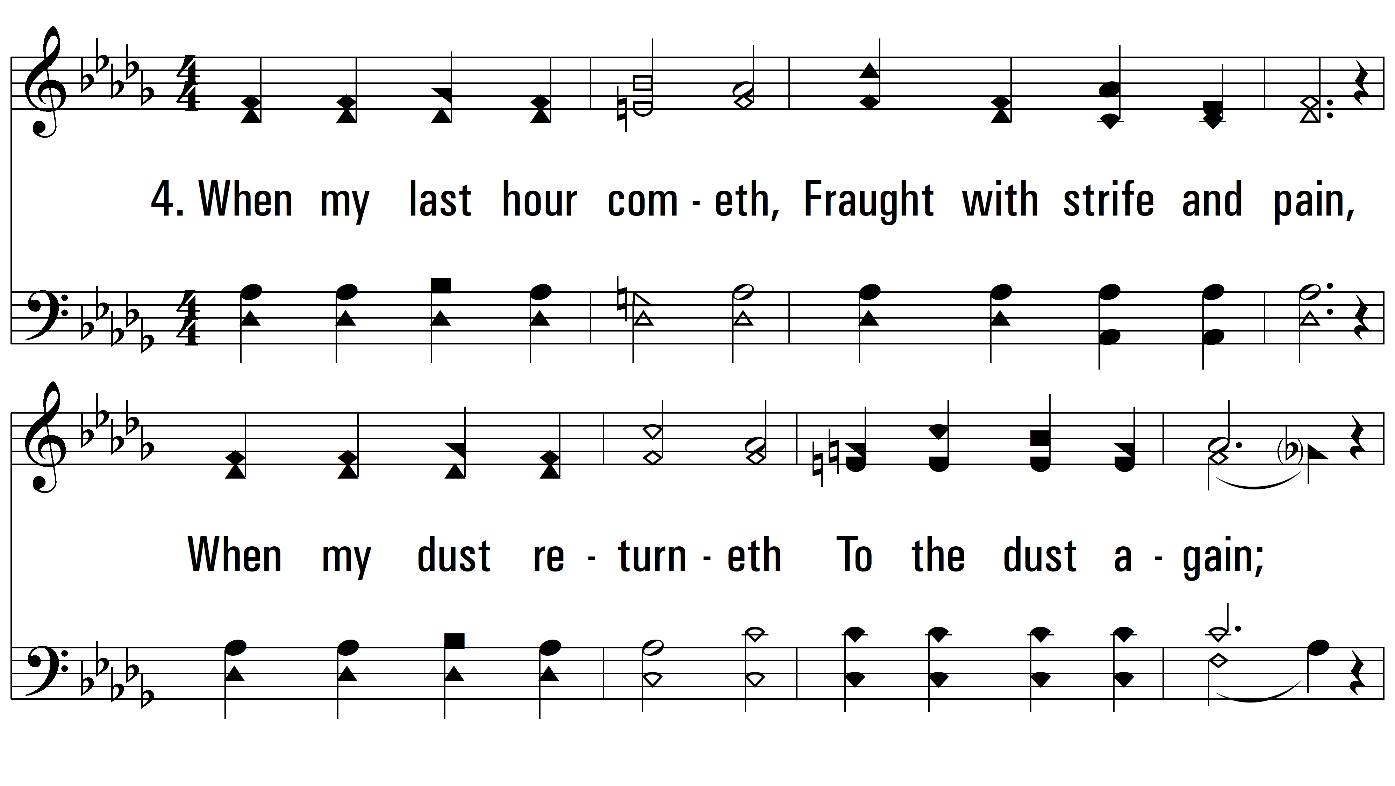
vs. 4 ~ In The Hour Of Trial

Slide 9
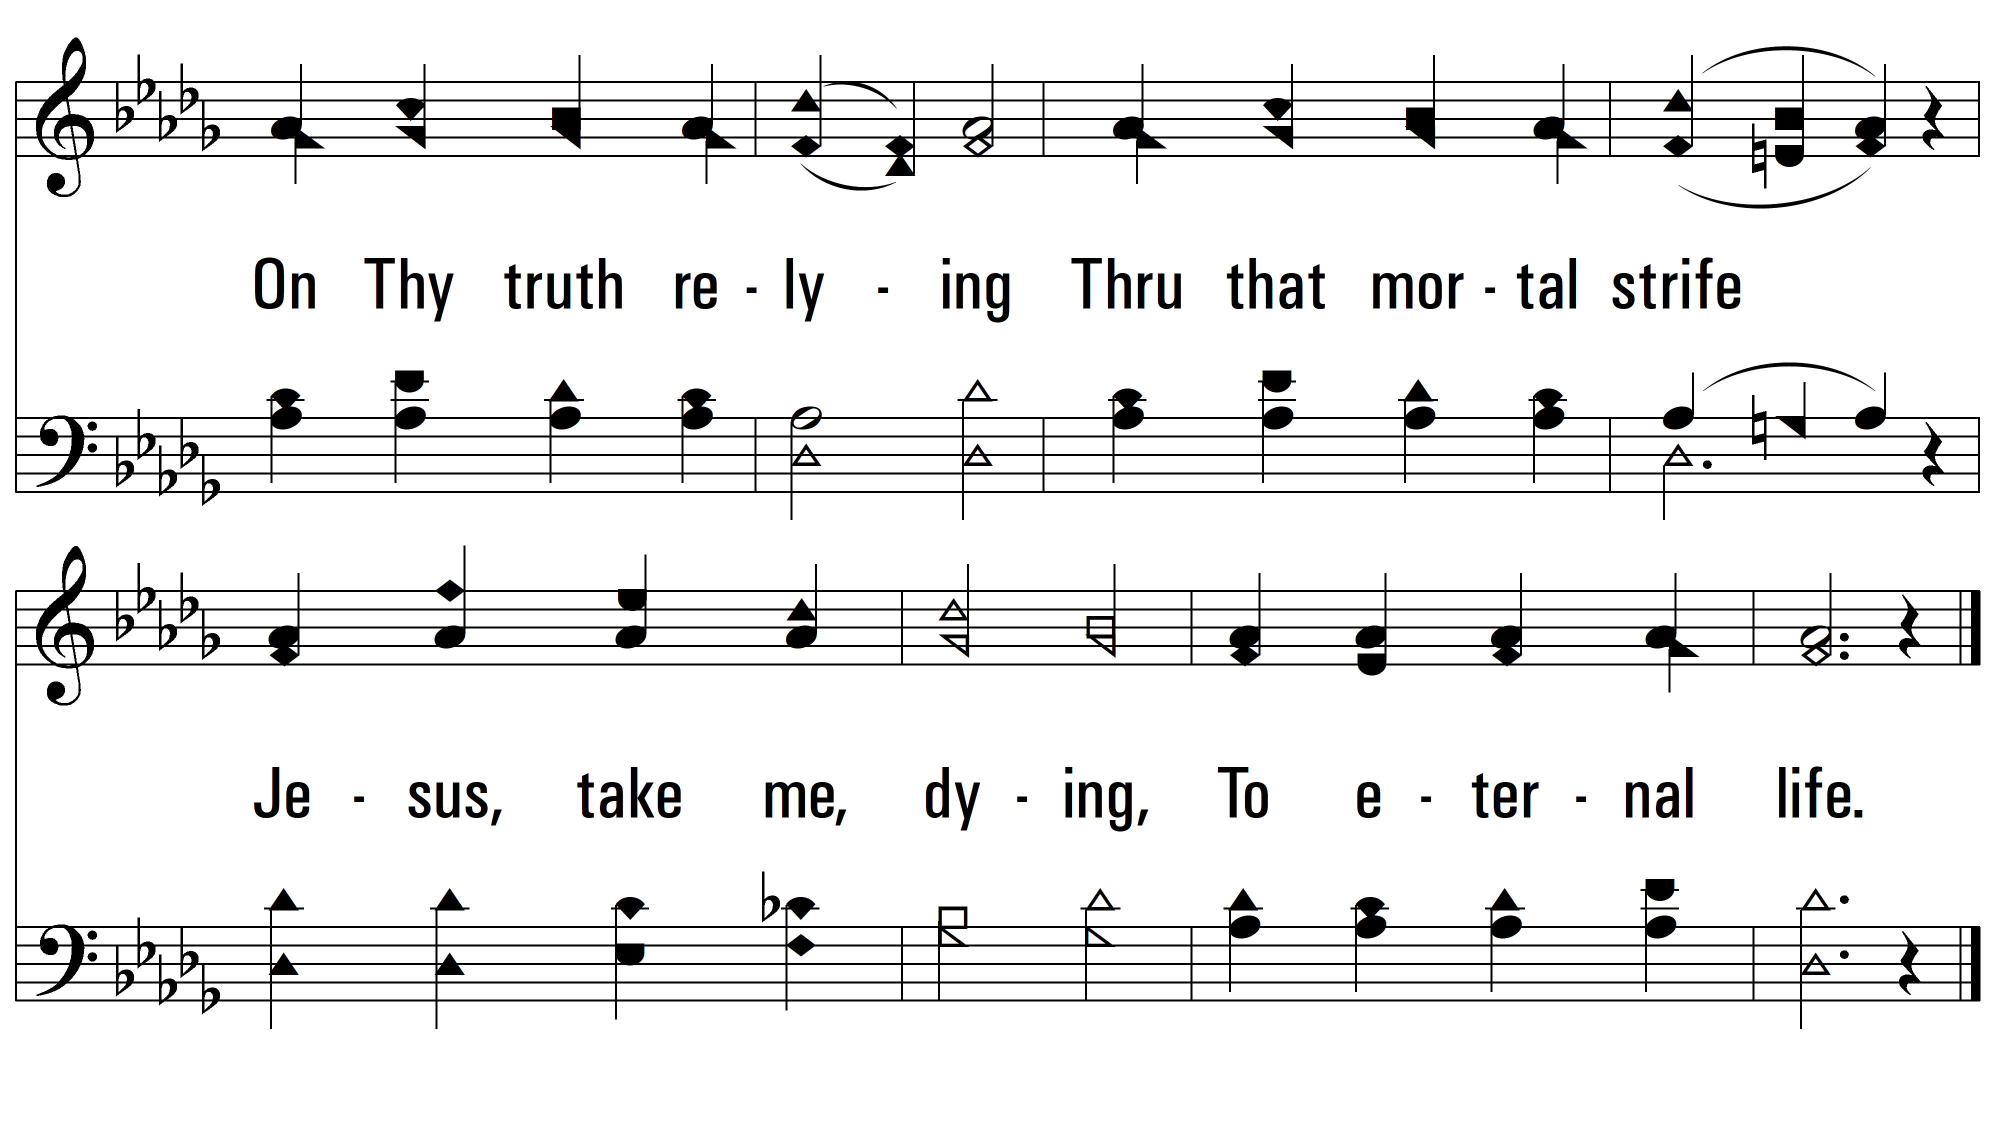
vs. 4
PDHymns.com
END

