Slide 1
In The Desert Of Sorrow And Sin
(The Water Of Life)
Words: | Henry R. Trickett (1887)
Music: | Fred A. Fillmore (1887)
4/4
C/C - DO
Verses: 3/Chorus
Lead - | DO
Alto - | DO
Tenor - | MI
Bass - | DO
PDHymns.com

Slide 2
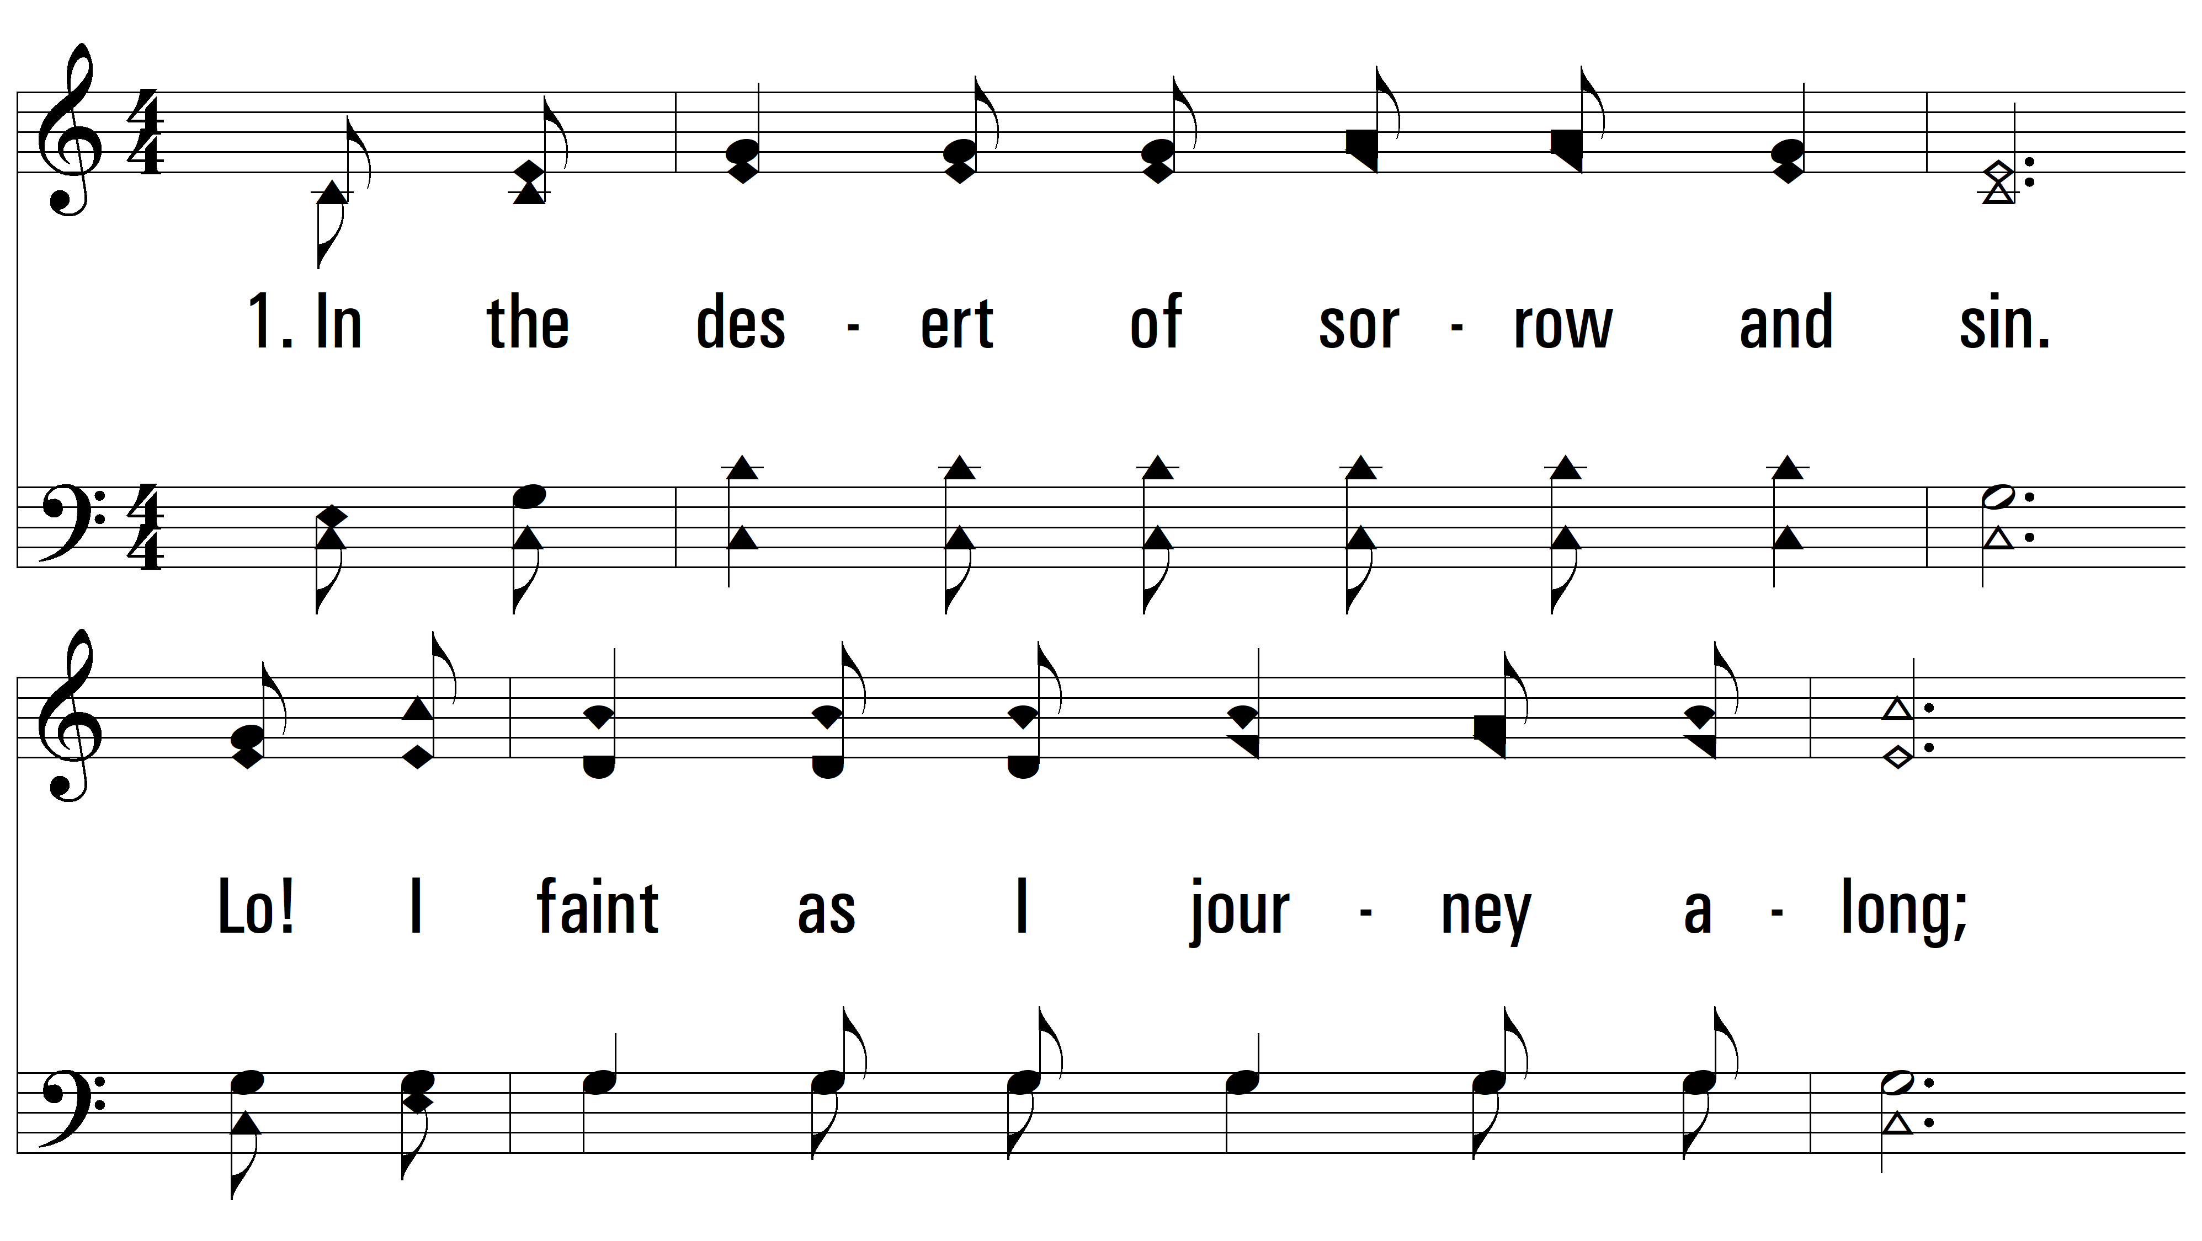
vs. 1 ~ In The Desert Of Sorrow And Sin

Slide 3
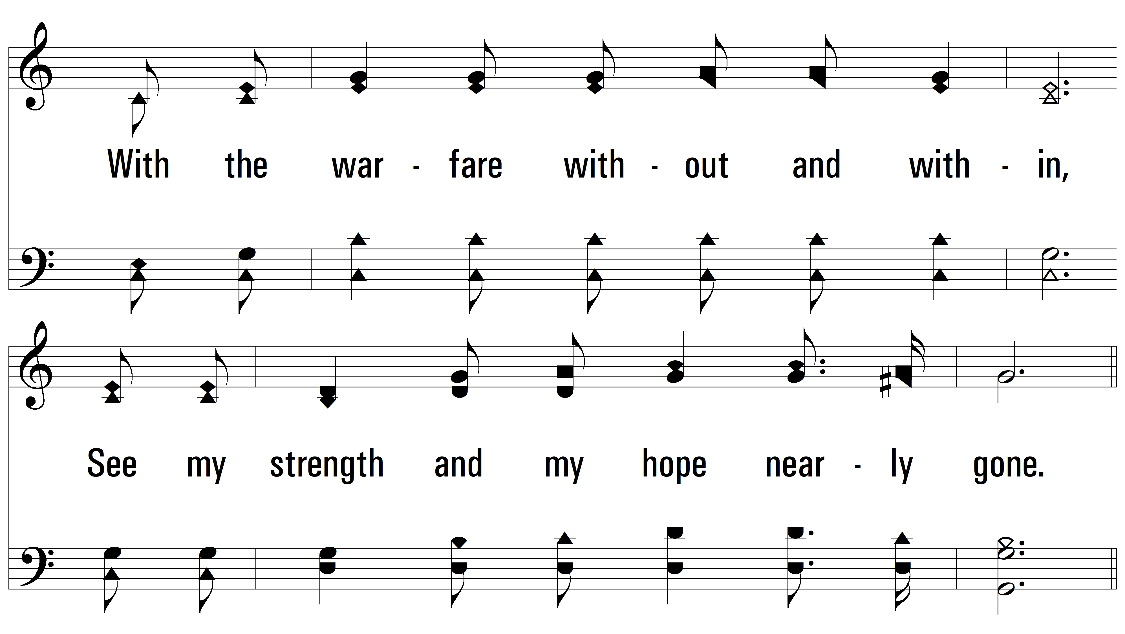
vs. 1

Slide 4
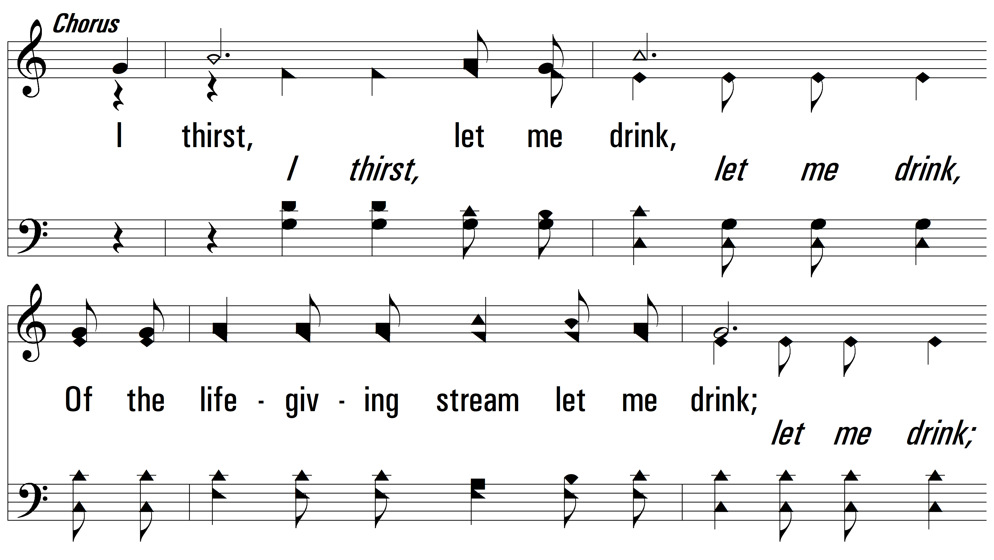
vs. 1

Slide 5
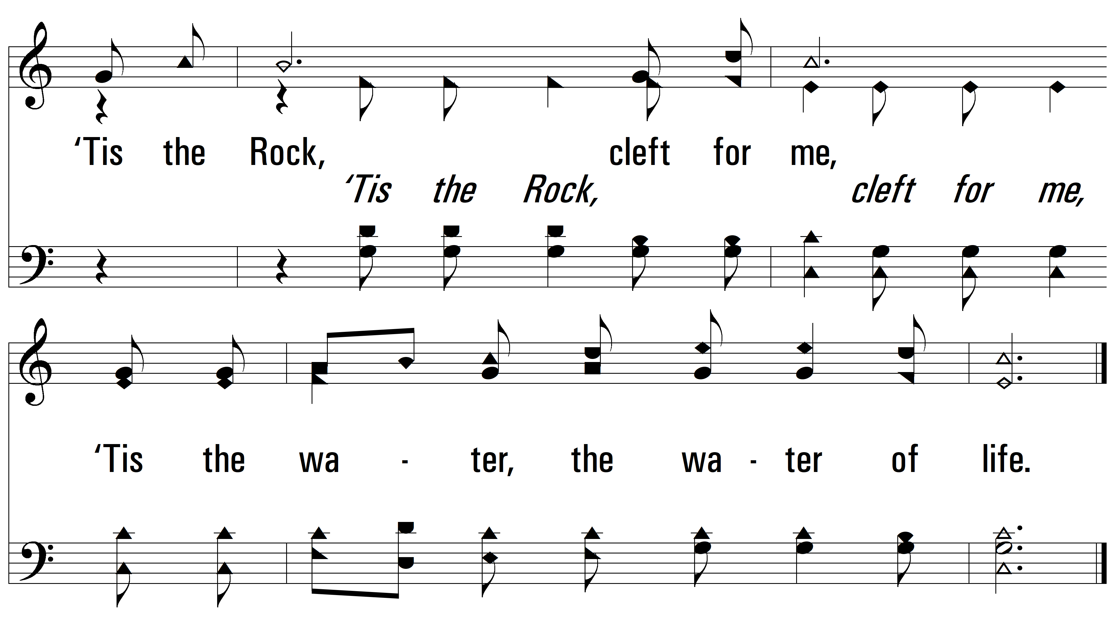
vs. 1

Slide 6
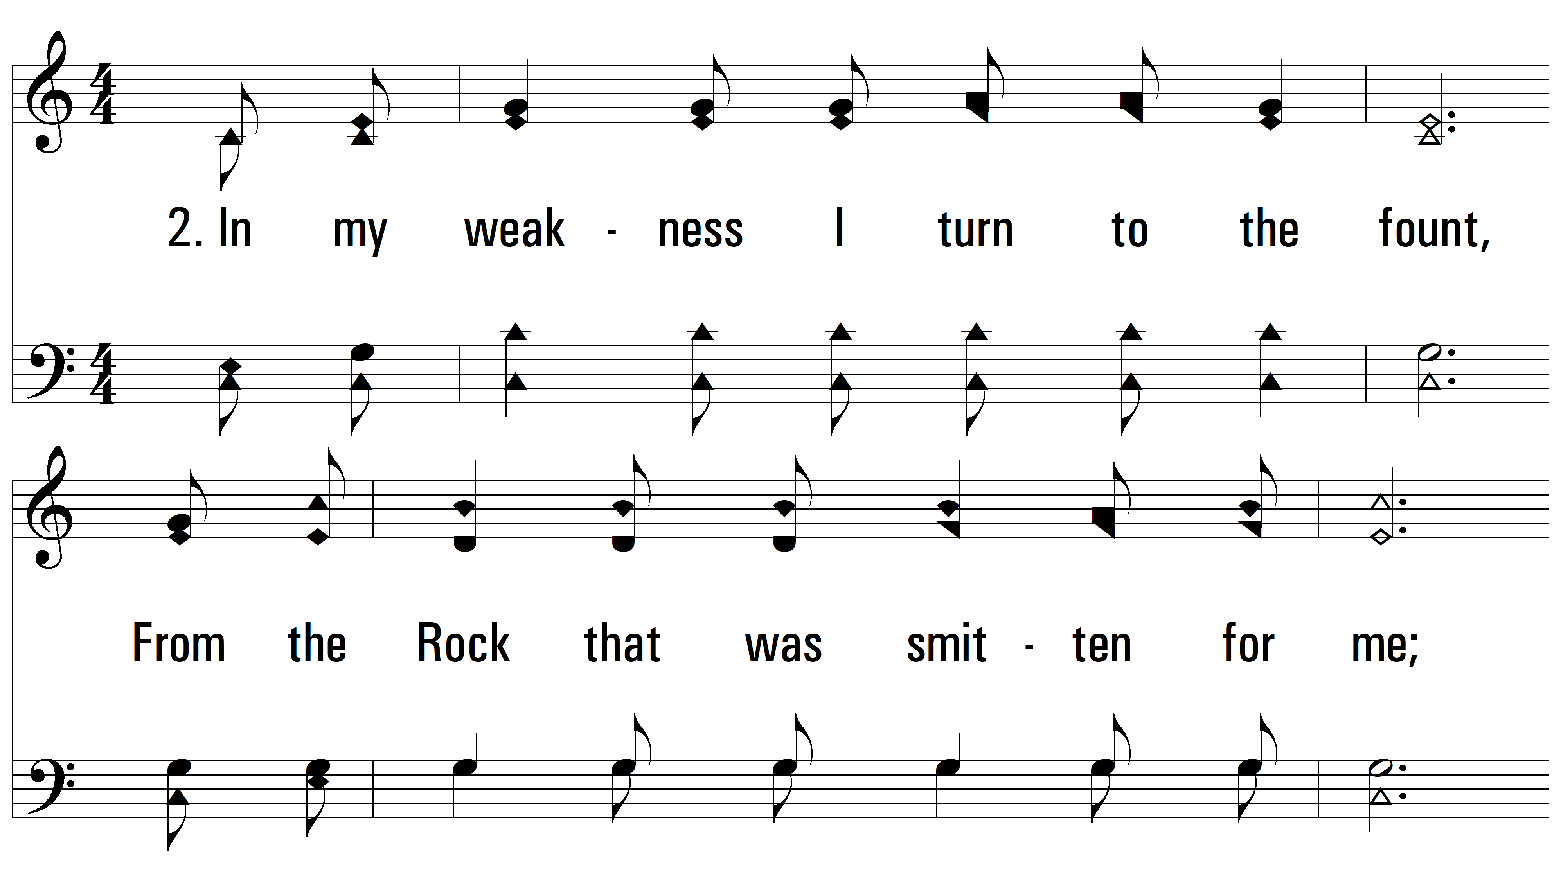
vs. 2 ~ In The Desert Of Sorrow And Sin

Slide 7
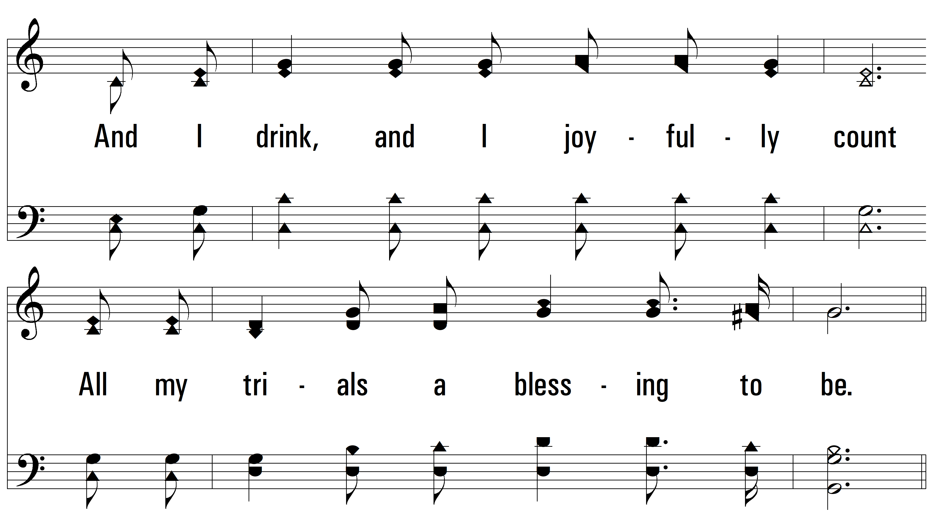
vs. 2

Slide 8
vs. 2

Slide 9
vs. 2

Slide 10
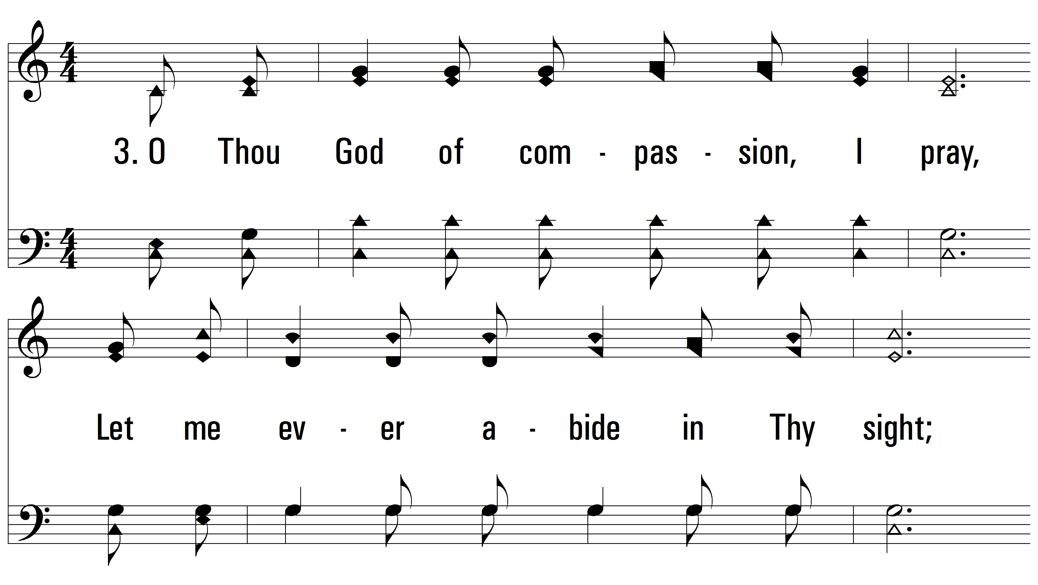
vs. 3 ~ In The Desert Of Sorrow And Sin

Slide 11
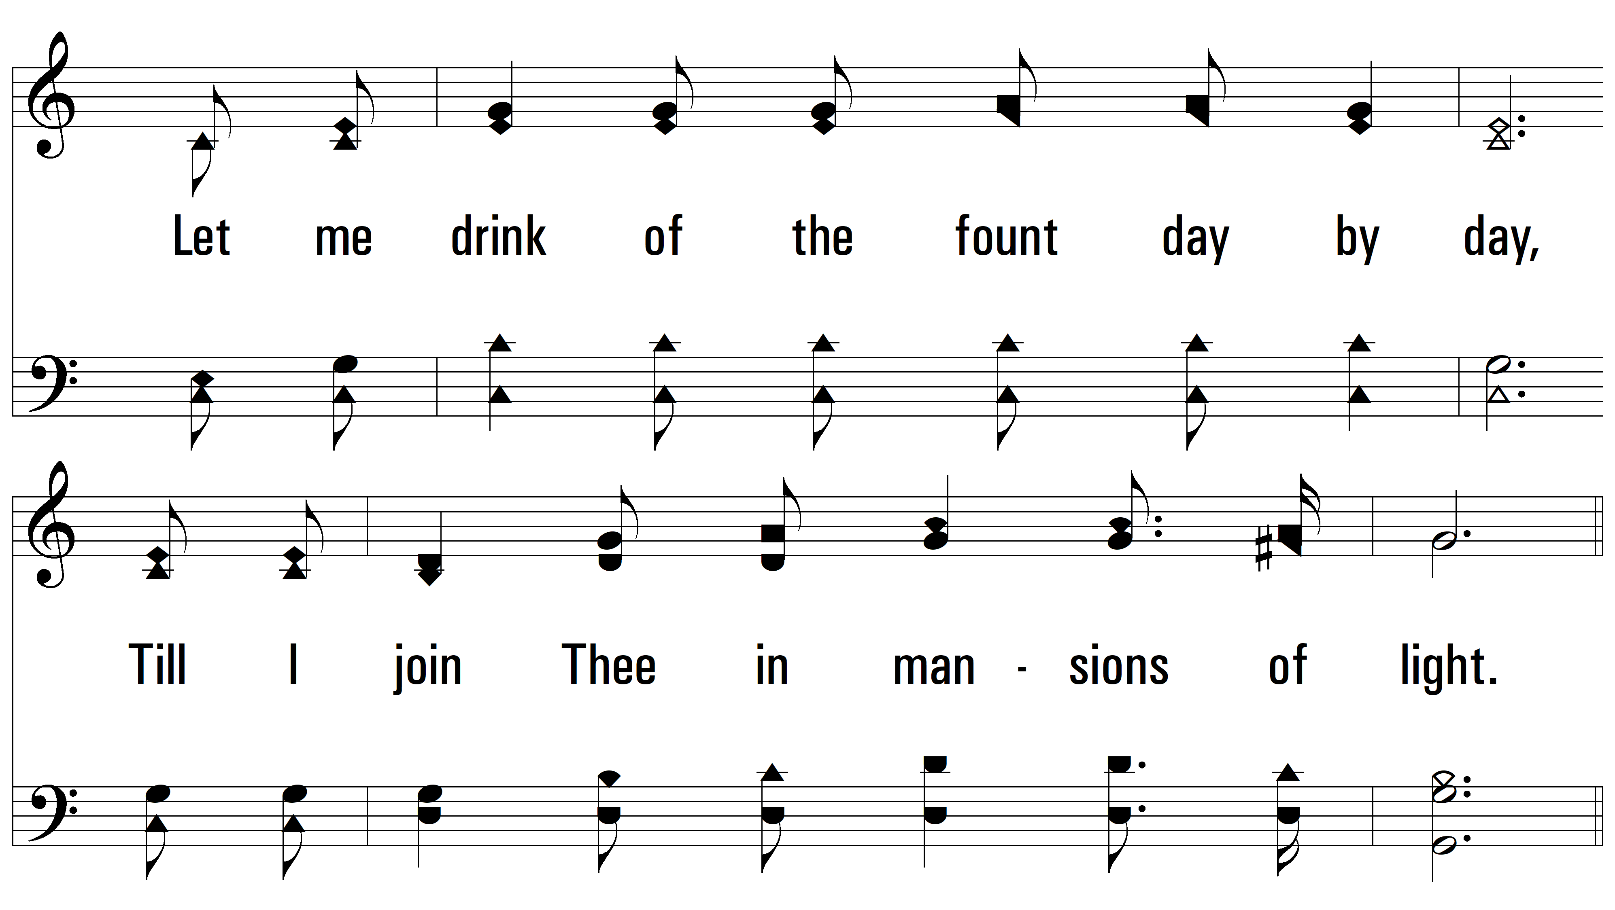
vs. 3

Slide 12
vs. 3

Slide 13
vs. 3
PDHymns.com
END

