Slide 1
In That Home Of The Soul
Words: | James W. Gaines (1775-1859)
Music: | James W. Gaines (1775-1859)
4/4
A^{b}/E^{b} - SOL
Verses: 3/Chorus
Lead - | SOL
Alto - | MI
Tenor - | DO
Bass - | DO
PDHymns.com

Slide 2
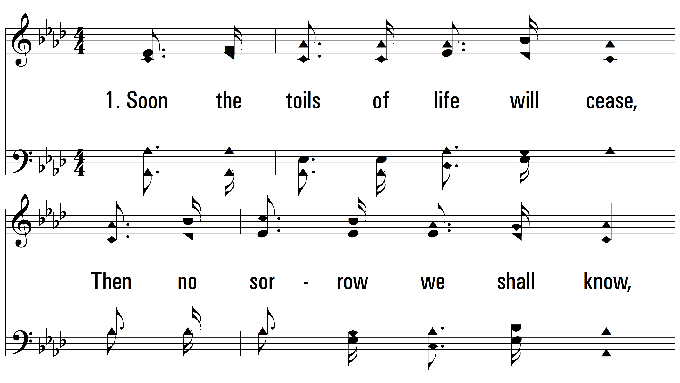
vs. 1 ~ In That Home Of The Soul

Slide 3
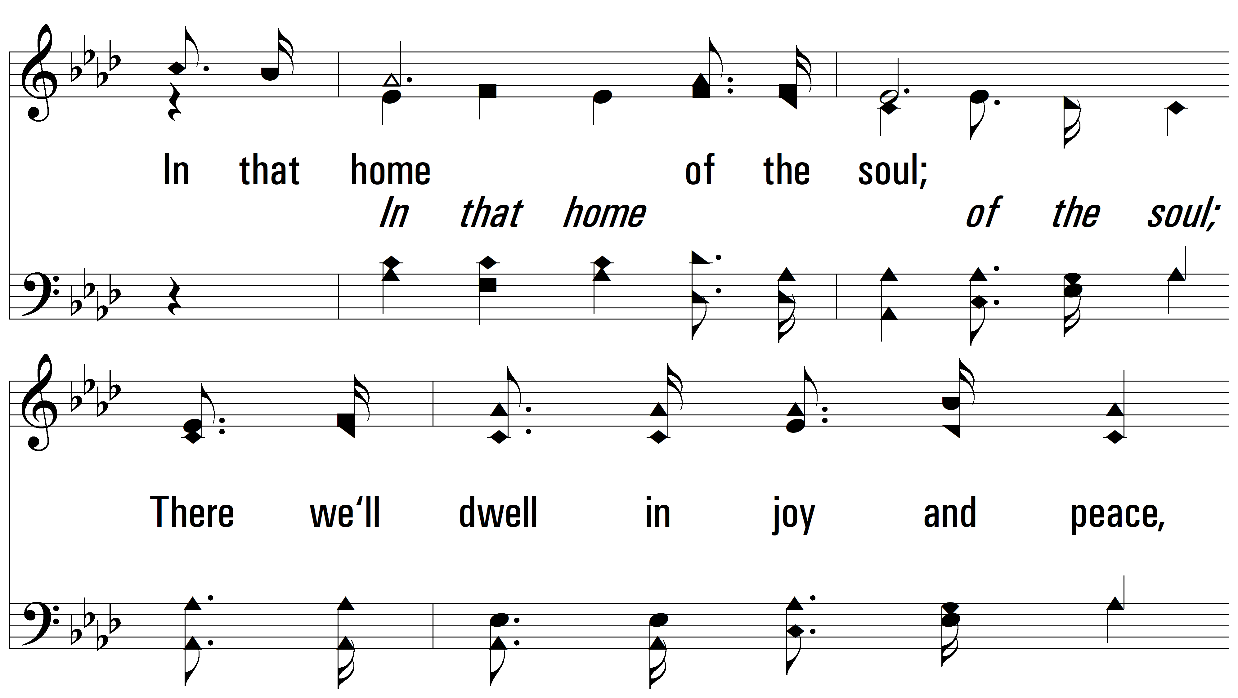
vs. 1

Slide 4
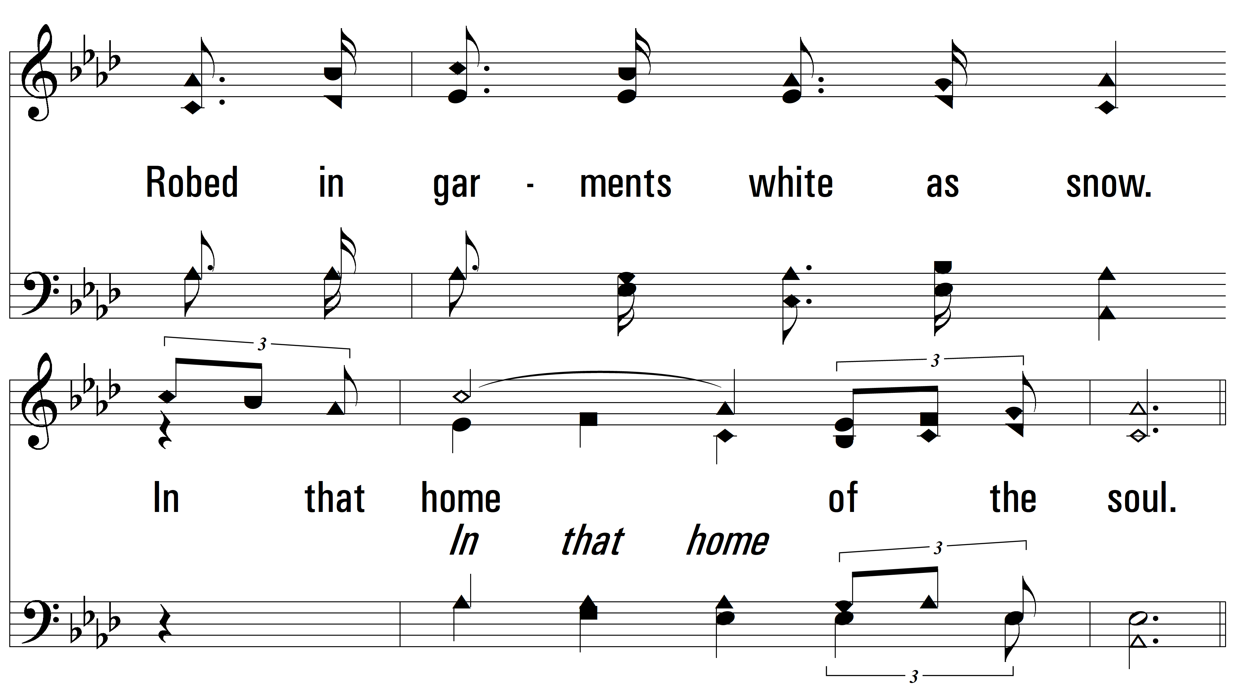
vs. 1

Slide 5
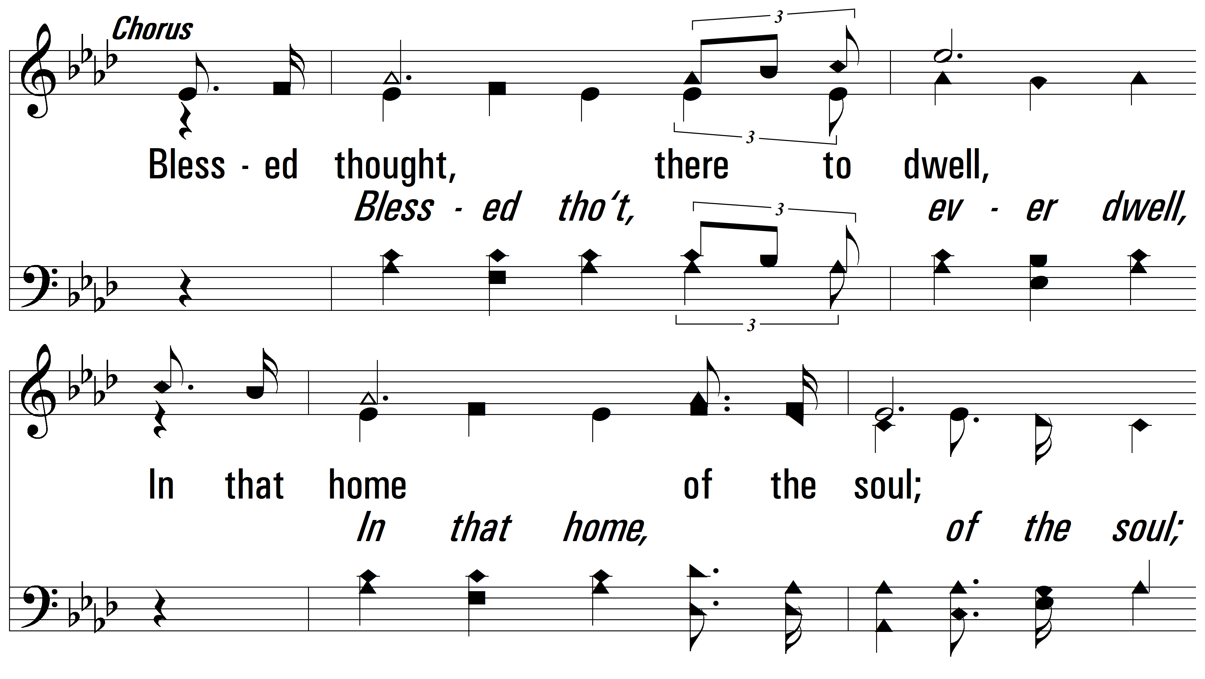
vs. 1

Slide 6
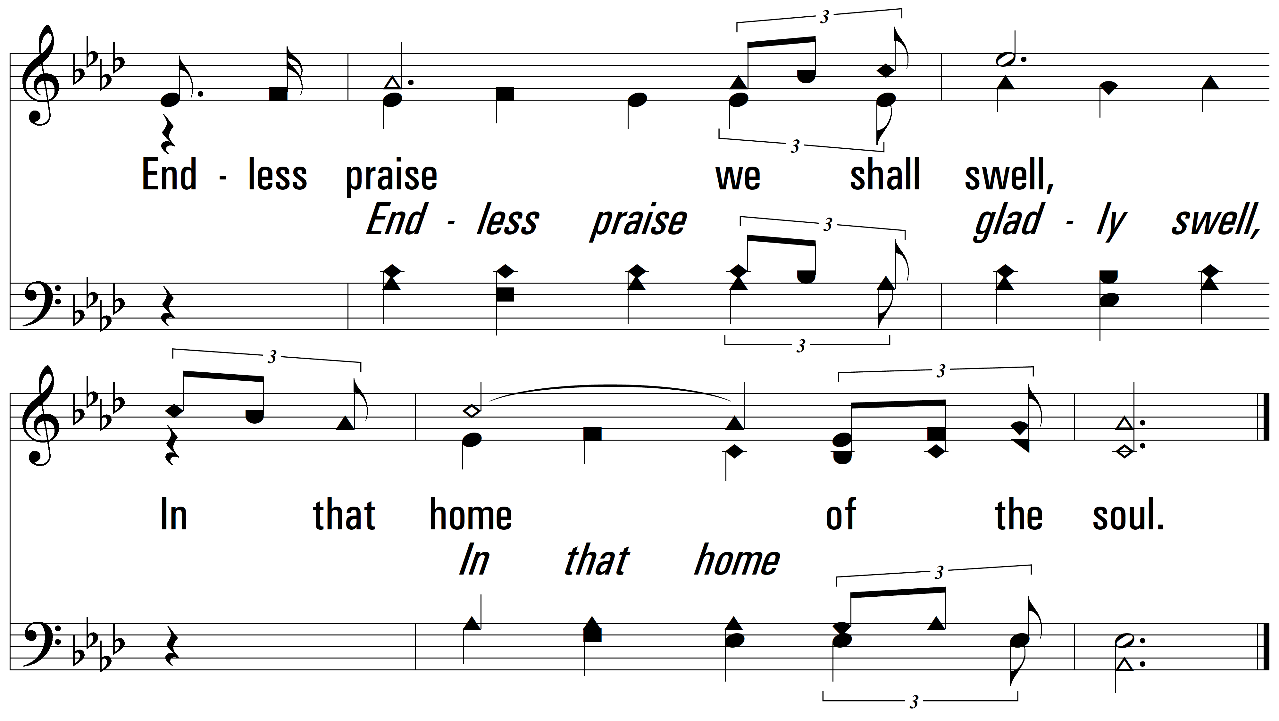
vs. 1

Slide 7
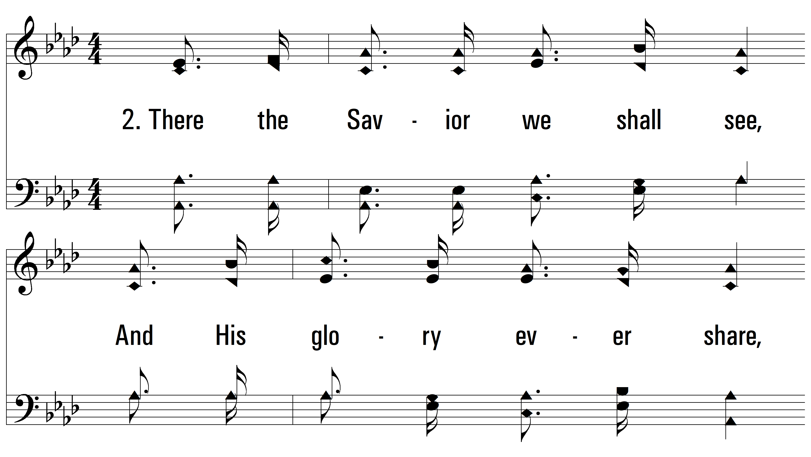
vs. 2 ~ In That Home Of The Soul

Slide 8
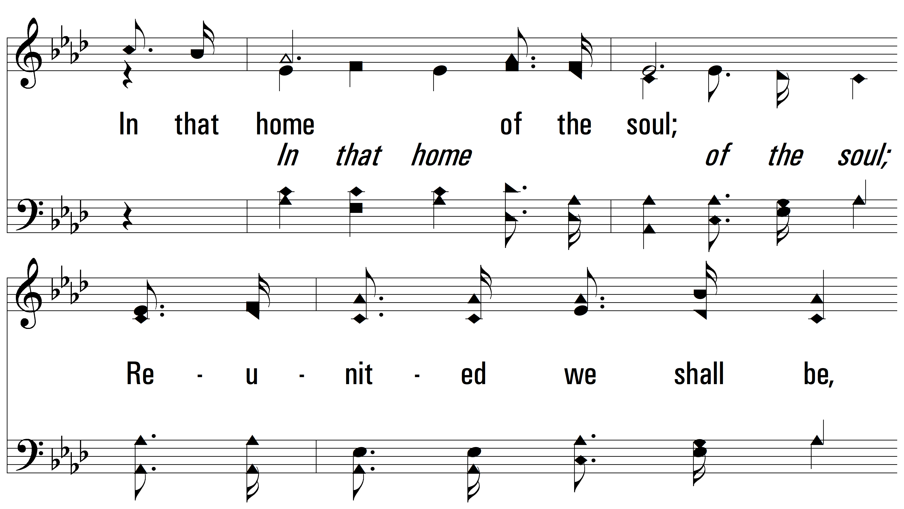
vs. 2

Slide 9
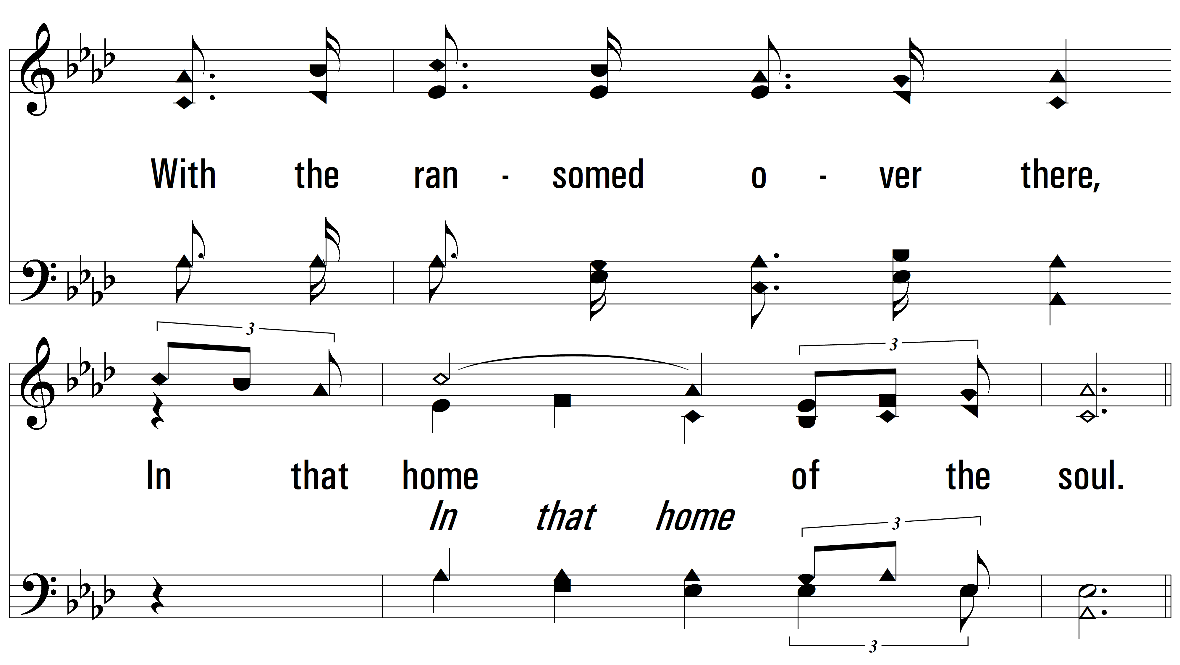
vs. 2

Slide 10
vs. 2

Slide 11
vs. 2

Slide 12
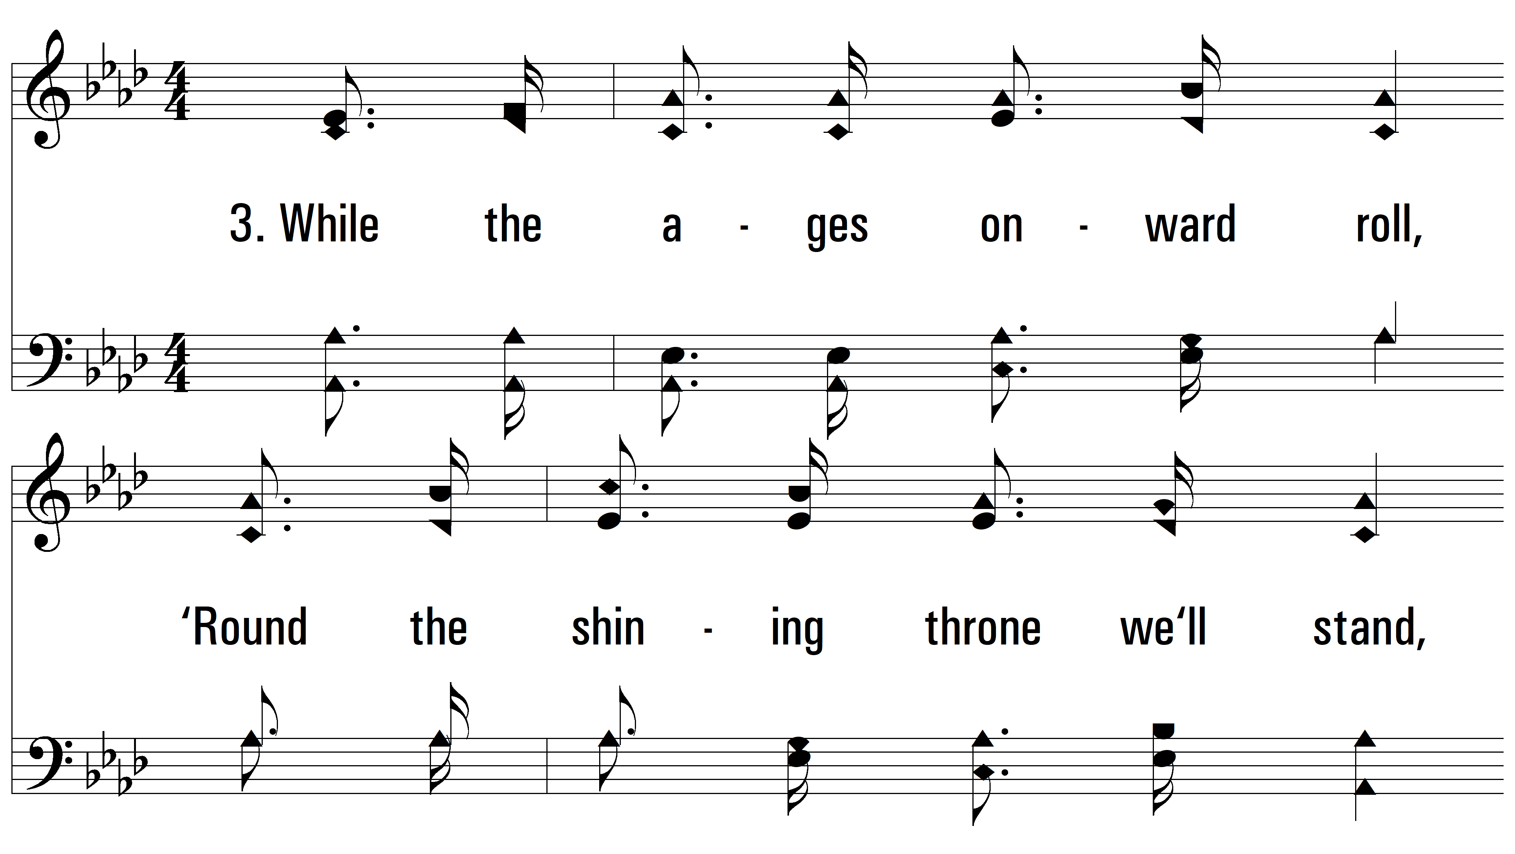
vs. 3 ~ In That Home Of The Soul

Slide 13
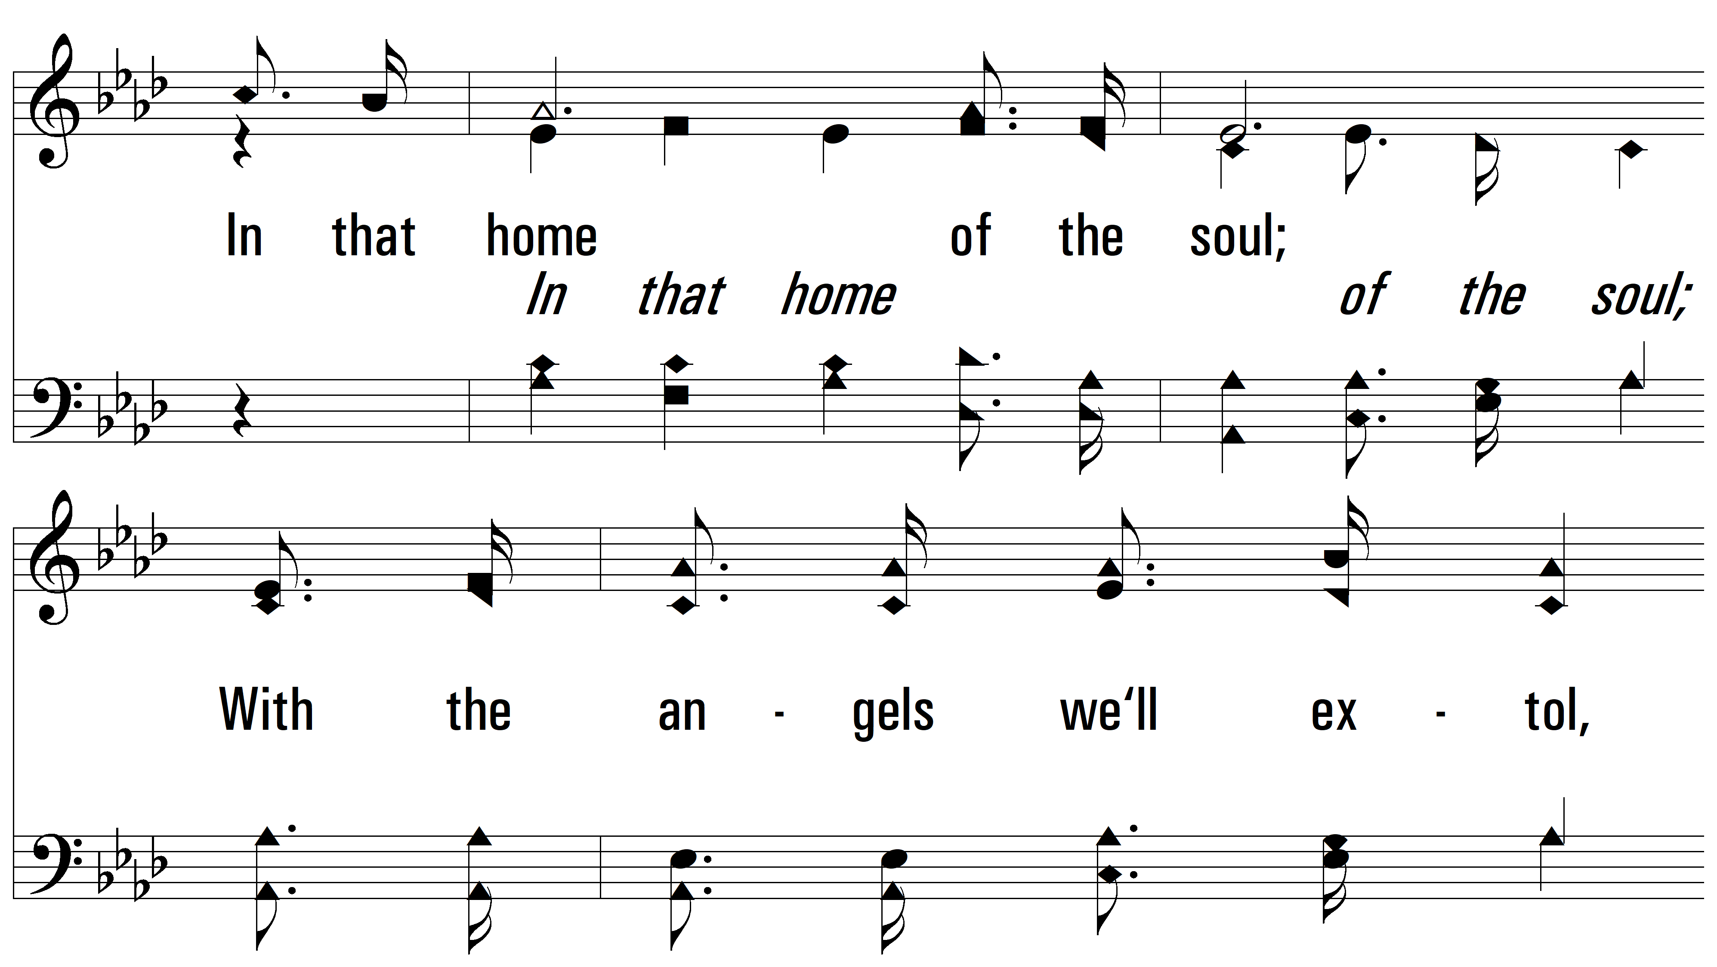
vs. 3

Slide 14
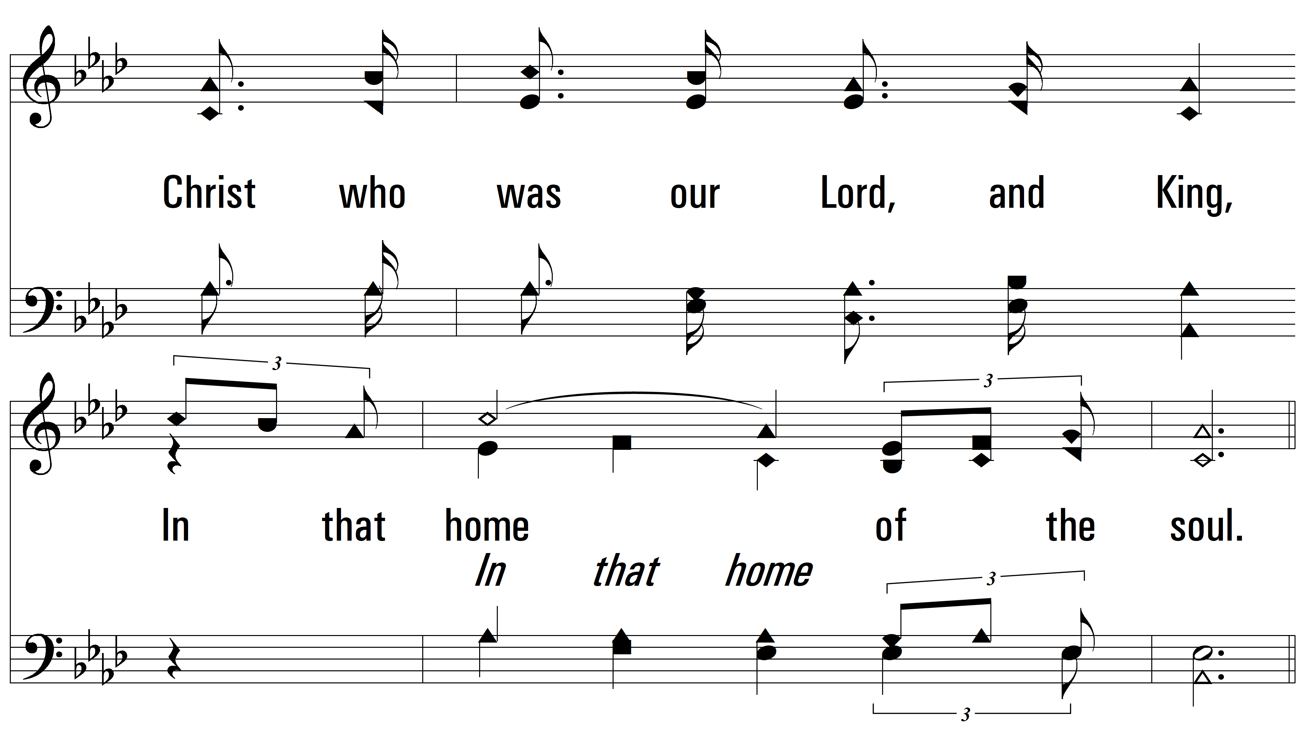
vs. 3

Slide 15
vs. 3

Slide 16
vs. 3
PDHymns.com
END

