Slide 1
In Memory Of The Savior's Love
WINCHESTER, OLD
CM
Words: | Thomas Cotterill (1805)
Music: | Este’s Psalter (1592)
4/4
F/F - DO
Verses: 3
Lead - | DO
Alto - | SOL
Tenor - | MI
Bass - | DO
PDHymns.com

Slide 2
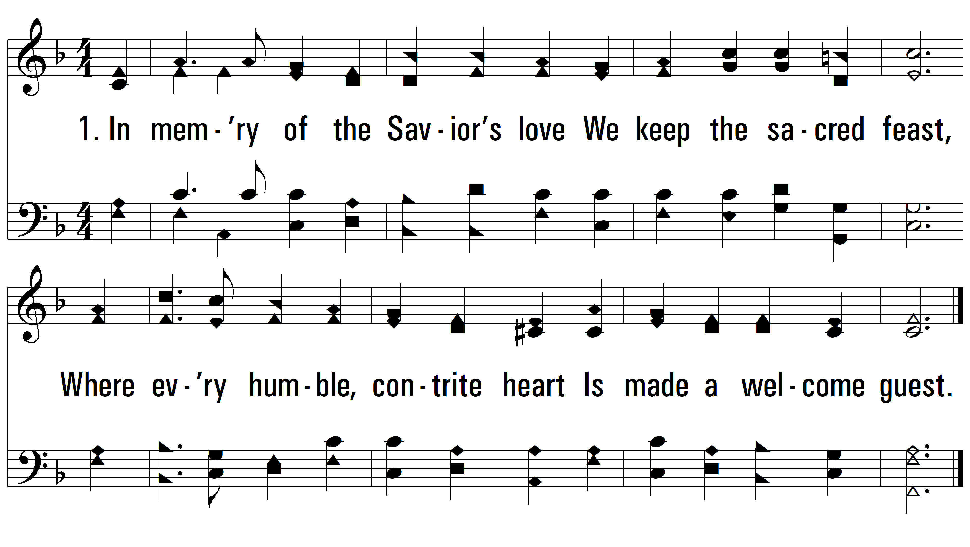
vs. 1 ~ In Memory Of The Savior's Love

Slide 3
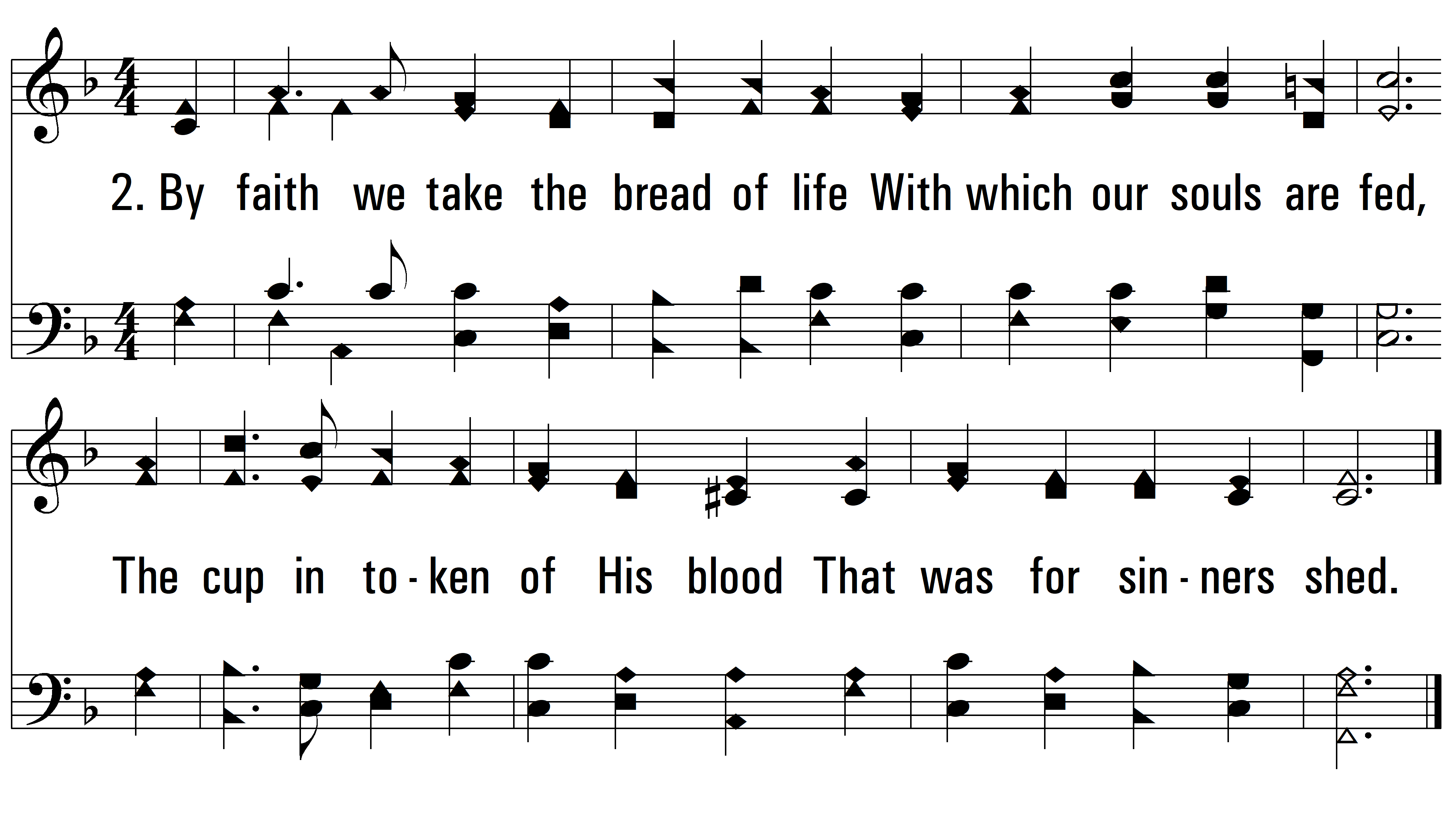
vs. 3 ~ In Memory Of The Savior's Love

Slide 4
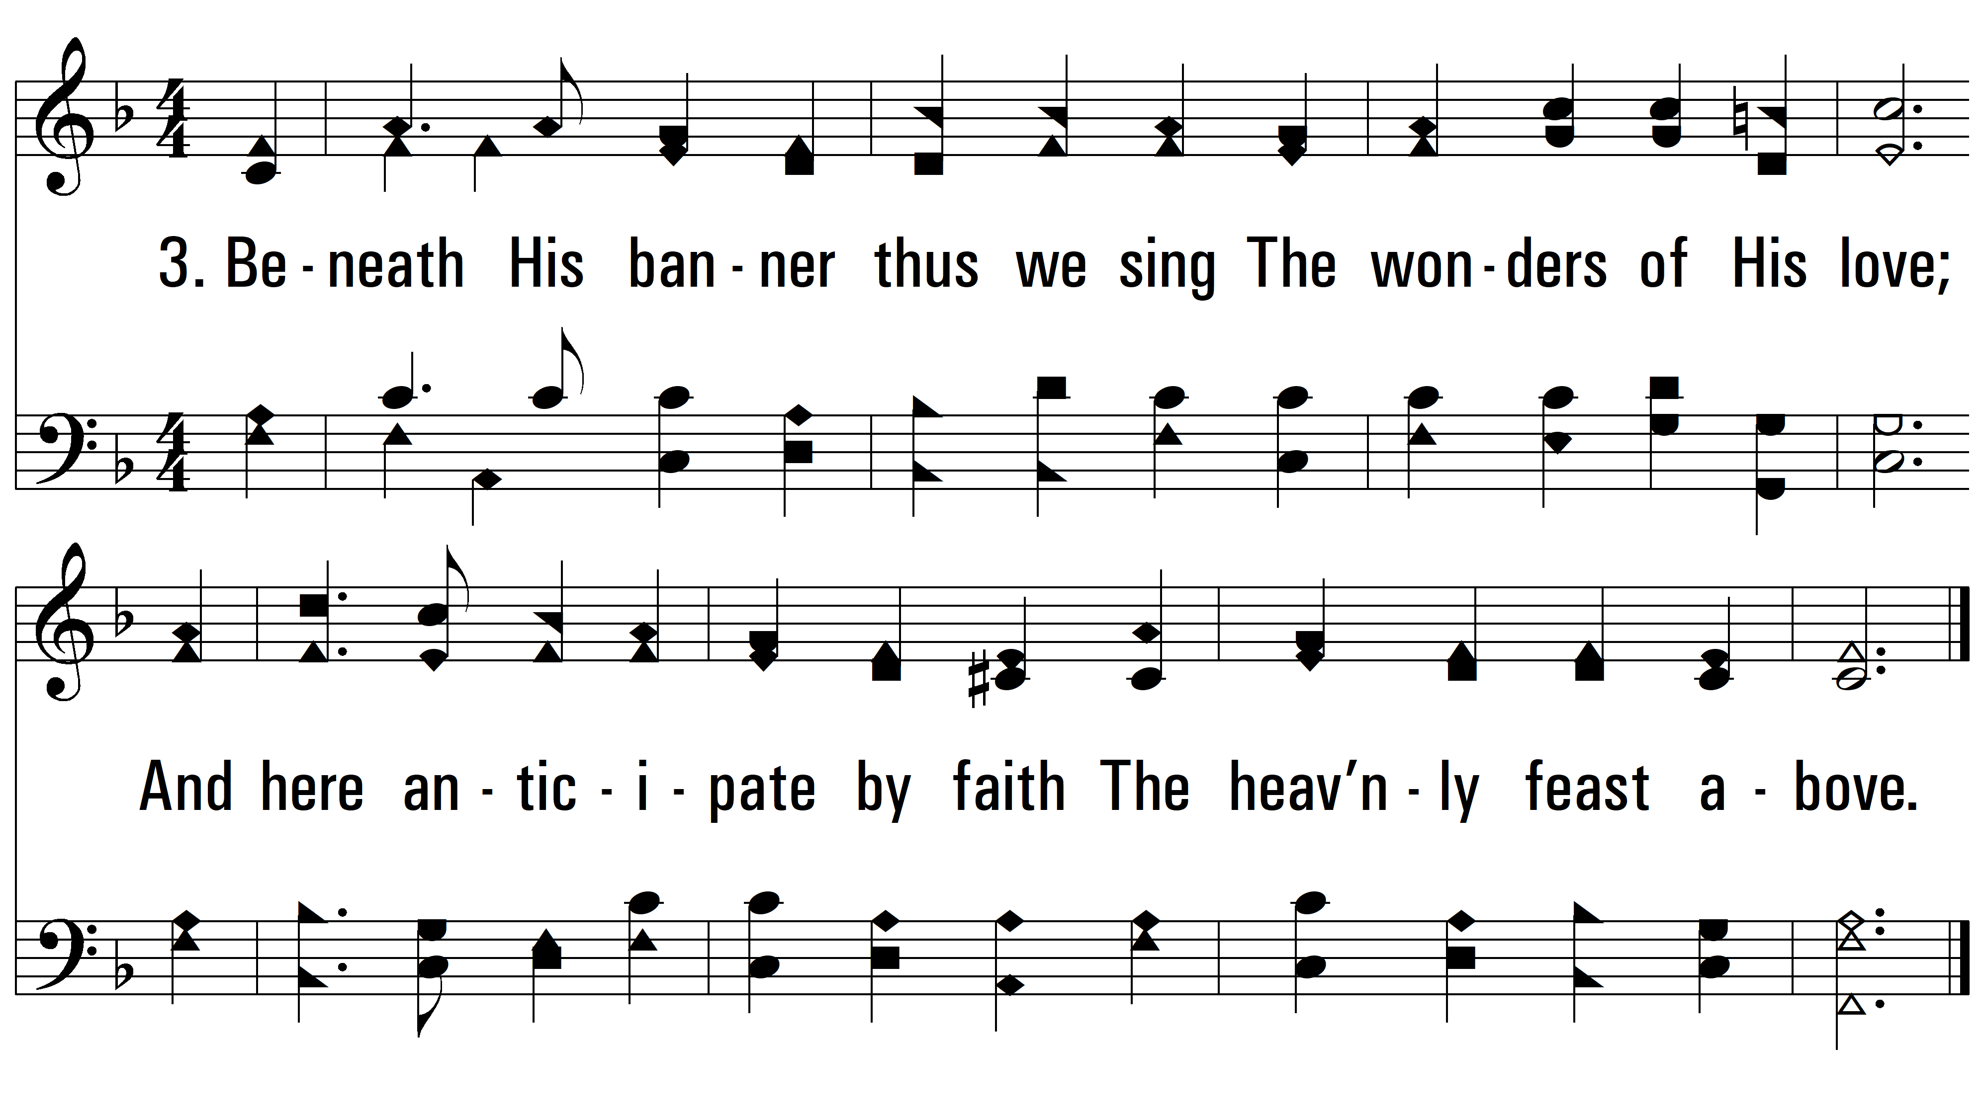
vs. 3 ~ In Memory Of The Savior's Love
PDHymns.com
END

