Slide 1
In Heavenly Love Abiding
SEASONS
7.6.7.6.D
Words: | Anna L. Waring (1850)
Music: | Felix Mendelssohn (1843)
4/4
E^{b}/B^{b} - SOL
Verses: 3
Lead - | SOL
Alto - | SOL
Tenor - | SOL
Bass - | SOL
PDHymns.com

Slide 2
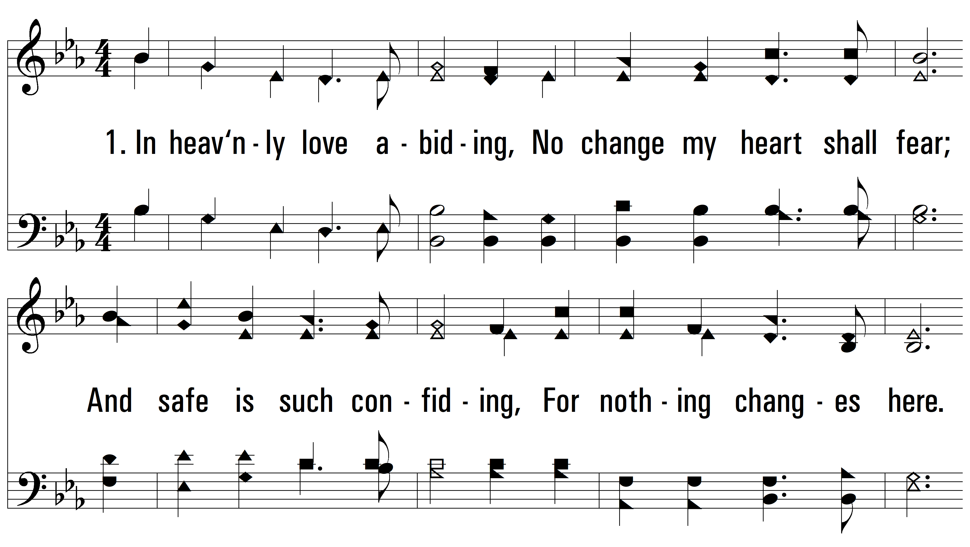
vs. 1 ~ In Heavenly Love Abiding

Slide 3
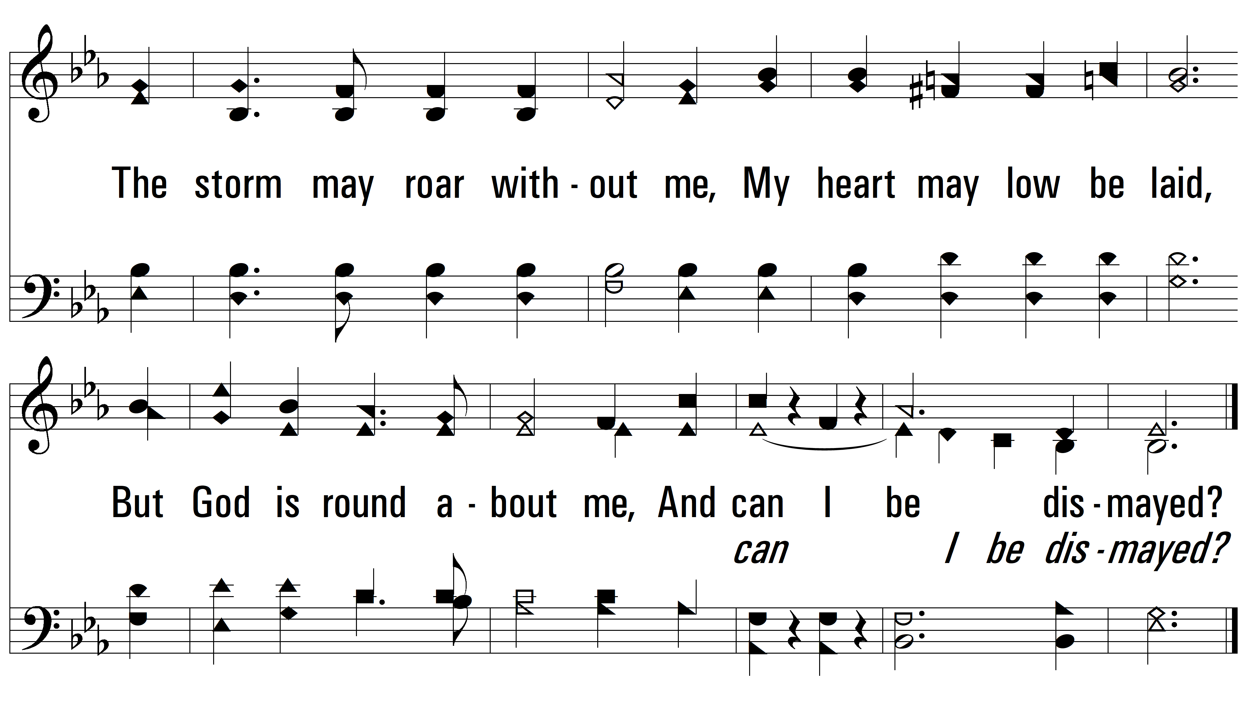
vs. 1

Slide 4
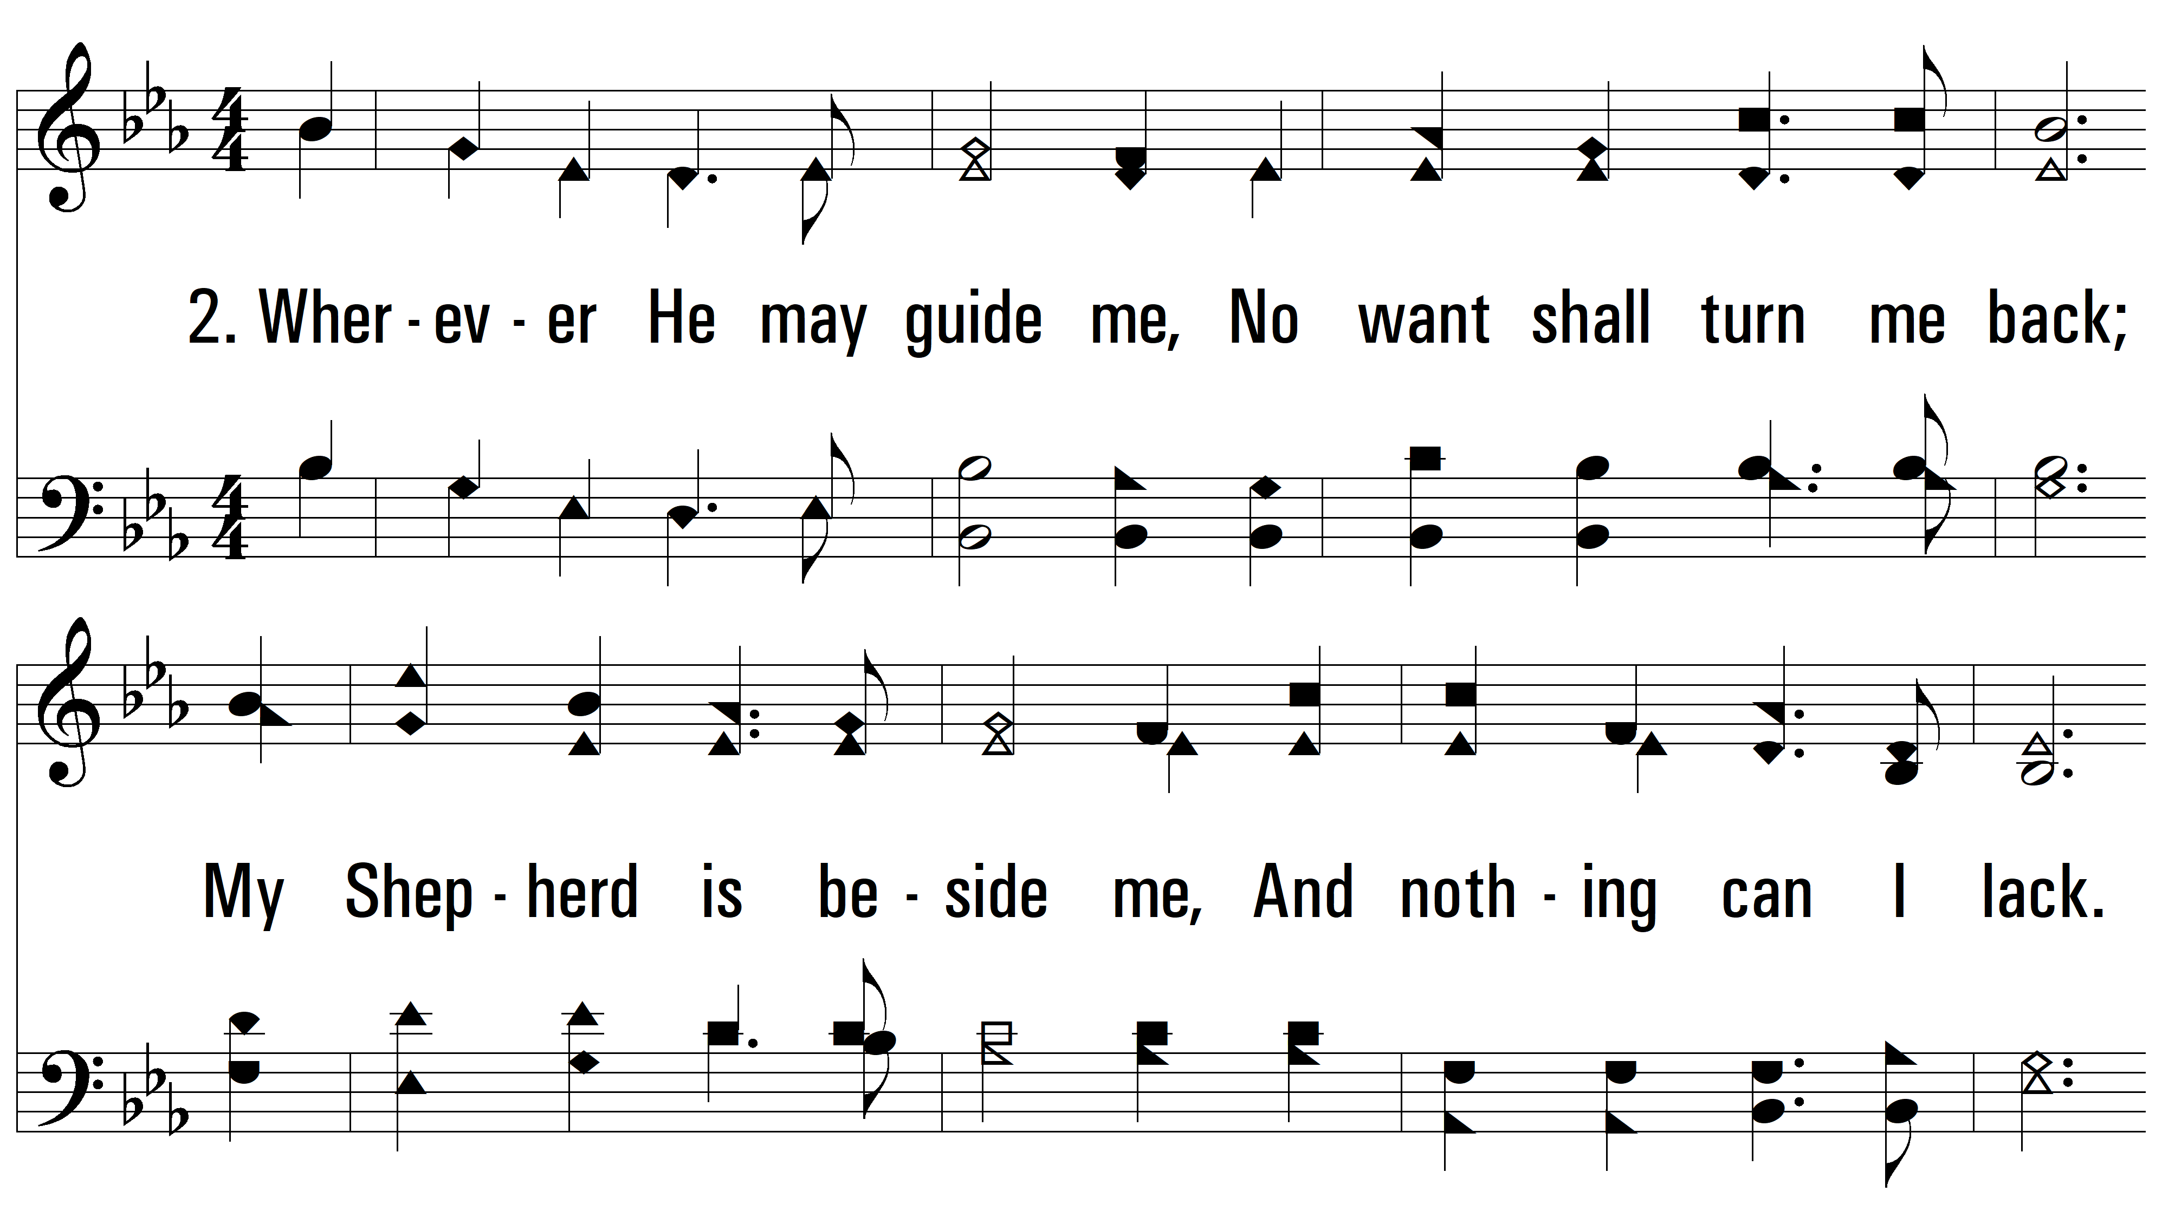
vs. 2 ~ In Heavenly Love Abiding

Slide 5
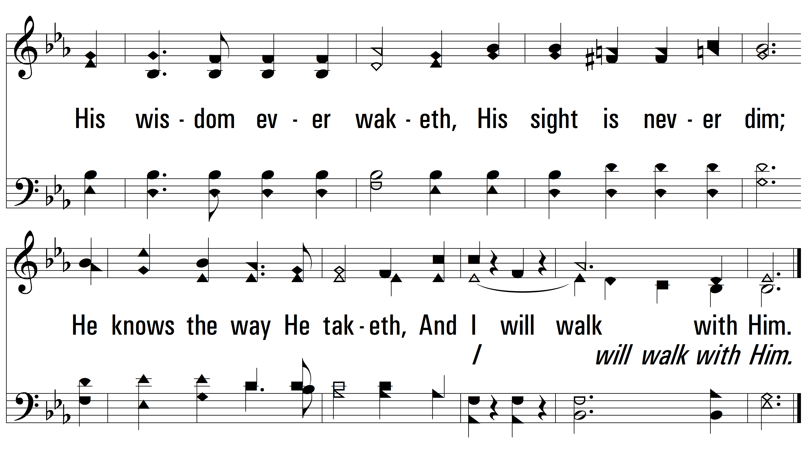
vs. 2

Slide 6
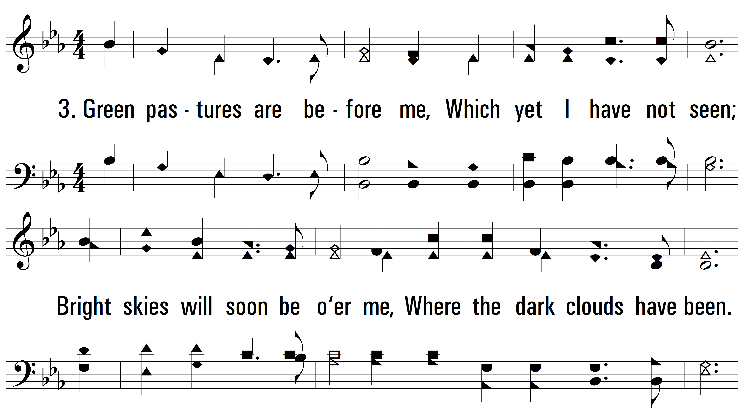
vs. 3 ~ In Heavenly Love Abiding

Slide 7
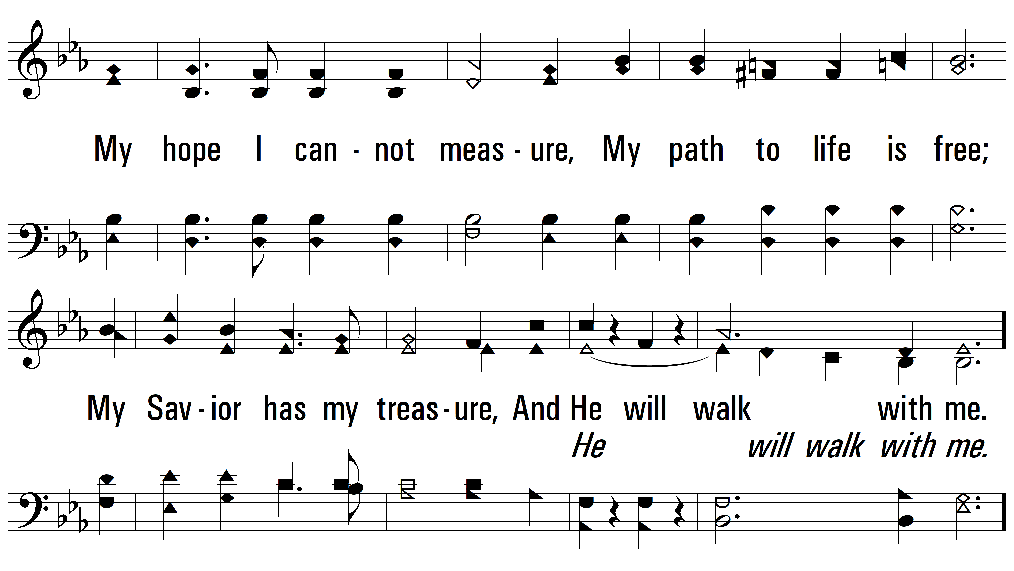
vs. 3
PDHymns.com
END

