Slide 1
Immortal, Invisible, God Only Wise
ST. DENIO
11.11.11.11
Words: | Walter Chalmers Smith (1867)
Music: | Robert’s Caniadau y Cyssegr (1839)
3/4
A^{b}/A^{b} - DO
Verses: 4
Lead - | DO
Alto - | SOL
Tenor - | MI
Bass - | DO
PDHymns.com

Slide 2
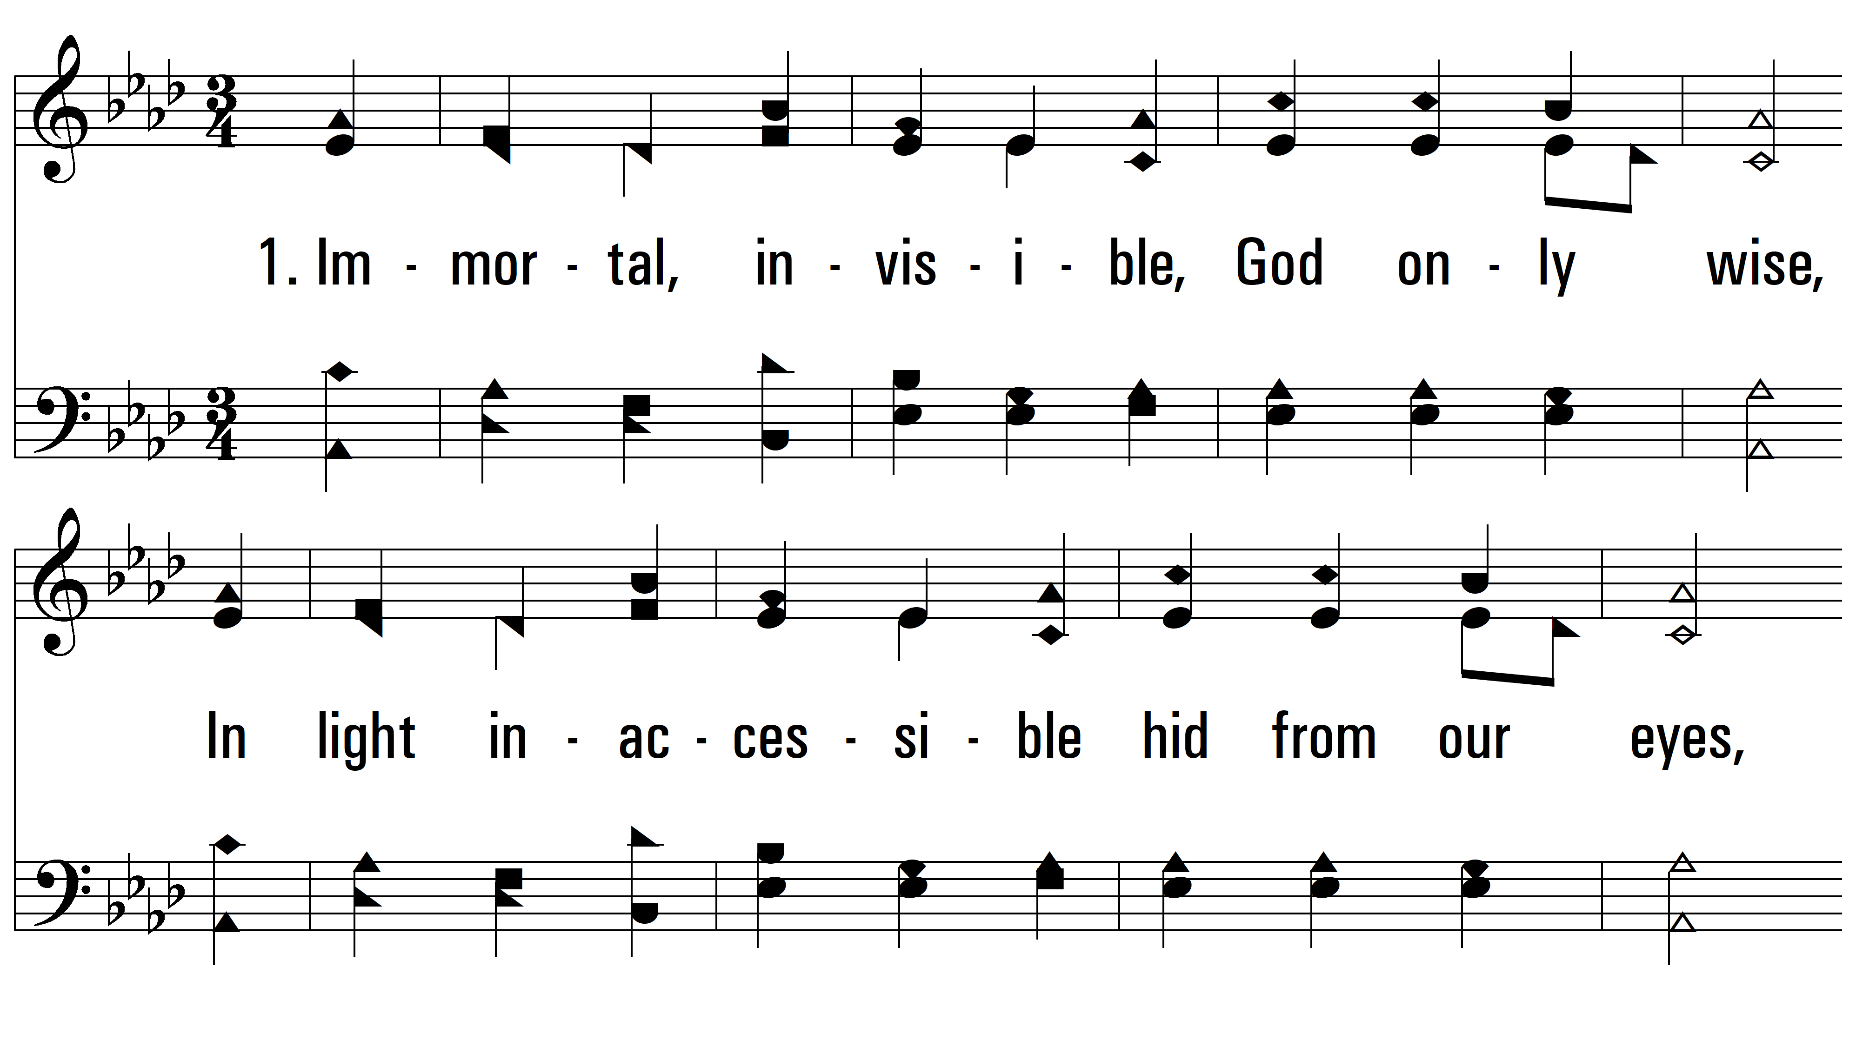
vs. 1 ~ Immortal, Invisible, God Only Wise

Slide 3
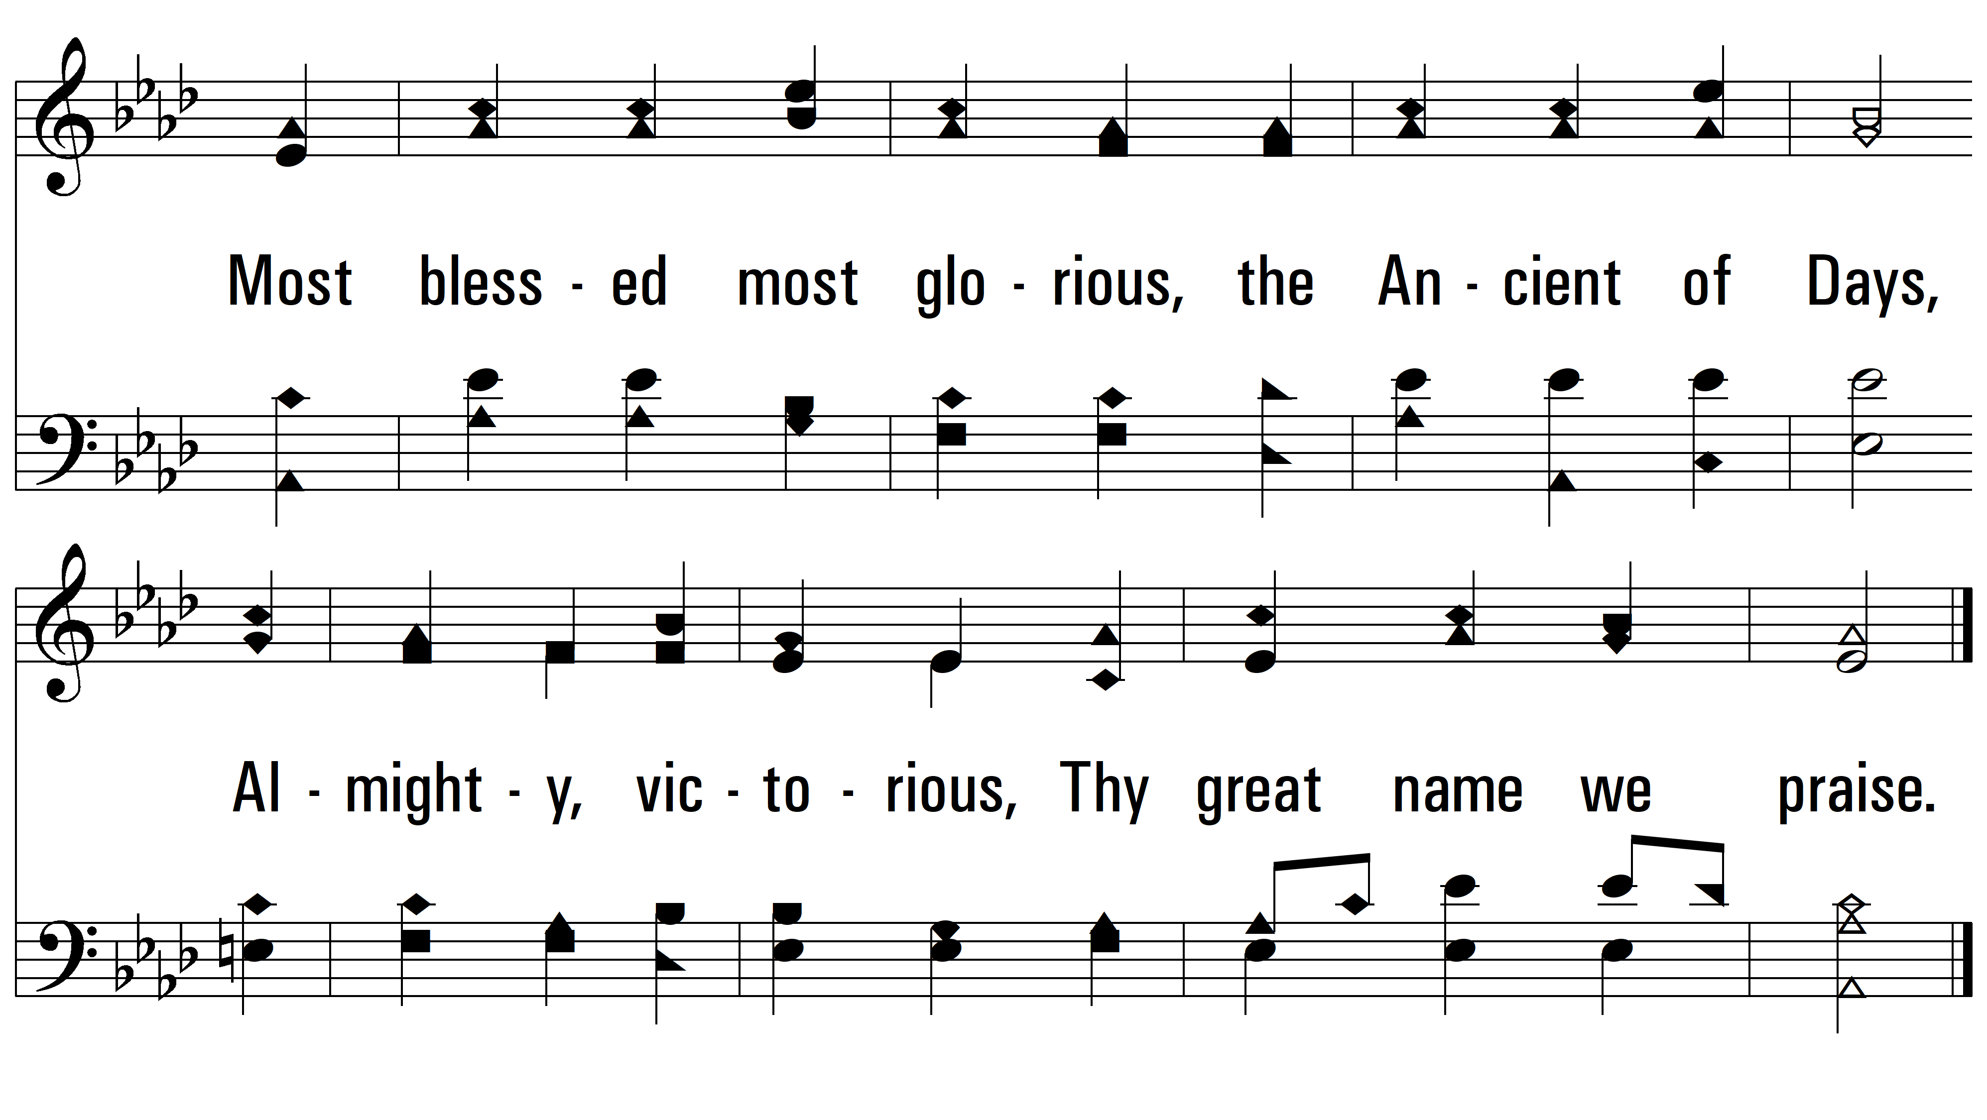
vs. 1

Slide 4
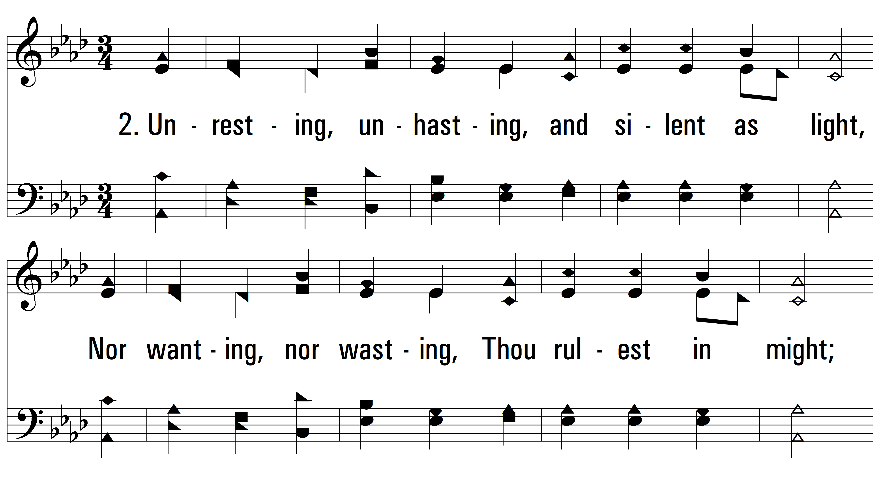
vs. 2 ~ Immortal, Invisible, God Only Wise

Slide 5
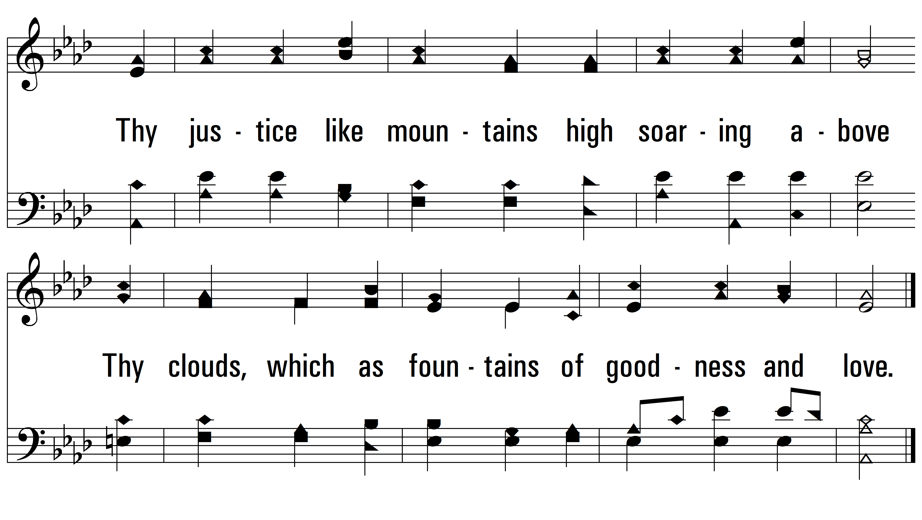
vs. 2

Slide 6
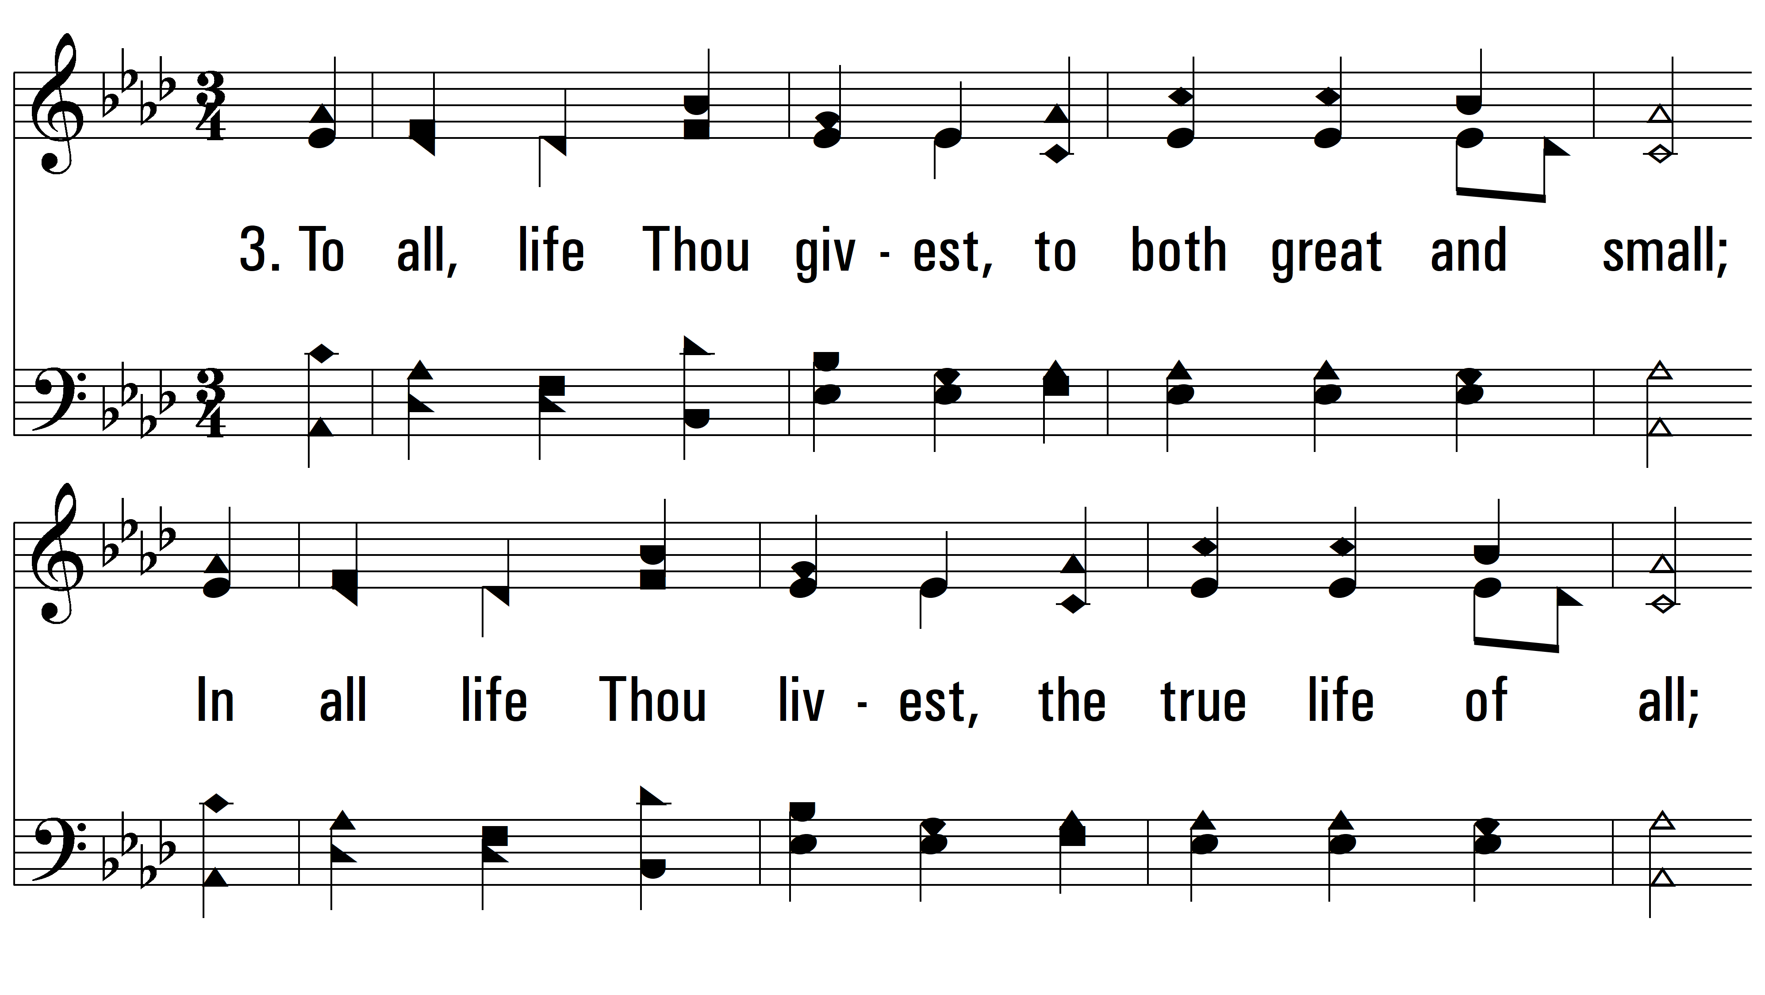
vs. 3 ~ Immortal, Invisible, God Only Wise

Slide 7
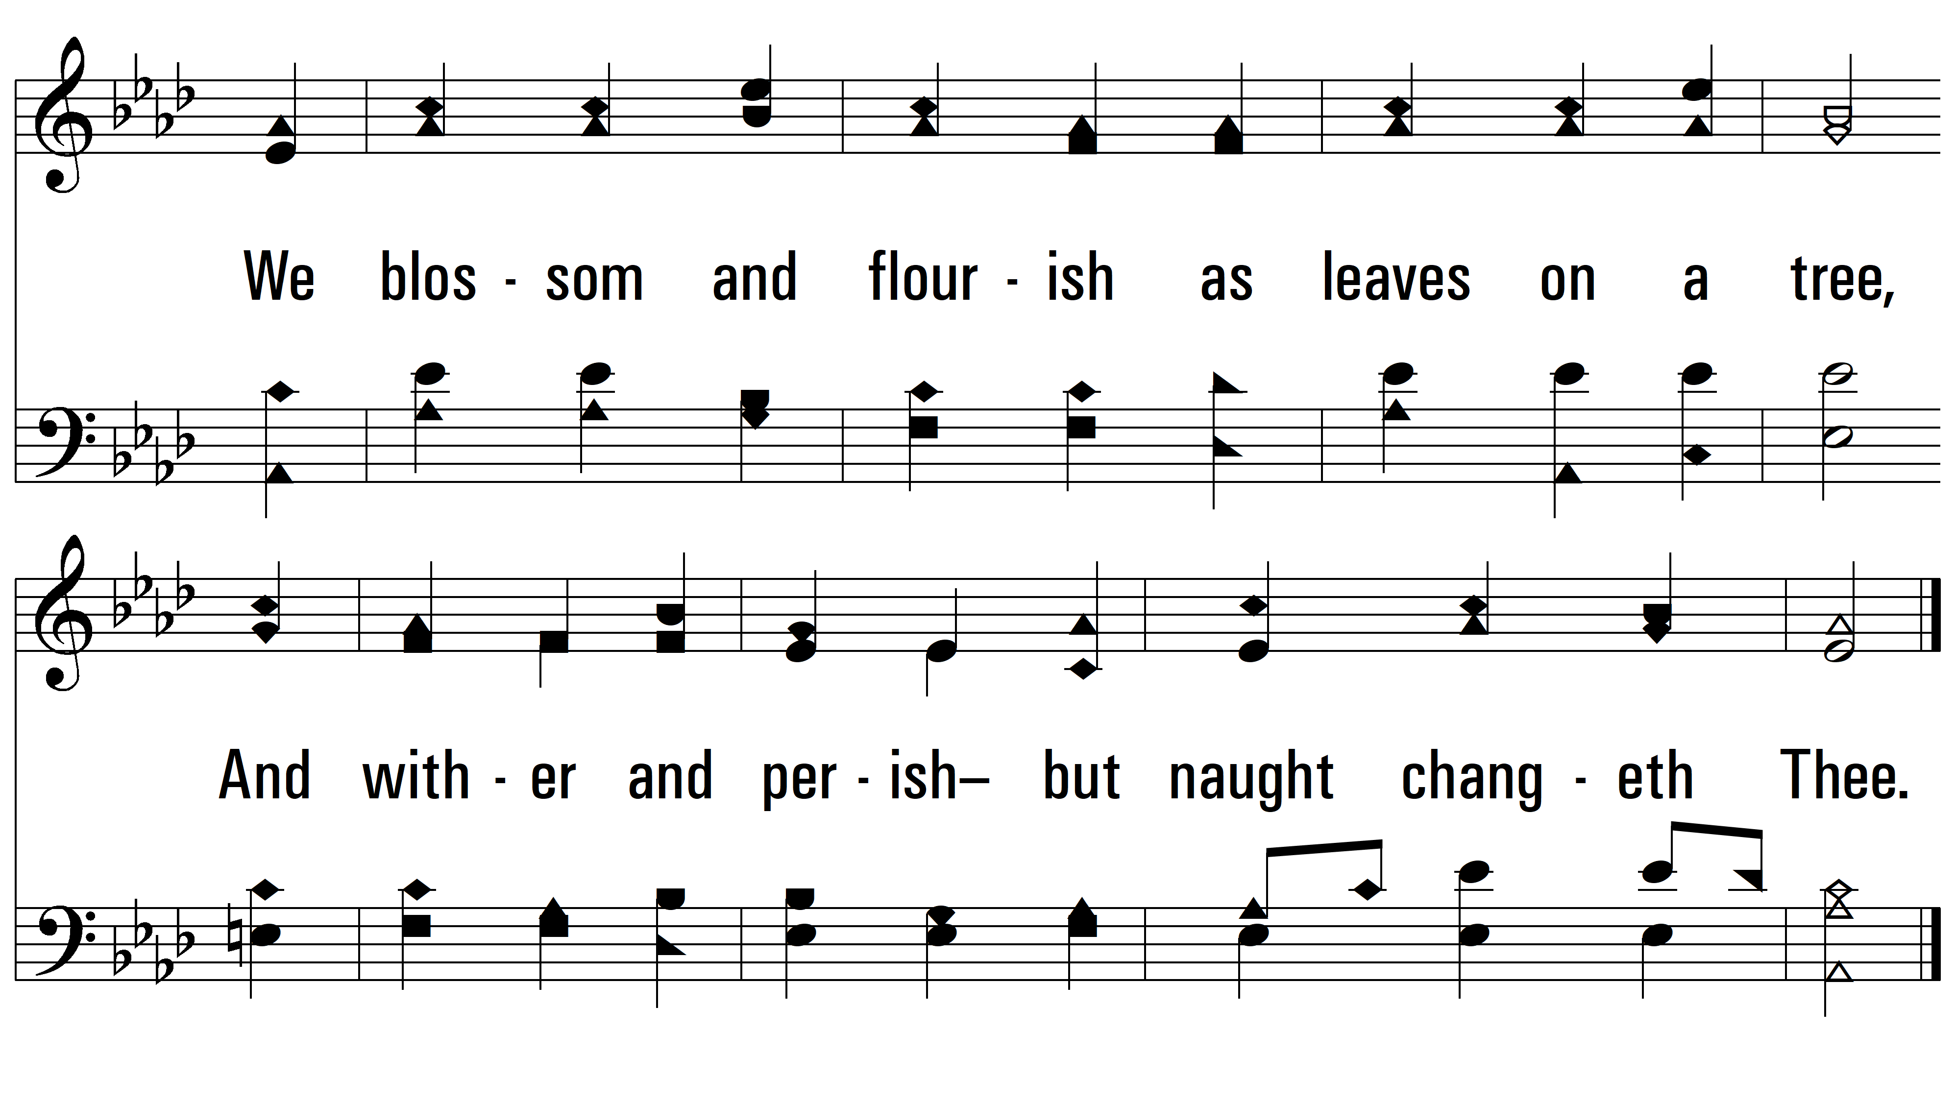
vs. 3

Slide 8
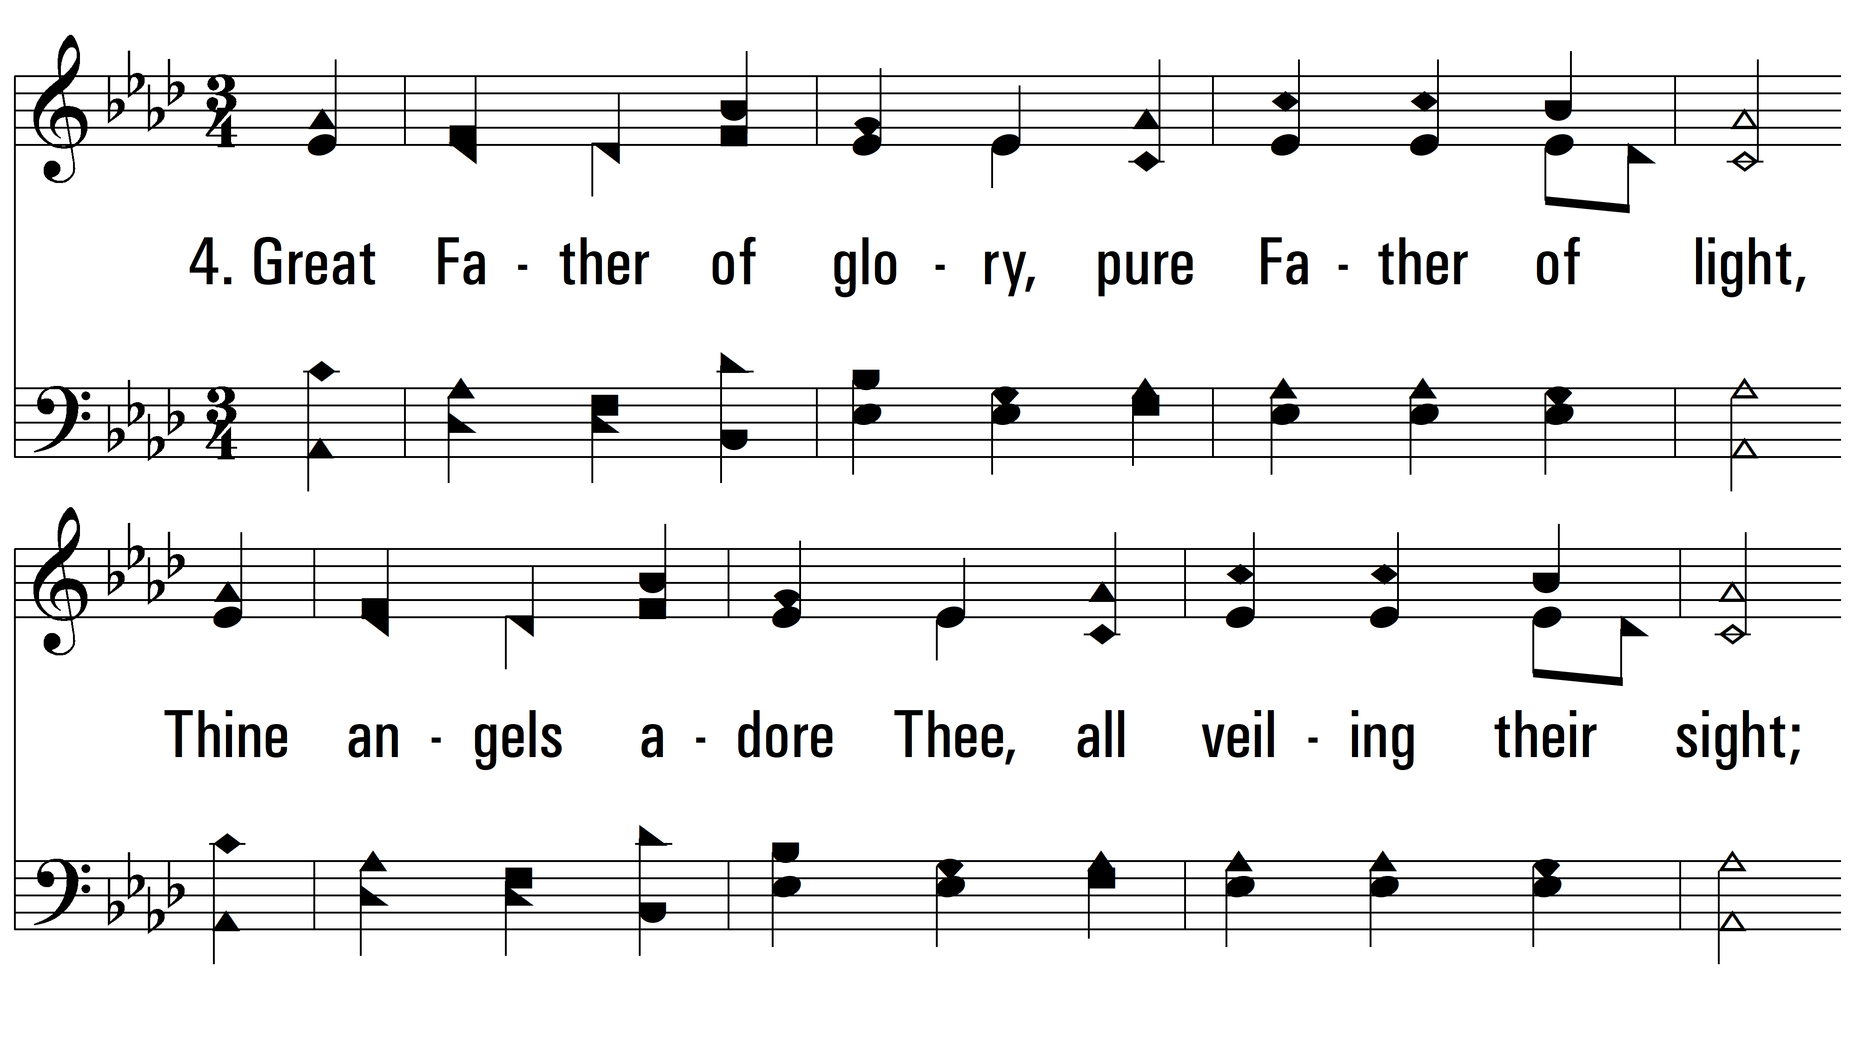
vs. 4 ~ Immortal, Invisible, God Only Wise

Slide 9
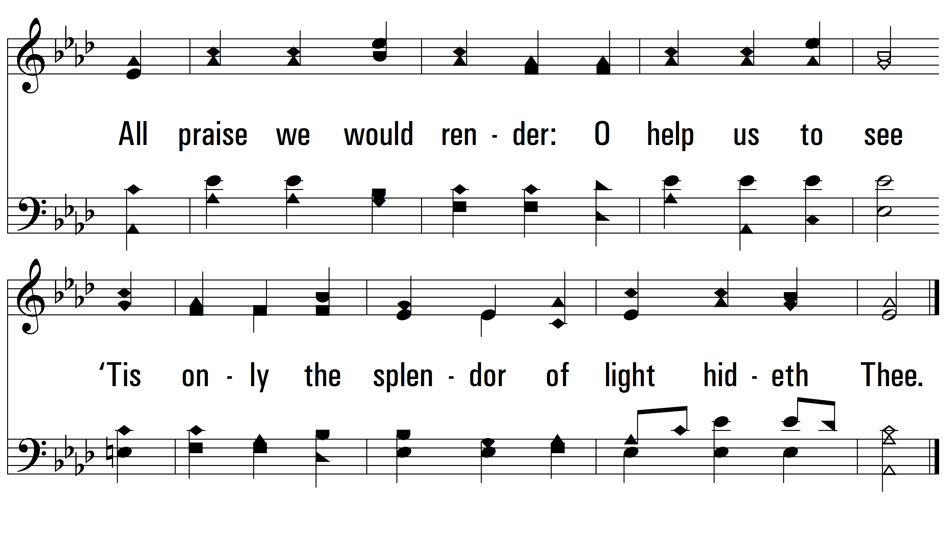
vs. 4
PDHymns.com
END

