Slide 1
I'm Not Ashamed To Own My Lord
AZMON
CM
Words: | Isaac Watts (1707)
Music: | Carl Glaser (1828)
3/2
A^{b}/E^{b} - SOL
Verses: 3
Lead - | SOL
Alto - | SOL
Tenor - | SOL
Bass - | SOL
PDHymns.com

Slide 2
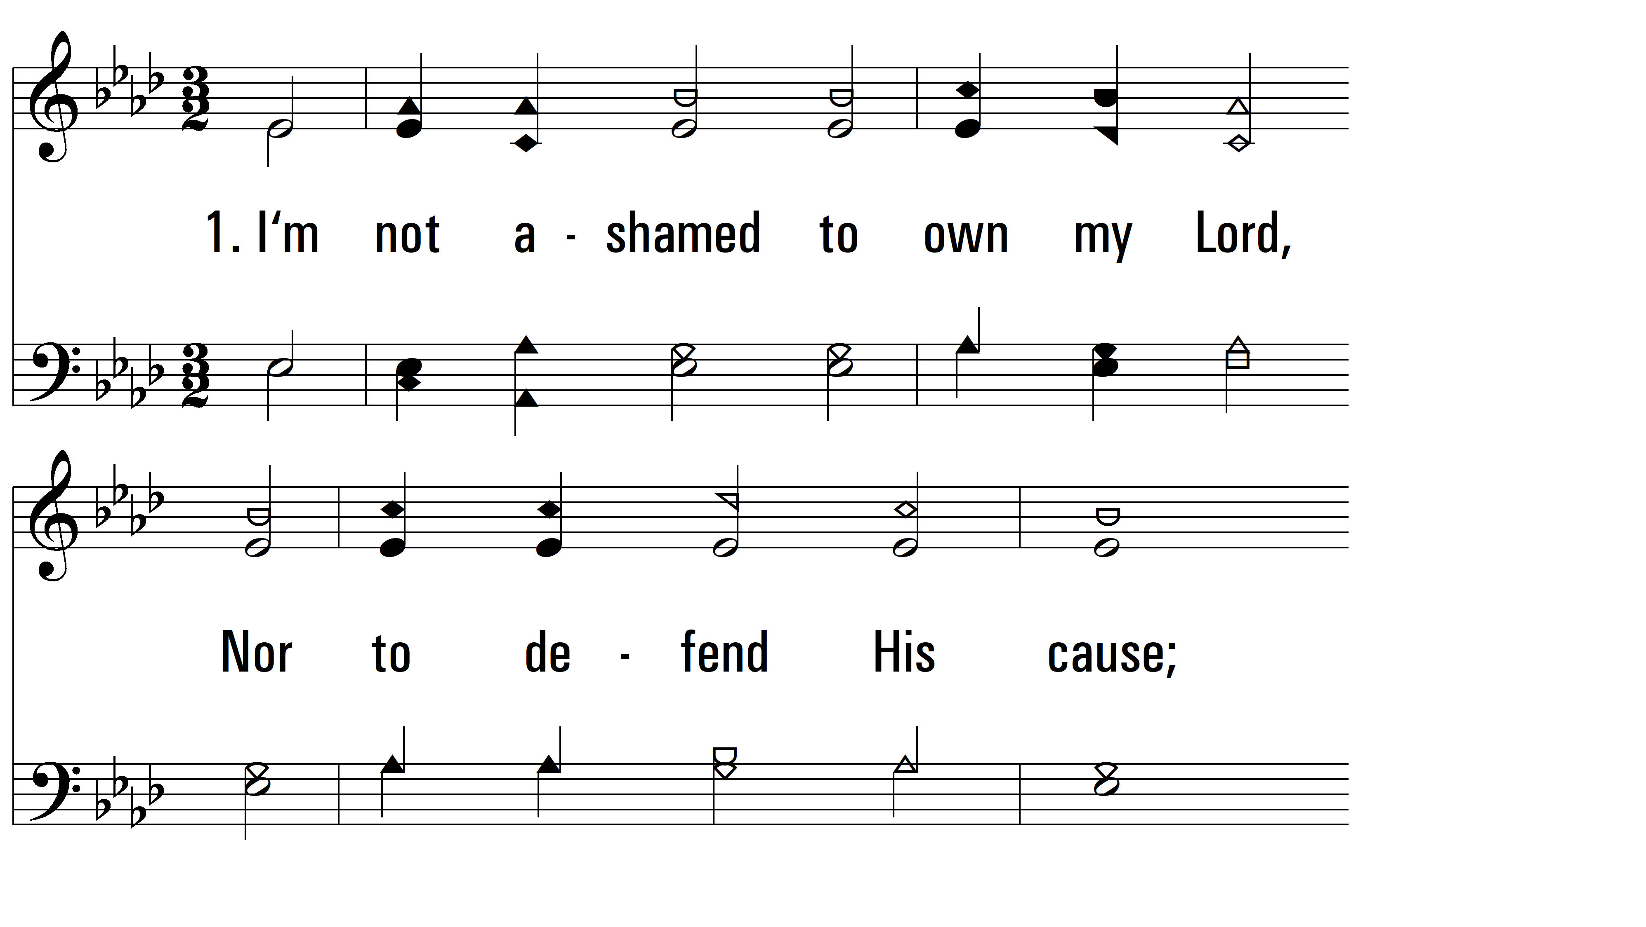
vs. 1 ~ I'm Not Ashamed To Own My Lord

Slide 3
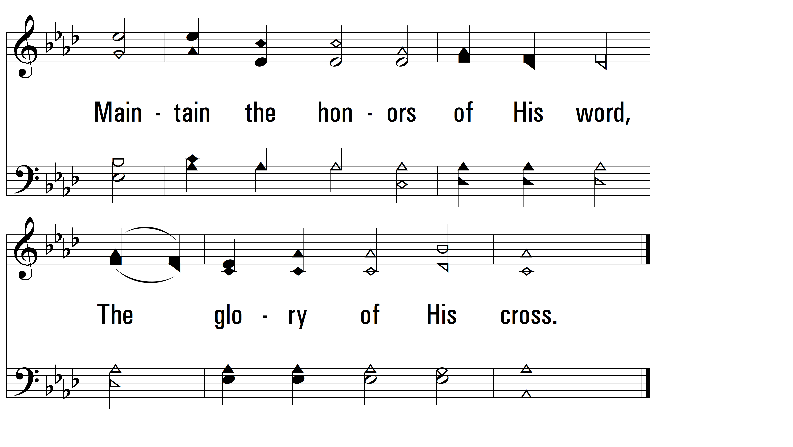
vs. 1

Slide 4
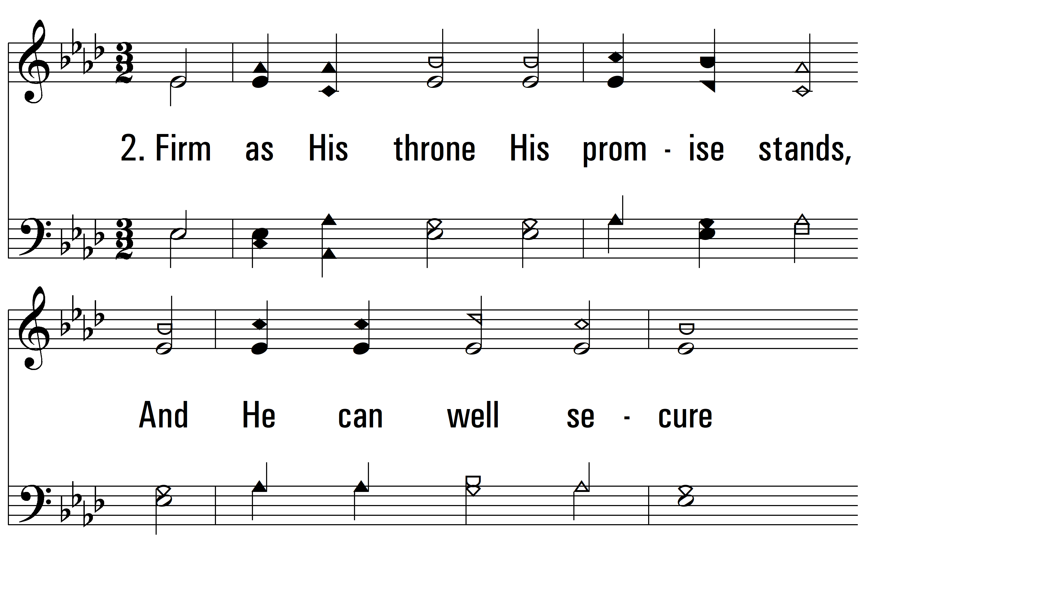
vs. 2 ~ I'm Not Ashamed To Own My Lord

Slide 5
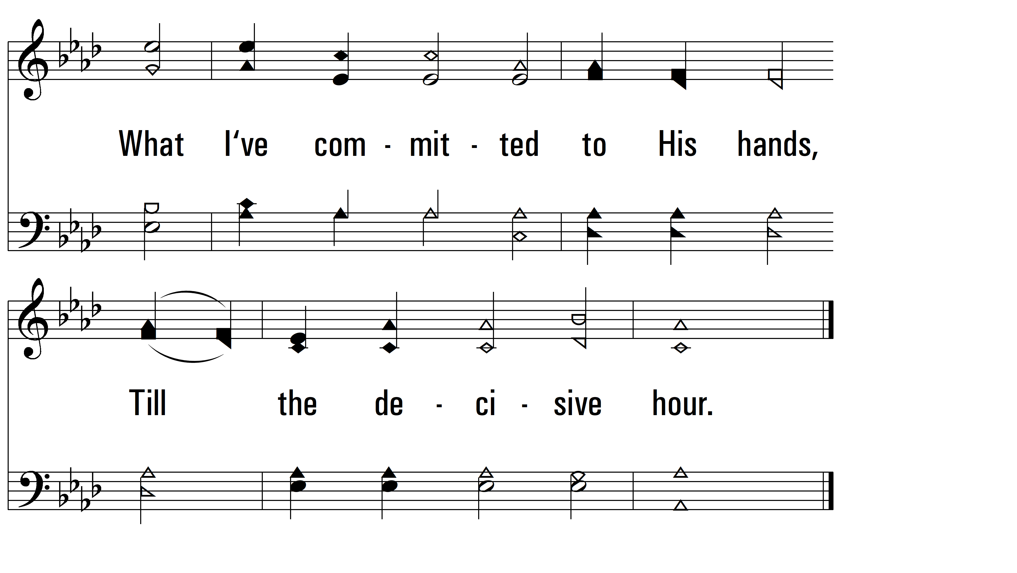
vs. 2

Slide 6
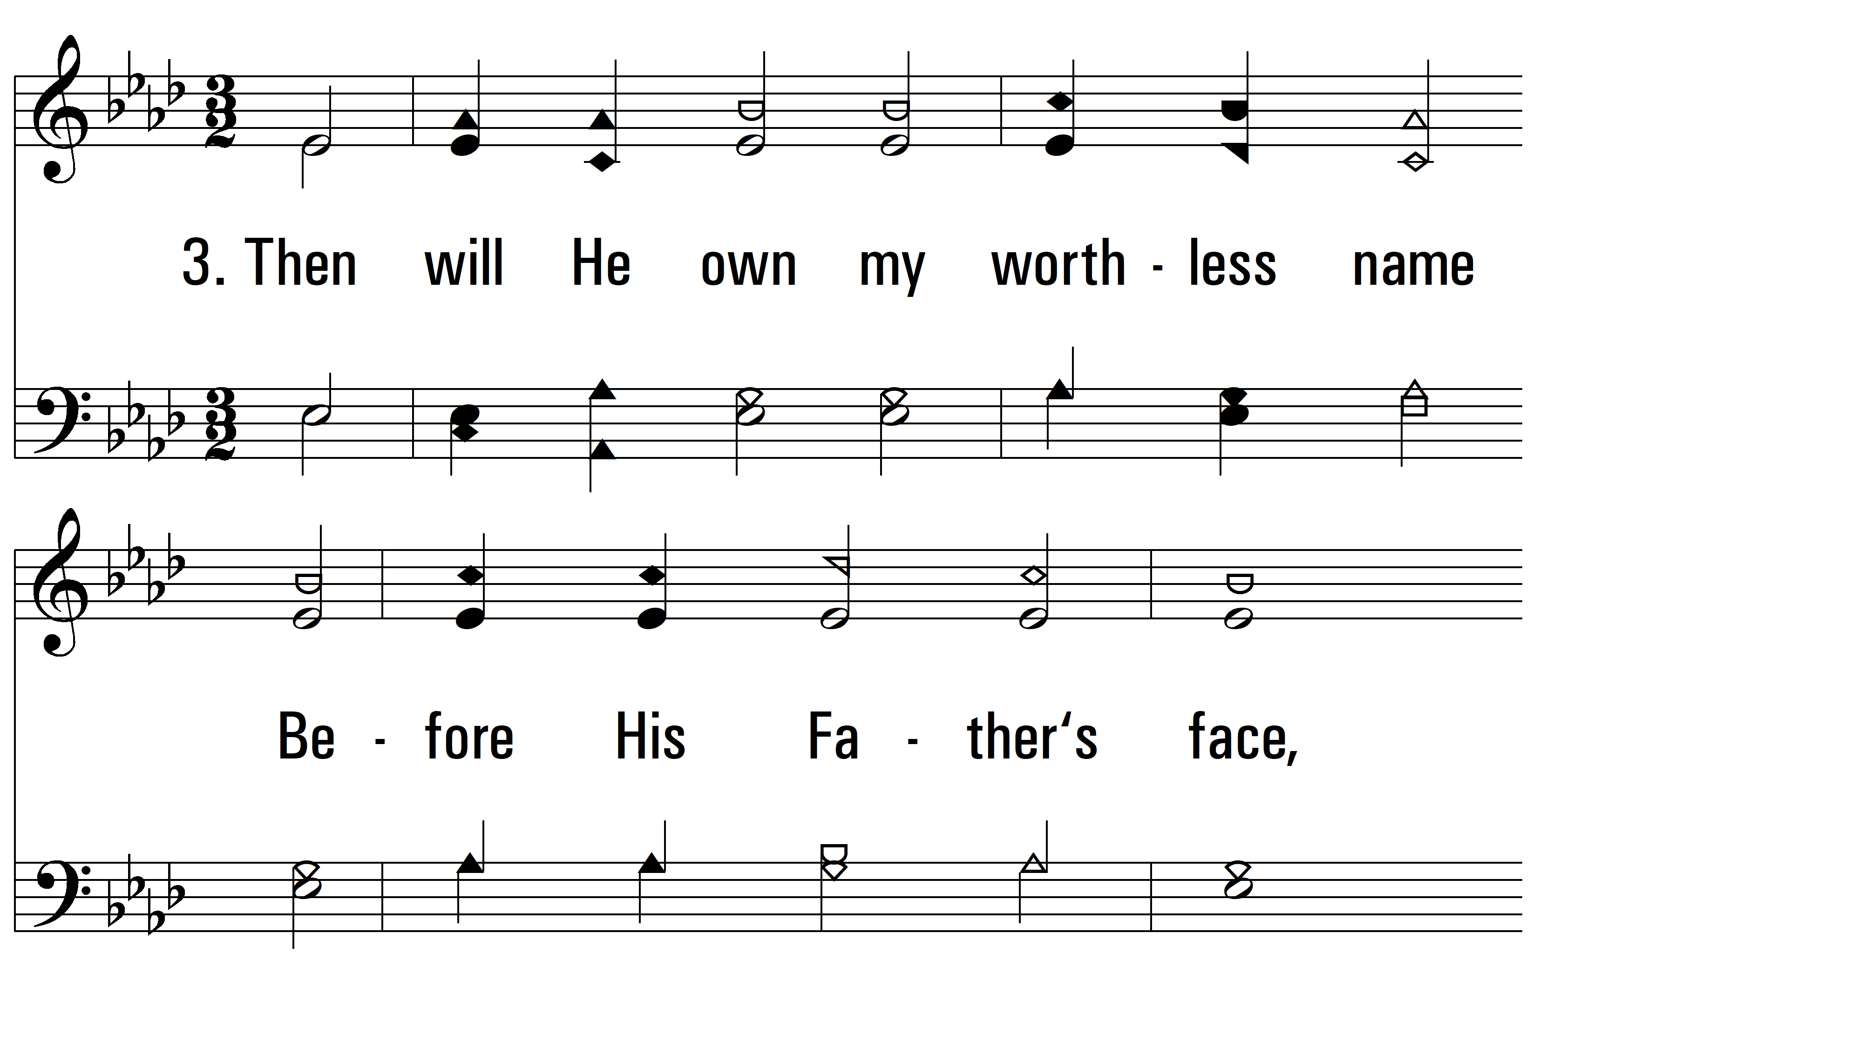
vs. 3~ I'm Not Ashamed To Own My Lord

Slide 7
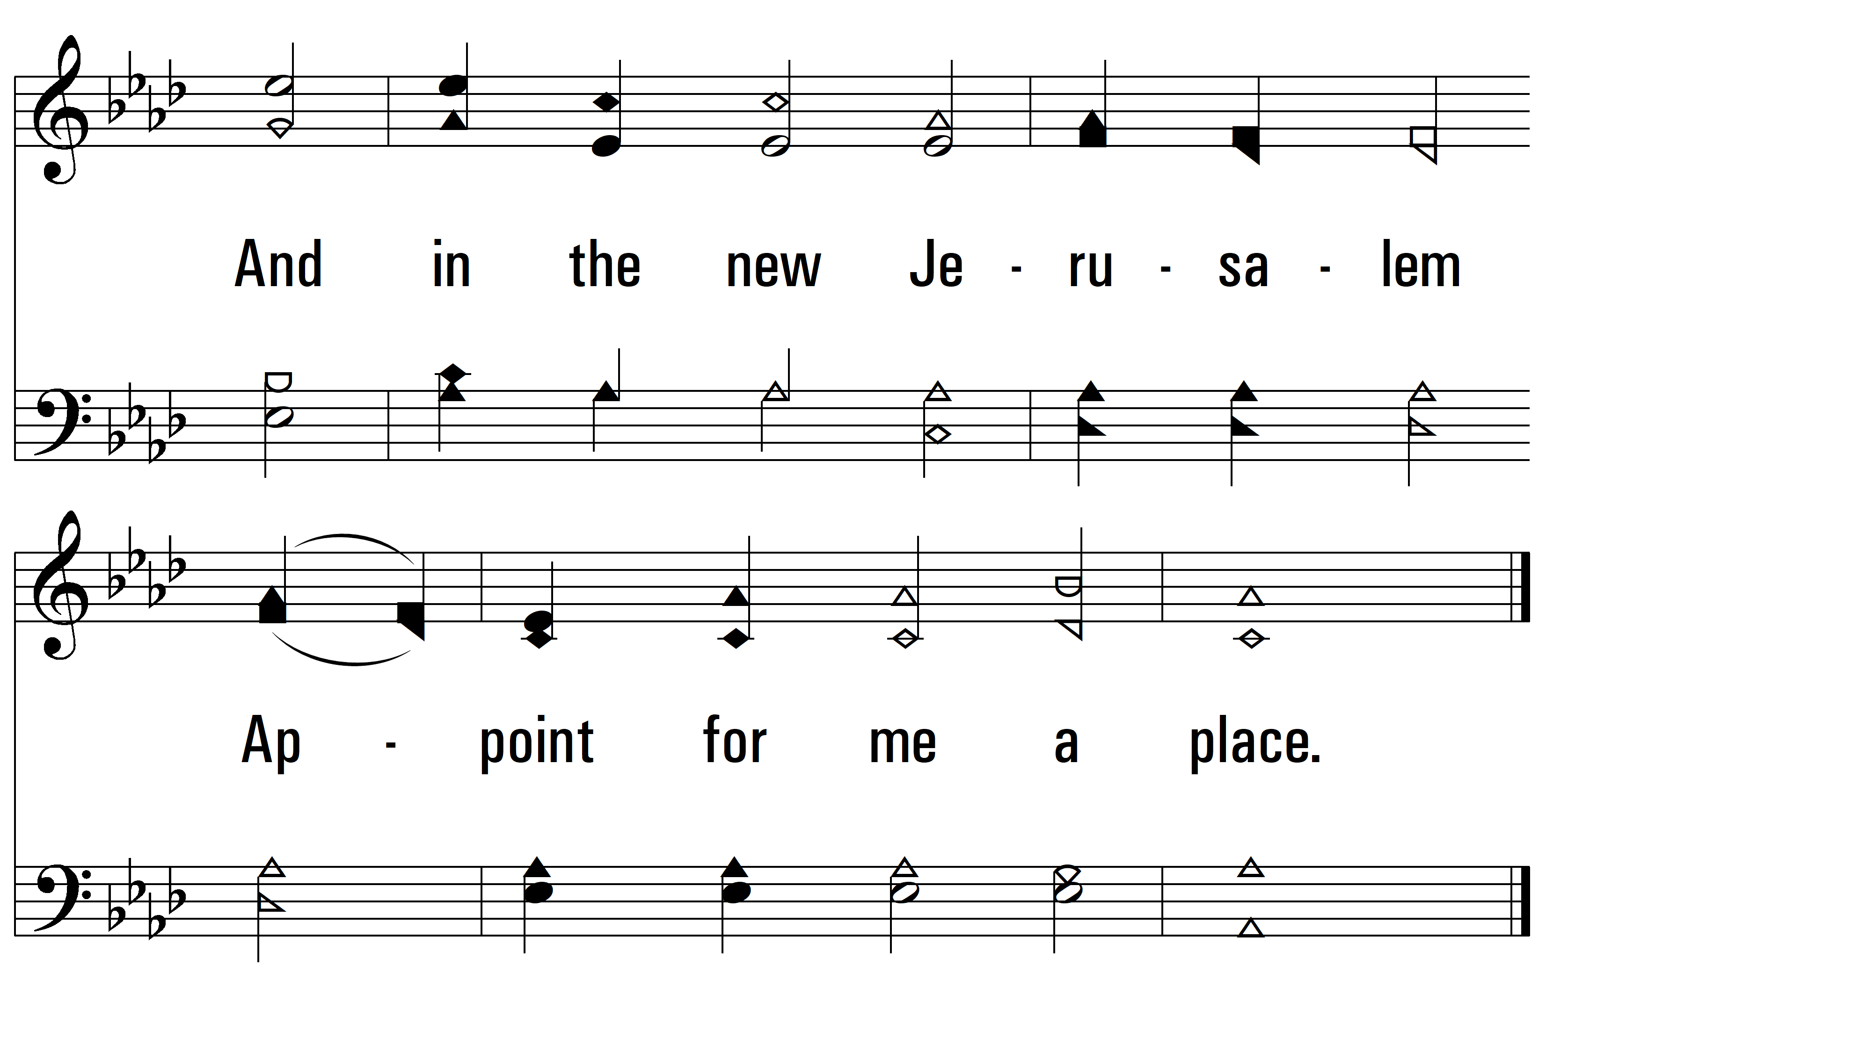
vs. 3
PDHymns.com
END

