Slide 1
I'll Live For Him
Words: | Ralph E. Hudson (1882)
Music: | C. R. Dunbar (1882)
3/4
F/C - SOL
Verses: 2/Chorus
Lead - | SOL
Alto - | SOL
Tenor - | MI
Bass - | DO
PDHymns.com

Slide 2
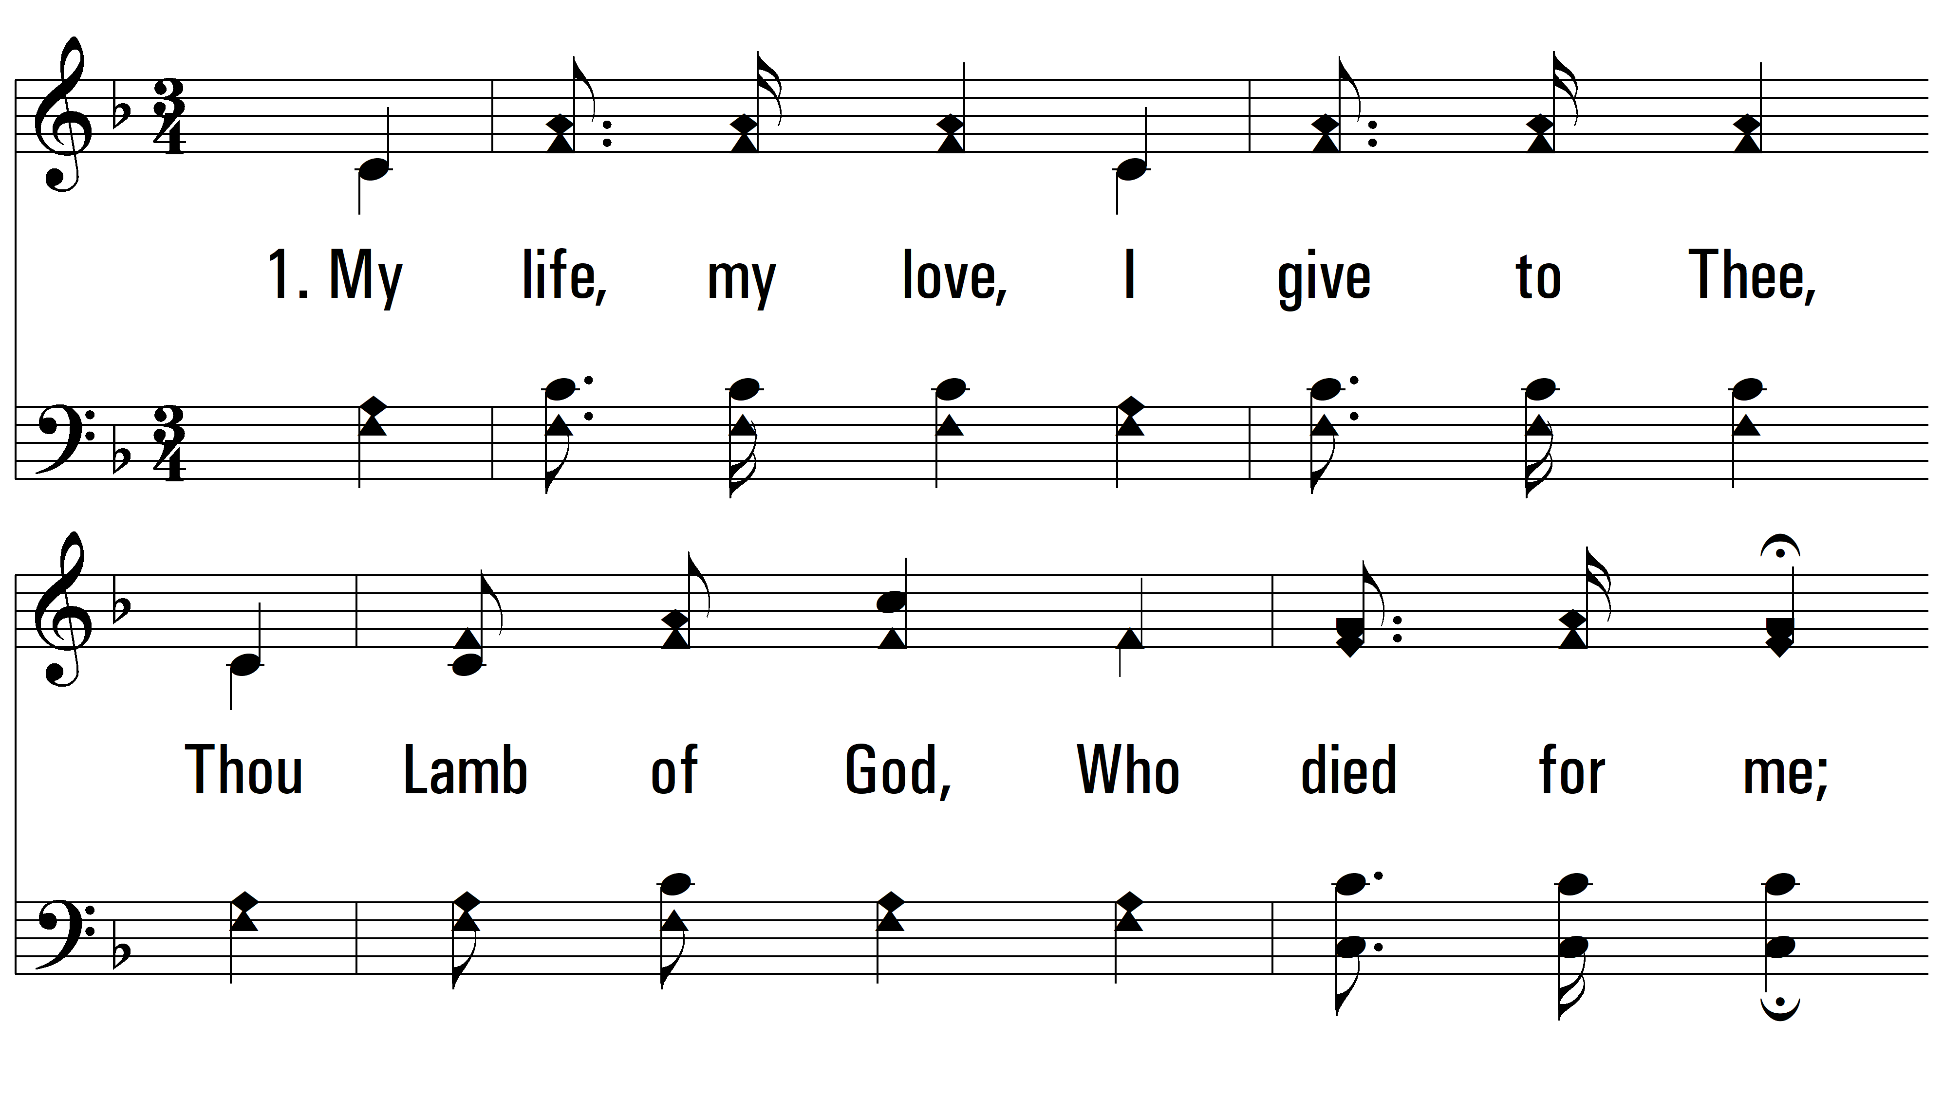
vs. 1 ~ I'll Live For Him

Slide 3
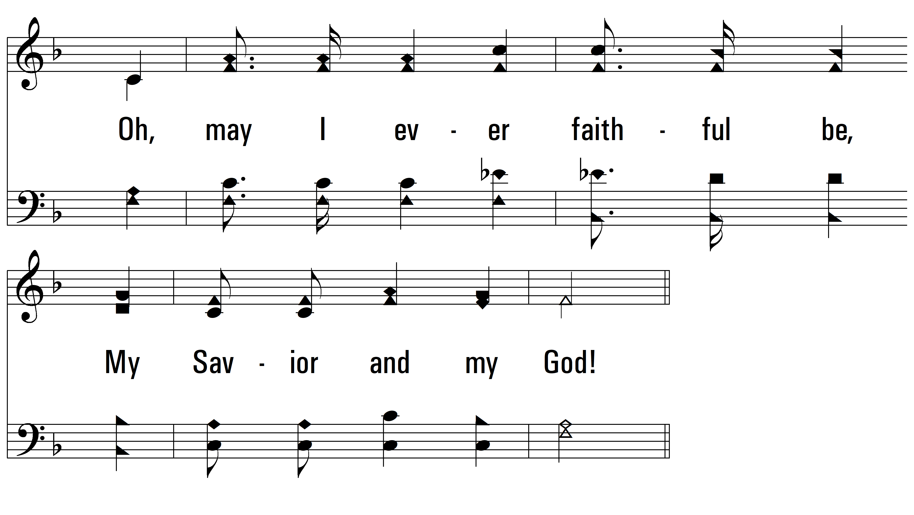
vs. 1

Slide 4
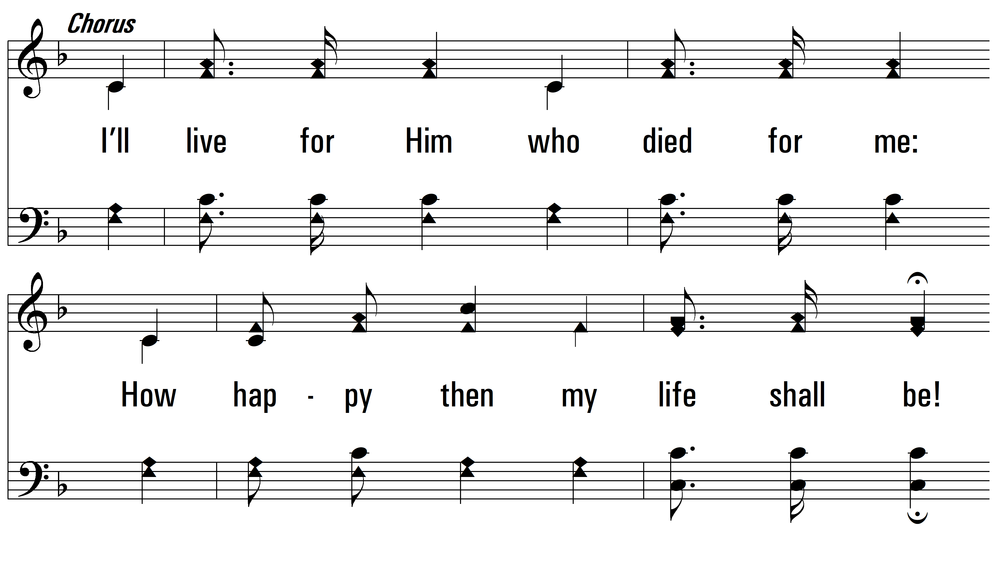
vs. 1

Slide 5
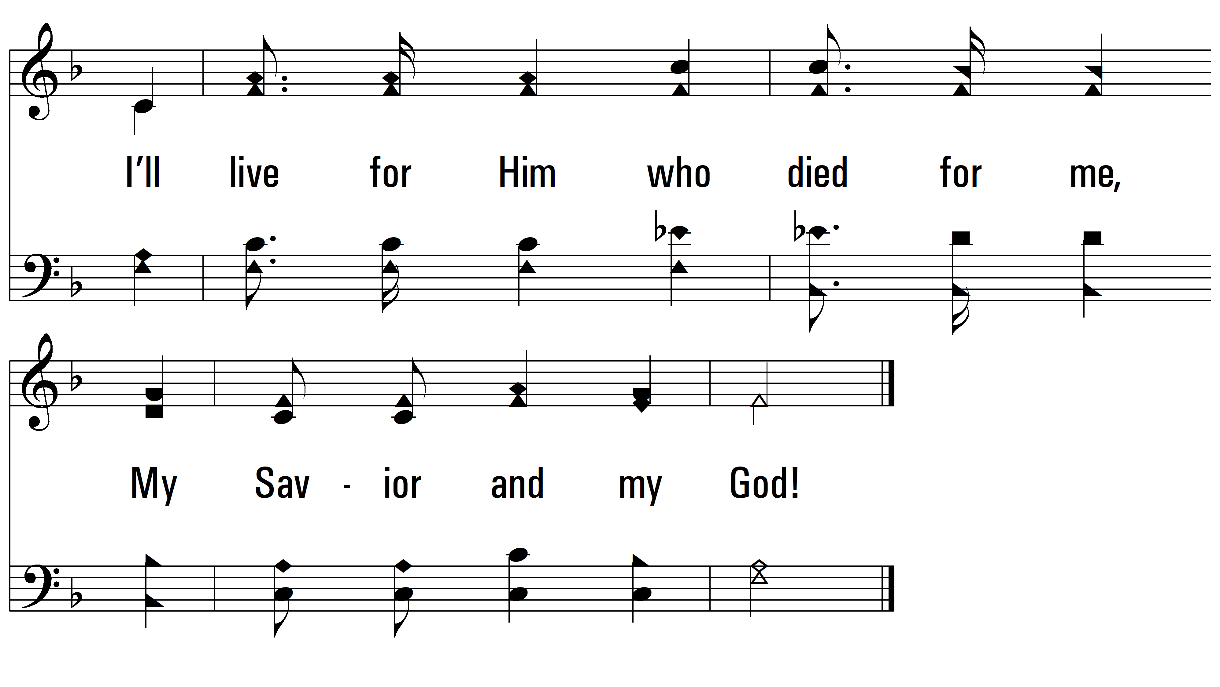
vs. 1

Slide 6
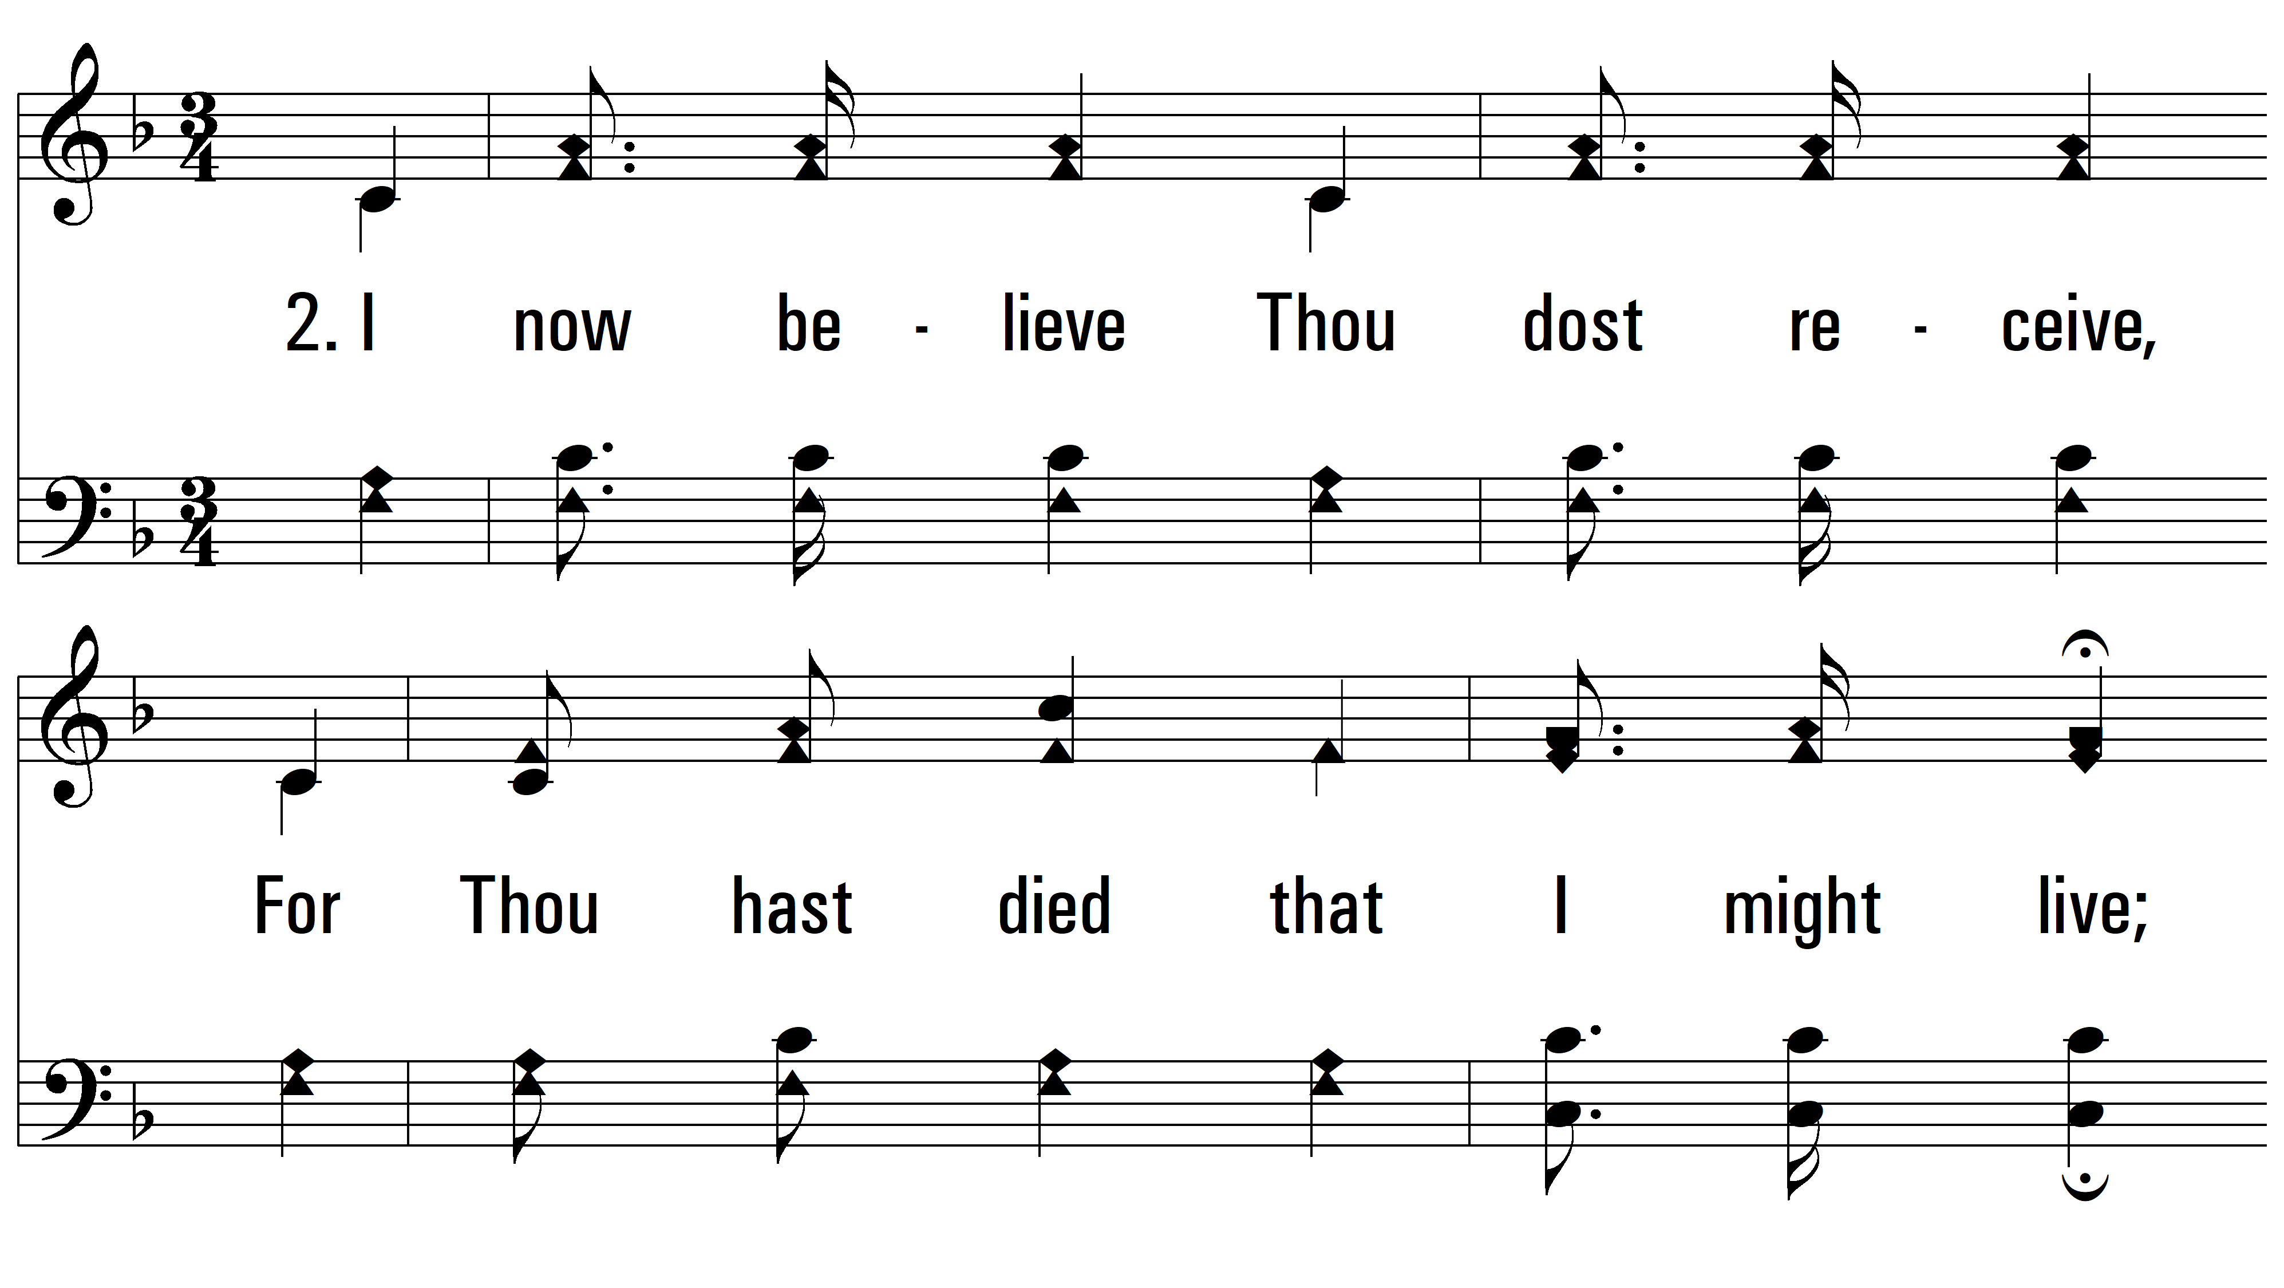
vs. 2 ~ I'll Live For Him

Slide 7
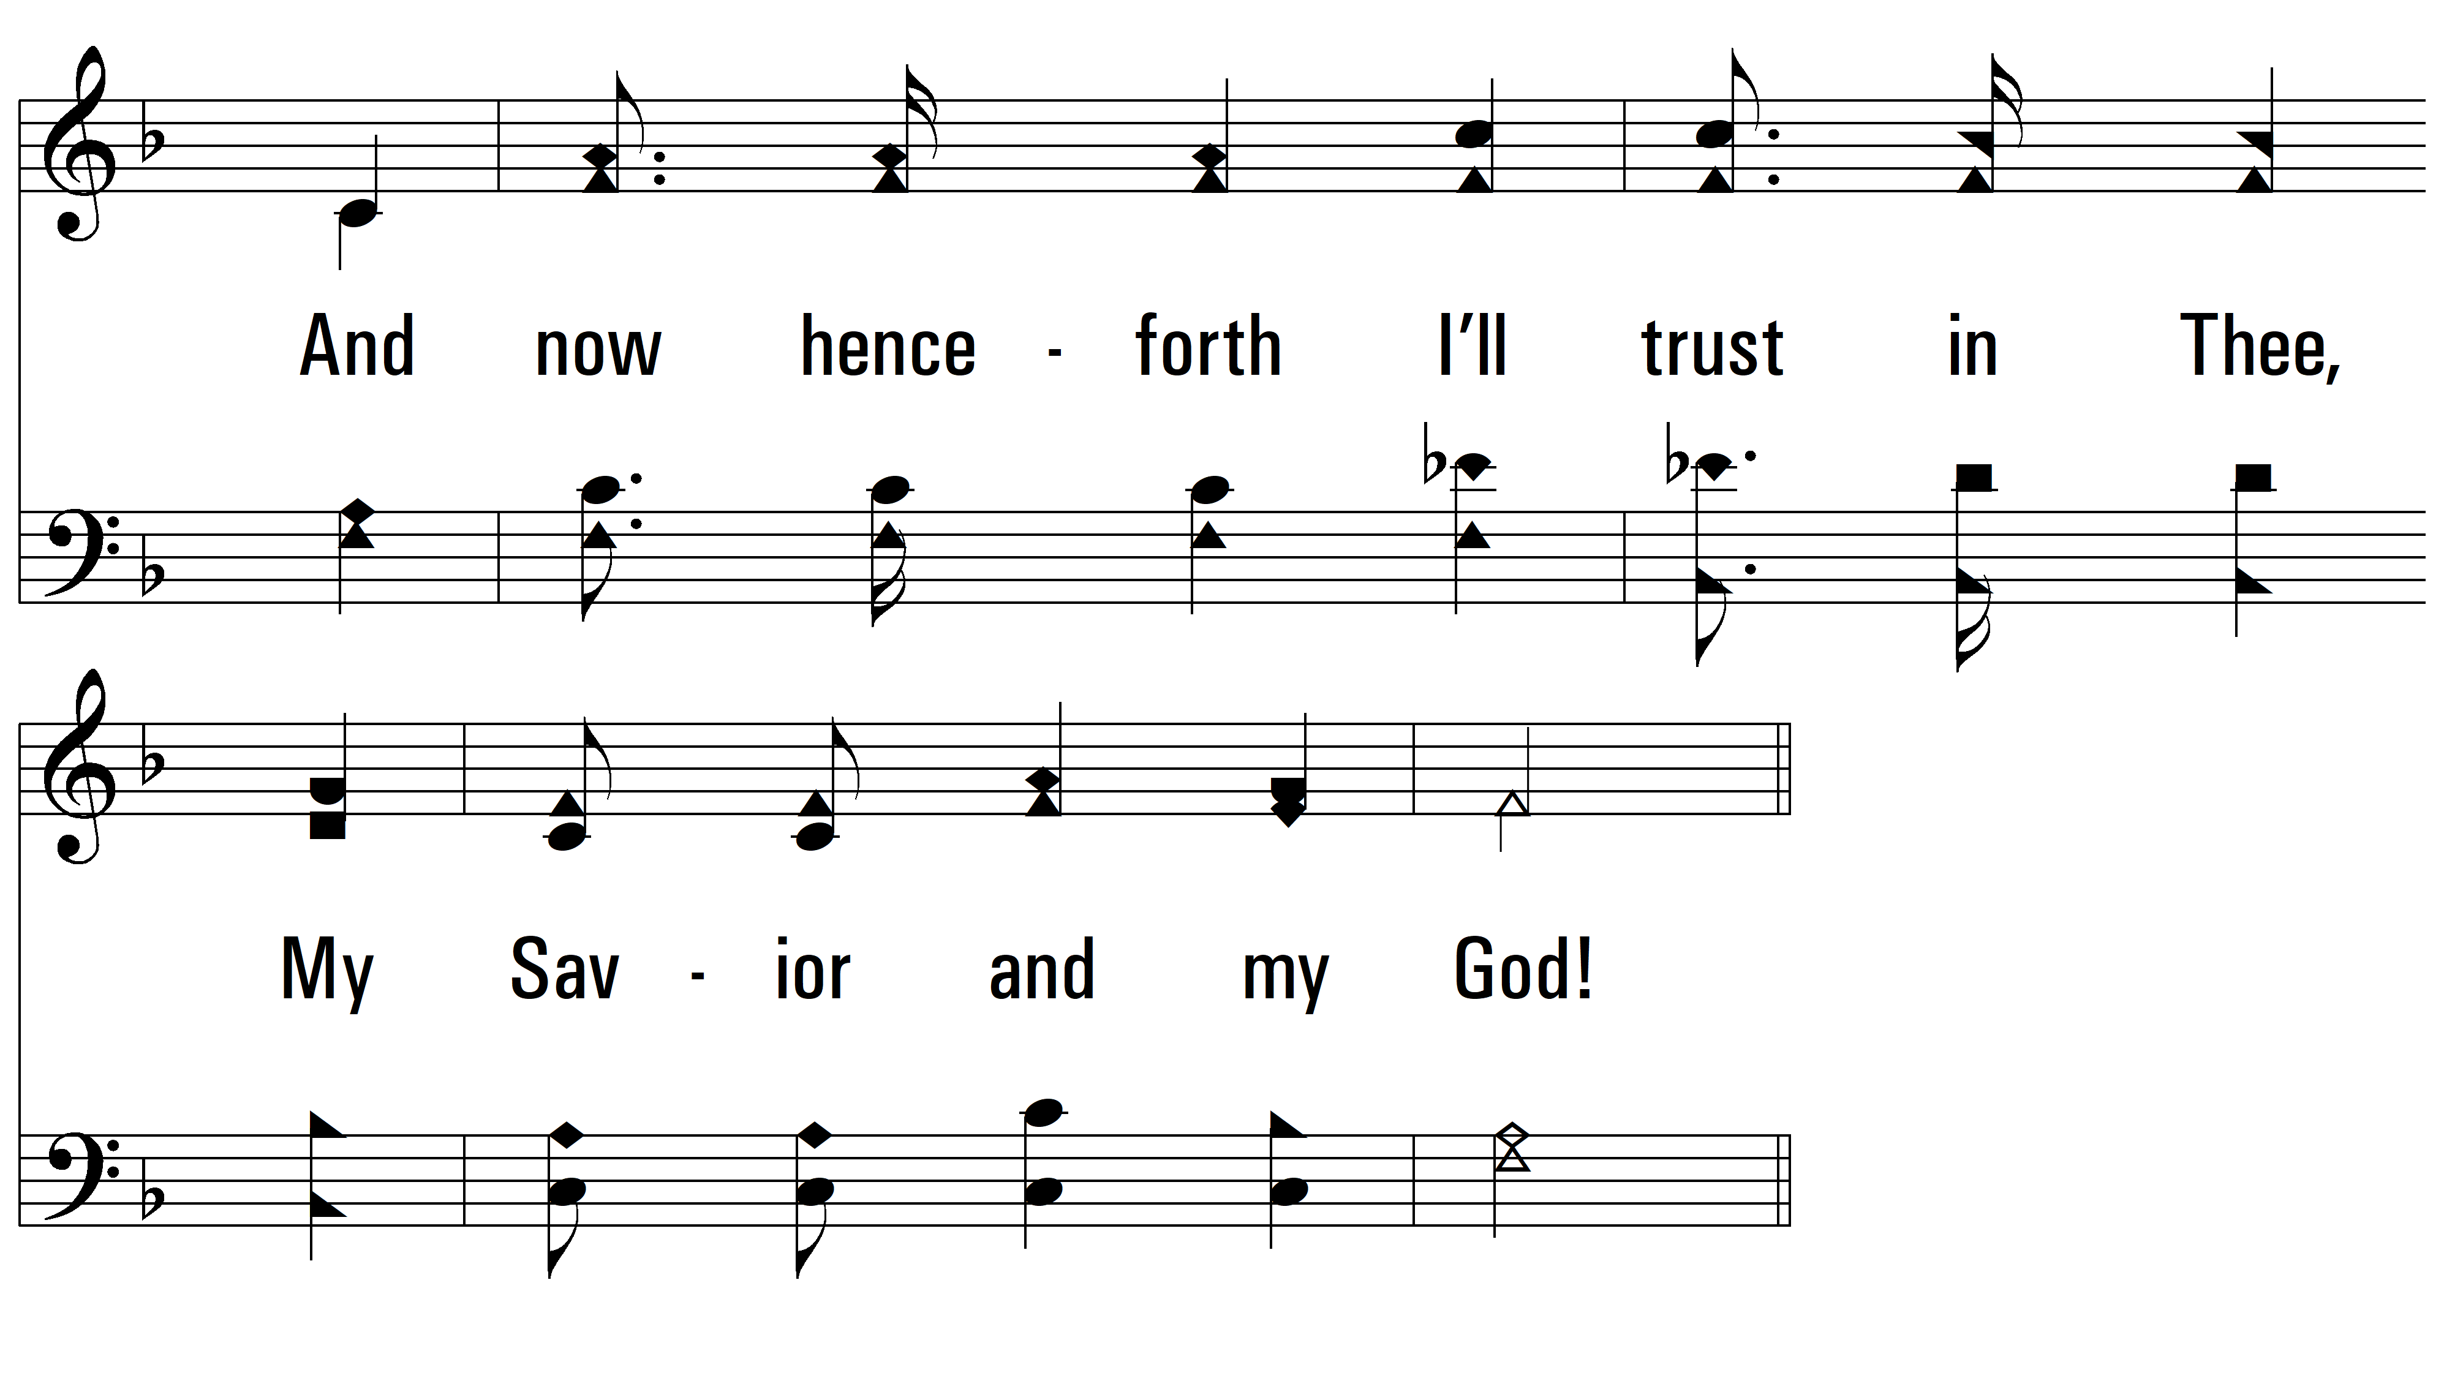
vs. 2

Slide 8
vs. 2

Slide 9
vs. 2
PDHymns.com
END

