Slide 1
If I Have Wounded Any Soul
(An Evening Prayer)
Words: | C. Maude Battersby (c. 1895), Arr. by Charles H. Gabriel (1911)
Music: | Charles H. Gabriel (1911)
4/4
A/E - SOL
Verses: 4
Lead - | SOL
Alto - | MI
Tenor - | DO
Bass - | DO
PDHymns.com

Slide 2
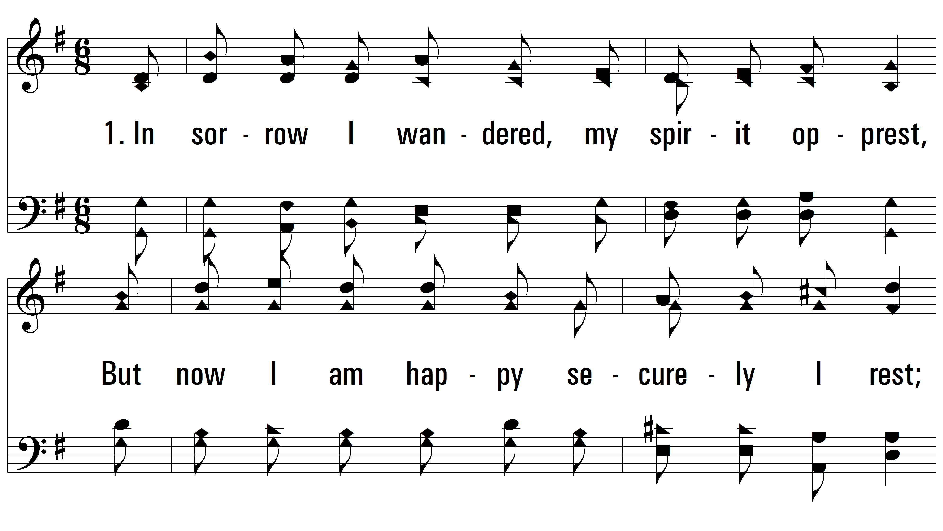
vs. 1 ~ If I Have Wounded Any Soul

Slide 3
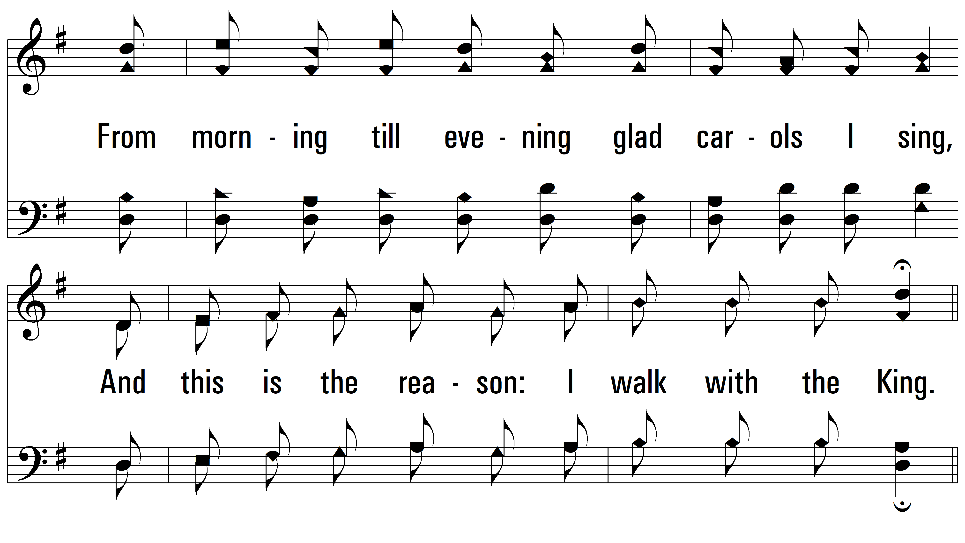
vs. 1

Slide 4
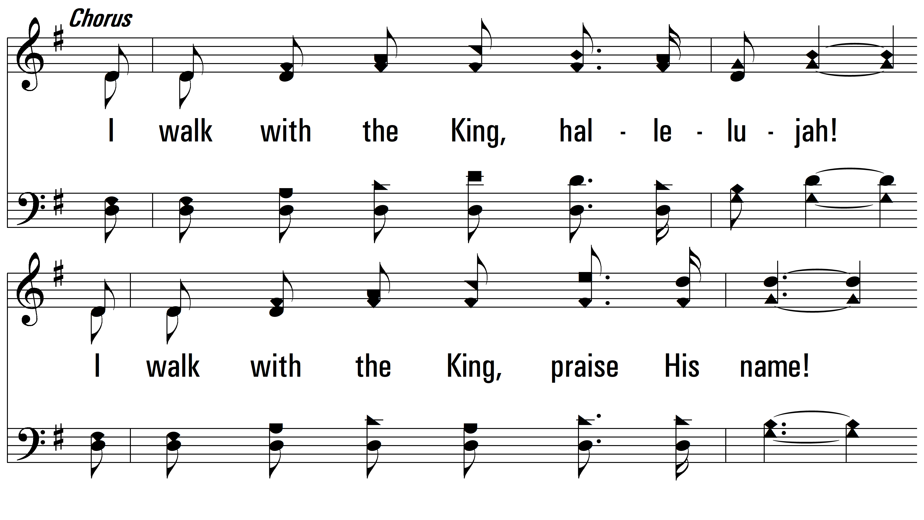
vs. 1

Slide 5
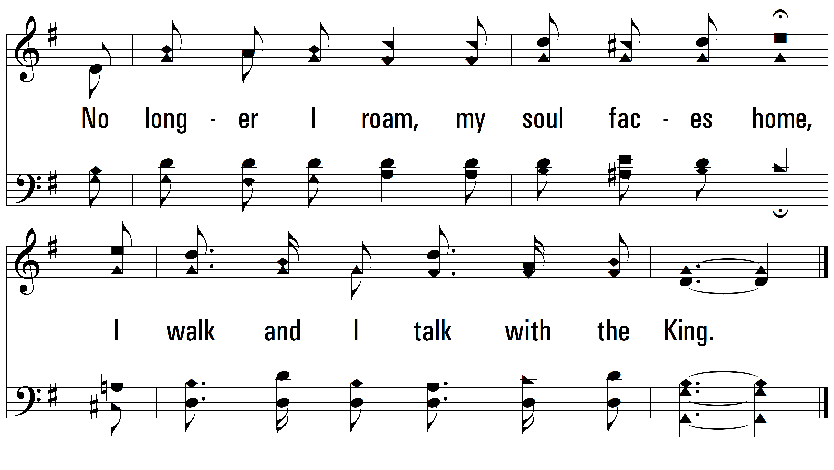
vs. 1

Slide 6
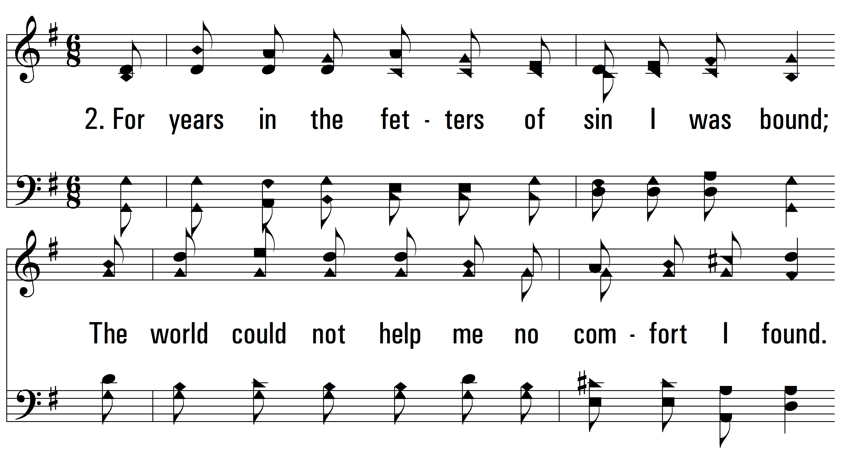
vs. 2 ~ If I Have Wounded Any Soul

Slide 7
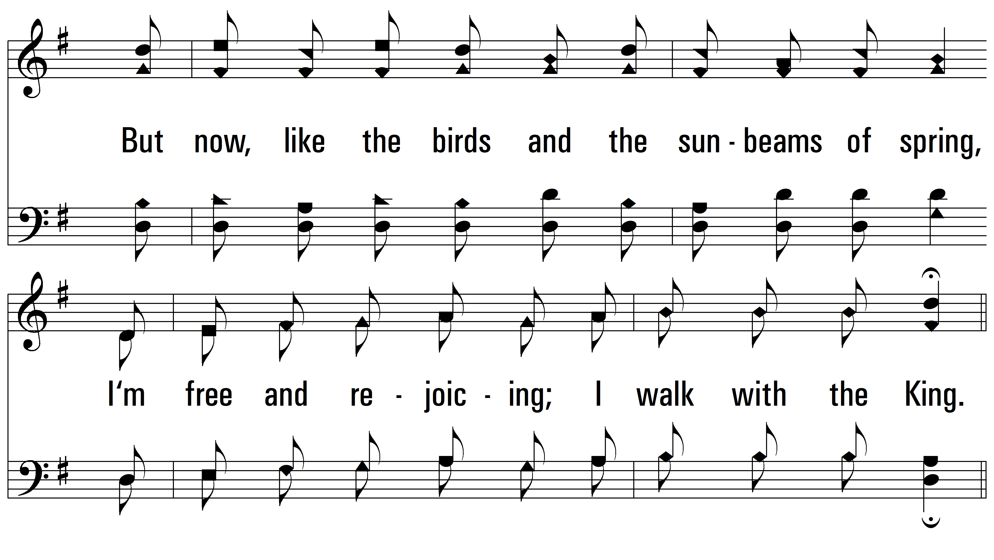
vs. 2

Slide 8
vs. 2

Slide 9
vs. 2

Slide 10
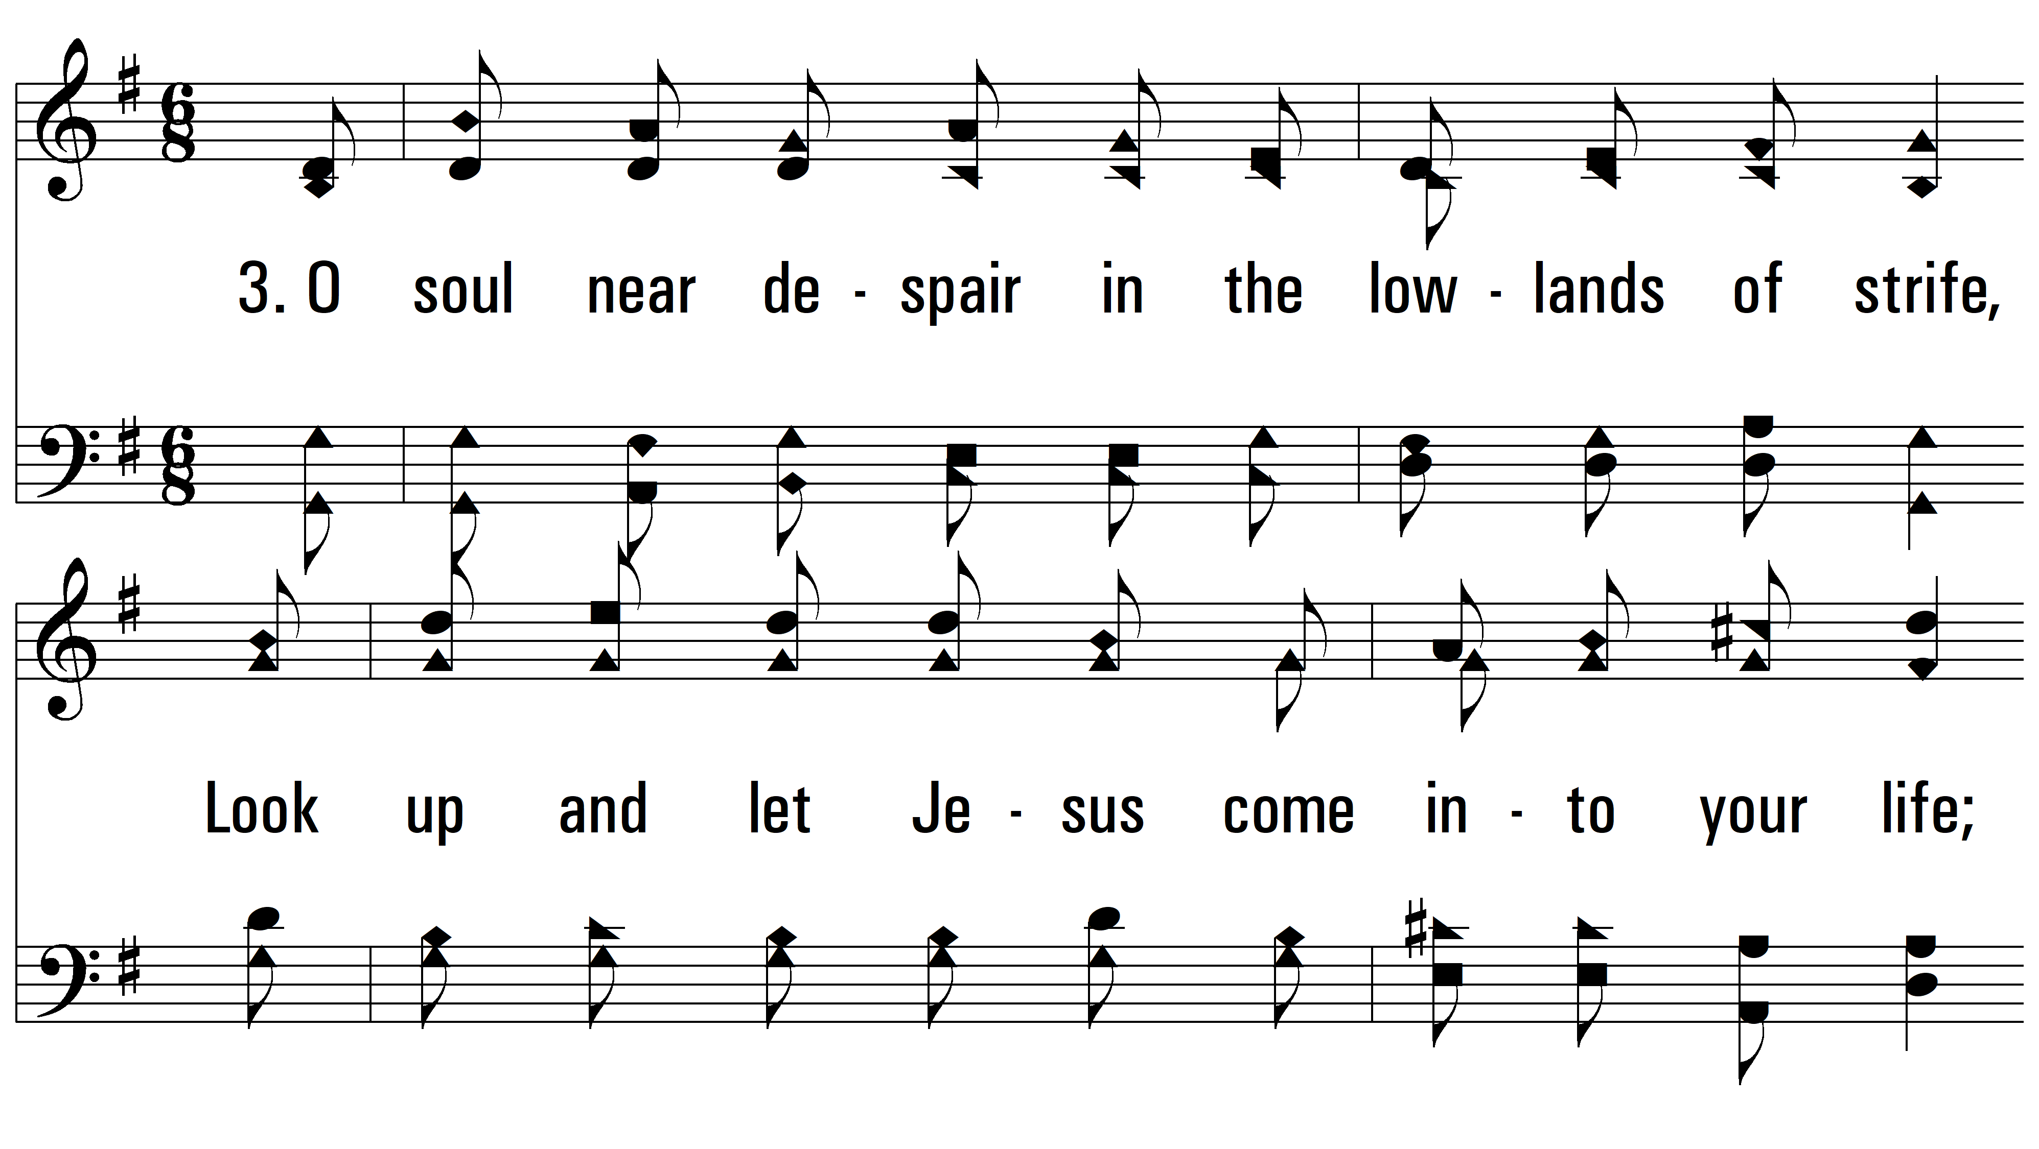
vs. 3~ If I Have Wounded Any Soul

Slide 11
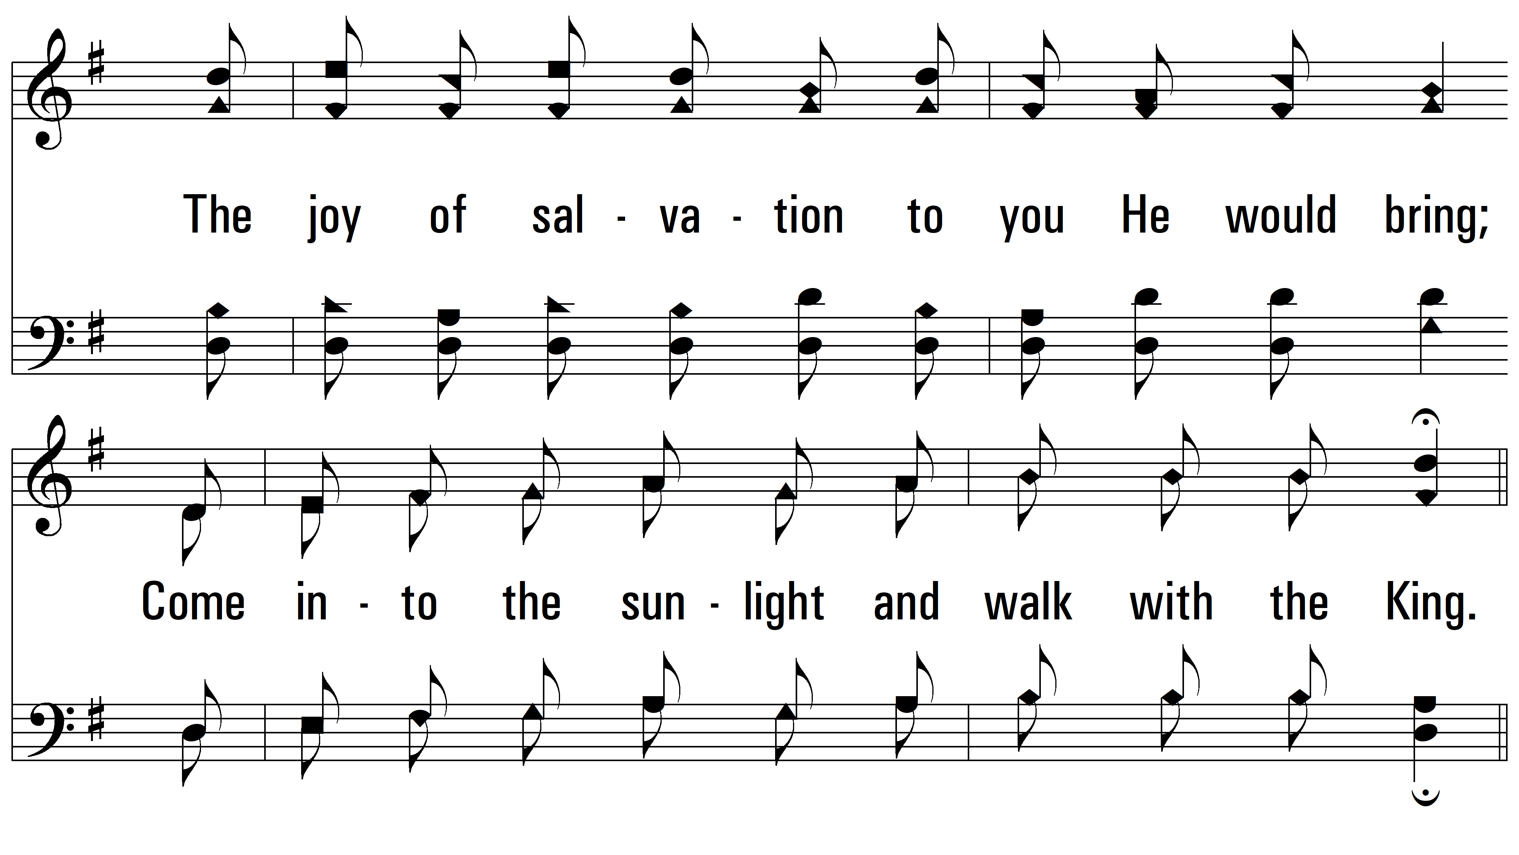
vs. 3

Slide 12
vs. 3

Slide 13
vs. 3
PDHymns.com
END

