Slide 1
I Will Sing The Wondrous Story
Words: | Francis H. Rowley (1886), Arr. Ira D. Snakey (1887)
Music: | Peter P. Bilhorn (1886)
3/4
E^{b}/G - MI
Verses: 5/Chorus
Lead - | MI
Alto - | DO
Tenor - | SOL
Bass - | DO
PDHymns.com

Slide 2
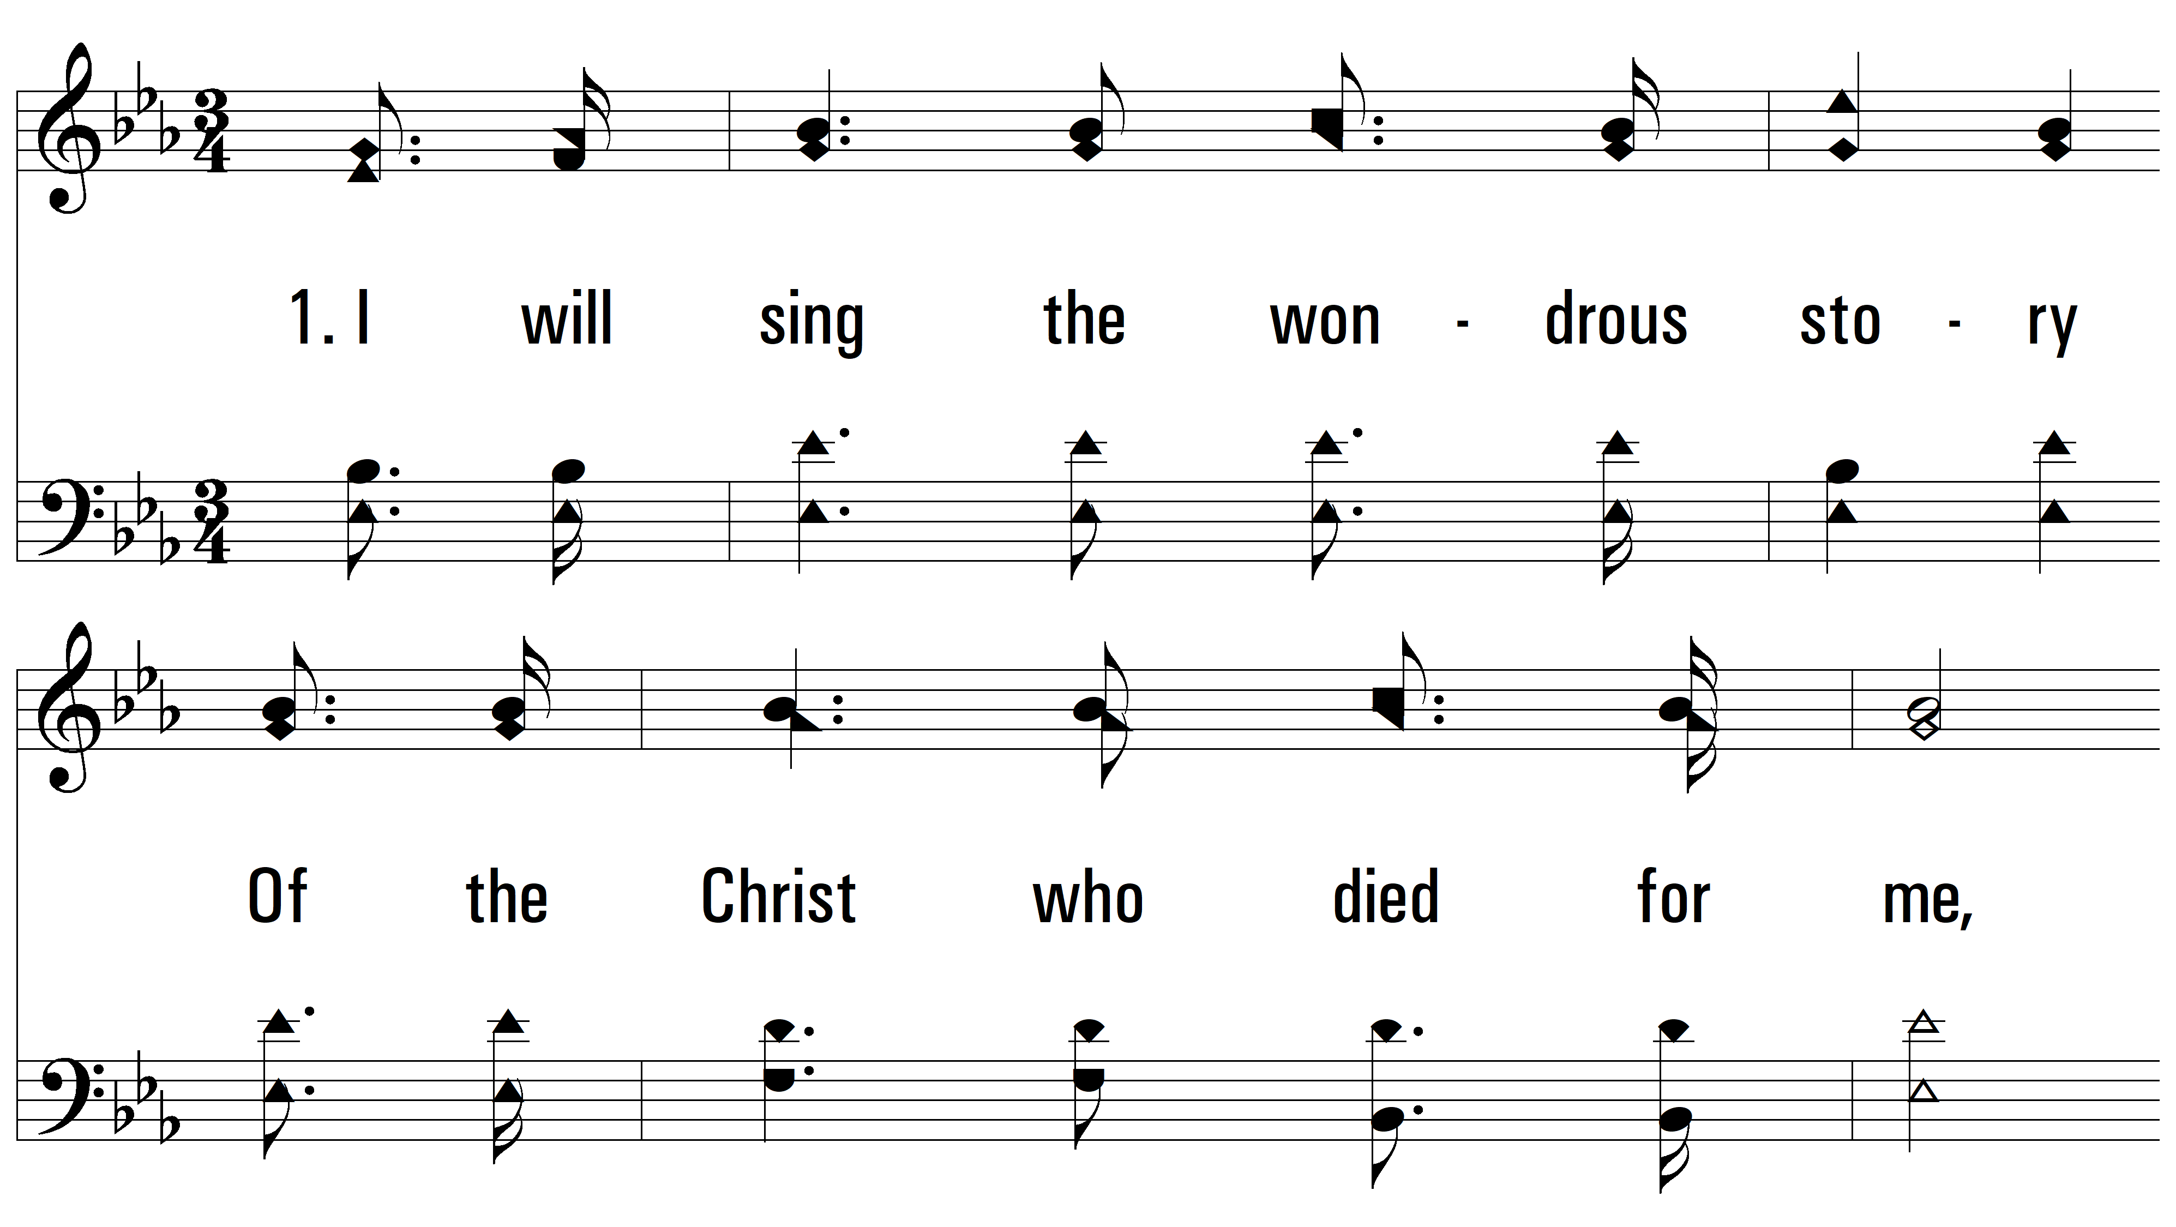
vs. 1 ~ I Will Sing The Wondrous Story

Slide 3
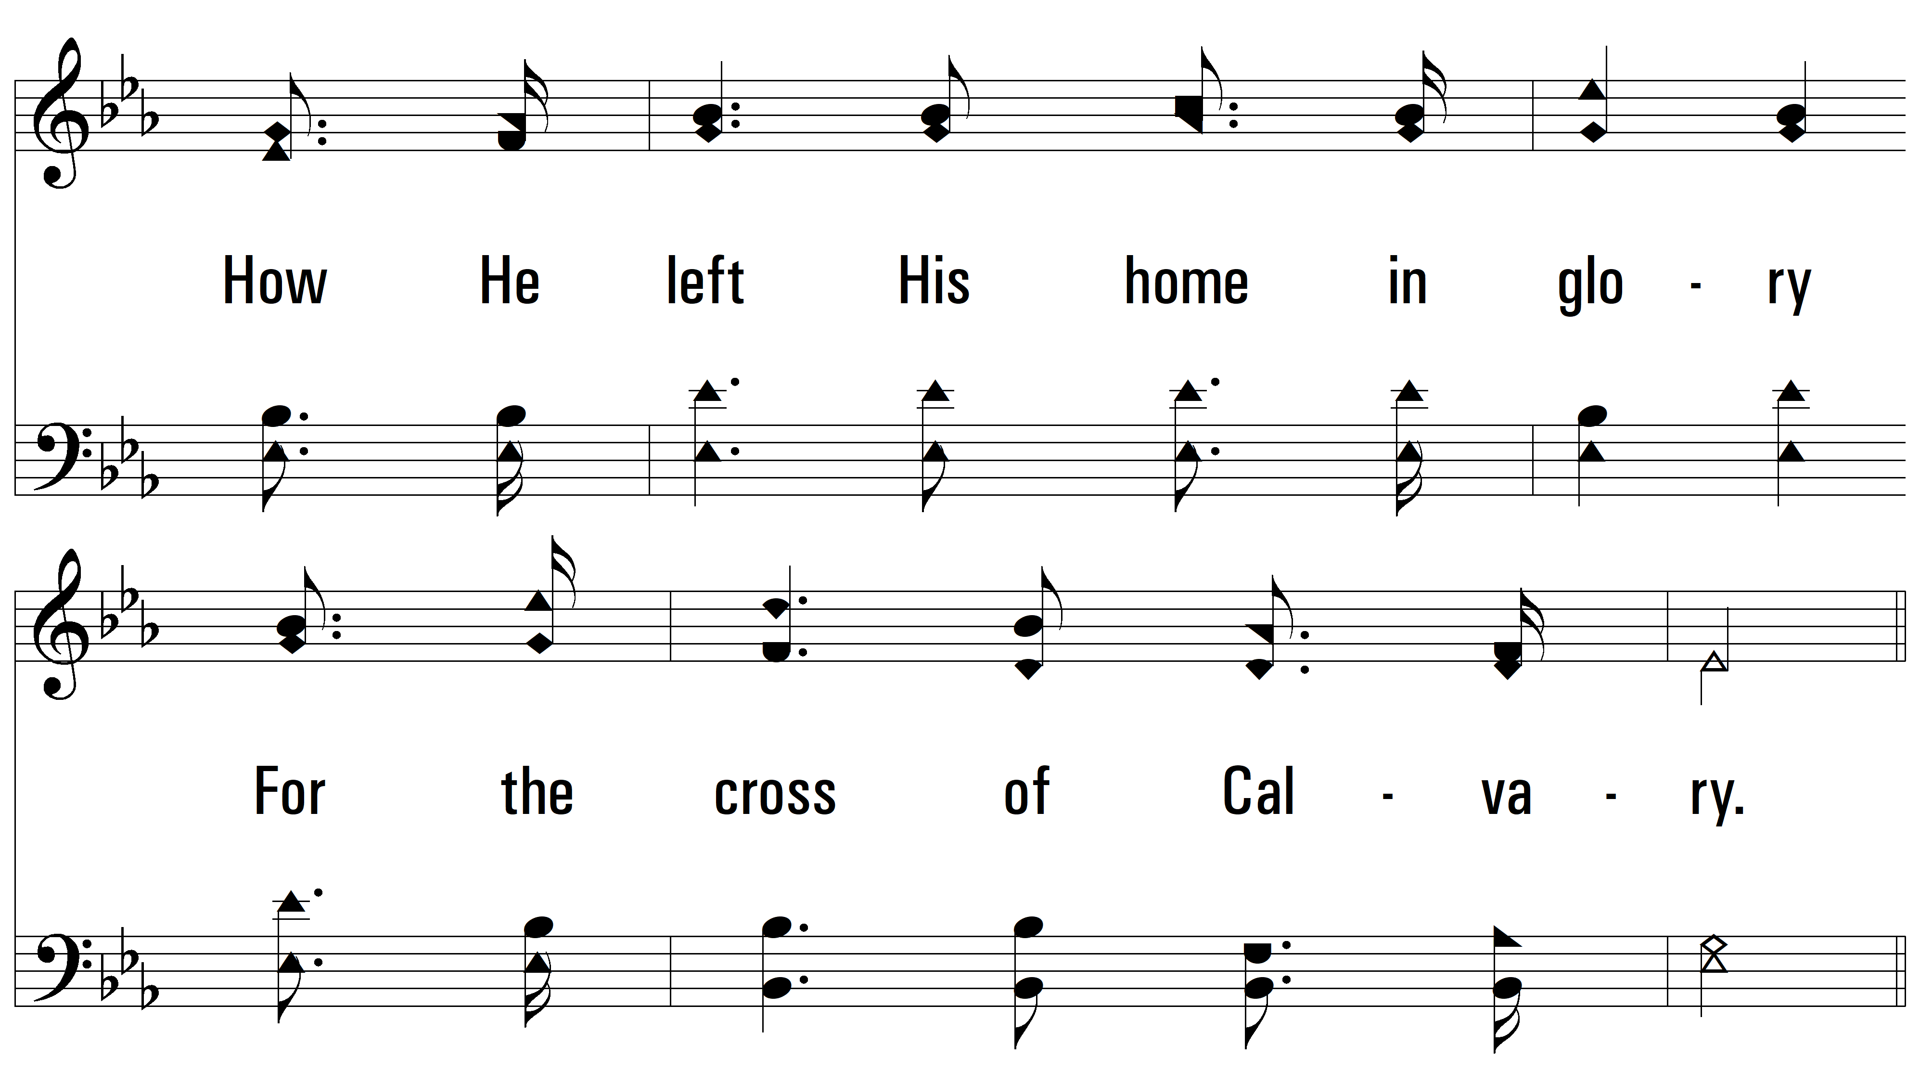
vs. 1

Slide 4
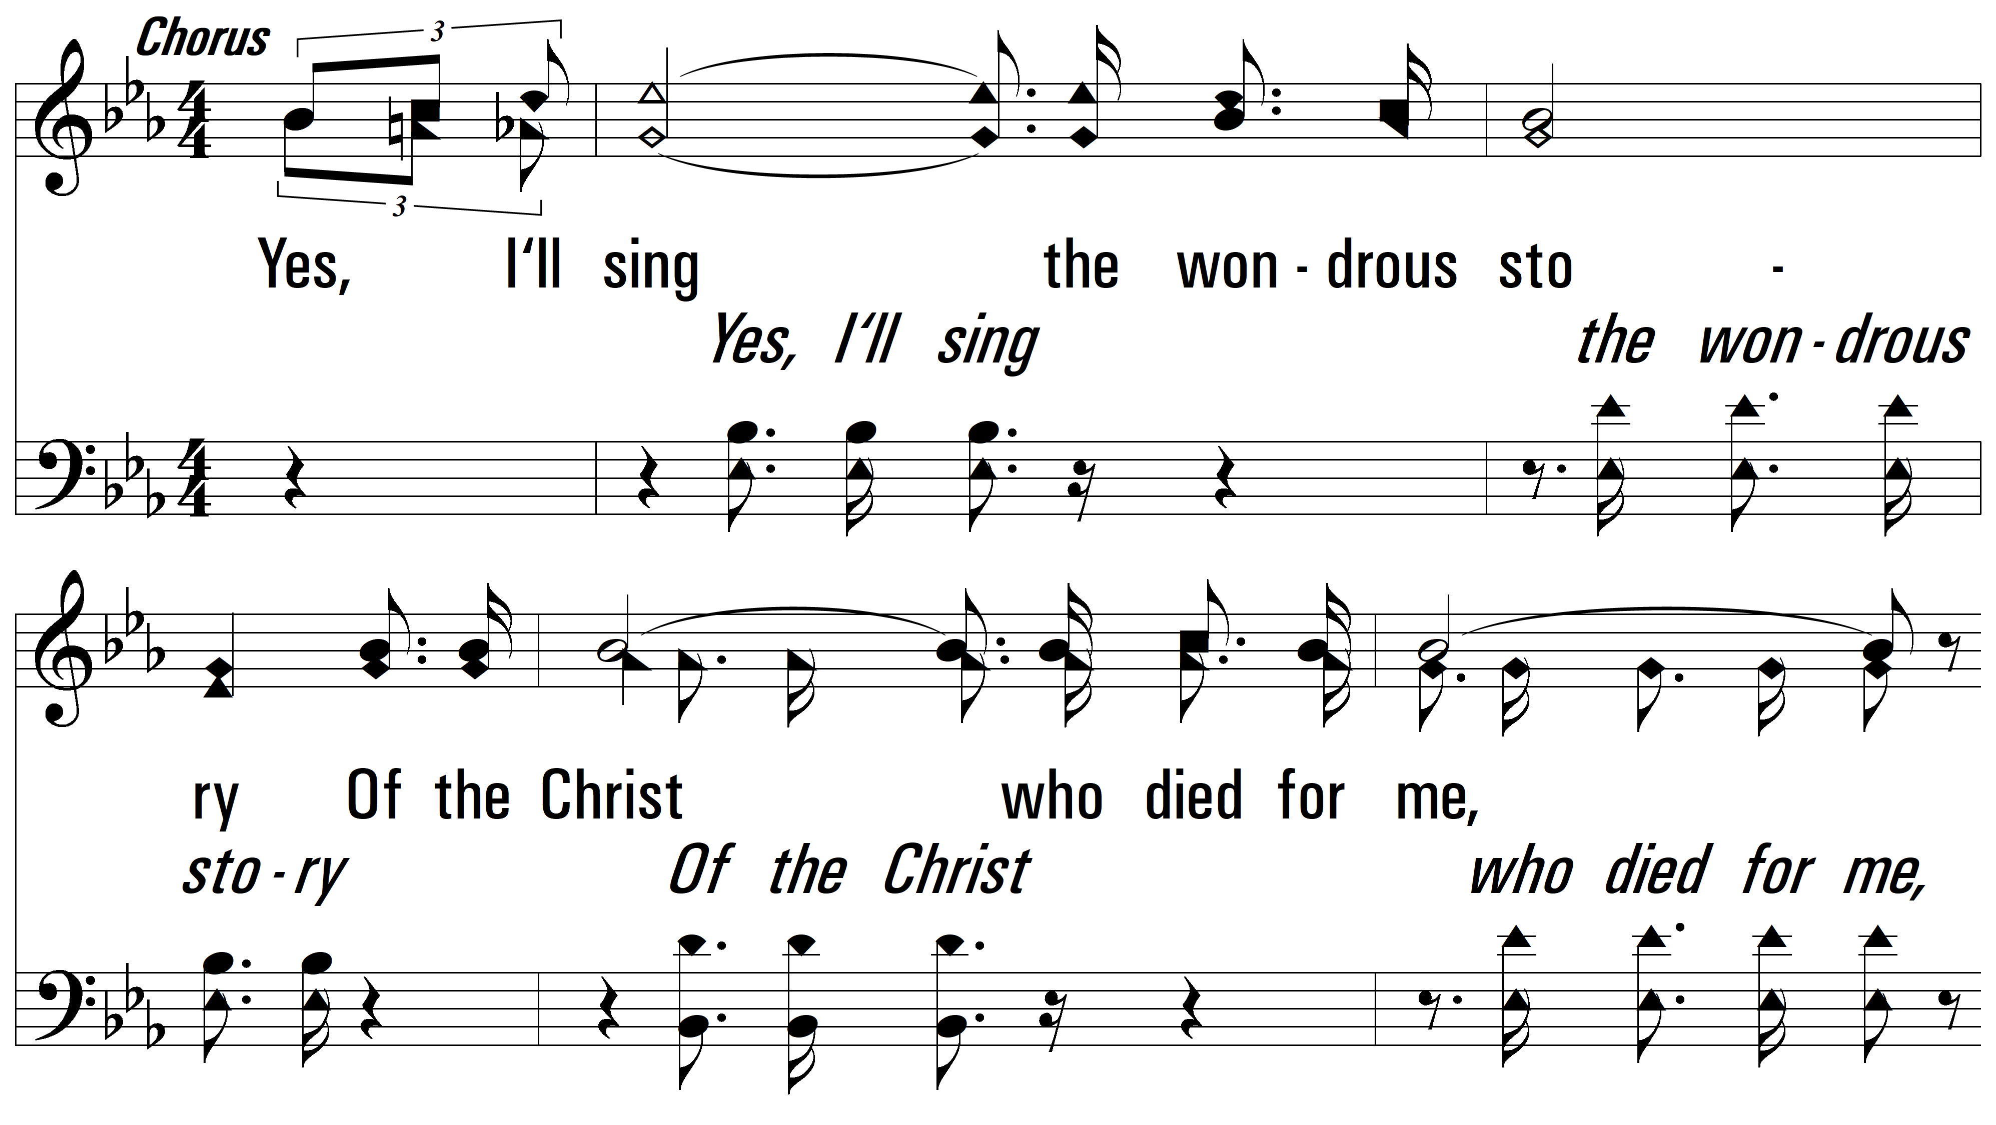
vs. 1

Slide 5
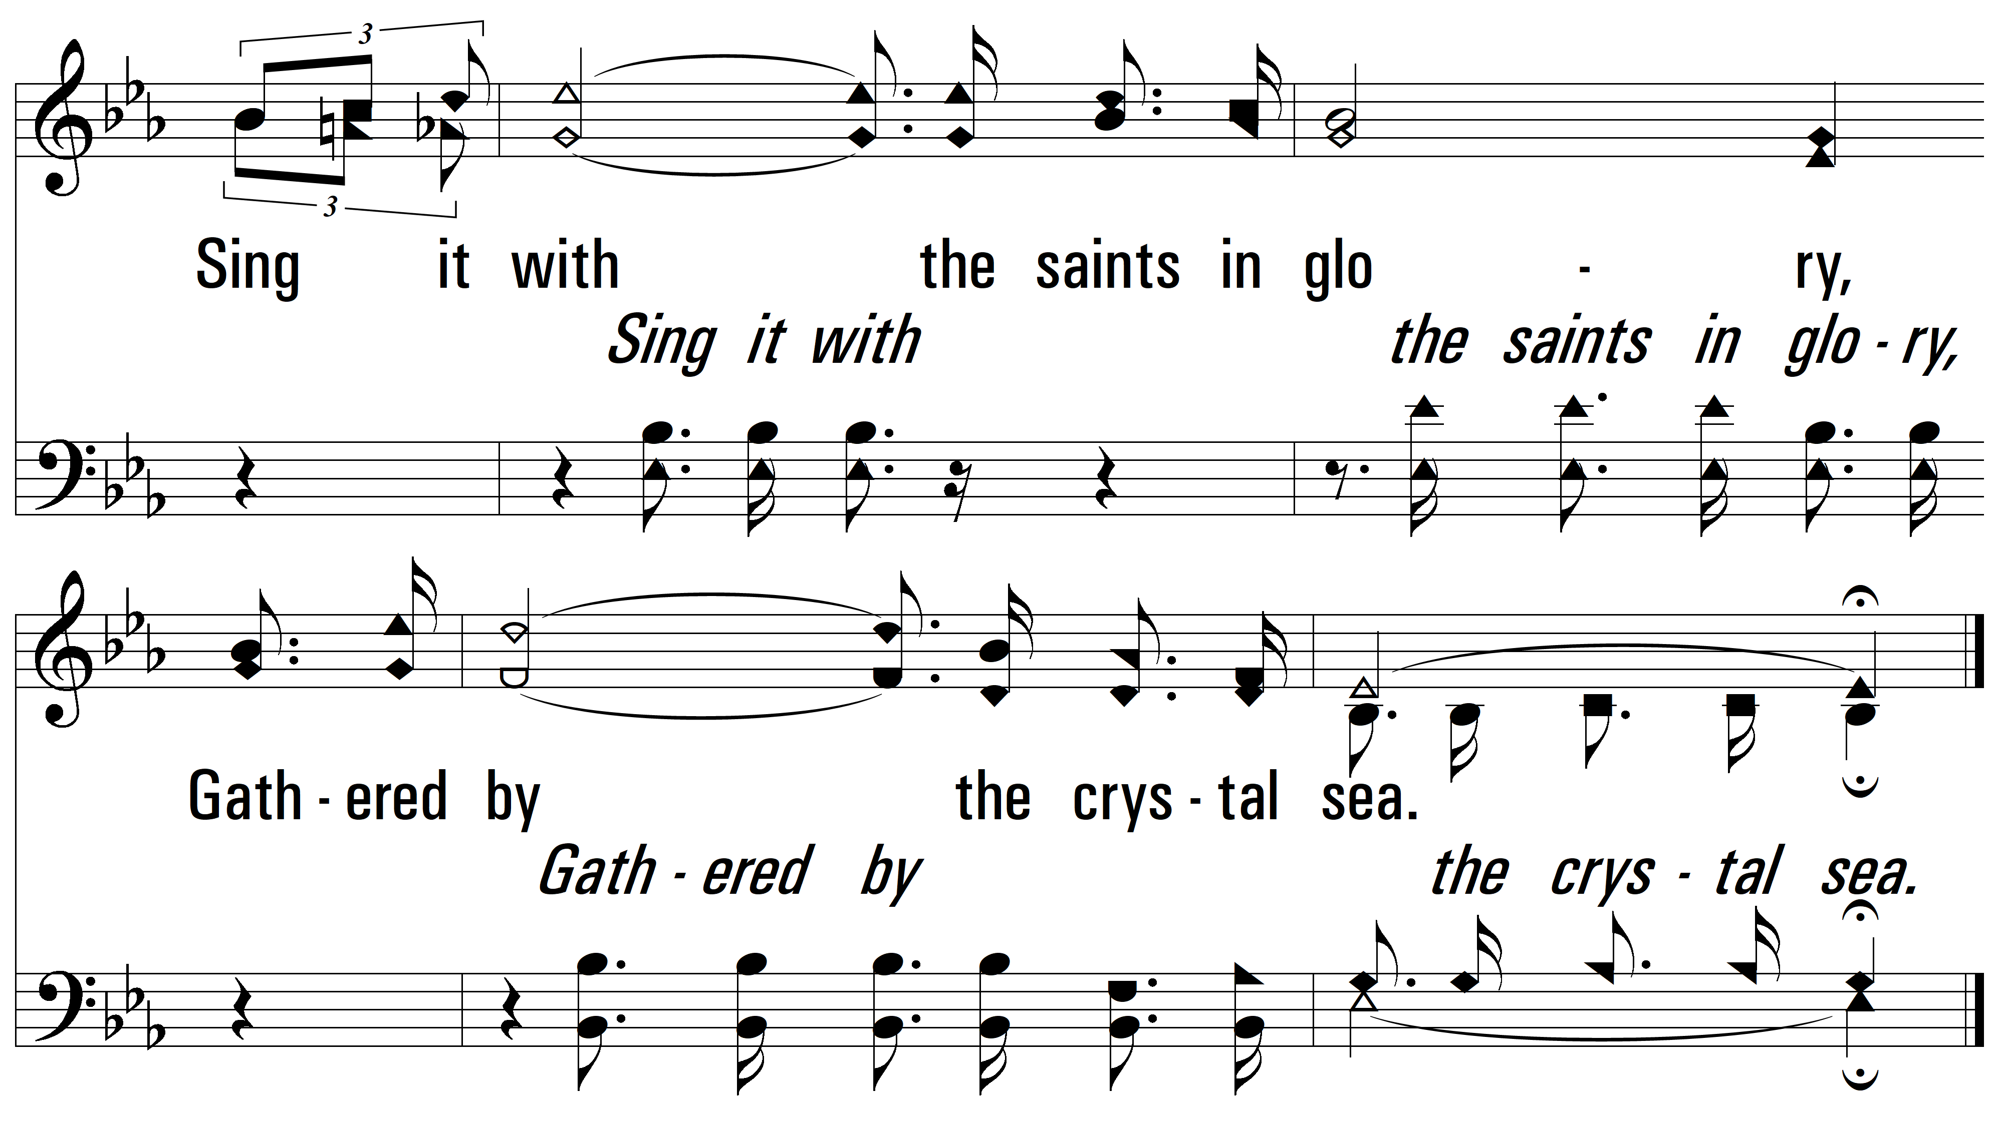
vs. 1

Slide 6
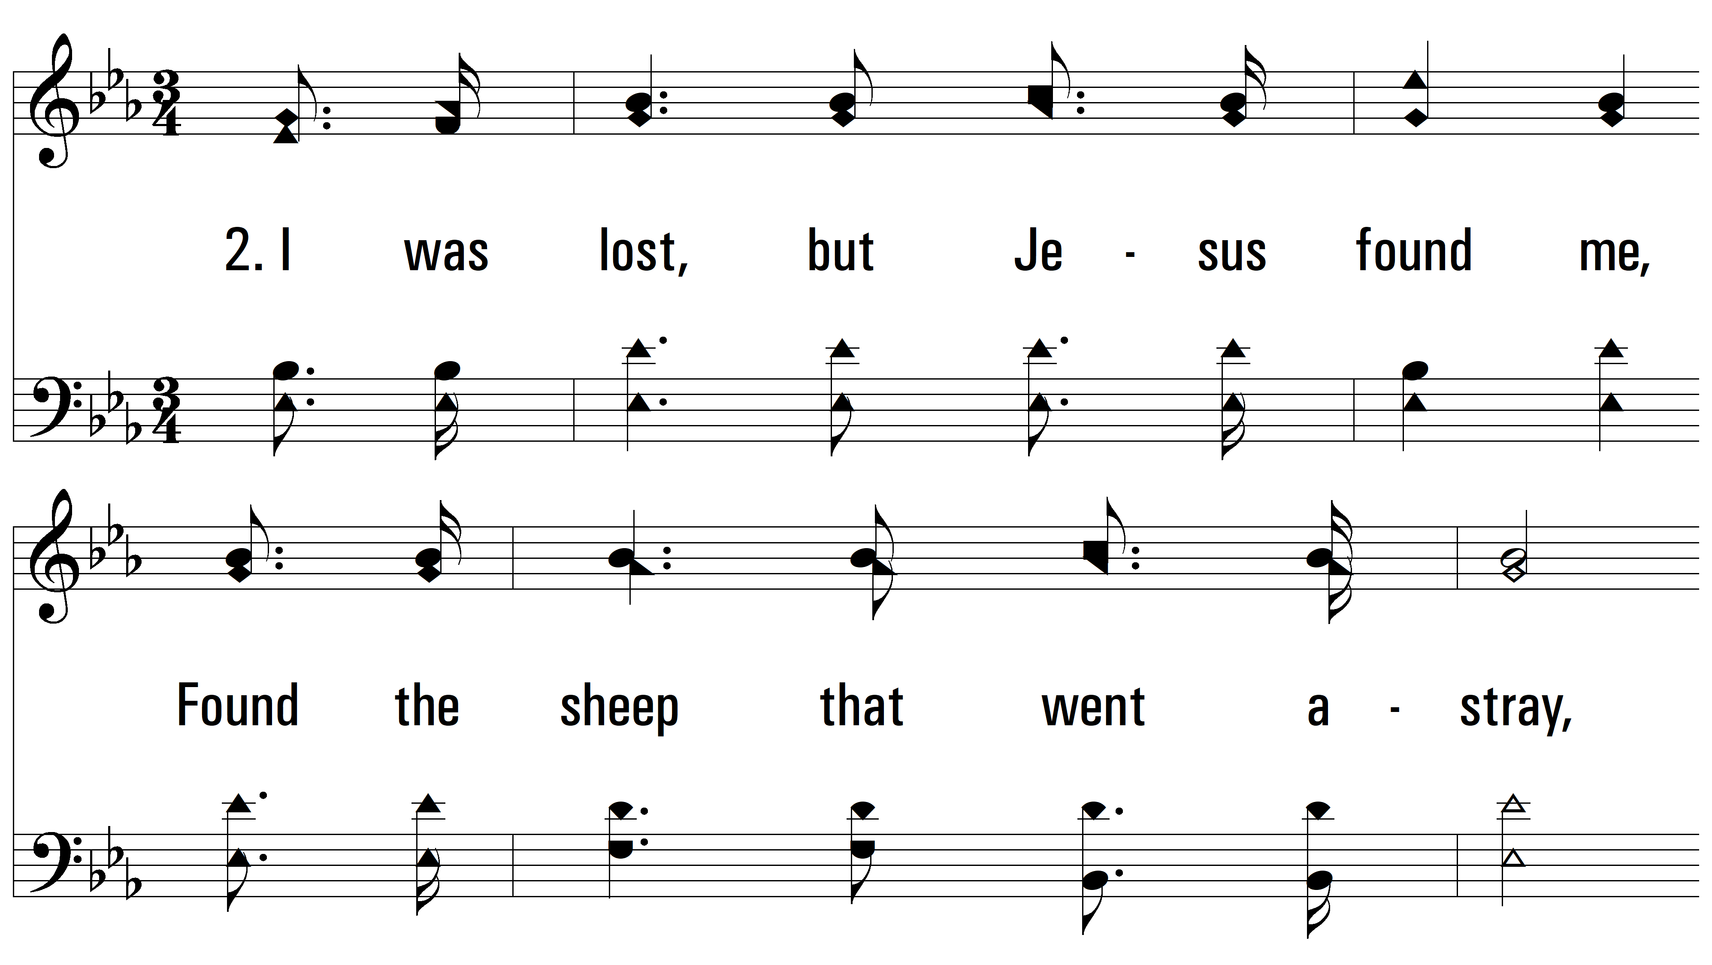
vs. 2 ~ I Will Sing The Wondrous Story

Slide 7
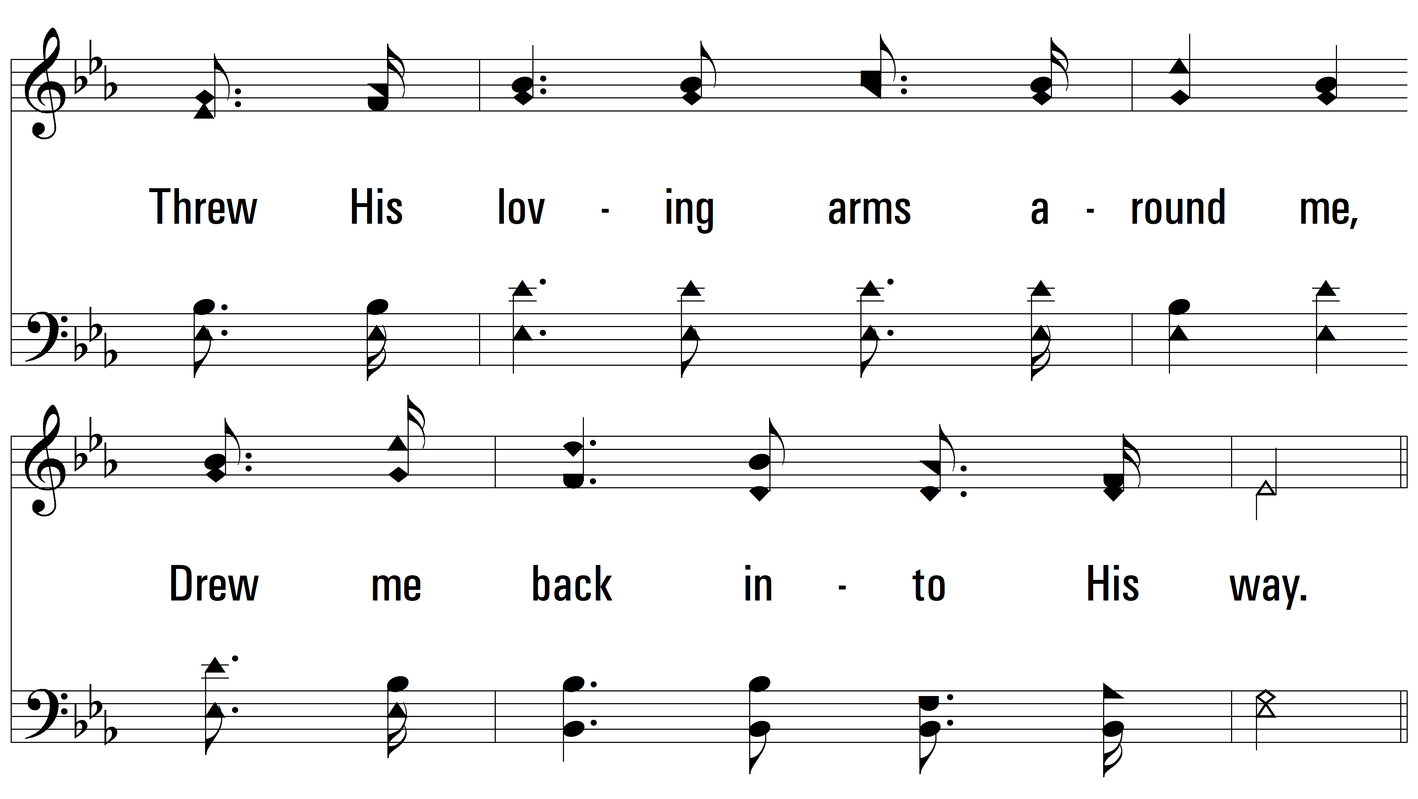
vs. 2

Slide 8
vs. 2

Slide 9
vs. 2

Slide 10
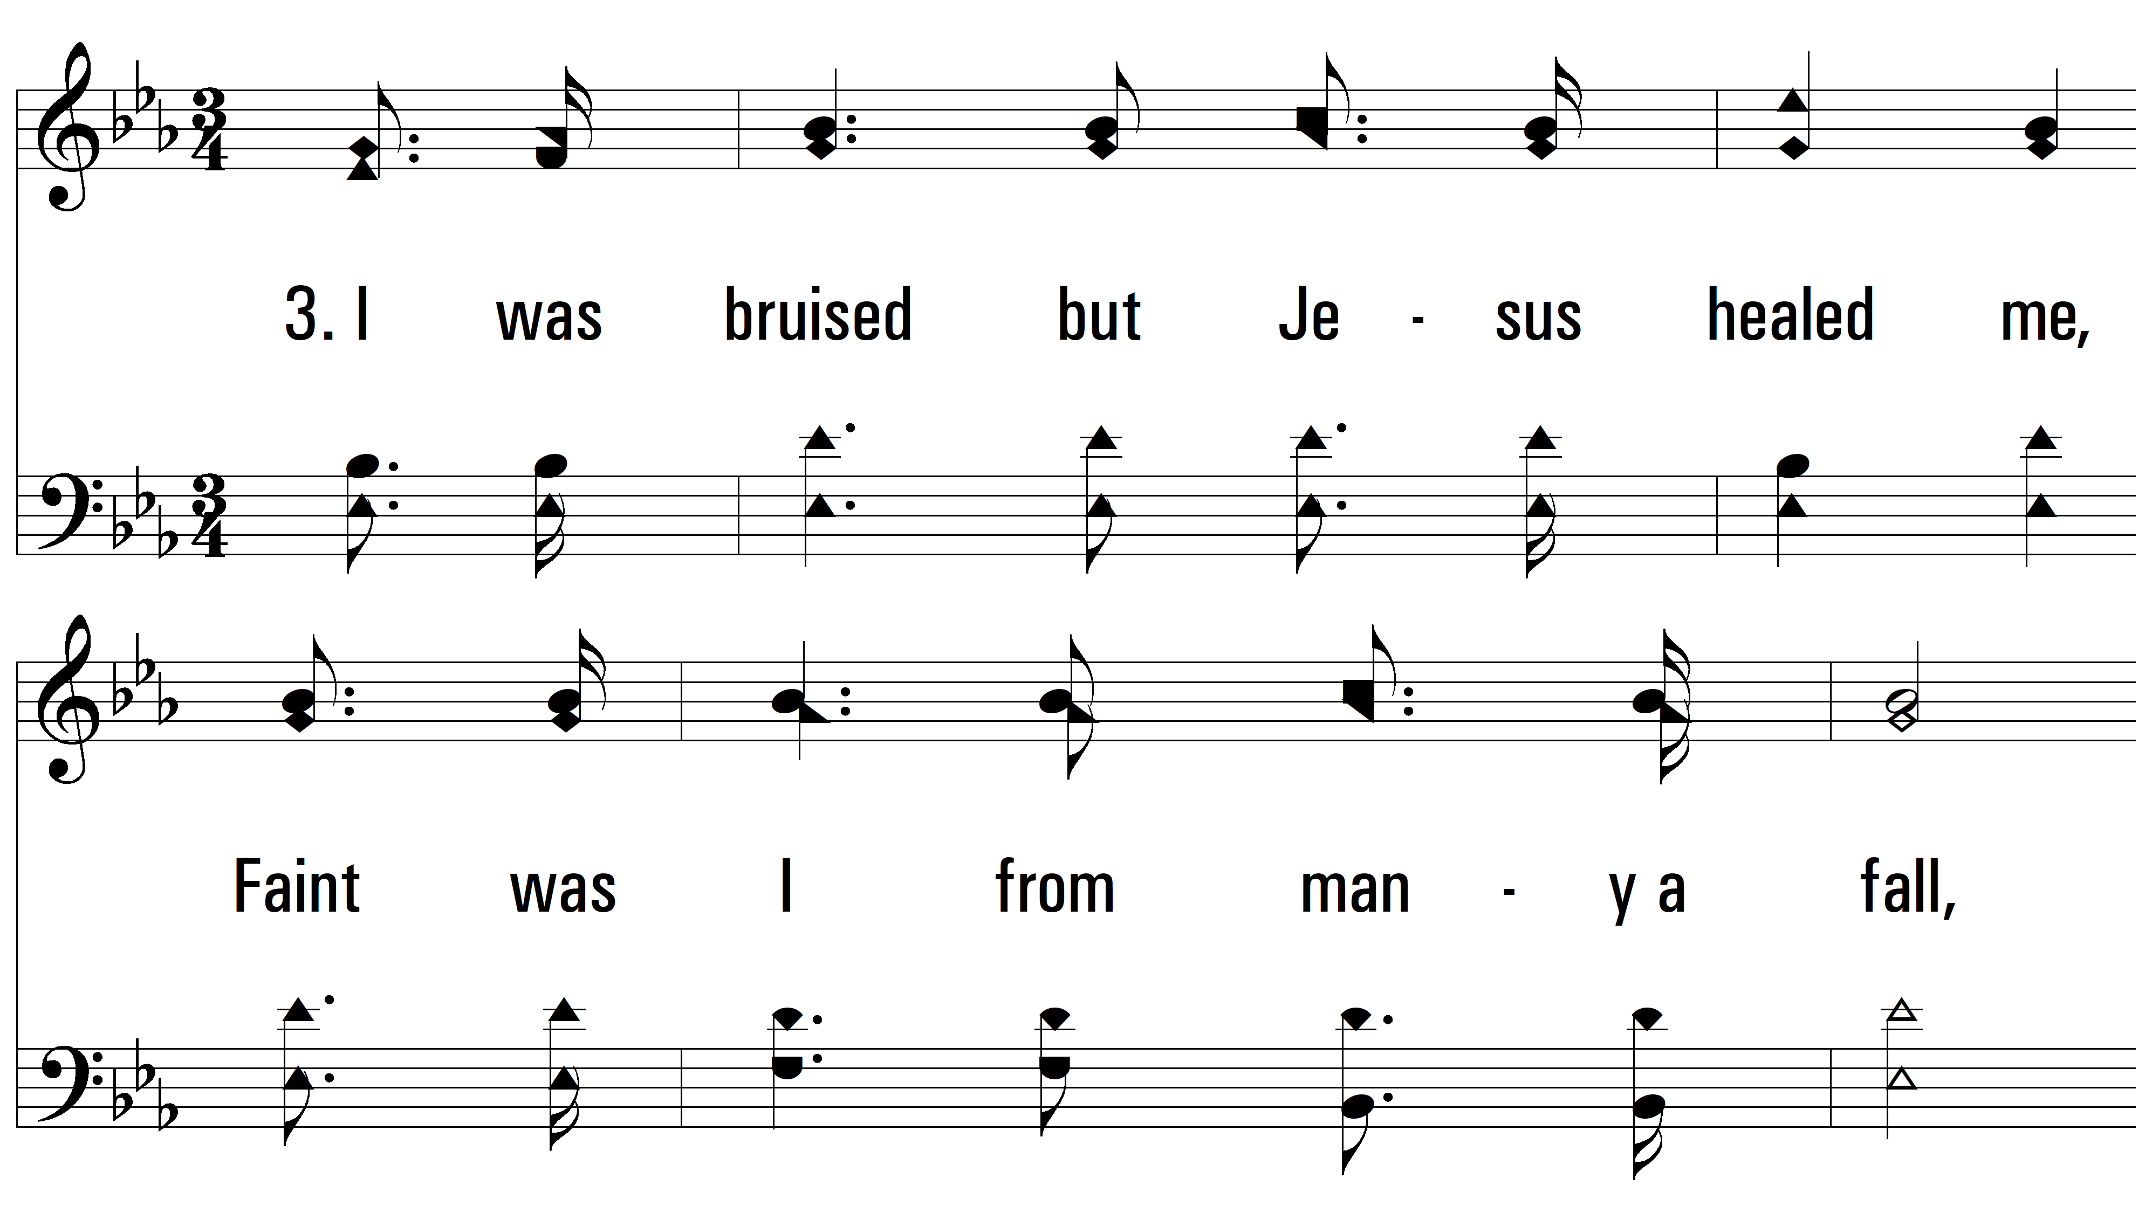
vs. 3 ~ I Will Sing The Wondrous Story

Slide 11
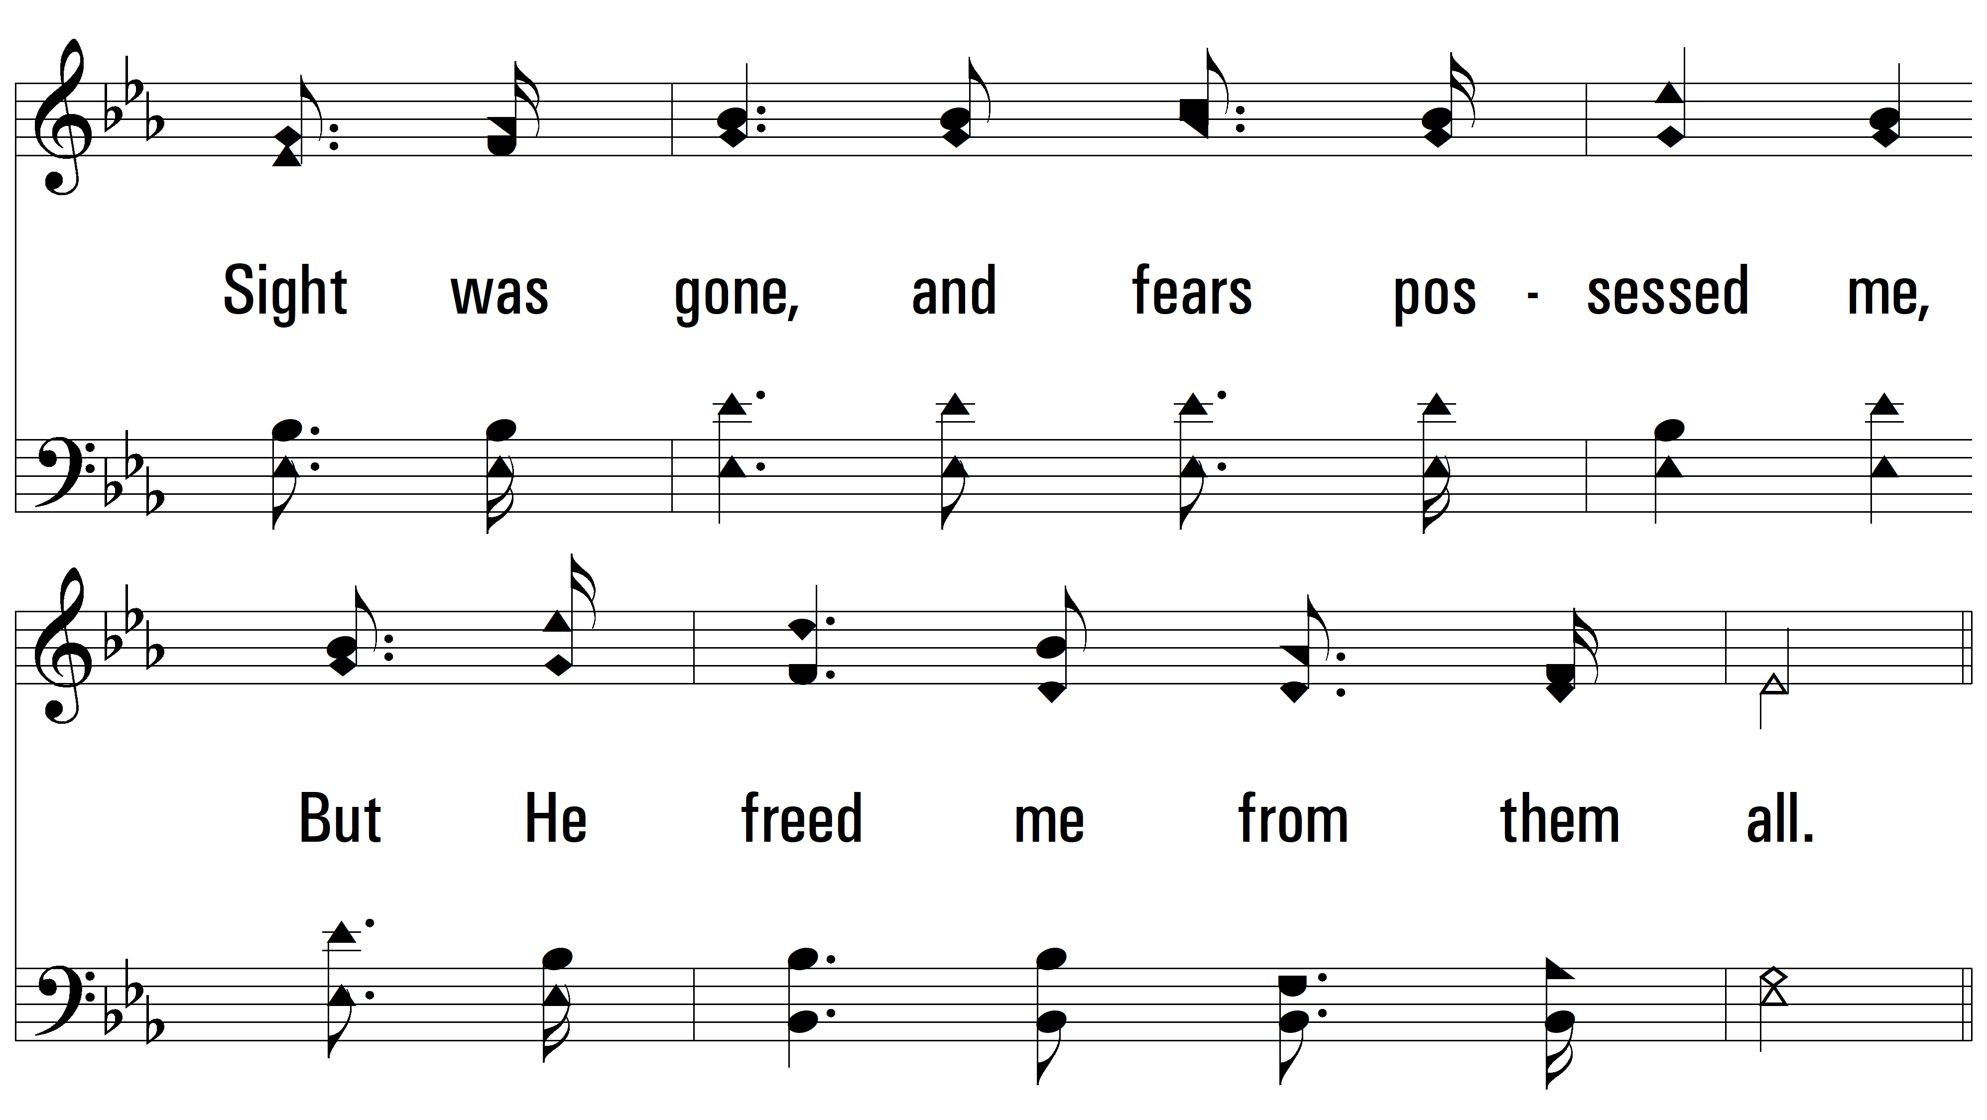
vs. 3

Slide 12
vs. 3

Slide 13
vs. 3

Slide 14
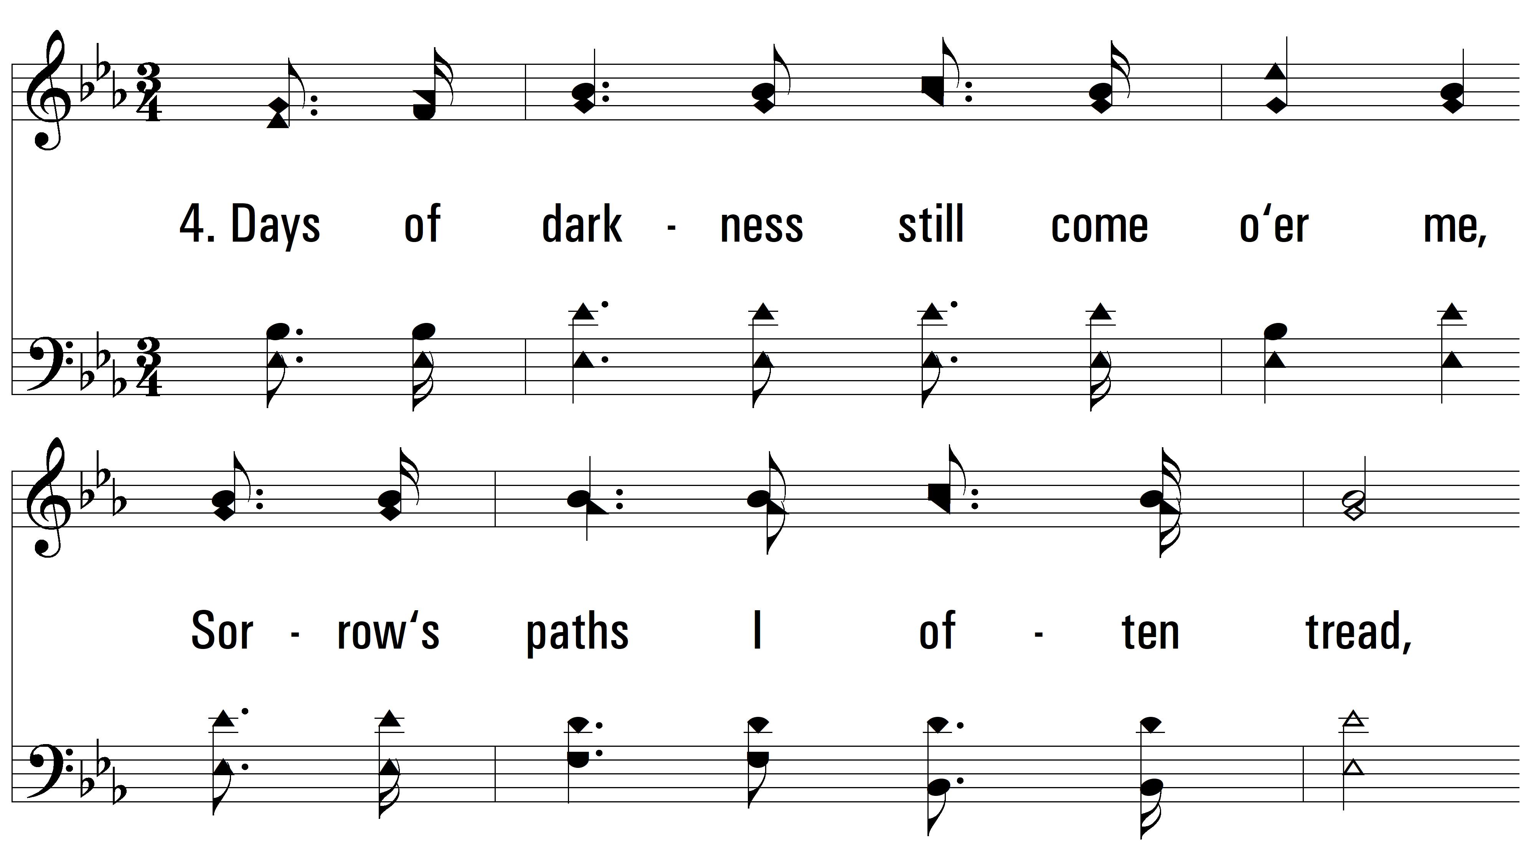
vs. 4 ~ I Will Sing The Wondrous Story

Slide 15
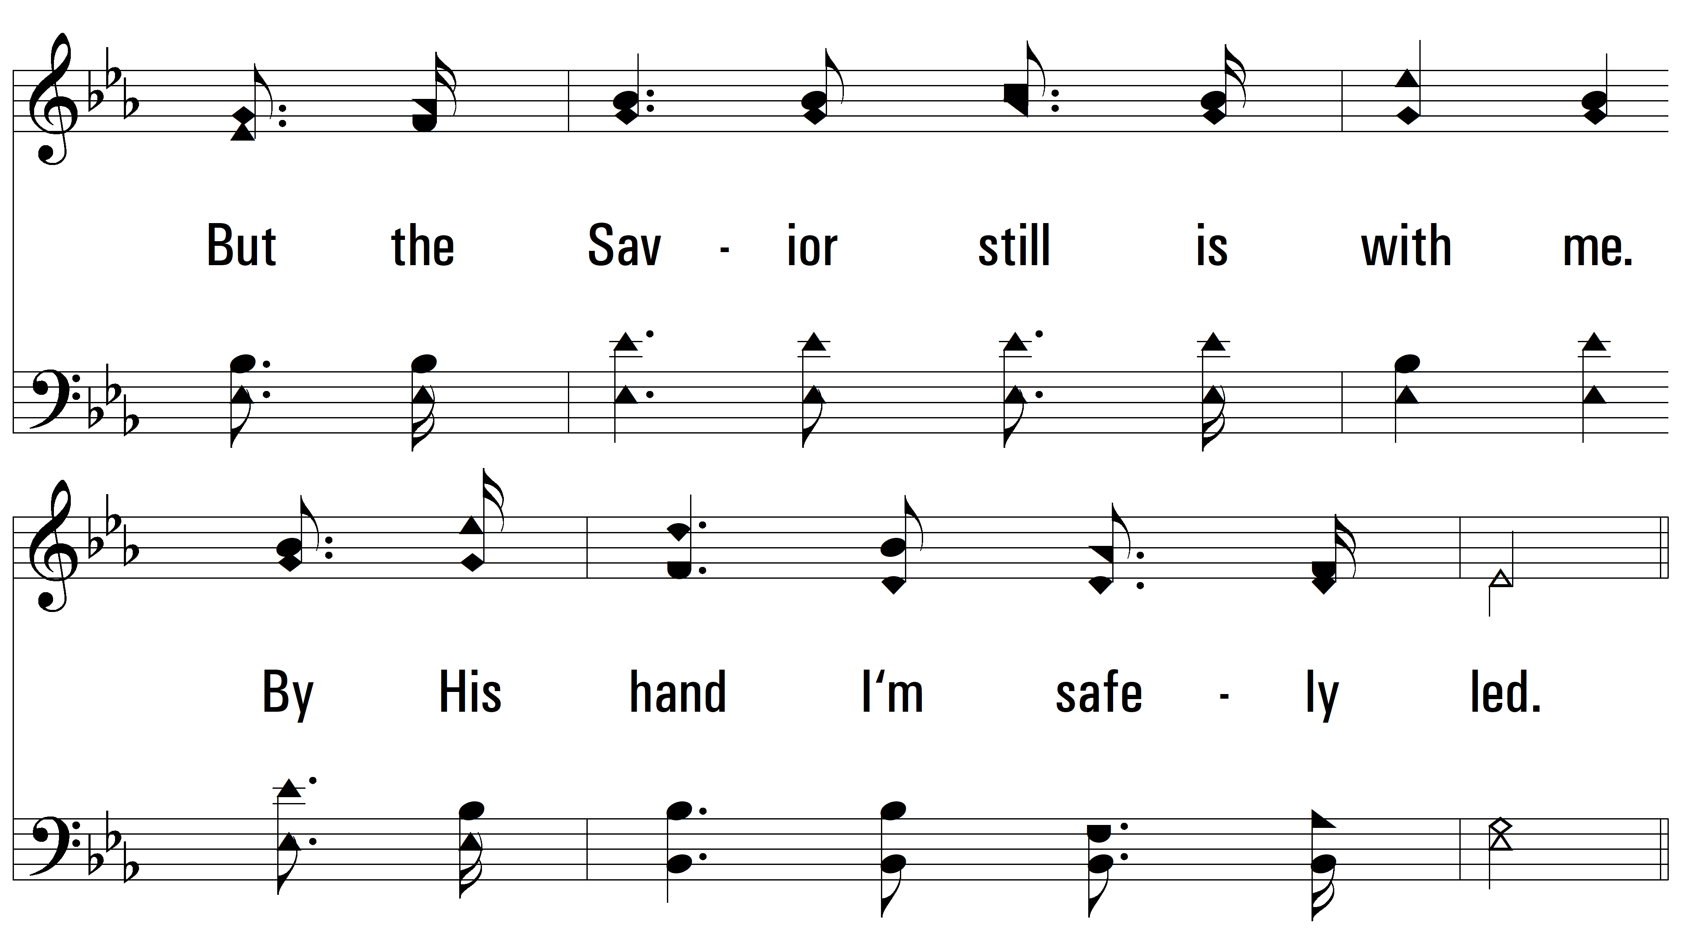
vs. 4

Slide 16
vs. 4

Slide 17
vs. 4

Slide 18
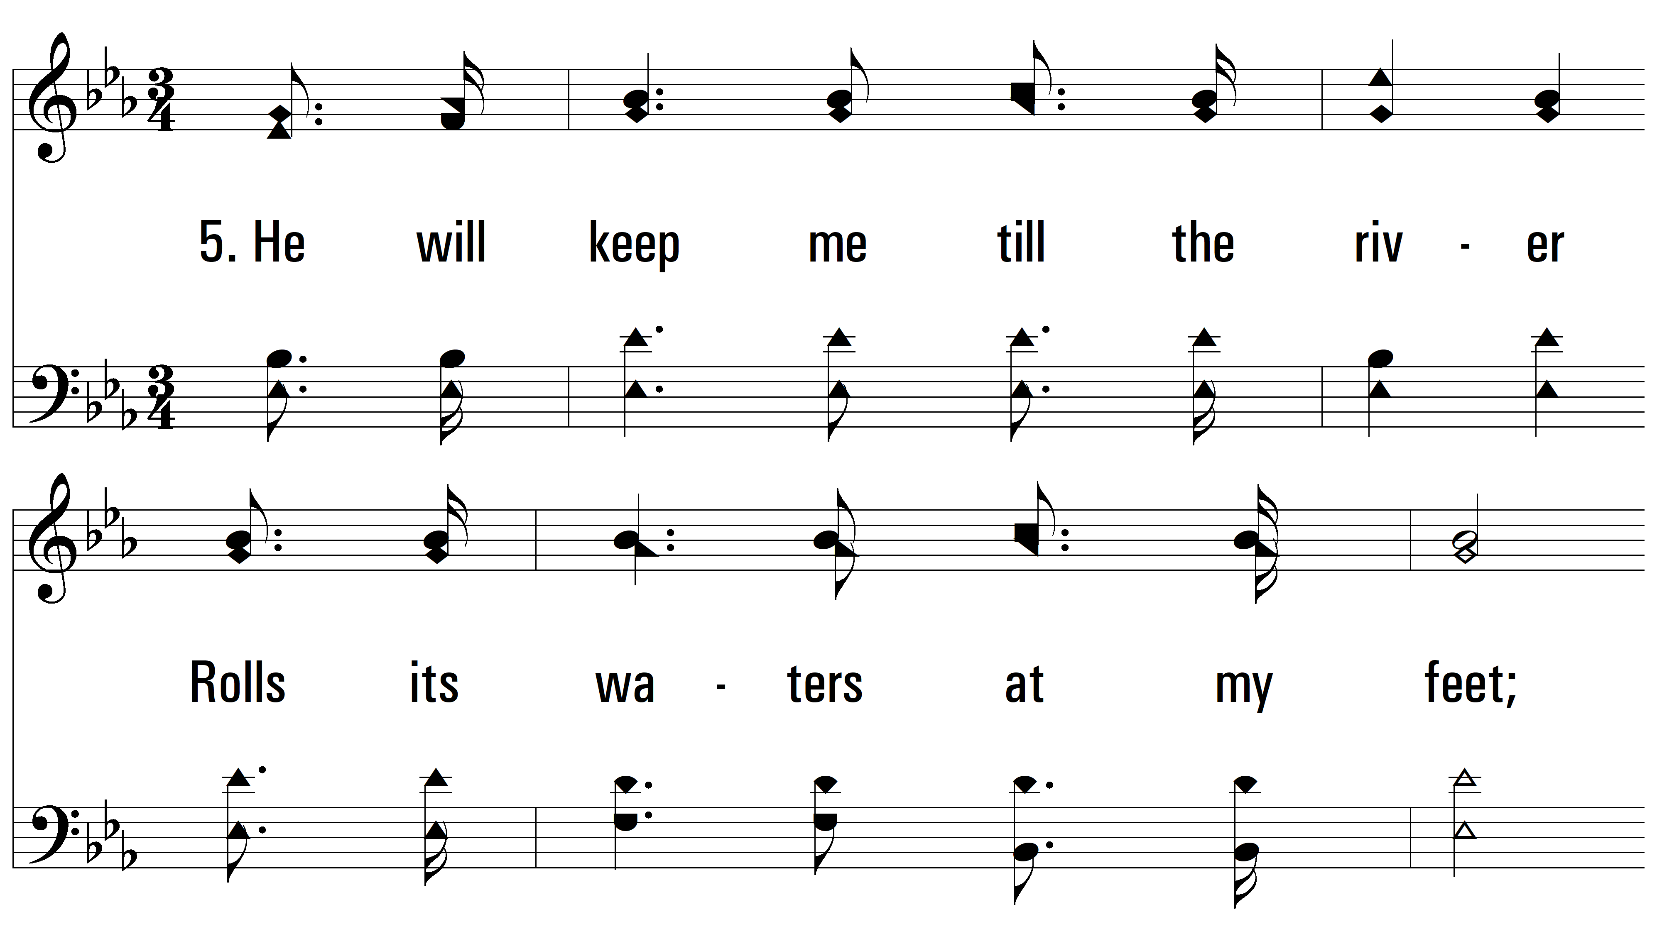
vs. 5 ~ I Will Sing The Wondrous Story

Slide 19
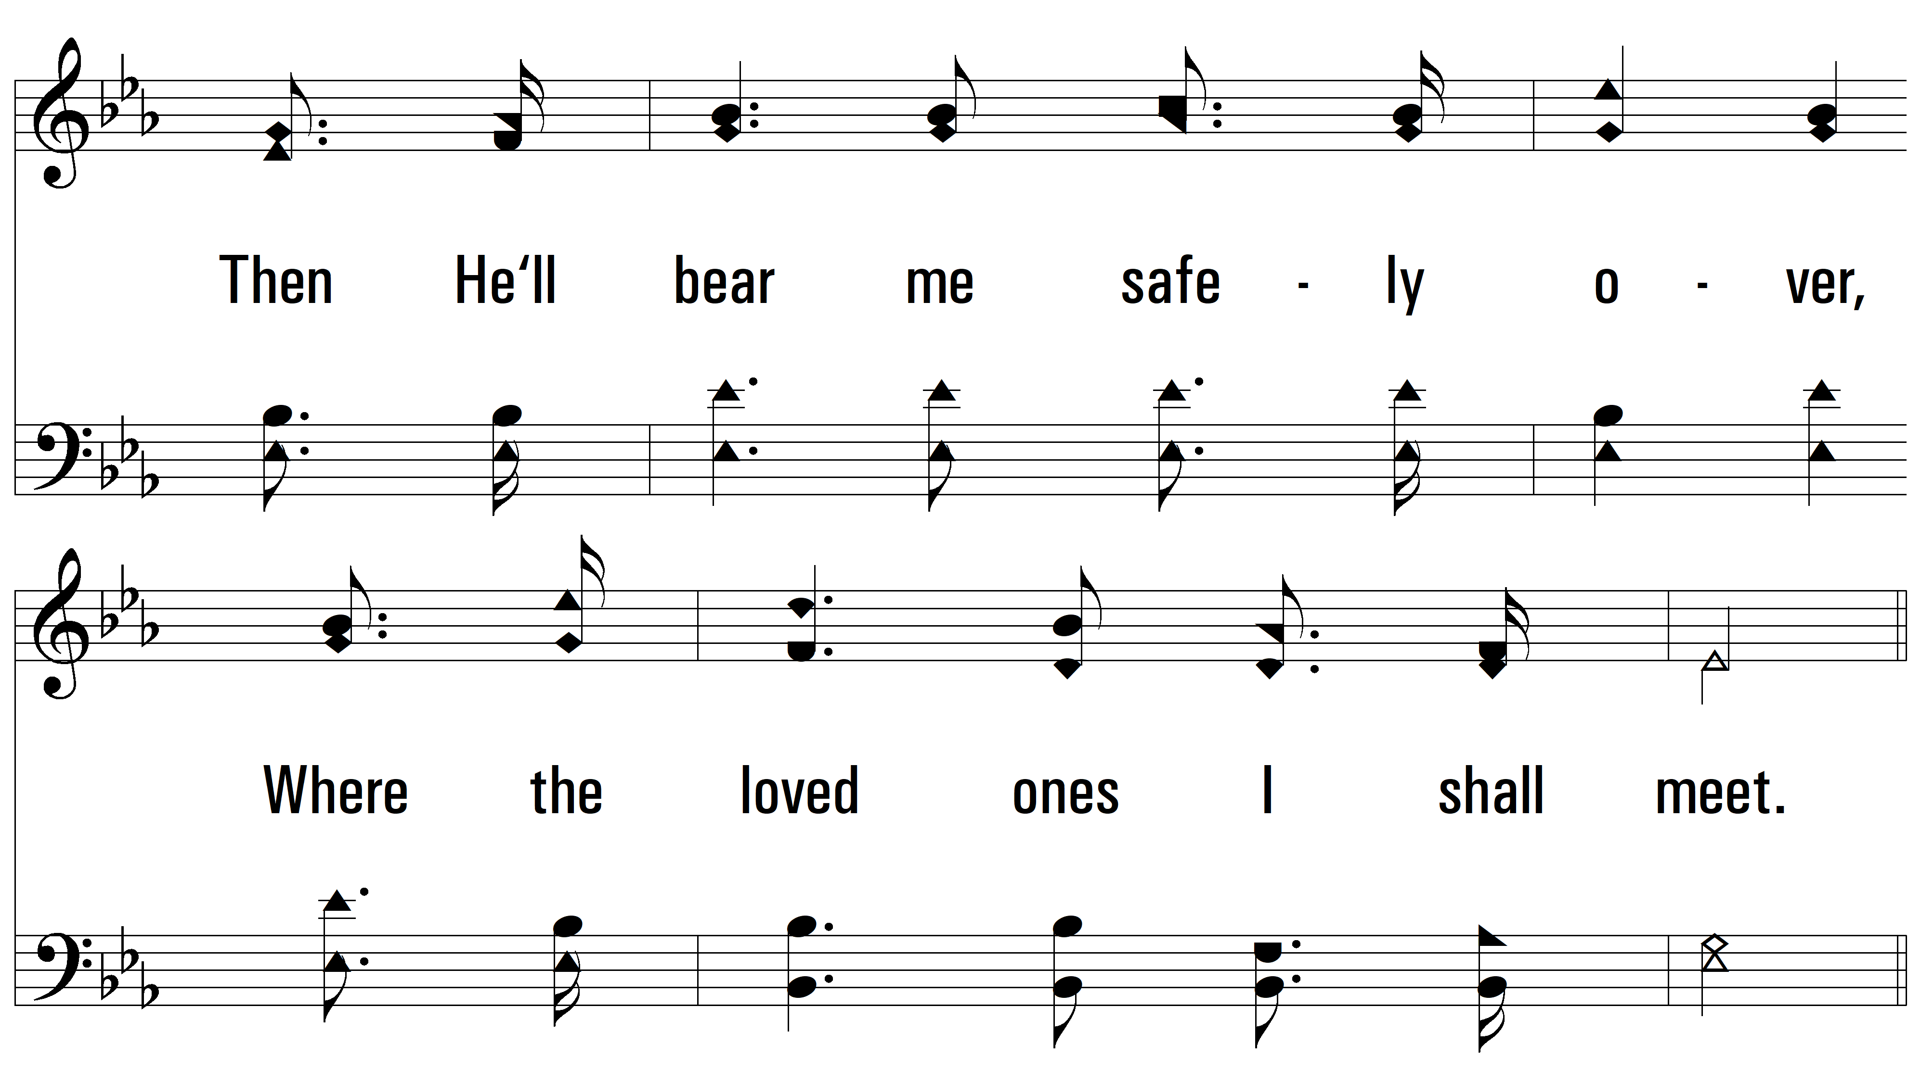
vs. 5

Slide 20
vs. 5

Slide 21
vs. 5
PDHymns.com
END

