Slide 1
I Will Sing Of My Redeemer
(My Redeemer)
Words: | Phillip P. Bliss (1877)
Music: | James McGranshan (1877)
9/8
A^{b}/E^{b} - SOL
Verses: 4/Chorus
Lead - | SOL
Alto - | MI
Tenor - | DO
Bass - | DO
PDHymns.com

Slide 2
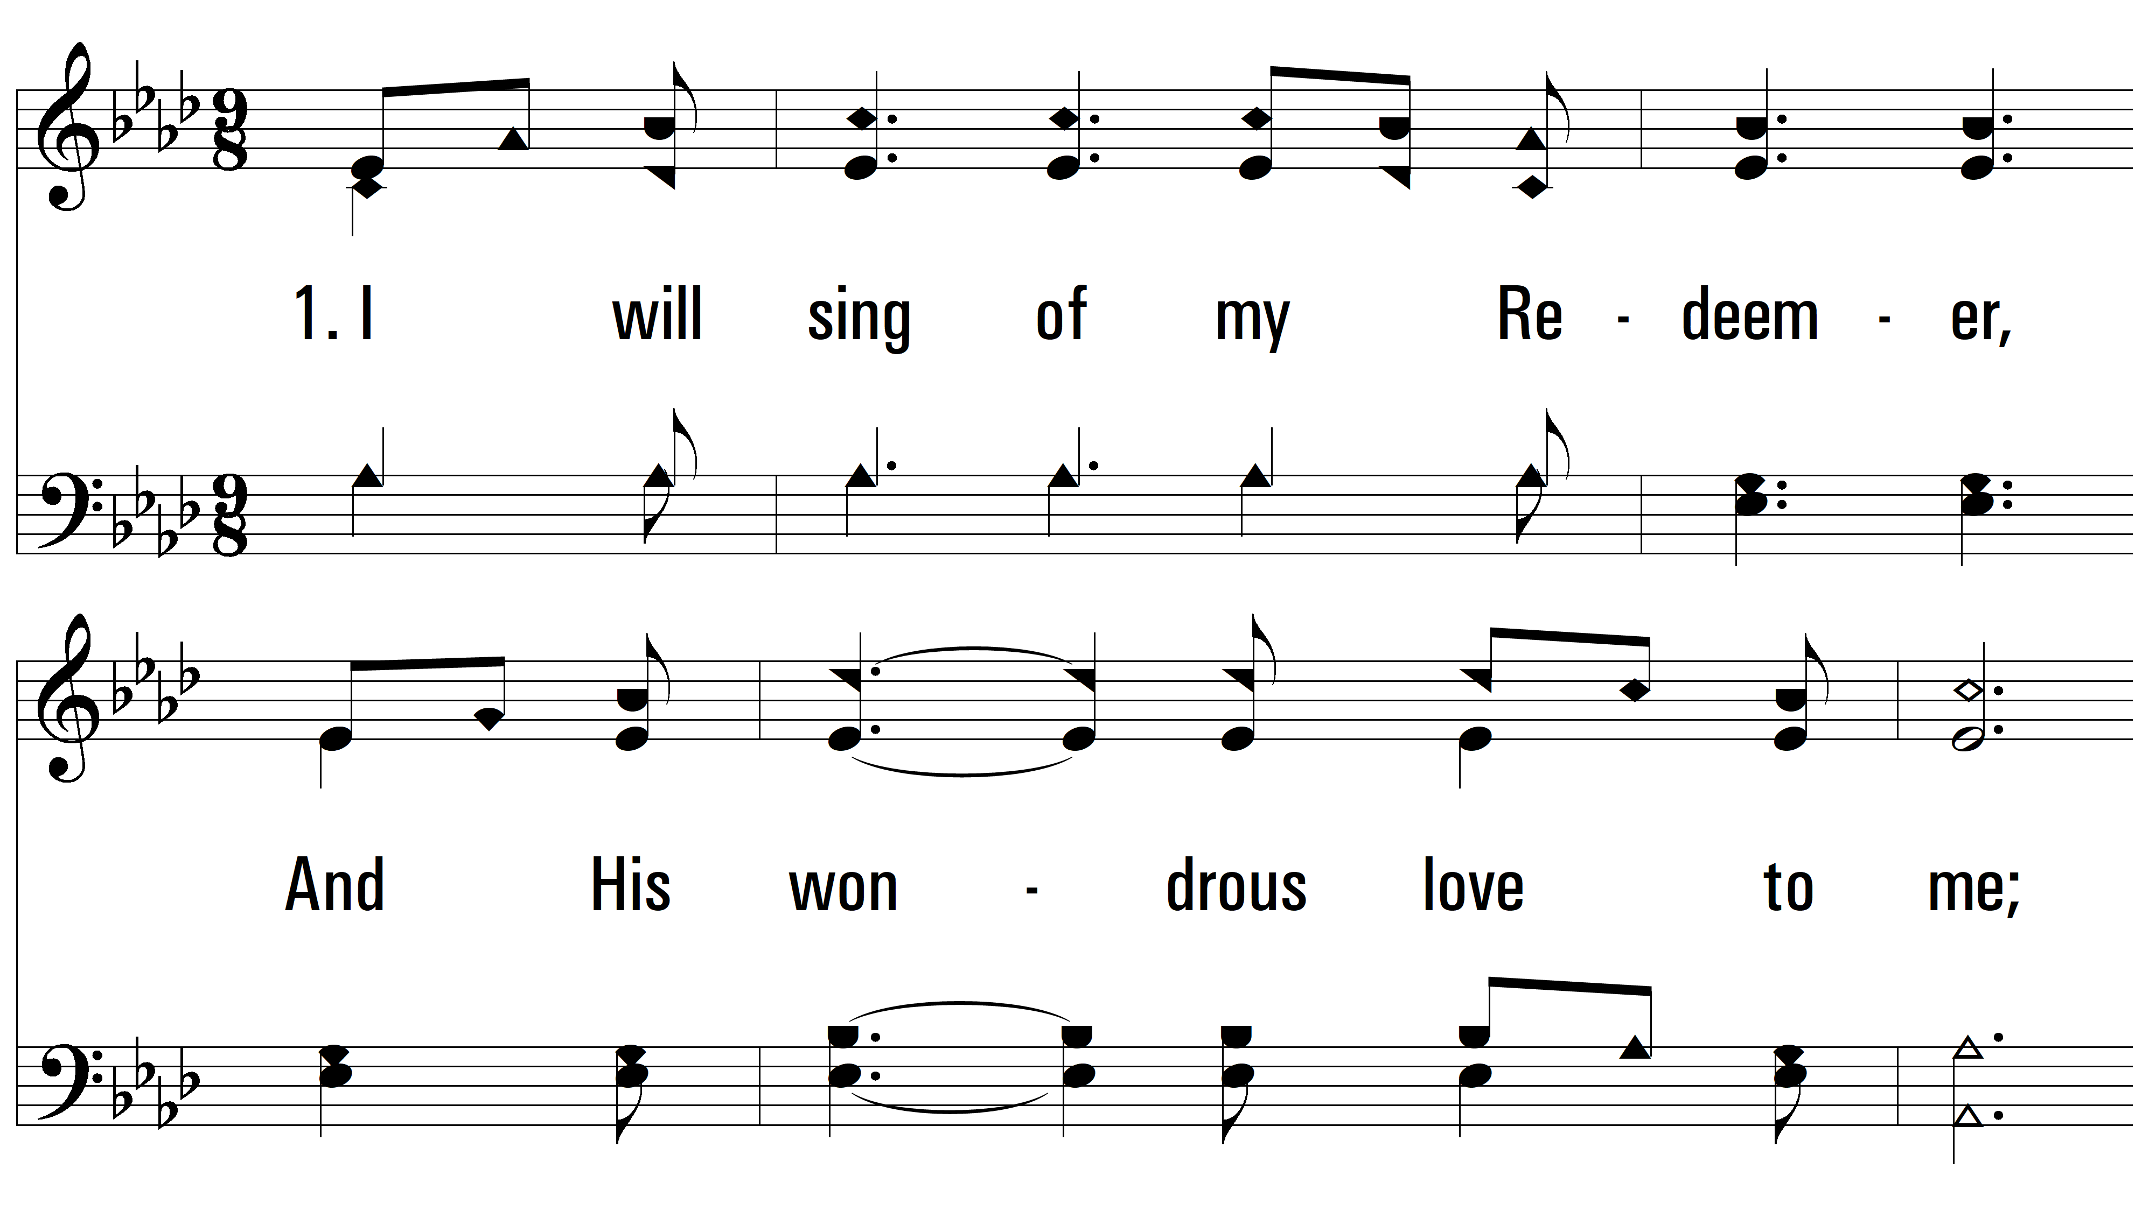
vs. 1 ~ I Will Sing Of My Redeemer

Slide 3
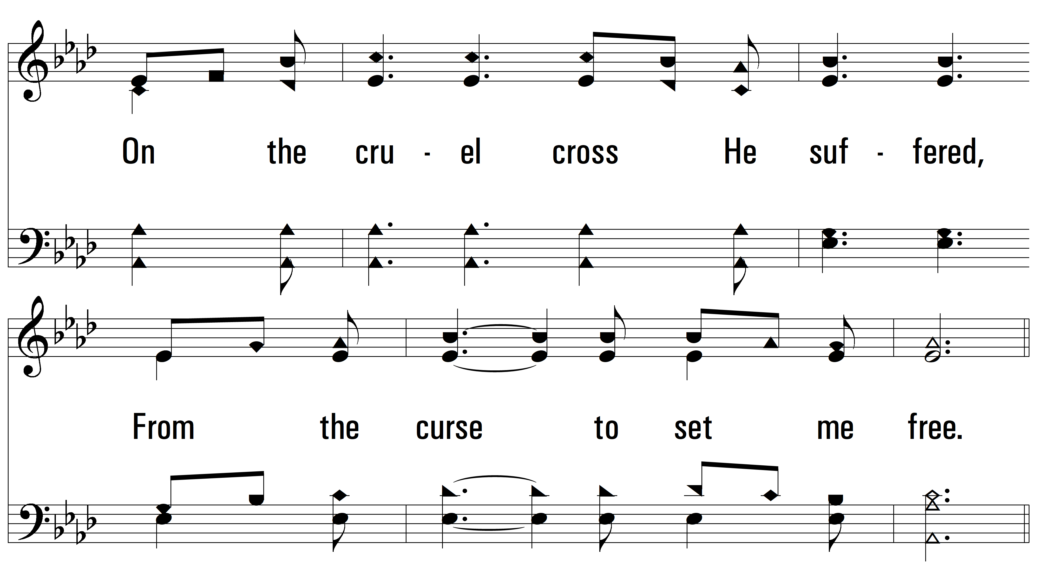
vs. 1

Slide 4
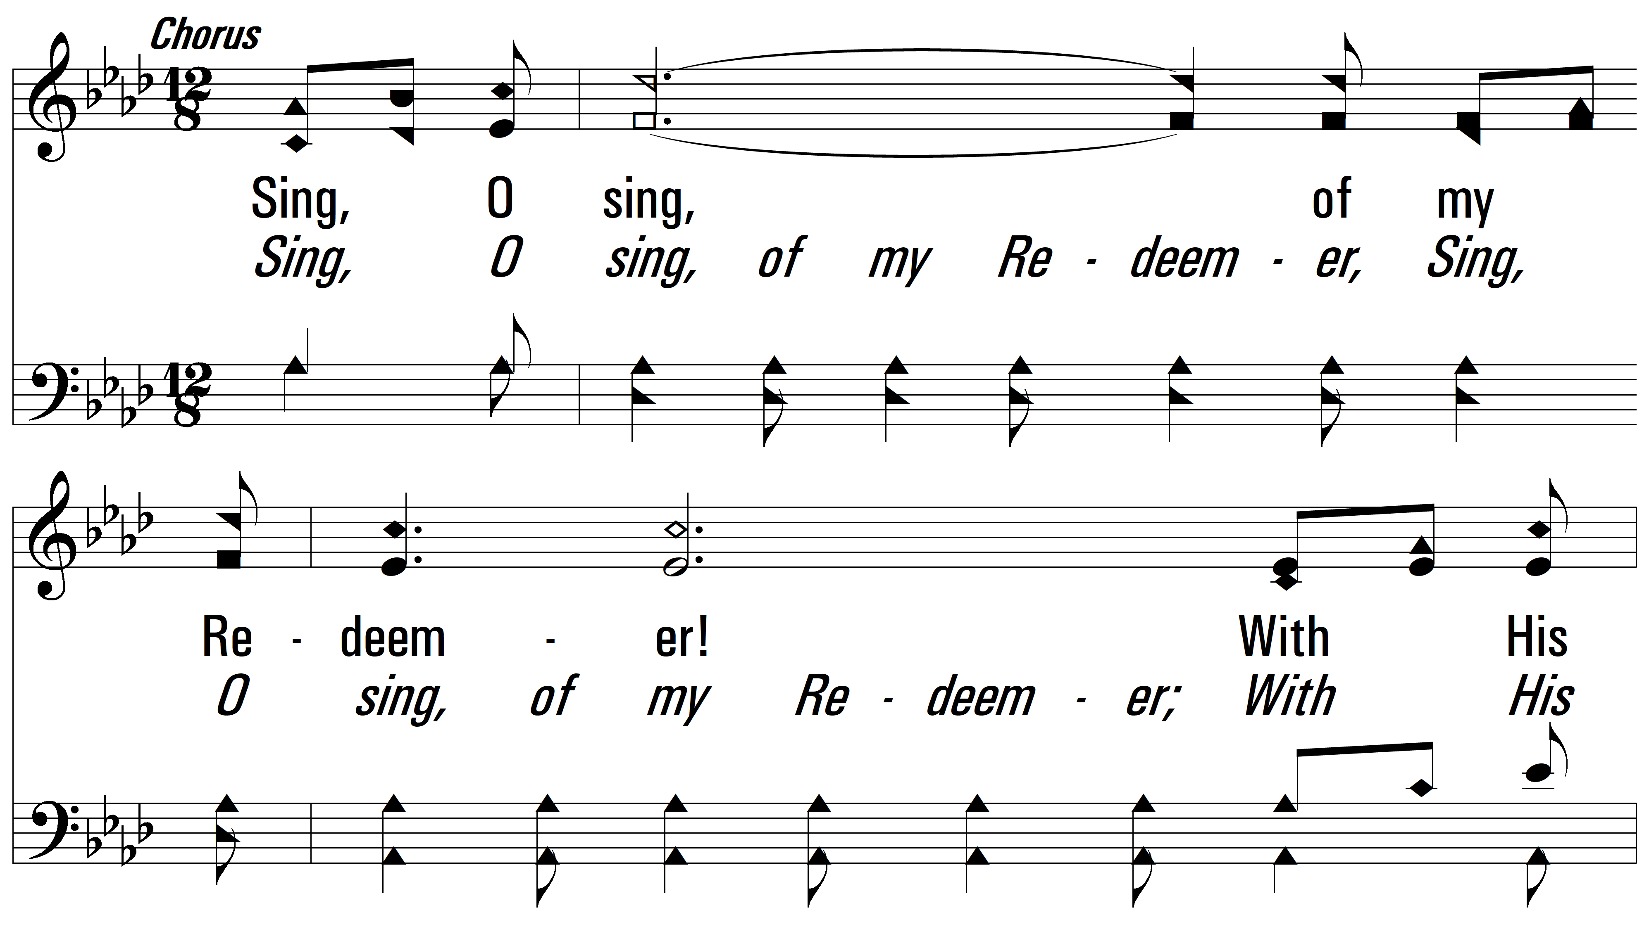
vs. 1

Slide 5
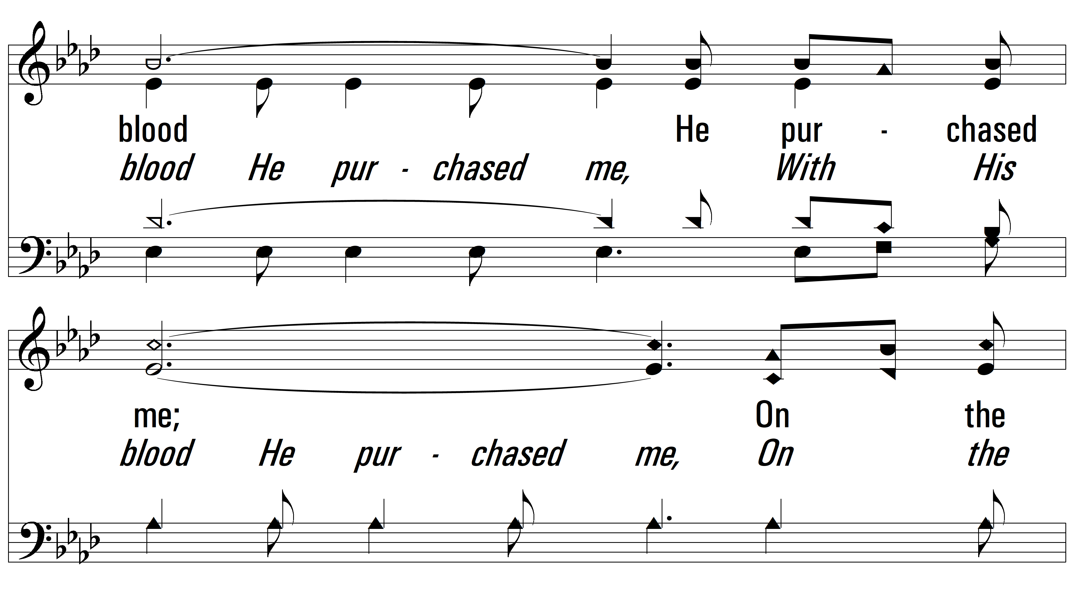
vs. 1

Slide 6
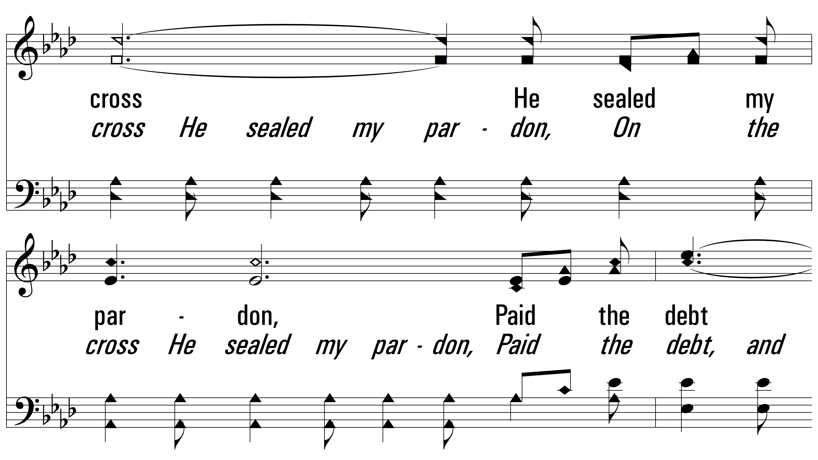
vs. 1

Slide 7
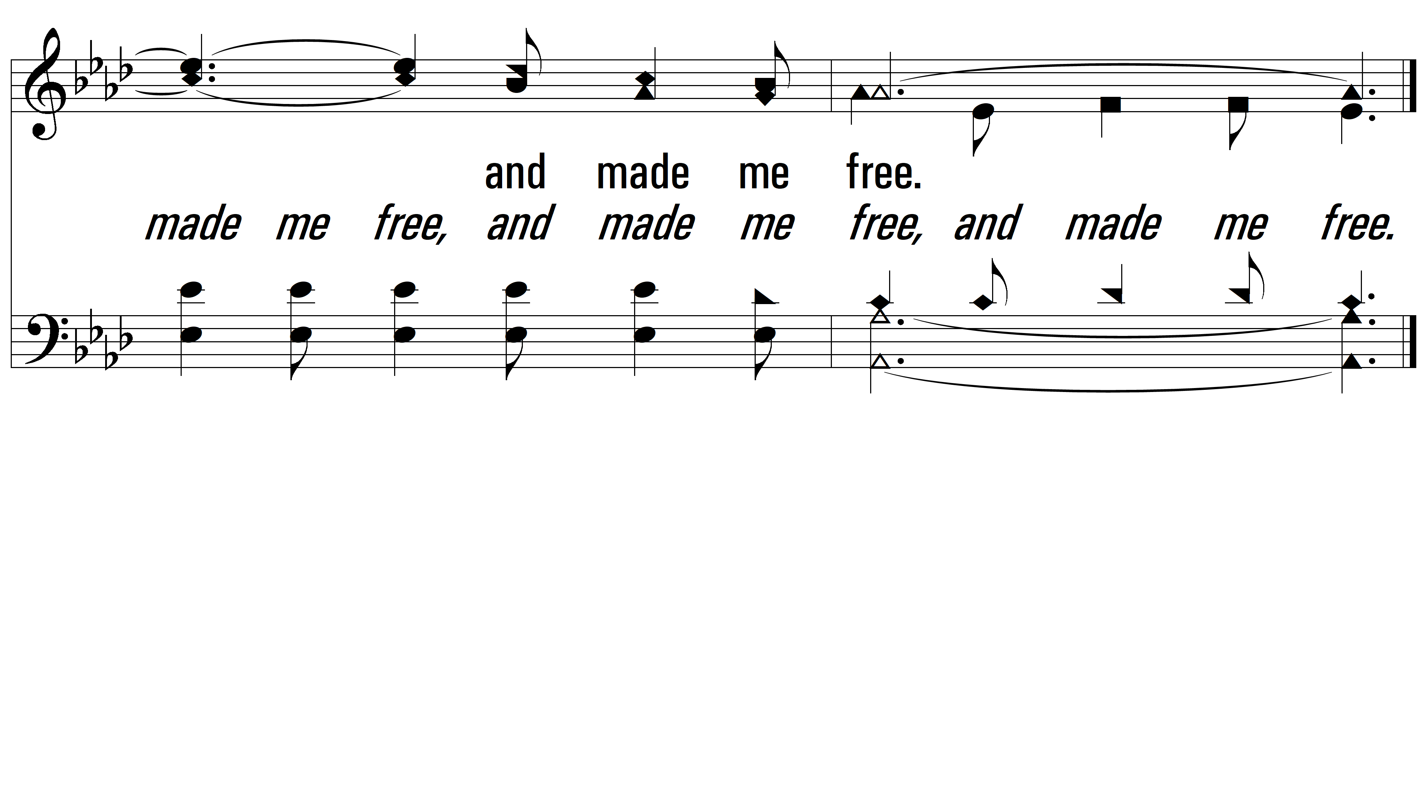
vs. 1

Slide 8
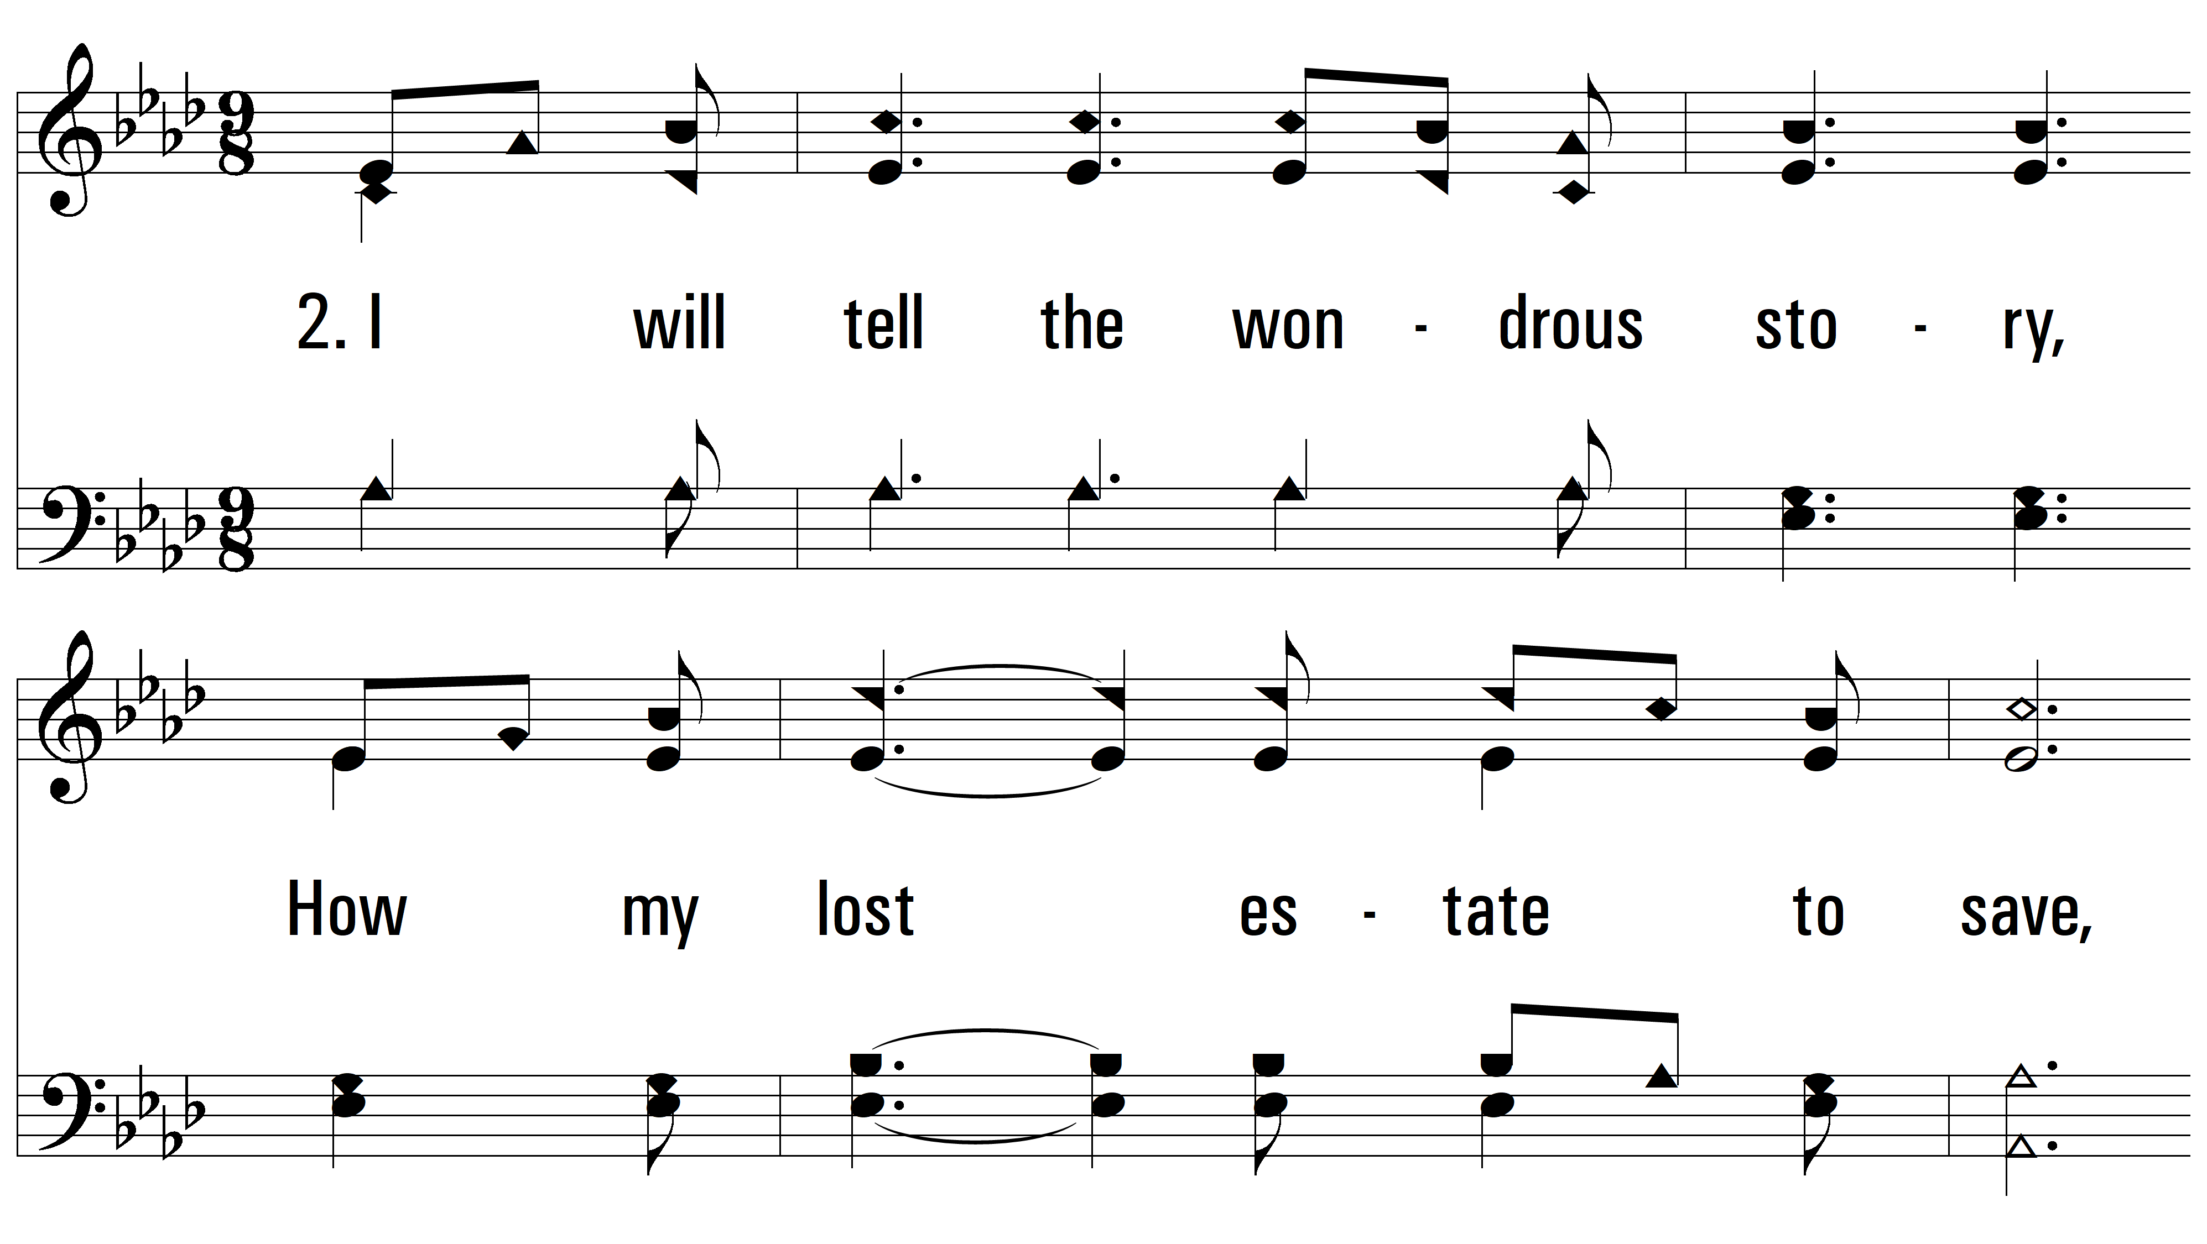
vs. 2 ~ I Will Sing Of My Redeemer

Slide 9
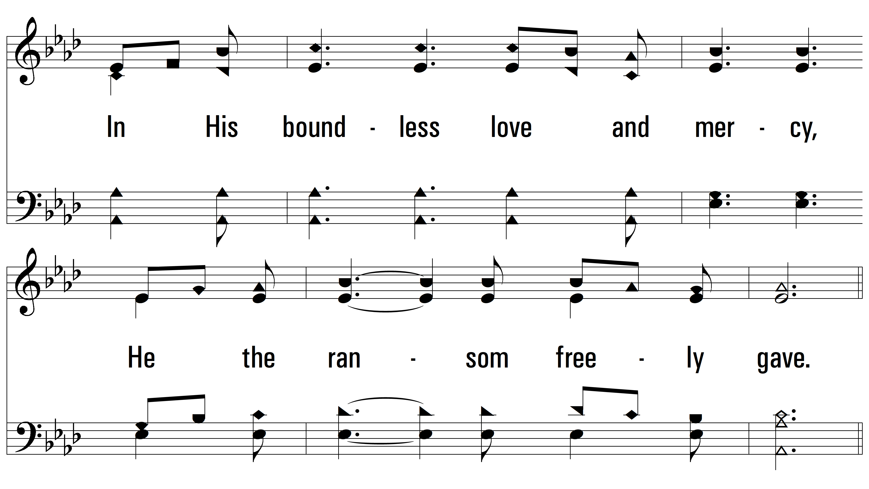
vs. 2

Slide 10
vs. 2

Slide 11
vs. 2

Slide 12
vs. 2

Slide 13
vs. 2

Slide 14
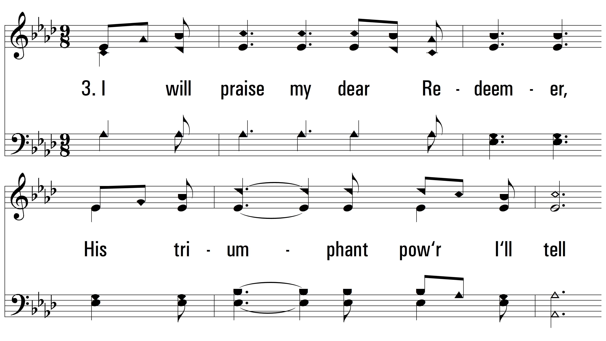
vs. 3 ~ I Will Sing Of My Redeemer

Slide 15
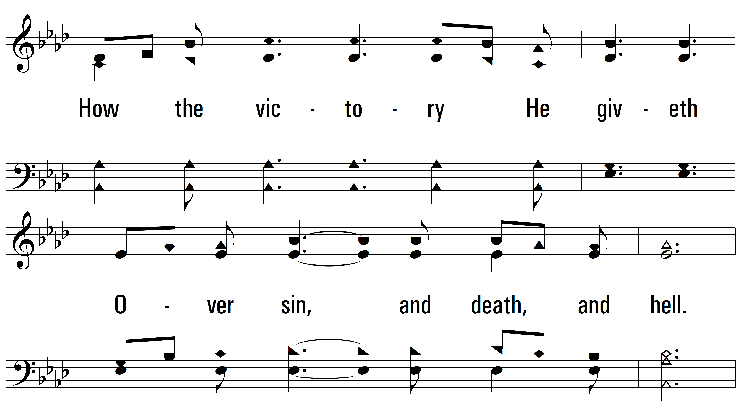
vs. 3

Slide 16
vs. 3

Slide 17
vs. 3

Slide 18
vs. 3

Slide 19
vs. 3

Slide 20
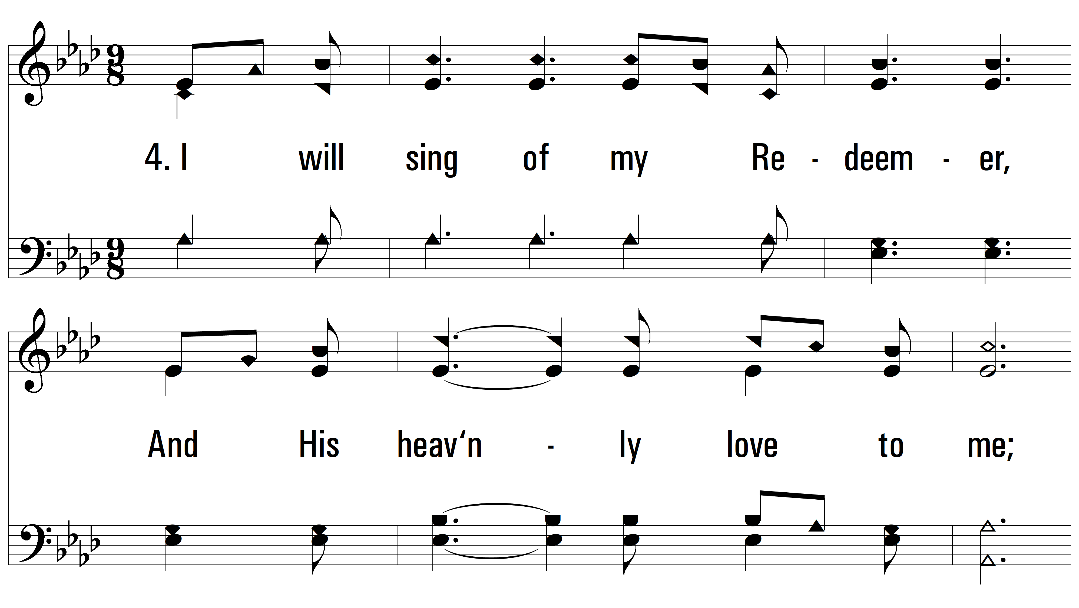
vs. 4 ~ I Will Sing Of My Redeemer

Slide 21
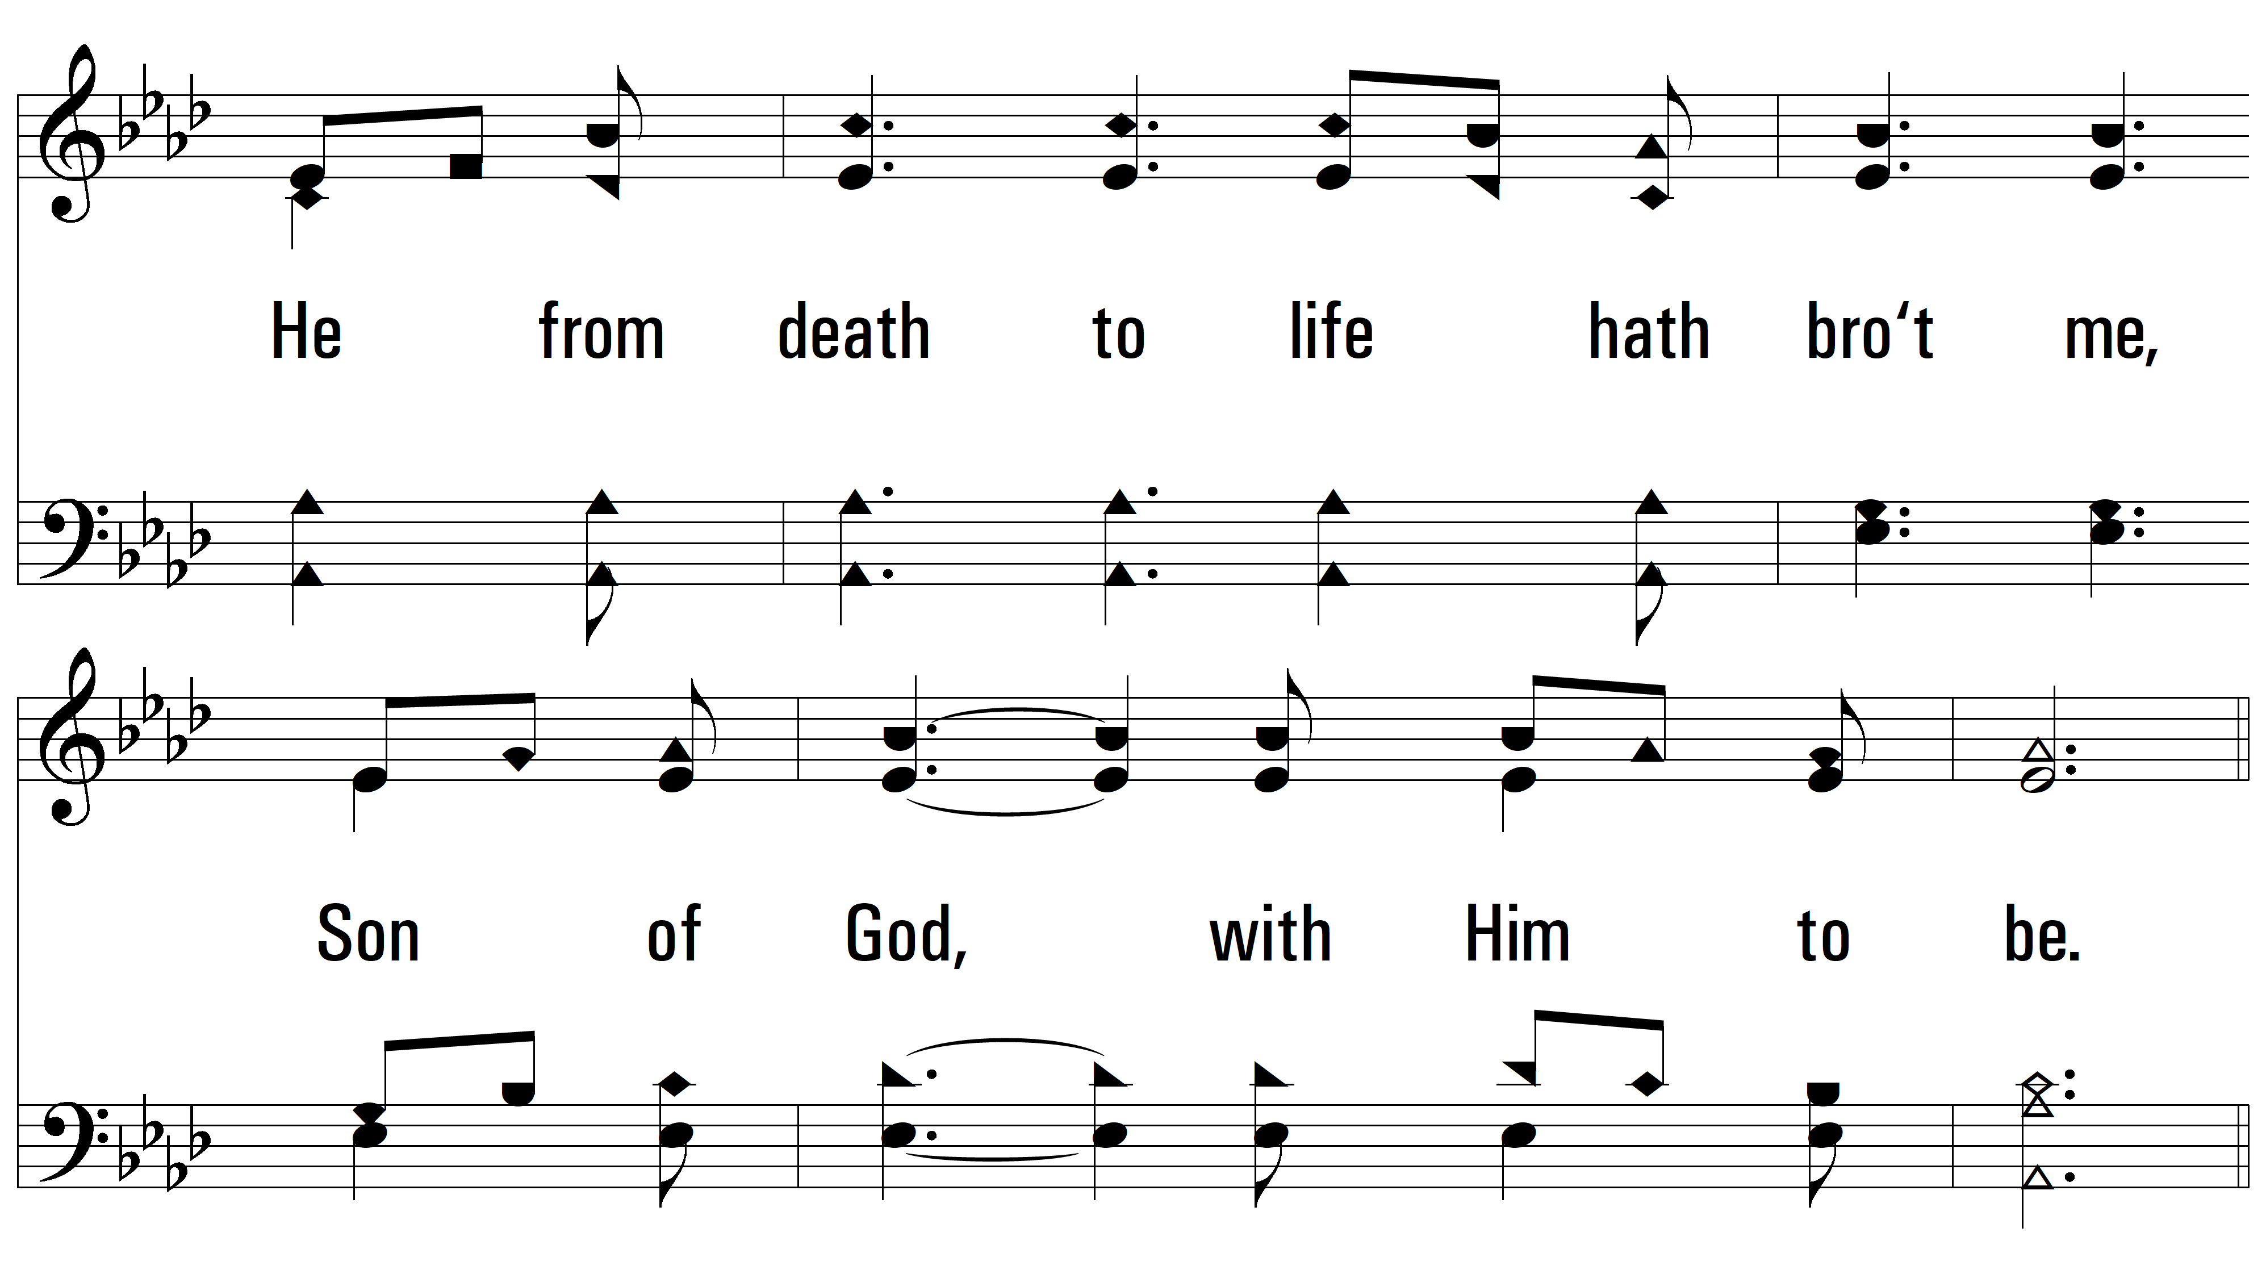
vs. 4

Slide 22
vs. 4

Slide 23
vs. 4

Slide 24
vs. 4

Slide 25
vs. 4
PDHymns.com
END

