Slide 1
I Will Pray
(Ever Will I Pray)
Words: | A. Cummings (1875)
Music: | John Harrison Tenney (1875)
3/4
F/A - MI
Verses: 4/Chorus
Lead - | SOL
Alto - | MI
Tenor - | DO
Bass - | DO
PDHymns.com

Slide 2
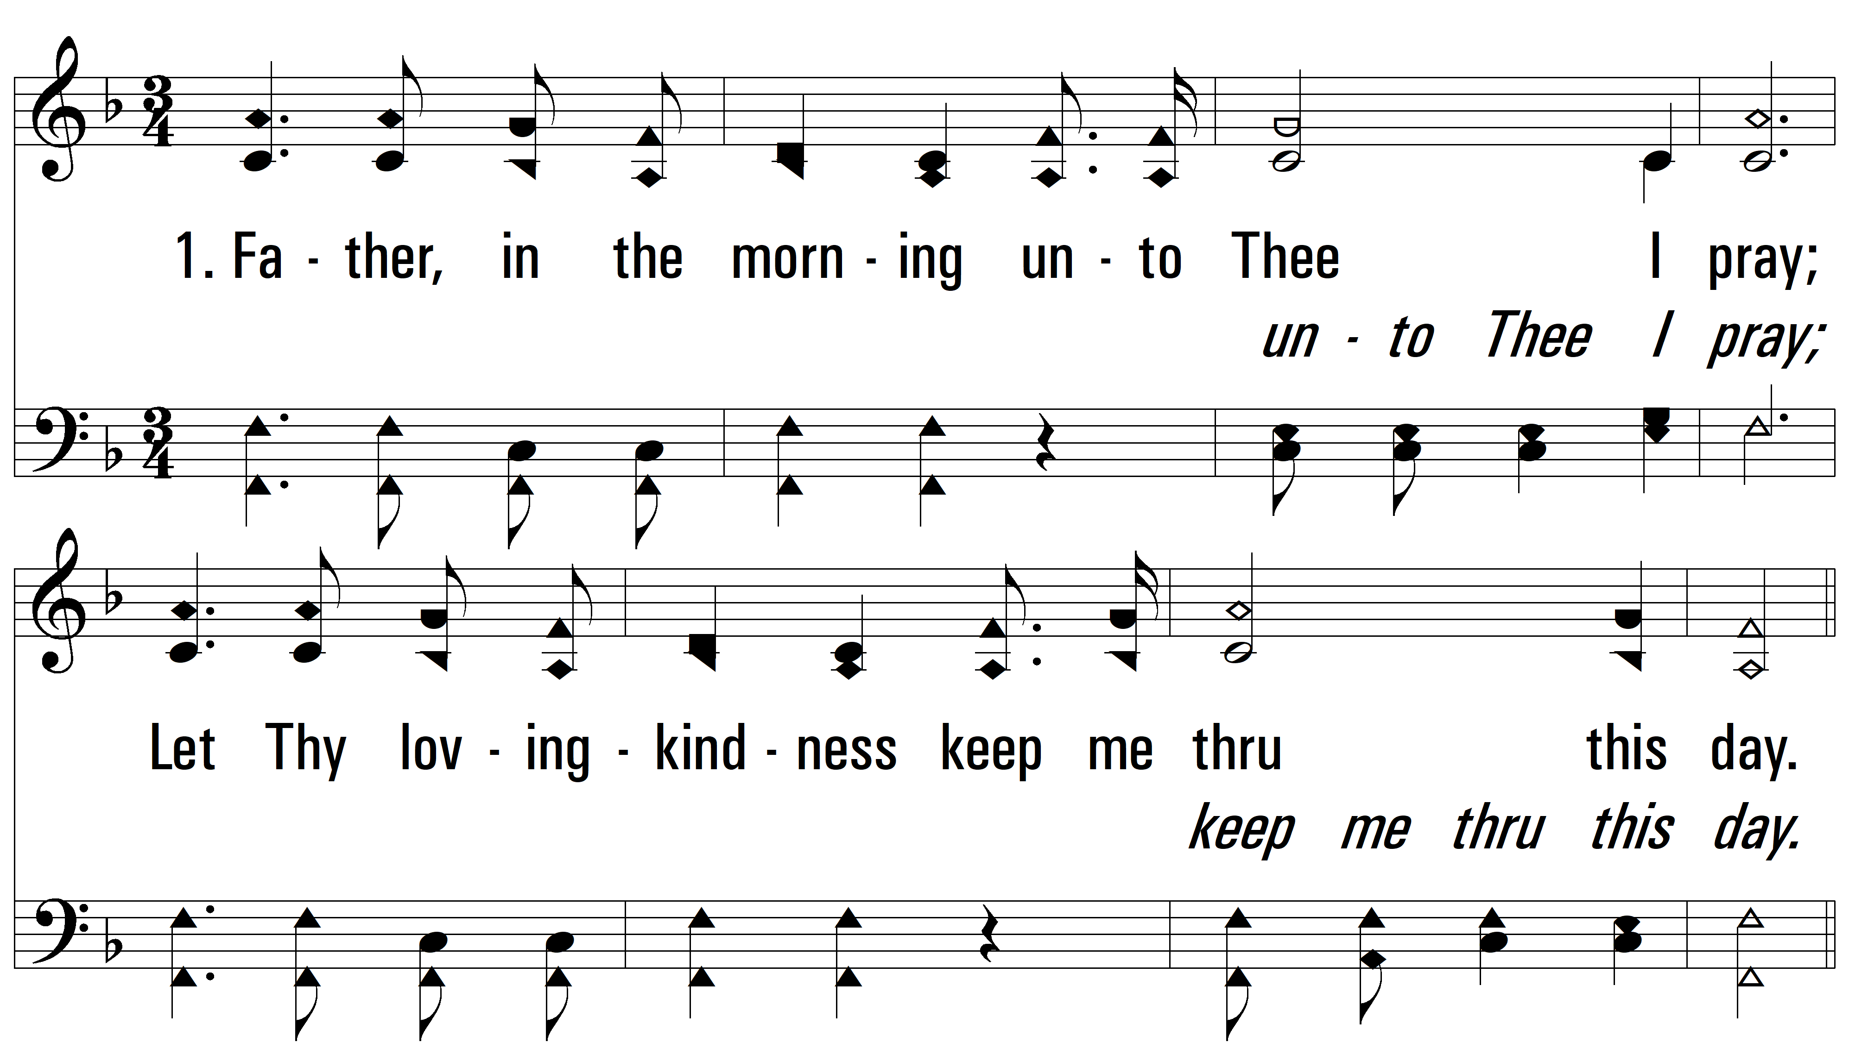
vs. 1 ~ I Will Pray

Slide 3
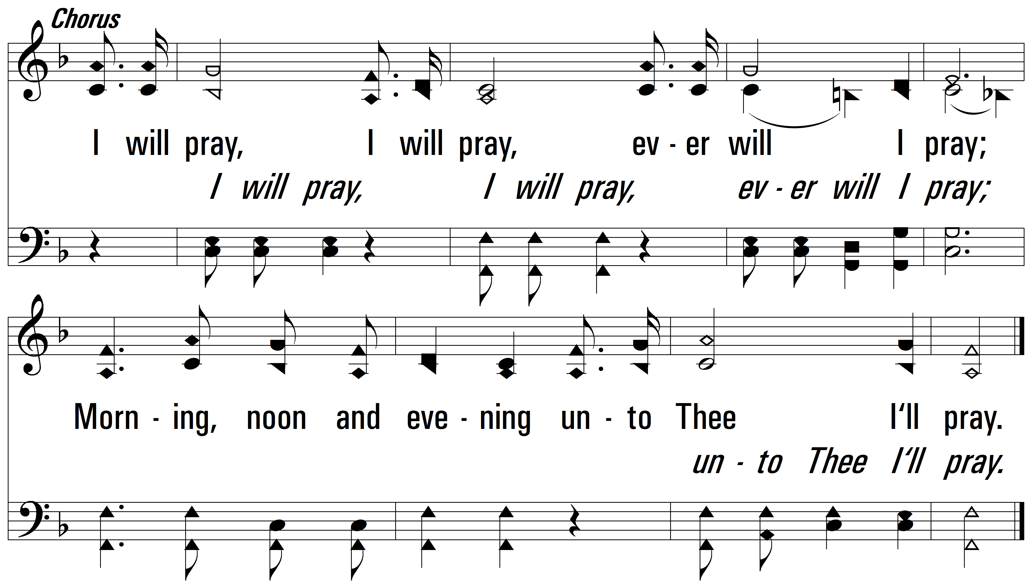
vs. 1

Slide 4
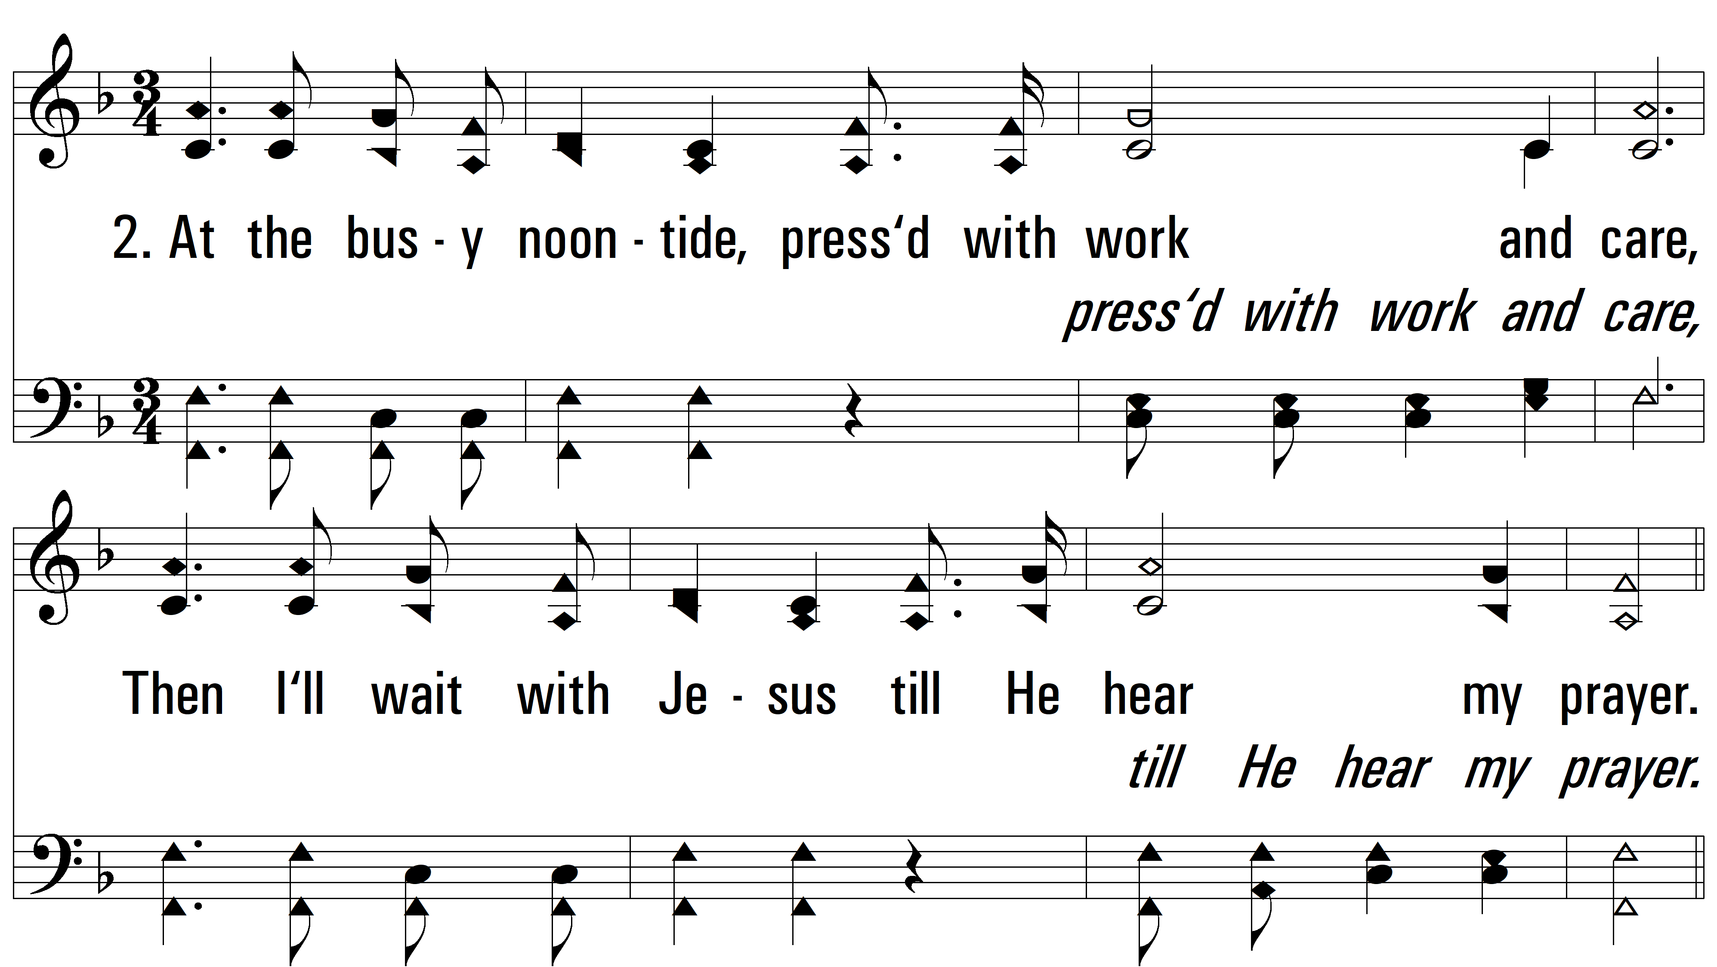
vs. 2 ~ I Will Pray

Slide 5
vs. 2

Slide 6
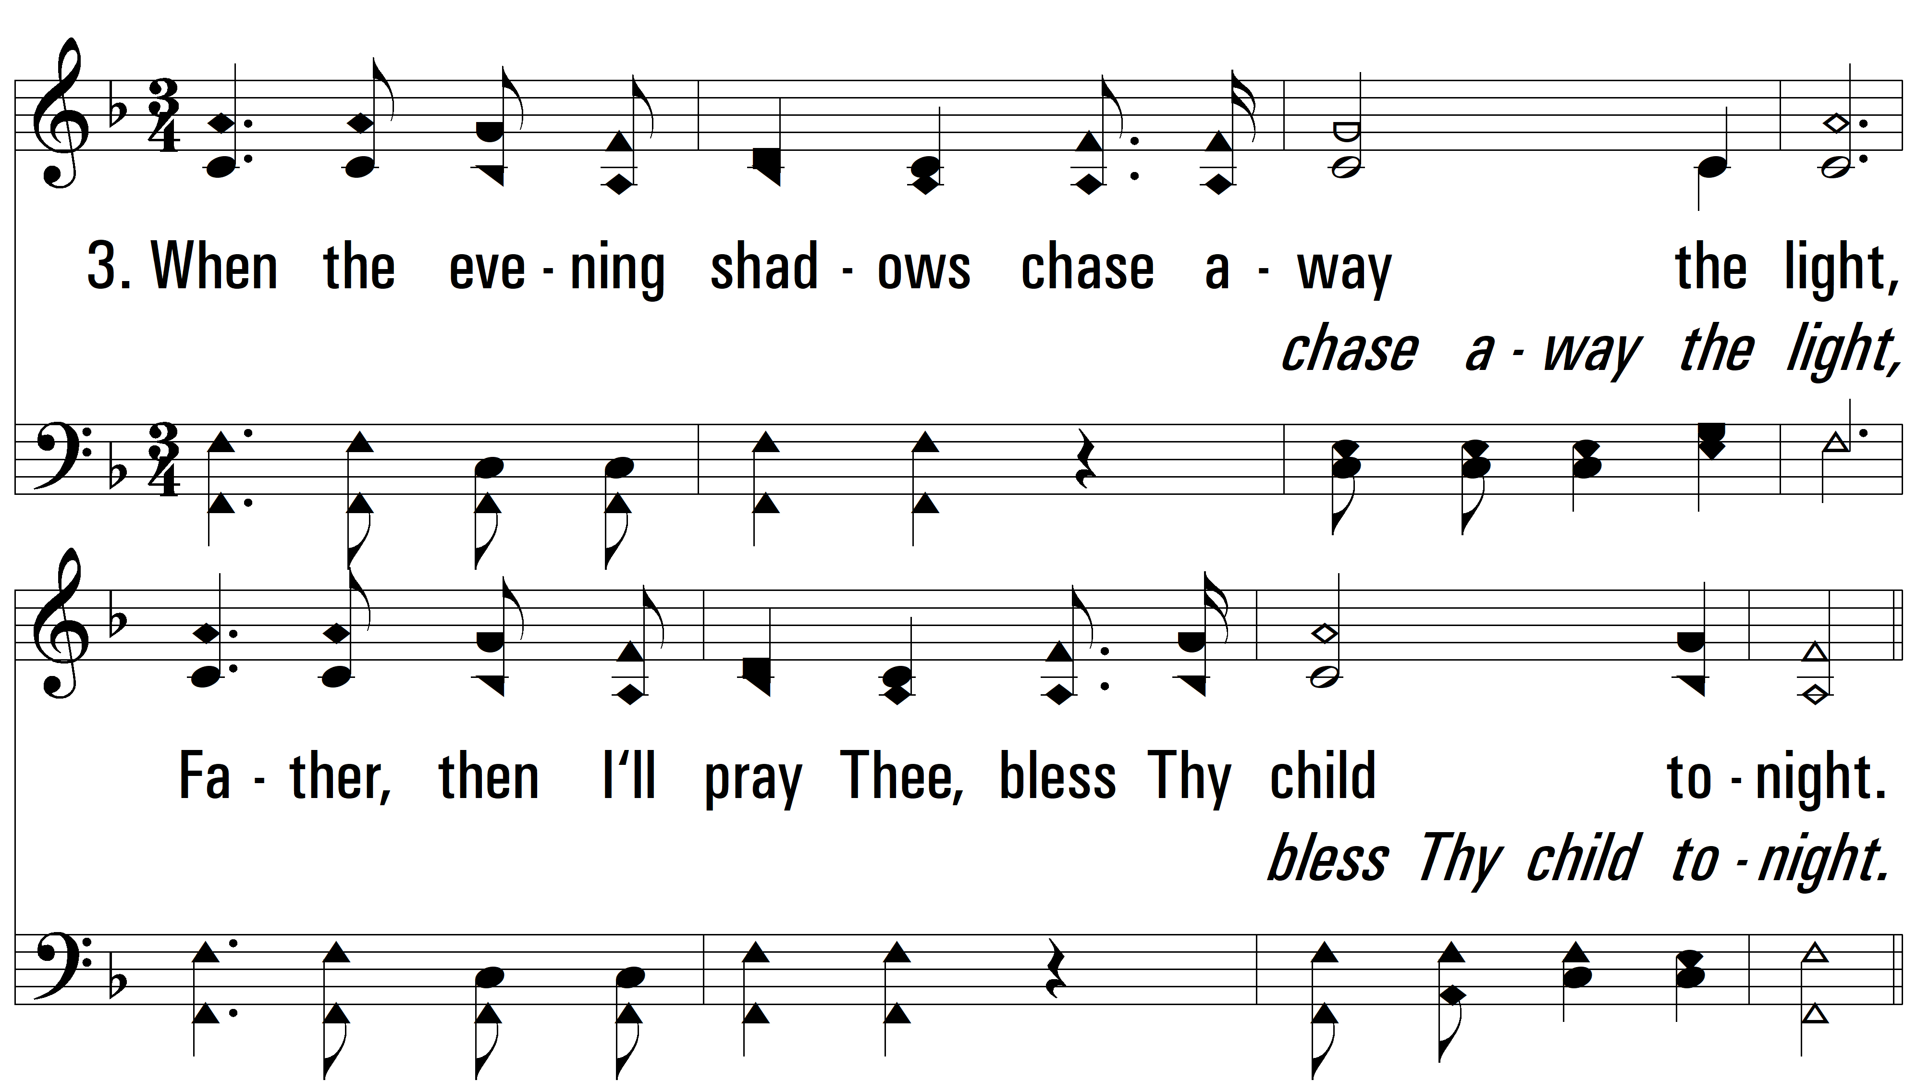
vs. 3 ~ I Will Pray

Slide 7
vs. 3

Slide 8
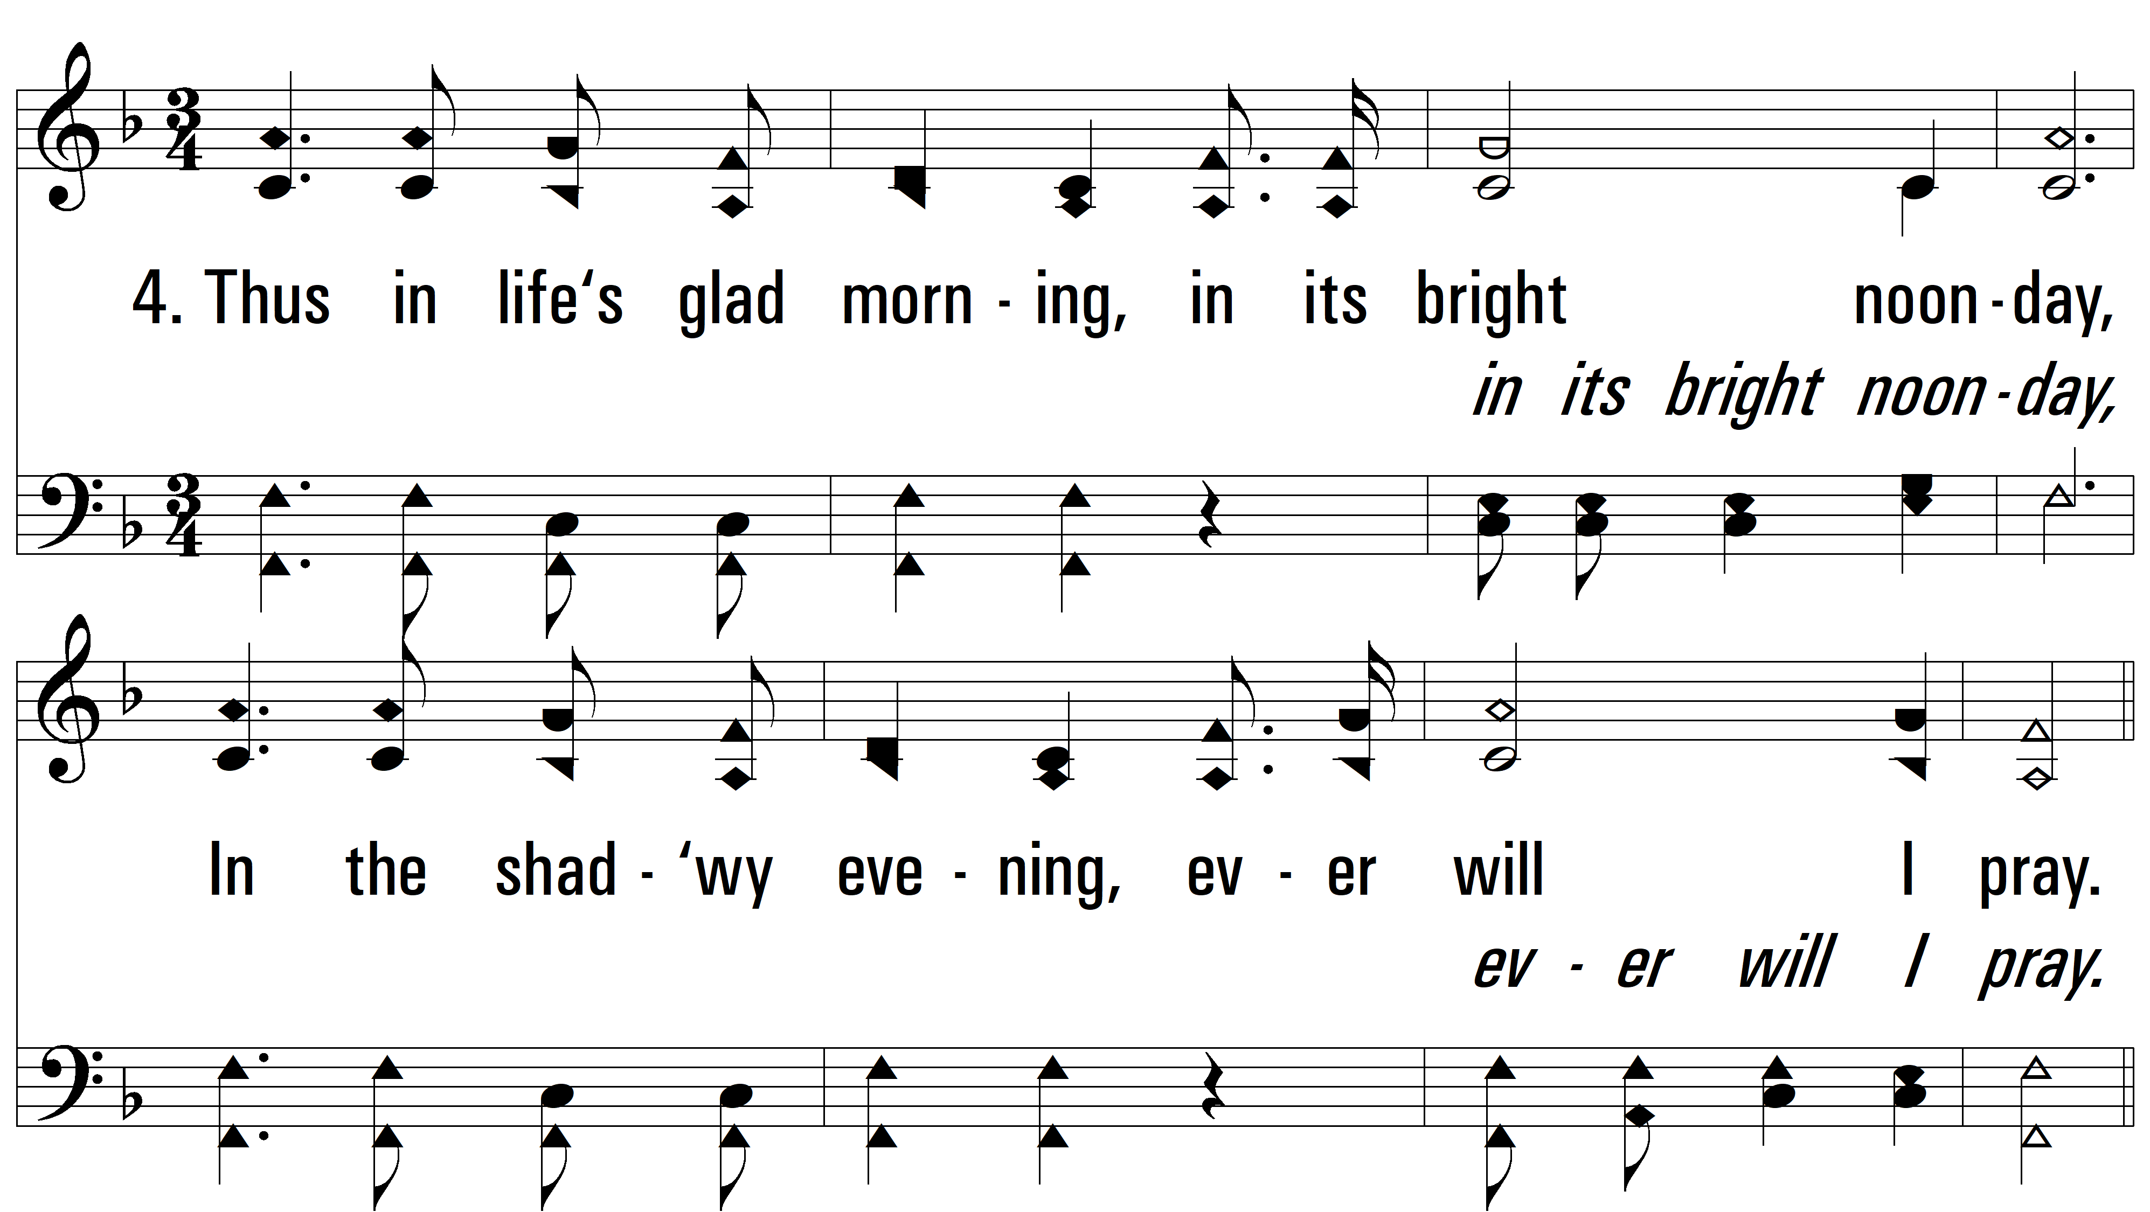
vs. 4 ~ I Will Pray

Slide 9
vs. 4
PDHymns.com
END

