Slide 1
I Love You, My Jesus
Words: | Traditional American Hymn
Music: | Ingall’s Christian Harmony (1805)
3/4
E^{b}/B^{b} - SOL
Verses: 2
Lead - | SOL
Alto - | SOL
Tenor - | MI
Bass - | DO
PDHymns.com

Slide 2
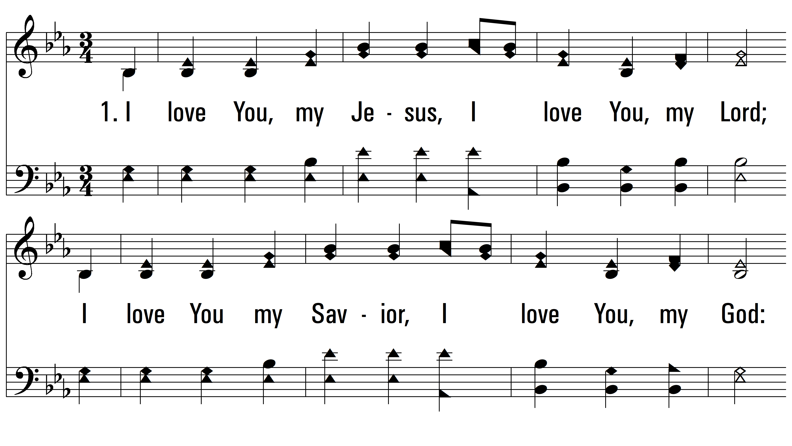
vs. 1 ~ I Love You, My Jesus

Slide 3
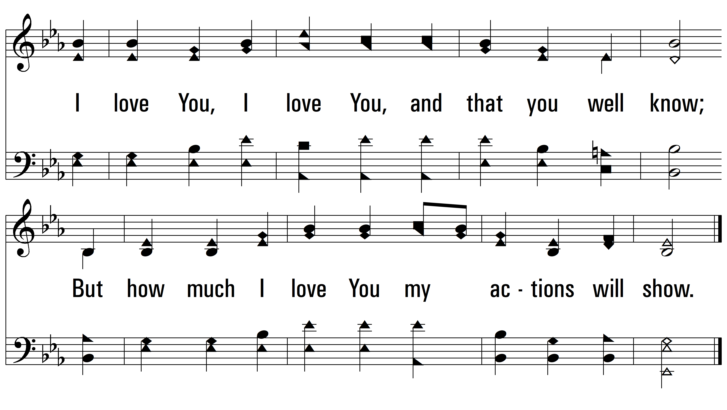
vs. 1

Slide 4
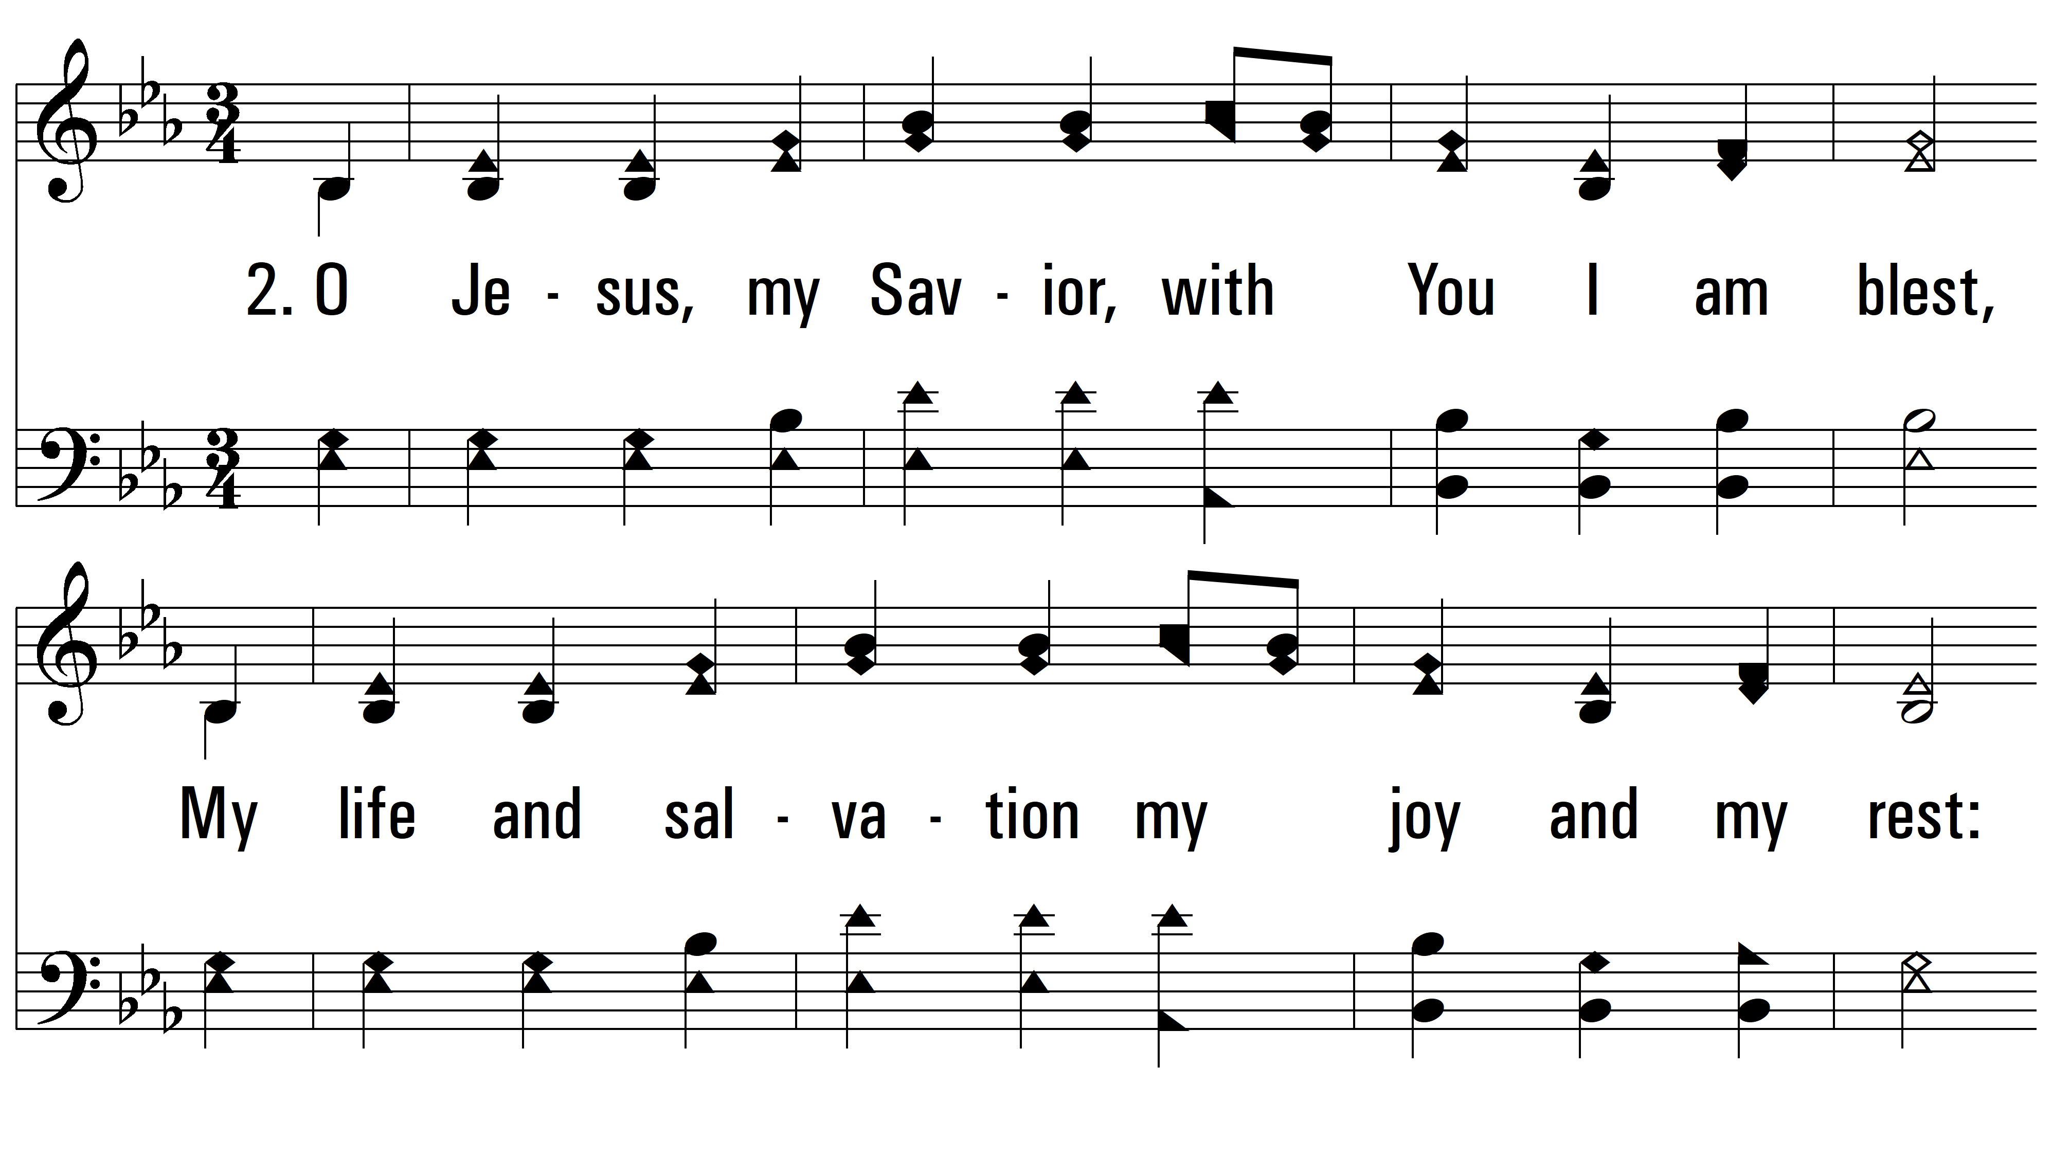
vs. 2 ~ I Love You, My Jesus

Slide 5
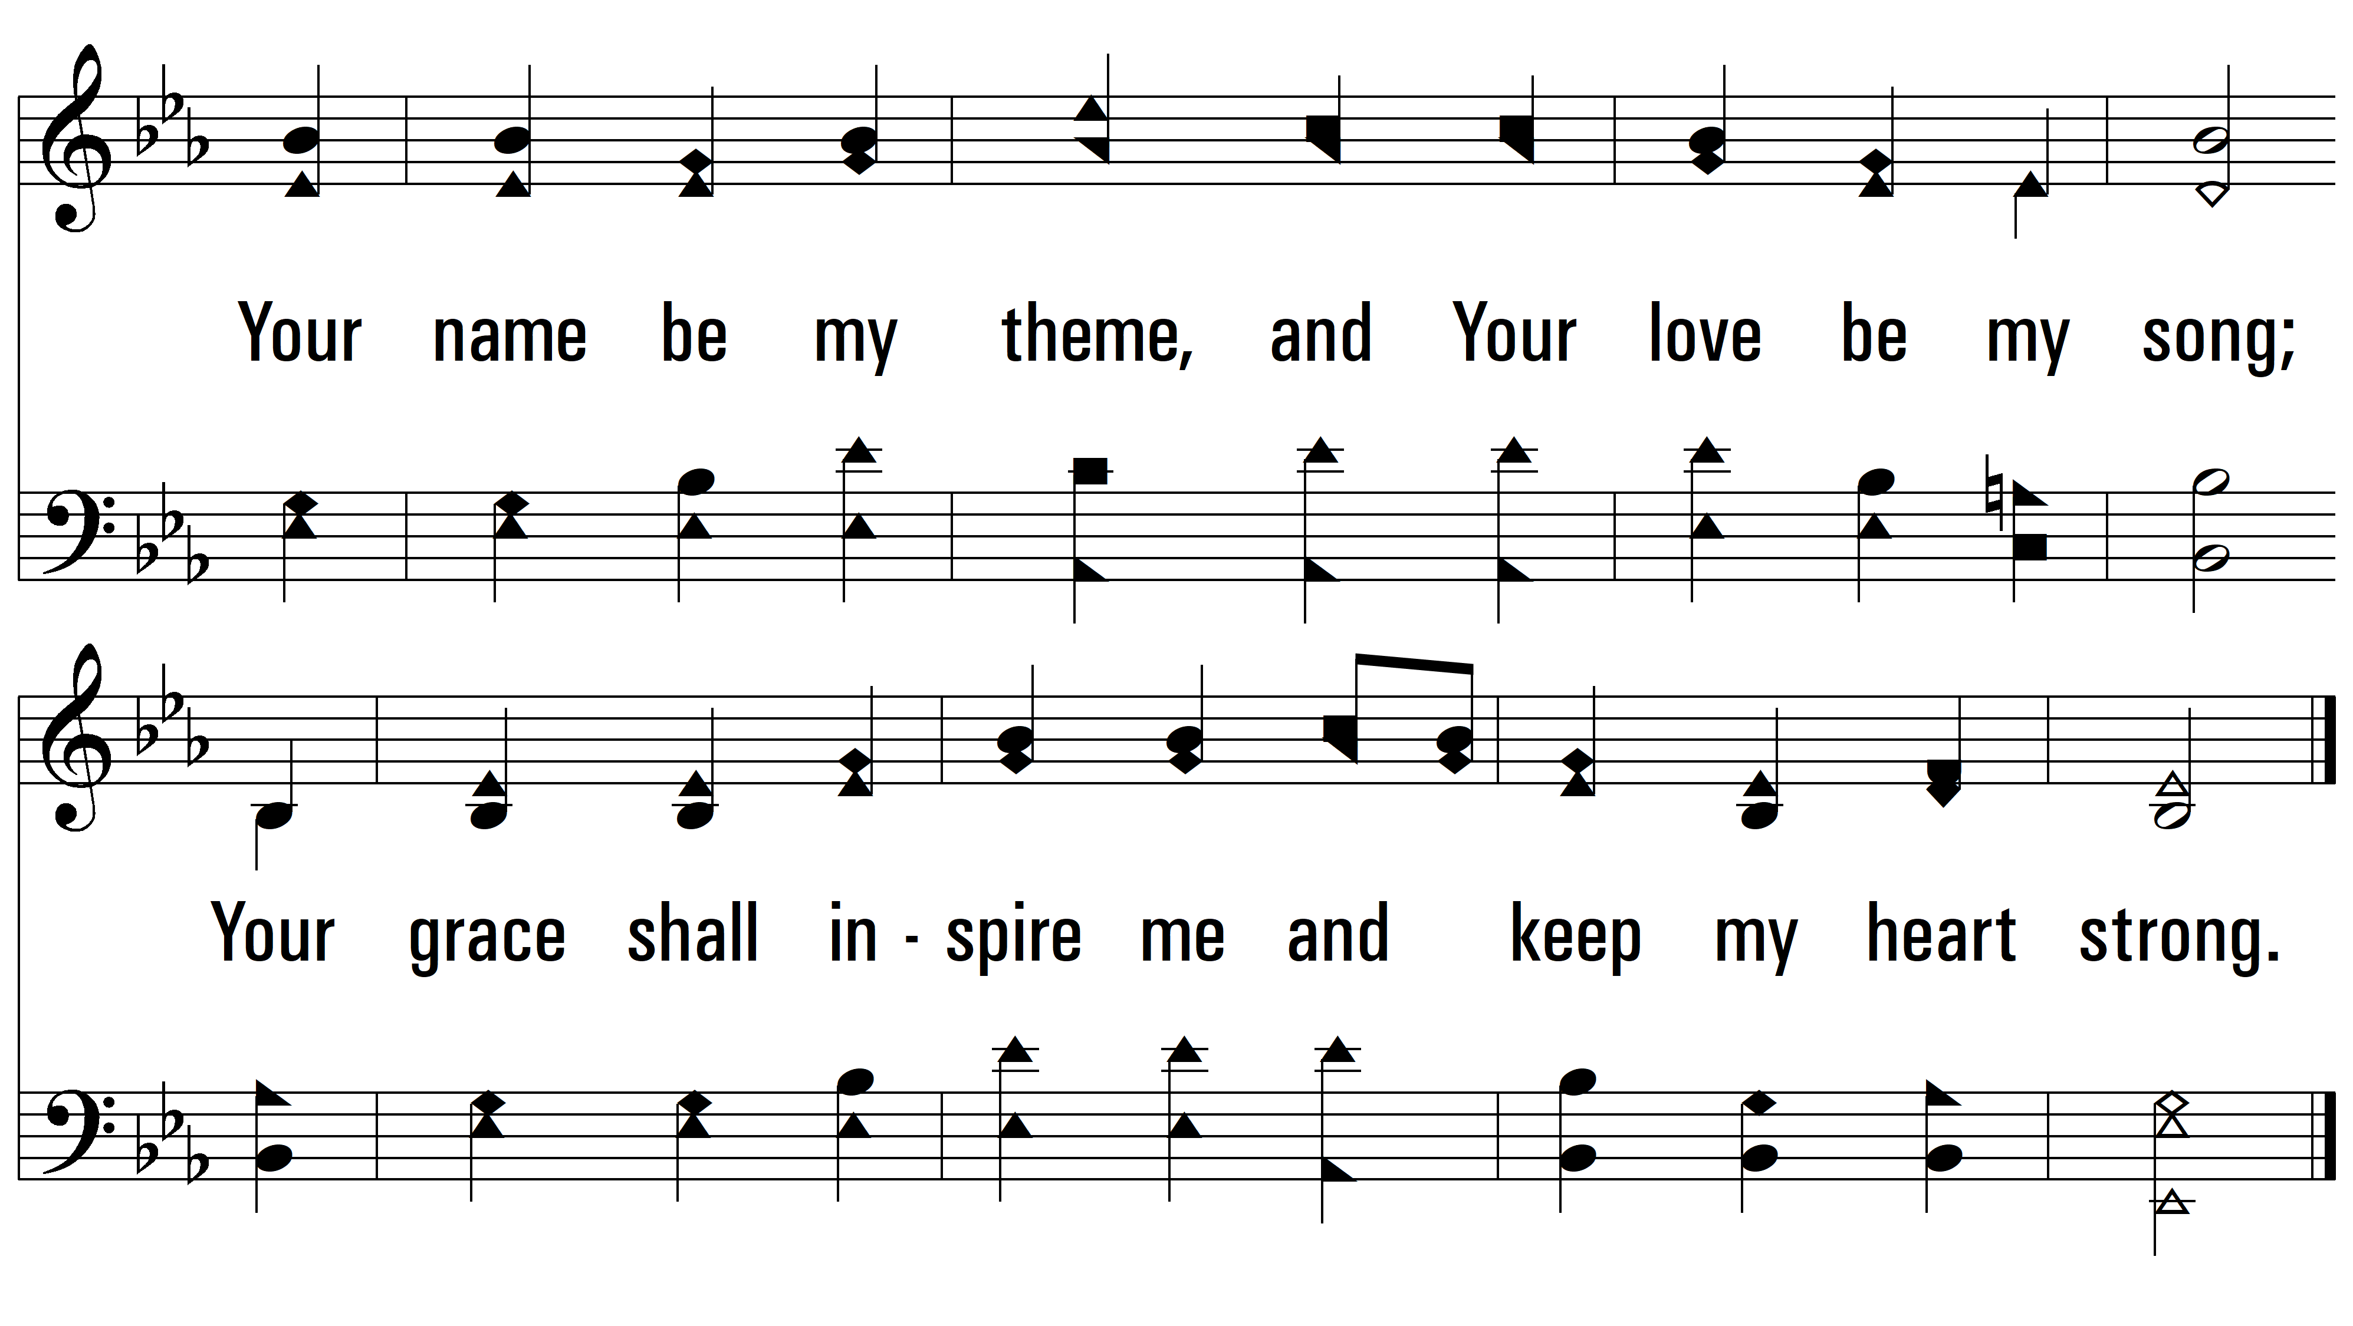
vs. 2
PDHymns.com
END

