Slide 1
I Love To Tell The Story
Words: | Catherine Hankey (1866), Chorus by William G. Fischer (1869)
Music: | William G. Fischer (1869)
4/4
A^{b}/E^{b} - SOL
Verses: 4/Chorus
Lead - | SOL
Alto - | MI
Tenor - | DO
Bass - | DO
PDHymns.com

Slide 2
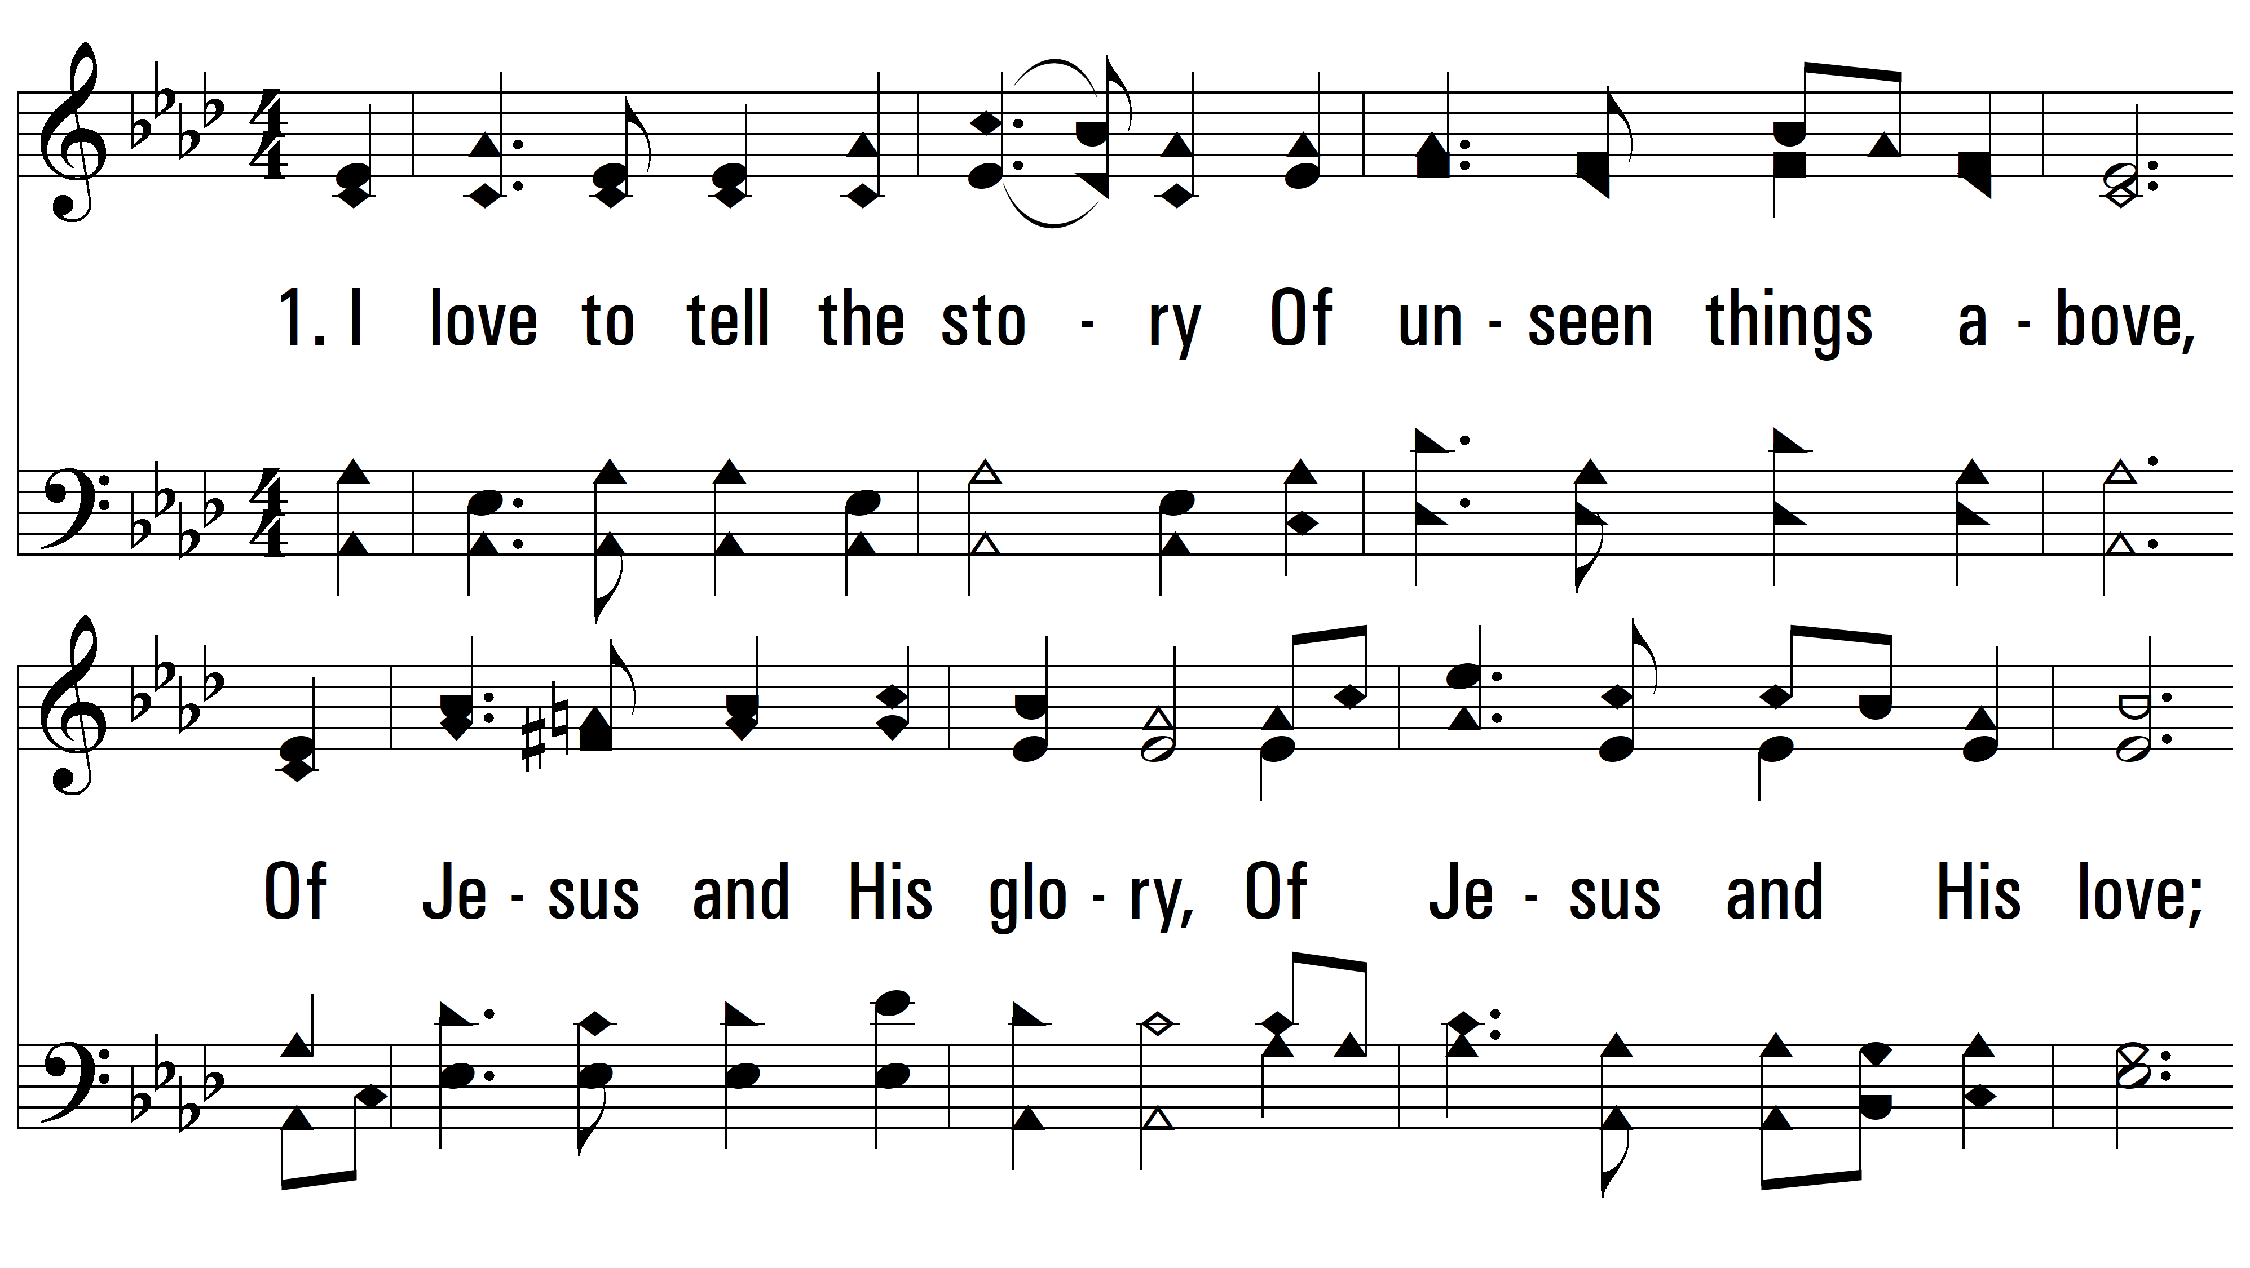
vs. 1 ~ I Love To Tell The Story

Slide 3
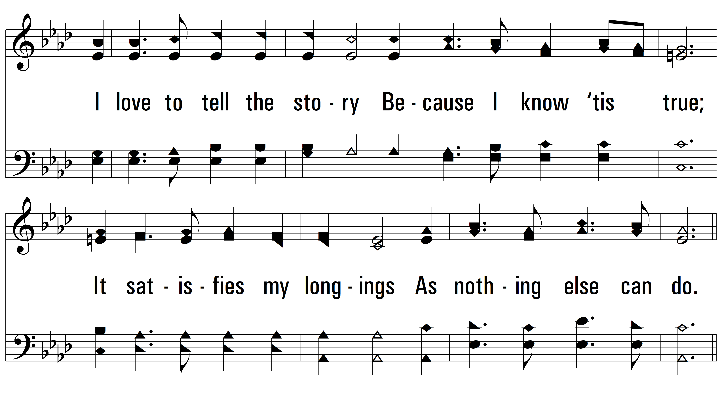
vs. 1

Slide 4
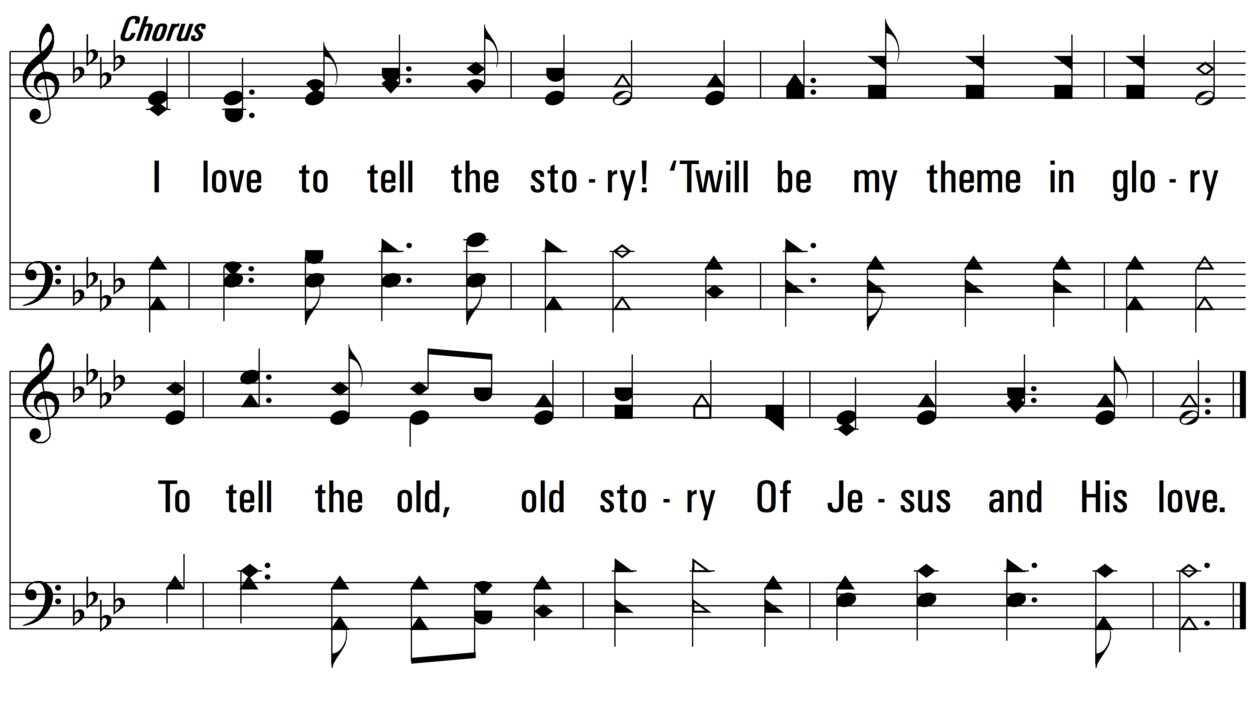
vs. 1

Slide 5
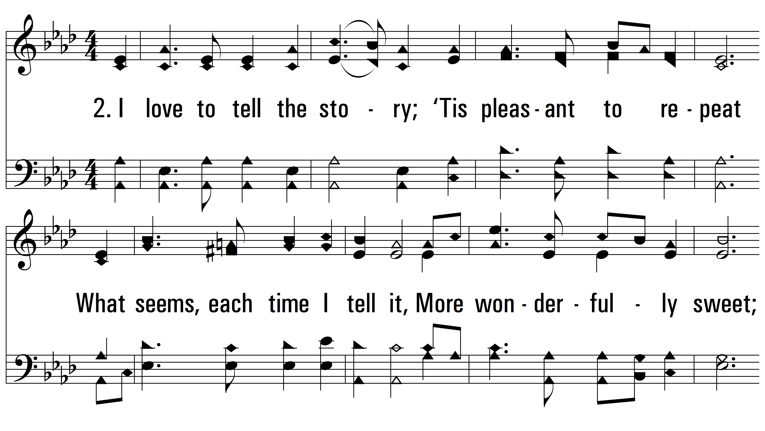
vs. 2 ~ I Love To Tell The Story

Slide 6
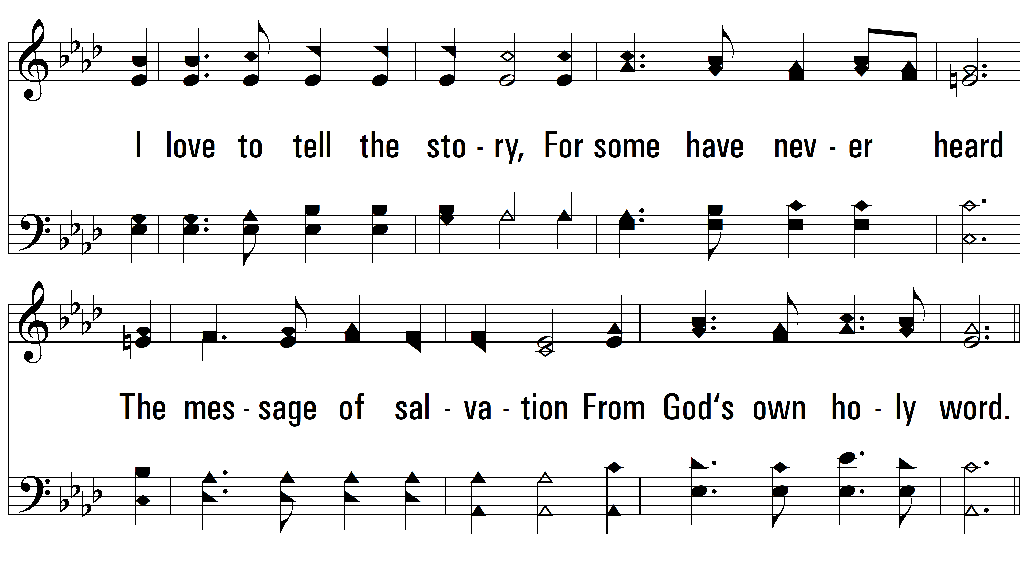
vs. 2

Slide 7
vs. 2

Slide 8
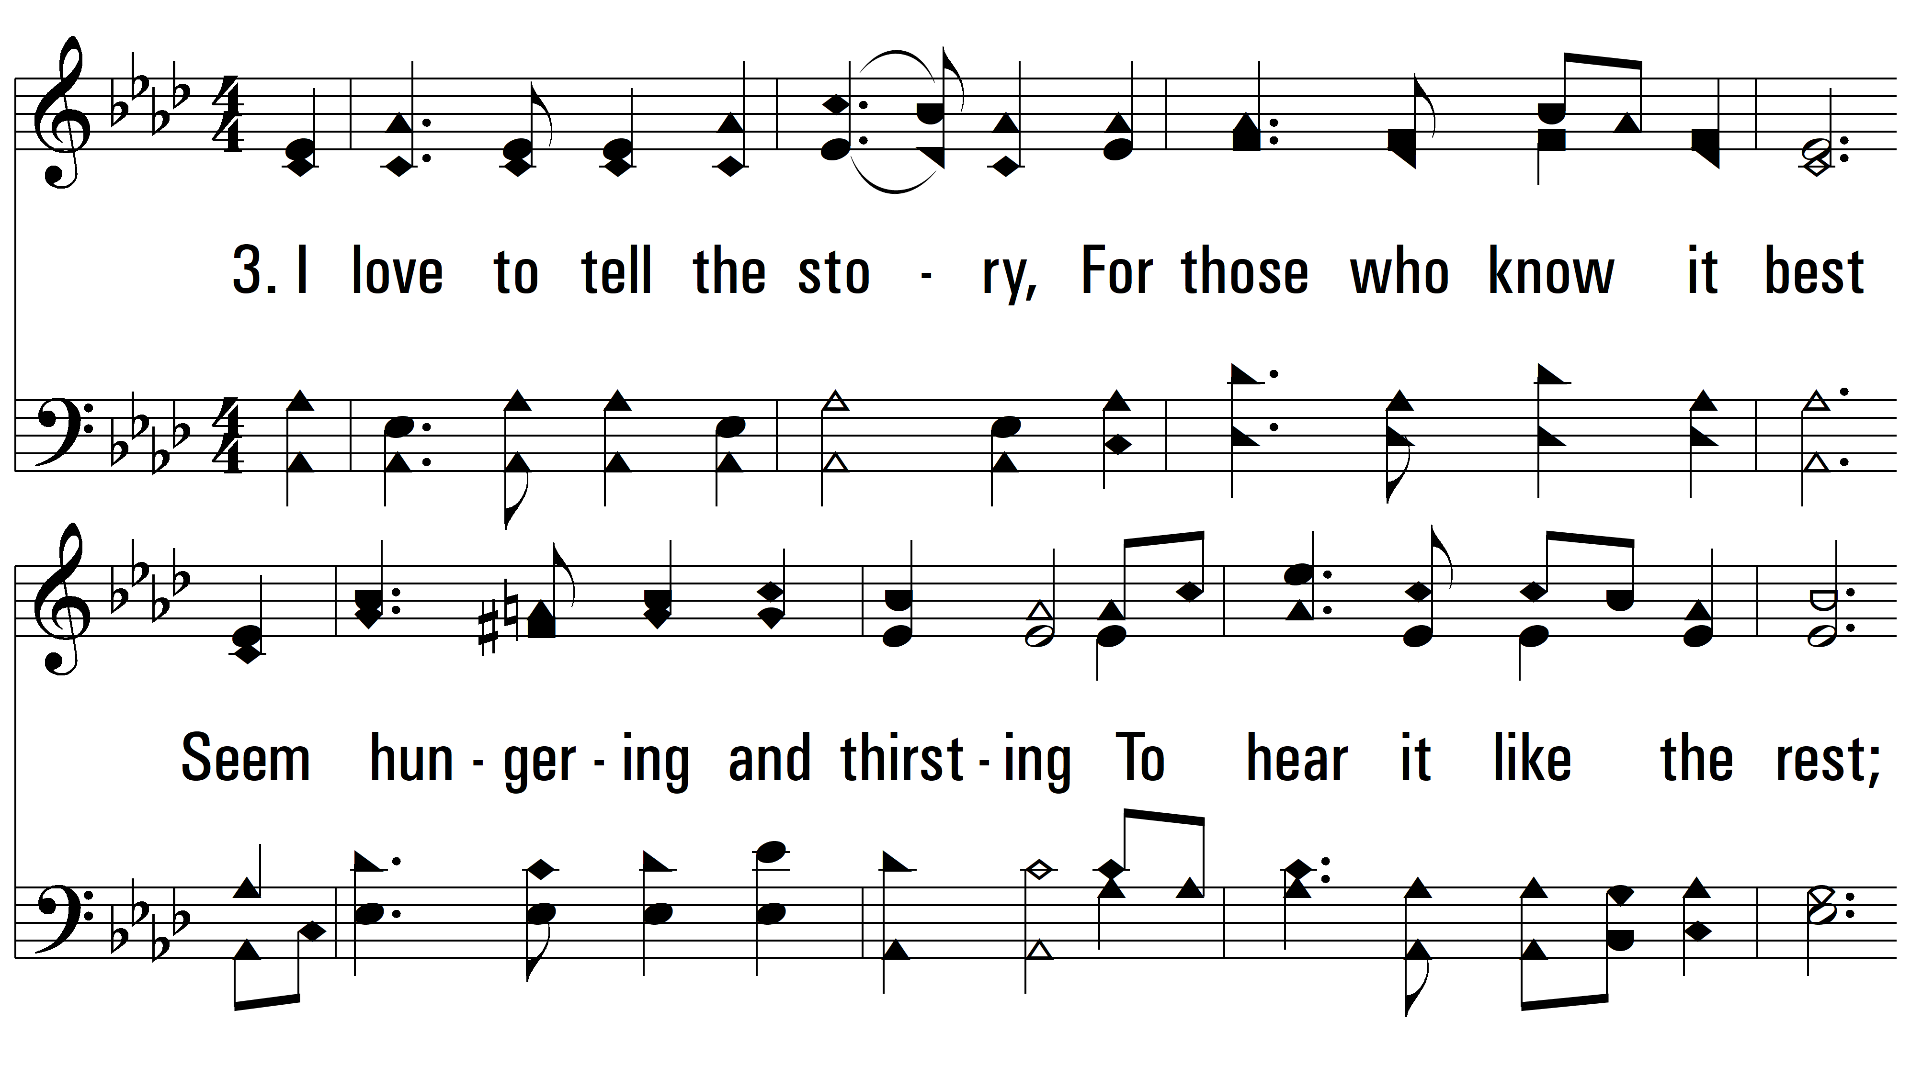
vs. 3 ~ I Love To Tell The Story

Slide 9
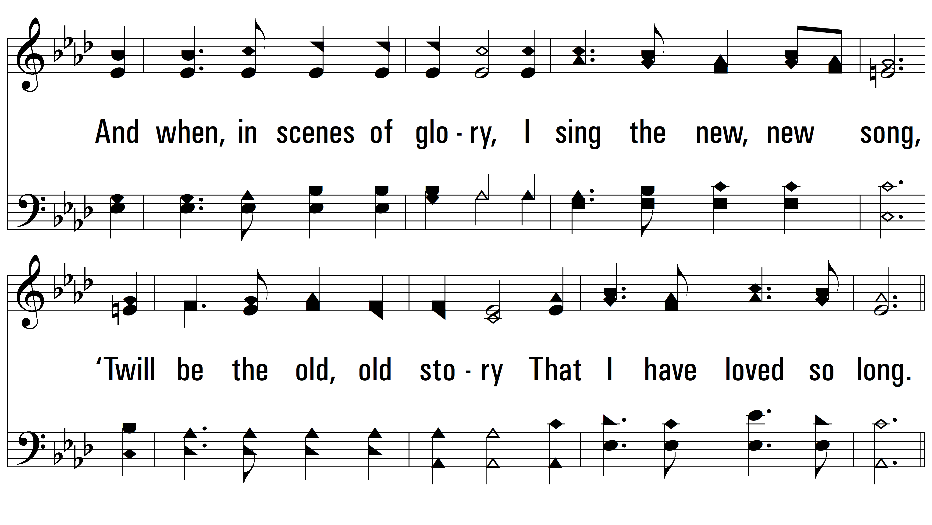
vs. 3

Slide 10
vs. 3
PDHymns.com
END

