Slide 1
I Love Thy Kingdom, Lord
BEALOTH
SMD
Words: | Timothy Dwight (1800)
Music: | A. B. Everett (1843)
4/4
A/E - SOL
Verses: 3
Lead - | SOL
Alto - | MI
Tenor - | DO
Bass - | DO
PDHymns.com

Slide 2
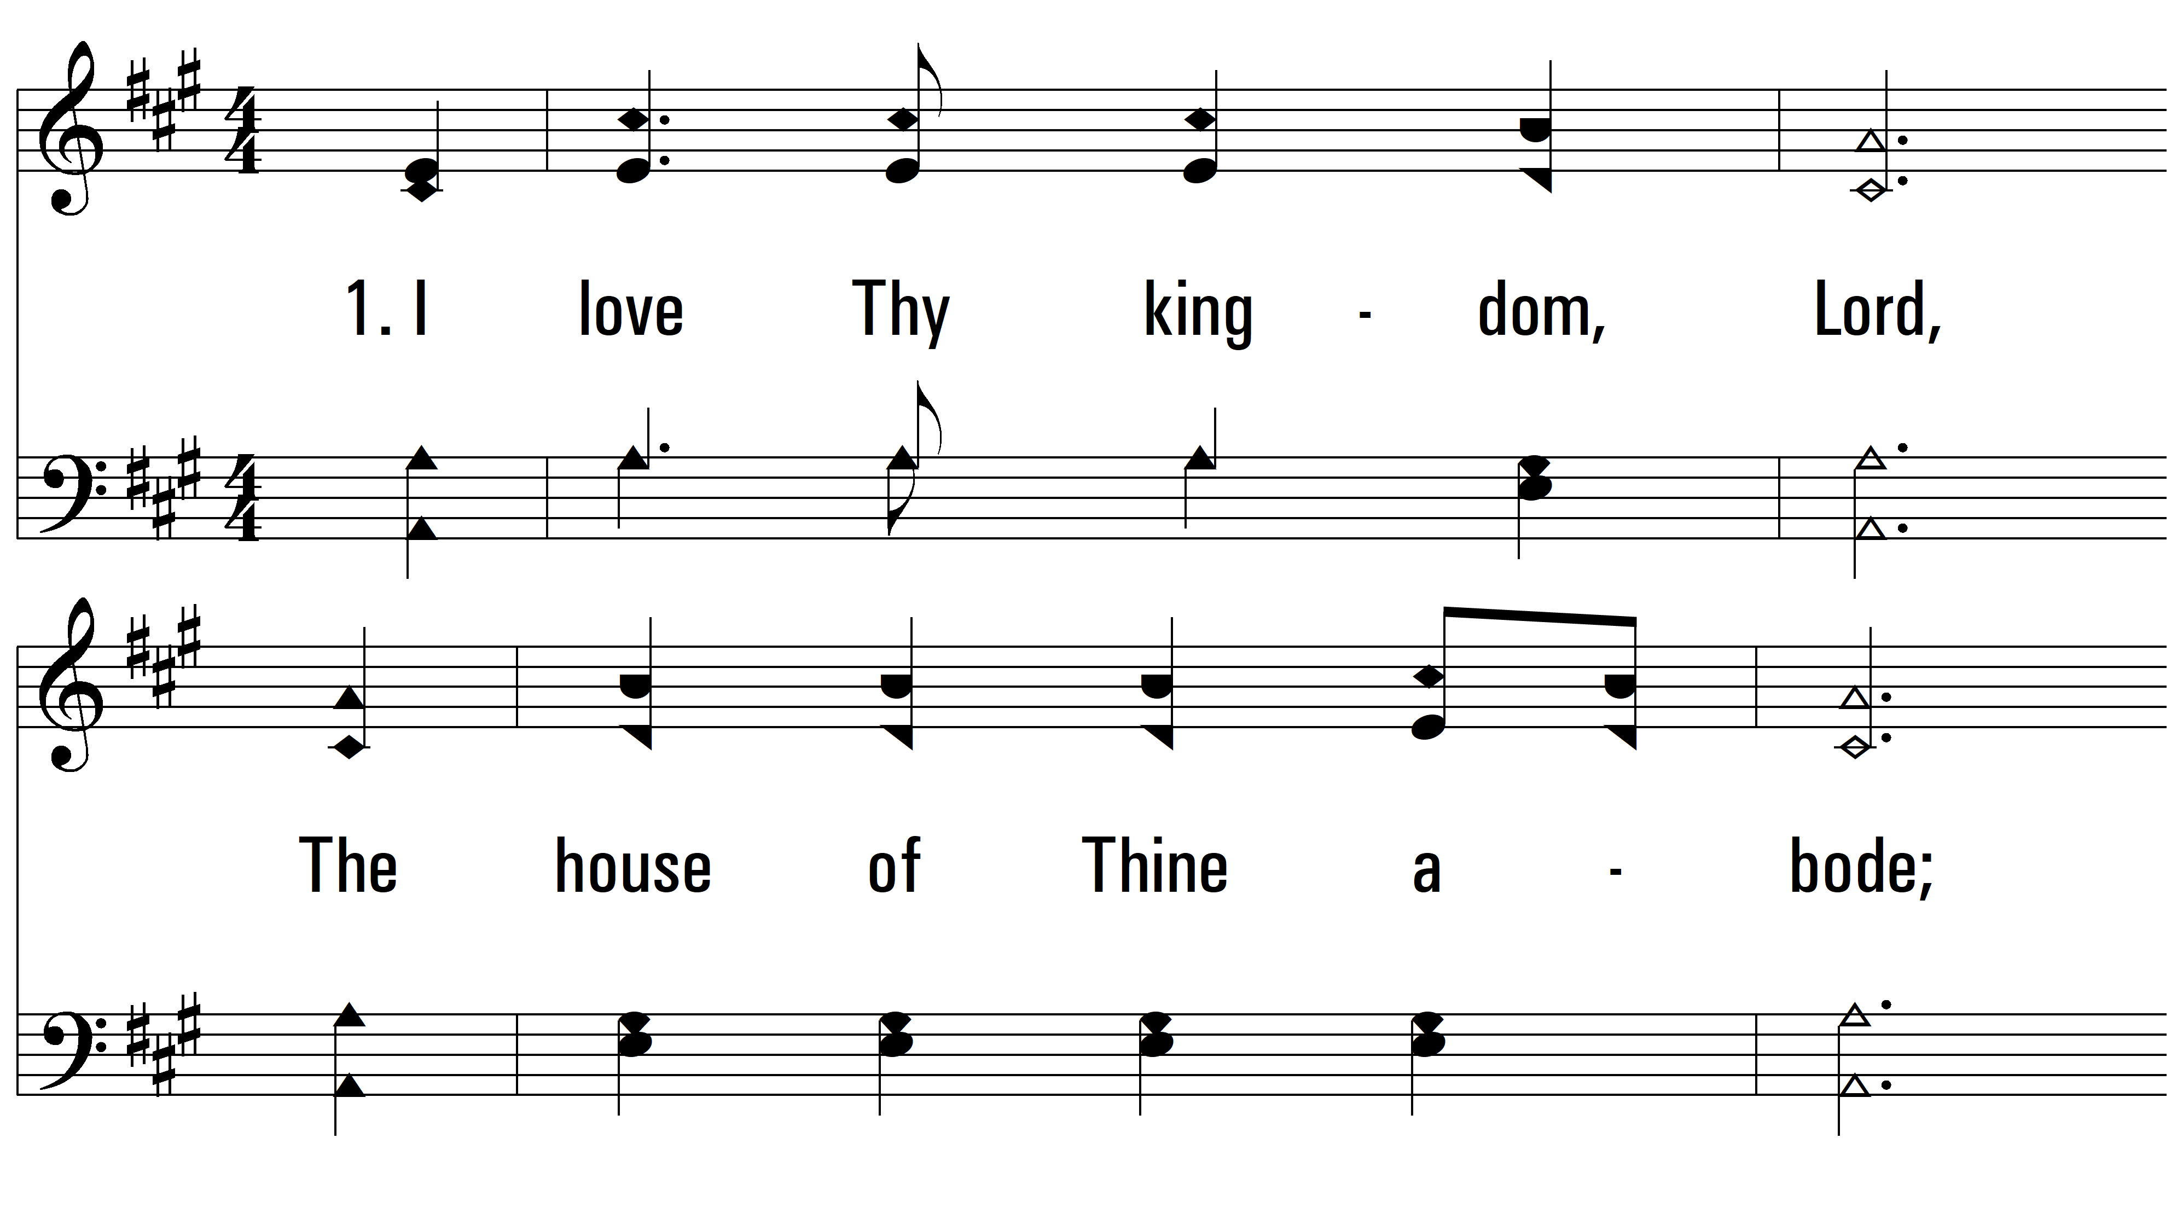
vs. 1 ~ I Love Thy Kingdom, Lord

Slide 3
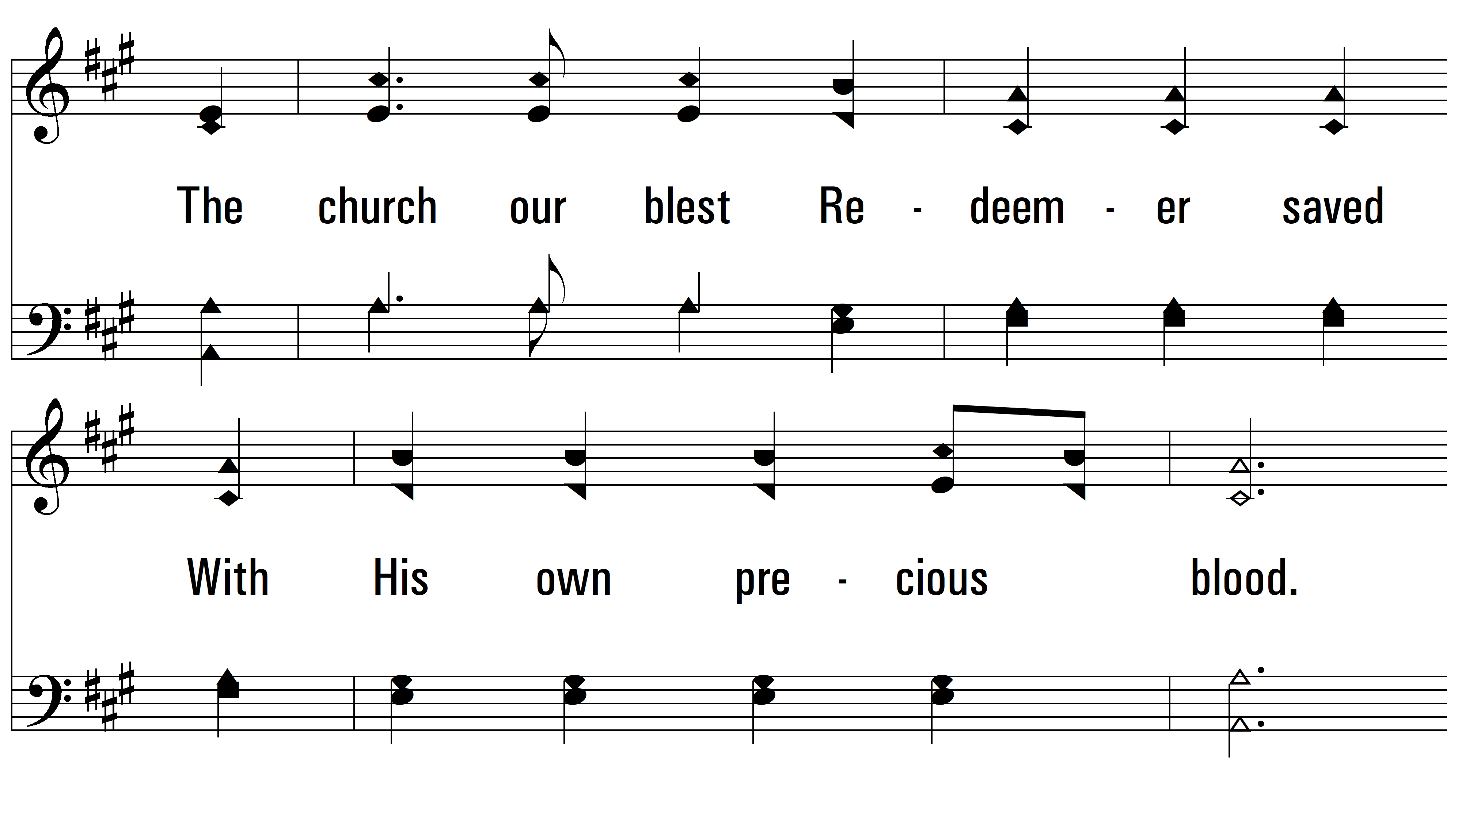
vs. 1

Slide 4
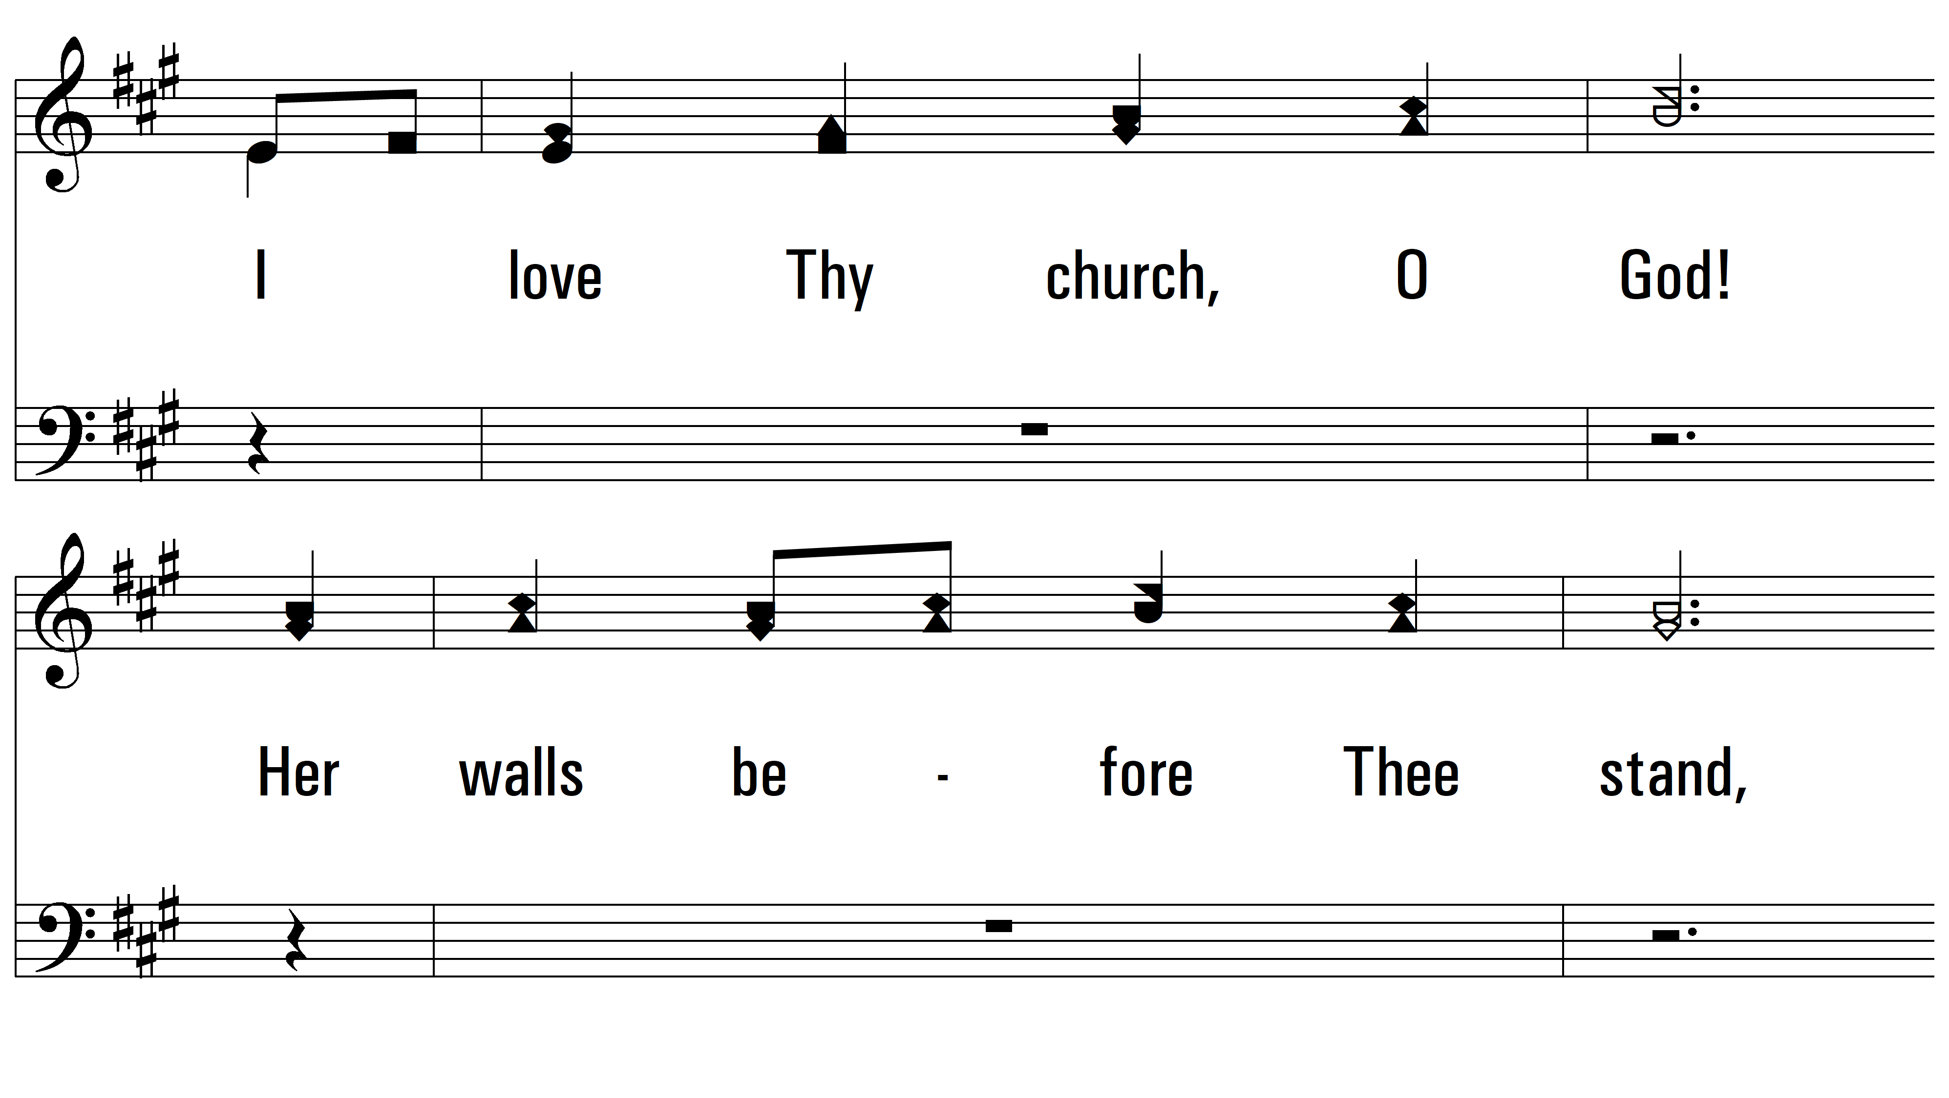
vs. 1

Slide 5
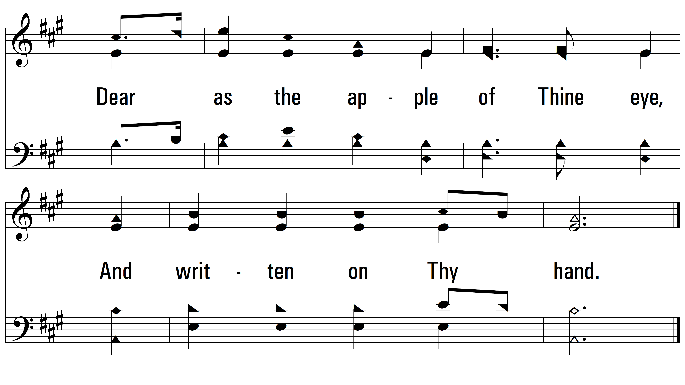
vs. 1

Slide 6
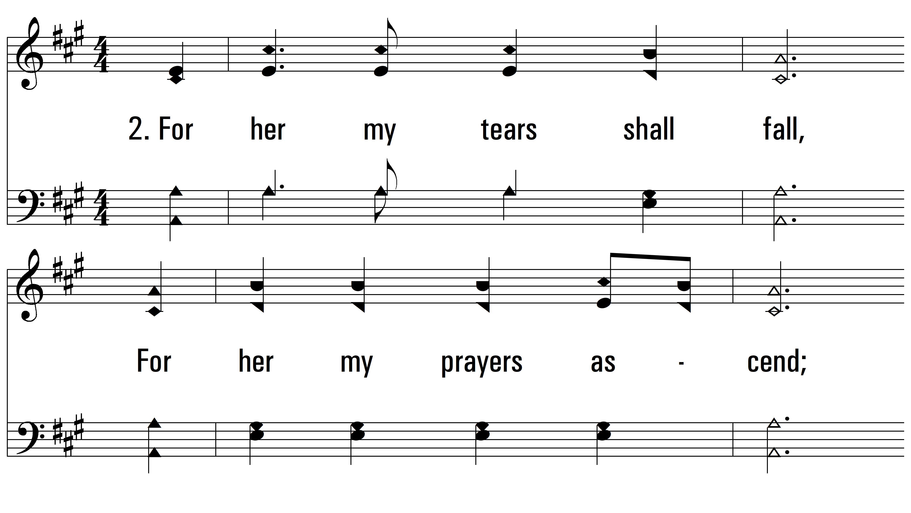
vs. 2 ~ I Love Thy Kingdom, Lord

Slide 7
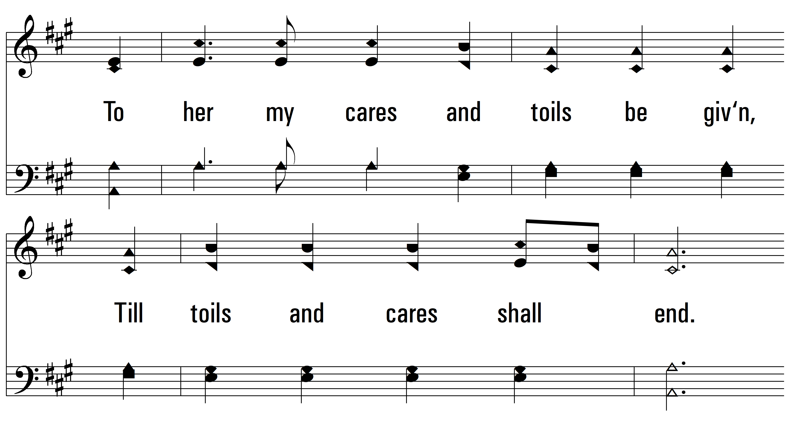
vs. 2

Slide 8
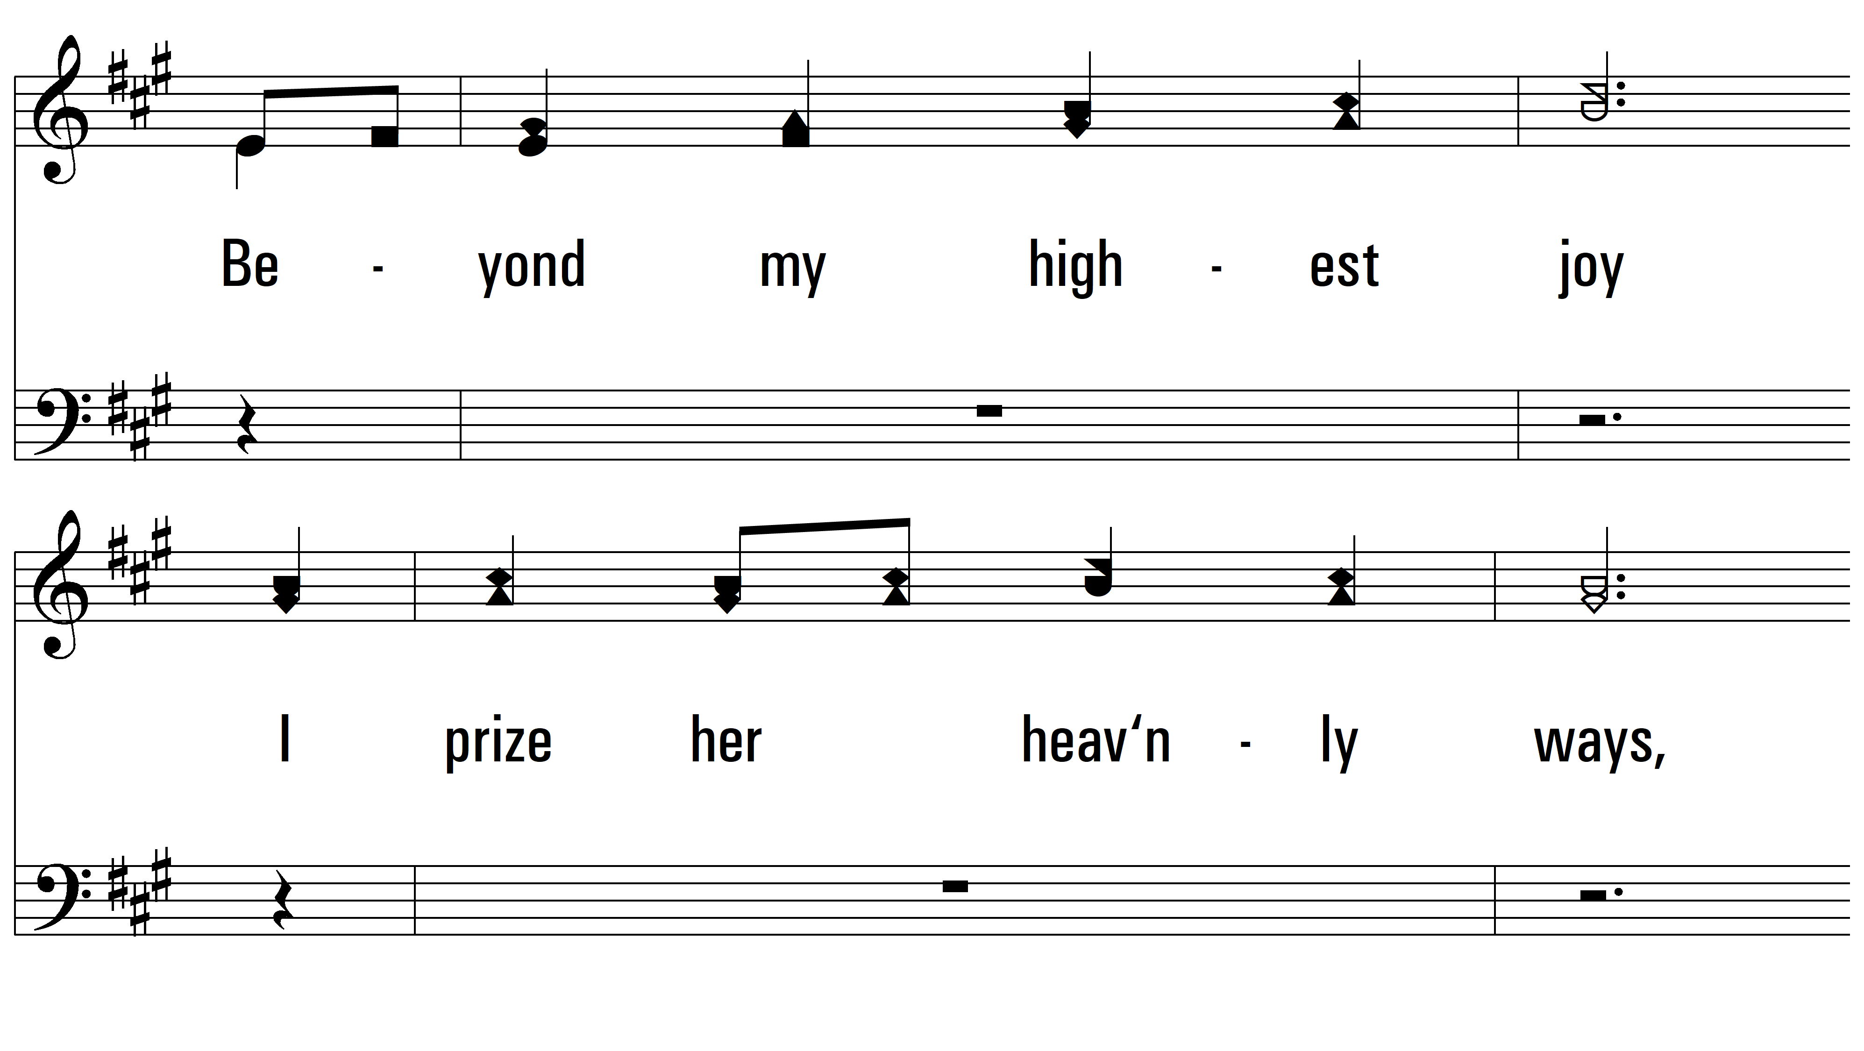
vs. 2

Slide 9
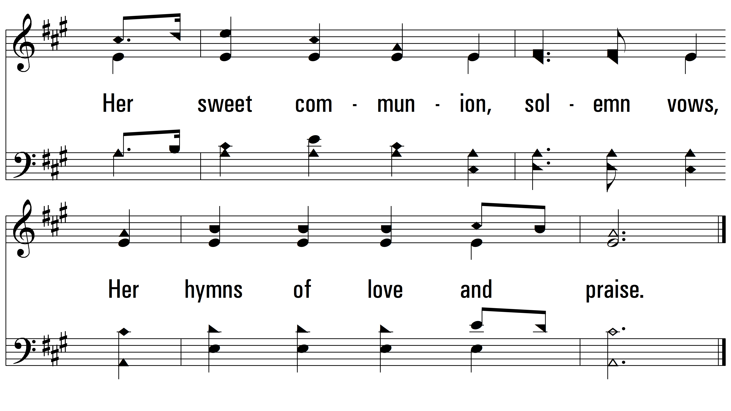
vs. 2

Slide 10
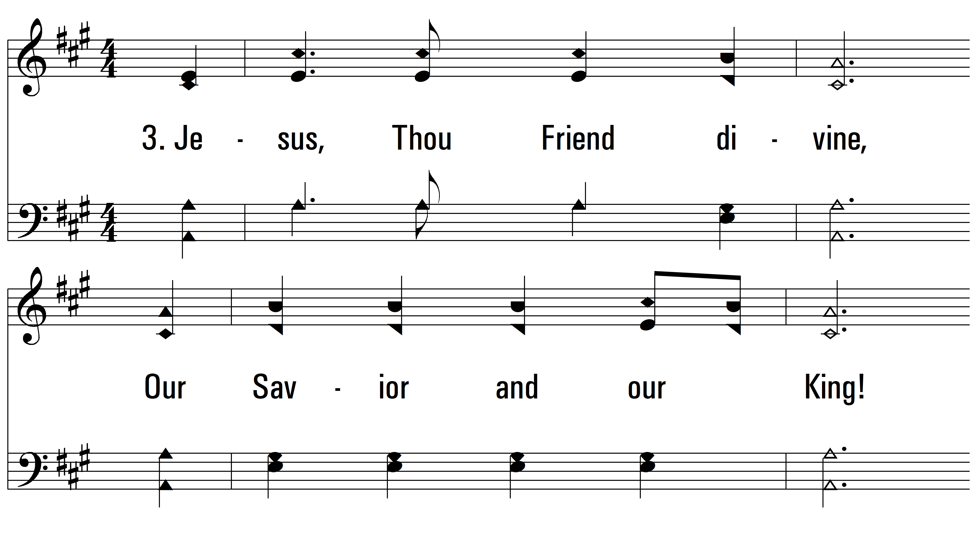
vs. 3 ~ I Love Thy Kingdom, Lord

Slide 11
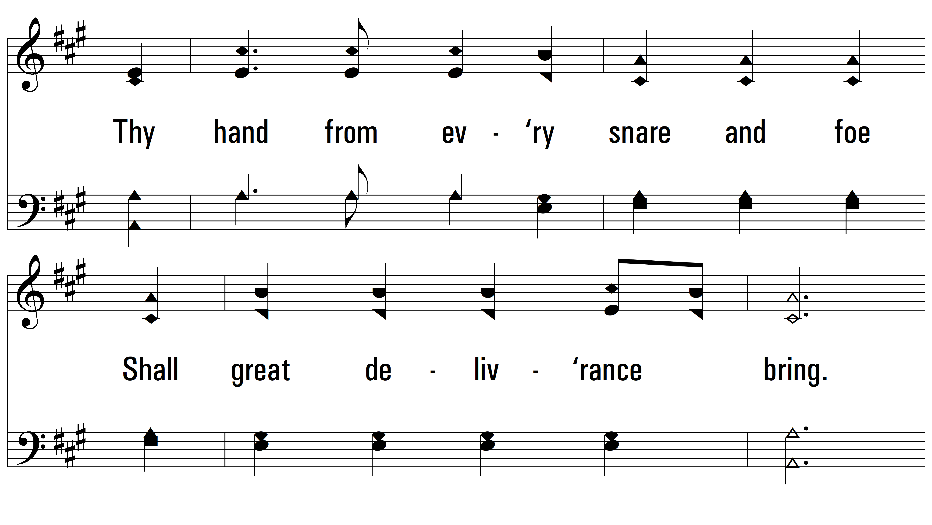
vs. 3

Slide 12
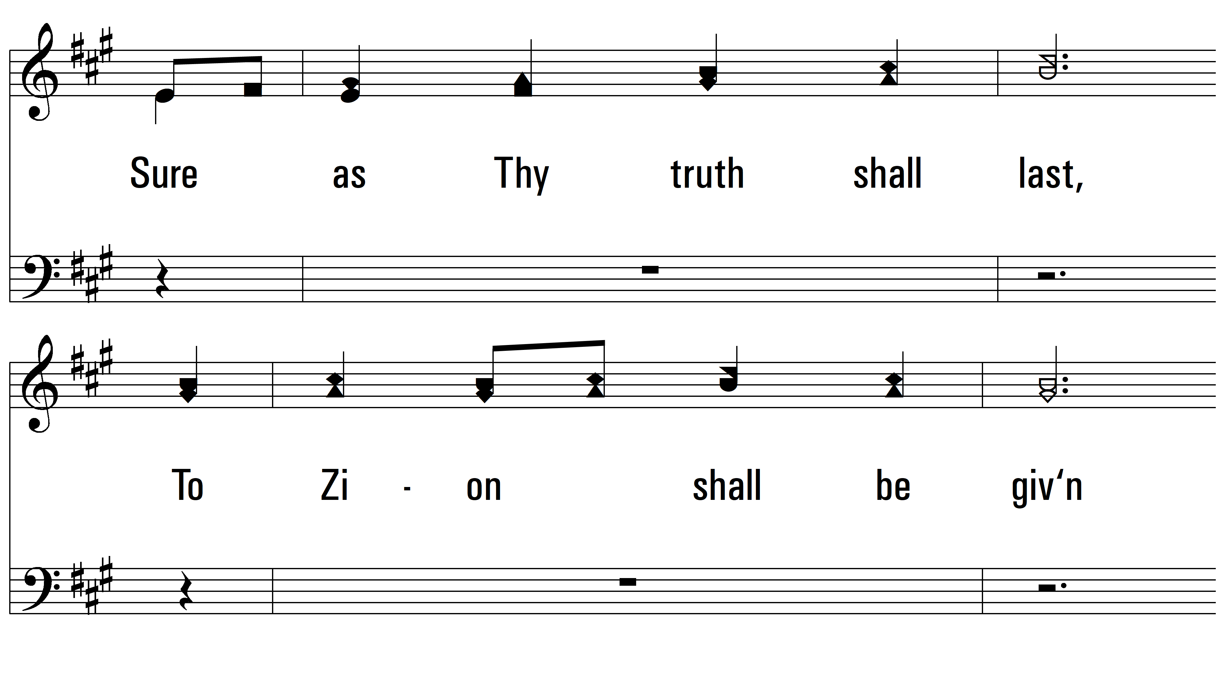
vs. 3

Slide 13

vs. 3
PDHymns.com
END

