Slide 1
I Know Whom I Have Believed
(I Know Not Why God’s Wondrous Grace)
Words: | El Nathan (1883)
Music: | James McGranshan (1883)
4/4
E^{b}/E^{b} - DO
Verses: 5/Chorus
Lead - | DO
Alto - | DO
Tenor - | MI
Bass - | DO
PDHymns.com

Slide 2
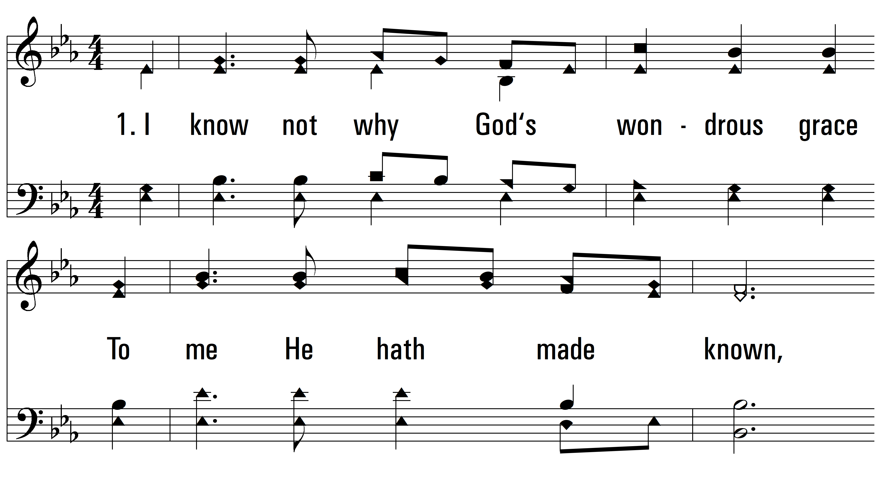
vs. 1 ~ I Know Whom I Have Believed

Slide 3
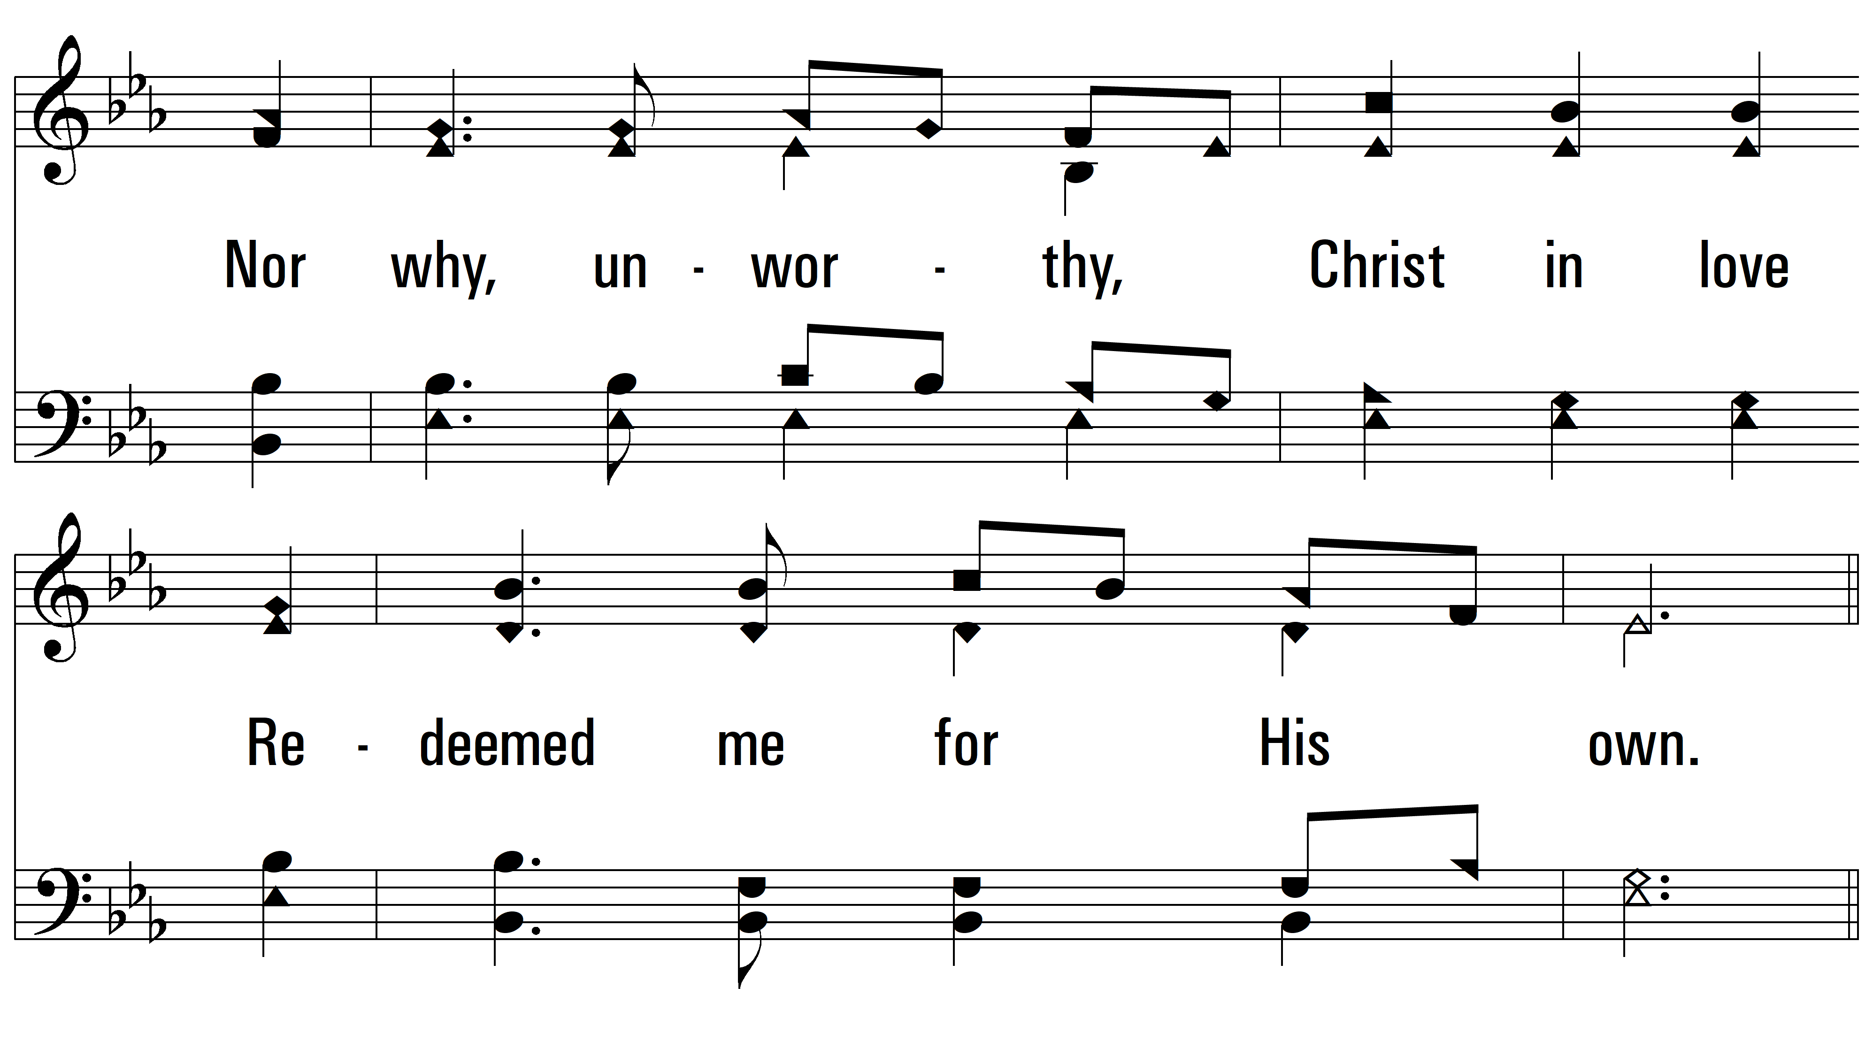
vs. 1

Slide 4
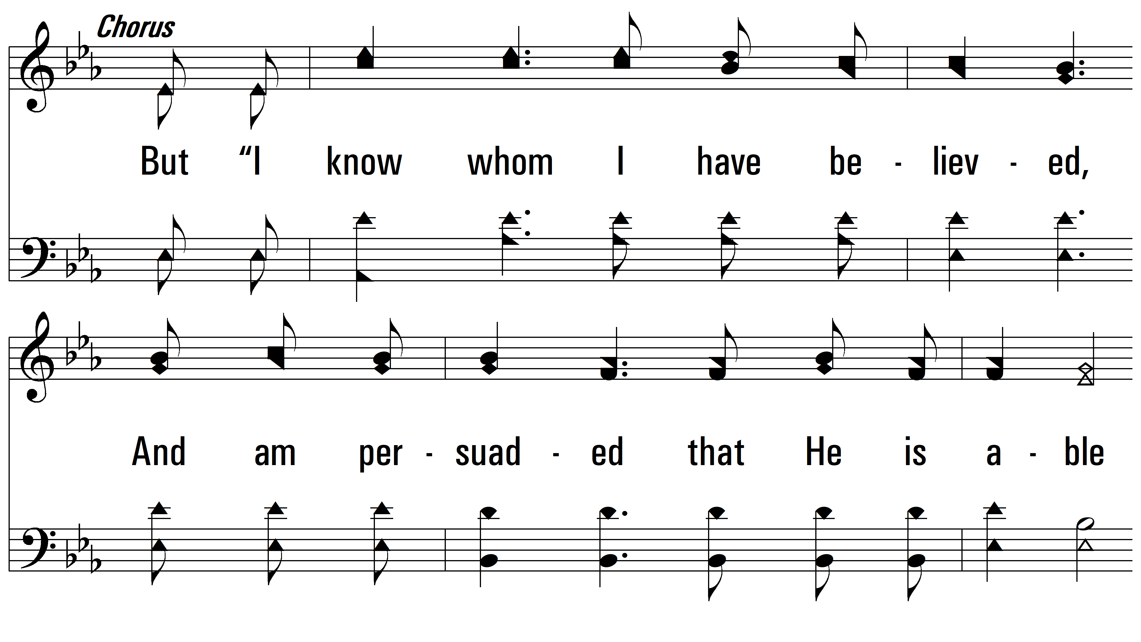
vs. 1

Slide 5
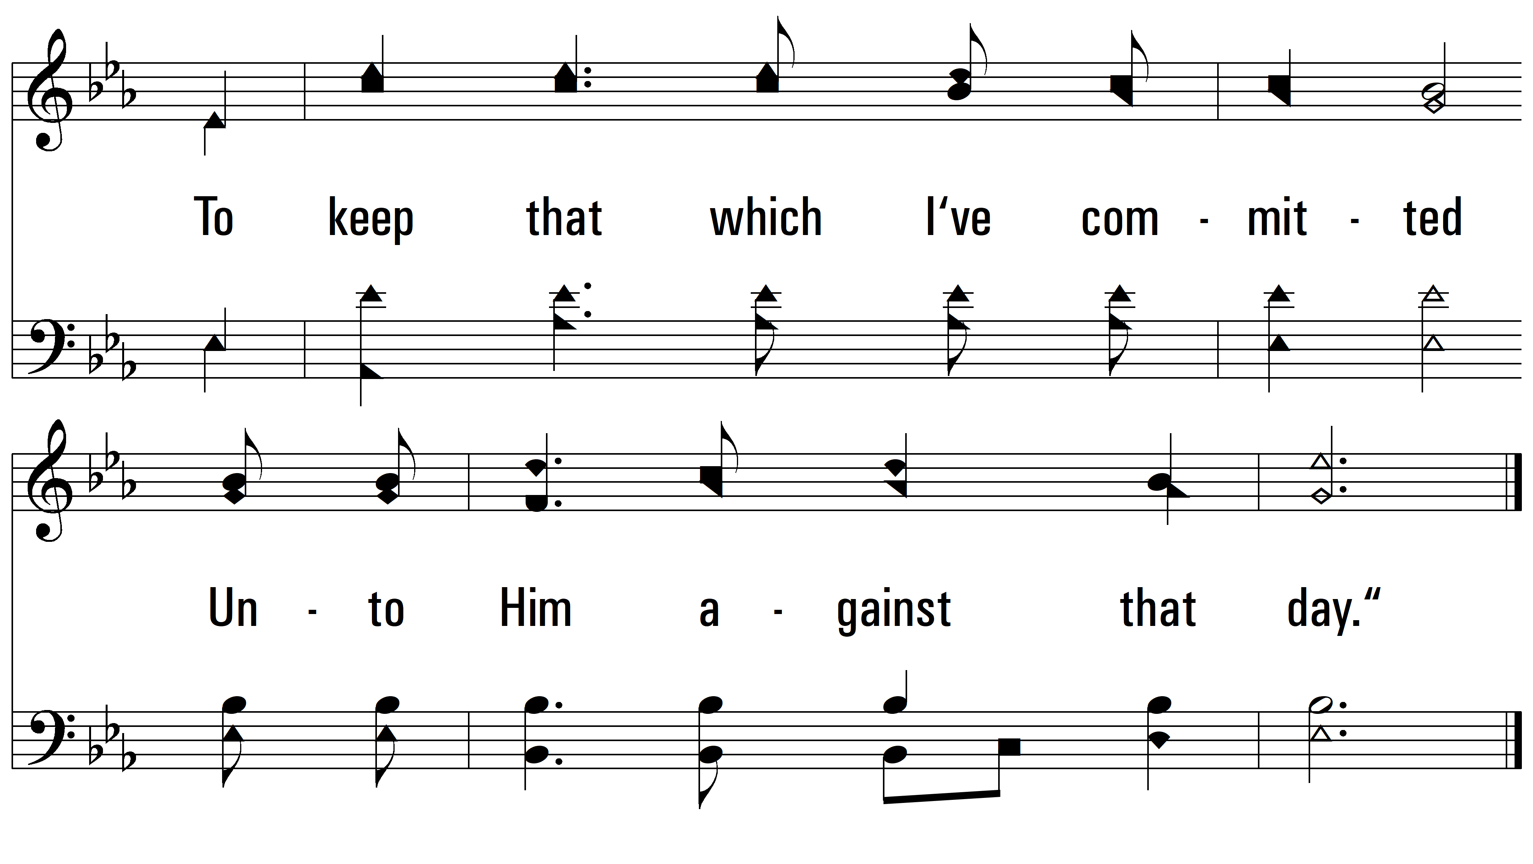
vs. 1

Slide 6

vs. 2 ~ I Know Whom I Have Believed

Slide 7
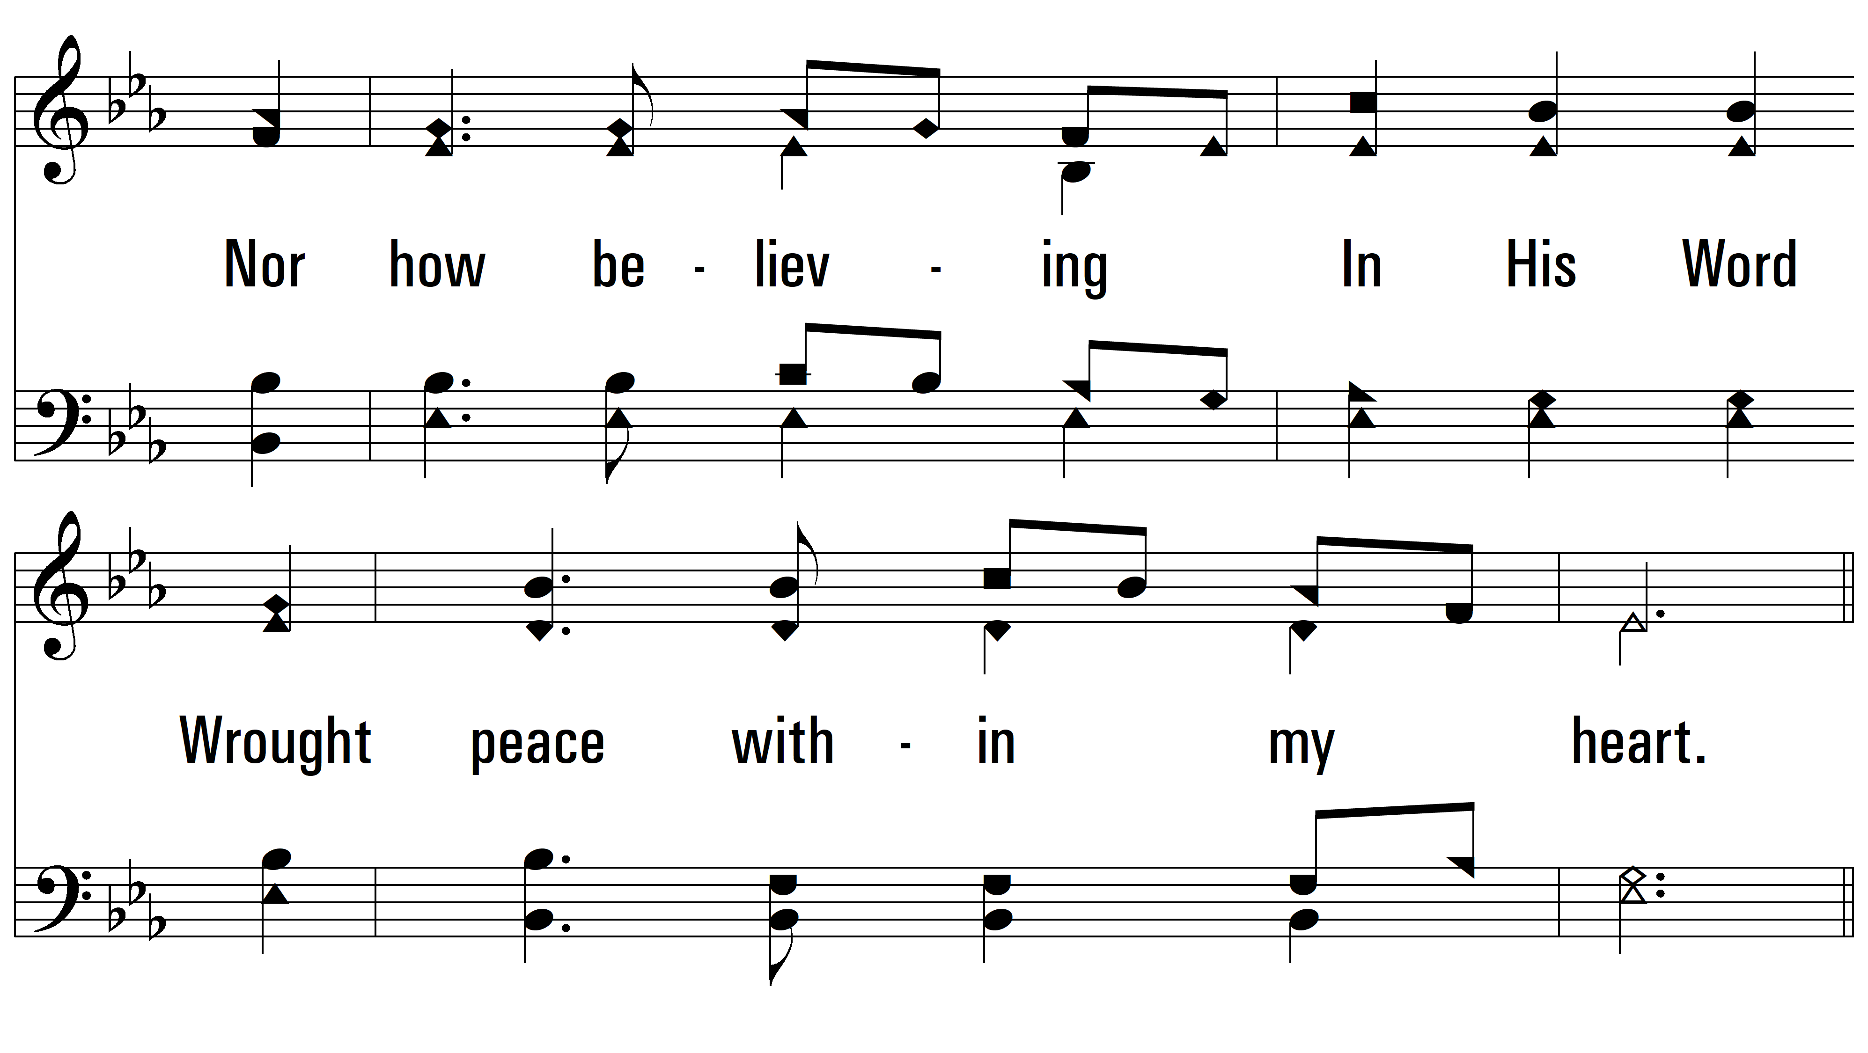
vs. 2

Slide 8
vs. 2

Slide 9
vs. 2

Slide 10
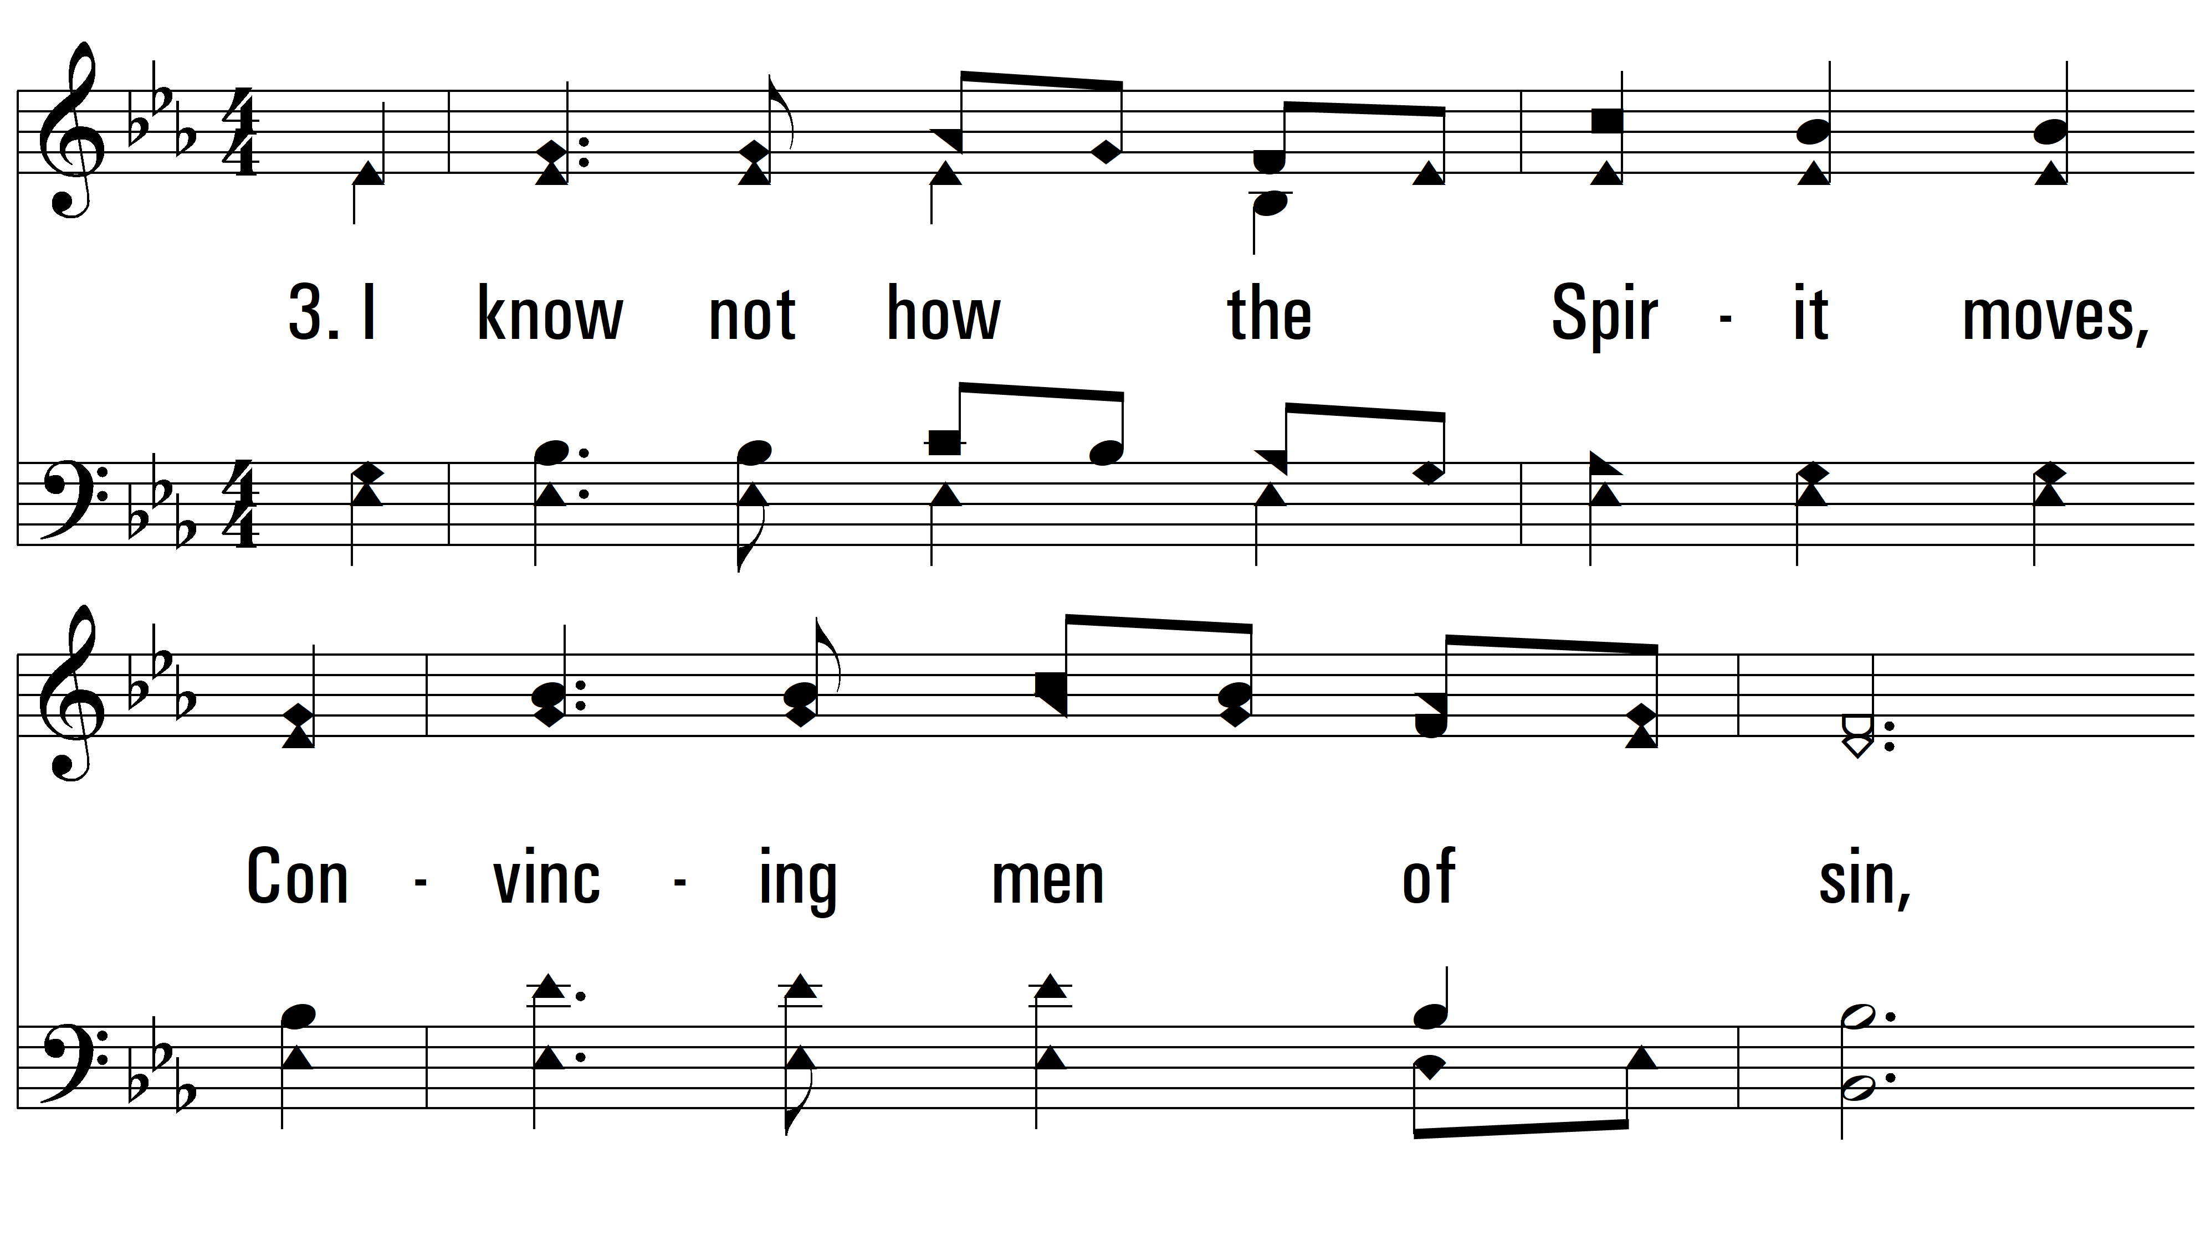
vs. 3 ~ I Know Whom I Have Believed

Slide 11
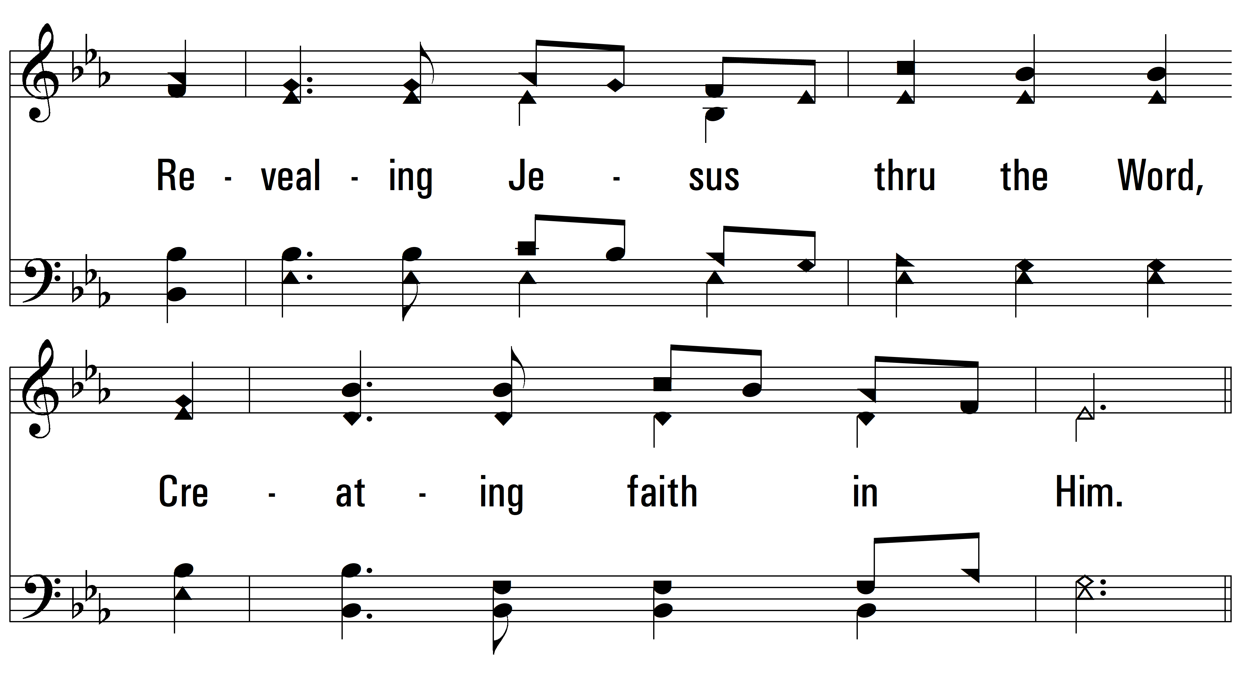
vs. 3

Slide 12
vs. 3

Slide 13
vs. 3

Slide 14
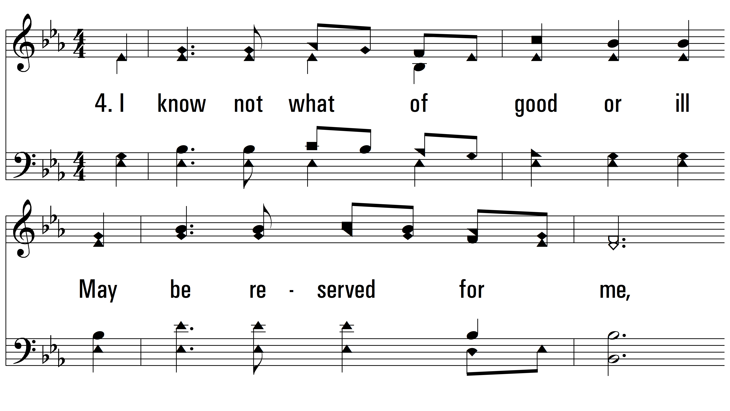
vs. 4 ~ I Know Whom I Have Believed

Slide 15
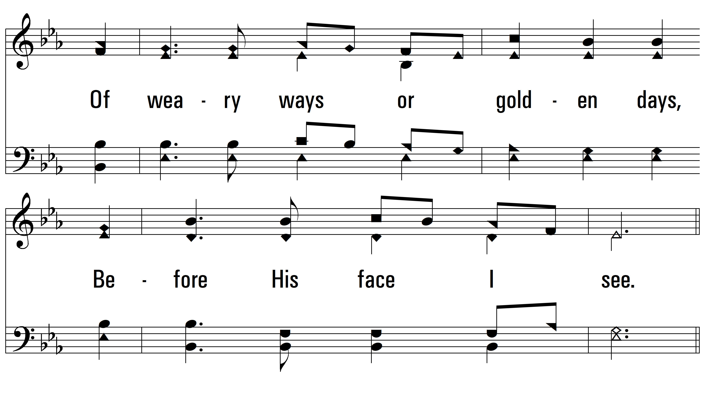
vs. 4

Slide 16
vs. 4

Slide 17
vs. 4

Slide 18
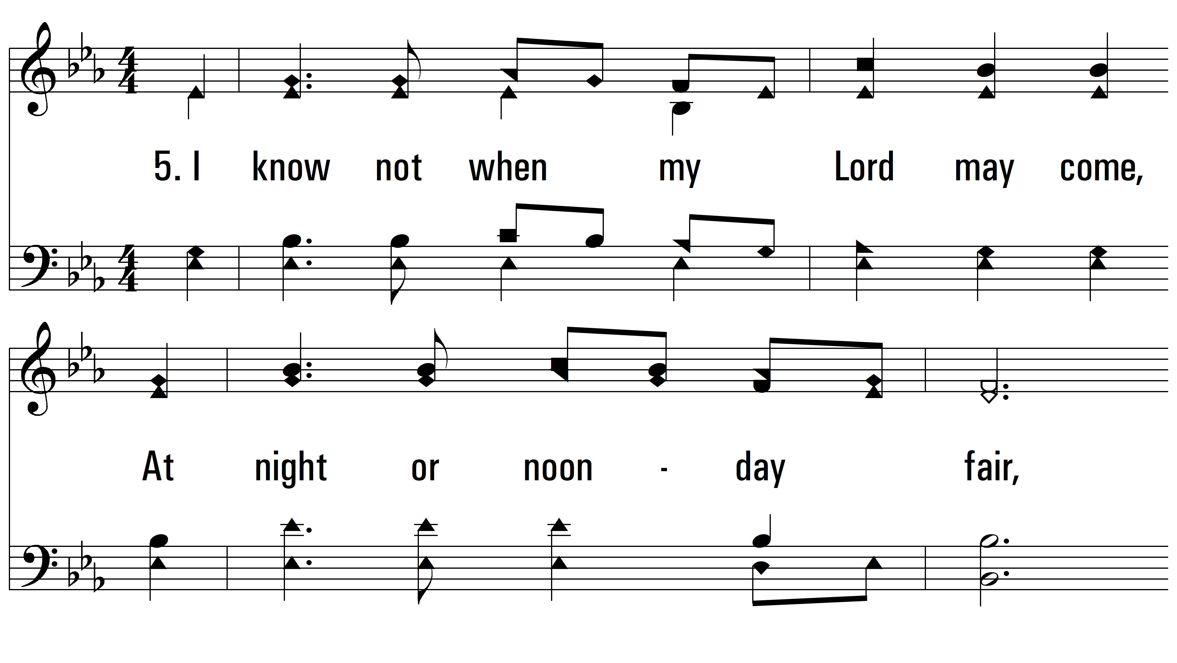
vs. 5 ~ I Know Whom I Have Believed

Slide 19
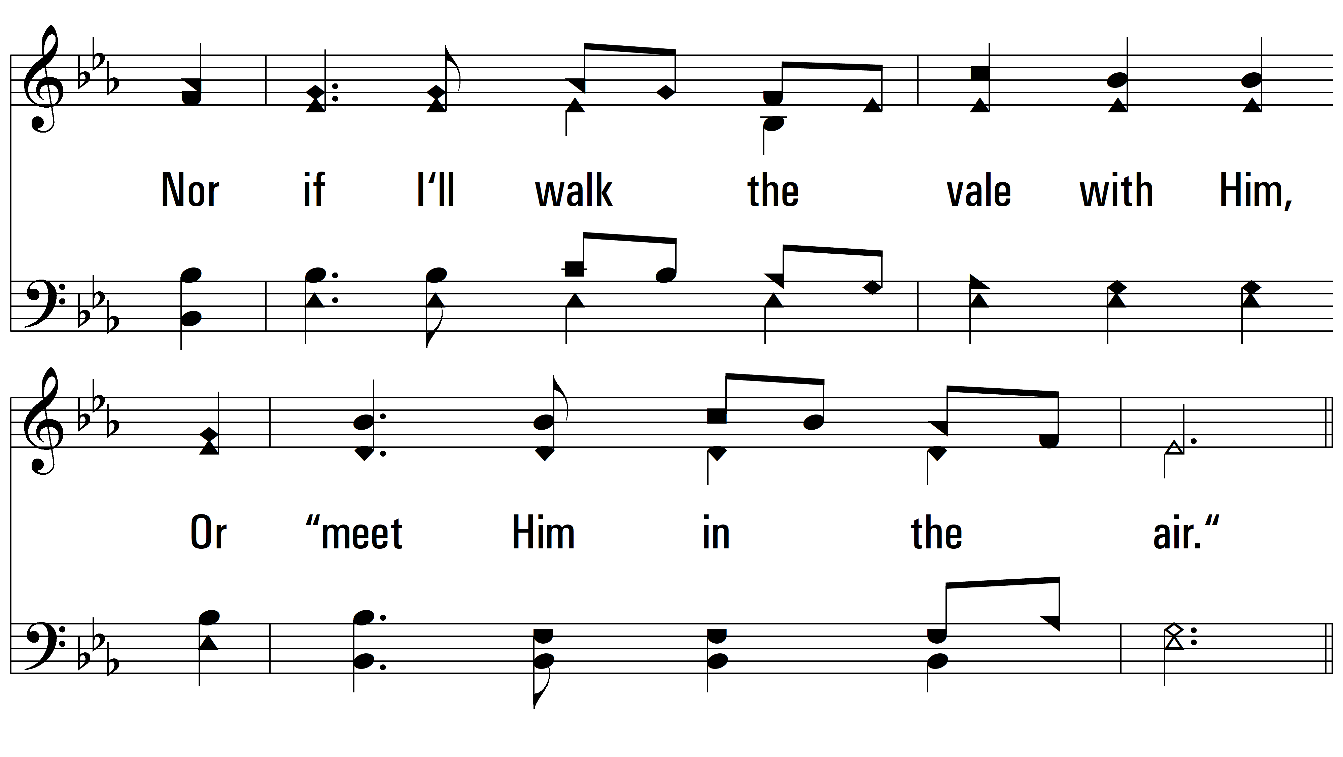
vs. 5

Slide 20
vs. 5

Slide 21
vs. 5
PDHymns.com
END

