Slide 1
I Know That My Redeemer Lives
Words: | Fred A. Fillmore (1917)
Music: | Fred A. Fillmore (1917)
4/4
B^{b}/D - MI
Verses: 4/Chorus
Lead - | MI
Alto - | DO
Tenor - | SOL
Bass - | DO
PDHymns.com

Slide 2
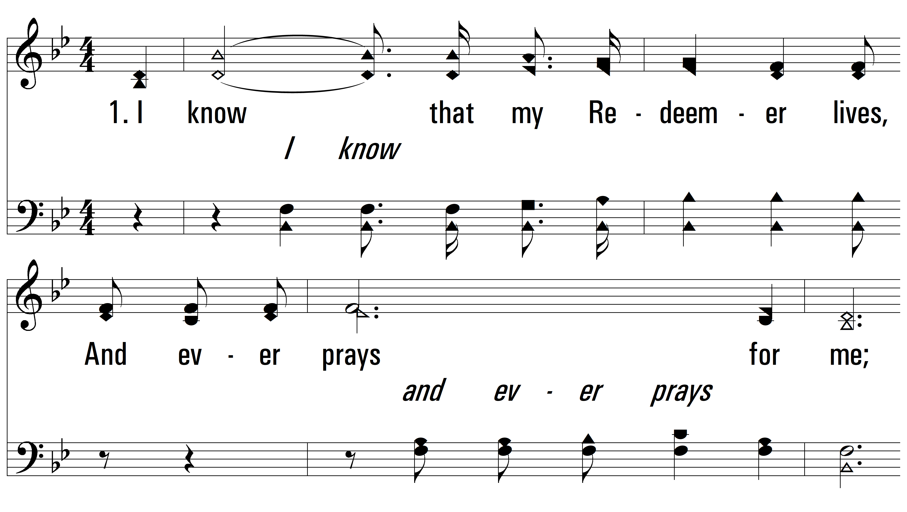
vs. 1 ~ I Know That My Redeemer Lives

Slide 3
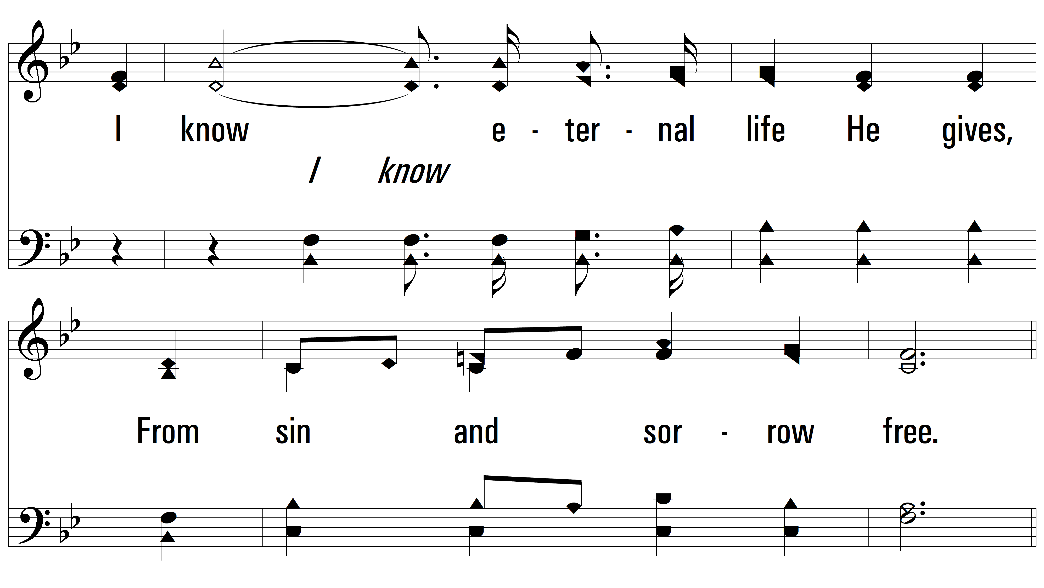
vs. 1

Slide 4
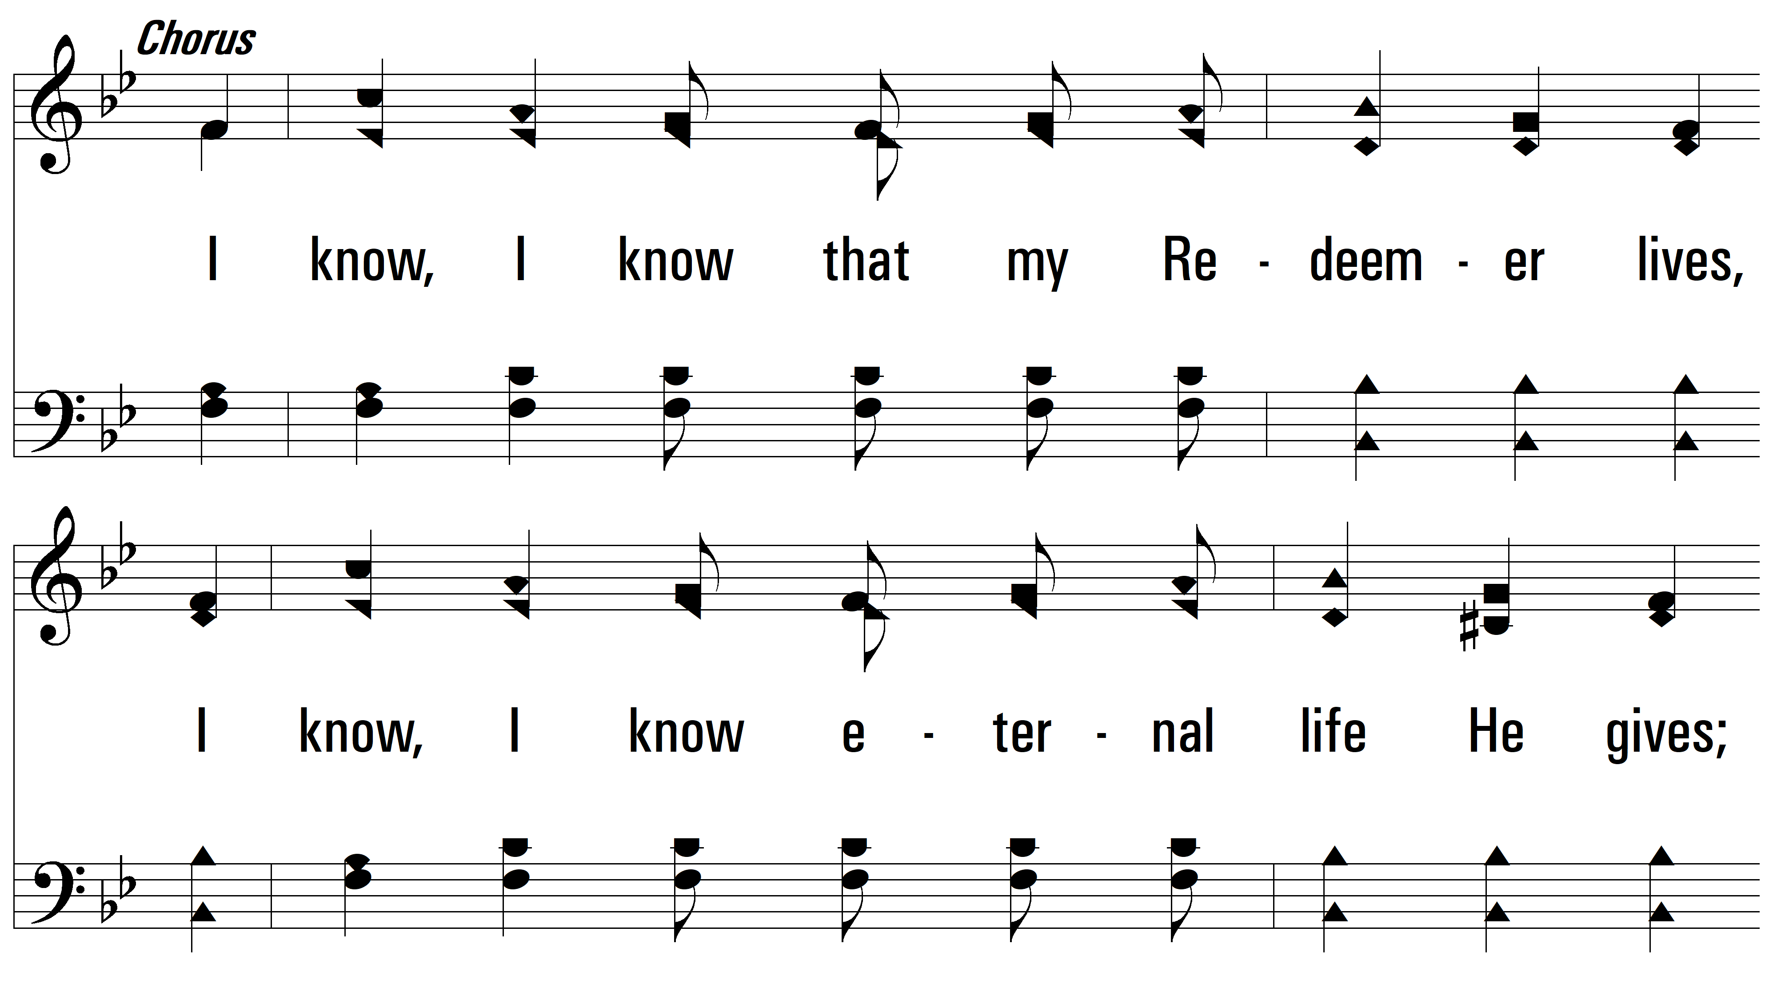
vs. 1

Slide 5
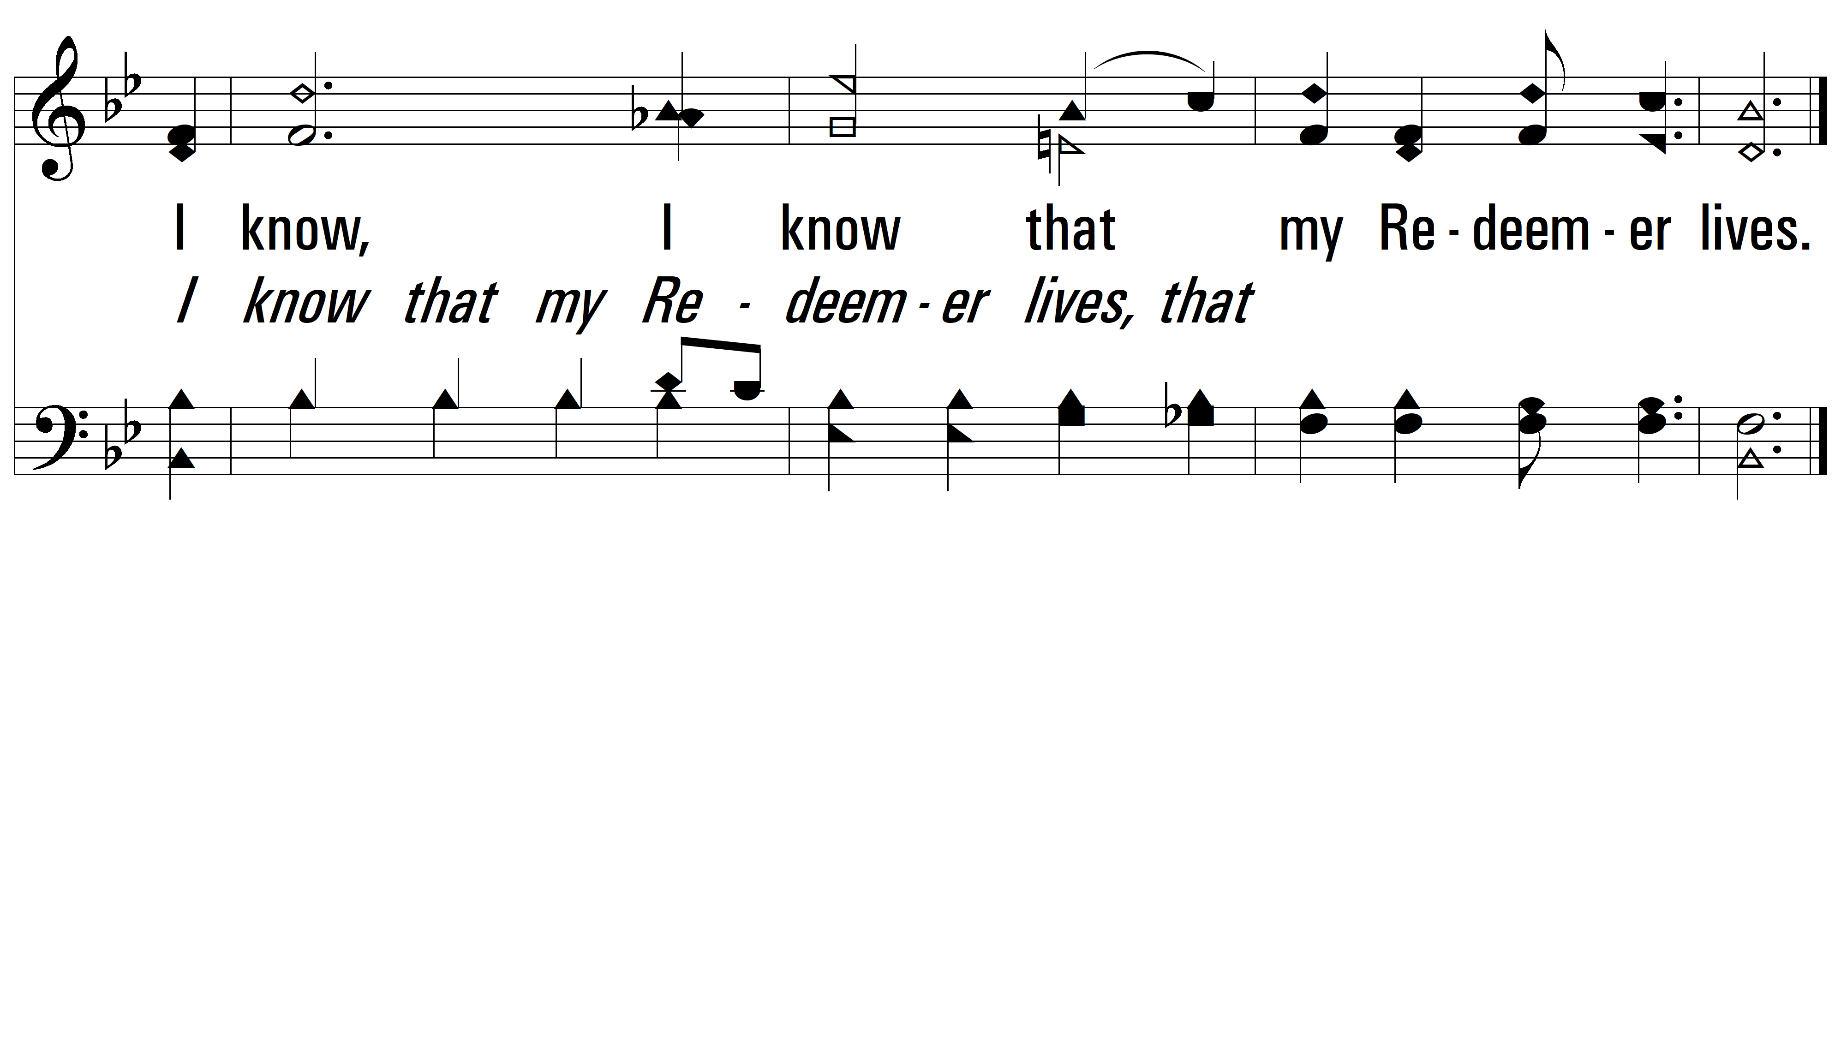
vs. 1

Slide 6
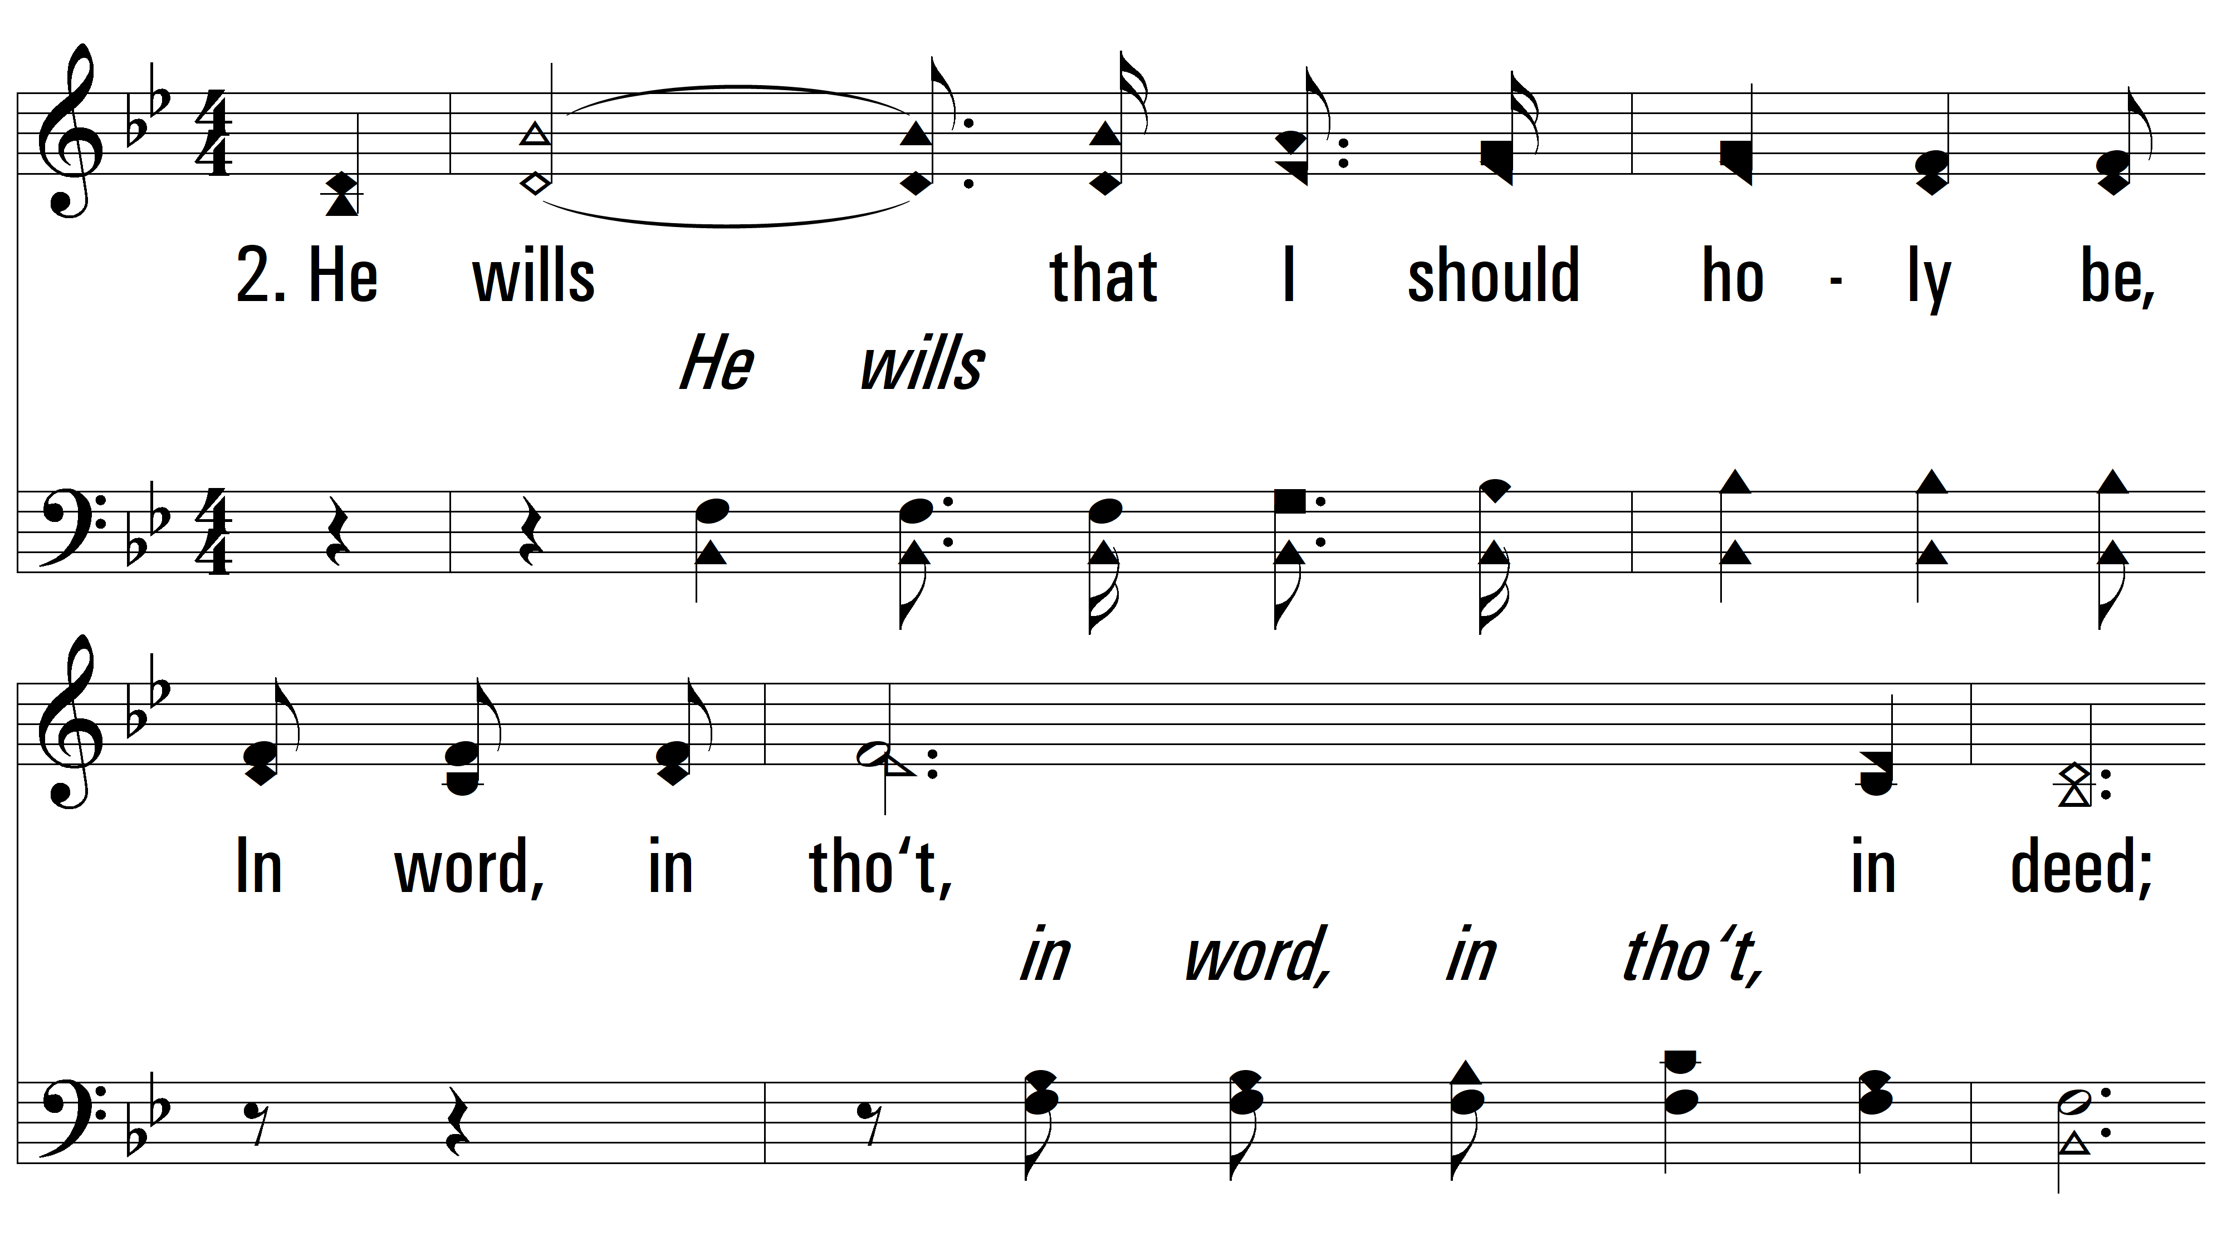
vs. 2 ~ I Know That My Redeemer Lives

Slide 7
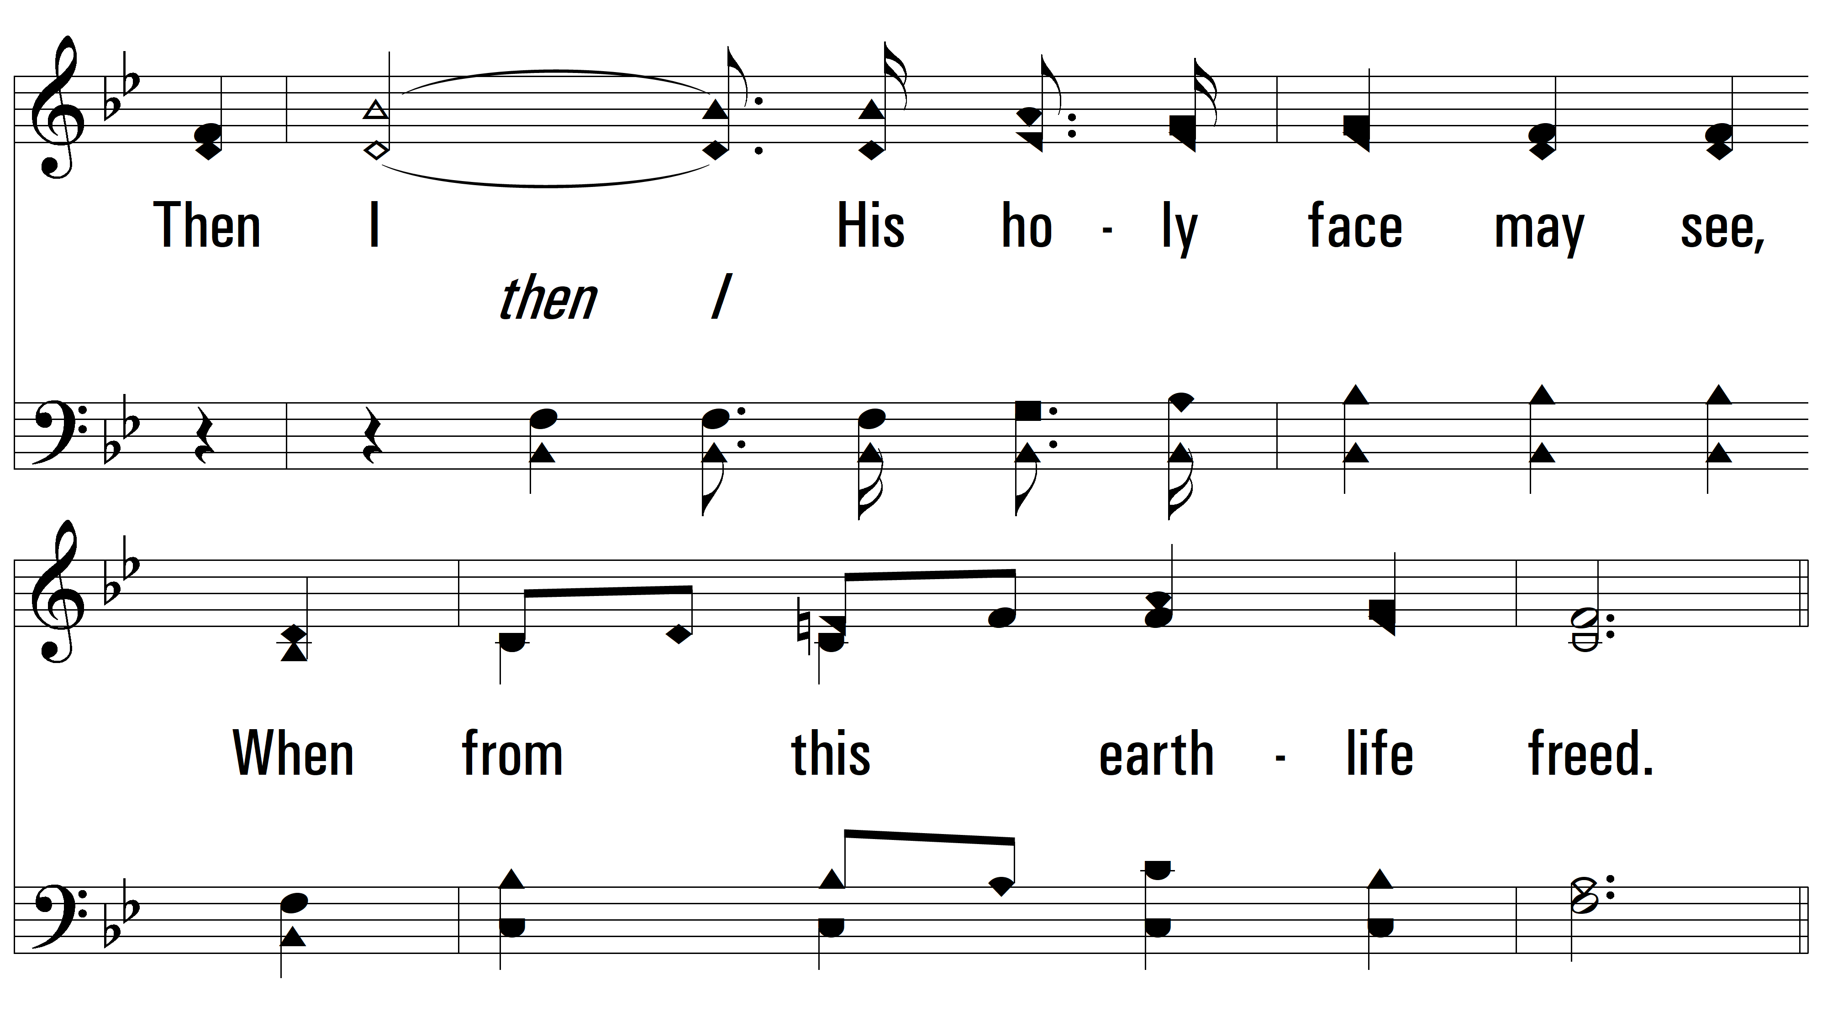
vs. 2

Slide 8
vs. 2

Slide 9
vs. 2

Slide 10
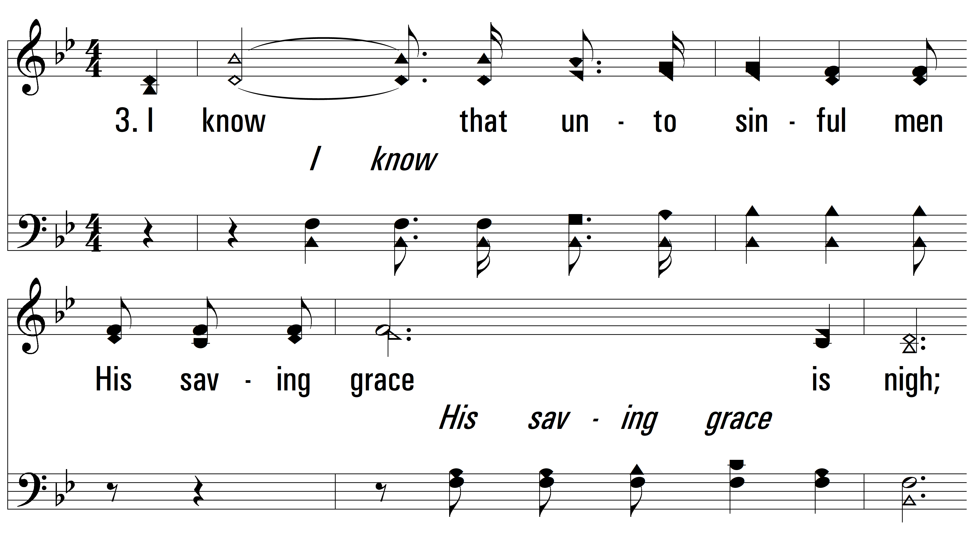
vs. 3 ~ I Know That My Redeemer Lives

Slide 11
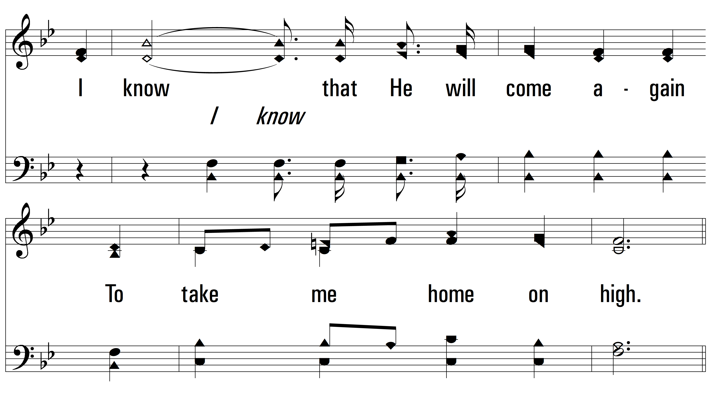
vs. 3

Slide 12
vs. 3

Slide 13
vs. 3

Slide 14
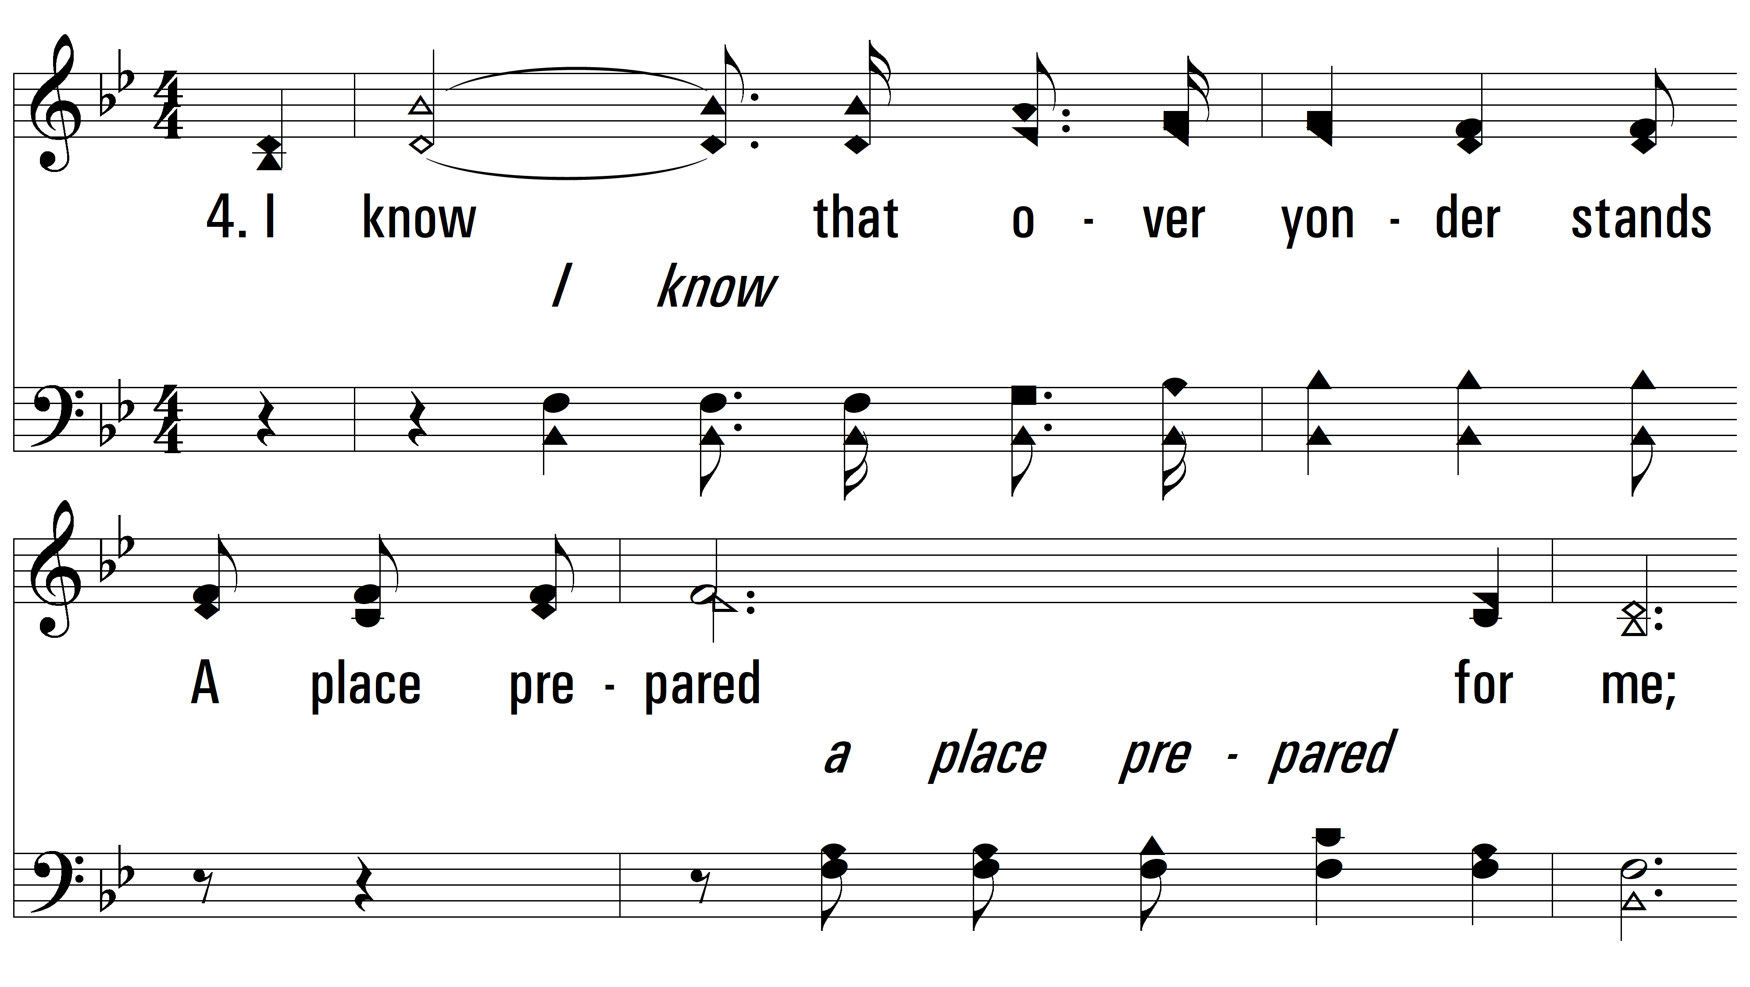
vs. 4 ~ I Know That My Redeemer Lives

Slide 15
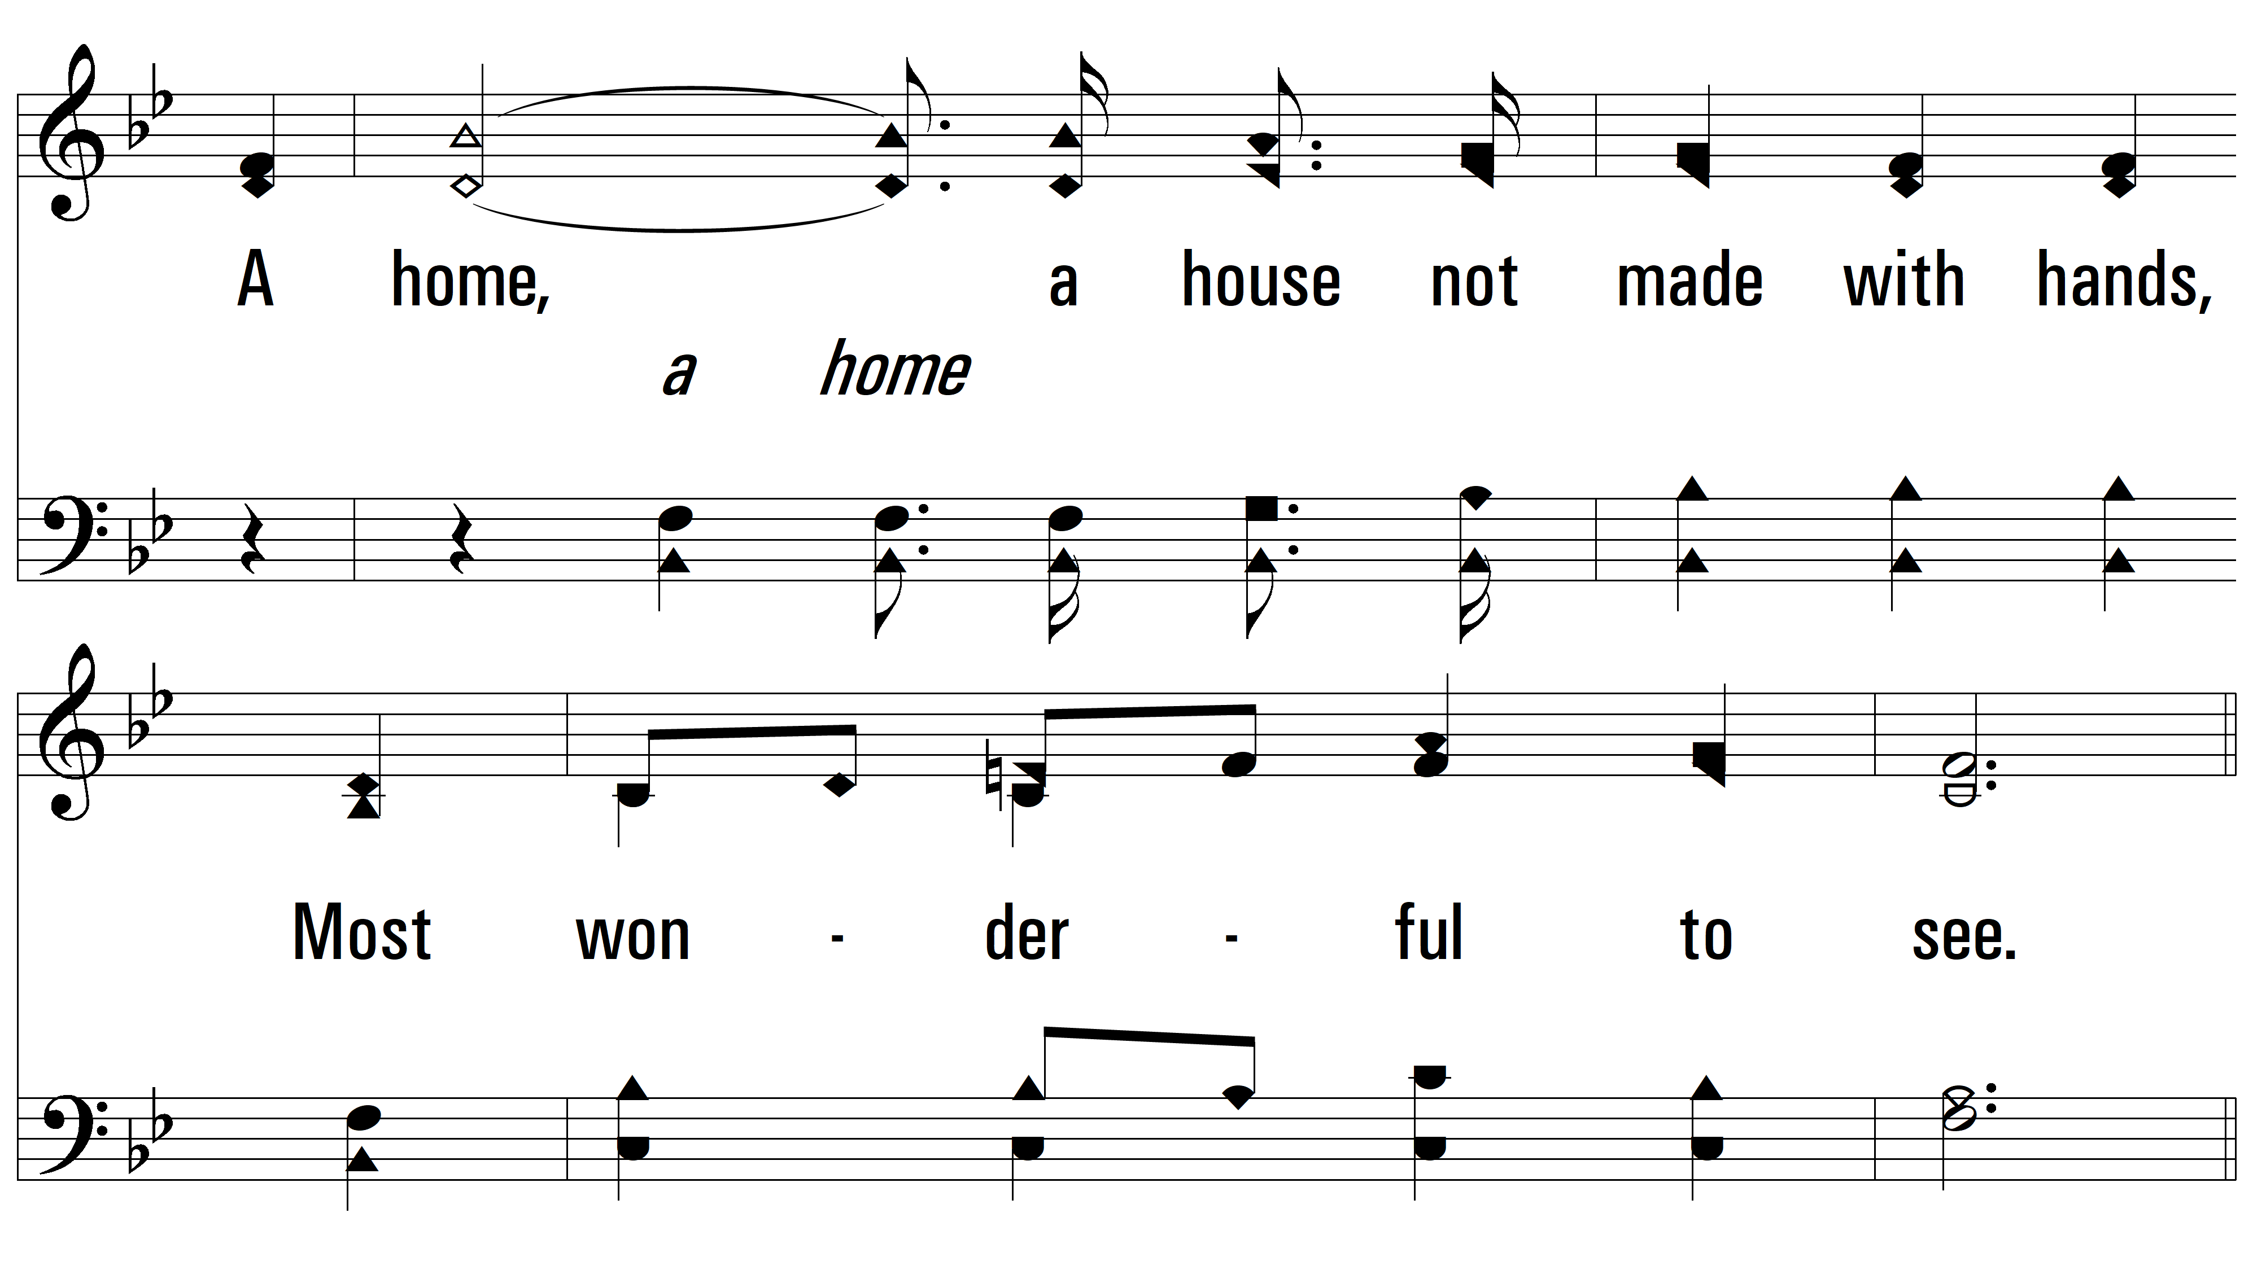
vs. 4

Slide 16
vs. 4

Slide 17
vs. 4
PDHymns.com
END

