Slide 1
I Hold To His Hand
Words: | J. R. Baxter Jr.
Music: | W. Allan Sims
6/8
D^{b}/F - MI
Verses: 3/Chorus
Lead - | MI
Alto - | DO
Tenor - | DO
Bass - | DO
PDHymns.com

Slide 2
vs. 1 ~ I Hold To His Hand

Slide 3
vs. 1

Slide 4
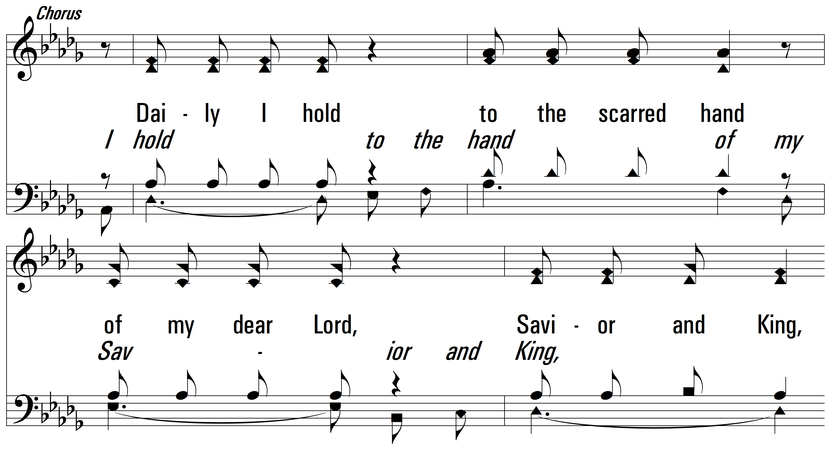
vs. 1

Slide 5
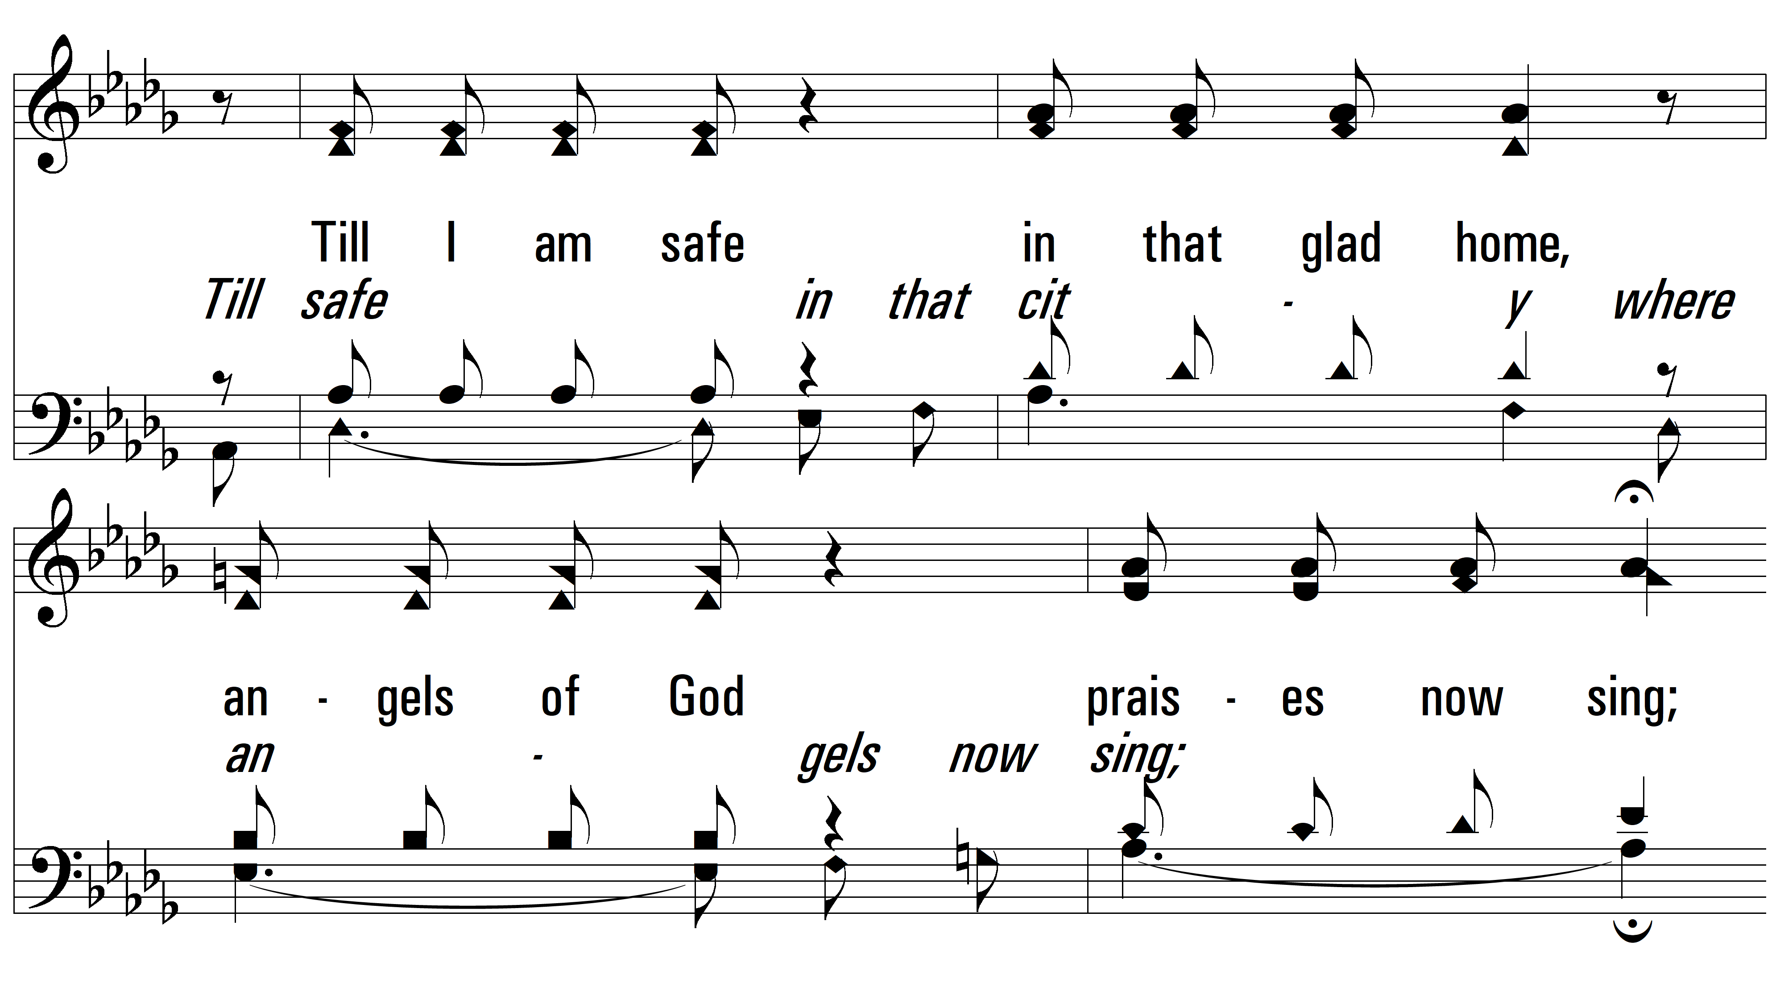
vs. 1

Slide 6
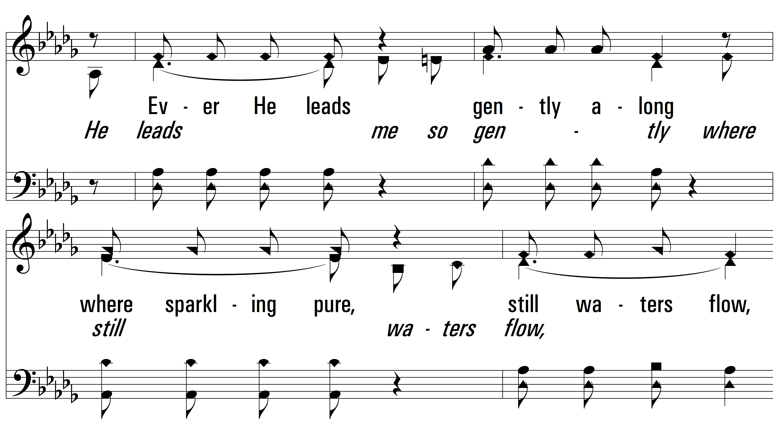
vs. 1

Slide 7
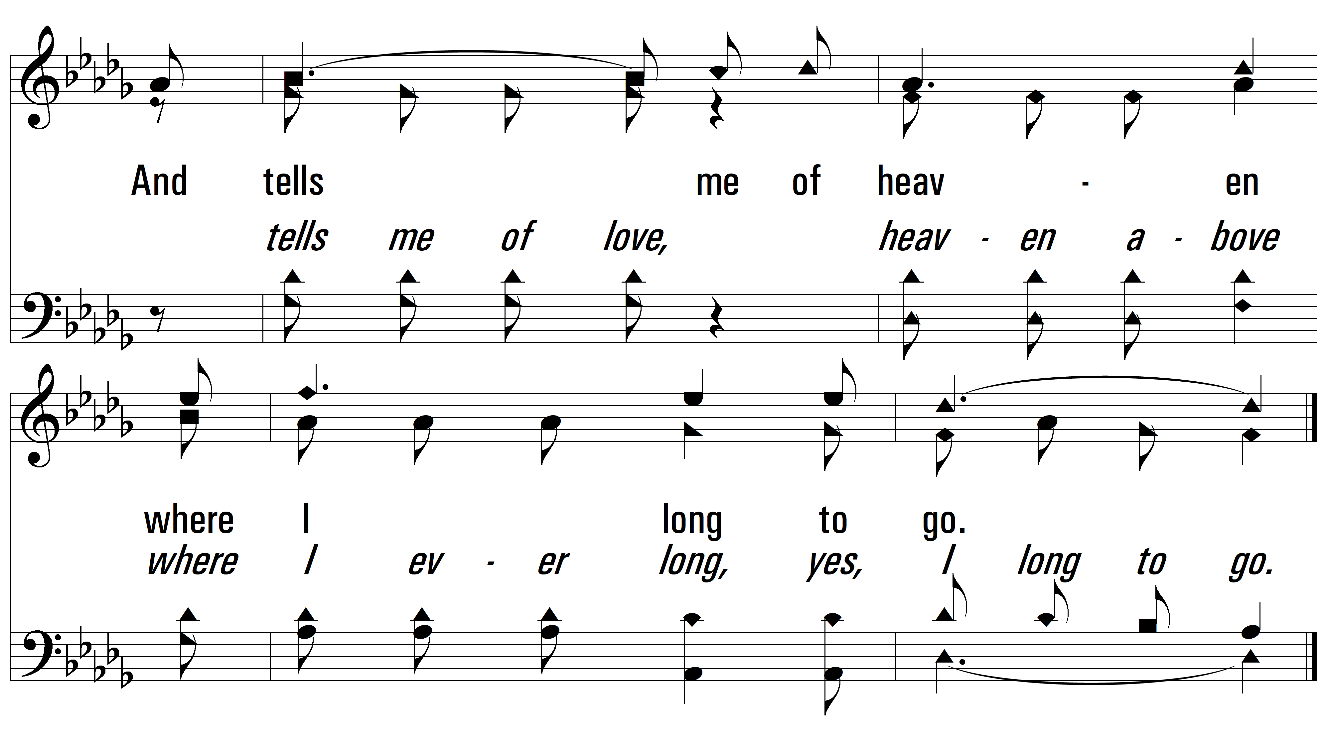
vs. 1

Slide 8
vs. 2 ~ I Hold To His Hand

Slide 9
vs. 2

Slide 10
vs. 2

Slide 11
vs. 2

Slide 12
vs. 2

Slide 13
vs. 2

Slide 14
vs. 3 ~ I Hold To His Hand

Slide 15
vs. 3

Slide 16
vs. 3

Slide 17
vs. 3

Slide 18
vs. 3

Slide 19
vs. 3
PDHymns.com
END

