Slide 1
I Heard The Voice Of Jesus Say
SPOHR
CMD
Words: | Horatius Bonar (1846)
Music: | Ludwig Spohr (1834)
6/8
D/A - SOL
Verses: 3/Chorus
Lead - | SOL
Alto - | MI
Tenor - | DO
Bass - | DO
PDHymns.com

Slide 2
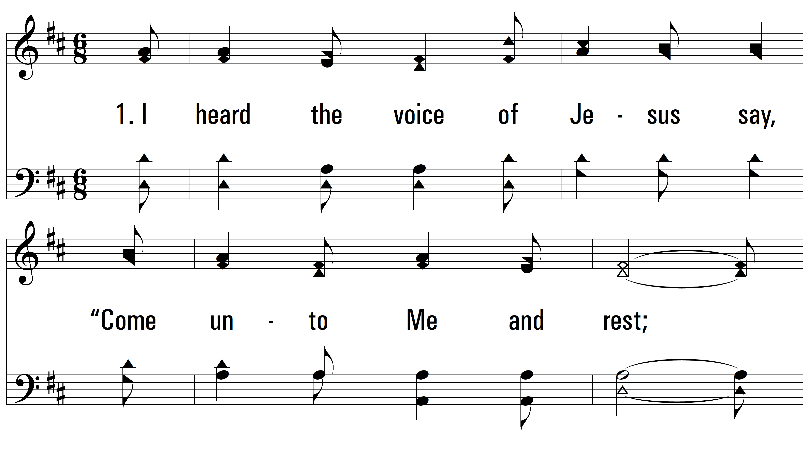
vs. 1 ~ I Heard The Voice Of Jesus Say

Slide 3
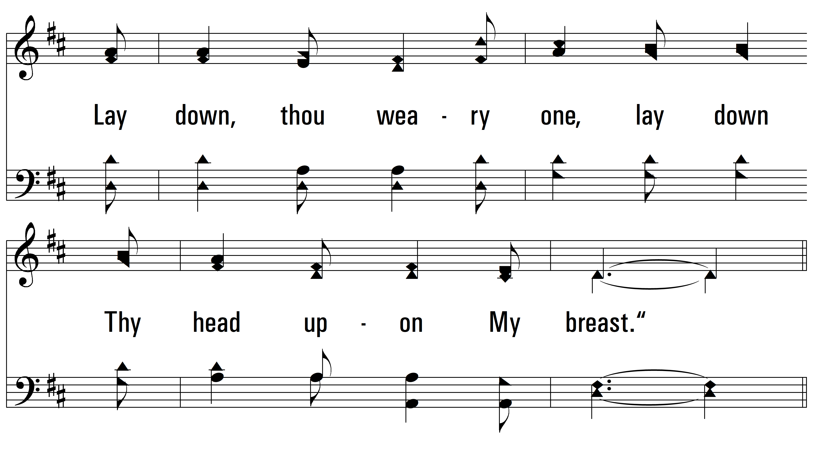
vs. 1

Slide 4
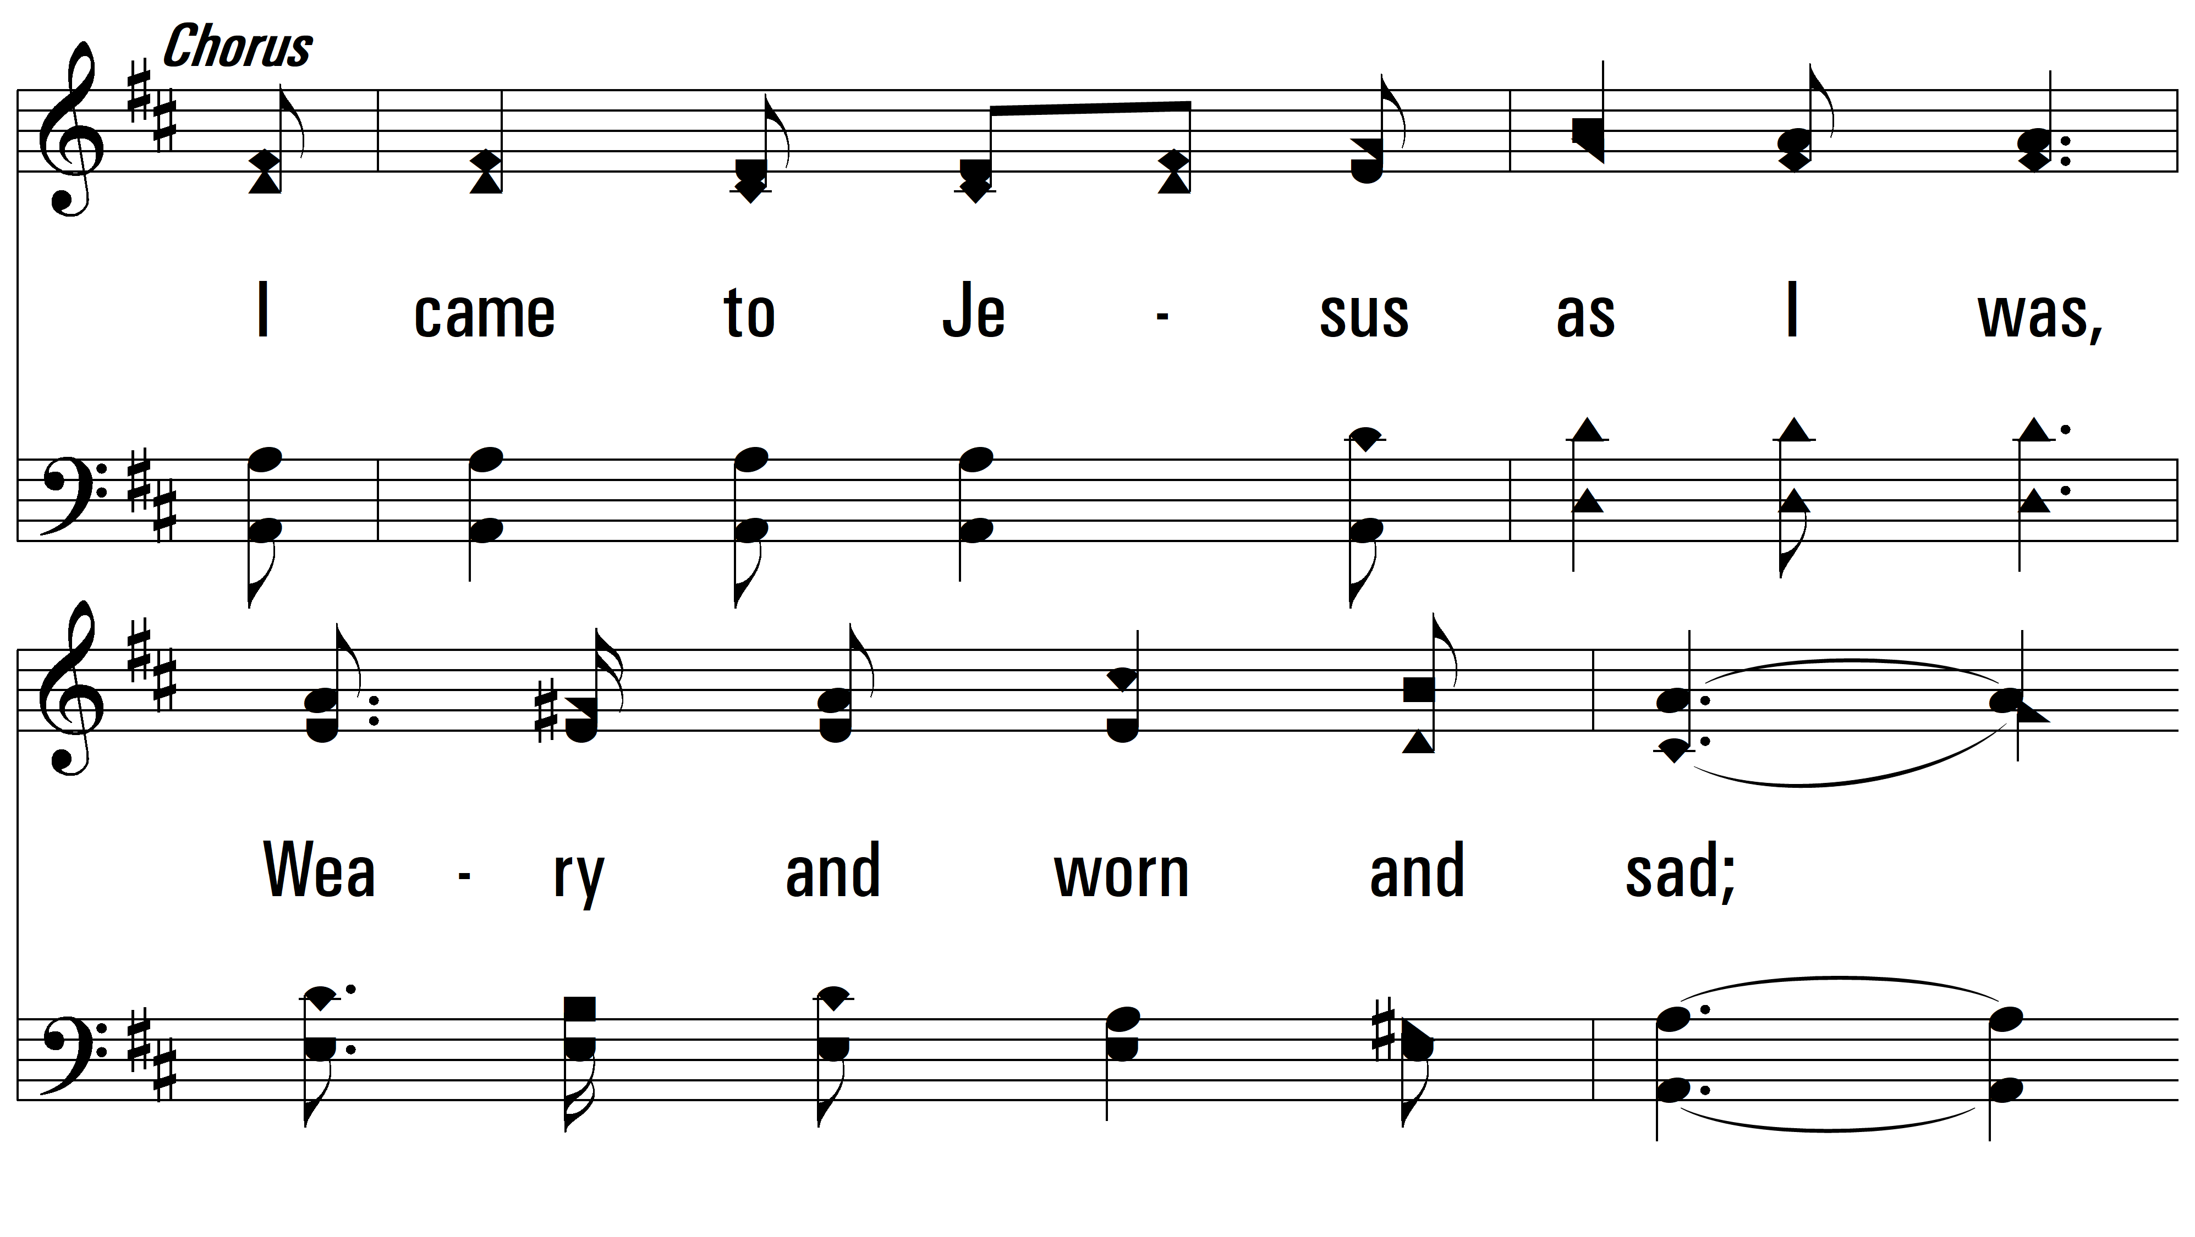
vs. 1

Slide 5
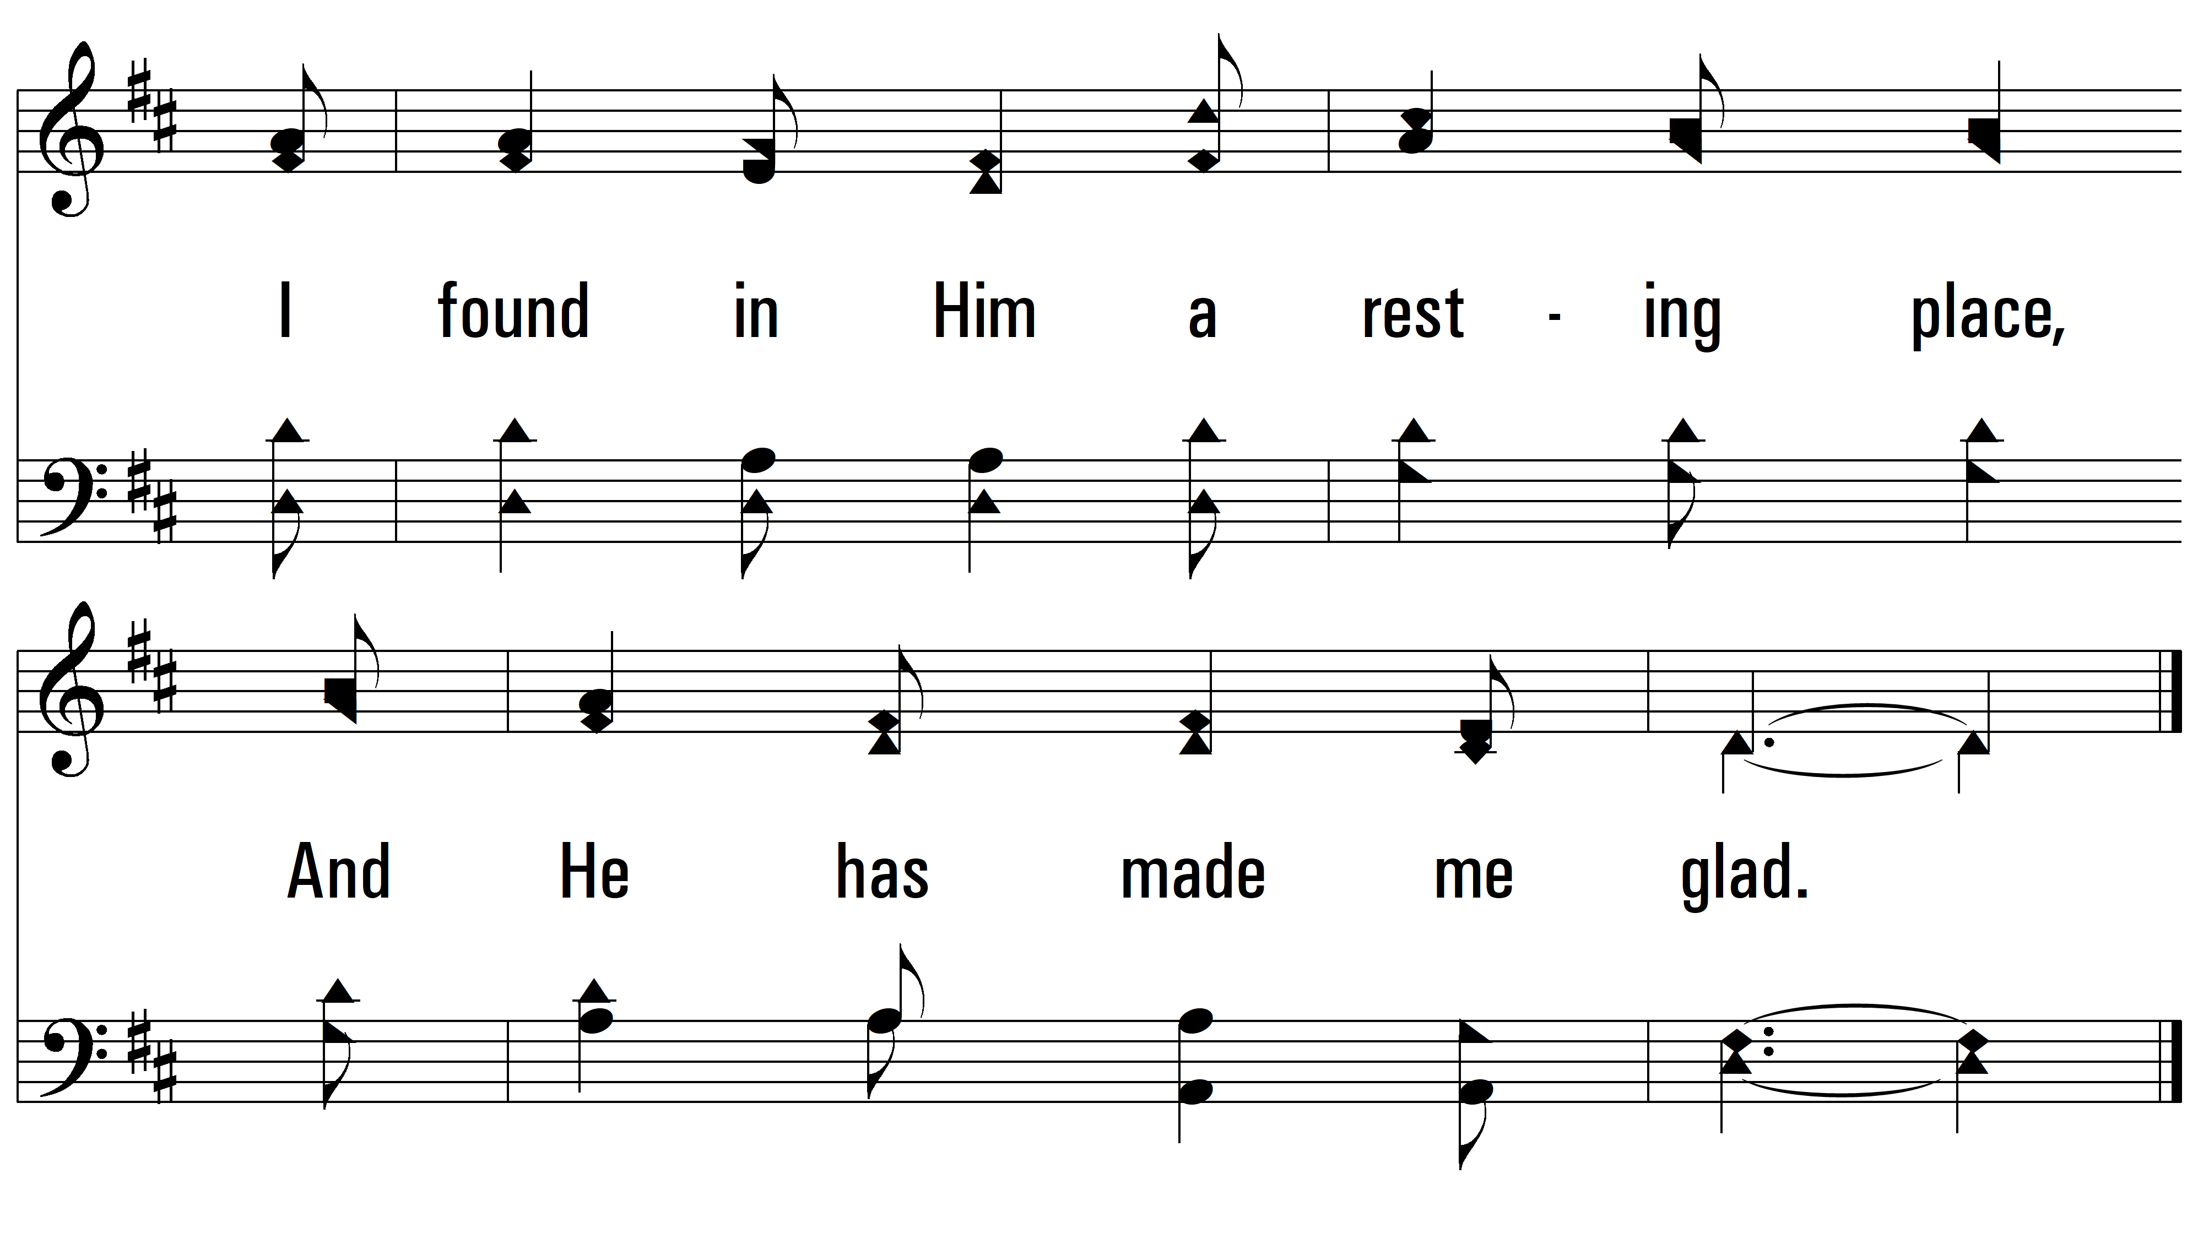
vs. 1

Slide 6
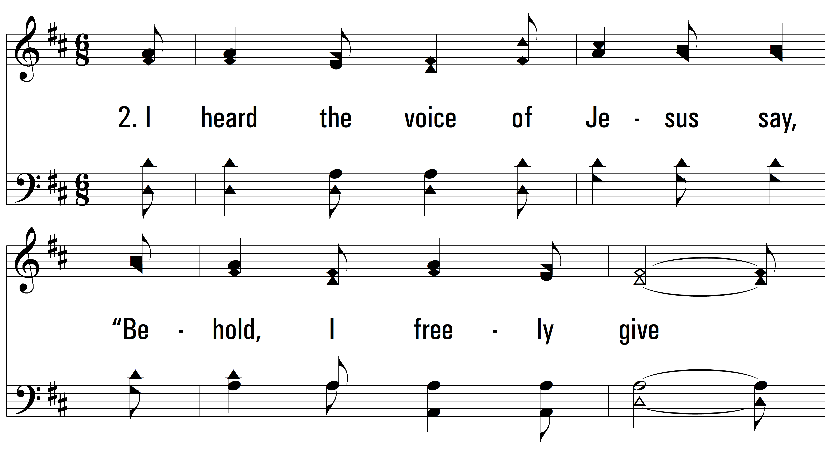
vs. 2 ~ I Heard The Voice Of Jesus Say

Slide 7
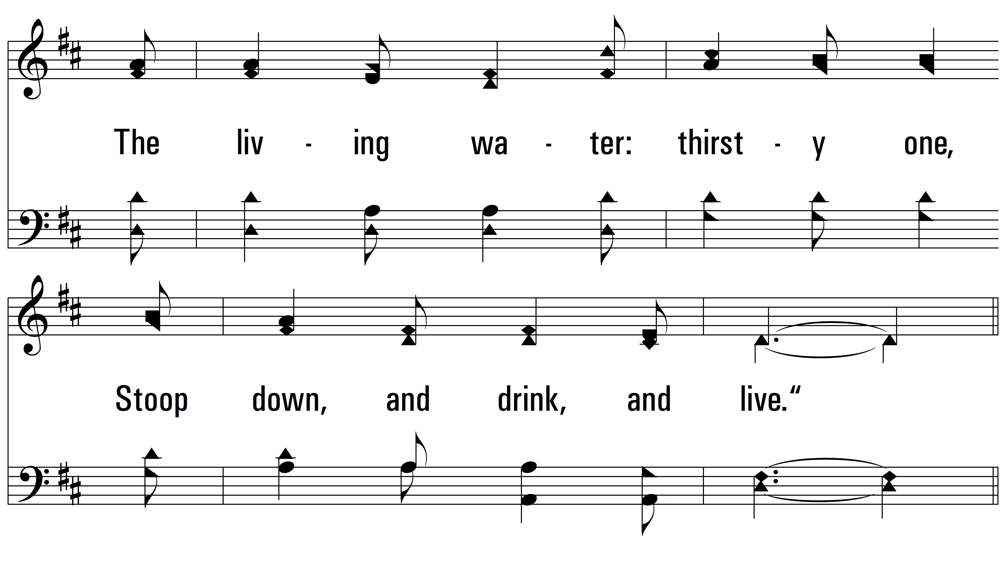
vs. 2

Slide 8
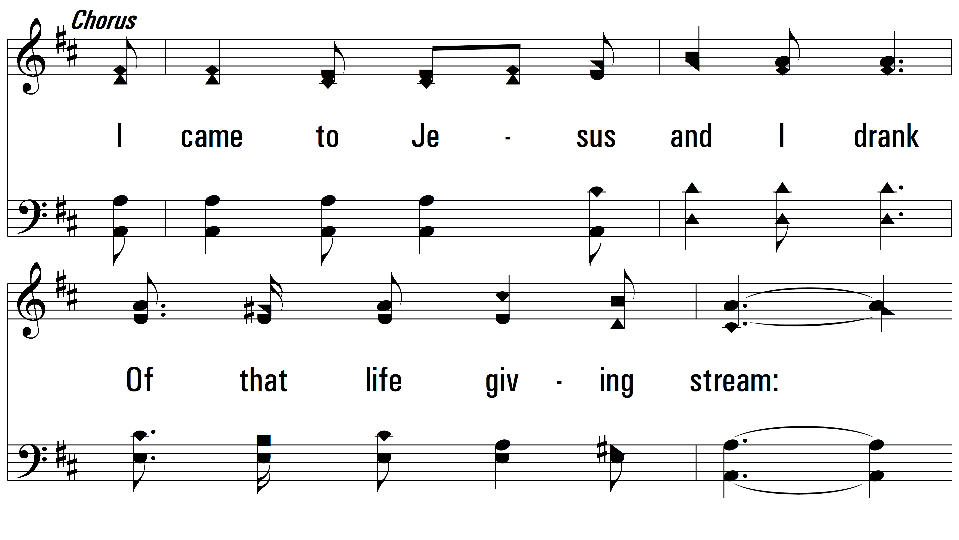
vs. 2

Slide 9
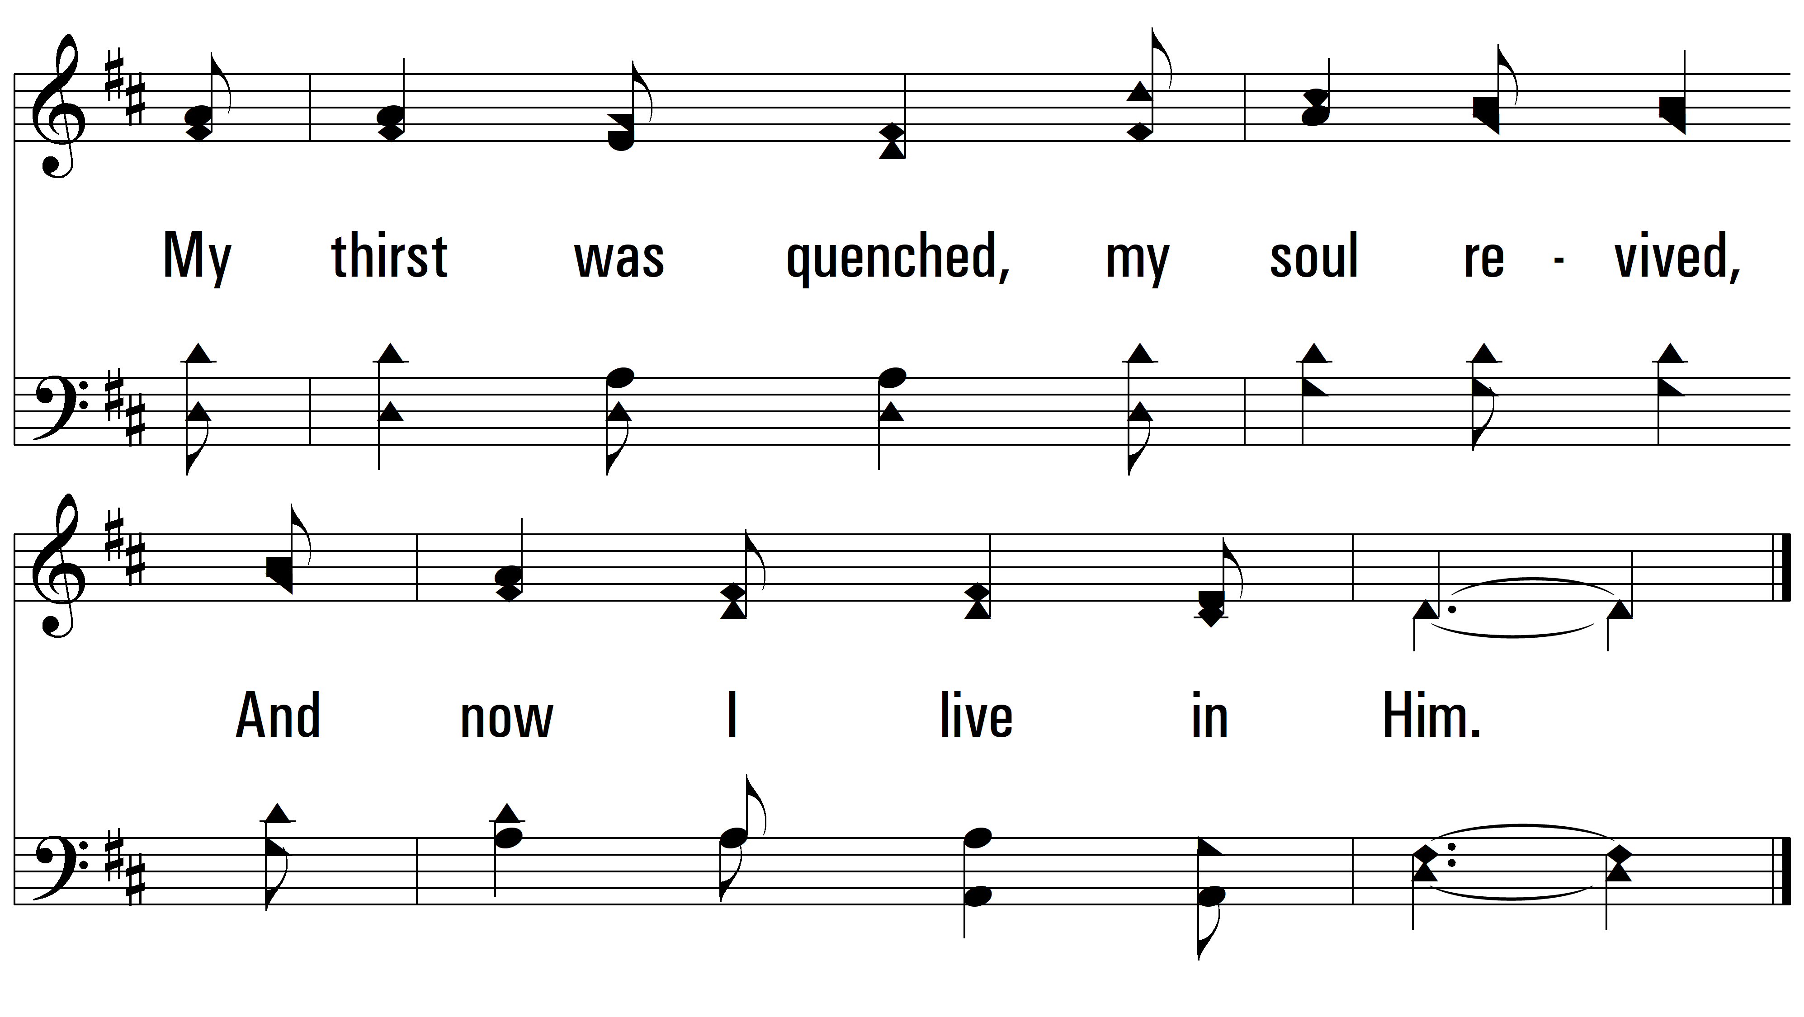
vs. 2

Slide 10
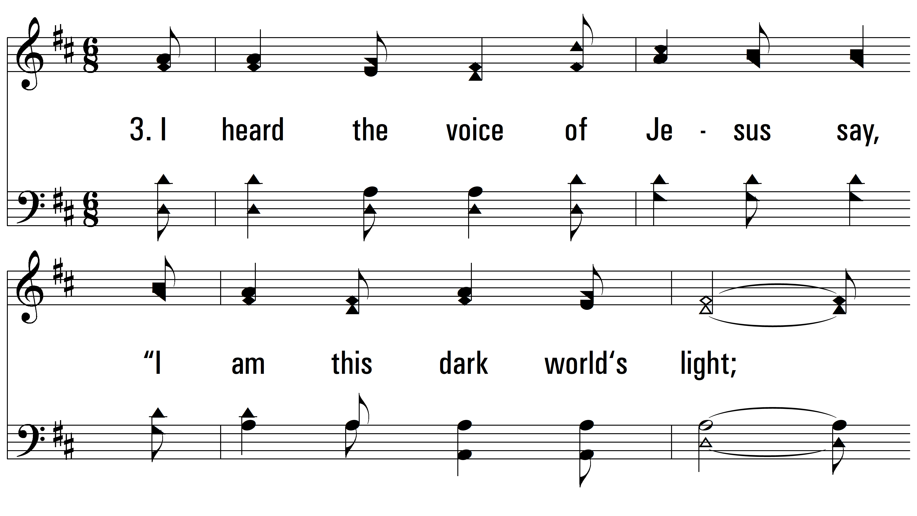
vs. 3 ~ I Heard The Voice Of Jesus Say

Slide 11
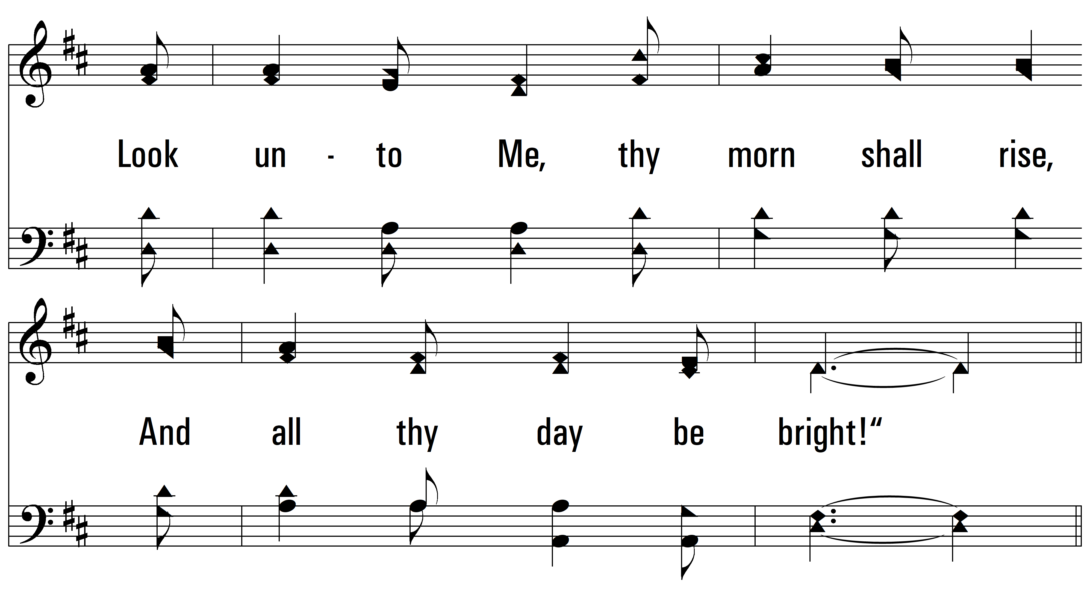
vs. 3

Slide 12
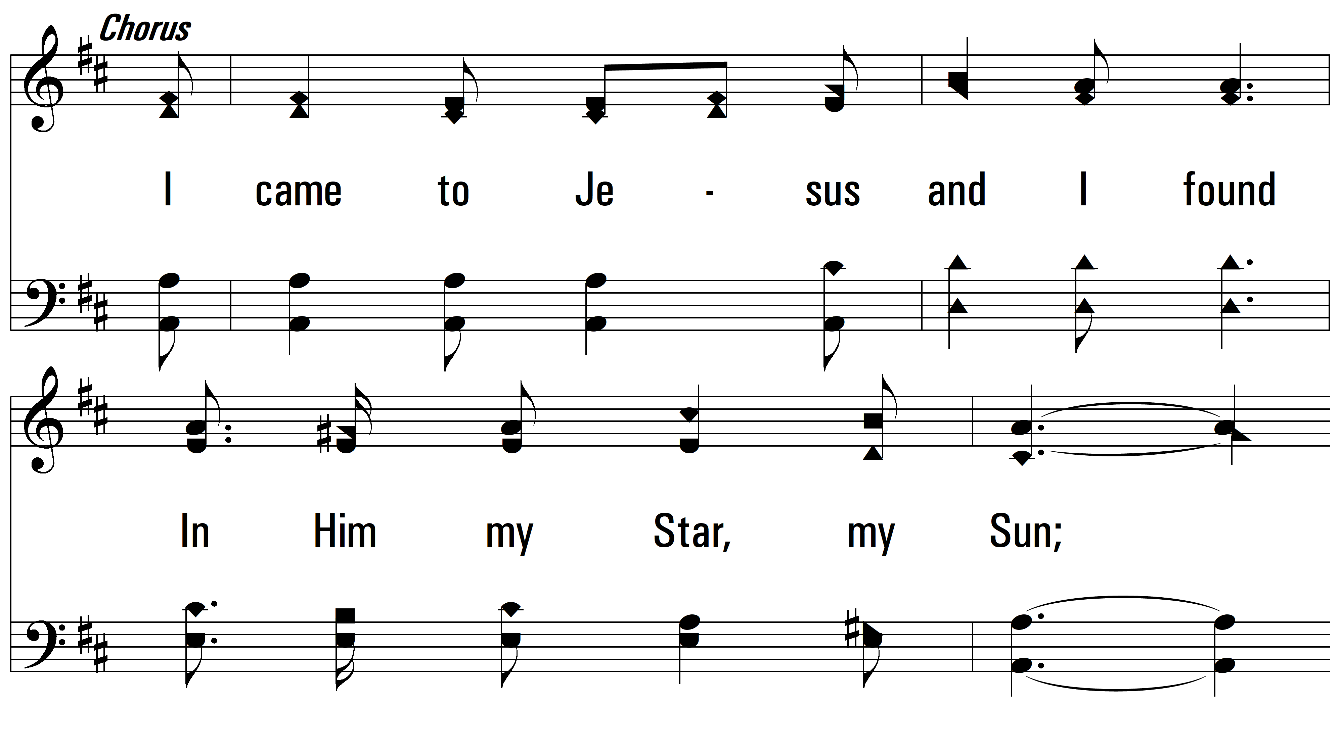
vs. 3

Slide 13
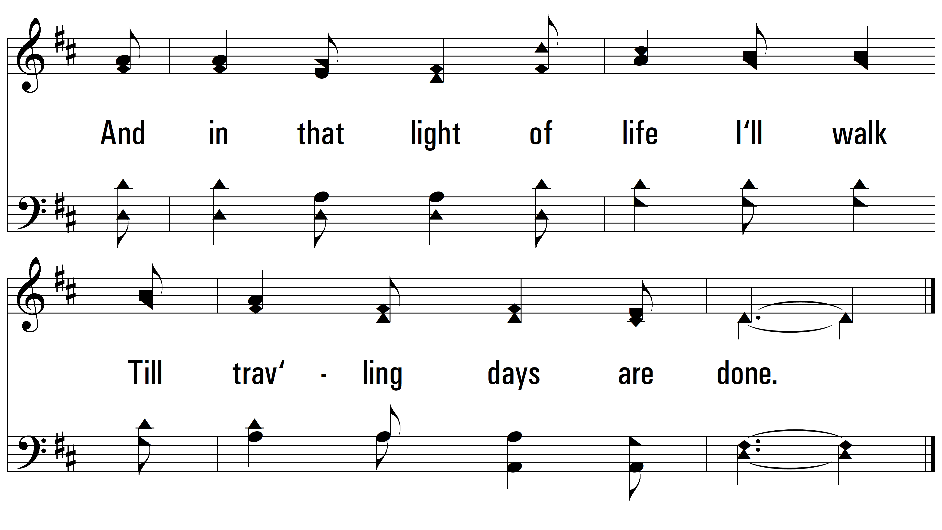
vs. 3
PDHymns.com
END

