Slide 1
I Gave My Life For Thee
KENOSIS
6.6.6.6.8.6
Words: | Frances R. Havergal (1858 & 1860)
Music: | Phillip P. Bliss (1873)
6/8
C/G - SOL
Verses: 4/Chorus
Lead - | SOL
Alto - | MI
Tenor - | DO
Bass - | DO
PDHymns.com

Slide 2
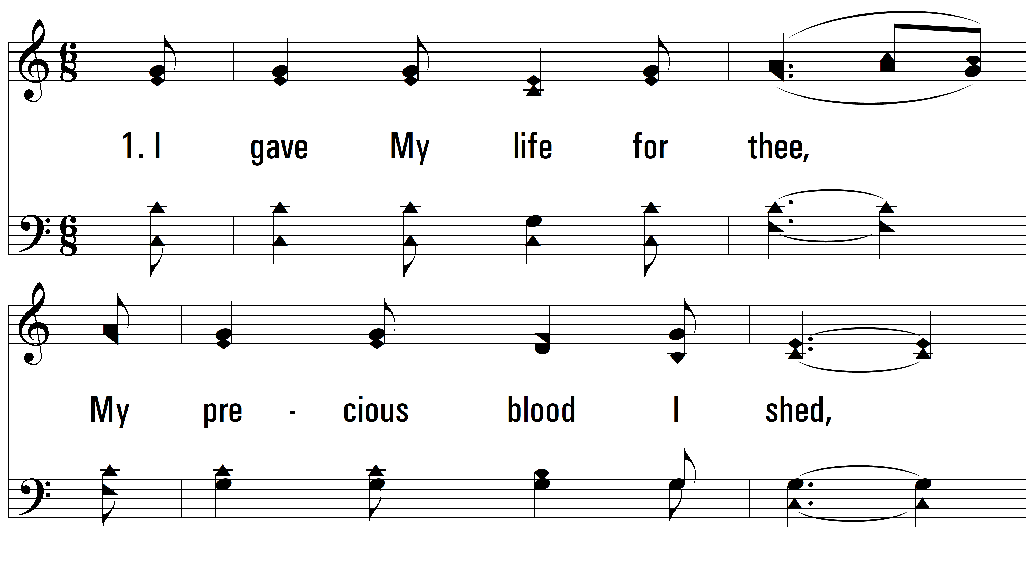
vs. 1 ~ I Gave My Life For Thee

Slide 3
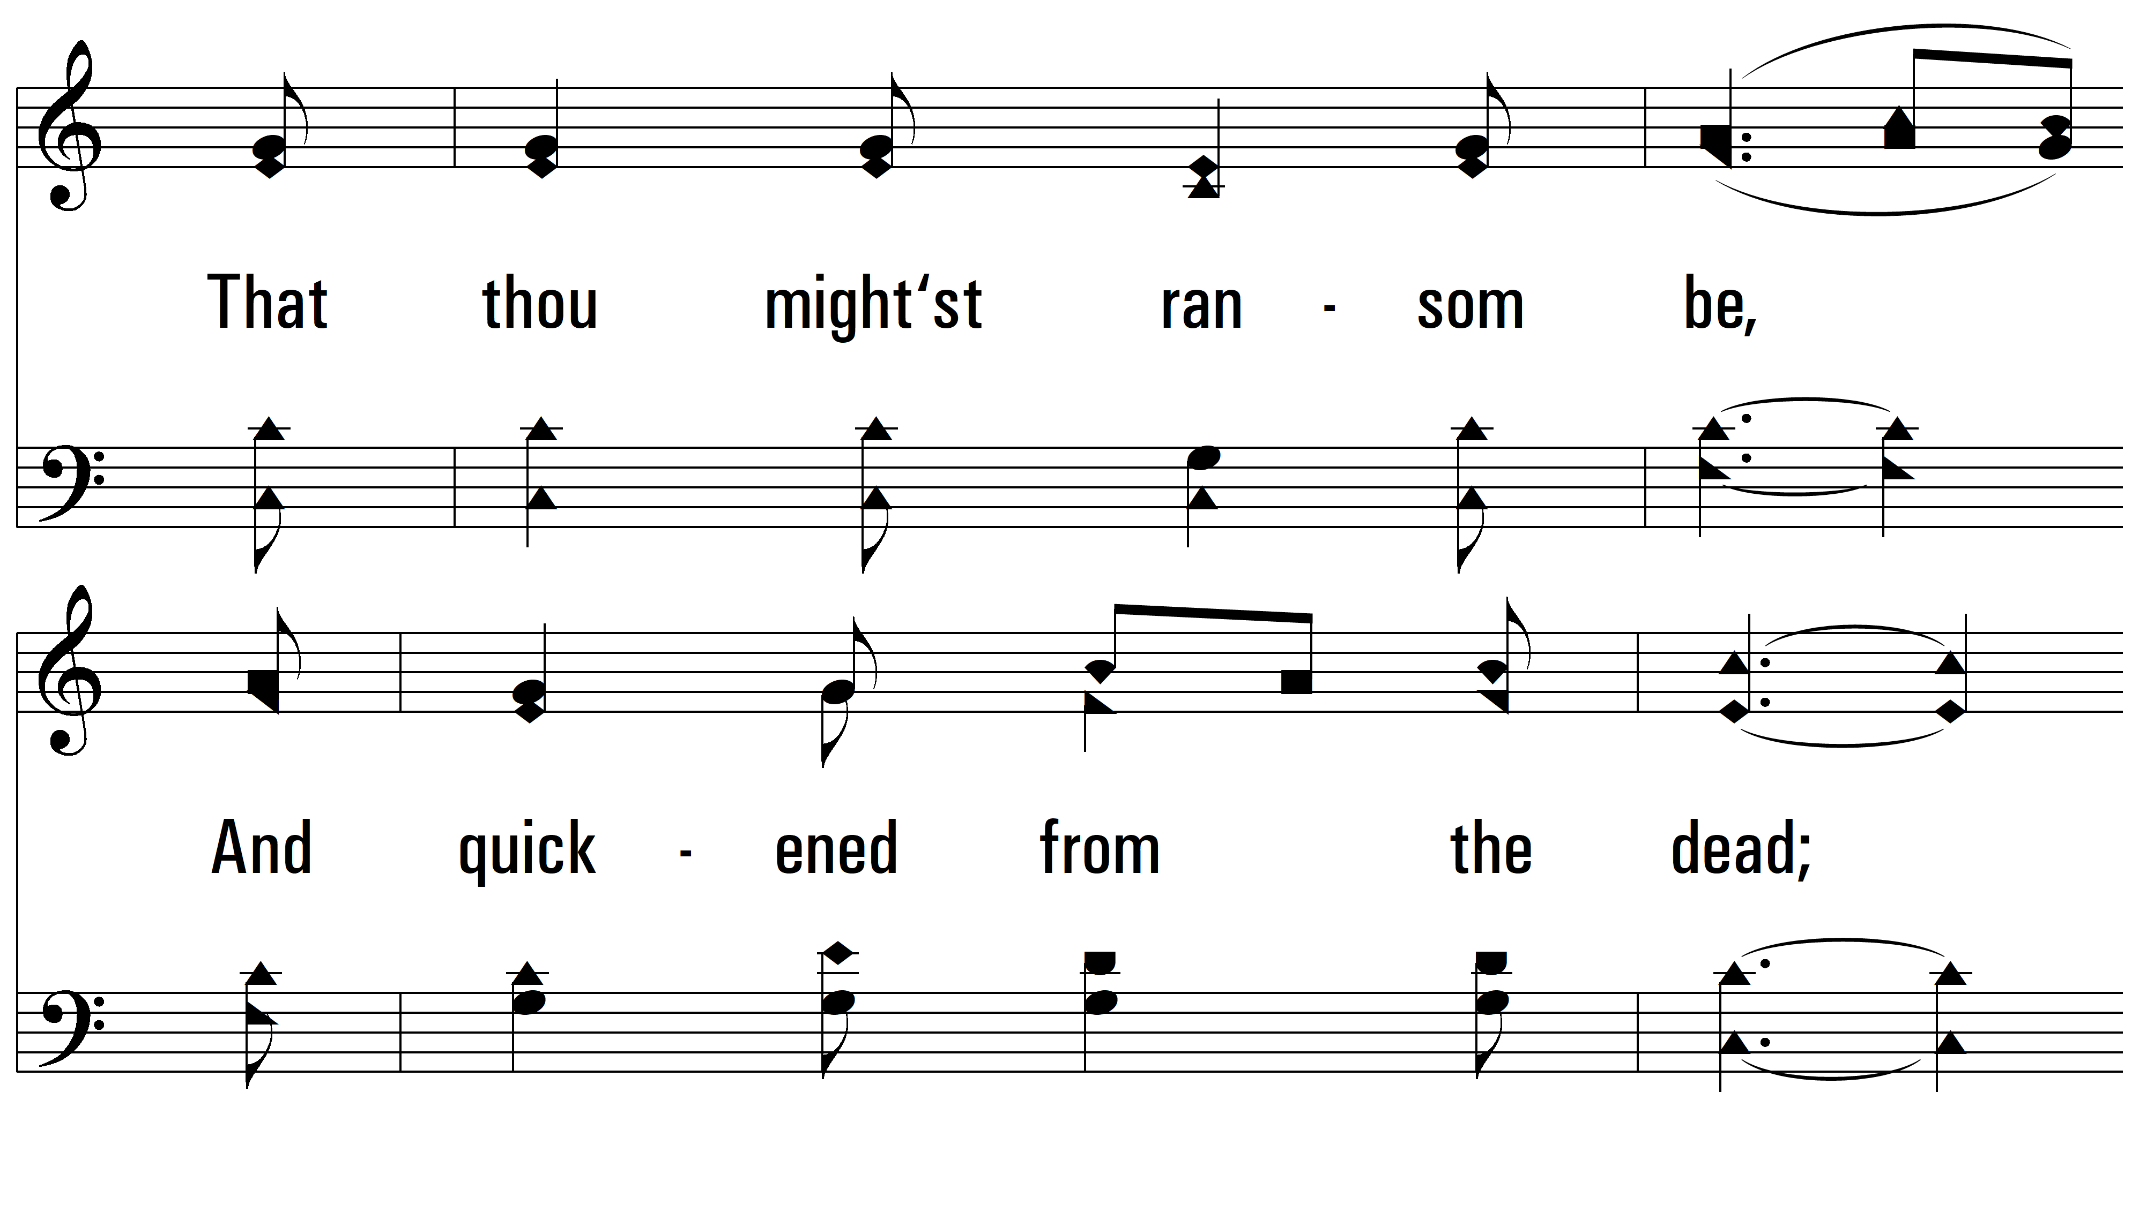
vs. 1

Slide 4
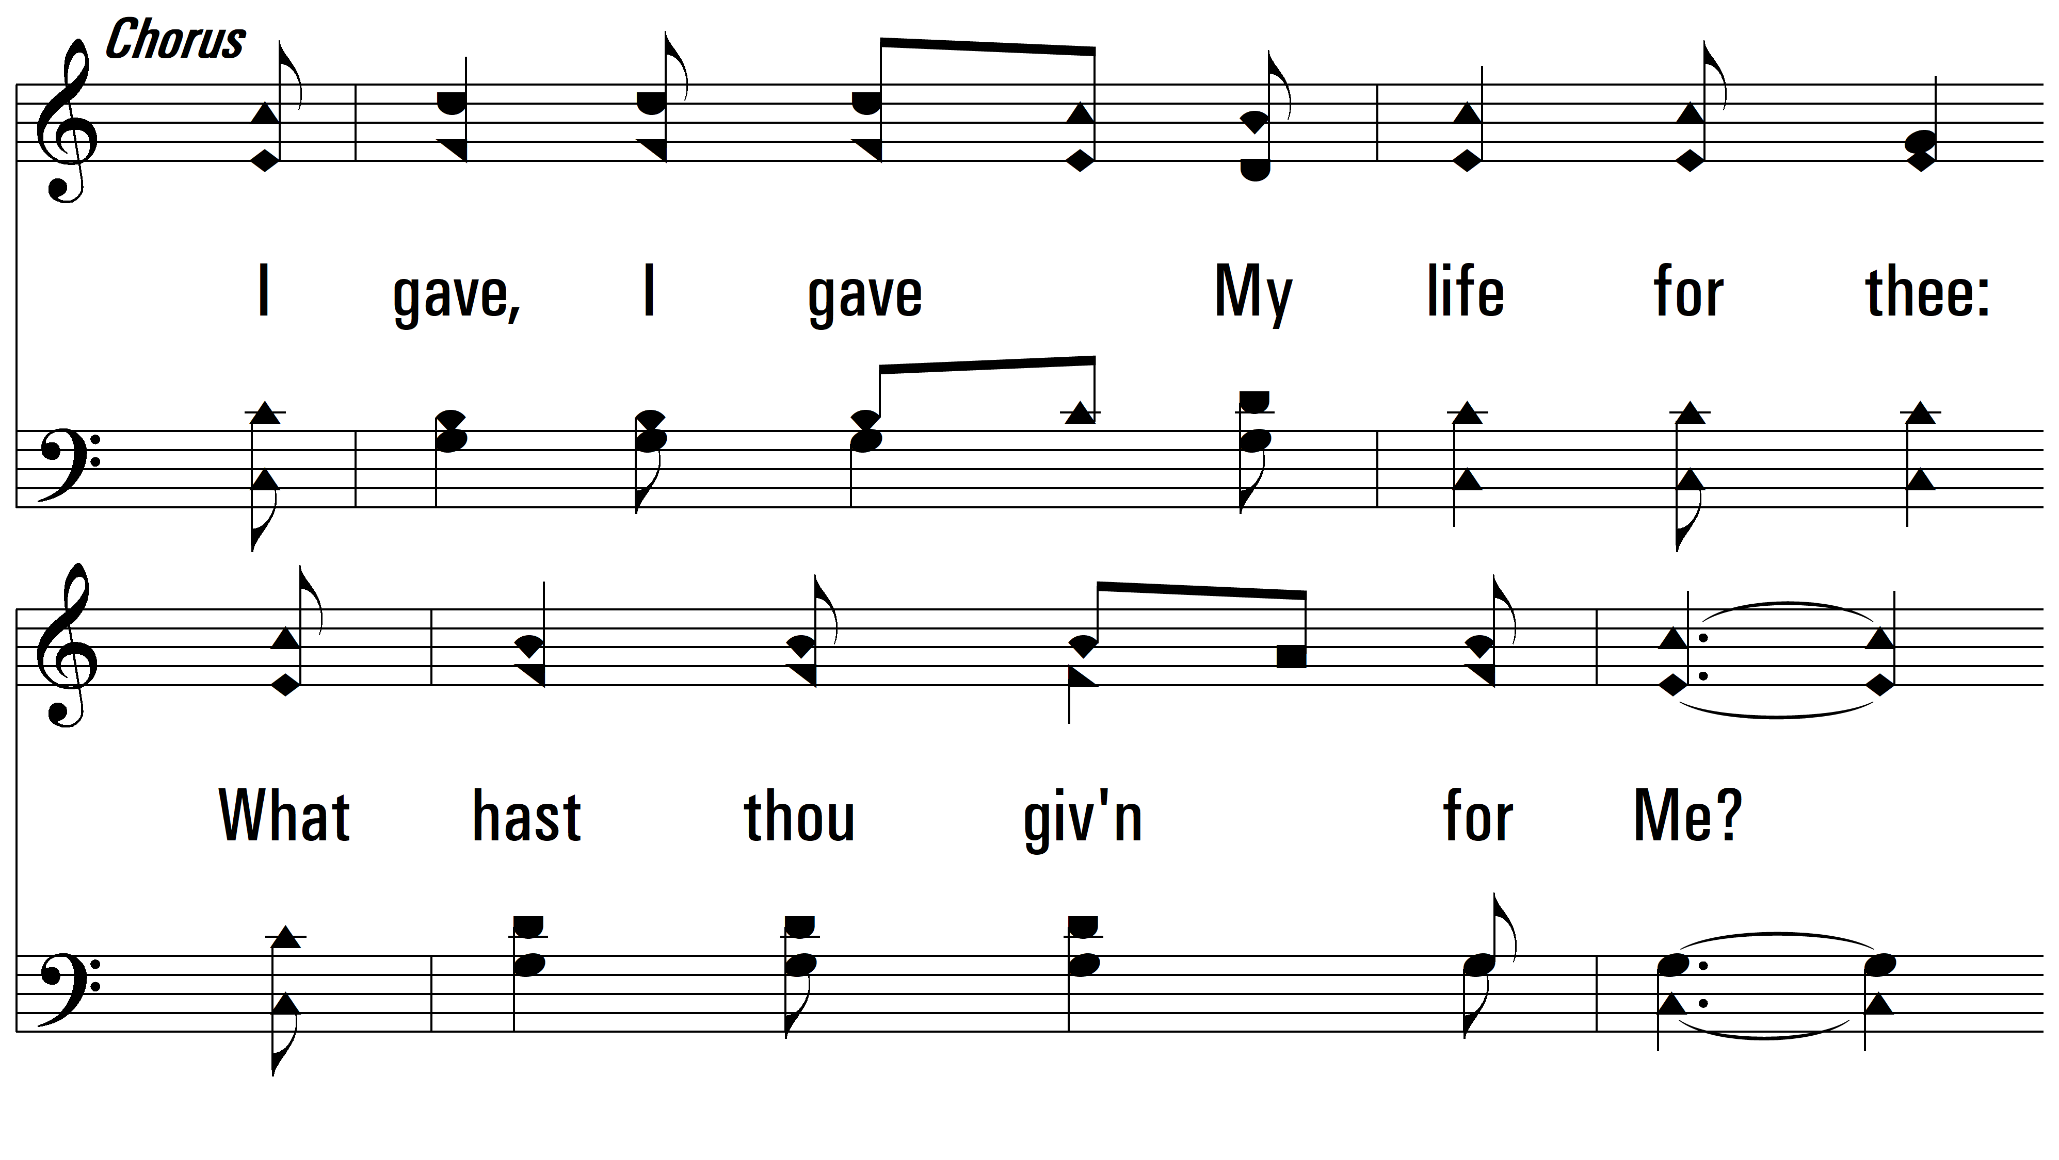
vs. 1

Slide 5
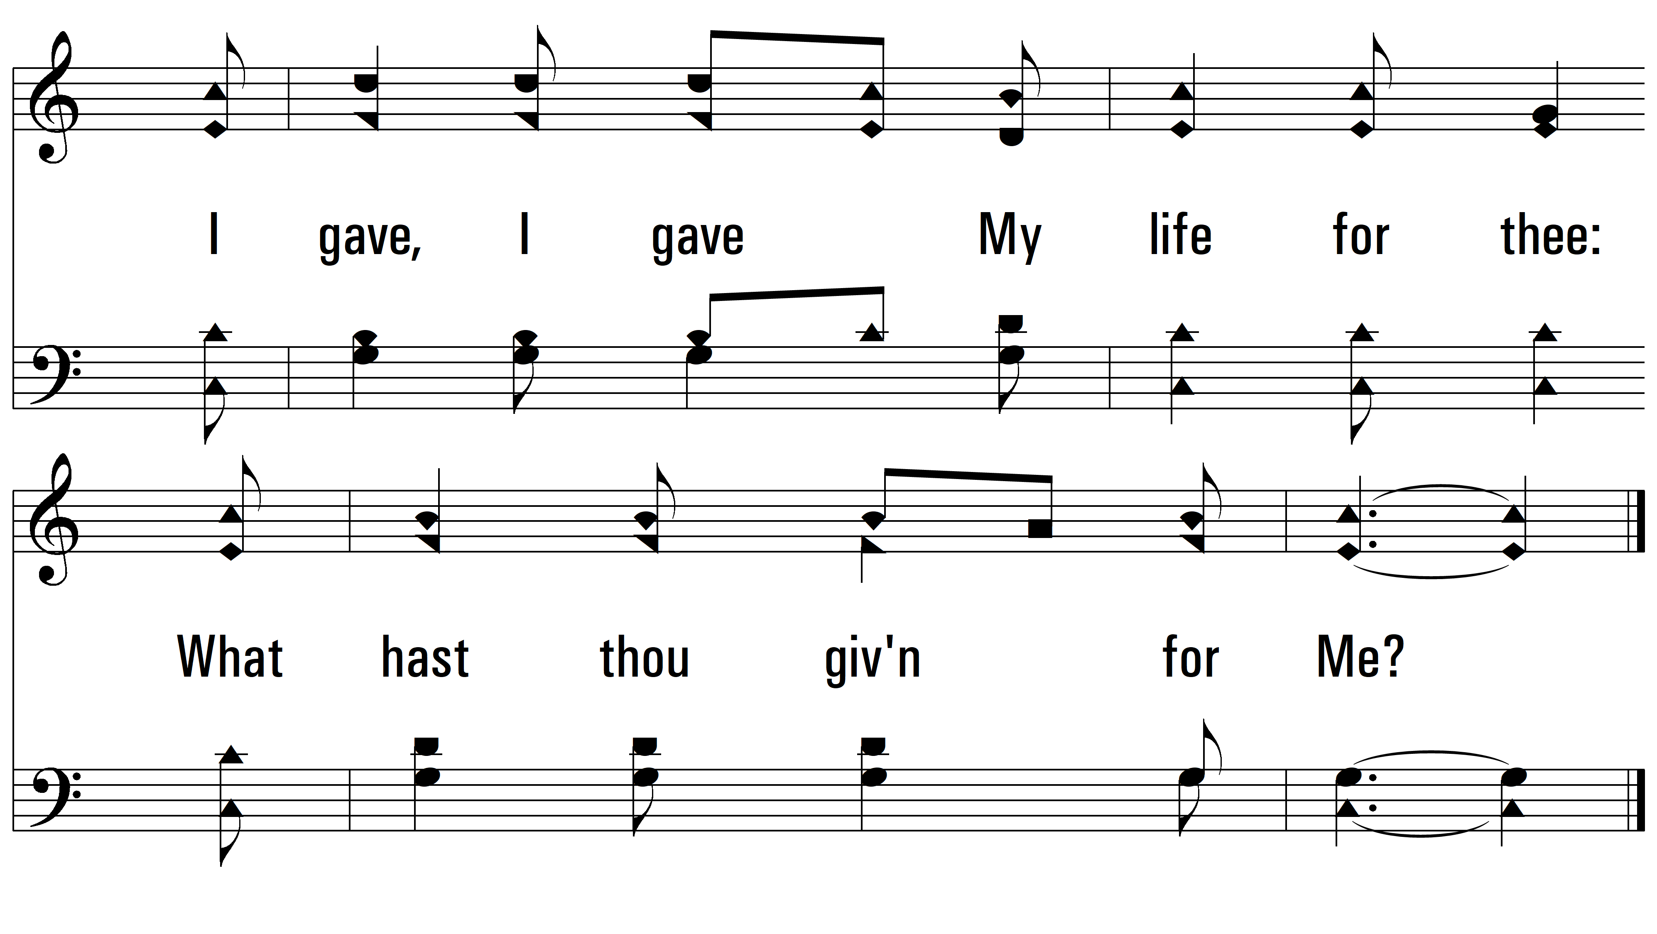
vs. 1

Slide 6
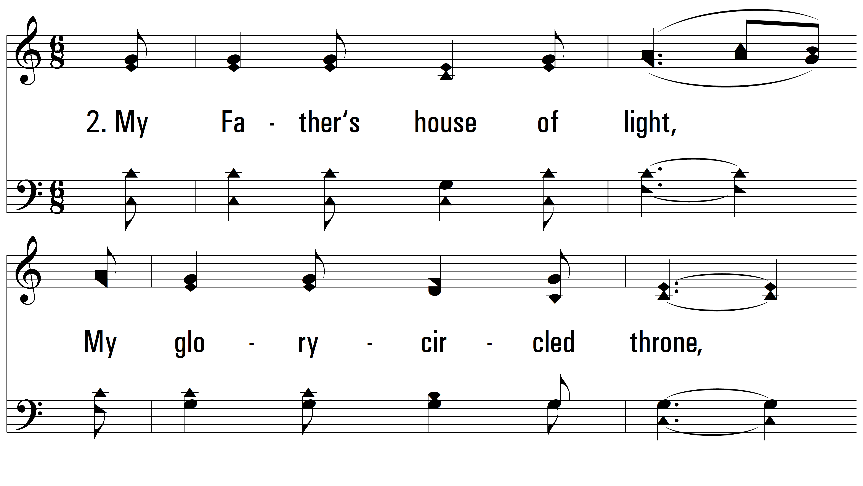
vs. 2 ~ I Gave My Life For Thee

Slide 7
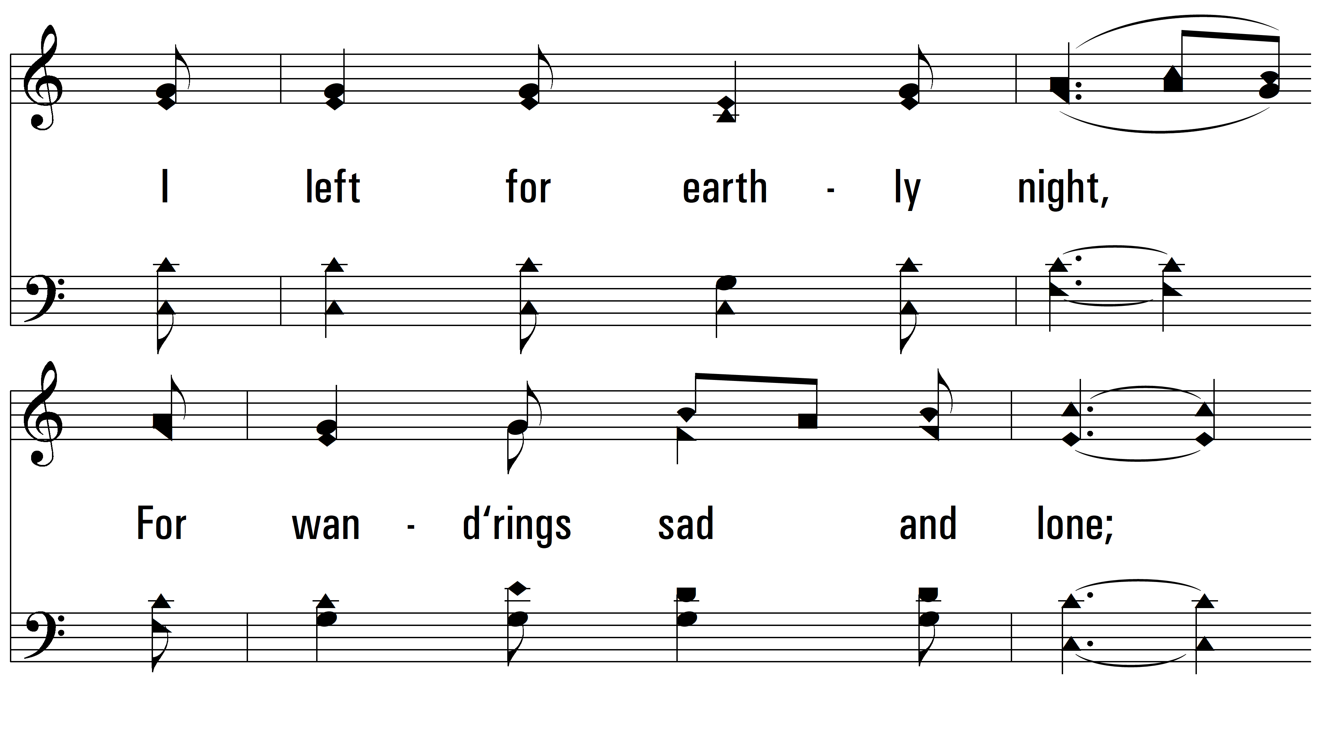
vs. 2

Slide 8
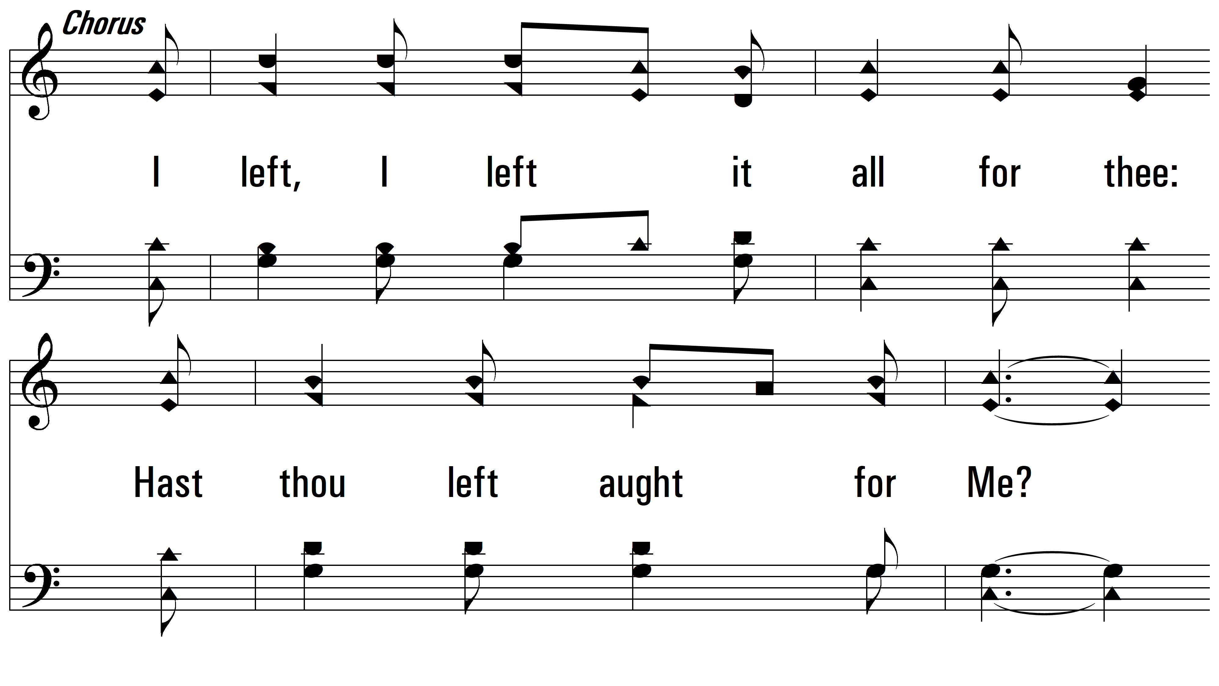
vs. 2

Slide 9
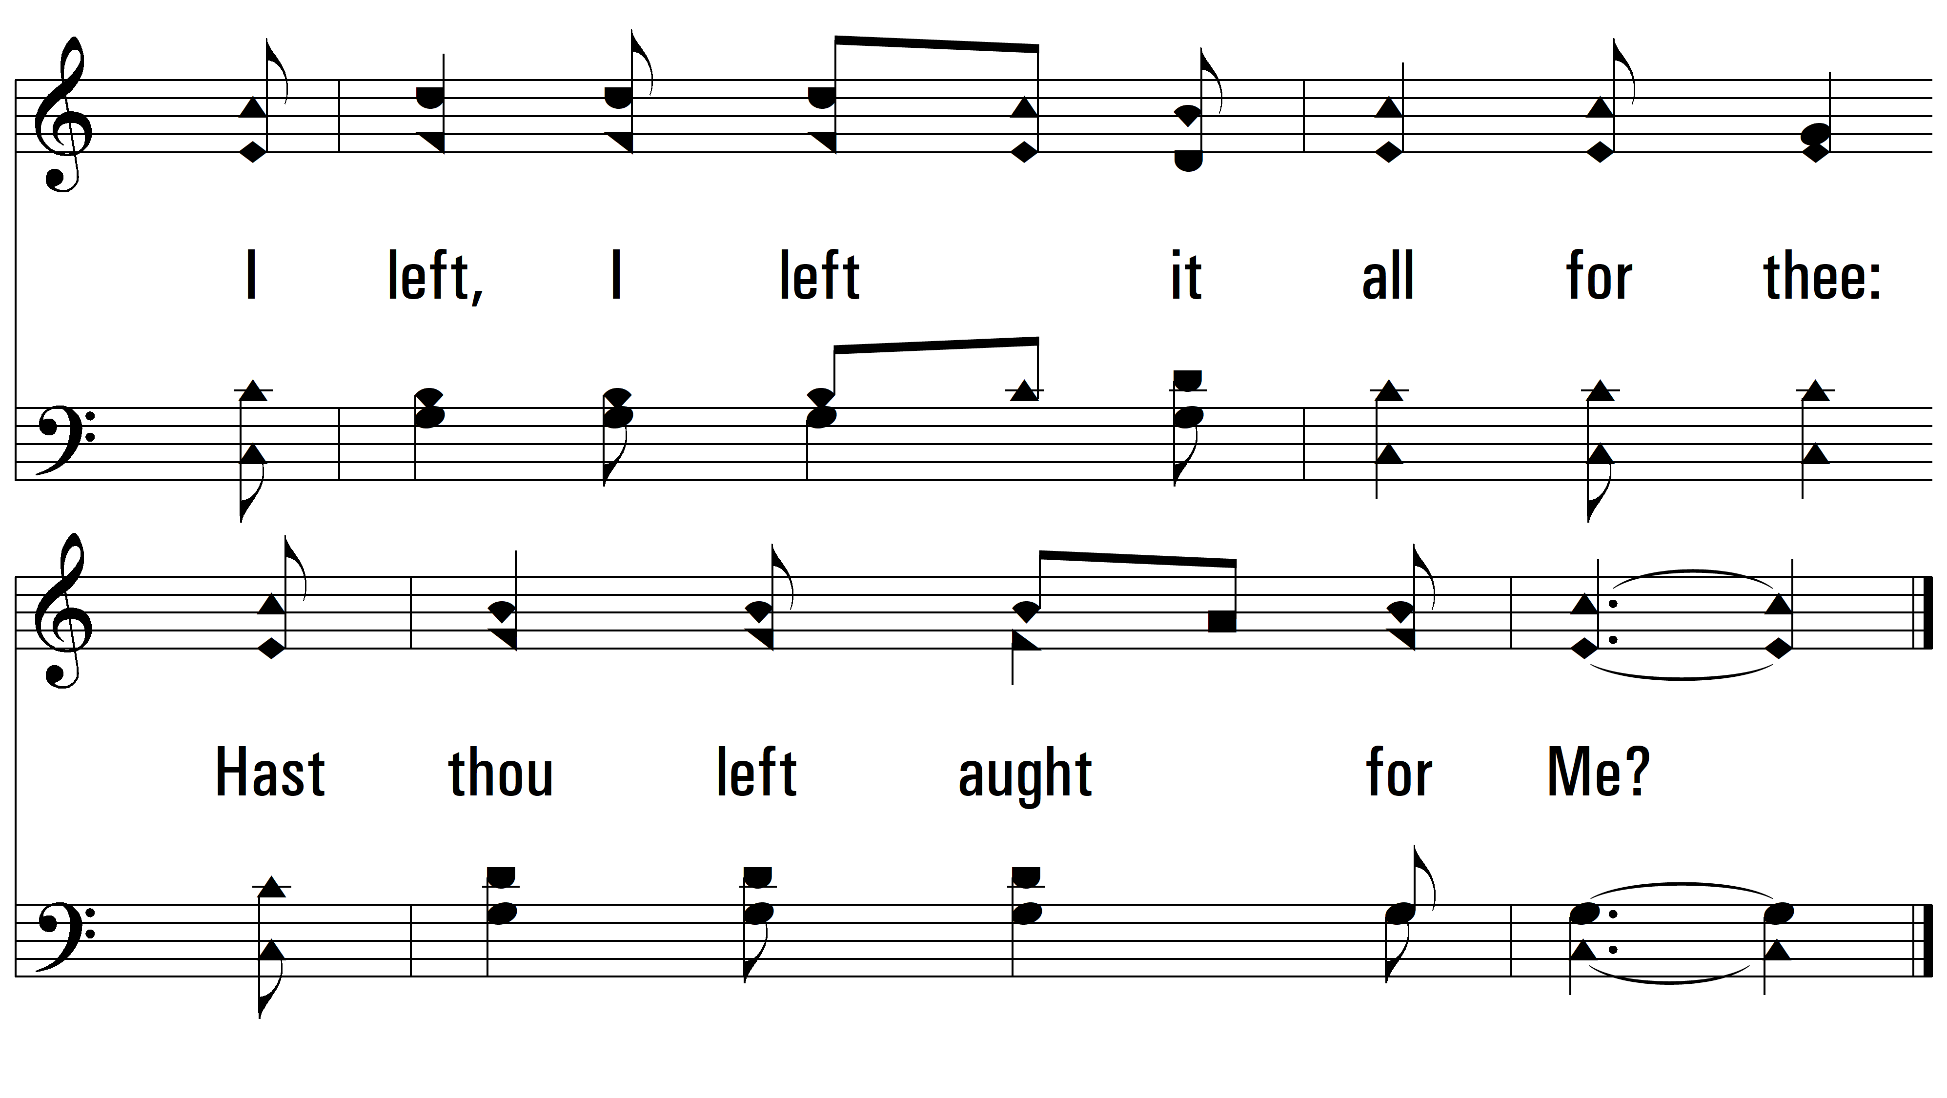
vs. 2

Slide 10
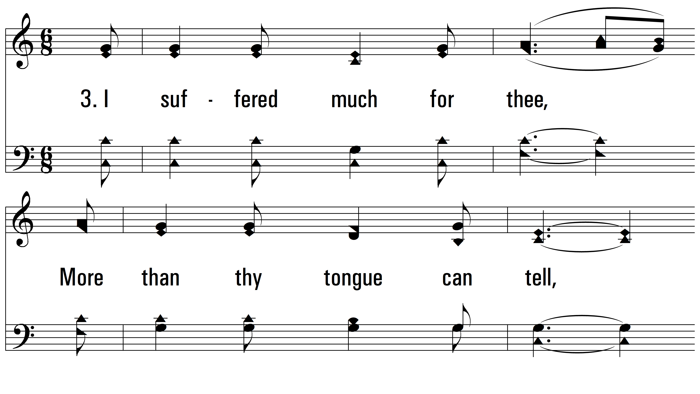
vs. 3 ~ I Gave My Life For Thee

Slide 11
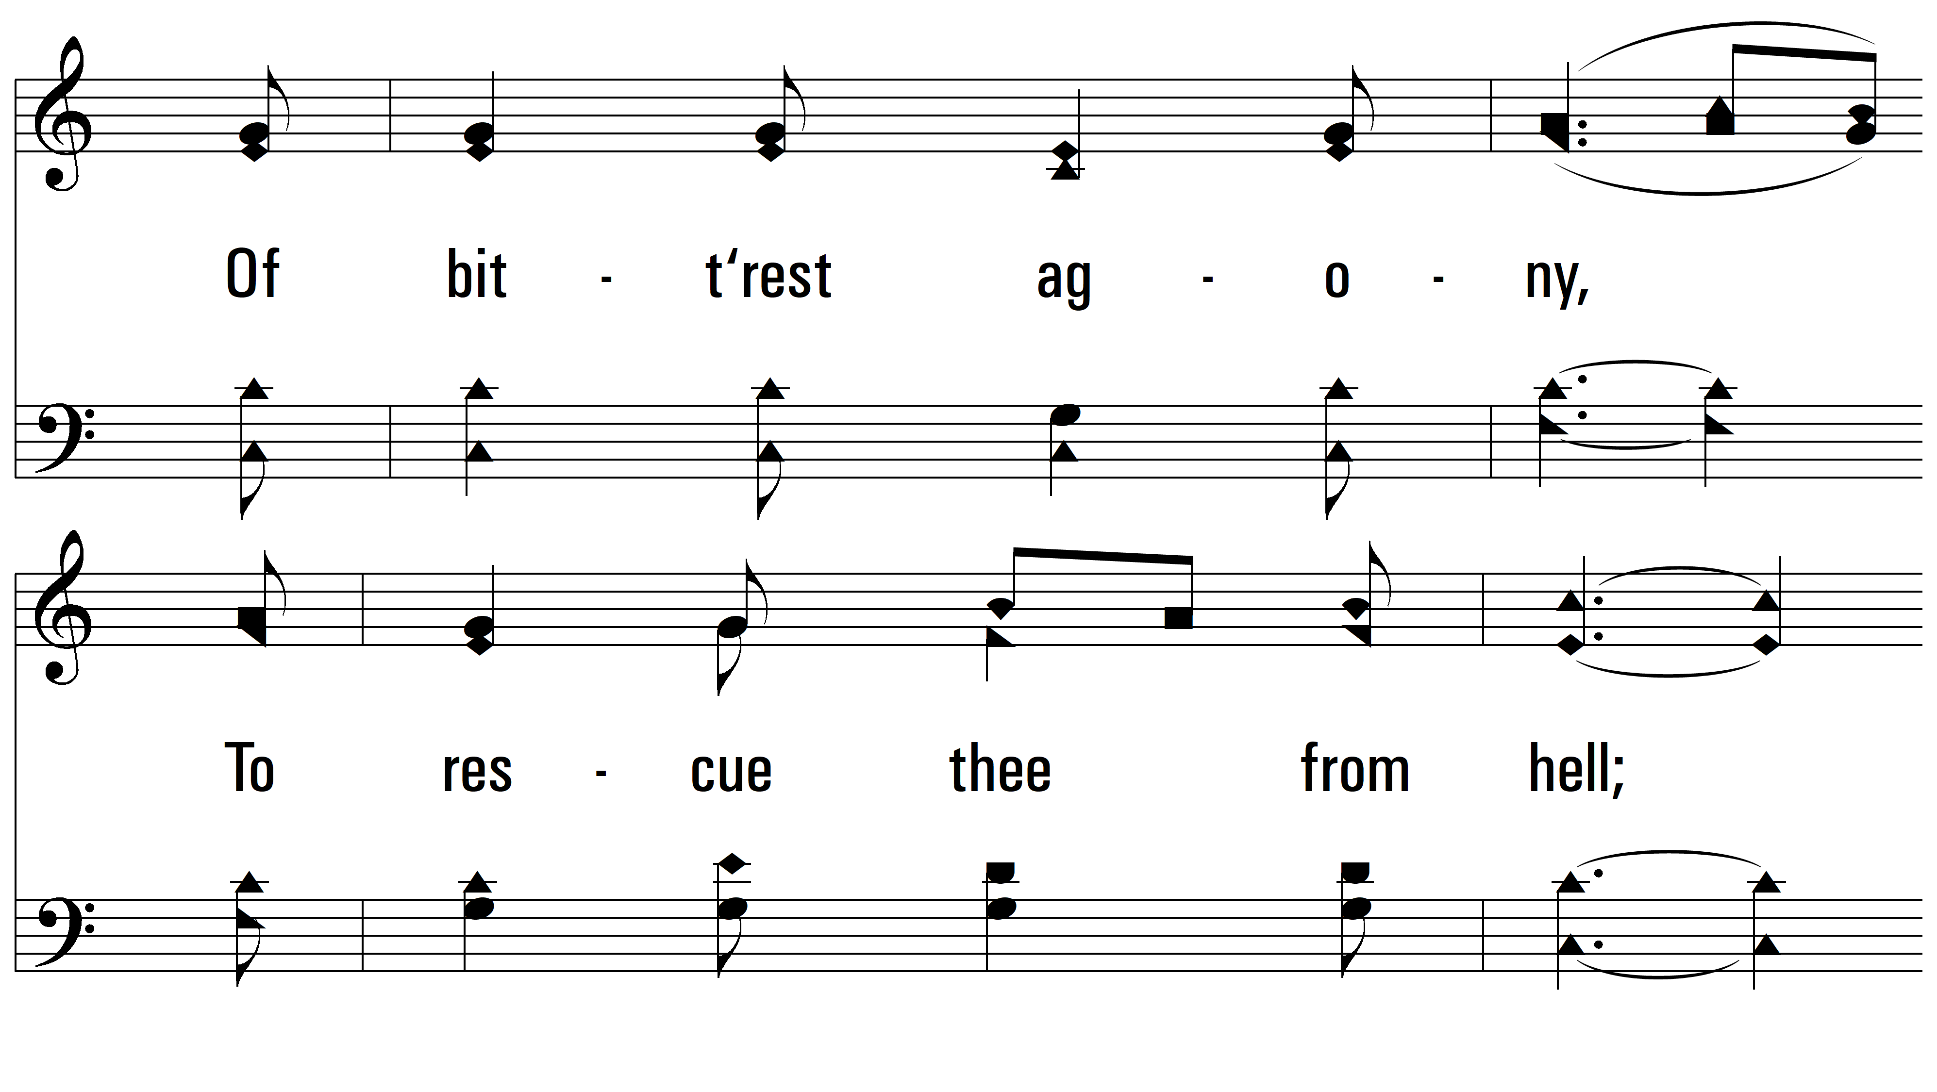
vs. 3

Slide 12
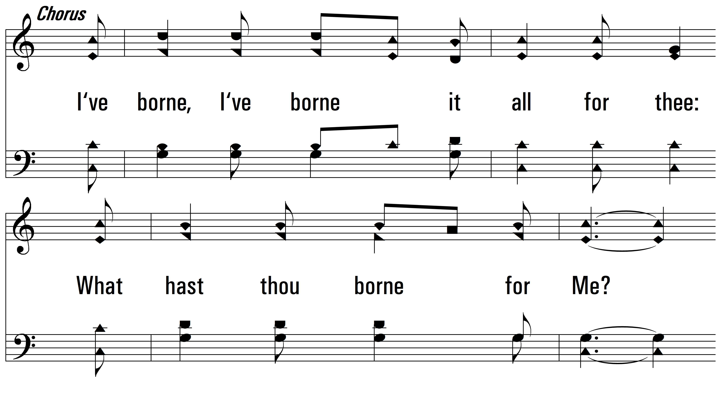
vs. 3

Slide 13
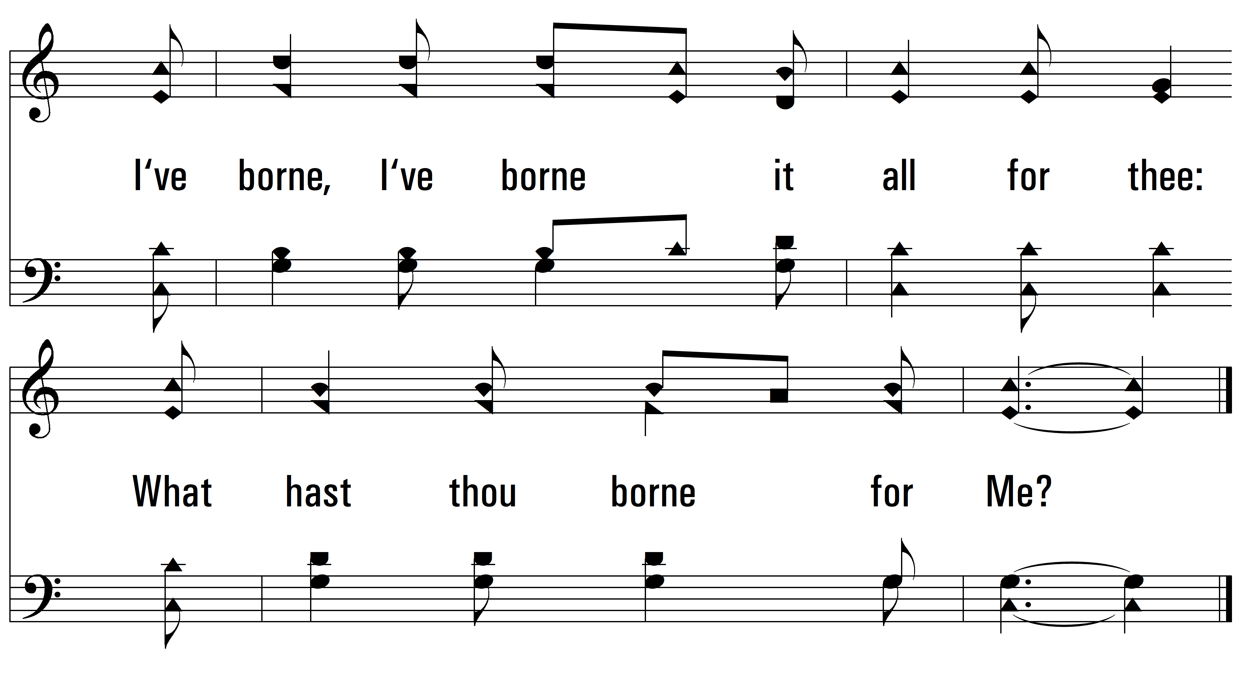
vs. 3

Slide 14
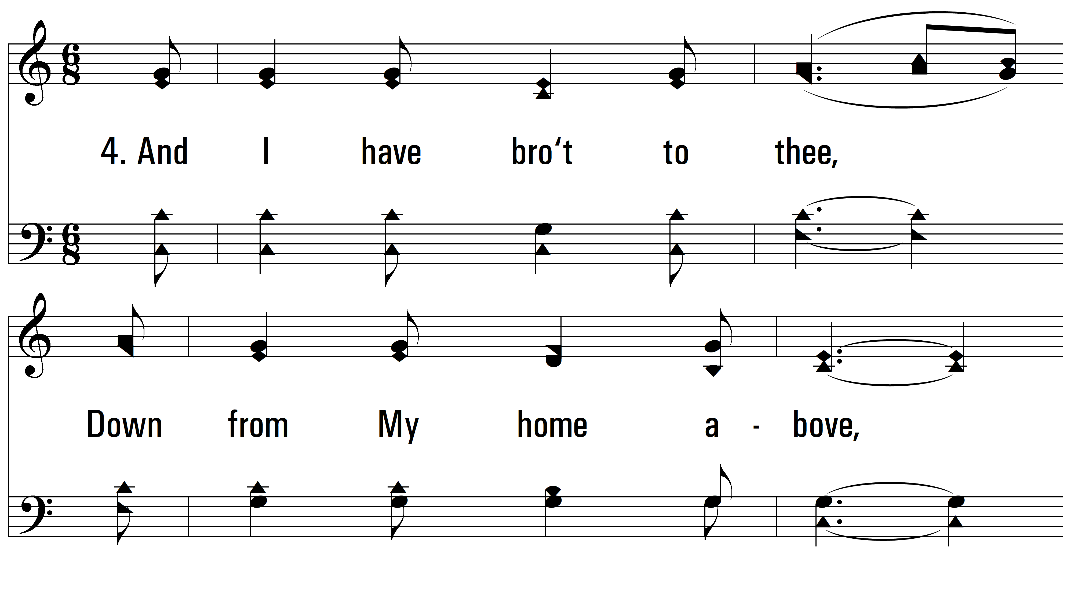
vs. 4 ~ I Gave My Life For Thee

Slide 15
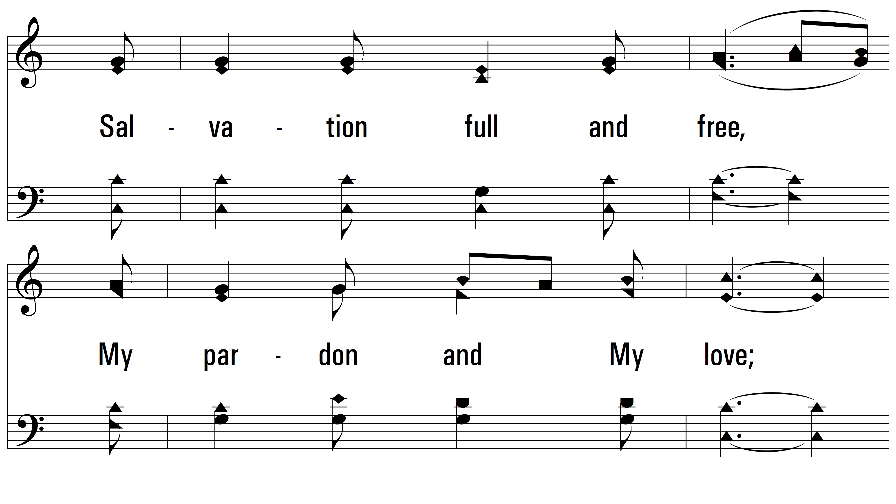
vs. 4

Slide 16
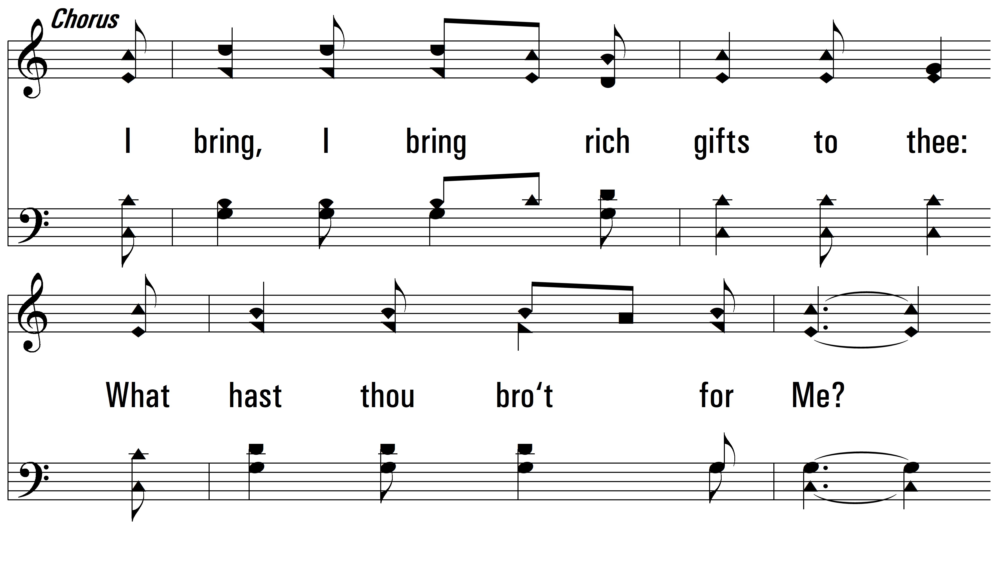
vs. 4

Slide 17
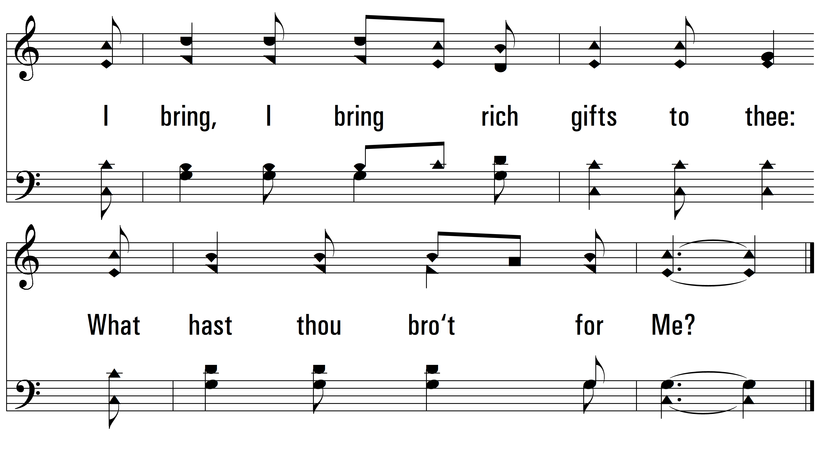
vs. 4
PDHymns.com
END

