Slide 1
I Bring My Sins To Thee
CLEARFIELD
6.6.6.6.8.8
Words: | Frances R. Havergal (1870)
Music: | Phillip P. Bliss (1870)
3/4
C/G - SOL
Verses: 4/Chorus
Lead - | SOL
Alto - | MI
Tenor - | SOL
Bass - | DO
PDHymns.com

Slide 2
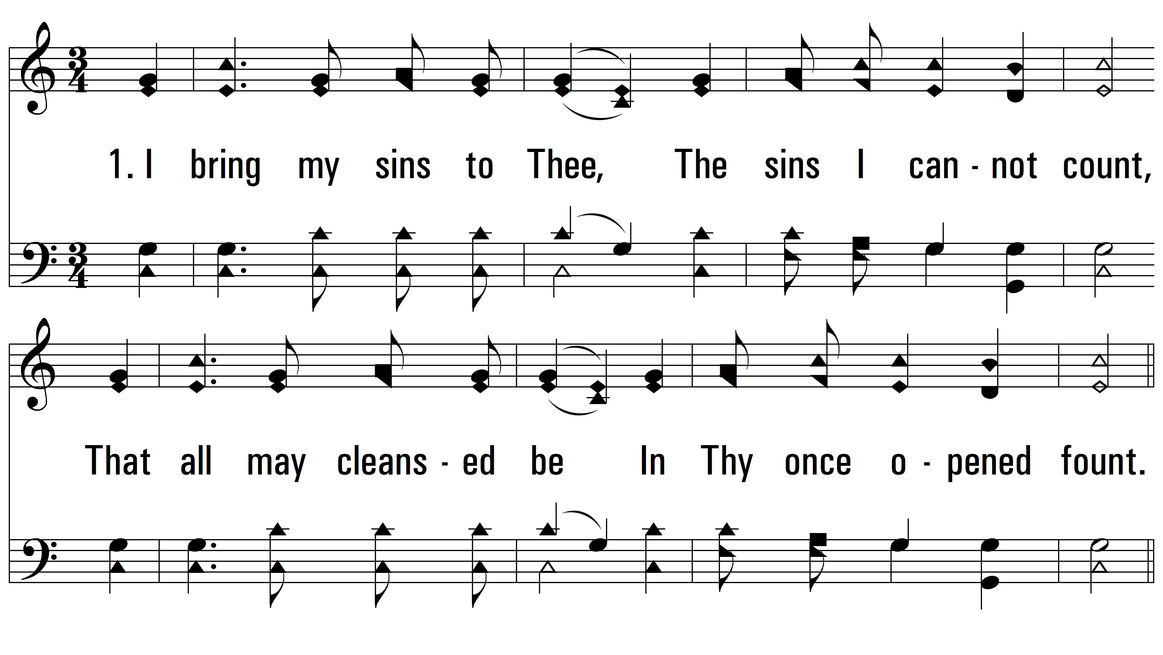
vs. 1 ~ I Bring My Sins To Thee

Slide 3
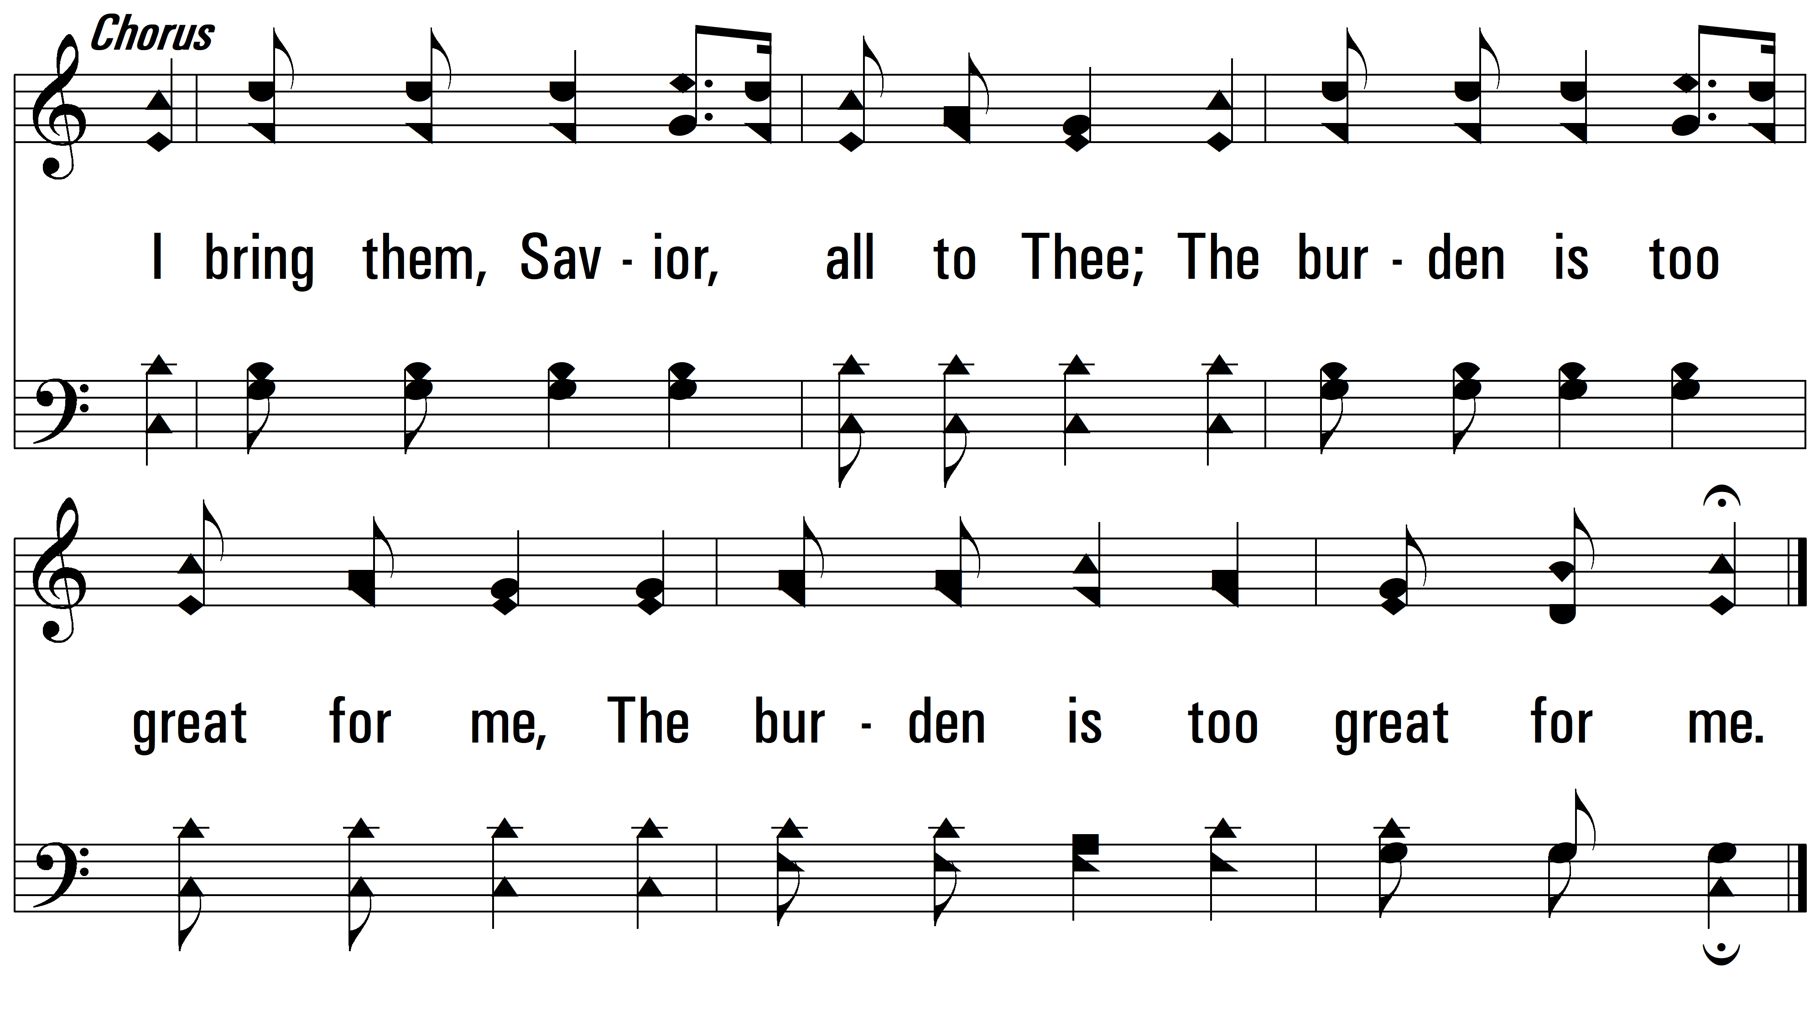
vs. 1

Slide 4
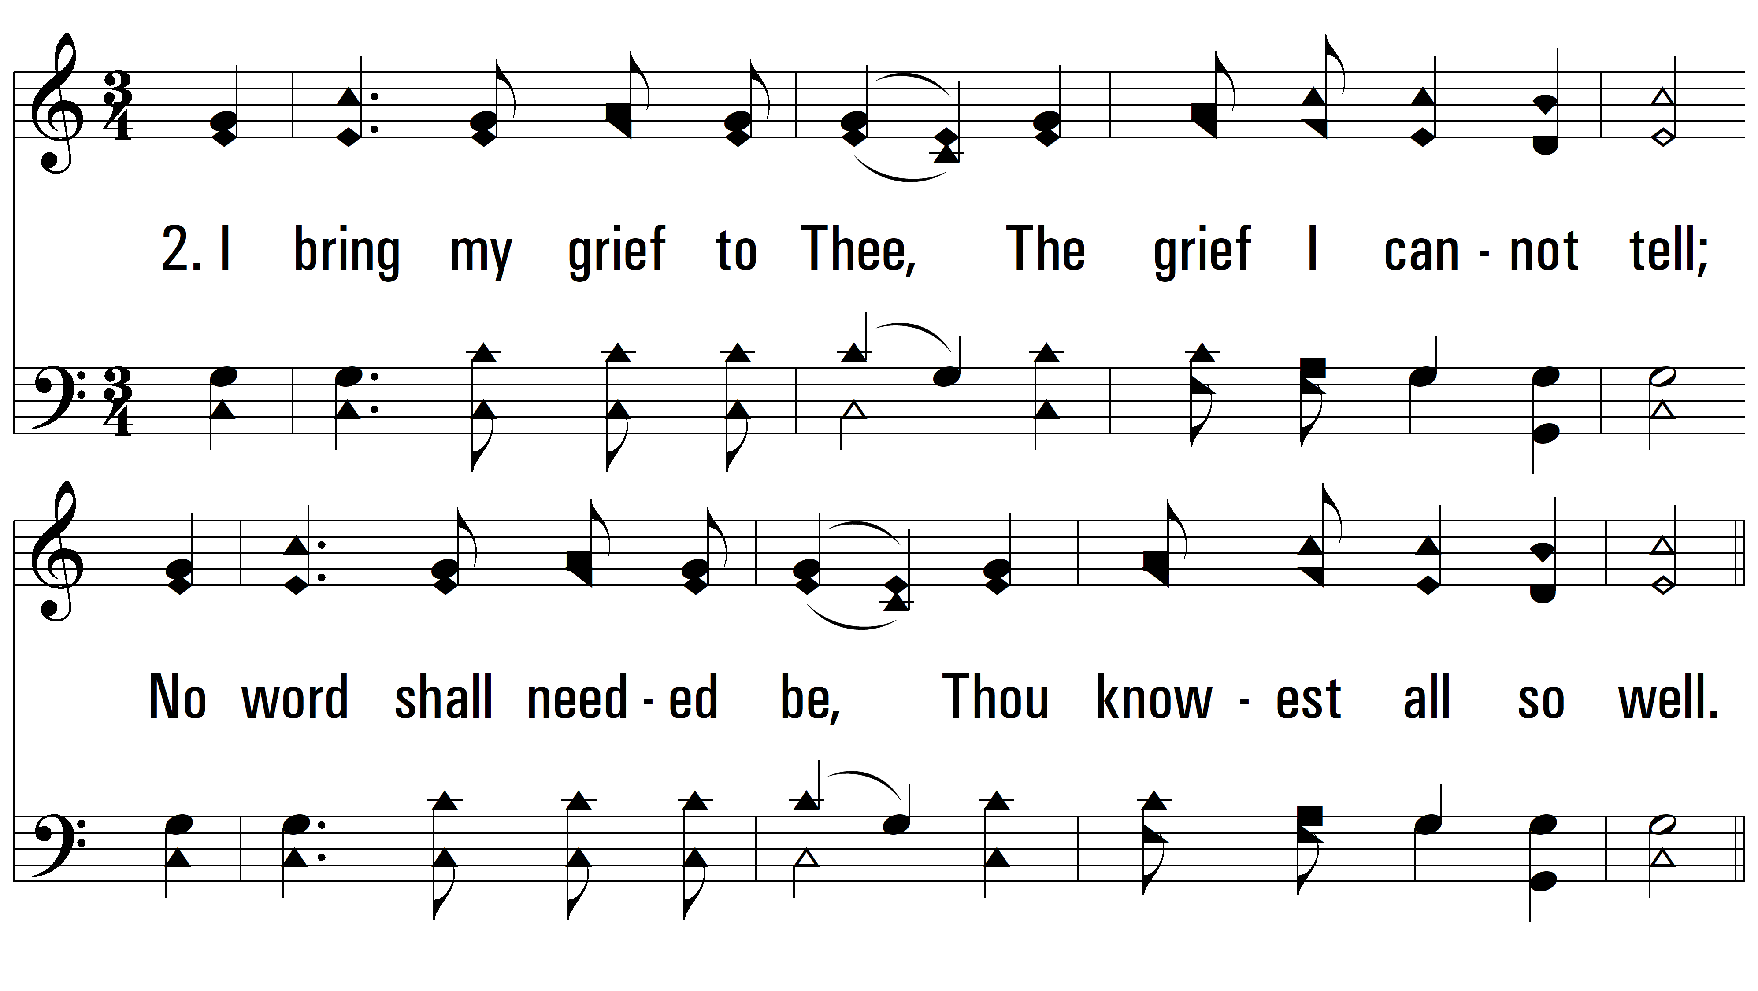
vs. 2 ~ I Bring My Sins To Thee

Slide 5
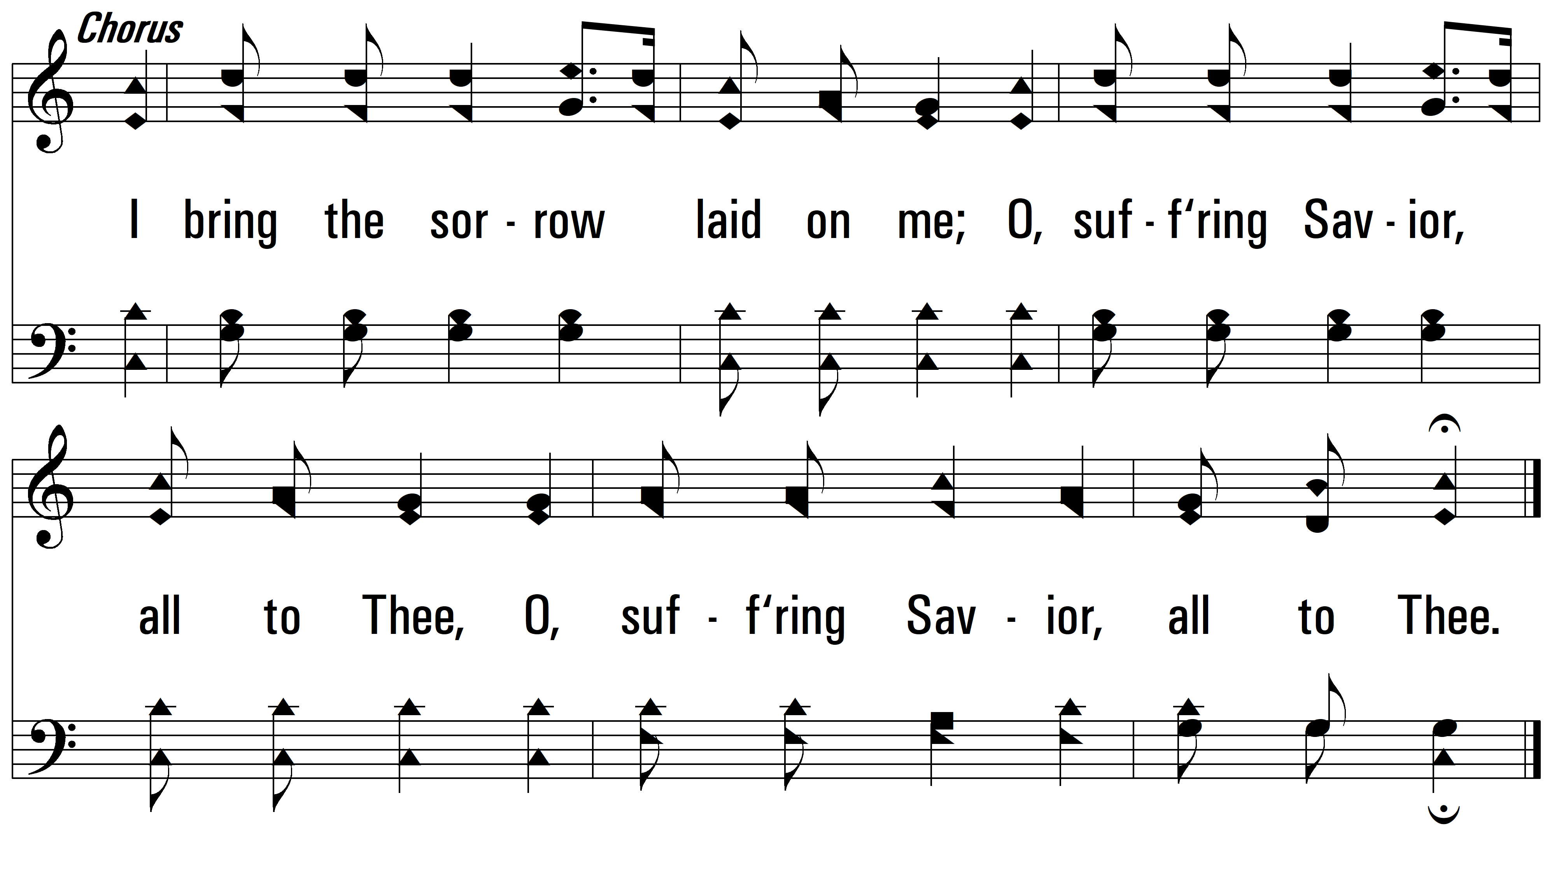
vs. 2

Slide 6
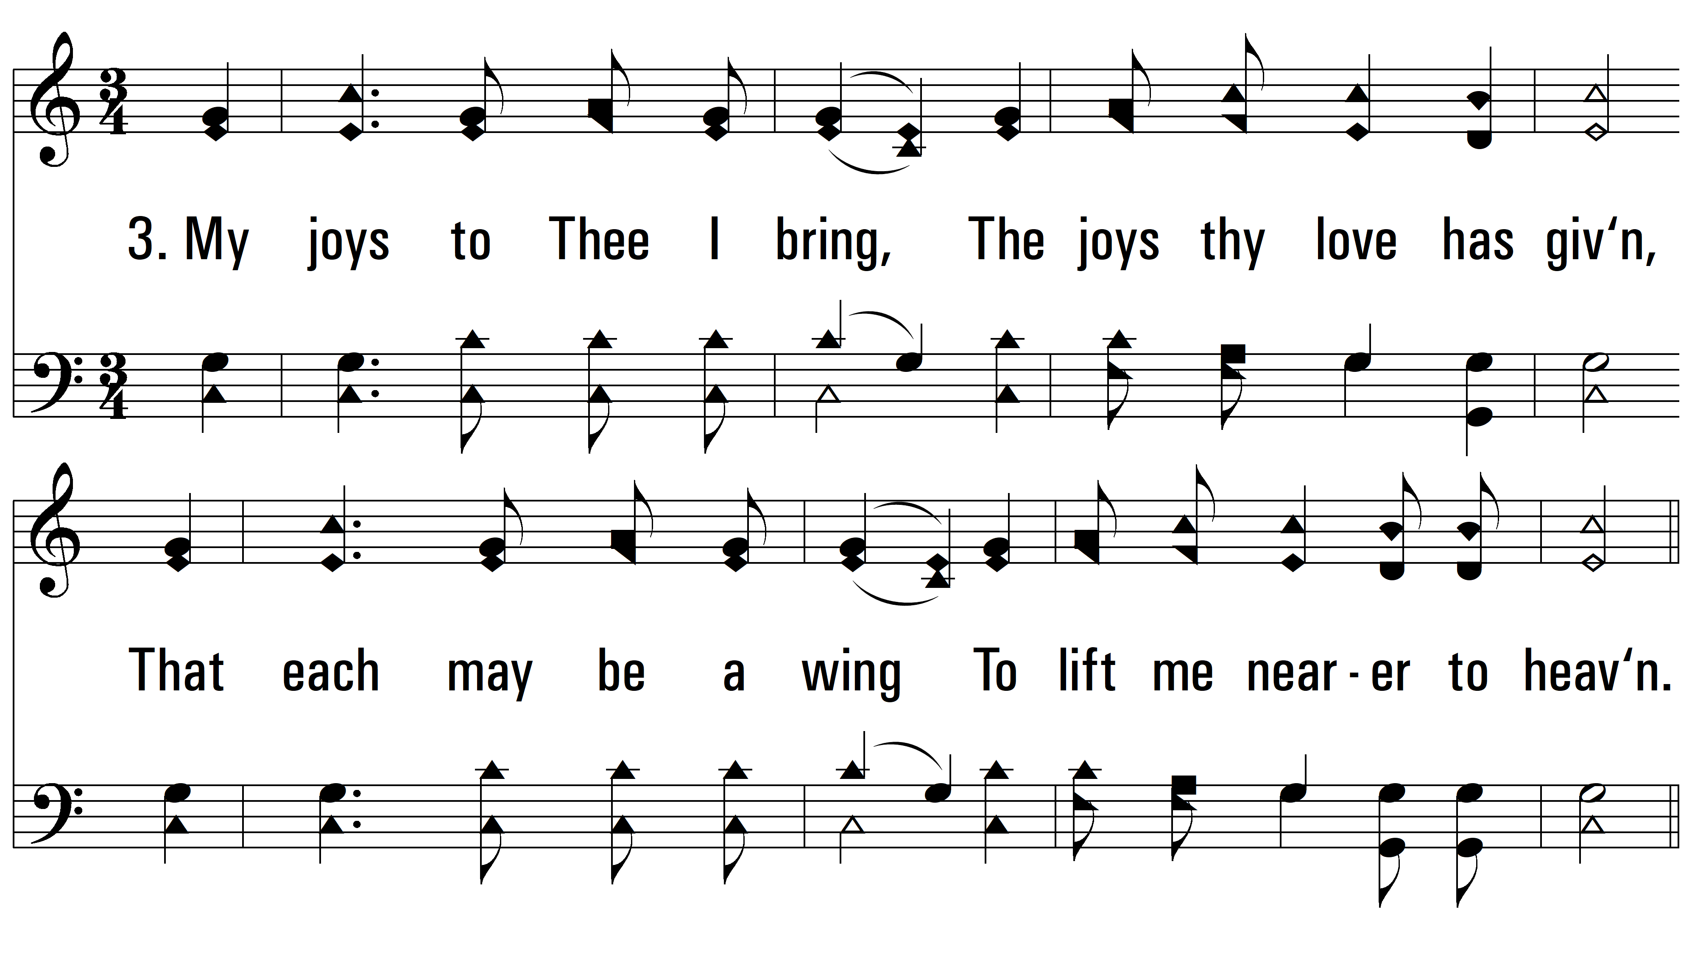
vs. 3 ~ I Bring My Sins To Thee

Slide 7
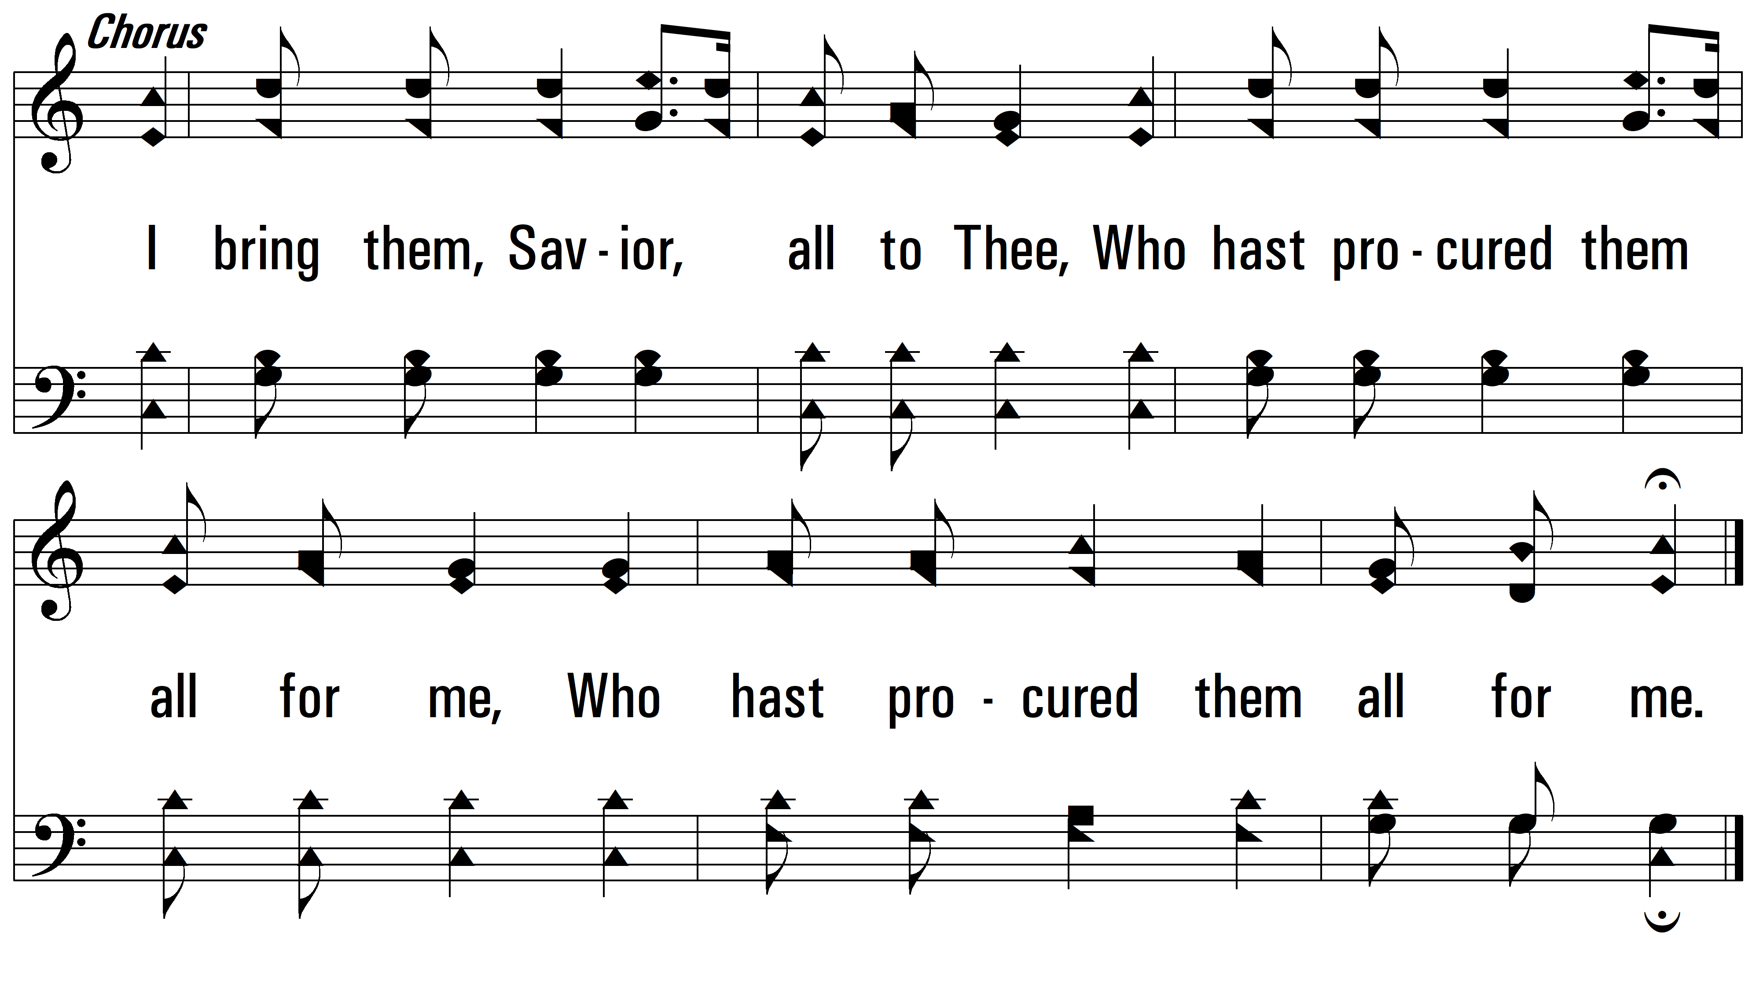
vs. 3

Slide 8
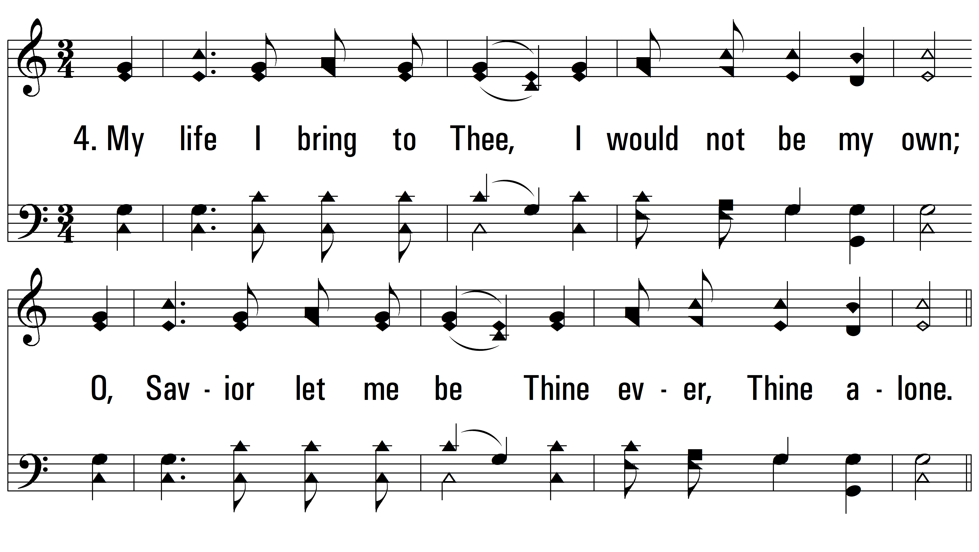
vs. 4 ~ I Bring My Sins To Thee

Slide 9
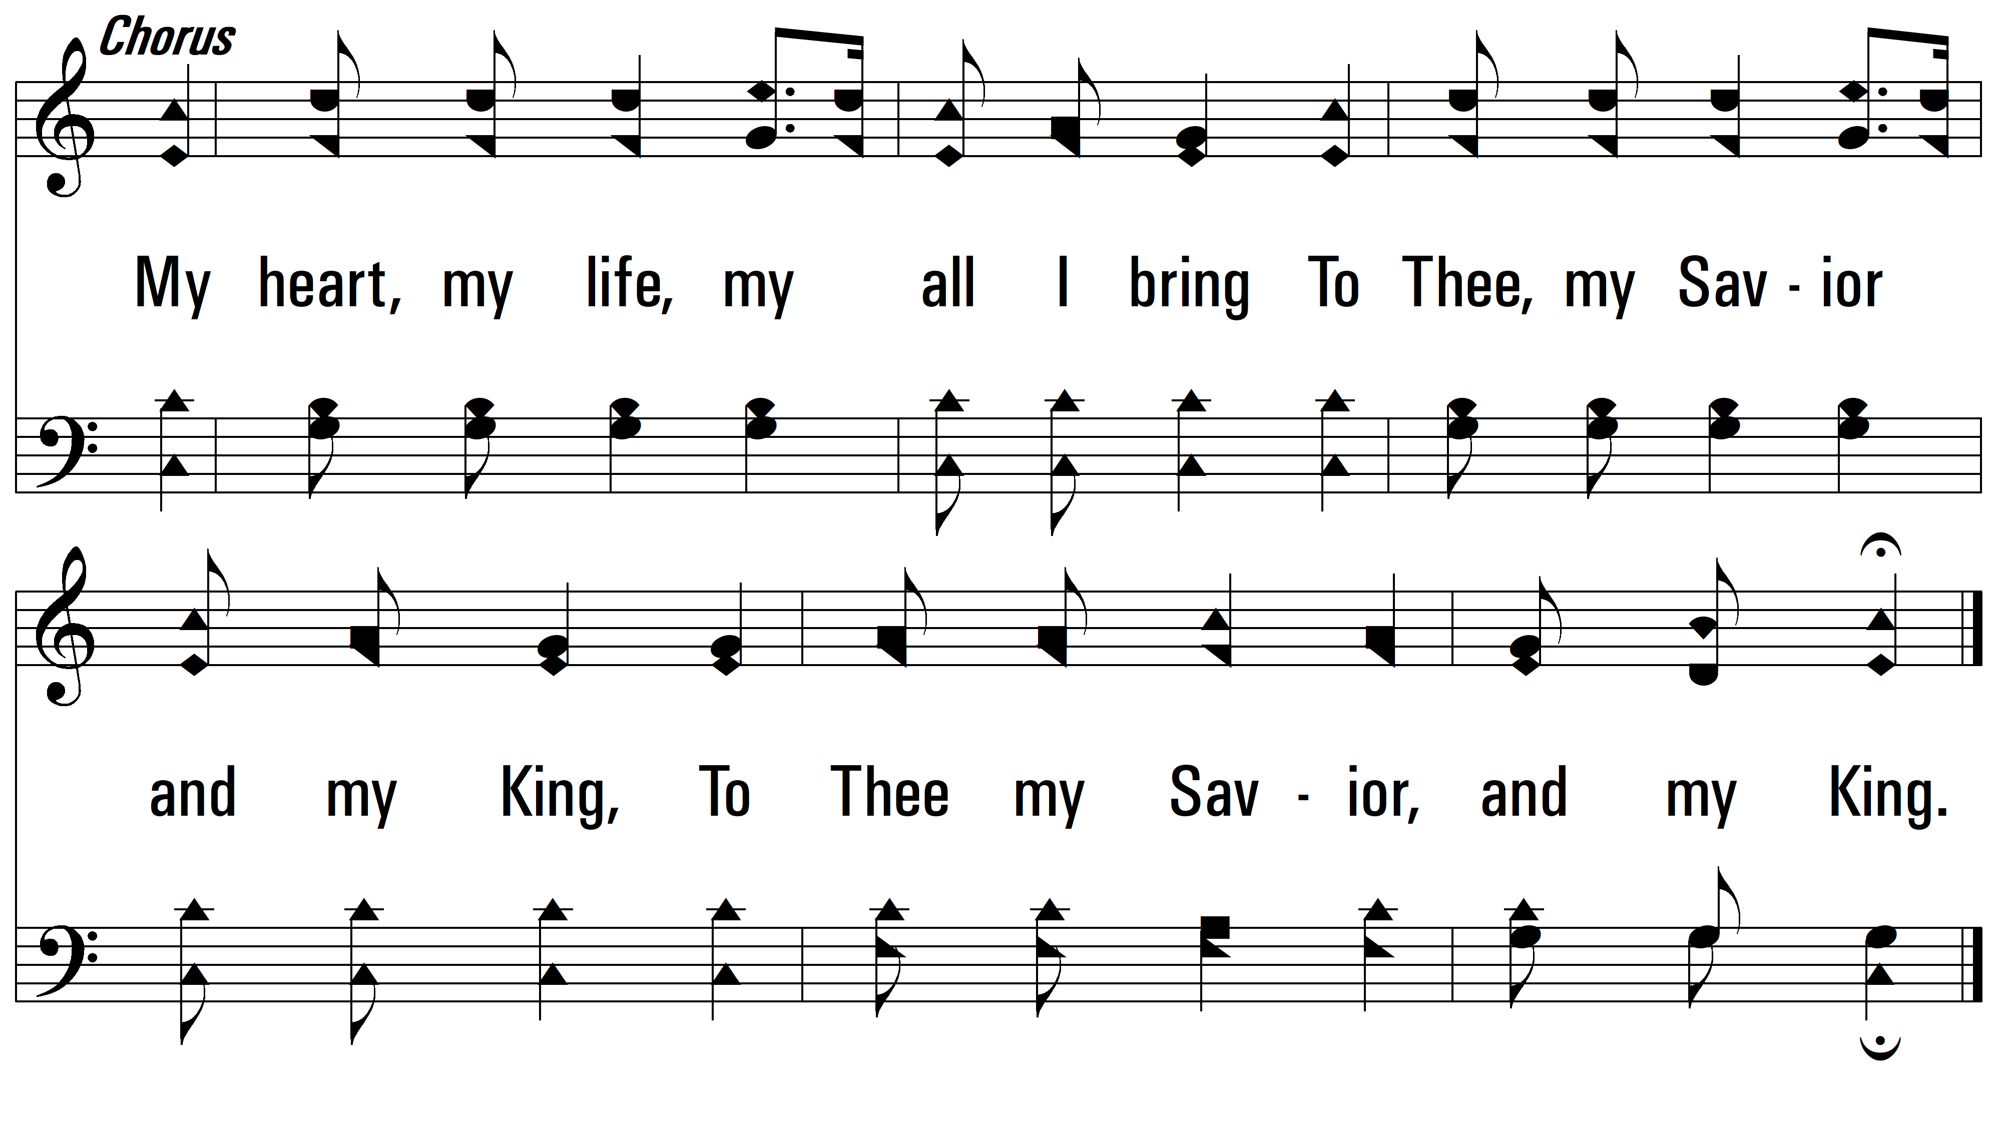
vs. 4
PDHymns.com
END

