Slide 1
I Am So Glad
Words: | James Rowe (1870)
Music: | J. E. Thomas (1870)
6/8
F/C - SOL
Verses: 3/Chorus
Lead - | SOL
Alto - | SOL
Tenor - | MI
Bass - | DO
PDHymns.com

Slide 2
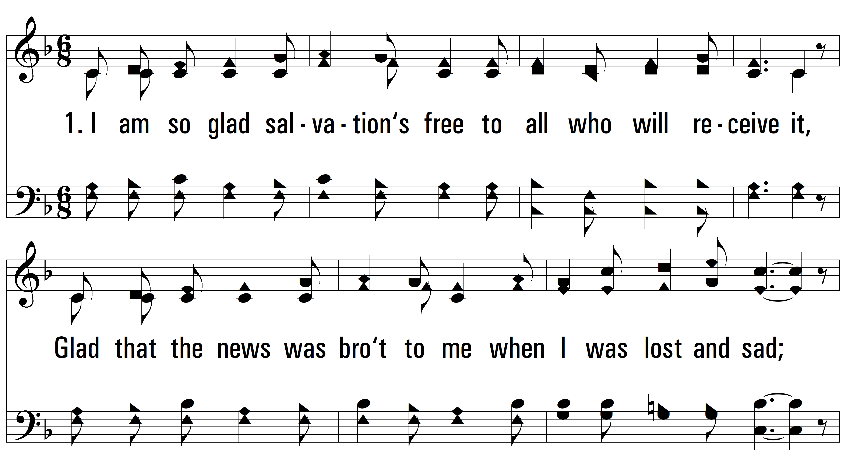
vs. 1 ~ I Am So Glad

Slide 3
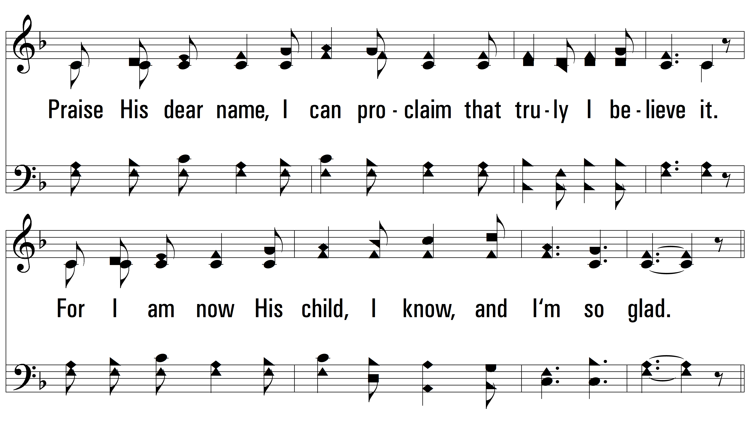
vs. 1

Slide 4
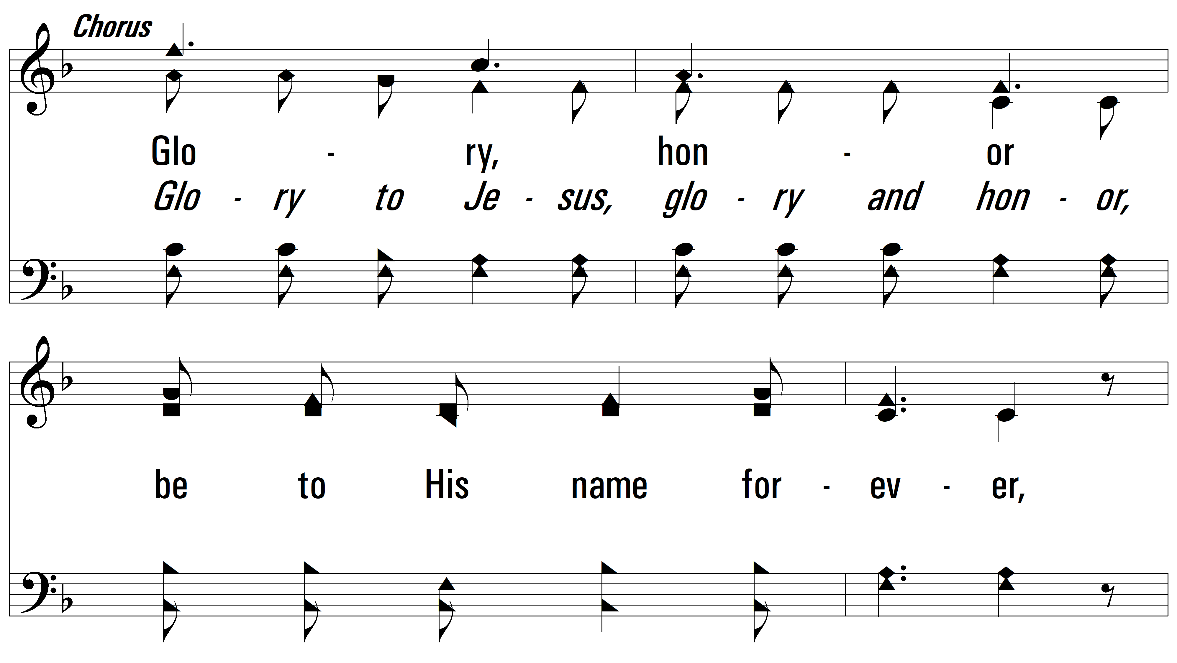
vs. 1

Slide 5
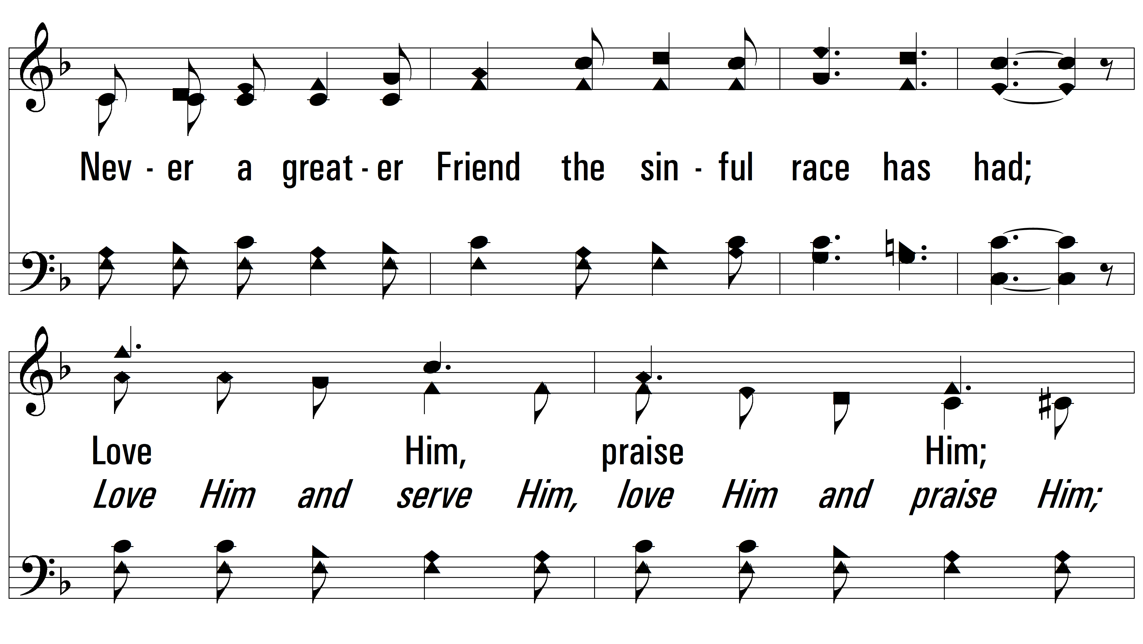
vs. 1

Slide 6
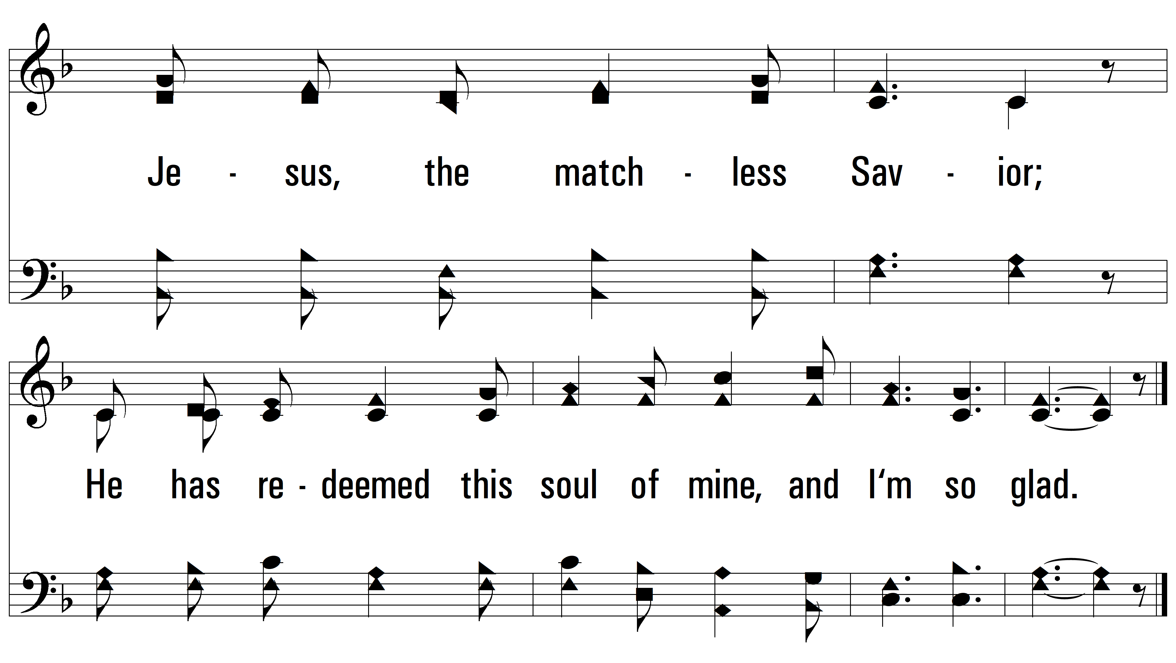
vs. 1

Slide 7
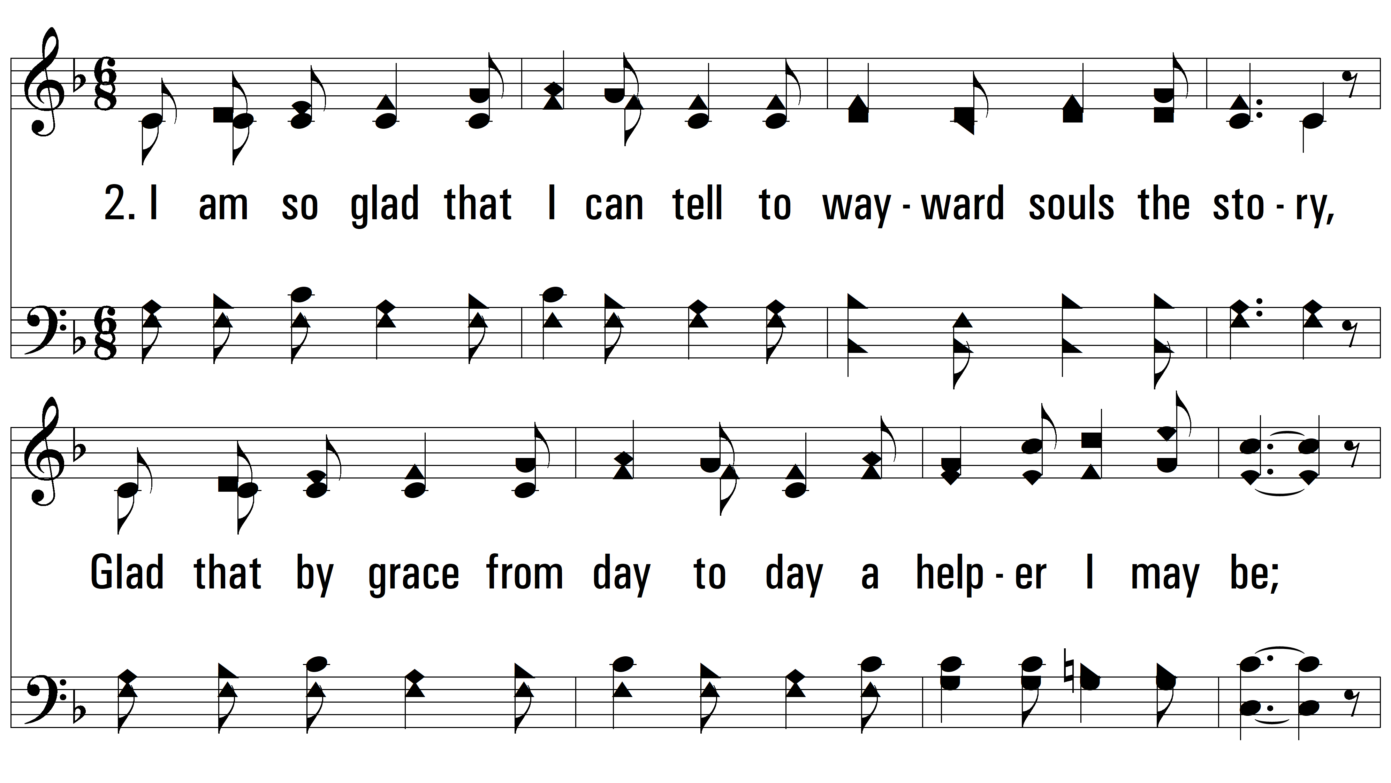
vs. 2 ~ I Am So Glad

Slide 8
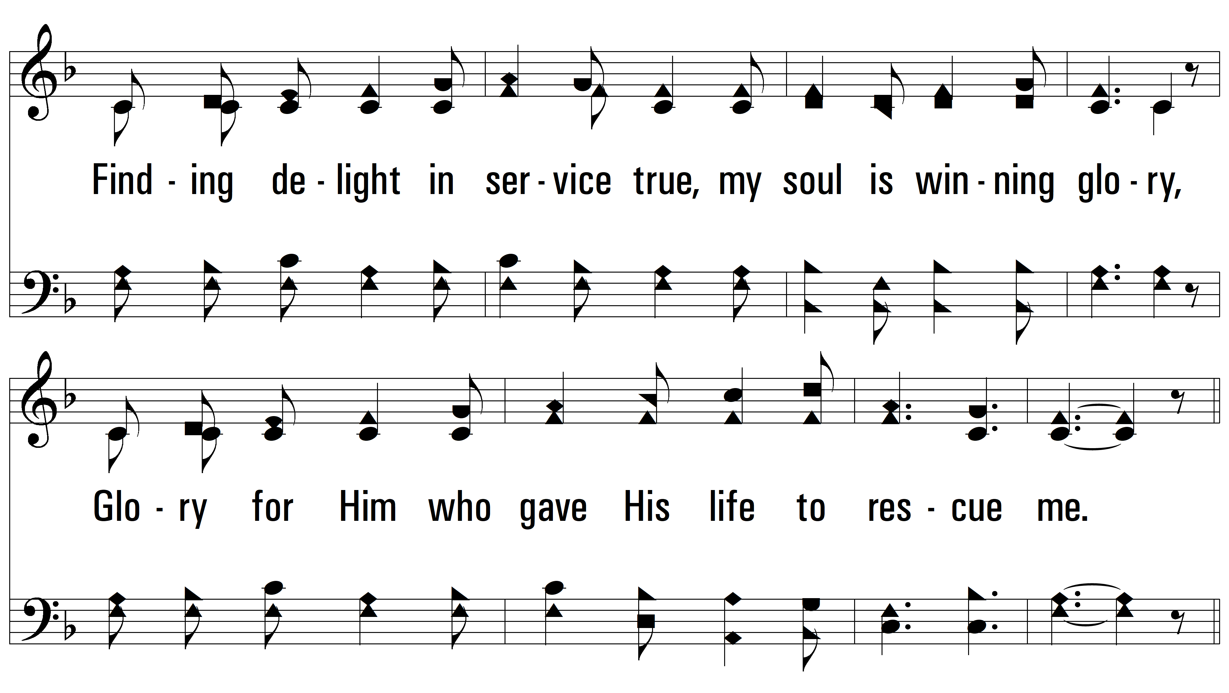
vs. 2

Slide 9
vs. 2

Slide 10
vs. 2

Slide 11
vs. 2

Slide 12
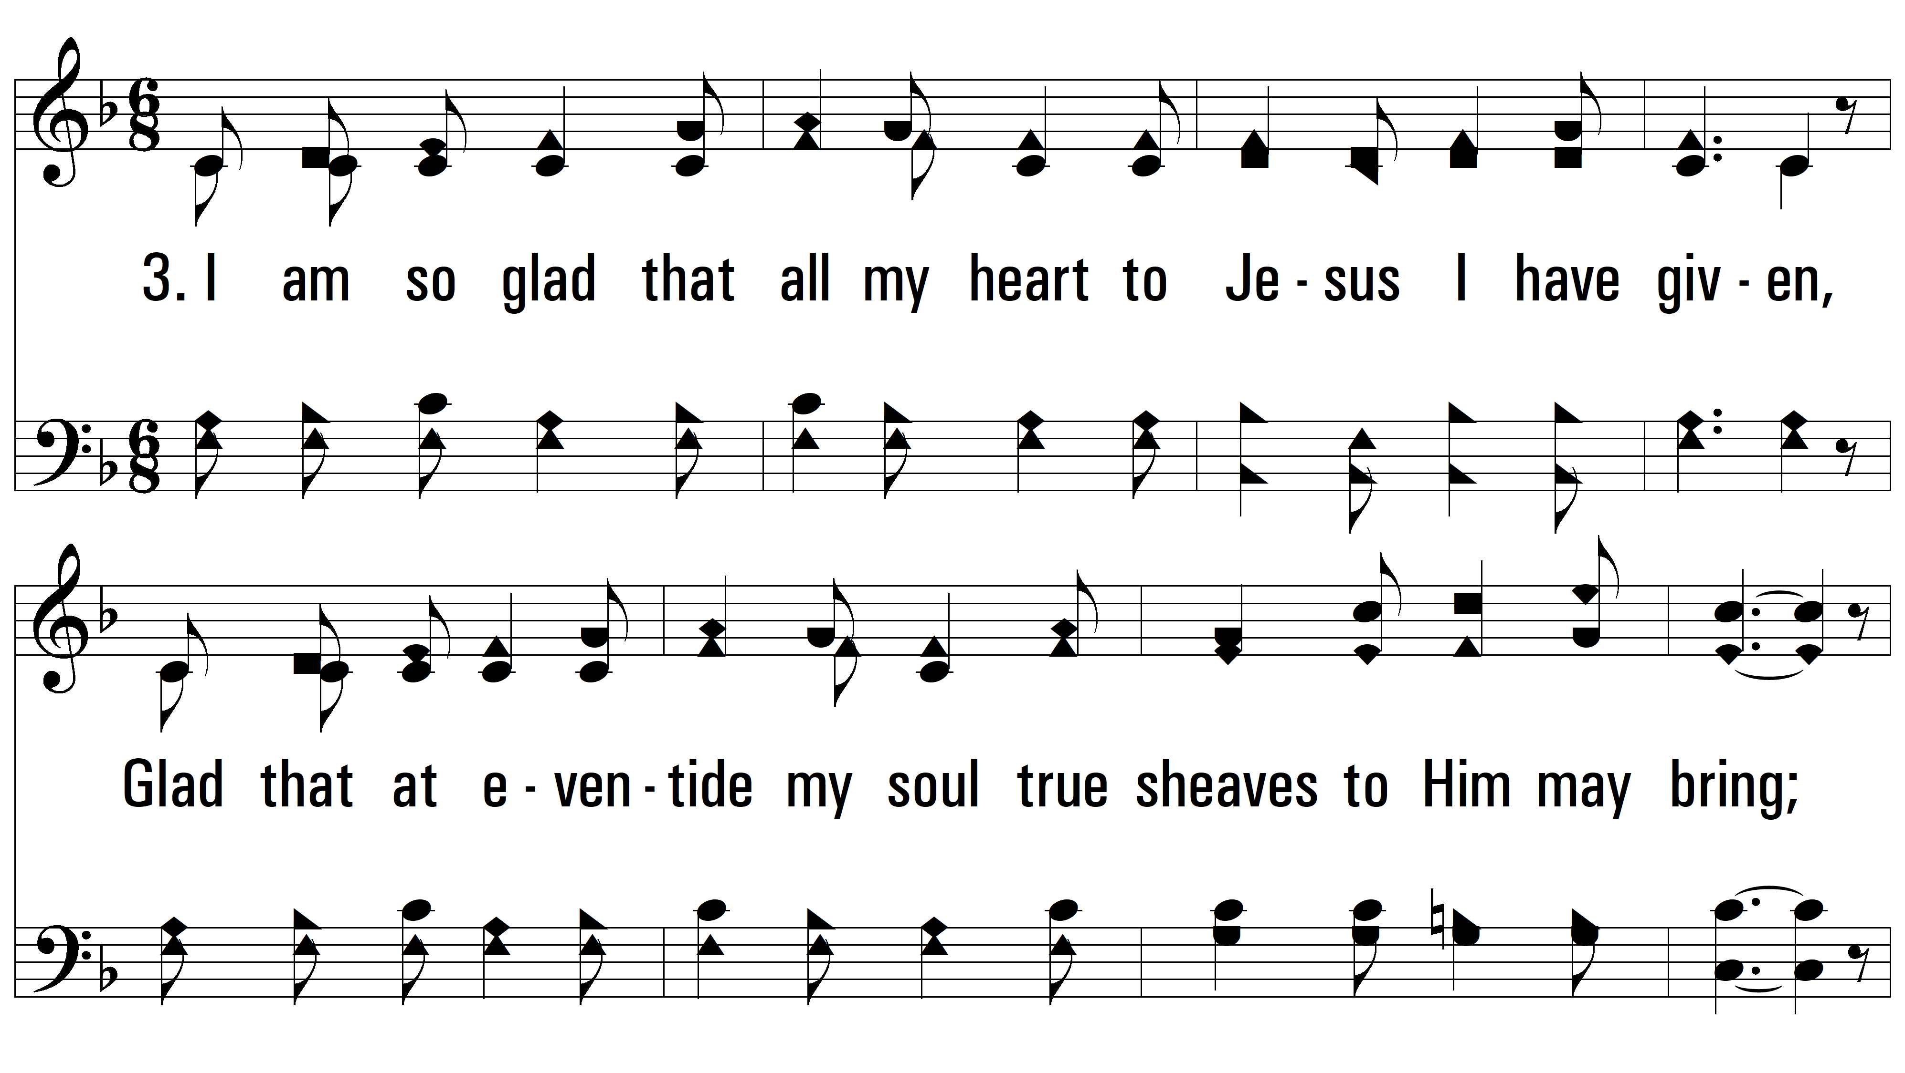
vs. 3 ~ I Am So Glad

Slide 13
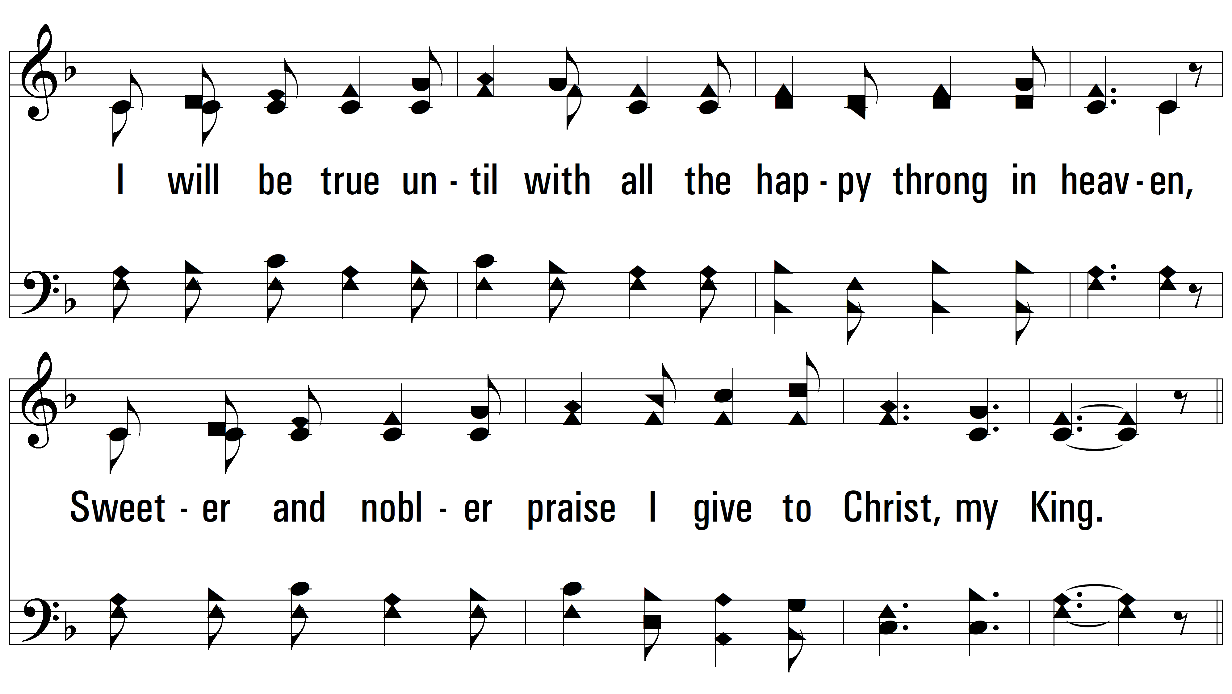
vs. 3

Slide 14
vs. 3

Slide 15
vs. 3

Slide 16
vs. 3
PDHymns.com
END

