Slide 1
I Am Praying For You
(I Have A Savior)
Words: | S. O’Maley Cuff (1860)
Music: | Ira D. Sankey (1875)
4/4
G/D - SOL
Verses: 3/Chorus
Lead - | SOL
Alto - | MI
Tenor - | DO
Bass - | DO
PDHymns.com

Slide 2
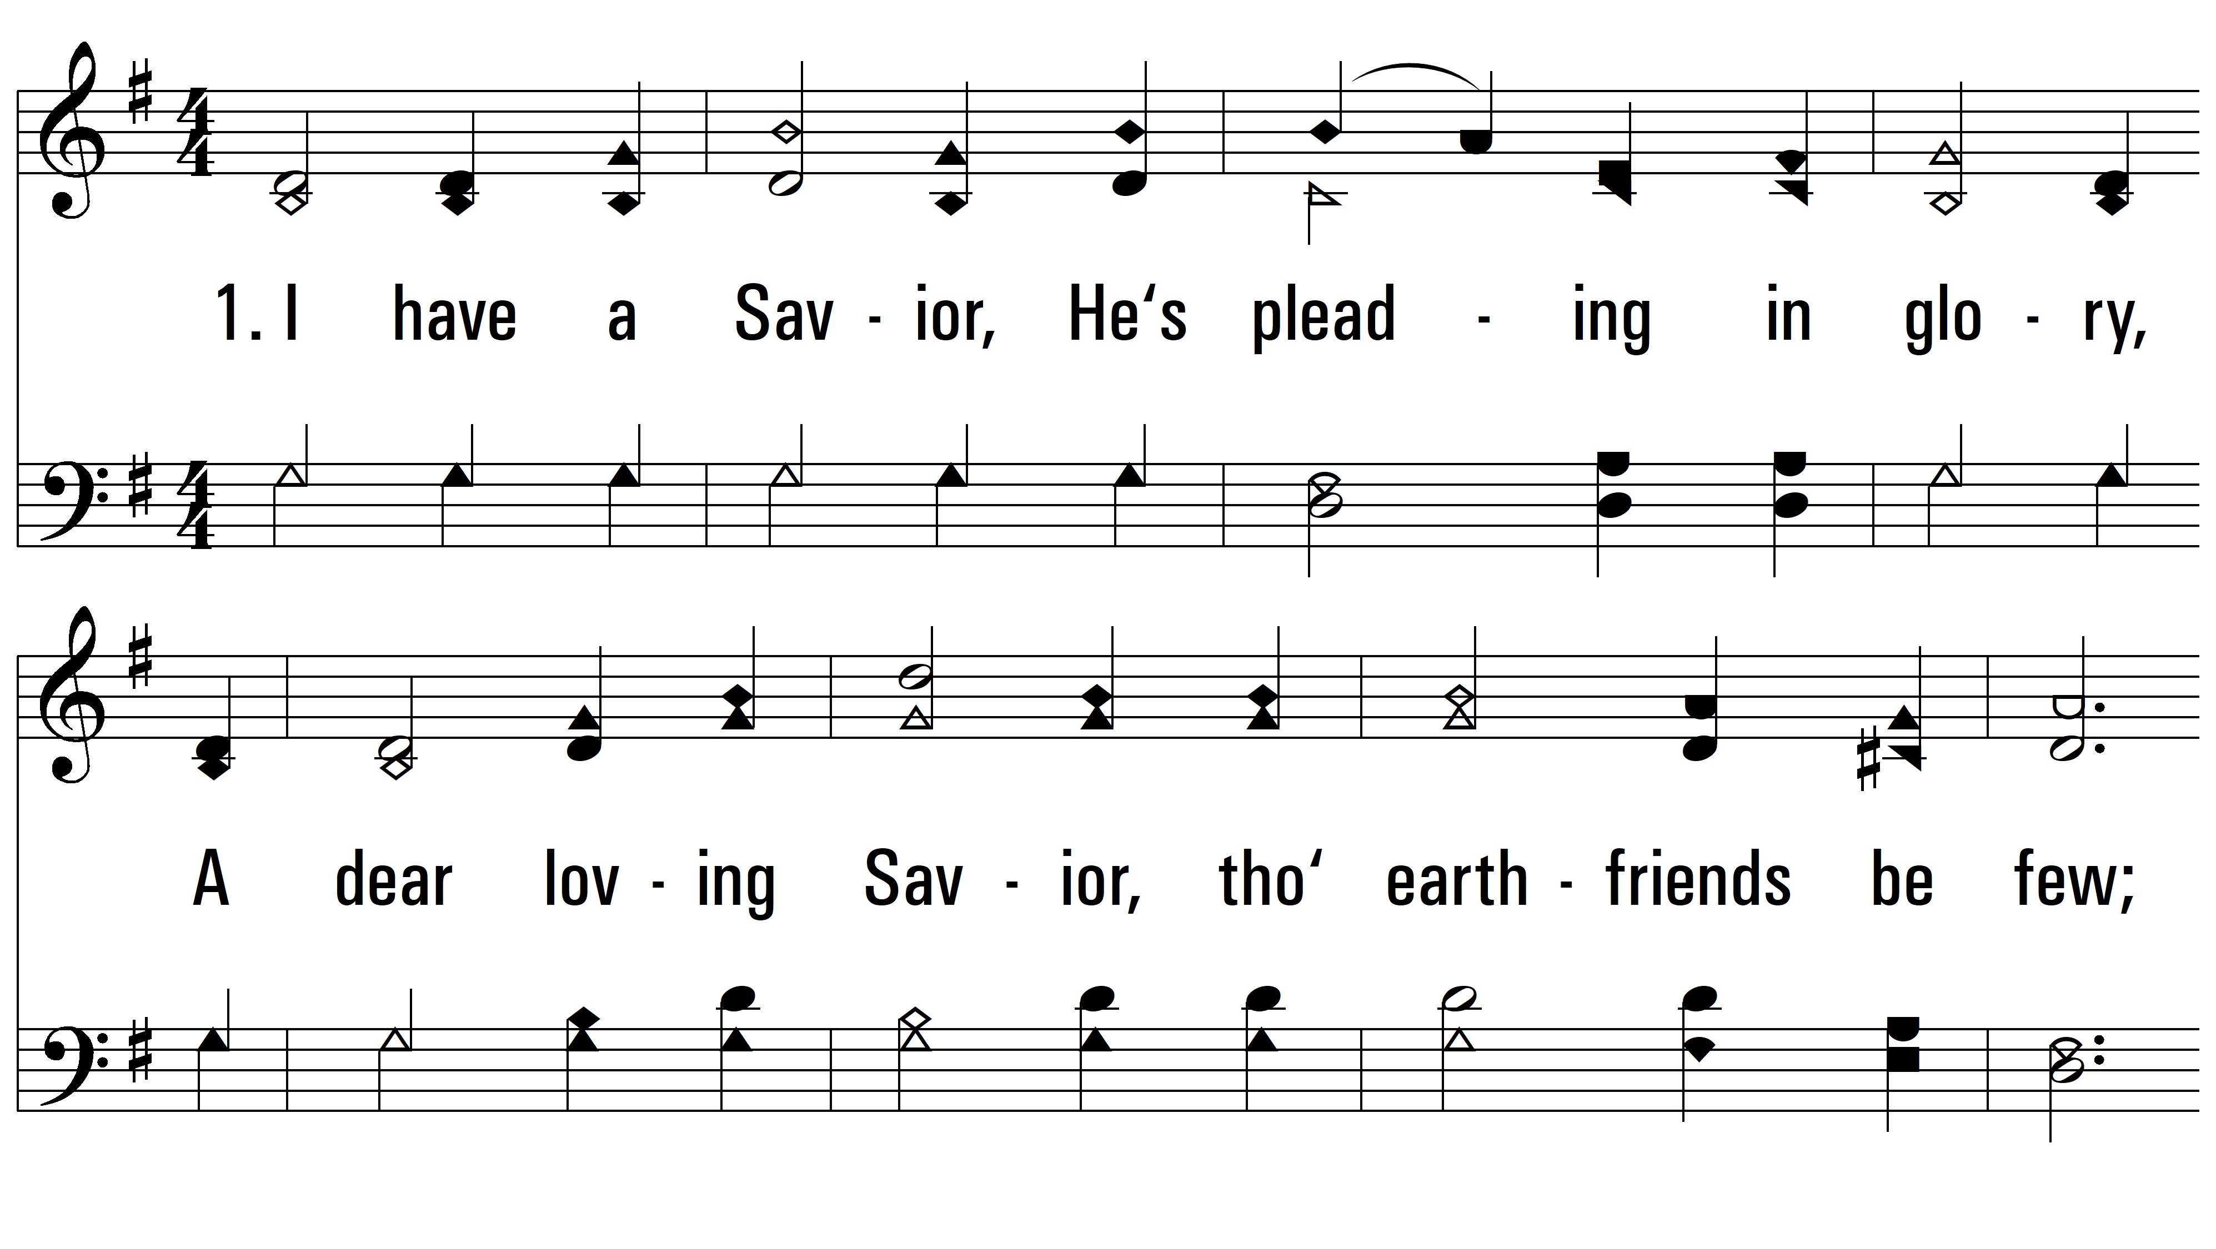
vs. 1 ~ I Am Praying For You

Slide 3
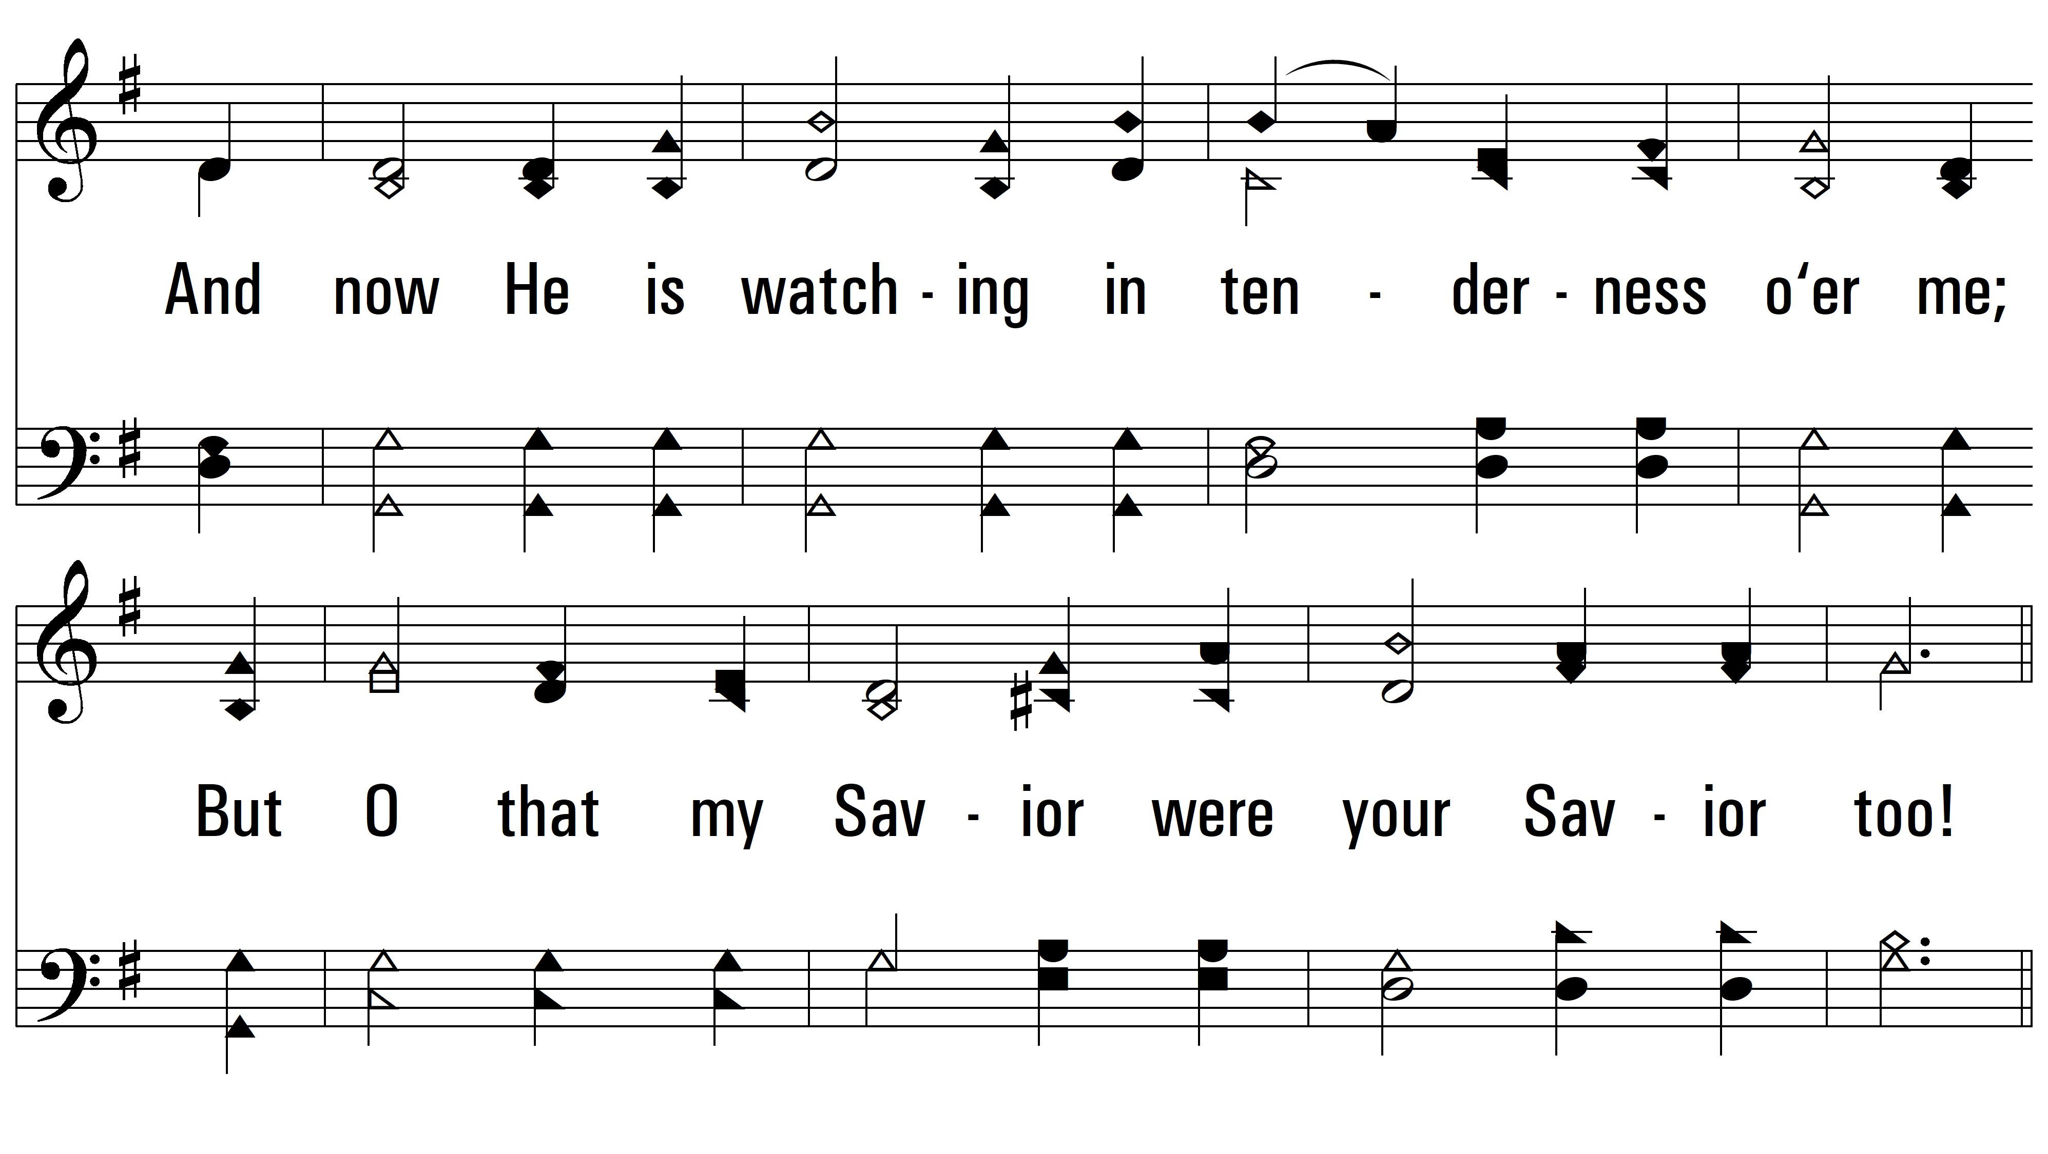
vs. 1

Slide 4
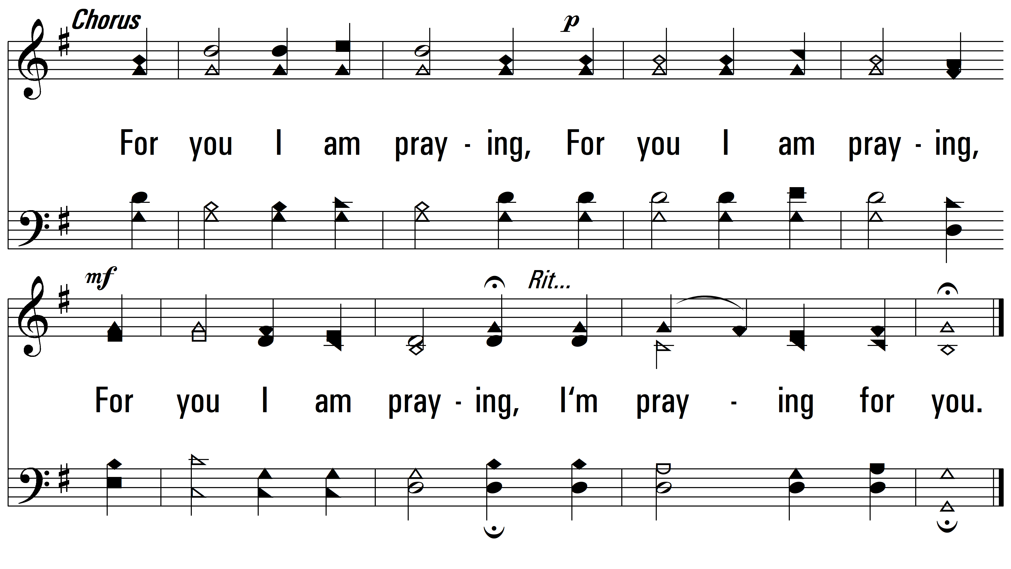
vs. 1

Slide 5
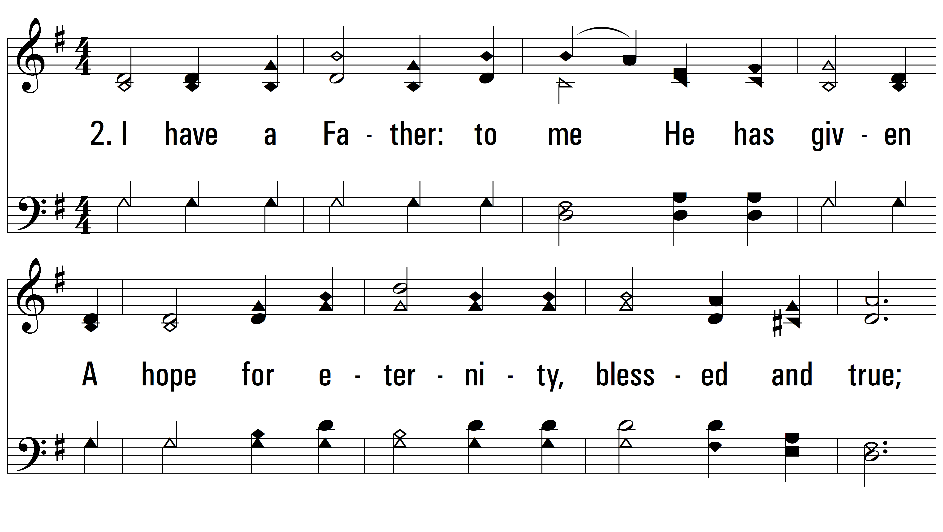
vs. 2 ~ I Am Praying For You

Slide 6
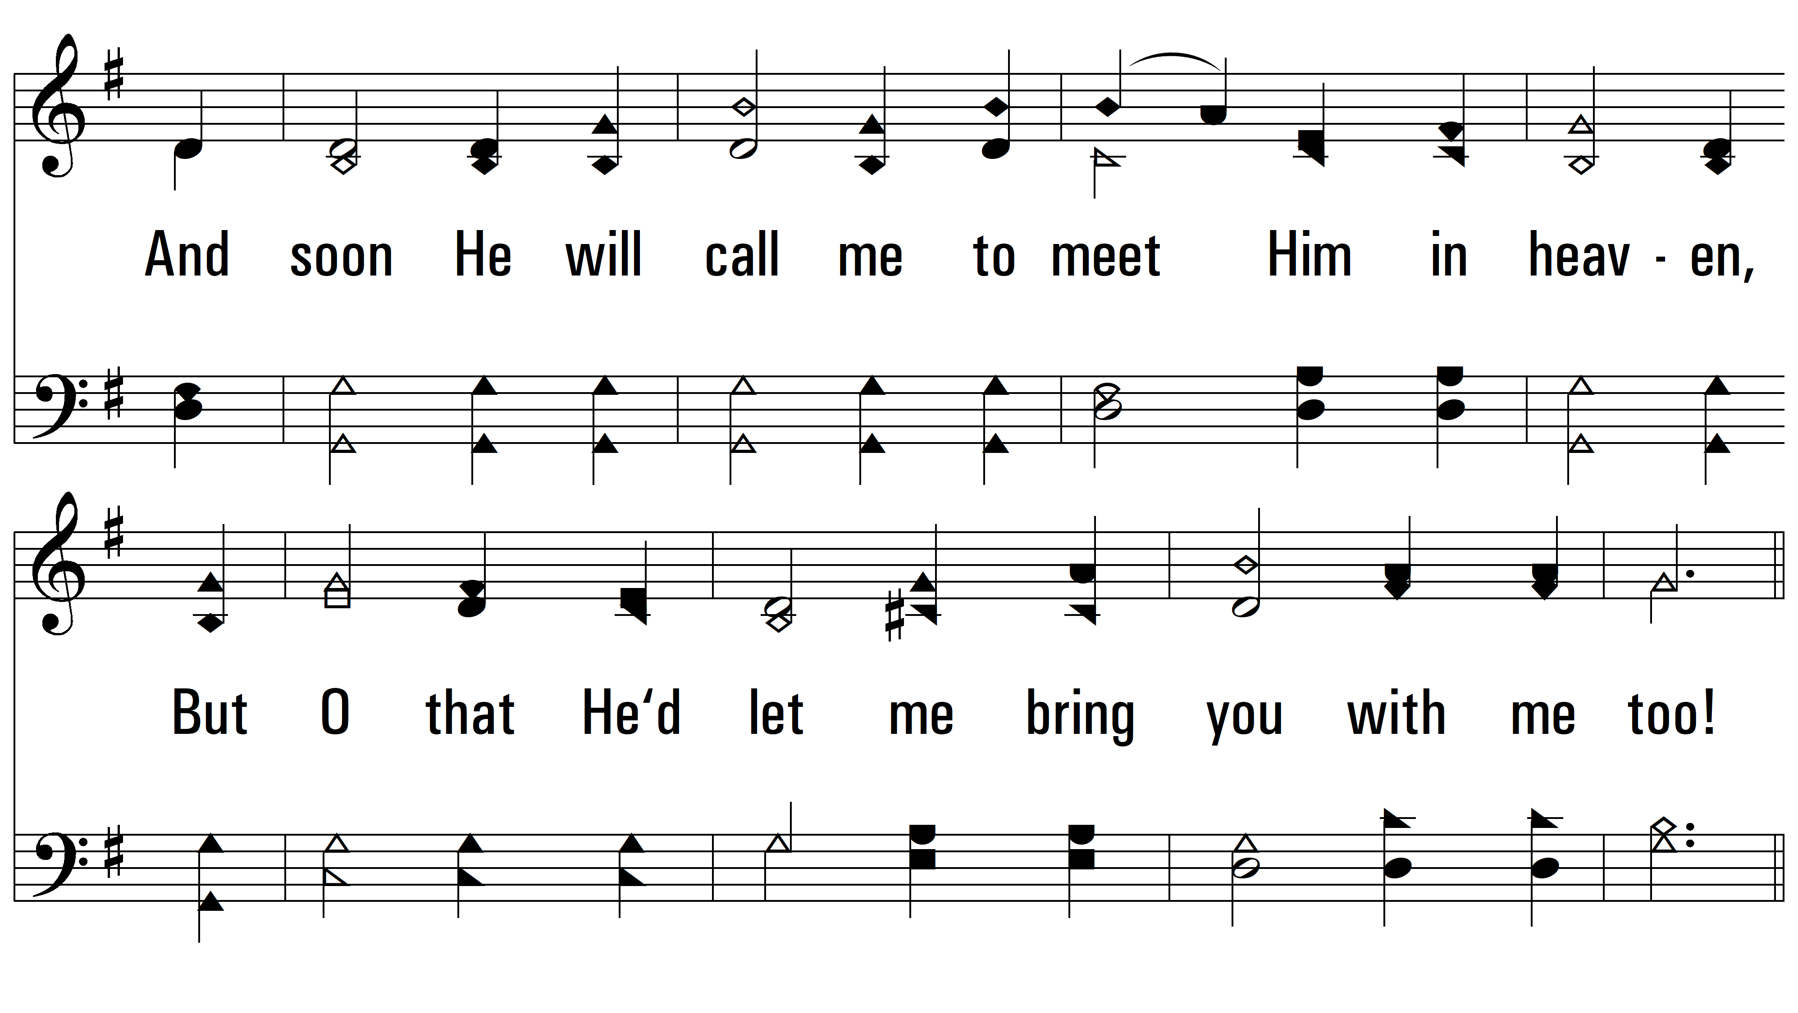
vs. 2

Slide 7
vs. 2

Slide 8
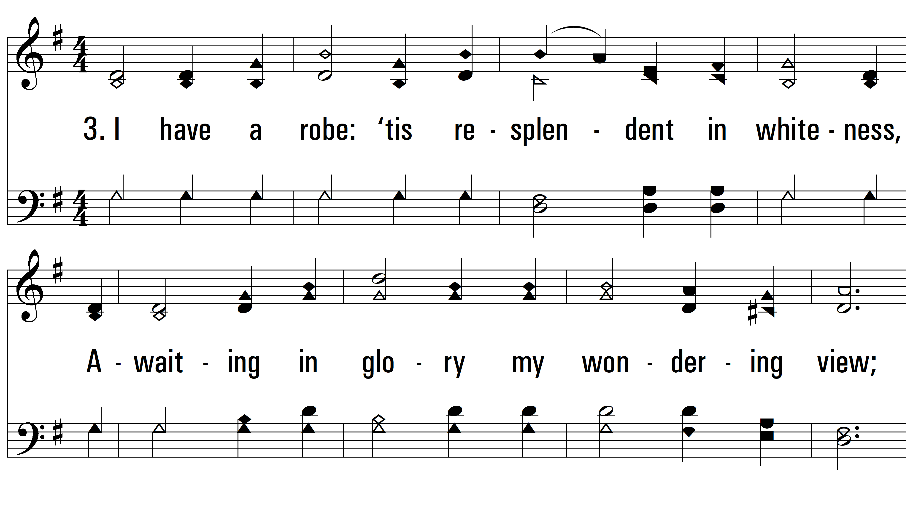
vs. 3 ~ I Am Praying For You

Slide 9
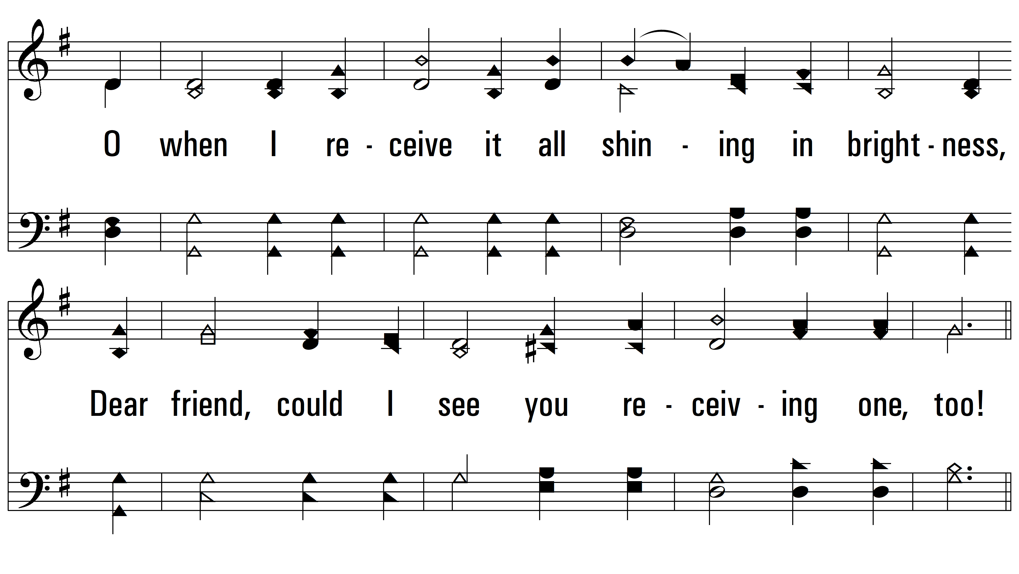
vs. 3

Slide 10
vs. 3
PDHymns.com
END

