Slide 1
I Am Mine No More
Words: | American Folk Hymn
Music: | American Folk Melody
3/4
E^{b}/E^{b} - DO
Verses: 4
Lead - | DO
Alto - | DO
Tenor - | MI
Bass - | DO
PDHymns.com

Slide 2
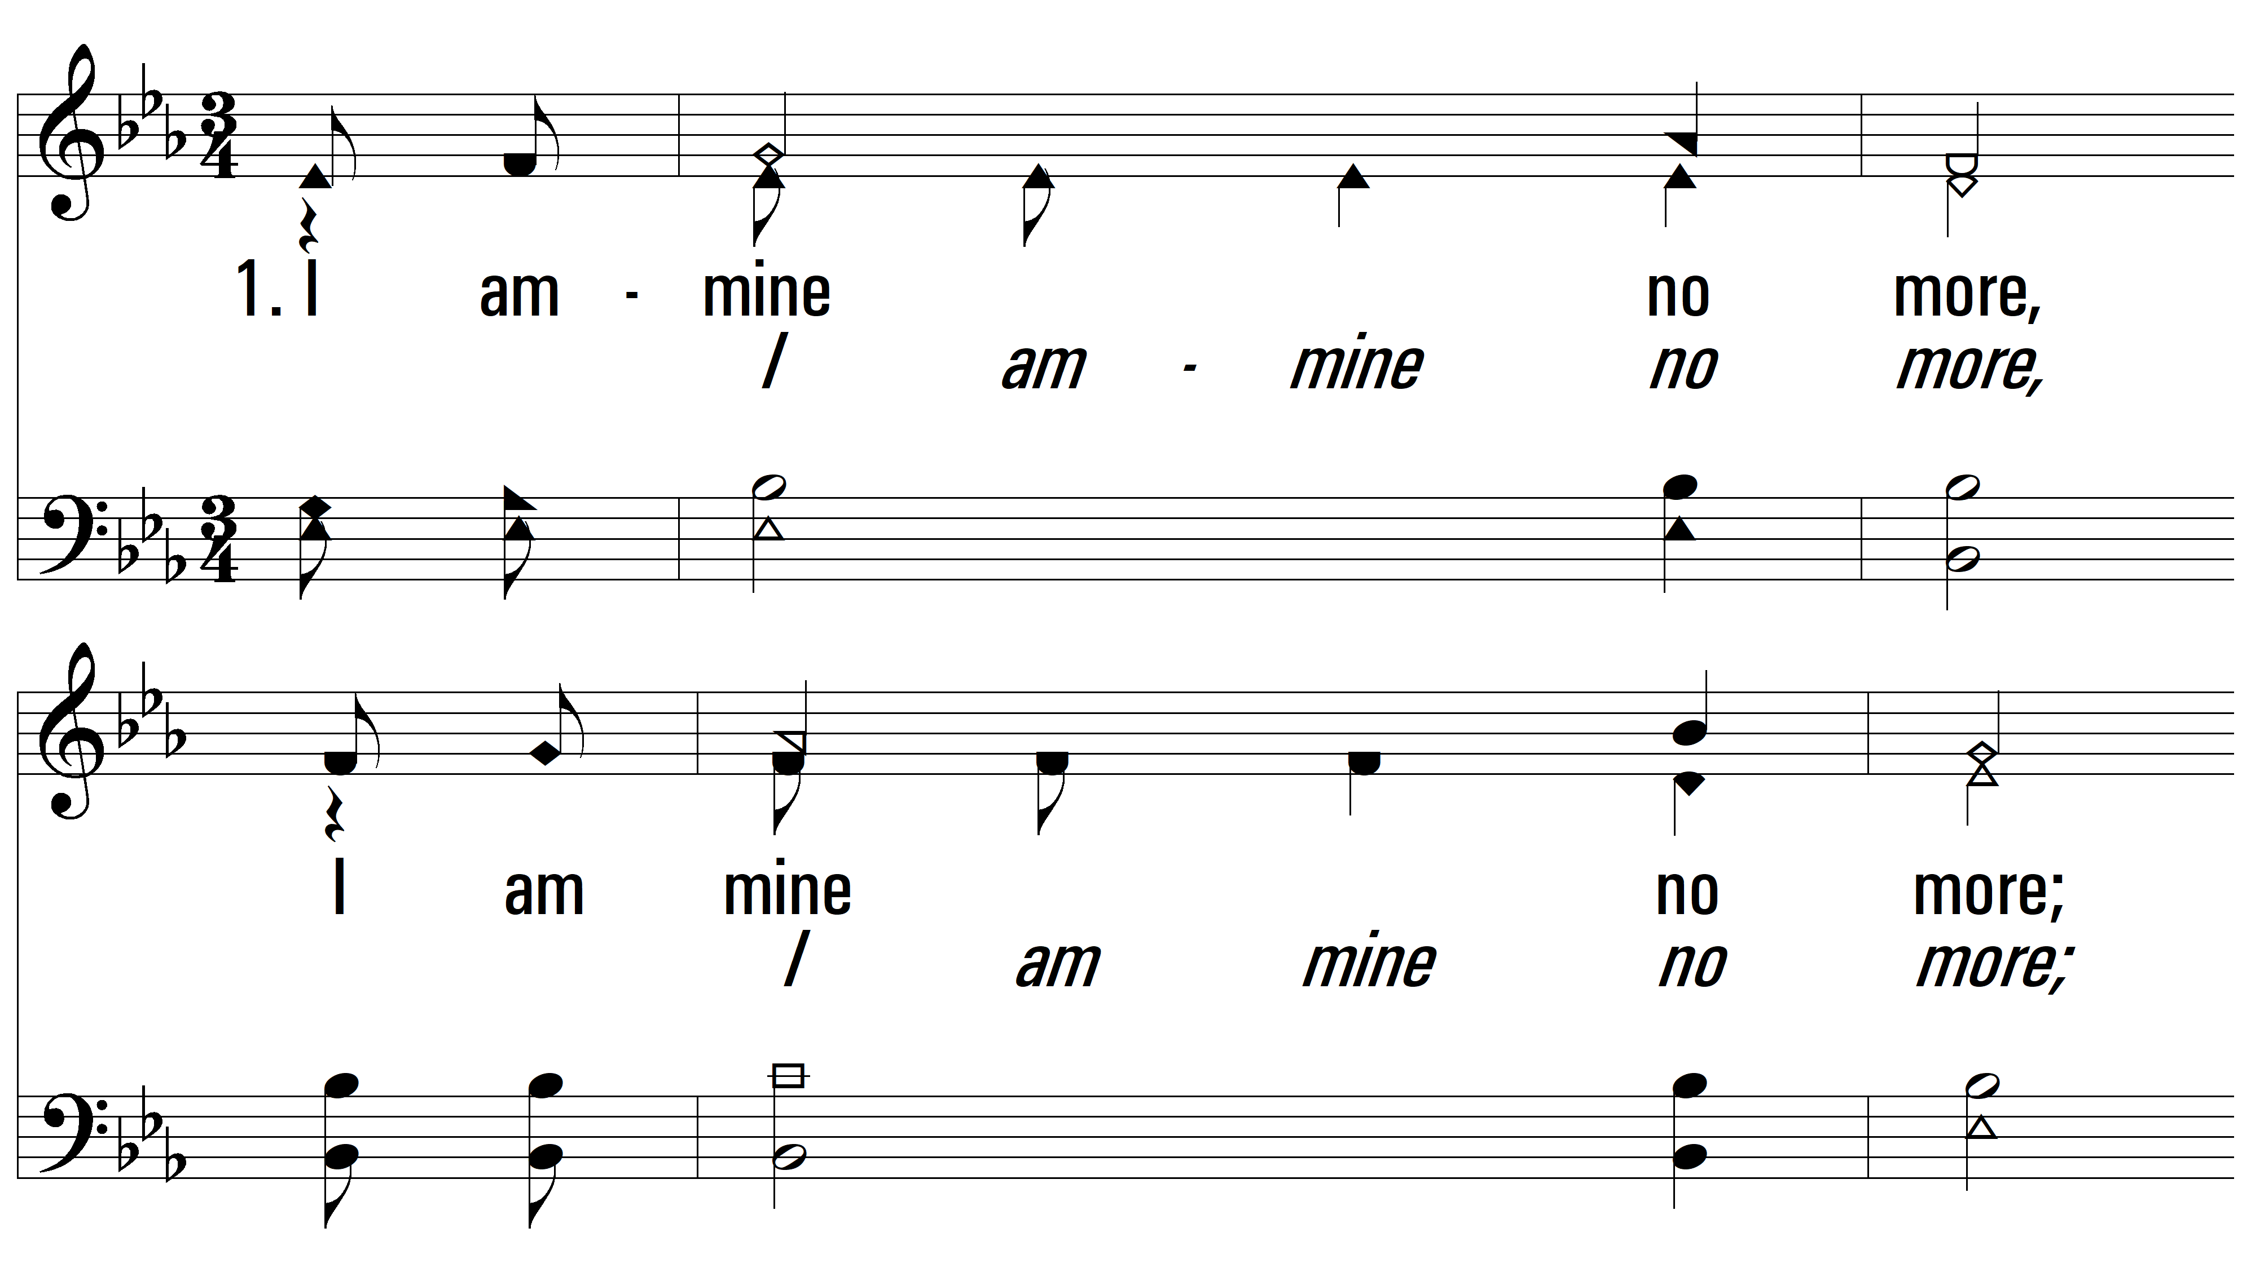
vs. 1 ~ I Am Mine No More

Slide 3
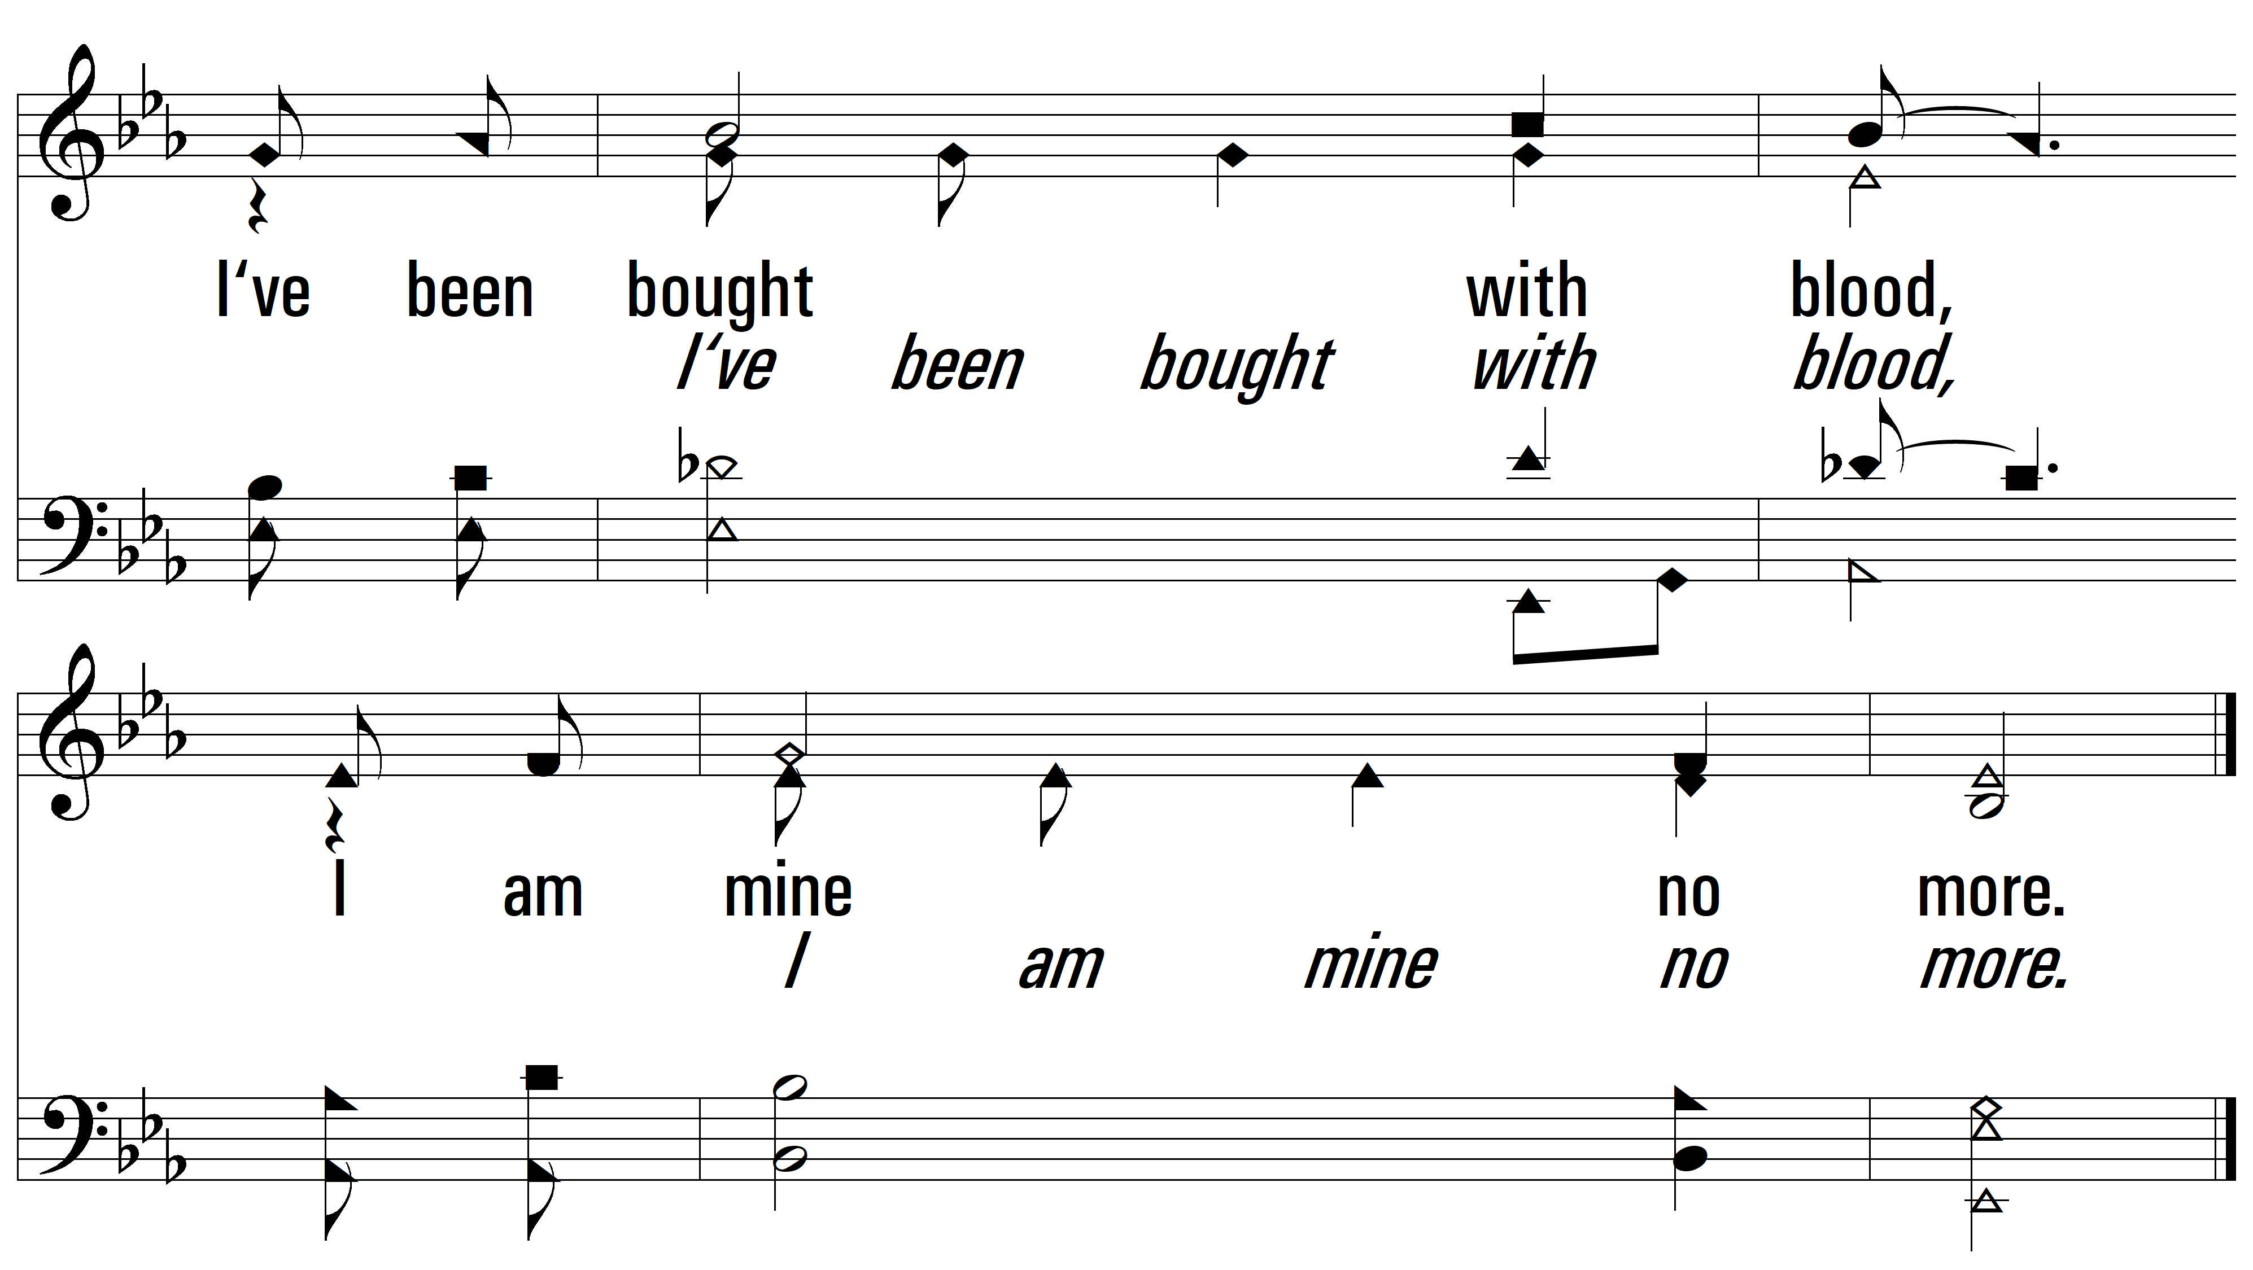
vs. 1

Slide 4
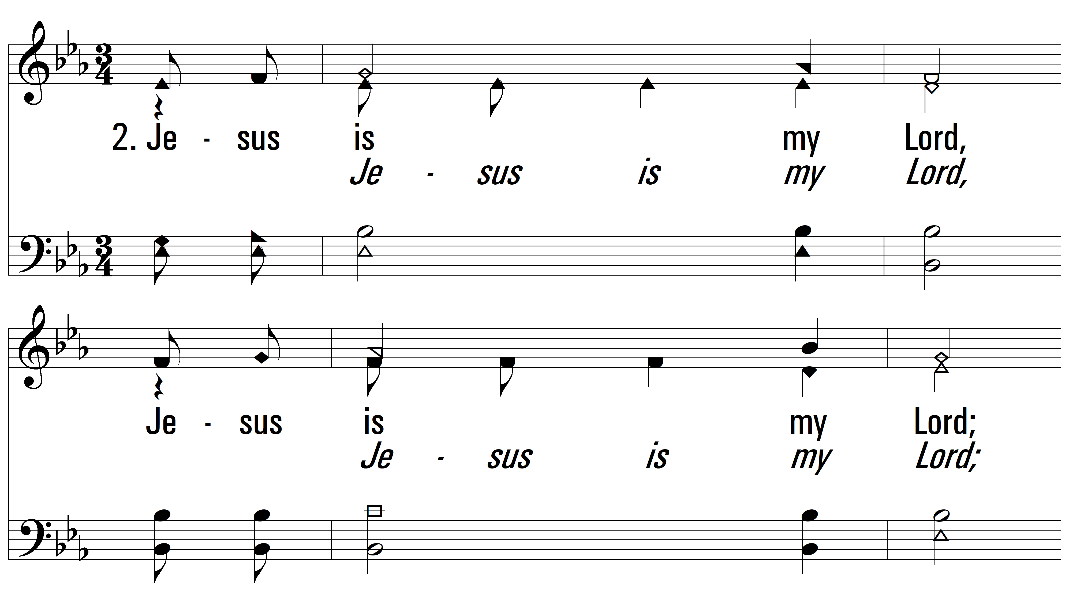
vs. 2 ~ I Am Mine No More

Slide 5
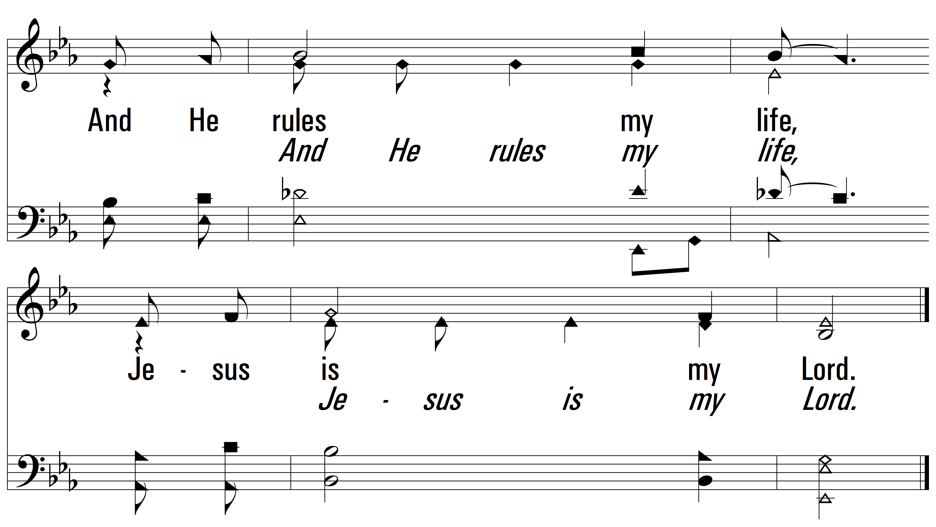
vs. 2

Slide 6
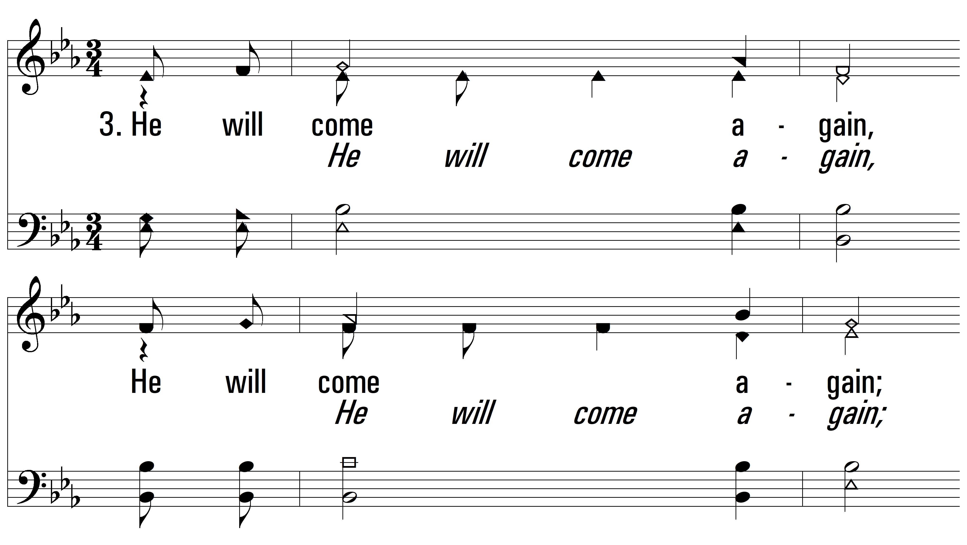
vs. 3 ~ I Am Mine No More

Slide 7
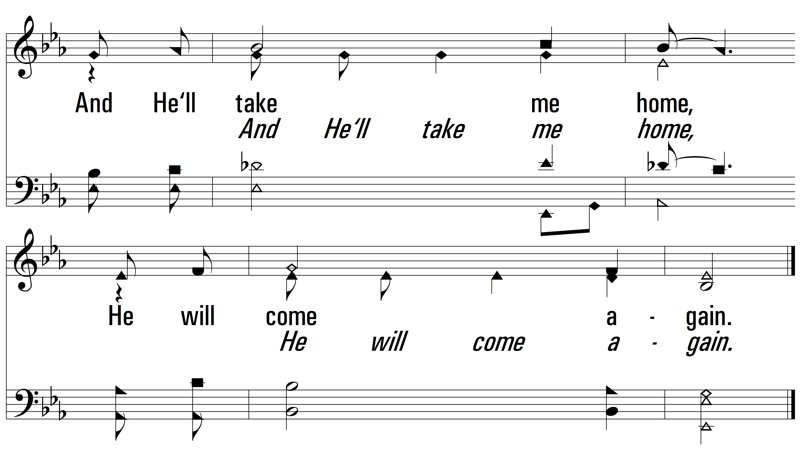
vs. 3

Slide 8
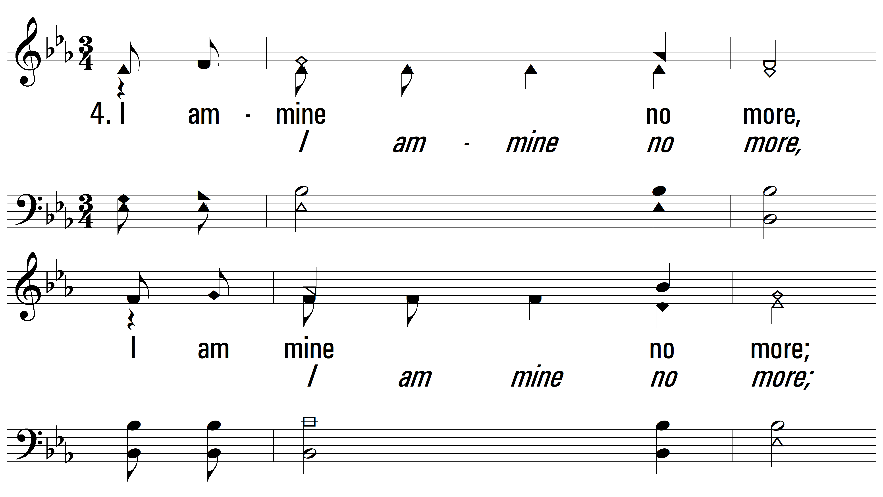
vs. 4 ~ I Am Mine No More

Slide 9
vs. 4
PDHymns.com
END

