Slide 1
His Eternal Plan
Traditional Shaker Tune
Words/Music: Jimmy Bagwell
Copyright © 2019 Jimmy Bagwell

Slide 2
1 - His Eternal Plan
Melody: Loosely based on an old shaker tune “Simple Gifts”.
Words/Music: Jimmy Bagwell
Copyright © 2019 Jimmy Bagwell

Slide 3
1 - His Eternal Plan

Slide 4
2 - His Eternal Plan
Melody: Loosely based on an old shaker tune “Simple Gifts”.
Words/Music: Jimmy Bagwell
Copyright © 2019 Jimmy Bagwell

Slide 5
2 - His Eternal Plan

Slide 6
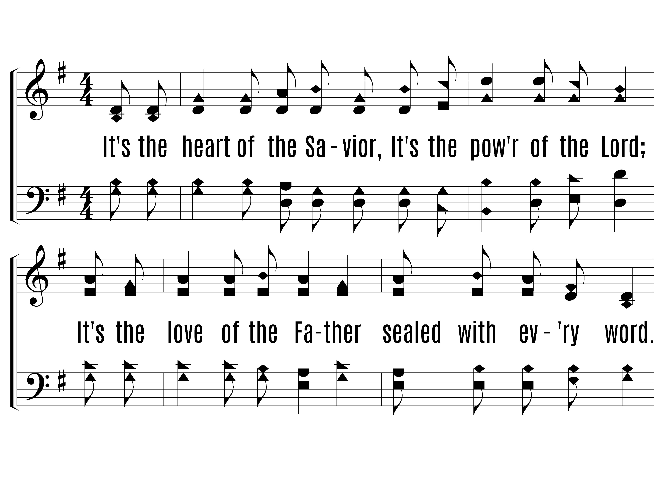
3 - His Eternal Plan
Melody: Loosely based on an old shaker tune “Simple Gifts”.
Words/Music: Jimmy Bagwell
Copyright © 2019 Jimmy Bagwell

Slide 7
3 - His Eternal Plan

Slide 8
4 - His Eternal Plan
Melody: Loosely based on an old shaker tune “Simple Gifts”.
Words/Music: Jimmy Bagwell
Copyright © 2019 Jimmy Bagwell

Slide 9
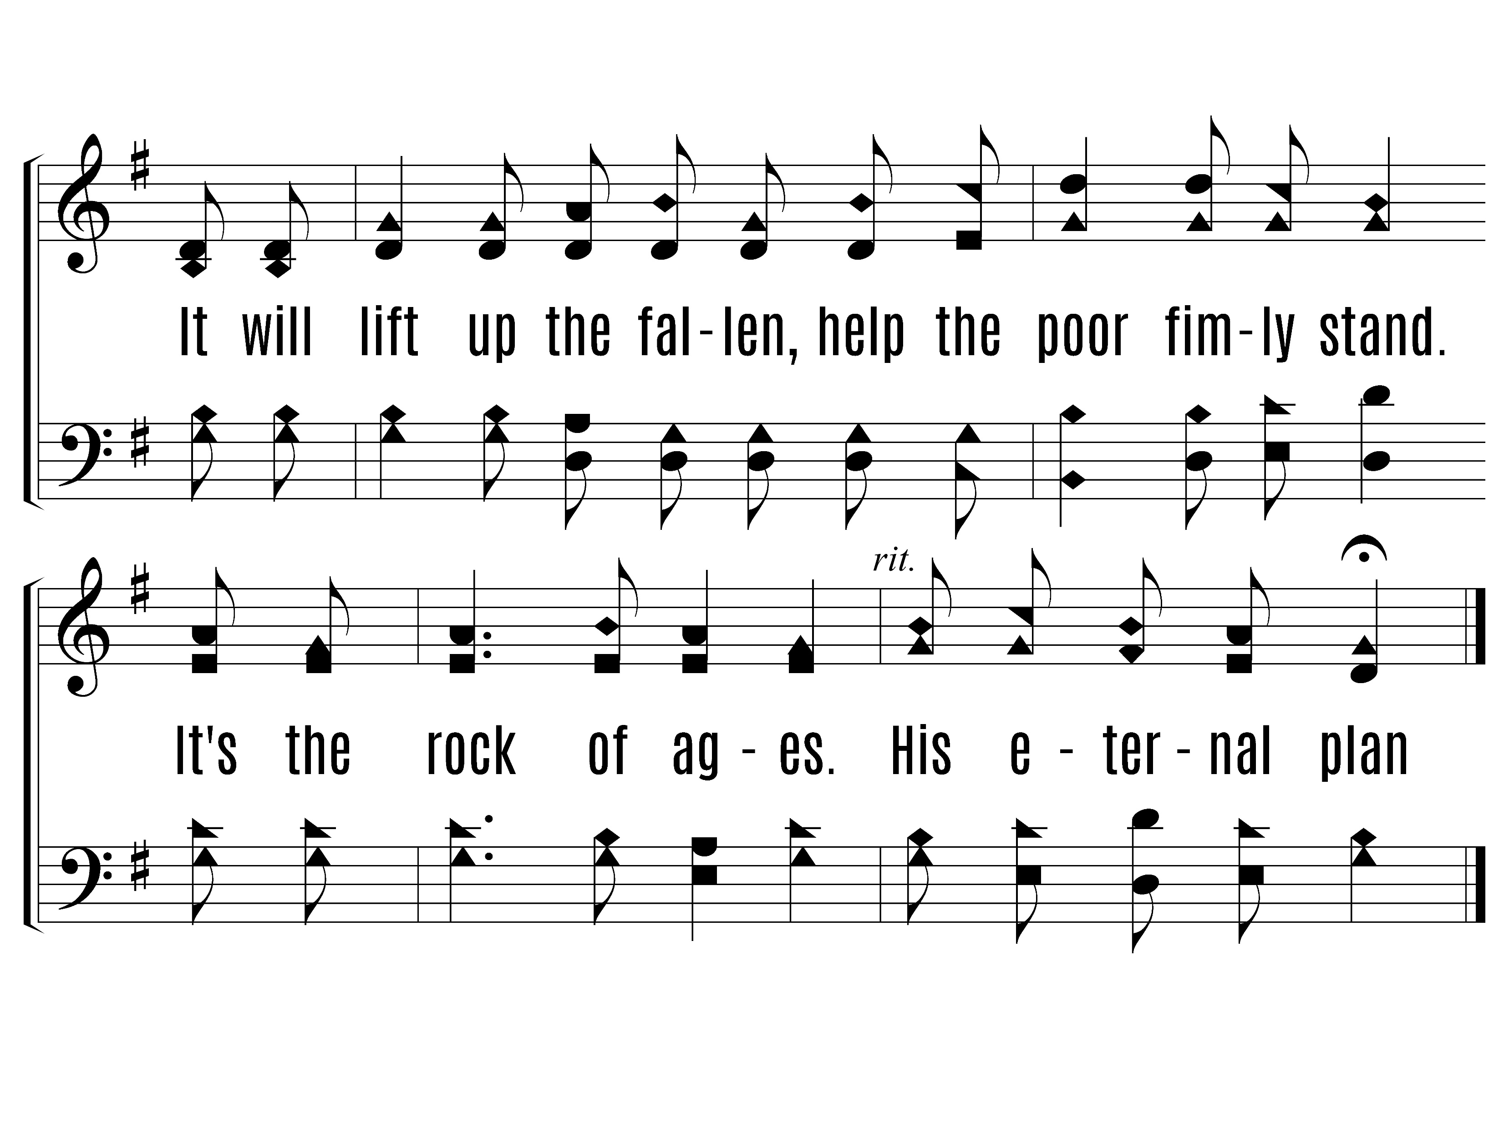
4 - His Eternal Plan

