Slide 1
How Sweet, How Heavenly
BROWN
CM
Words: | J. Swain (1792)
Music: | William B. Bradbury (1844)
4/4
B^{b}/F - SOL
Verses: 5
Lead - | SOL
Alto - | MI
Tenor - | DO
Bass - | DO
PDHymns.com

Slide 2
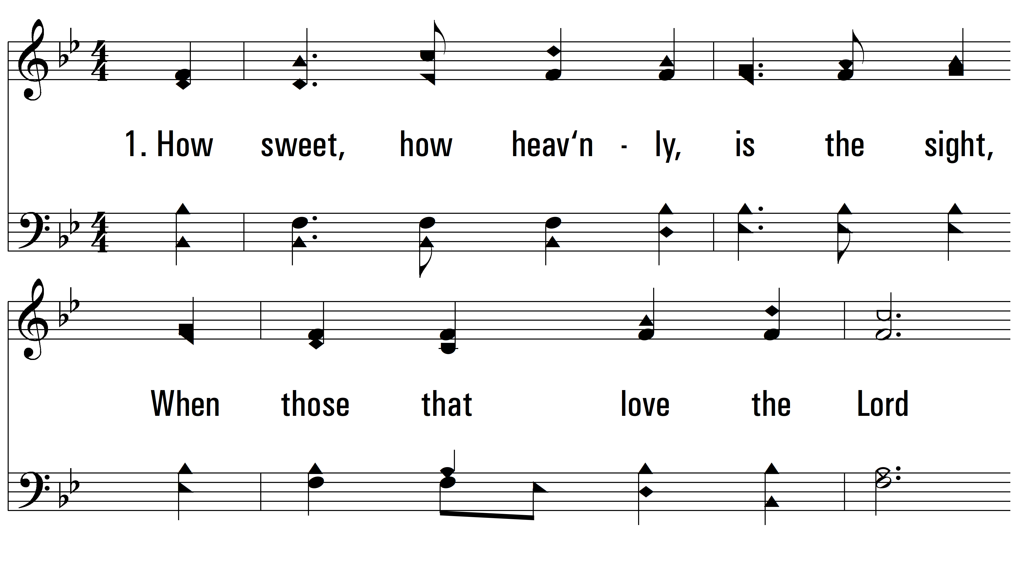
vs. 1 ~ How Sweet, How Heavenly

Slide 3
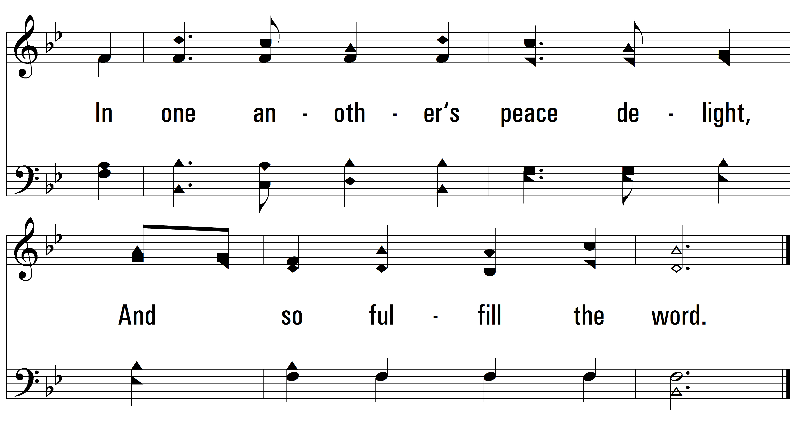
vs. 1

Slide 4
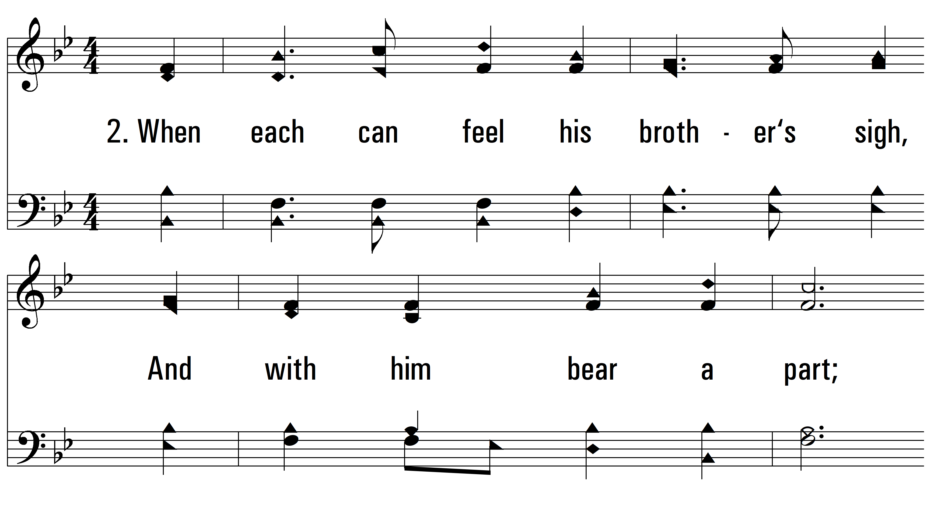
vs. 2 ~ How Sweet, How Heavenly

Slide 5
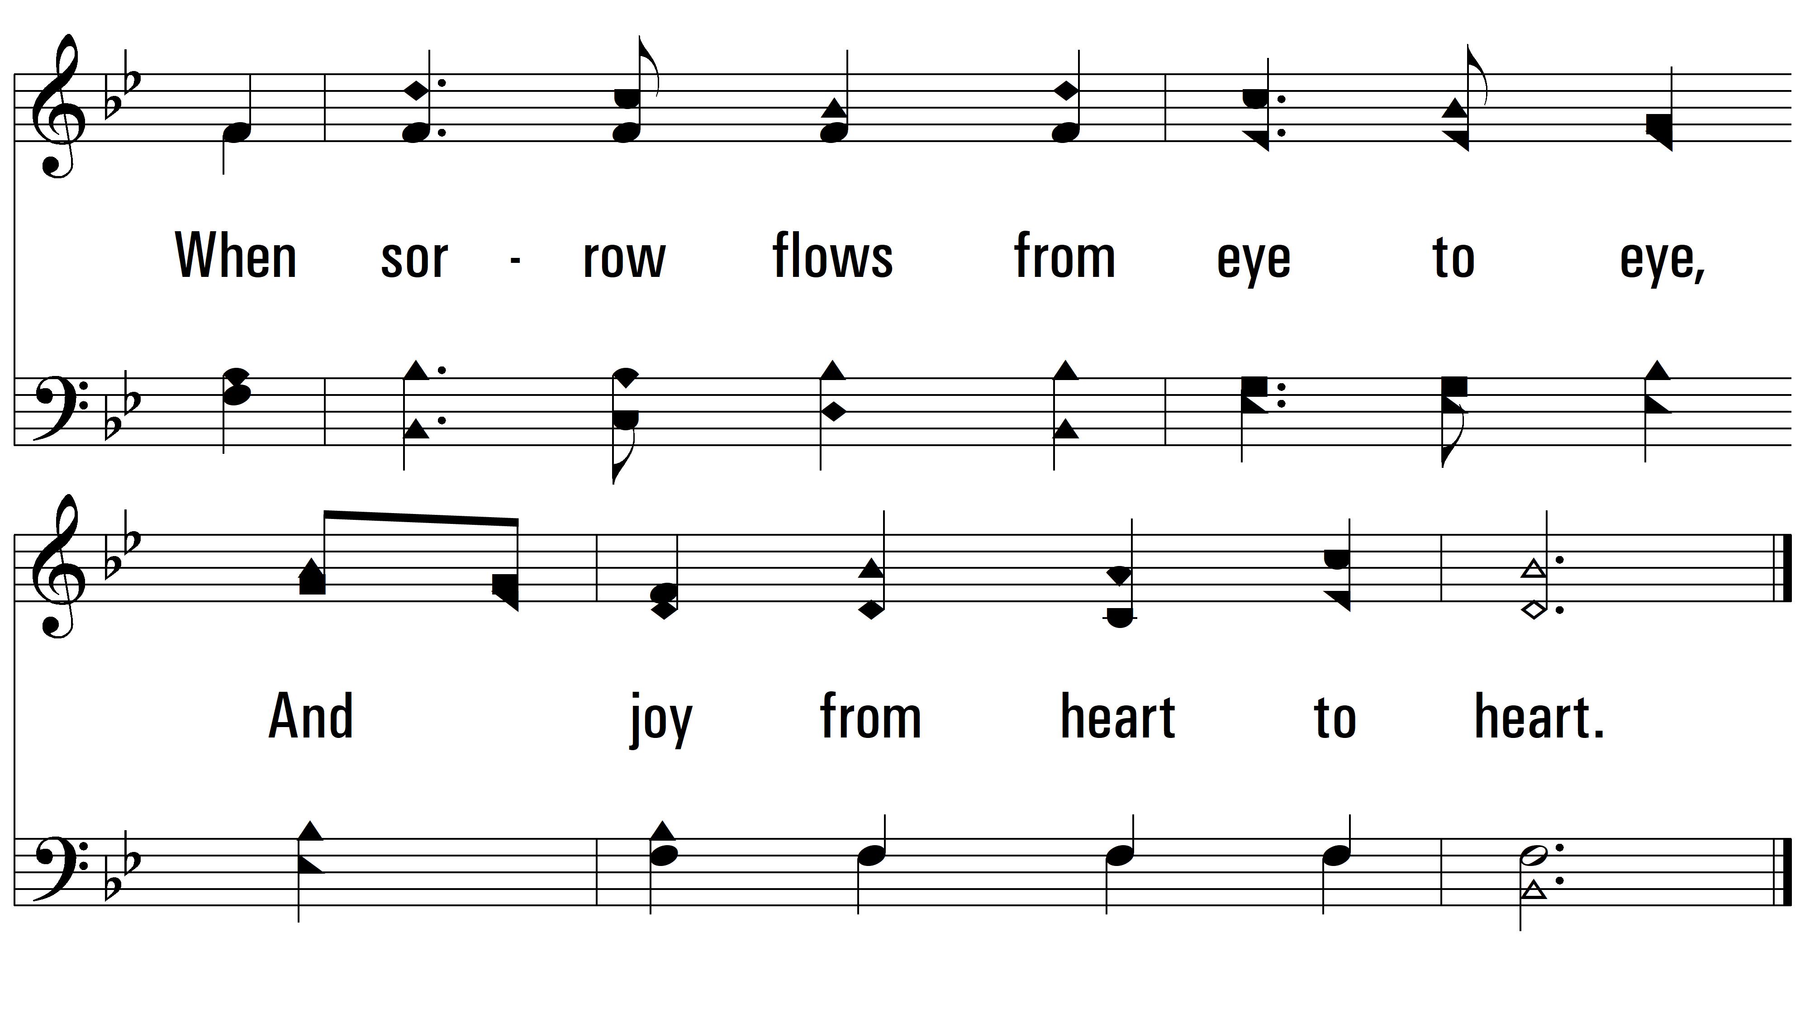
vs. 2

Slide 6
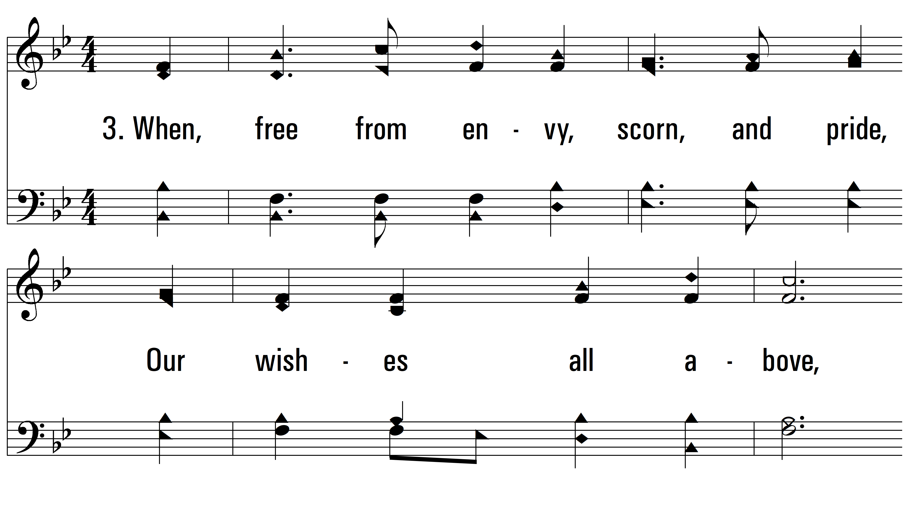
vs. 3 ~ How Sweet, How Heavenly

Slide 7
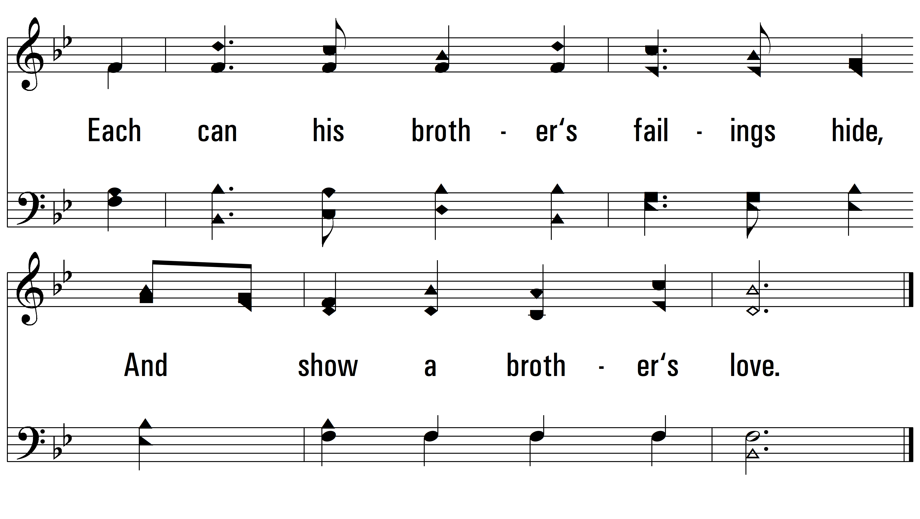
vs. 3

Slide 8
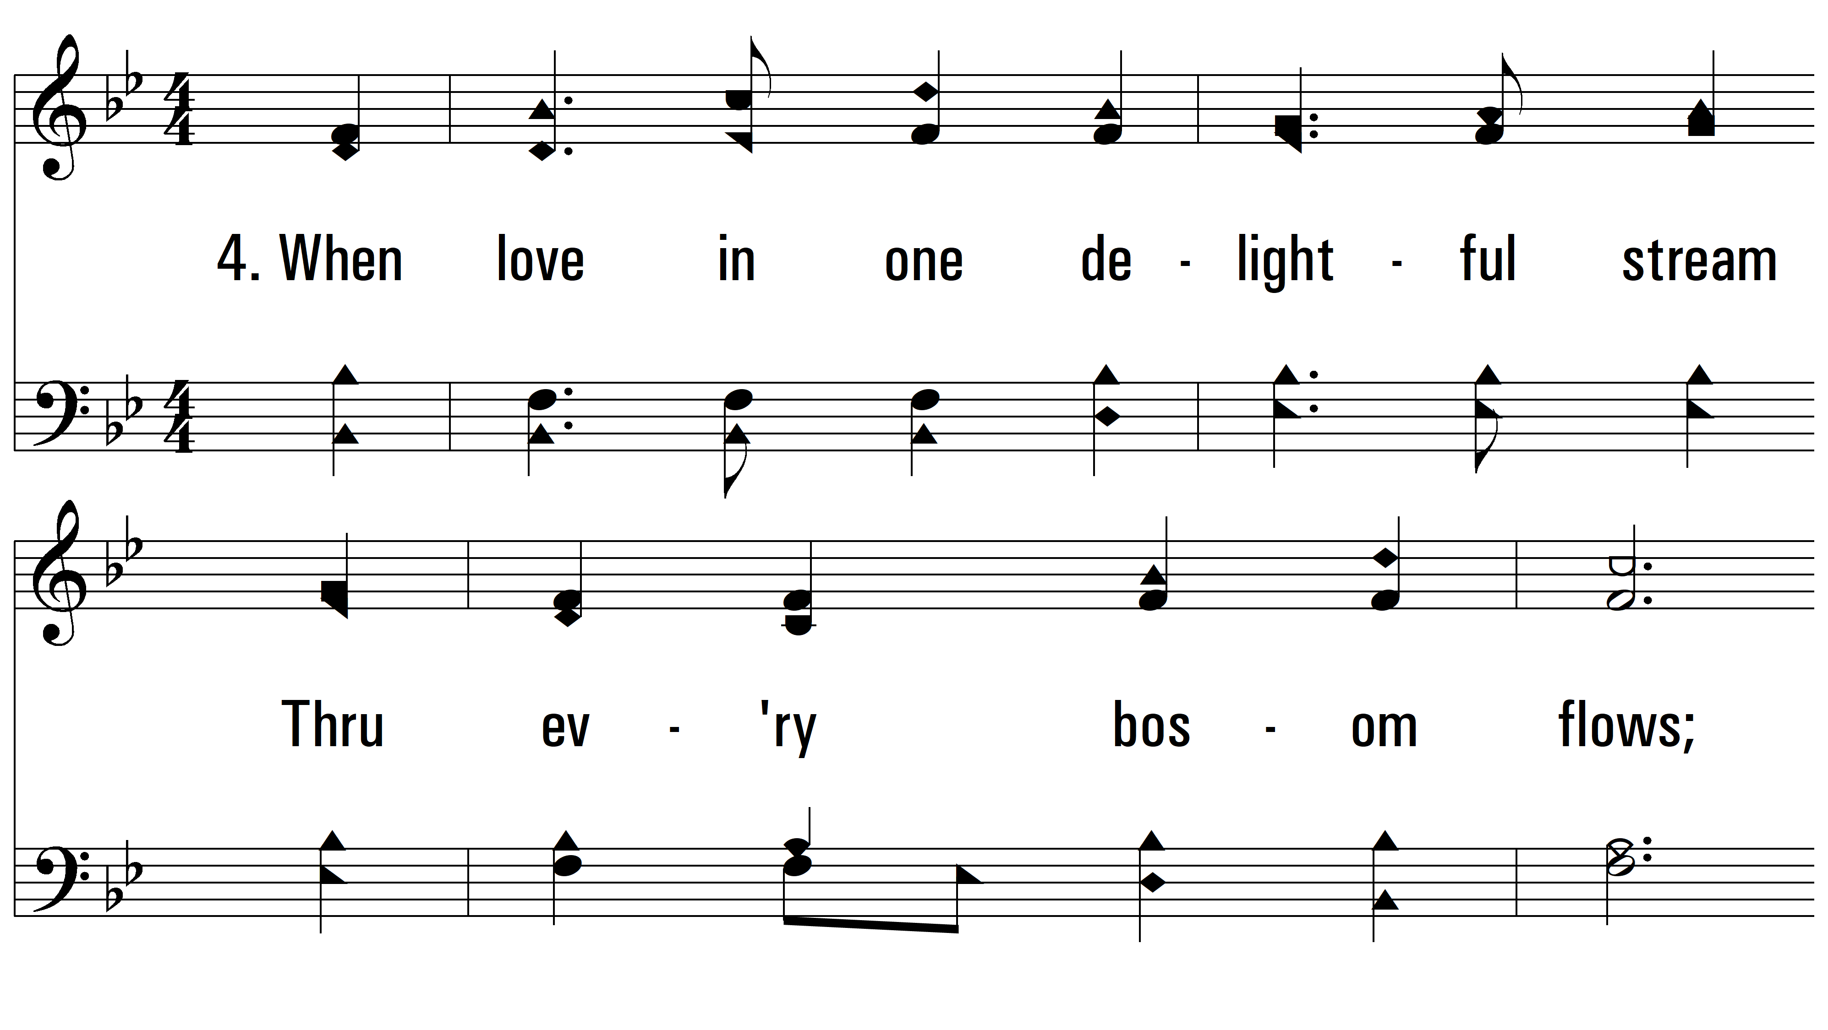
vs. 4 ~ How Sweet, How Heavenly

Slide 9
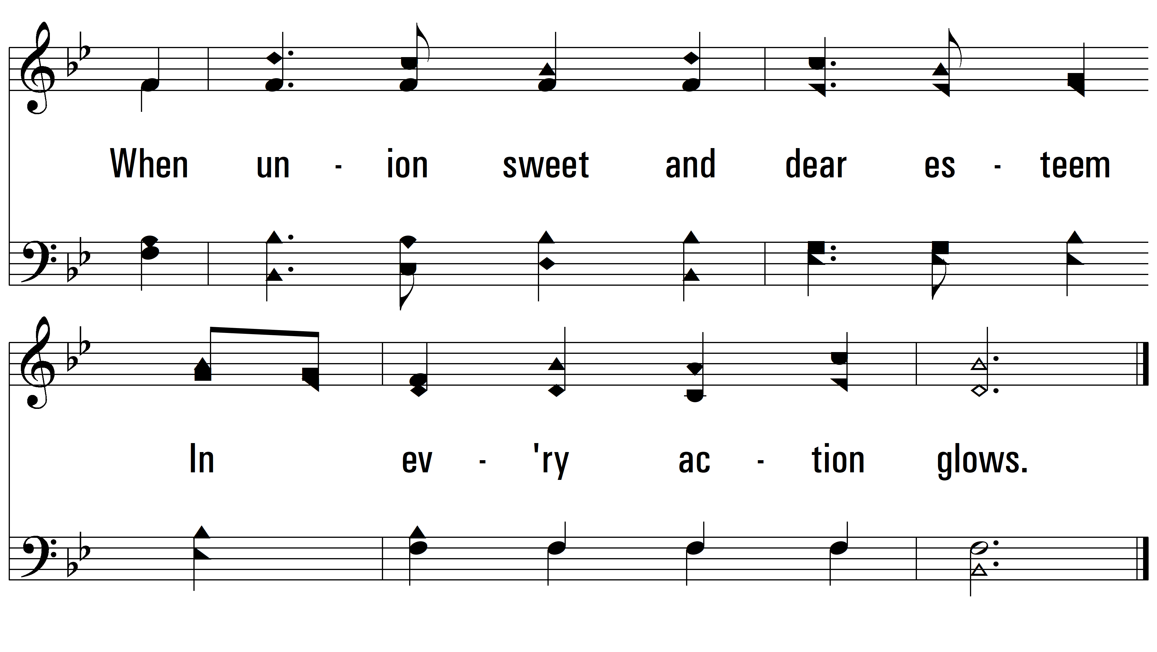
vs. 4

Slide 10
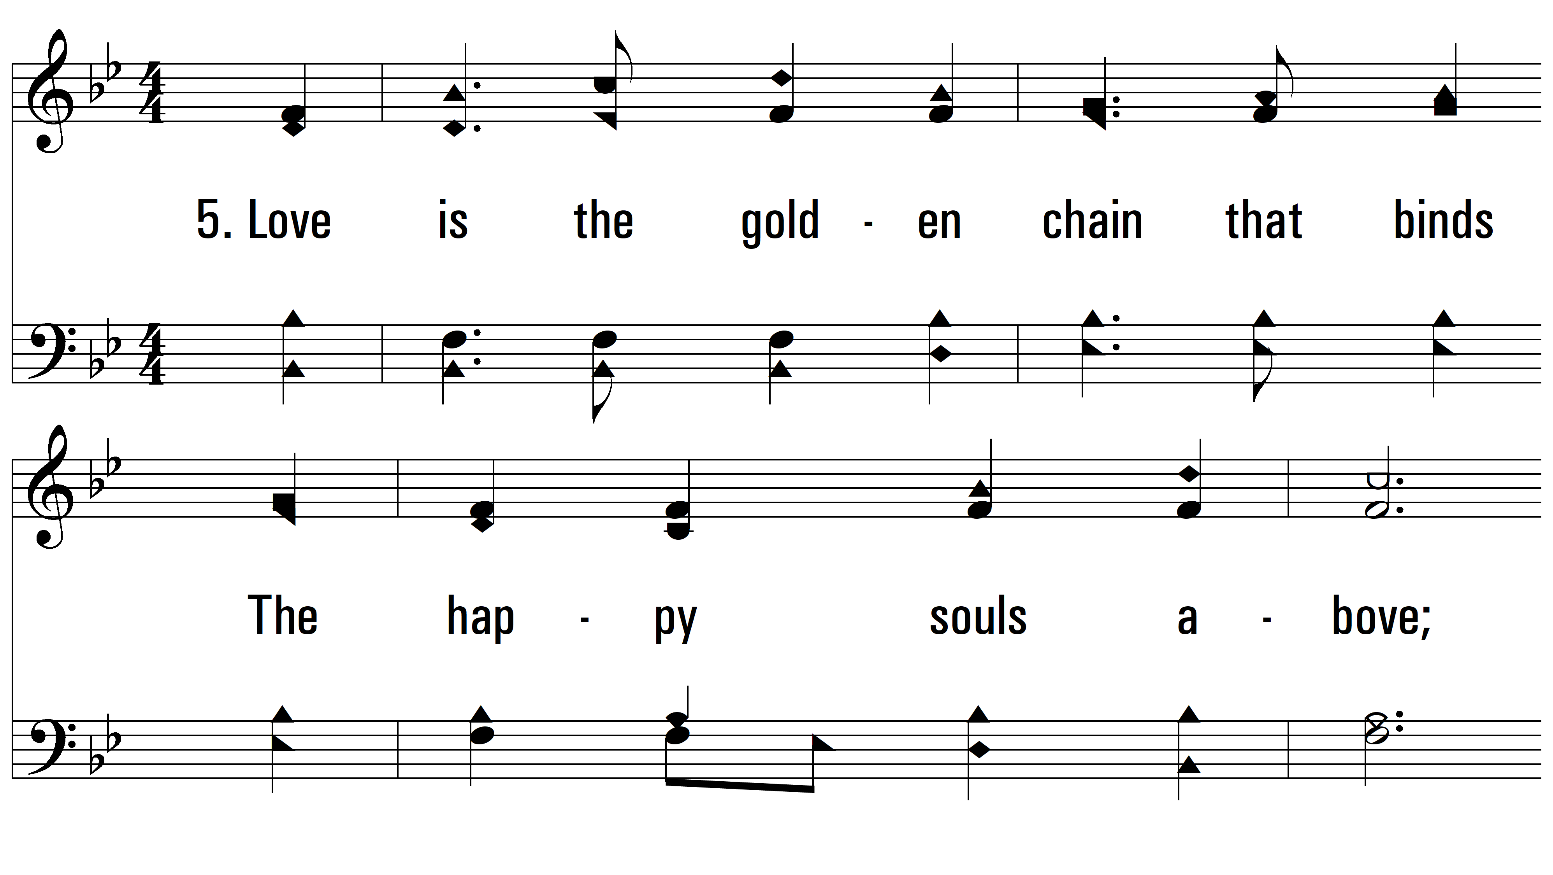
vs. 5 ~ How Sweet, How Heavenly

Slide 11
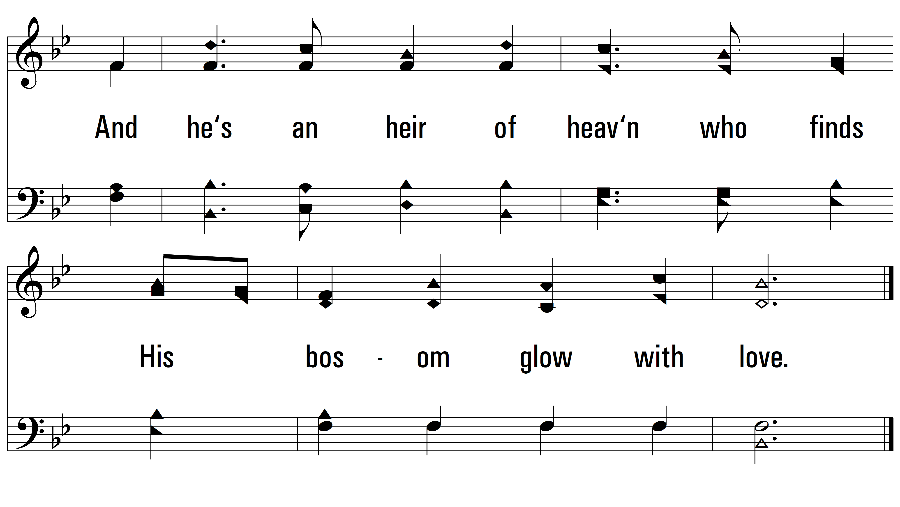
vs. 5
PDHymns.com
END

