Slide 1
How Best And How Joyous
(Christian’s United)
Words: | M. C. Kurfees (1887)
Music: | Alexander C. Hopkins (1887)
3/4
E^{b}/E^{b} - DO
Verses: 3/Chorus
Lead - | DO
Alto - | DO
Tenor - | MI
Bass - | DO
PDHymns.com

Slide 2
vs. 1 ~ How Best And How Joyous

Slide 3
vs. 1

Slide 4
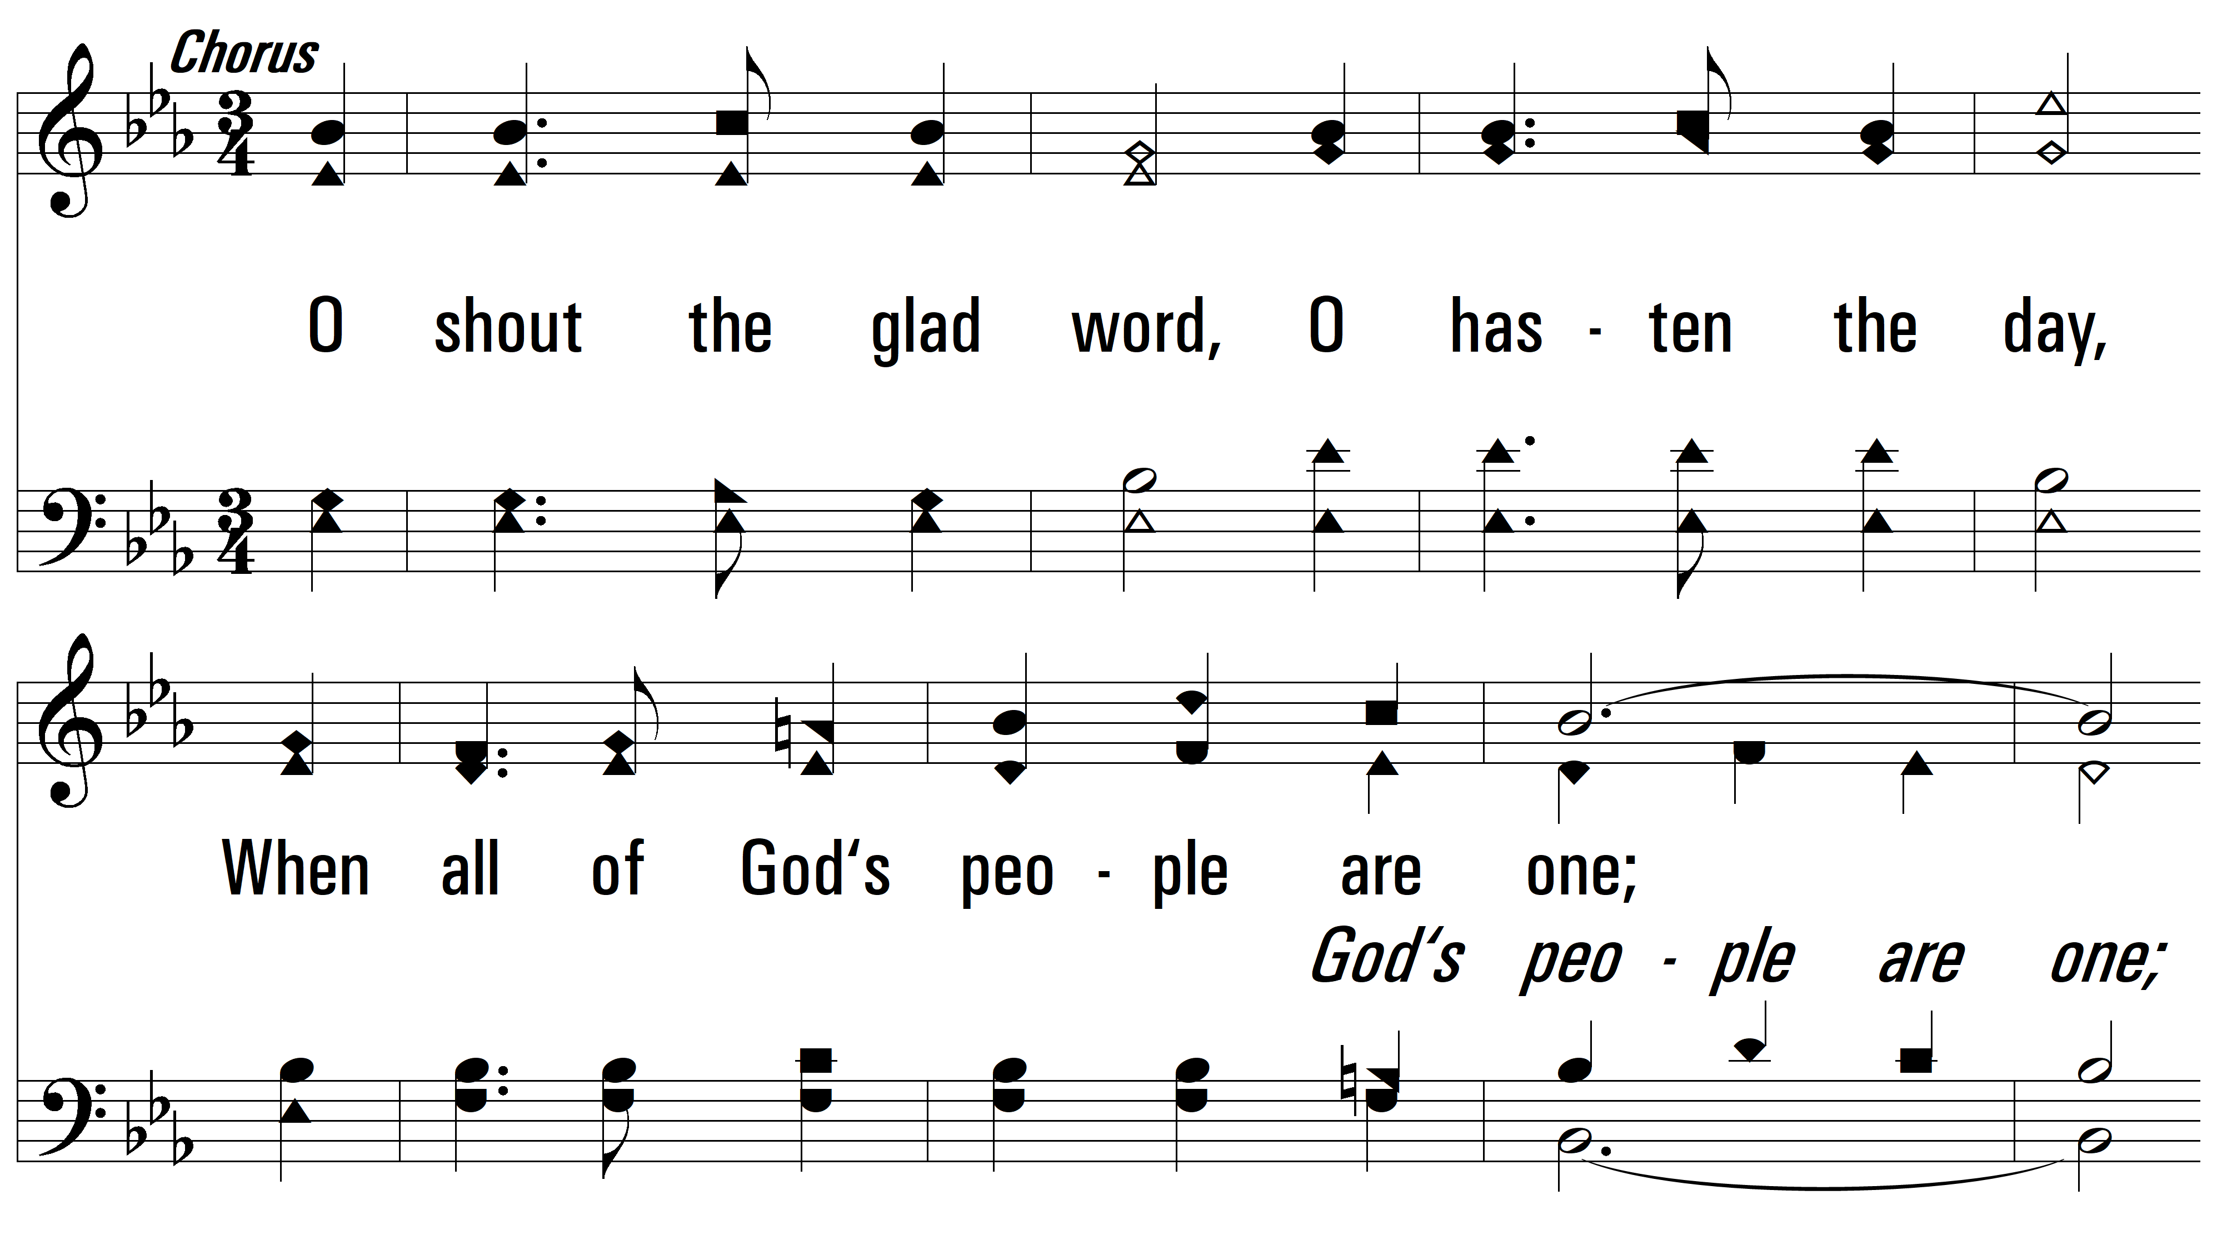
vs. 1

Slide 5
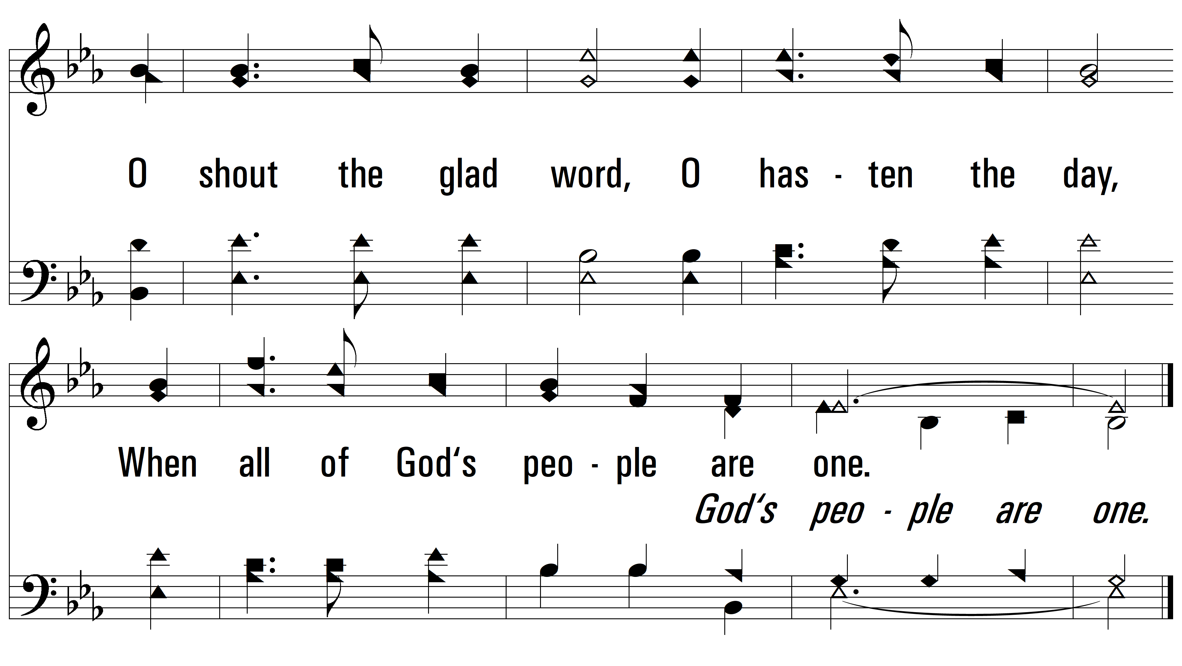
vs. 1

Slide 6
vs. 2 ~ How Best And How Joyous

Slide 7
vs. 2

Slide 8
vs. 2

Slide 9
vs. 2

Slide 10
vs. 3 ~ How Best And How Joyous

Slide 11
vs. 3

Slide 12
vs. 3

Slide 13
vs. 3
PDHymns.com
END

