Slide 1
Home Of The Soul
Words: | James Rowe (1911)
Music: | Samuel W. Beazley (1911)
6/8
G/B - MI
Verses: 3/Chorus
Lead - | MI
Alto - | SOL
Tenor - | DO
Bass - | DO
PDHymns.com

Slide 2
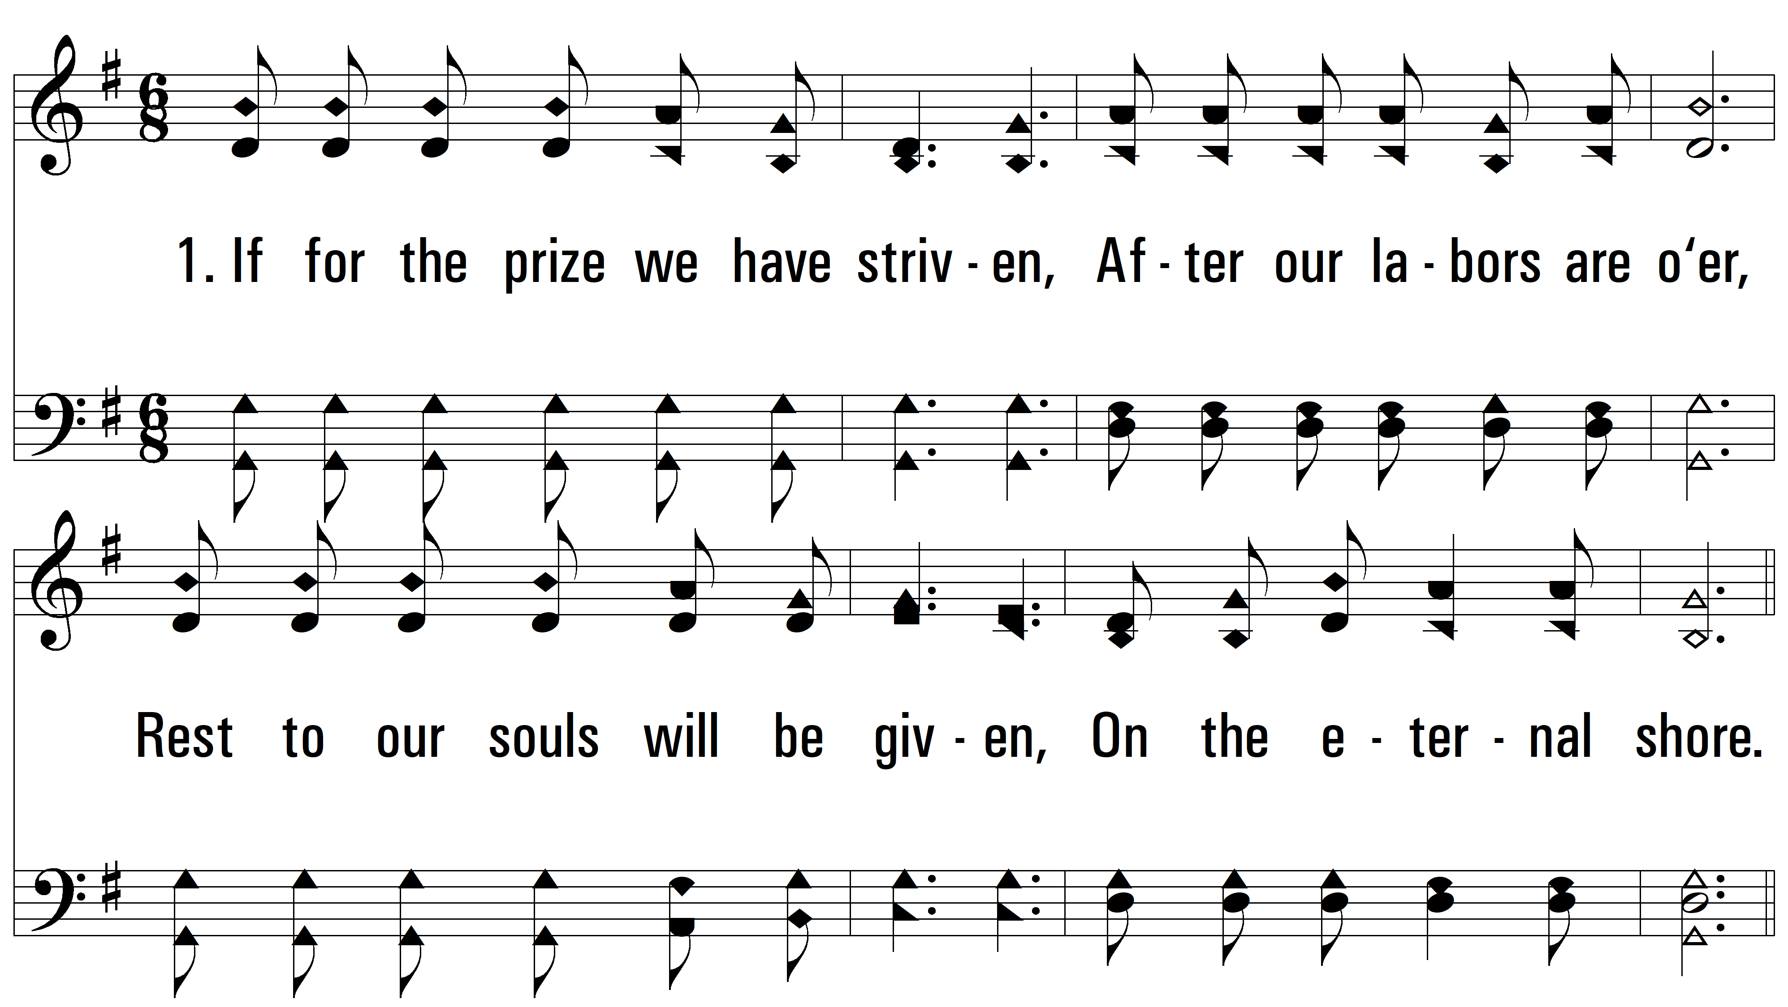
vs. 1 ~ Home Of The Soul

Slide 3
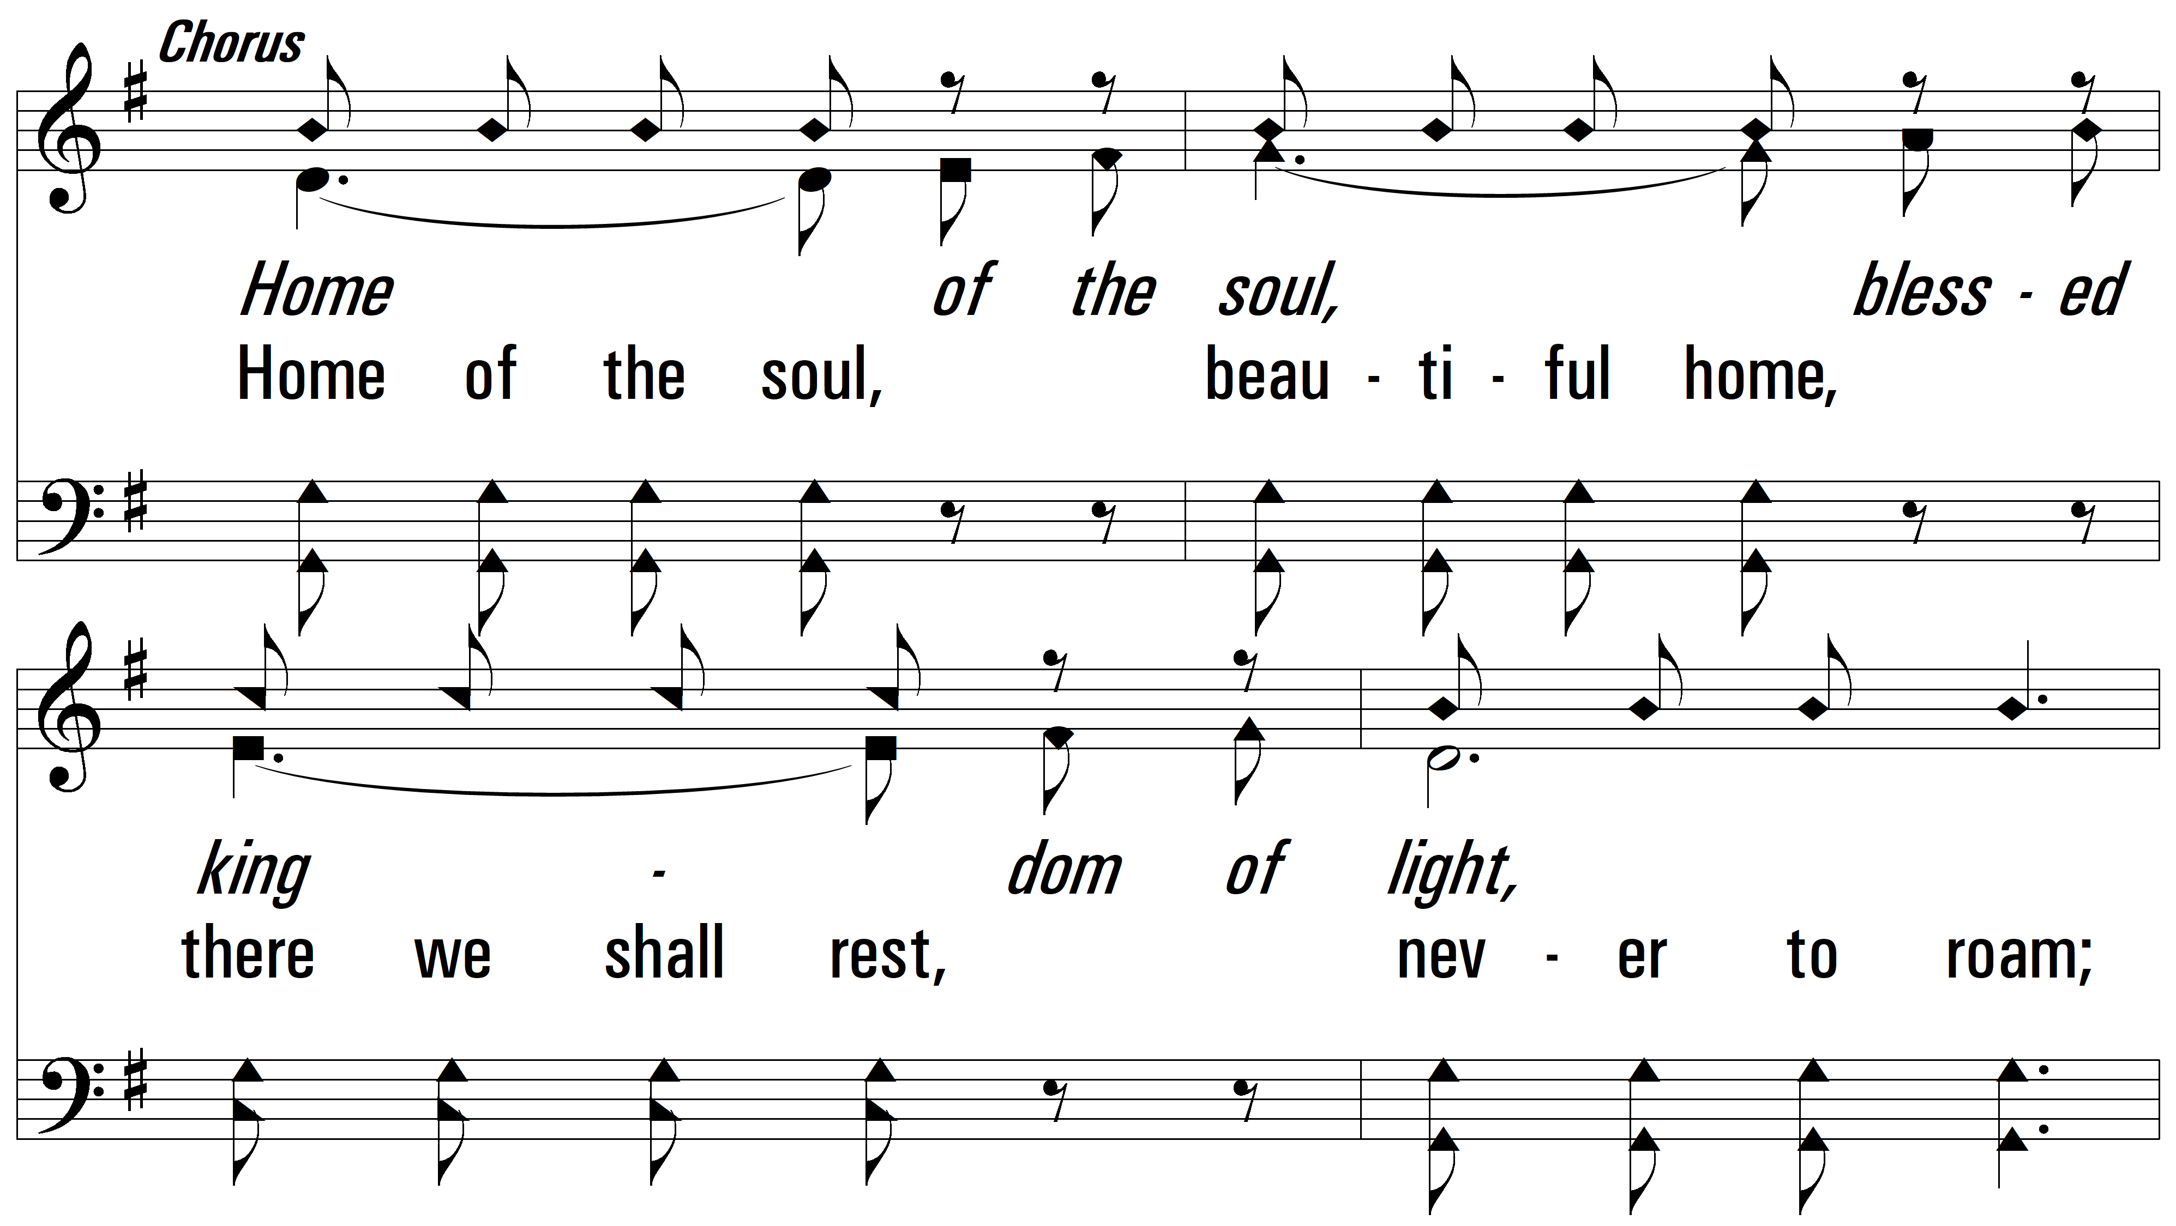
vs. 1

Slide 4
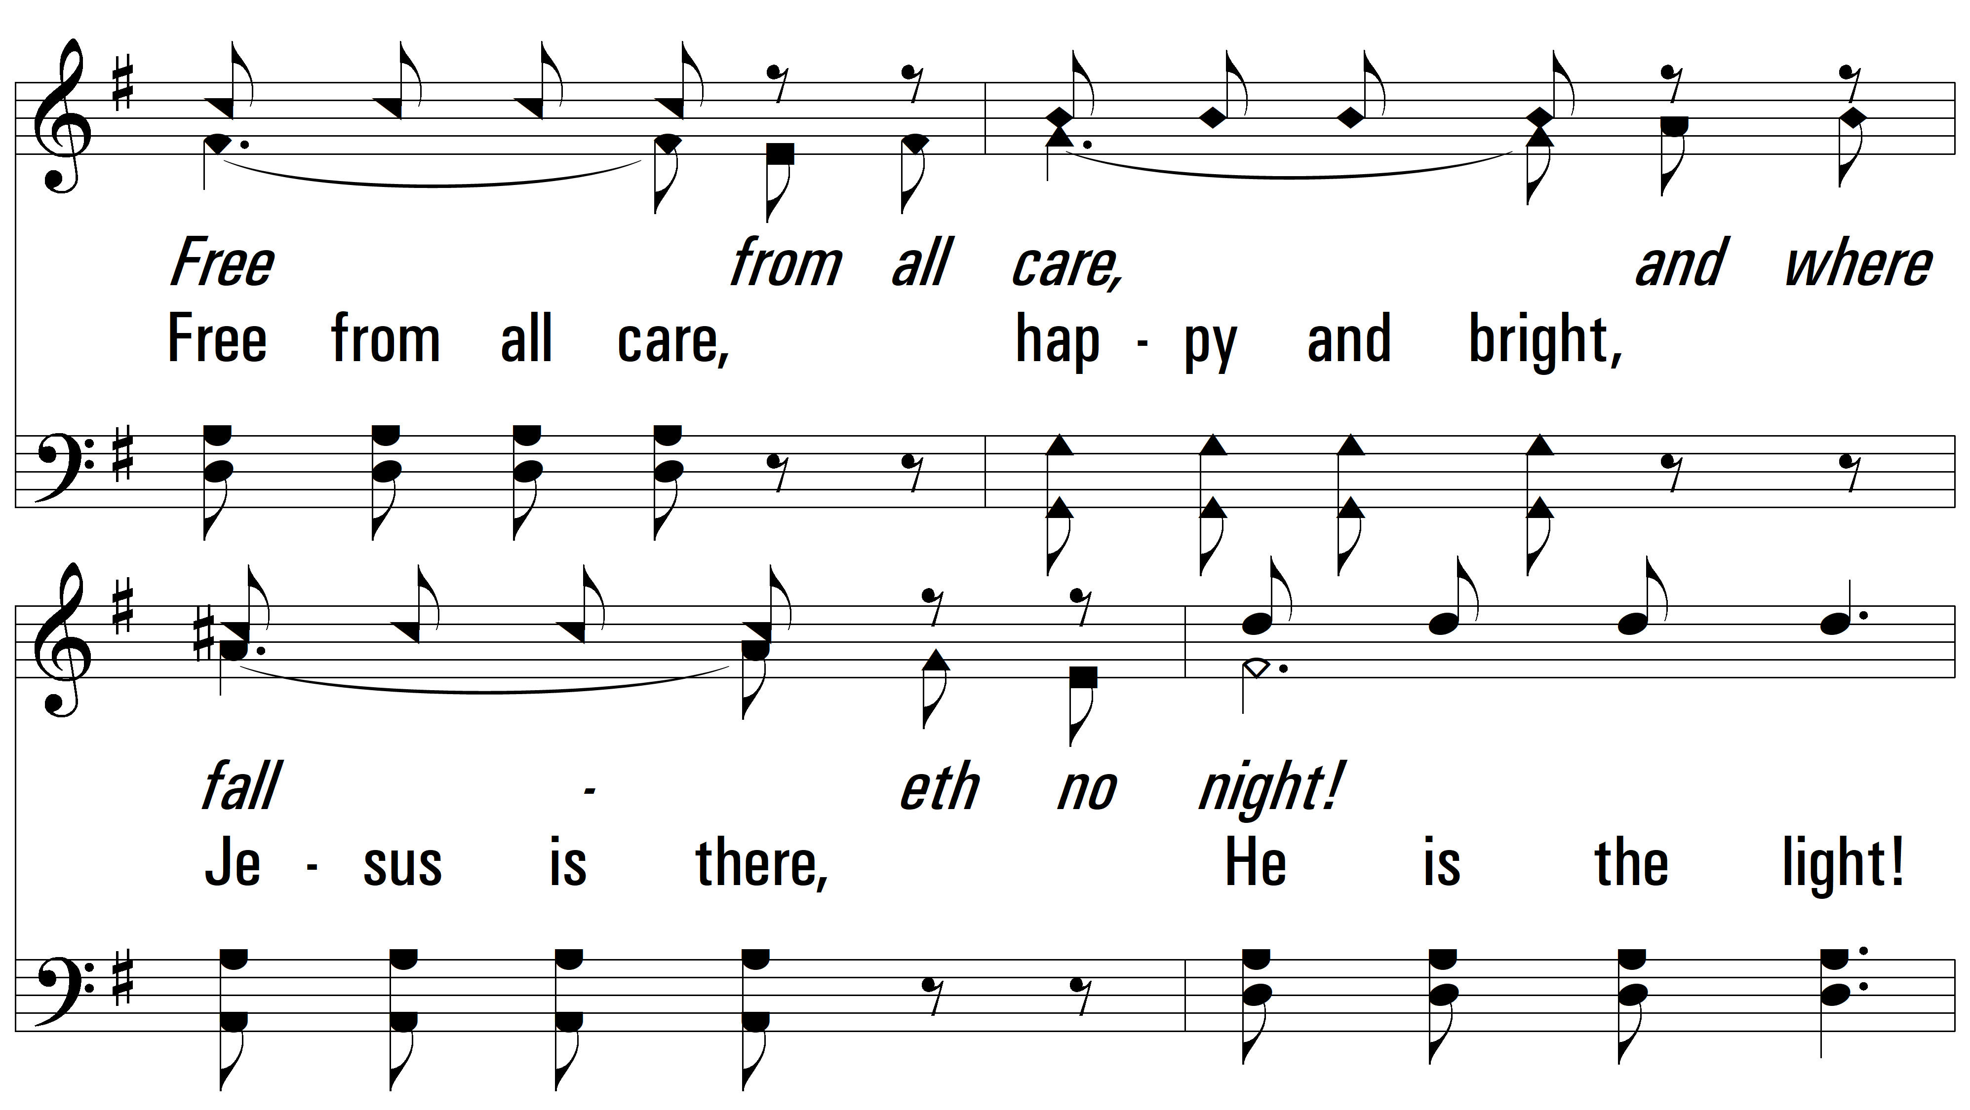
vs. 1

Slide 5
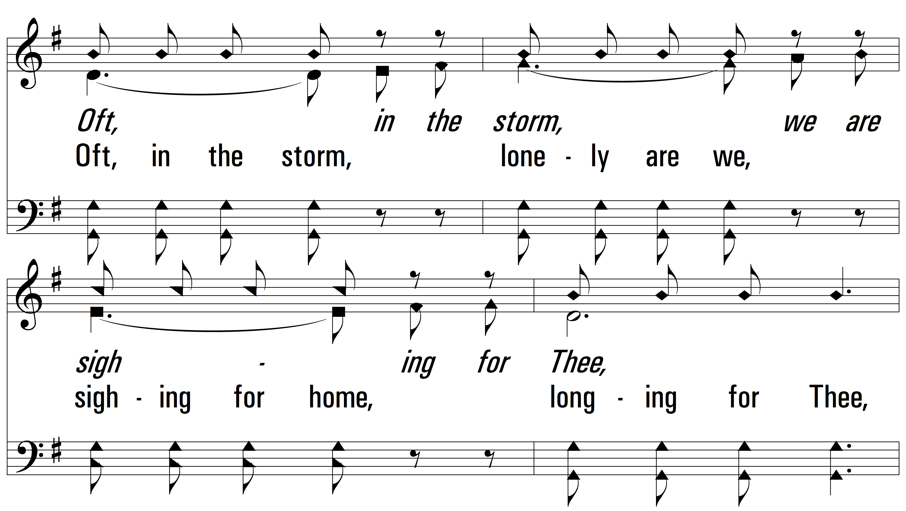
vs. 1

Slide 6
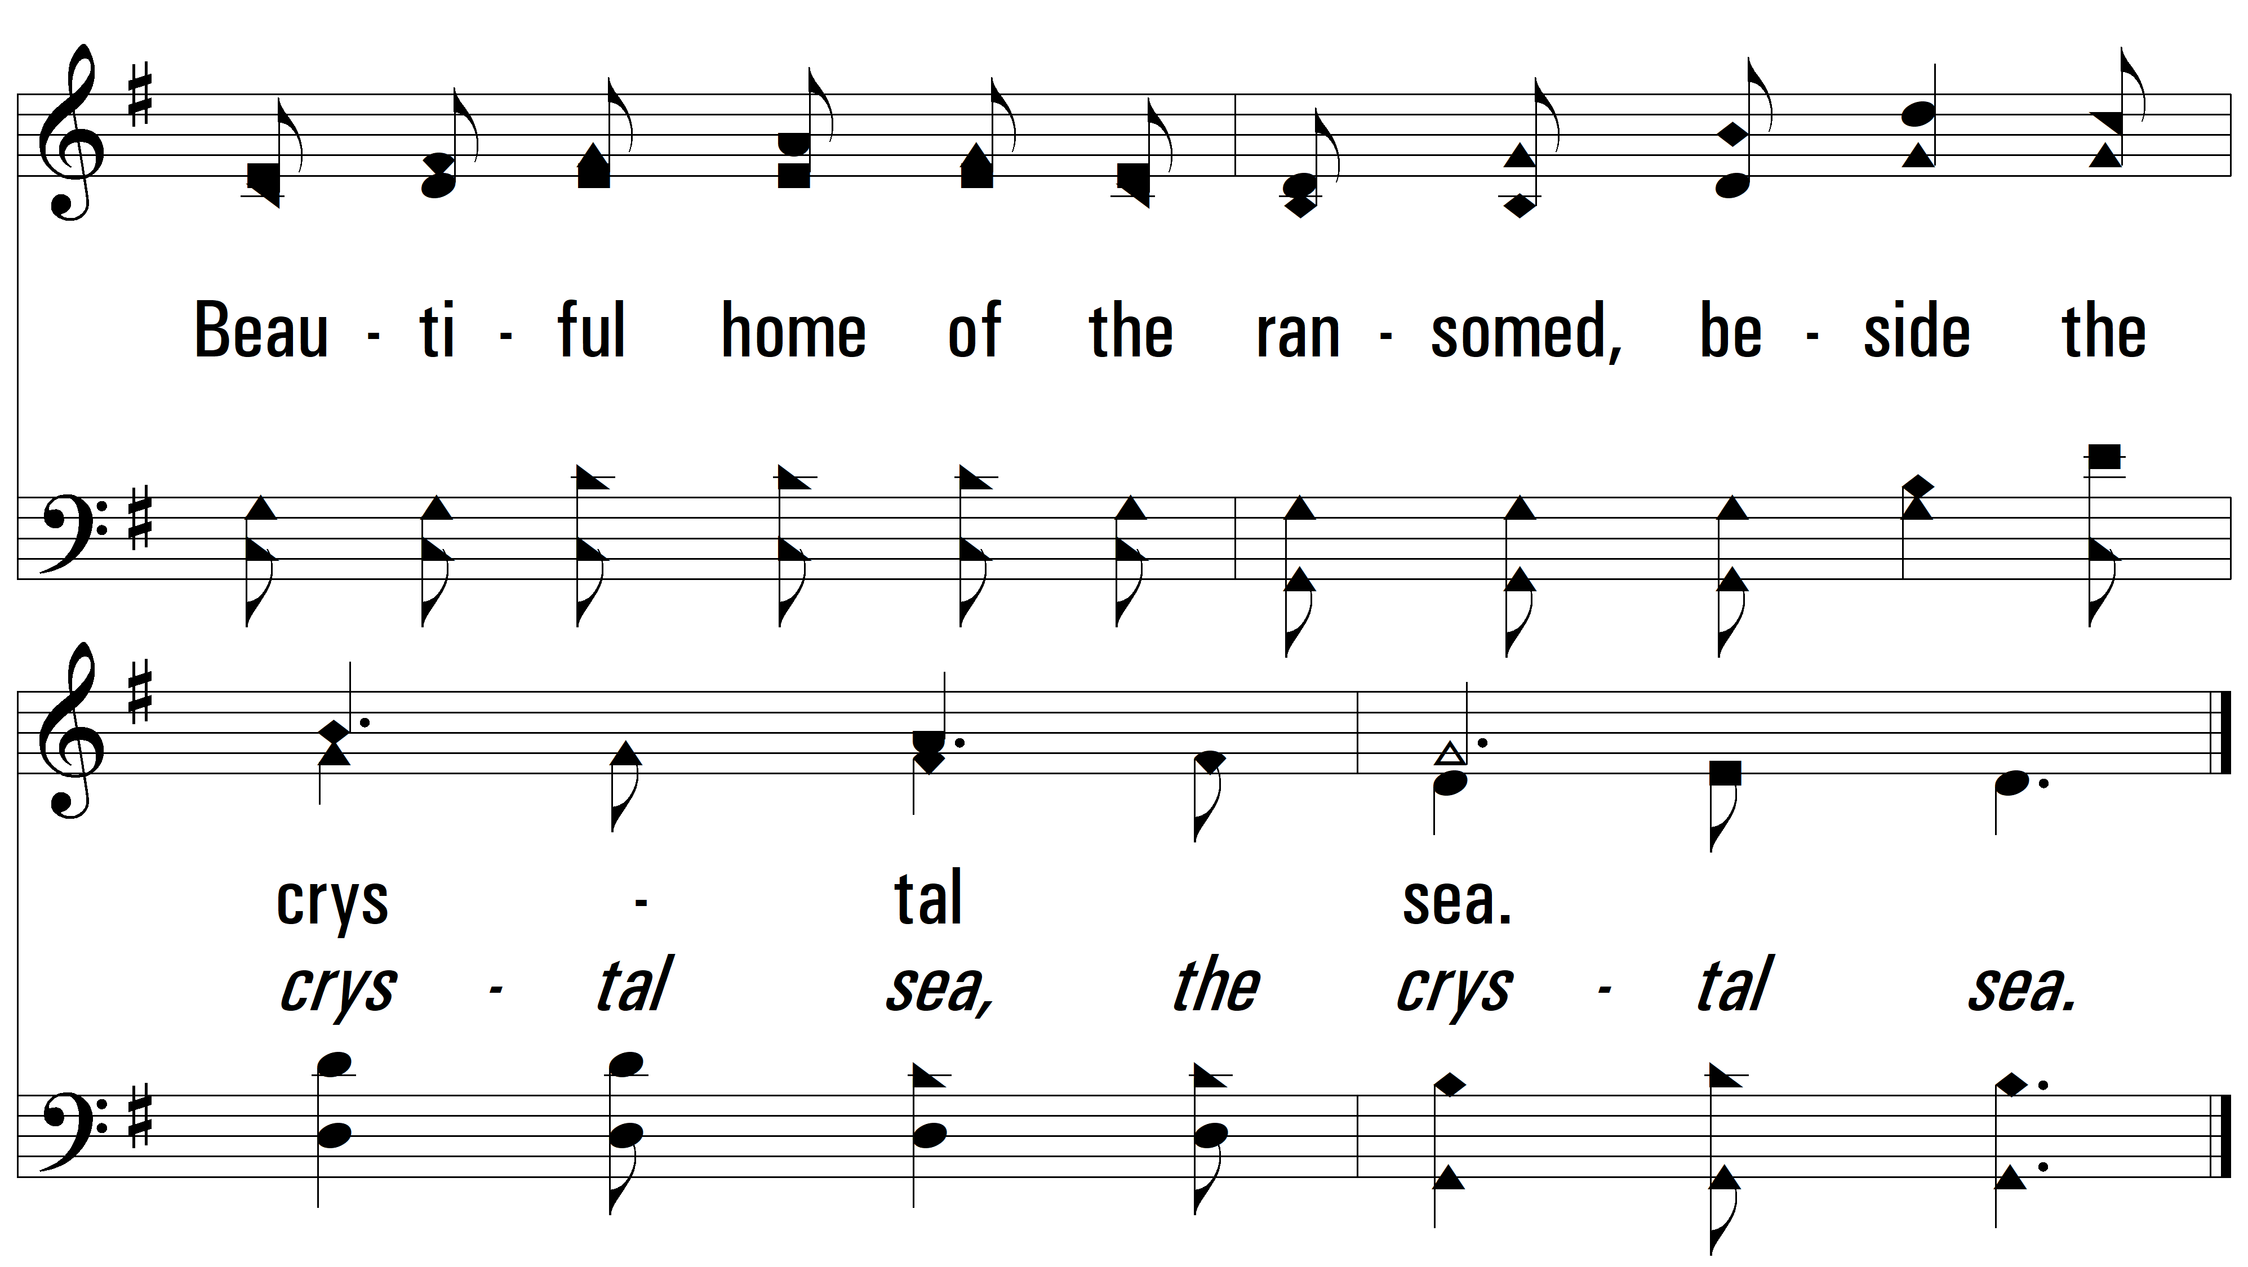
vs. 1

Slide 7
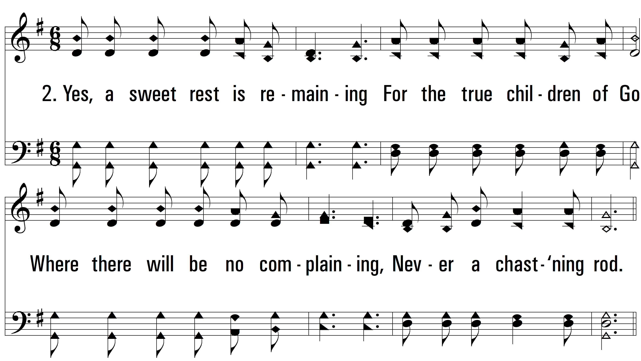
vs. 2 ~ Home Of The Soul

Slide 8
vs. 2

Slide 9
vs. 2

Slide 10
vs. 2

Slide 11
vs. 2

Slide 12
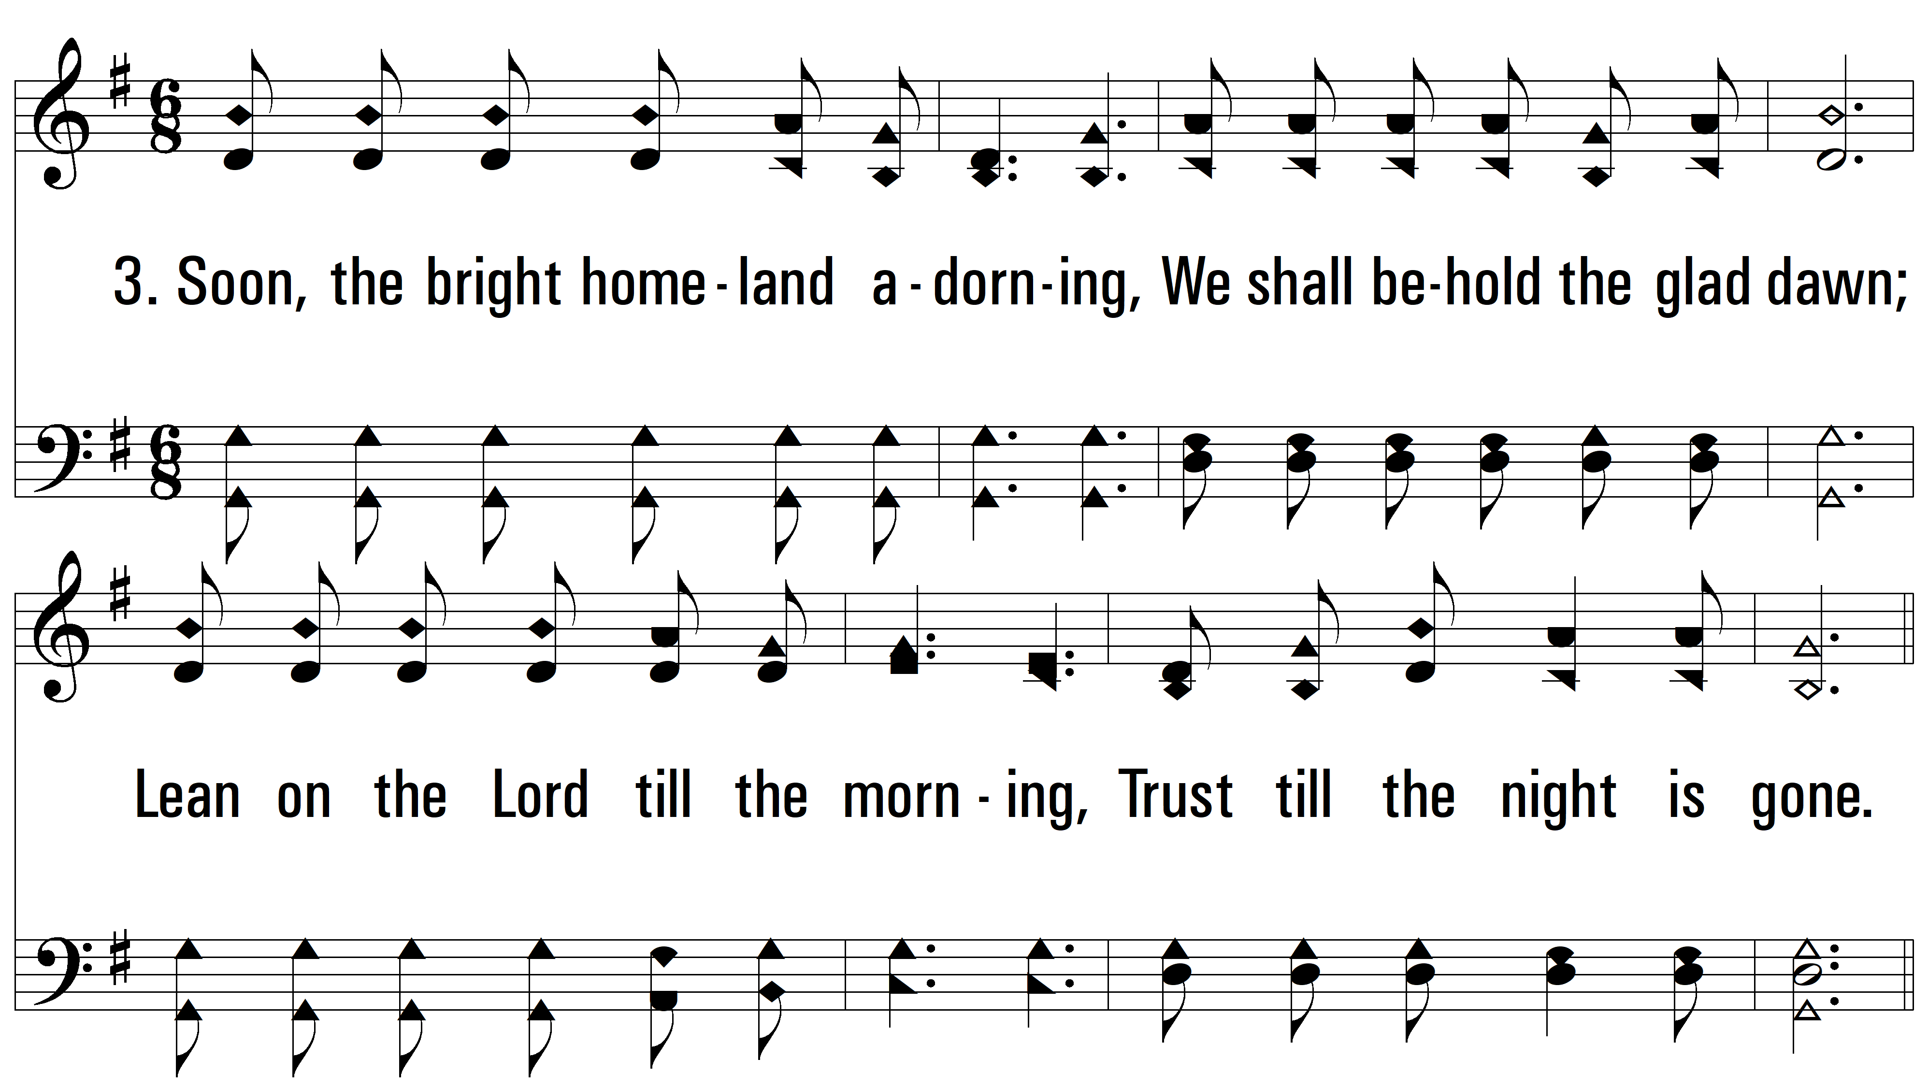
vs. 3 ~ Home Of The Soul

Slide 13
vs. 3

Slide 14
vs. 3

Slide 15
vs. 3

Slide 16
vs. 3
PDHymns.com
END

