Slide 1
Holy Is The Lord
Words: | Traditional, based On Isaiah 6:3
Music: | Franz Schubert (c. 1826)
3/4
E^{b}/G - MI
Verses: 2
Lead - | MI
Alto - | DO
Tenor - | SOL
Bass - | DO
PDHymns.com

Slide 2
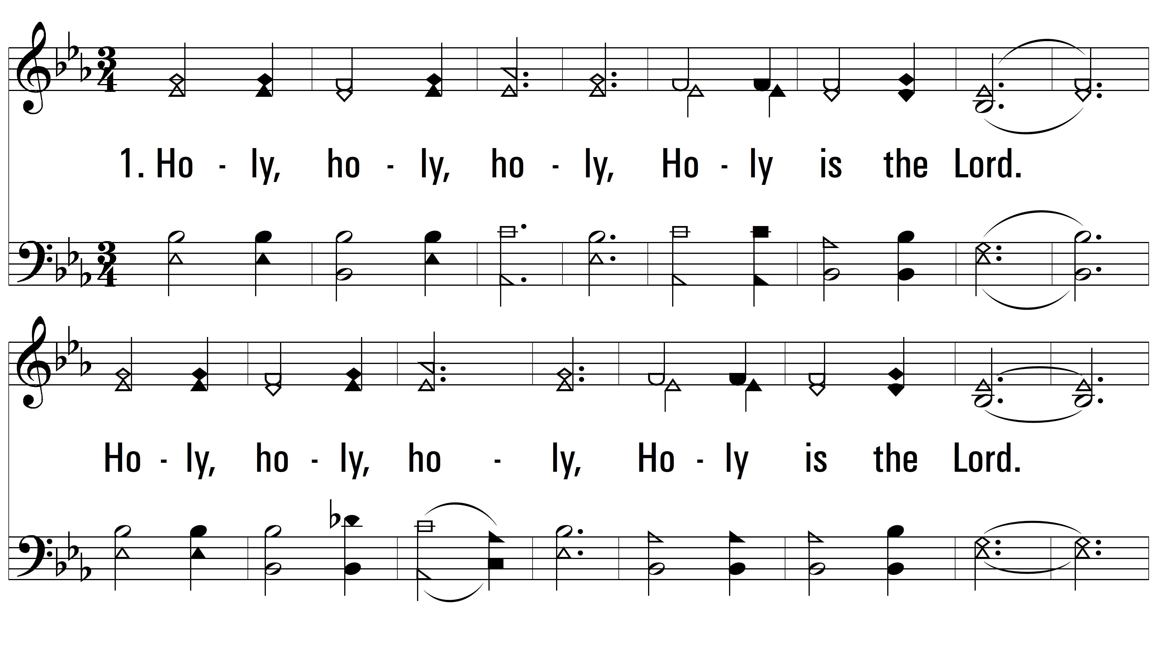
vs. 1 ~ Holy Is The Lord

Slide 3
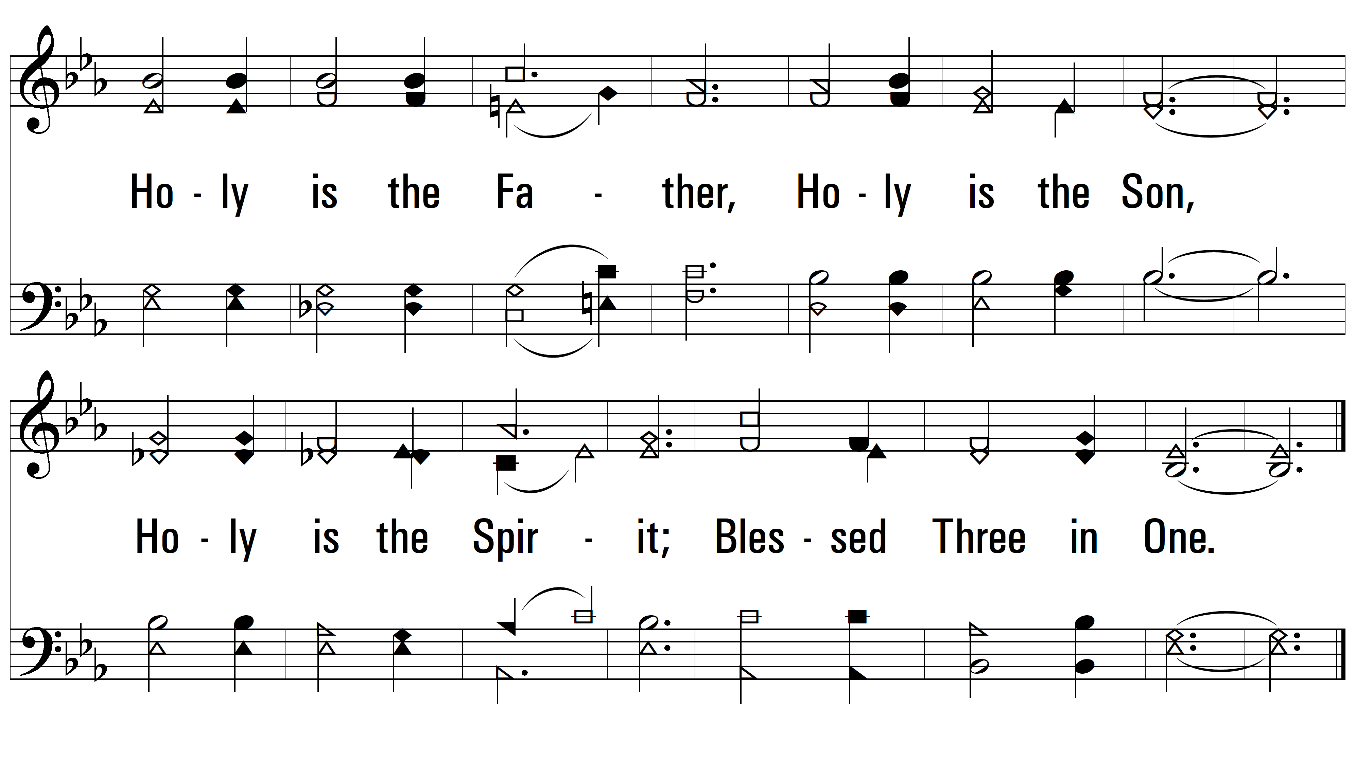
vs. 1

Slide 4
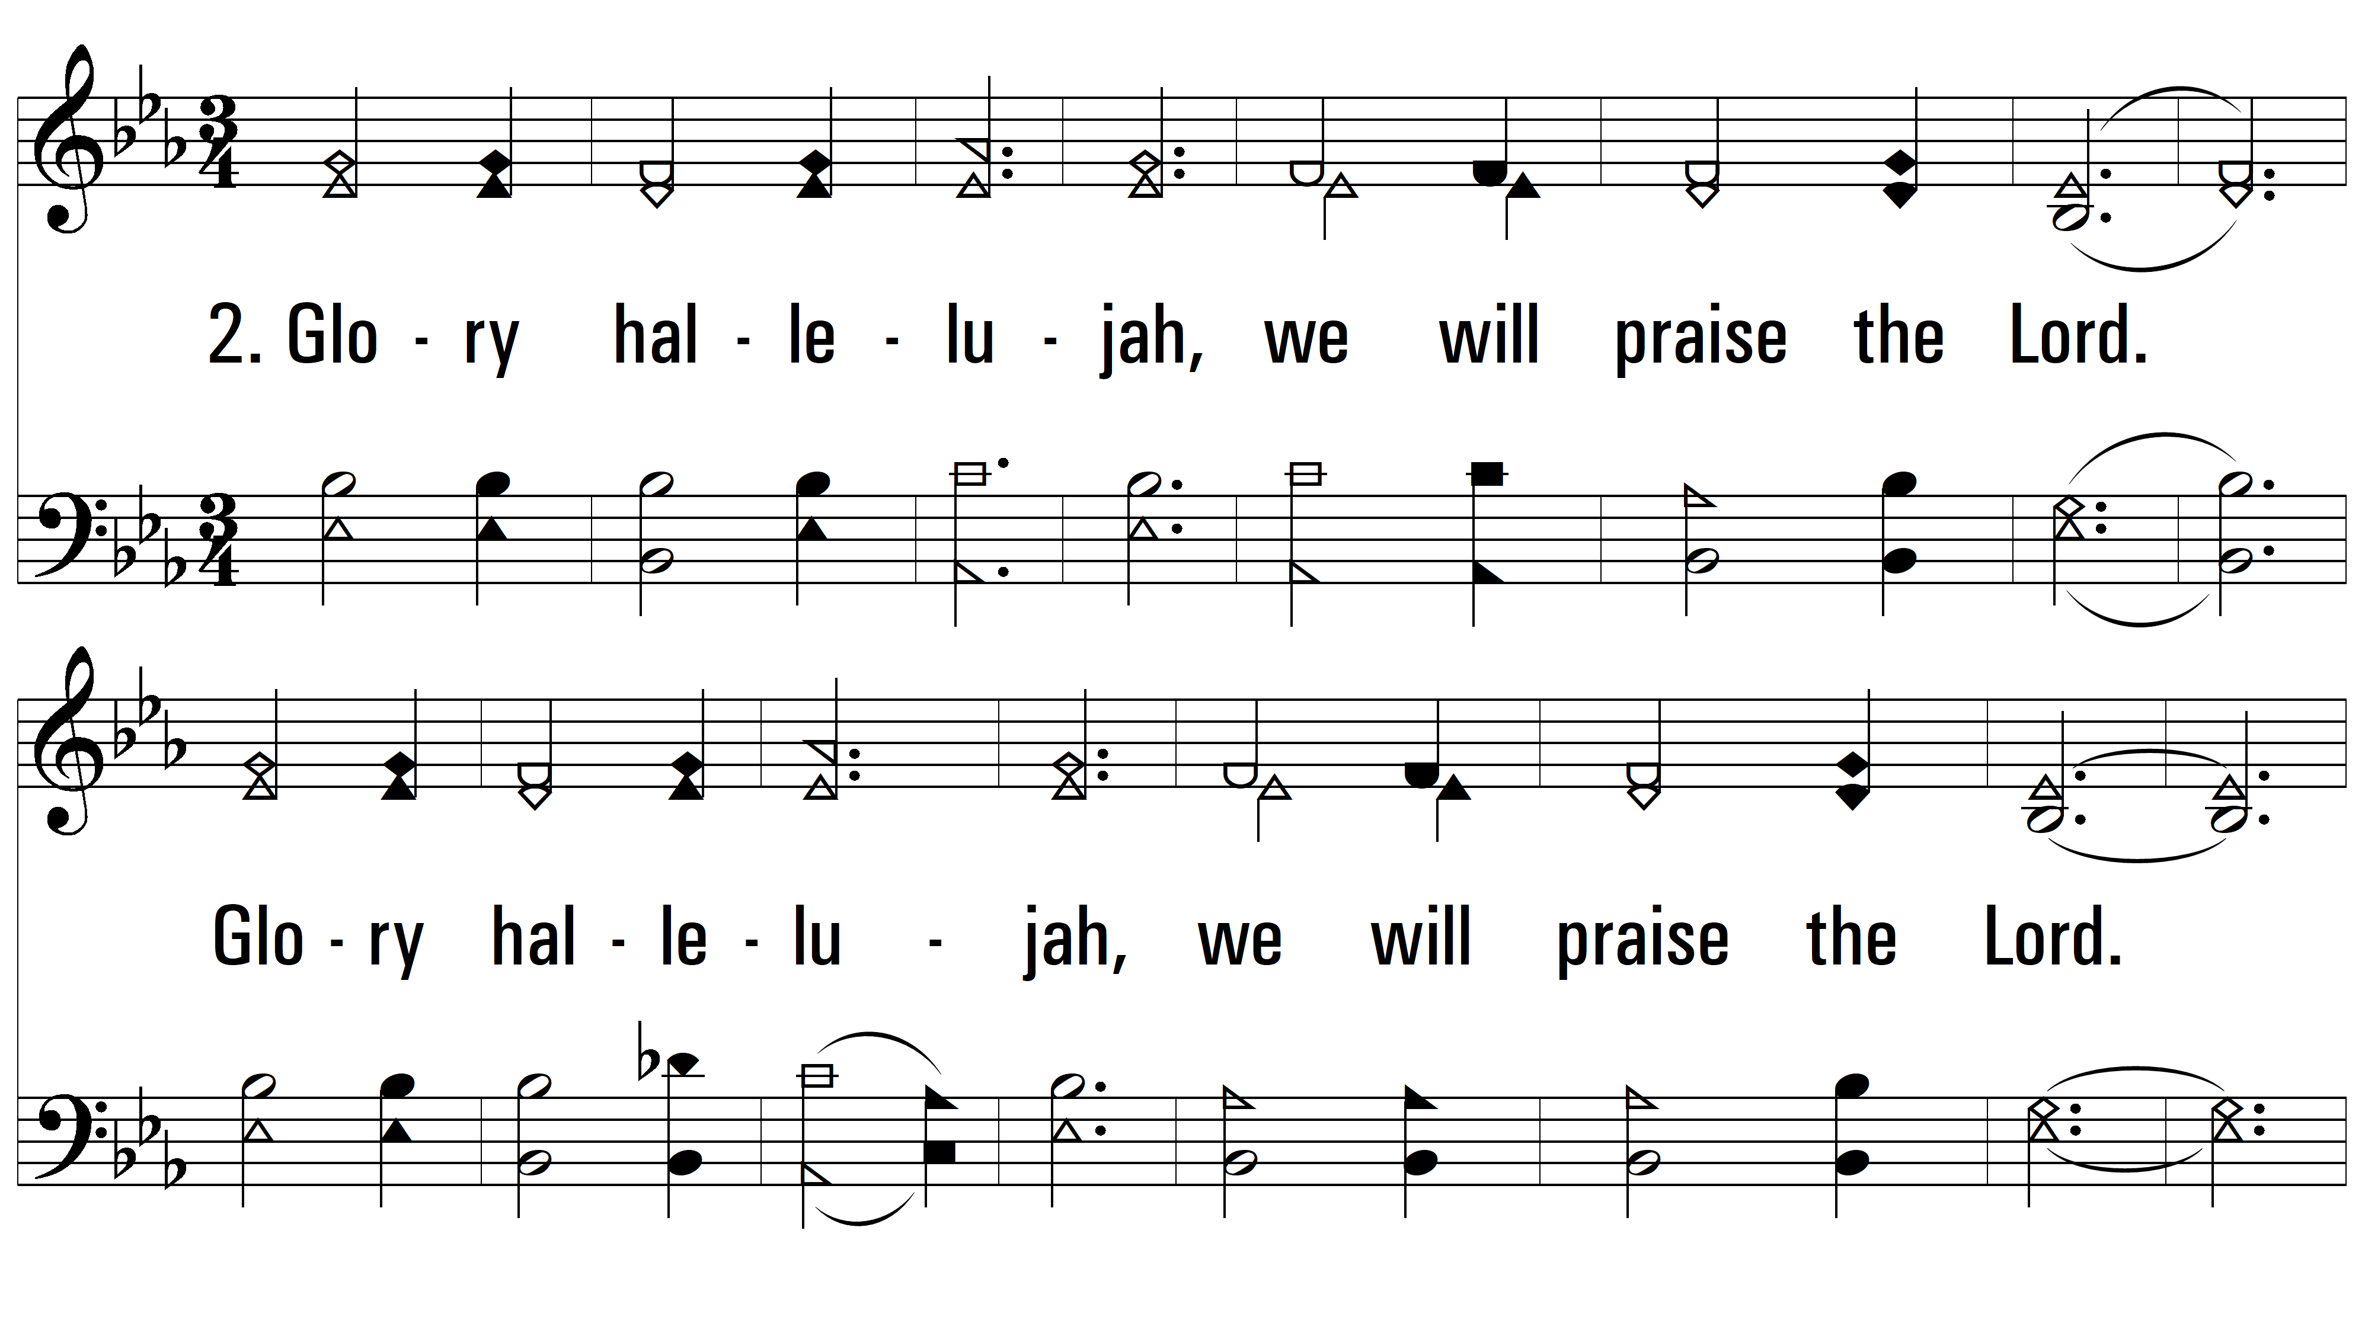
vs. 2 ~ Holy Is The Lord

Slide 5
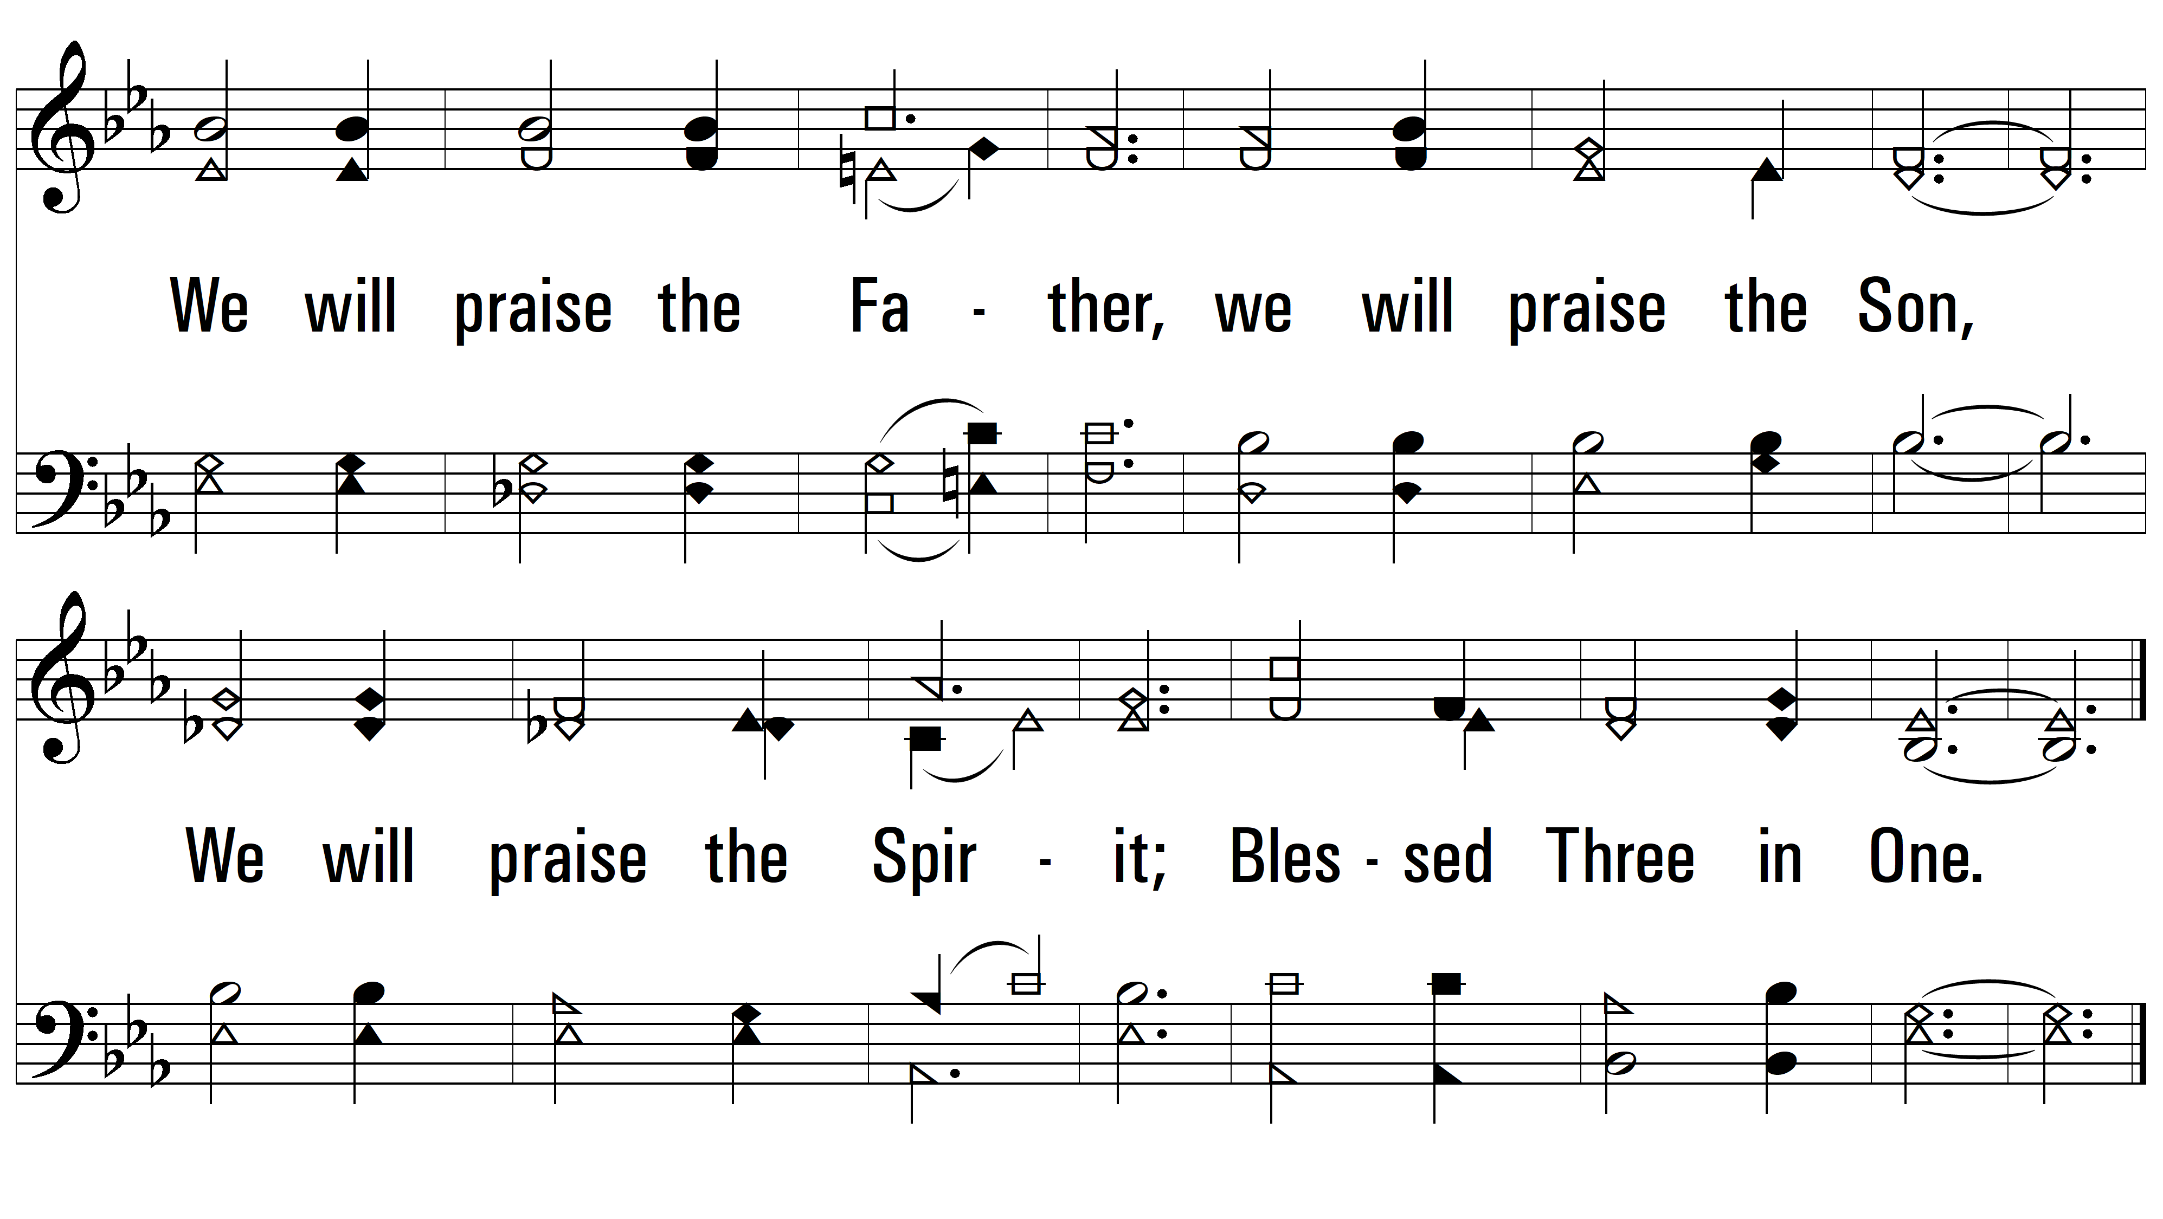
vs. 2
PDHymns.com
END

