Slide 1
Hold To God's Unchanging Hand
Words: | Jennie Wilson (1904)
Music: | F. L. Eiland (1904)
4/4
A^{b}/A^{b} - DO
Verses: 3/Chorus
Lead - | DO
Alto - | MI
Tenor - | SOL
Bass - | DO
PDHymns.com

Slide 2
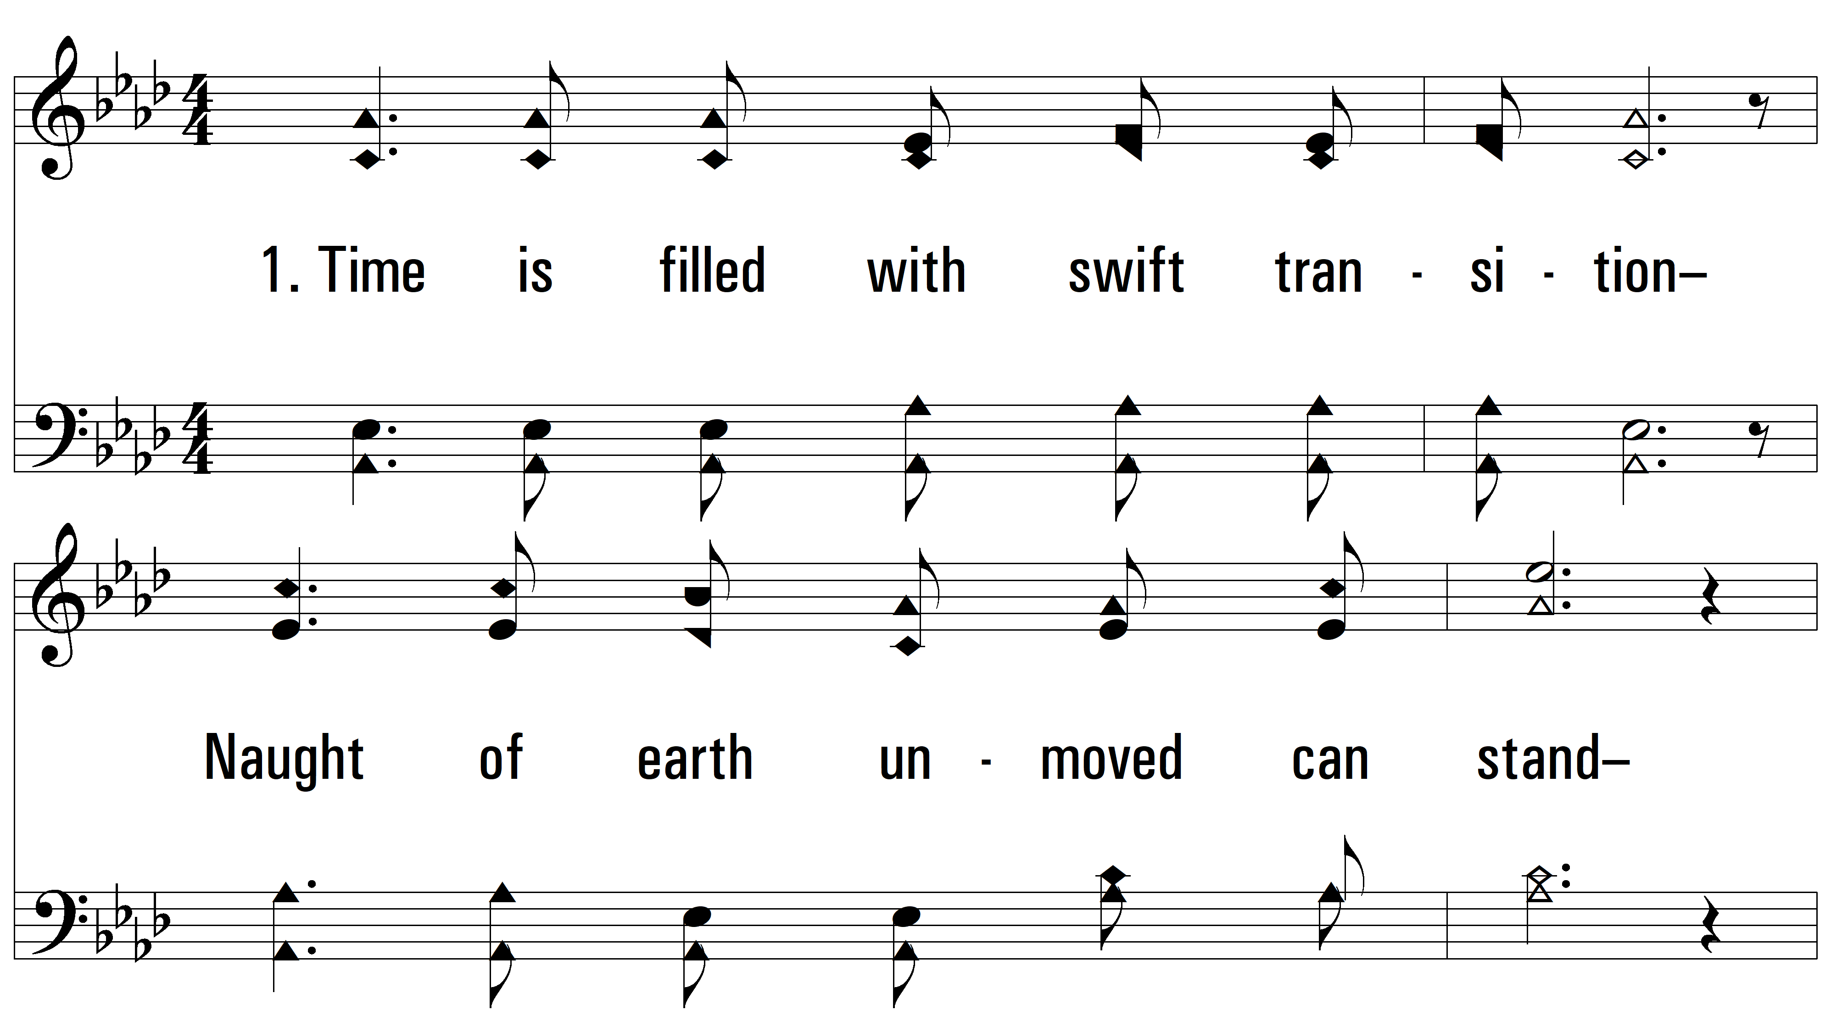
vs. 1 ~ Hold To God's Unchanging Hand

Slide 3
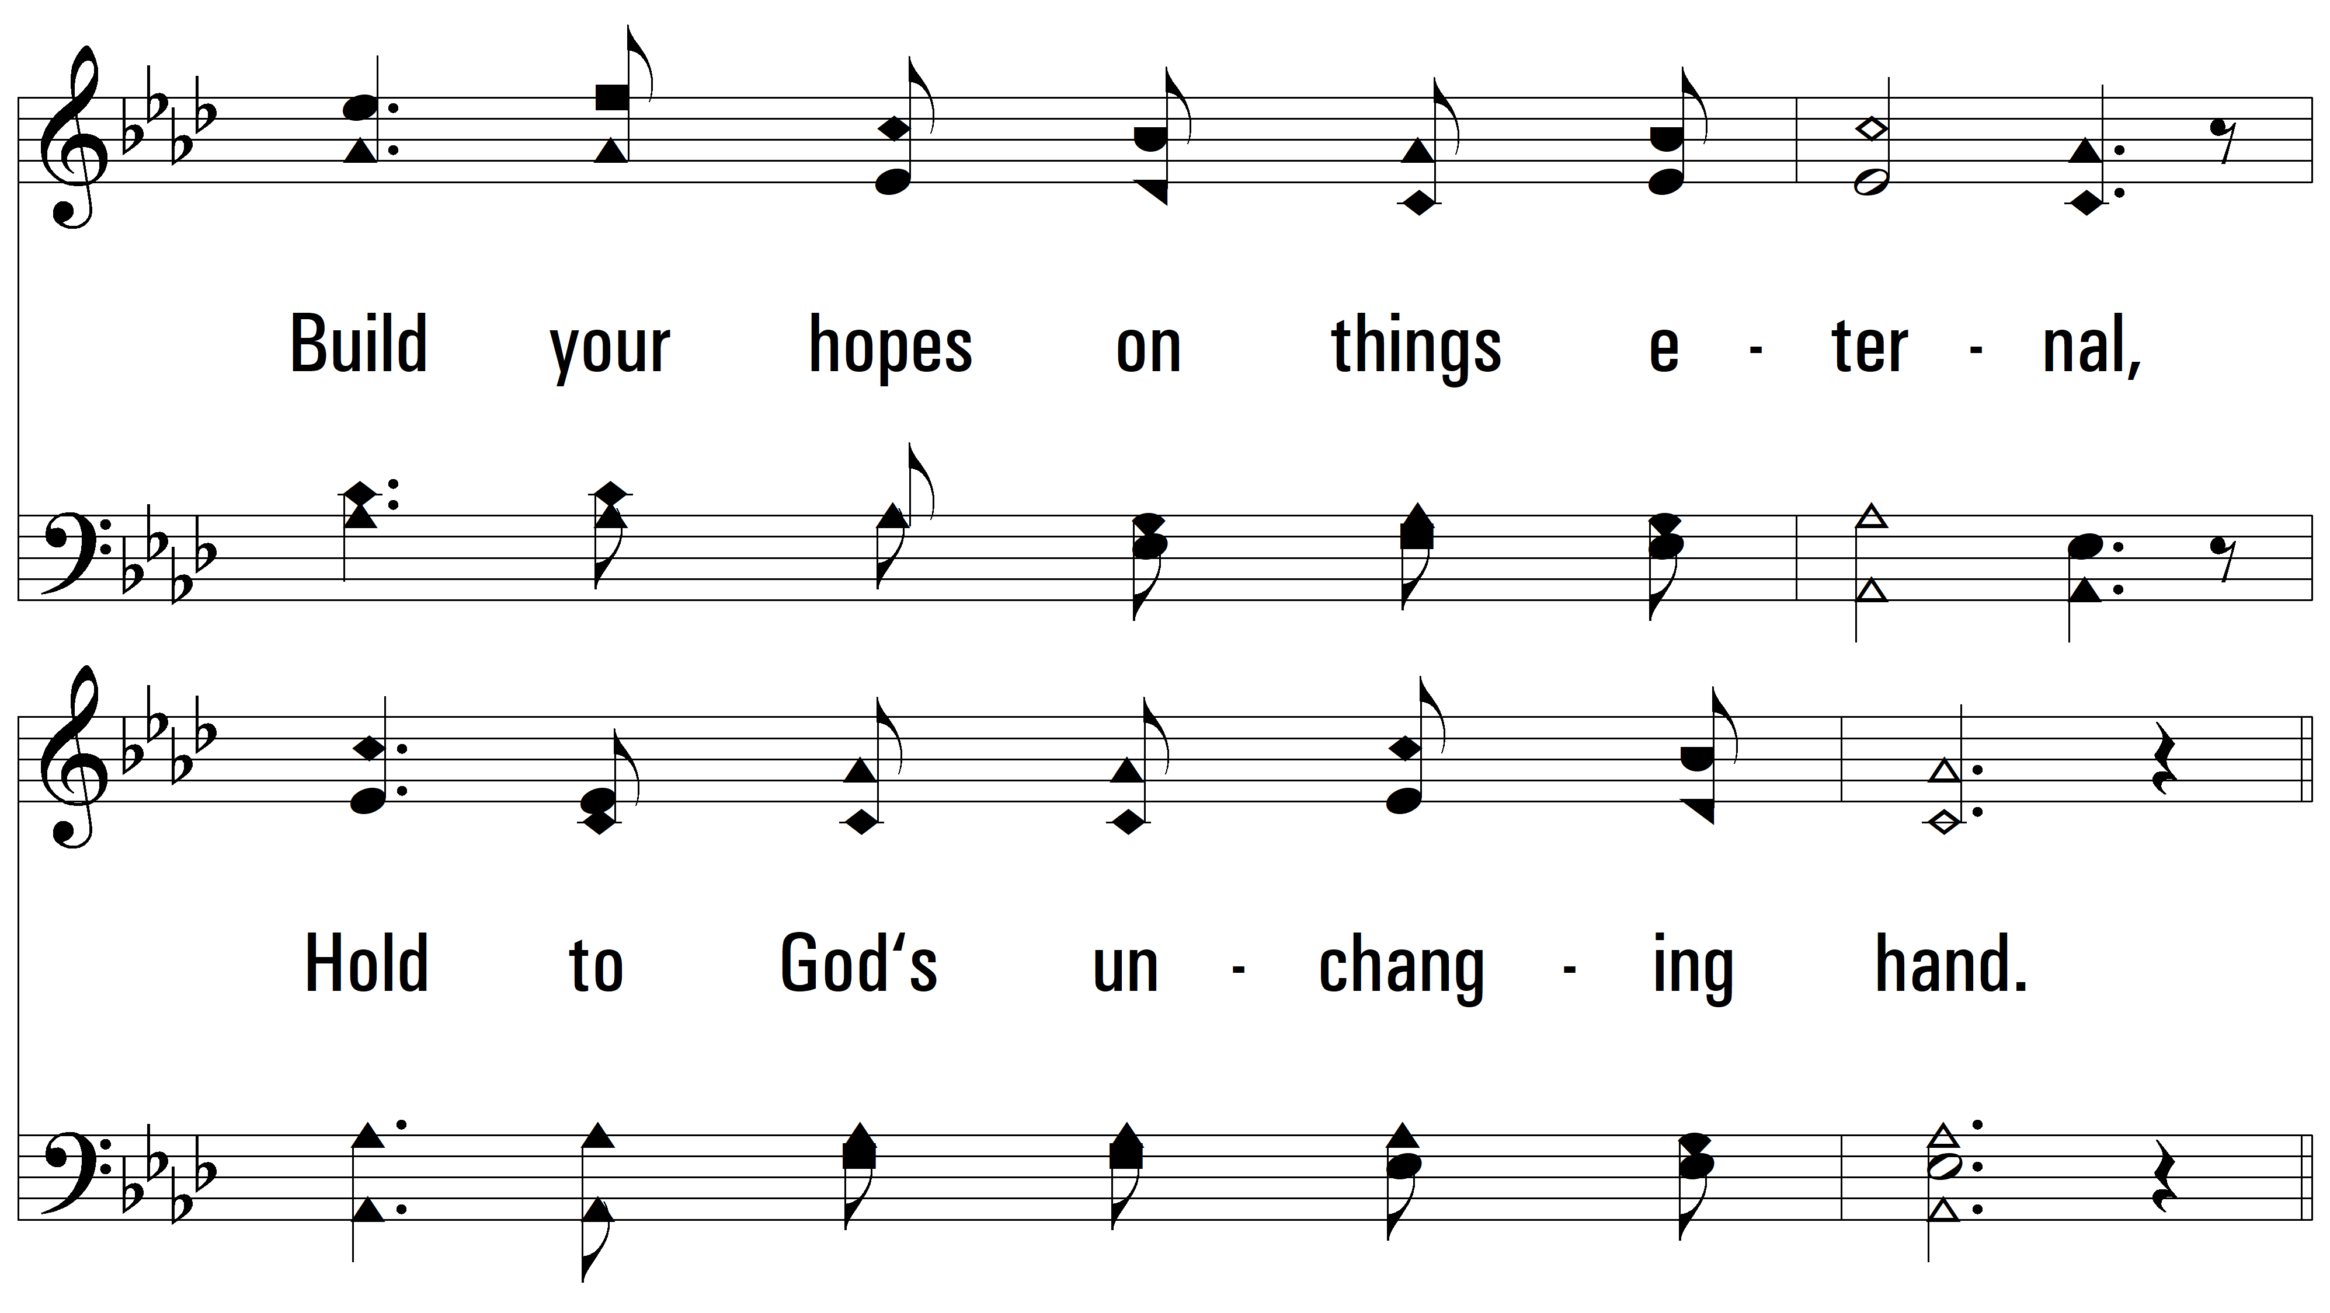
vs. 1

Slide 4
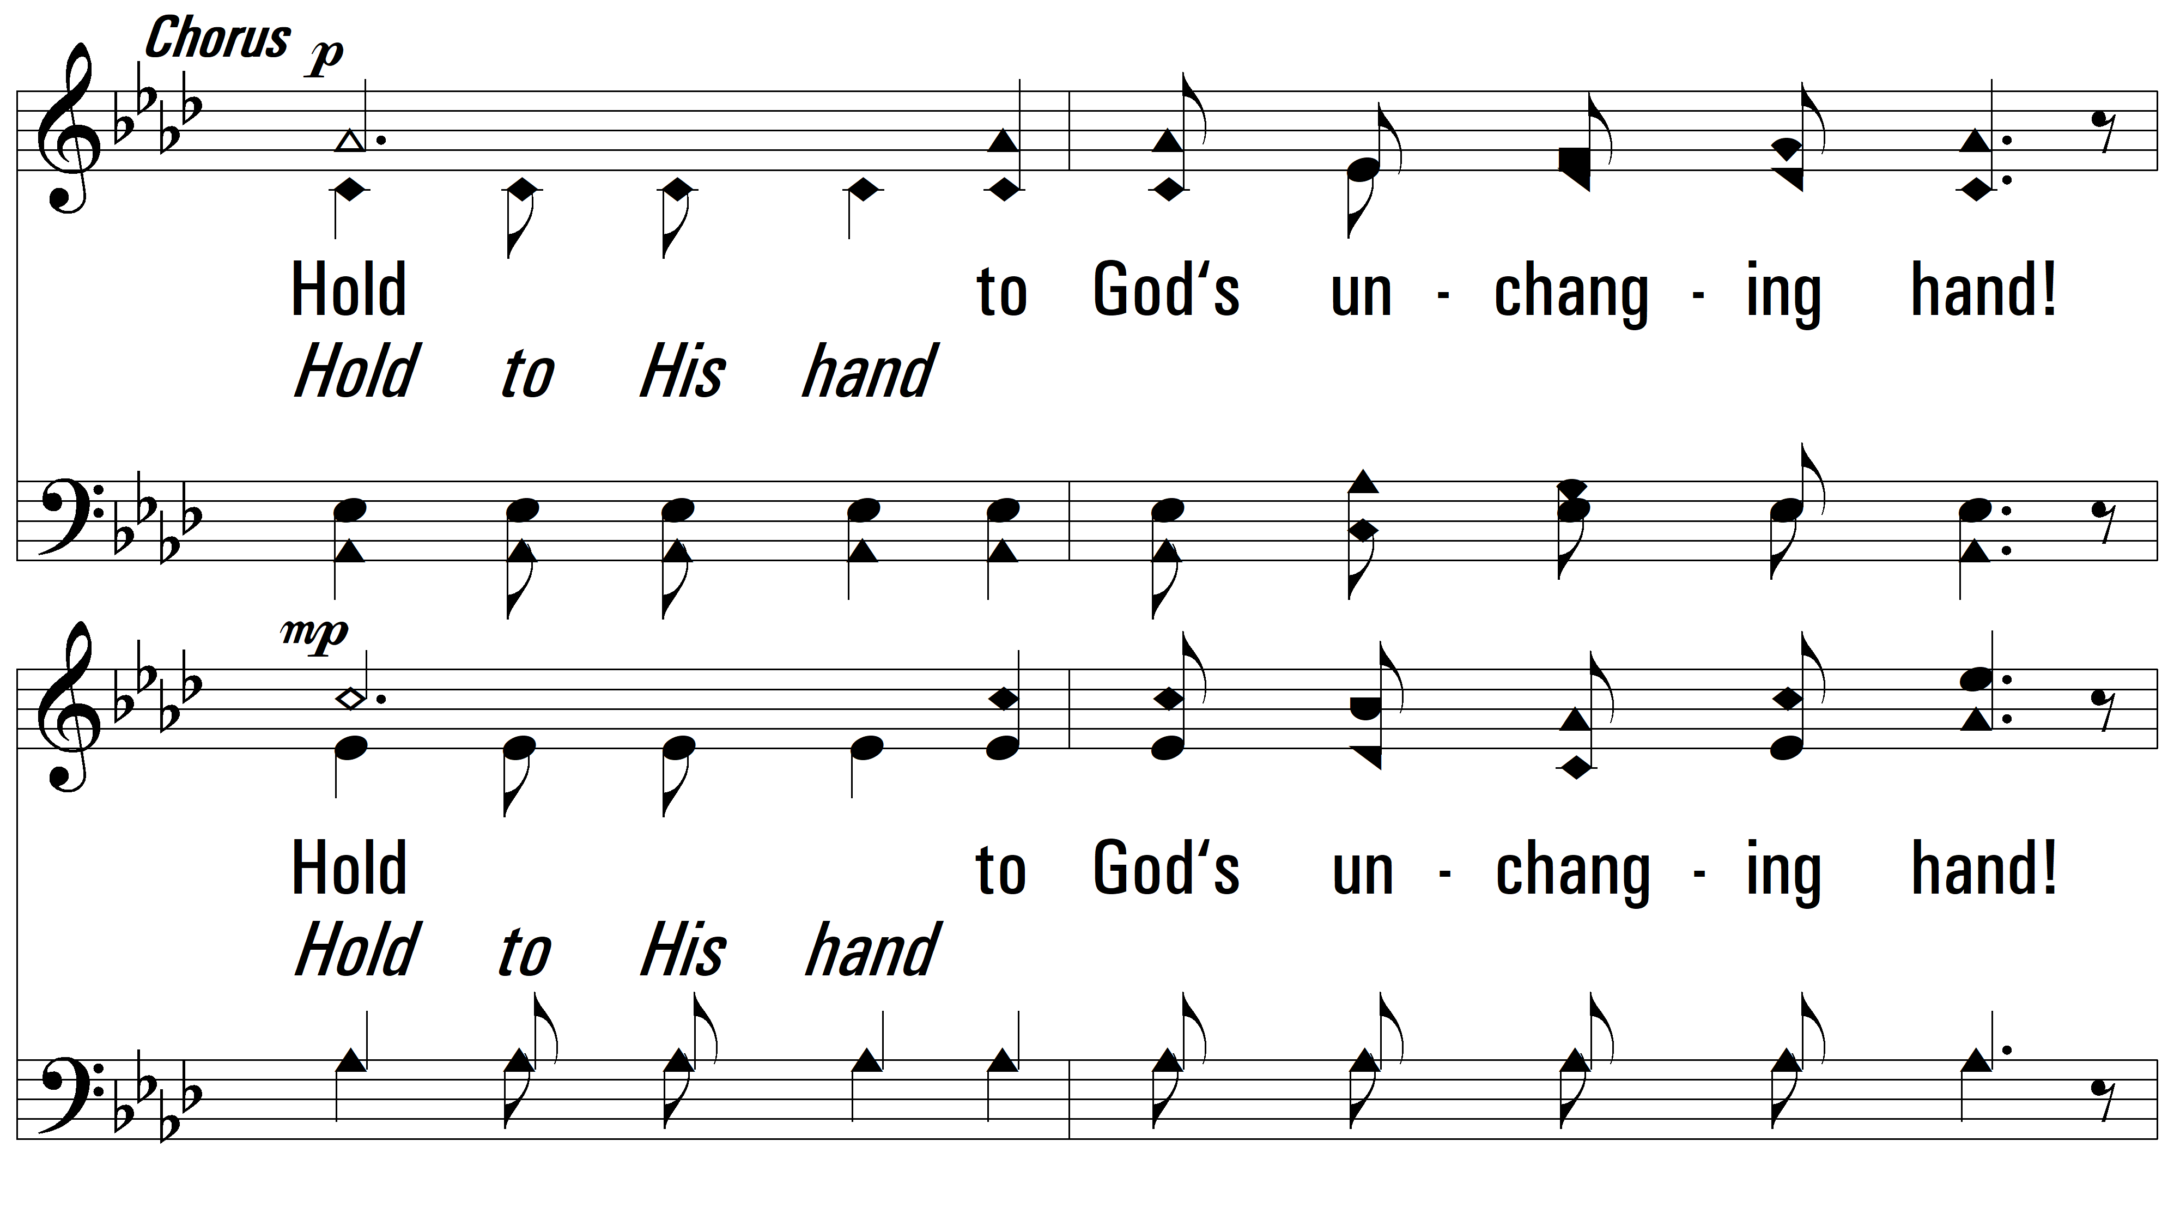
vs. 1

Slide 5
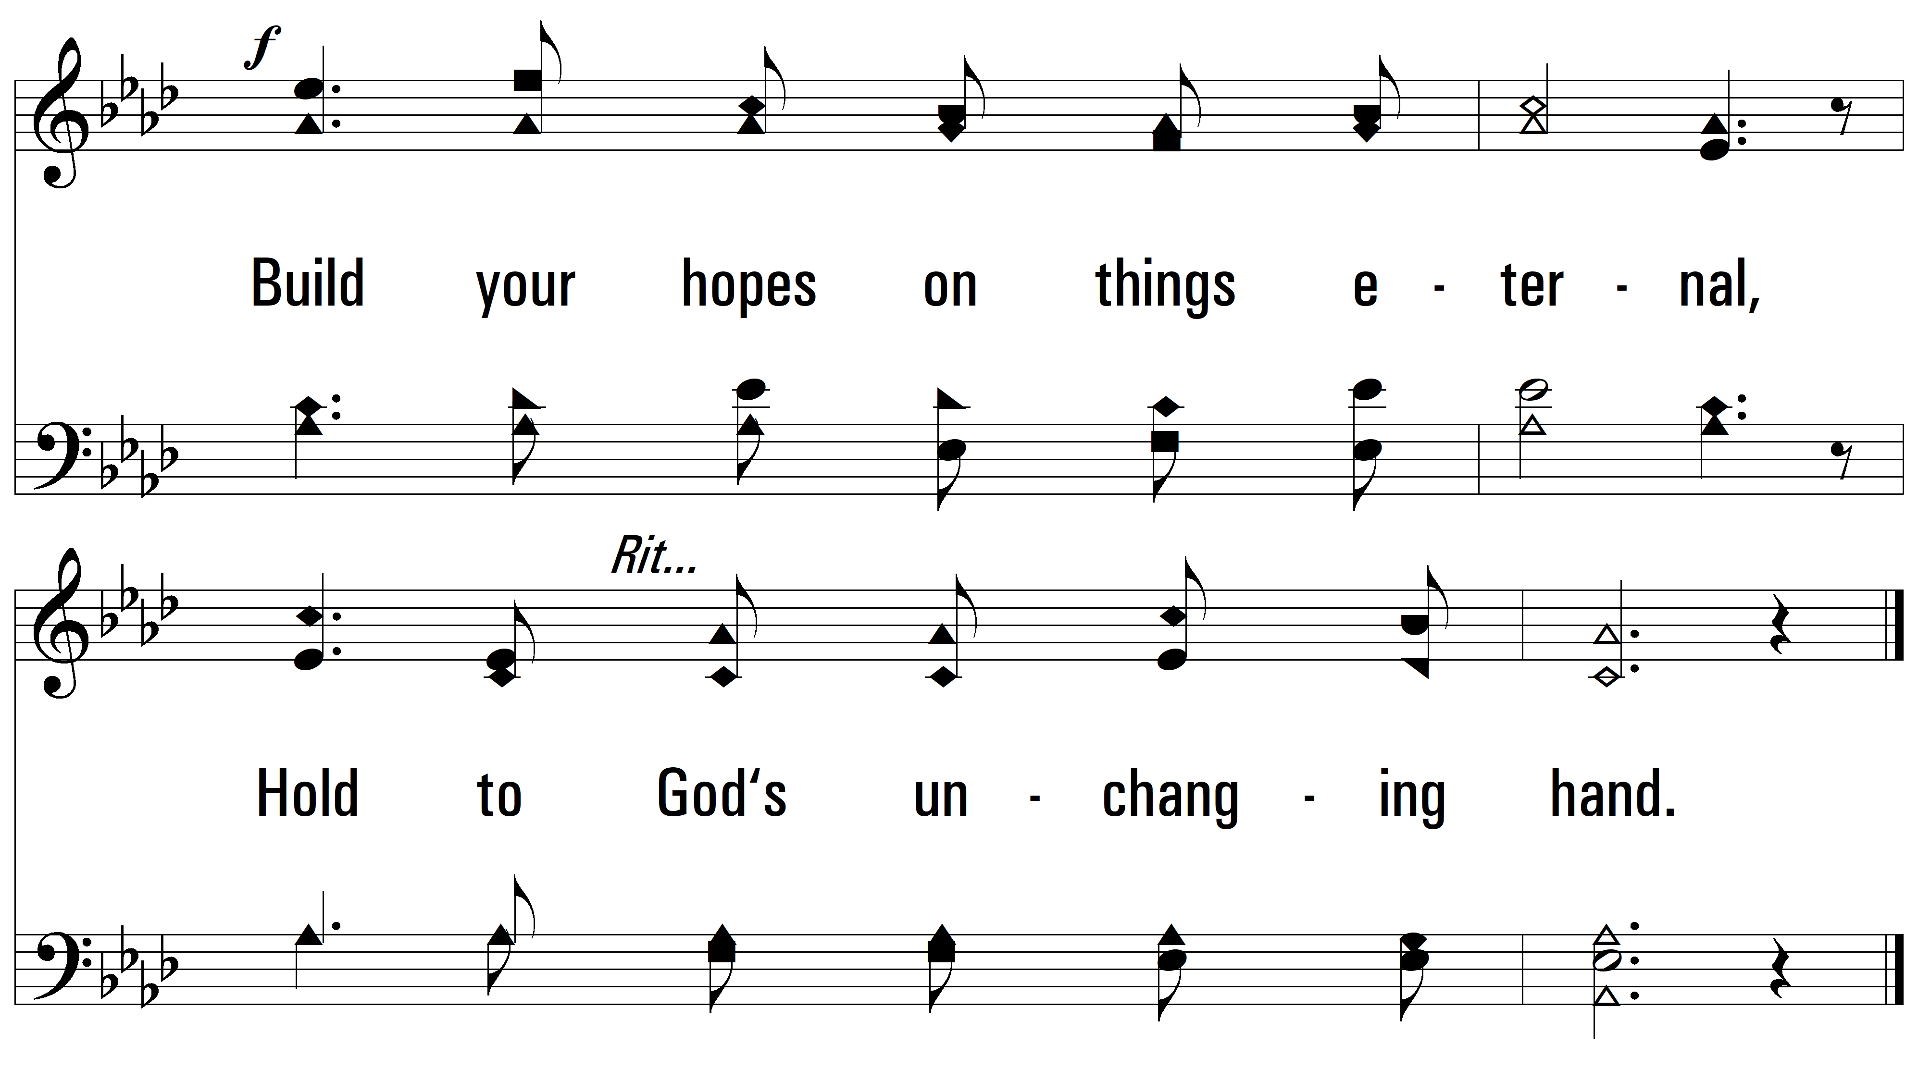
vs. 1

Slide 6
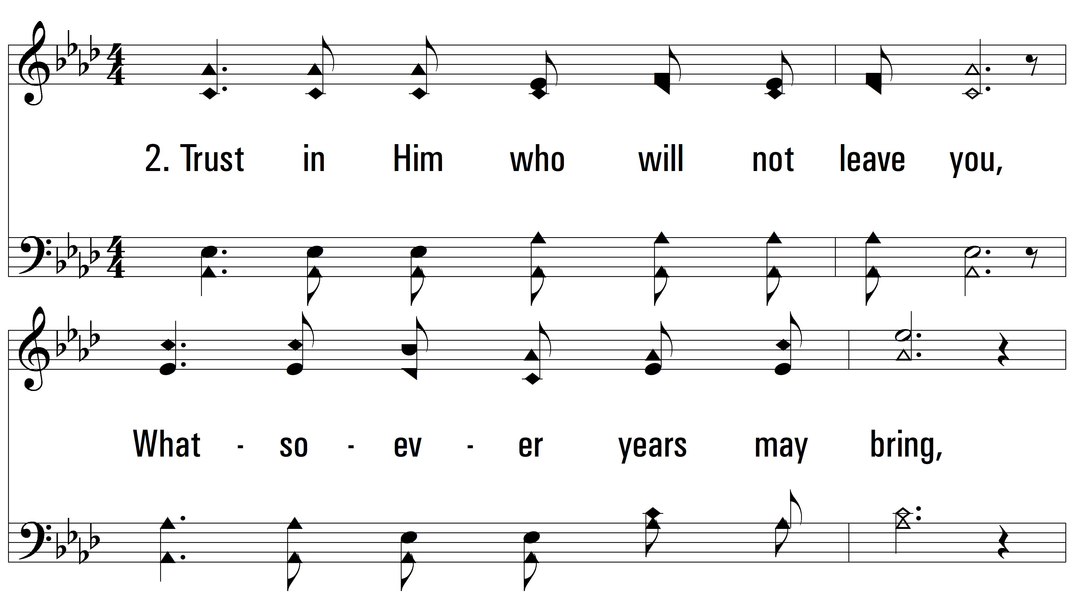
vs. 2 ~ Hold To God's Unchanging Hand

Slide 7
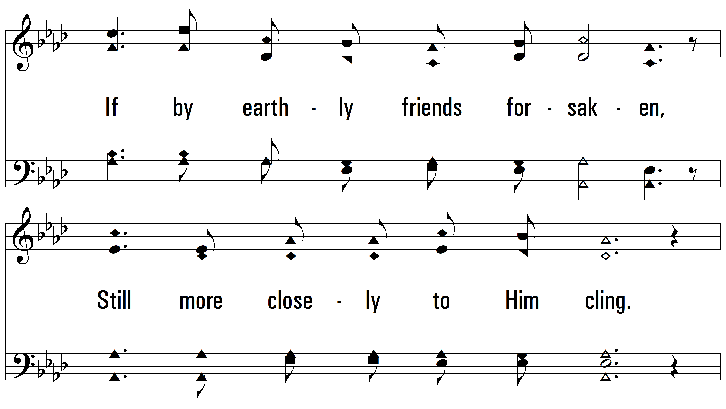
vs. 2

Slide 8
vs. 2

Slide 9
vs. 2

Slide 10
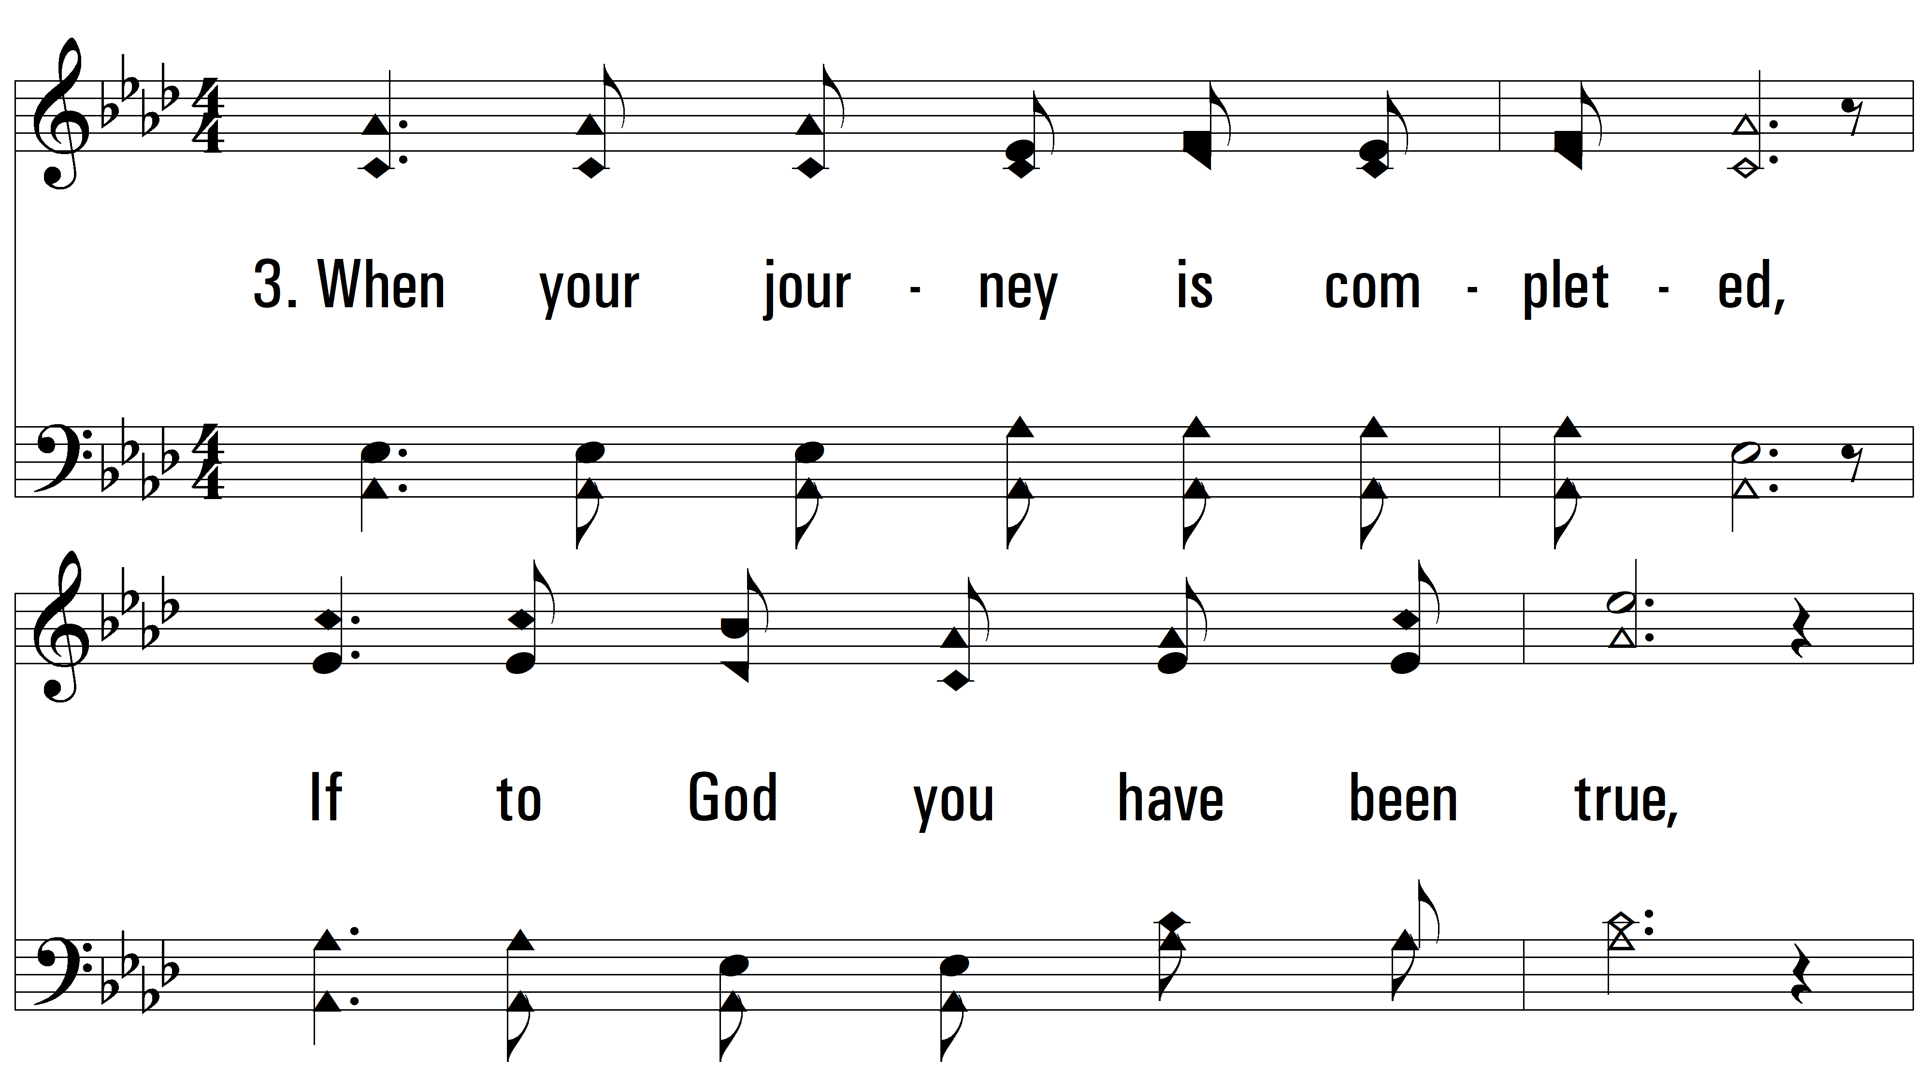
vs. 3 ~ Hold To God's Unchanging Hand

Slide 11
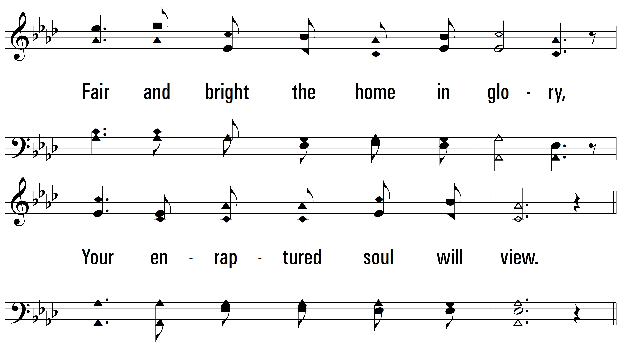
vs. 3

Slide 12
vs. 3

Slide 13
vs. 3
PDHymns.com
END

