Slide 1
Higher Ground
Words: | Johnson Oatman (1892)
Music: | Charles H. Gabriel (1898)
3/4
A^{b}/E^{b} - SOL
Verses: 5/Chorus
Lead - | SOL
Alto - | MI
Tenor - | DO
Bass - | DO
PDHymns.com

Slide 2
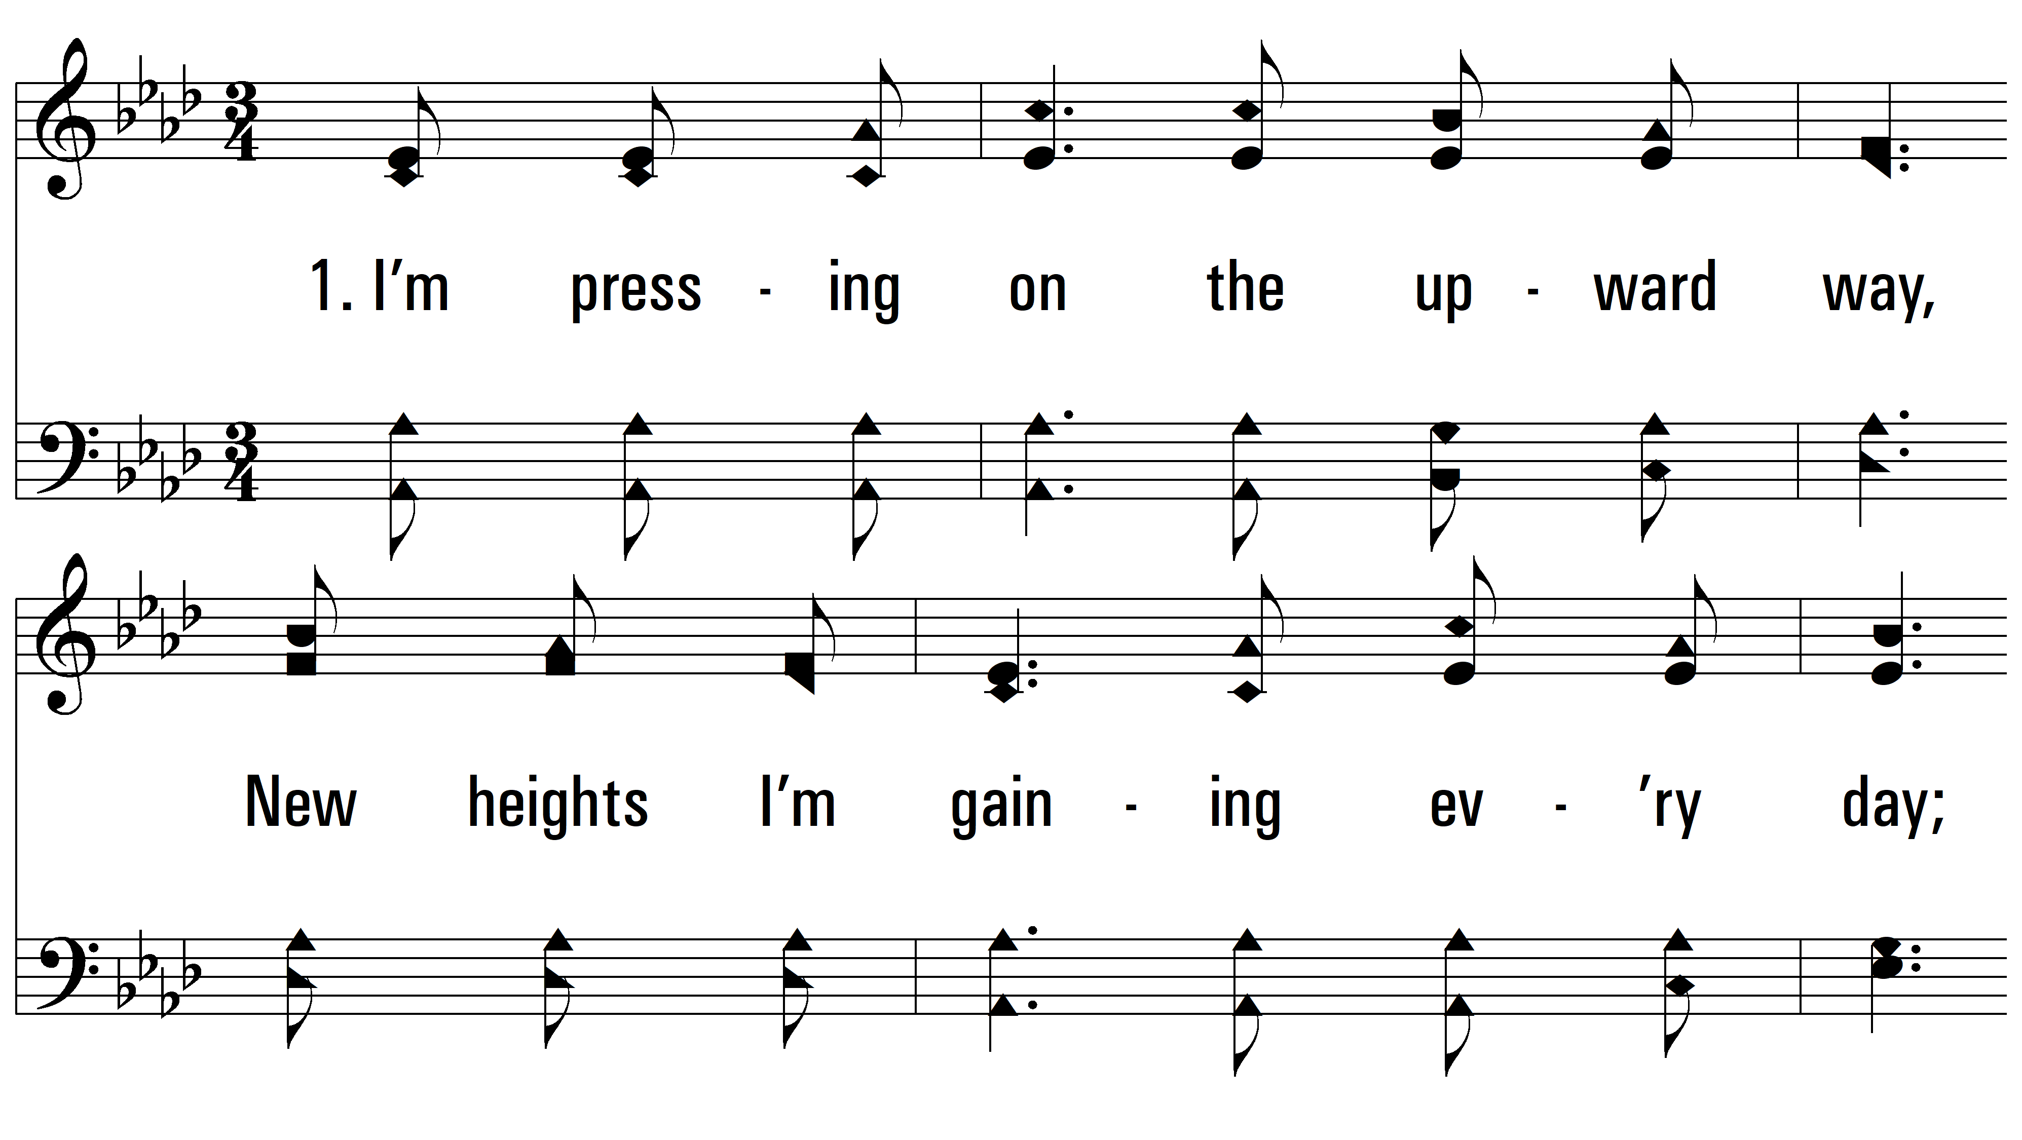
vs. 1 ~ Higher Ground

Slide 3
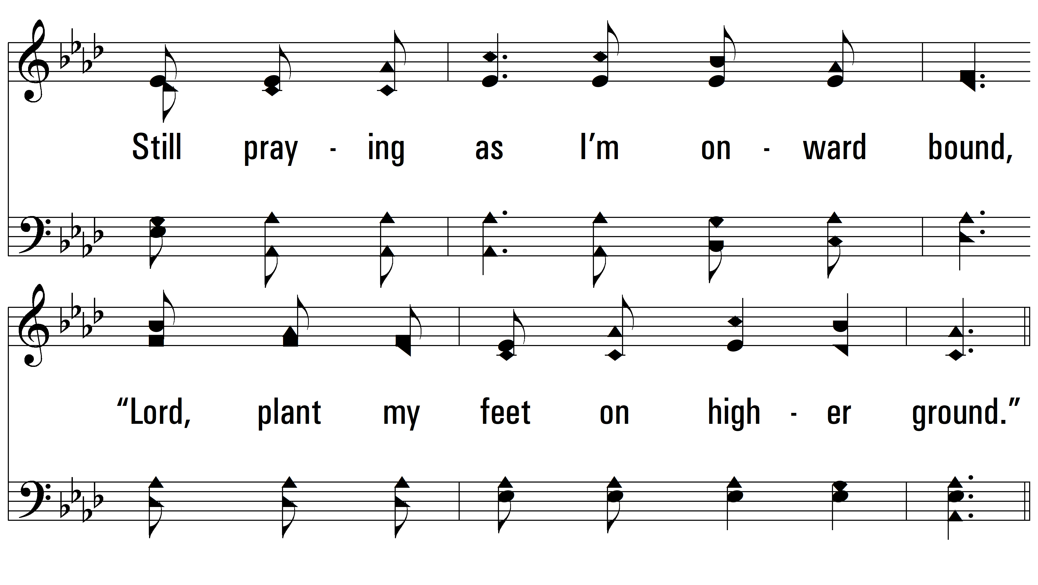
vs. 1

Slide 4
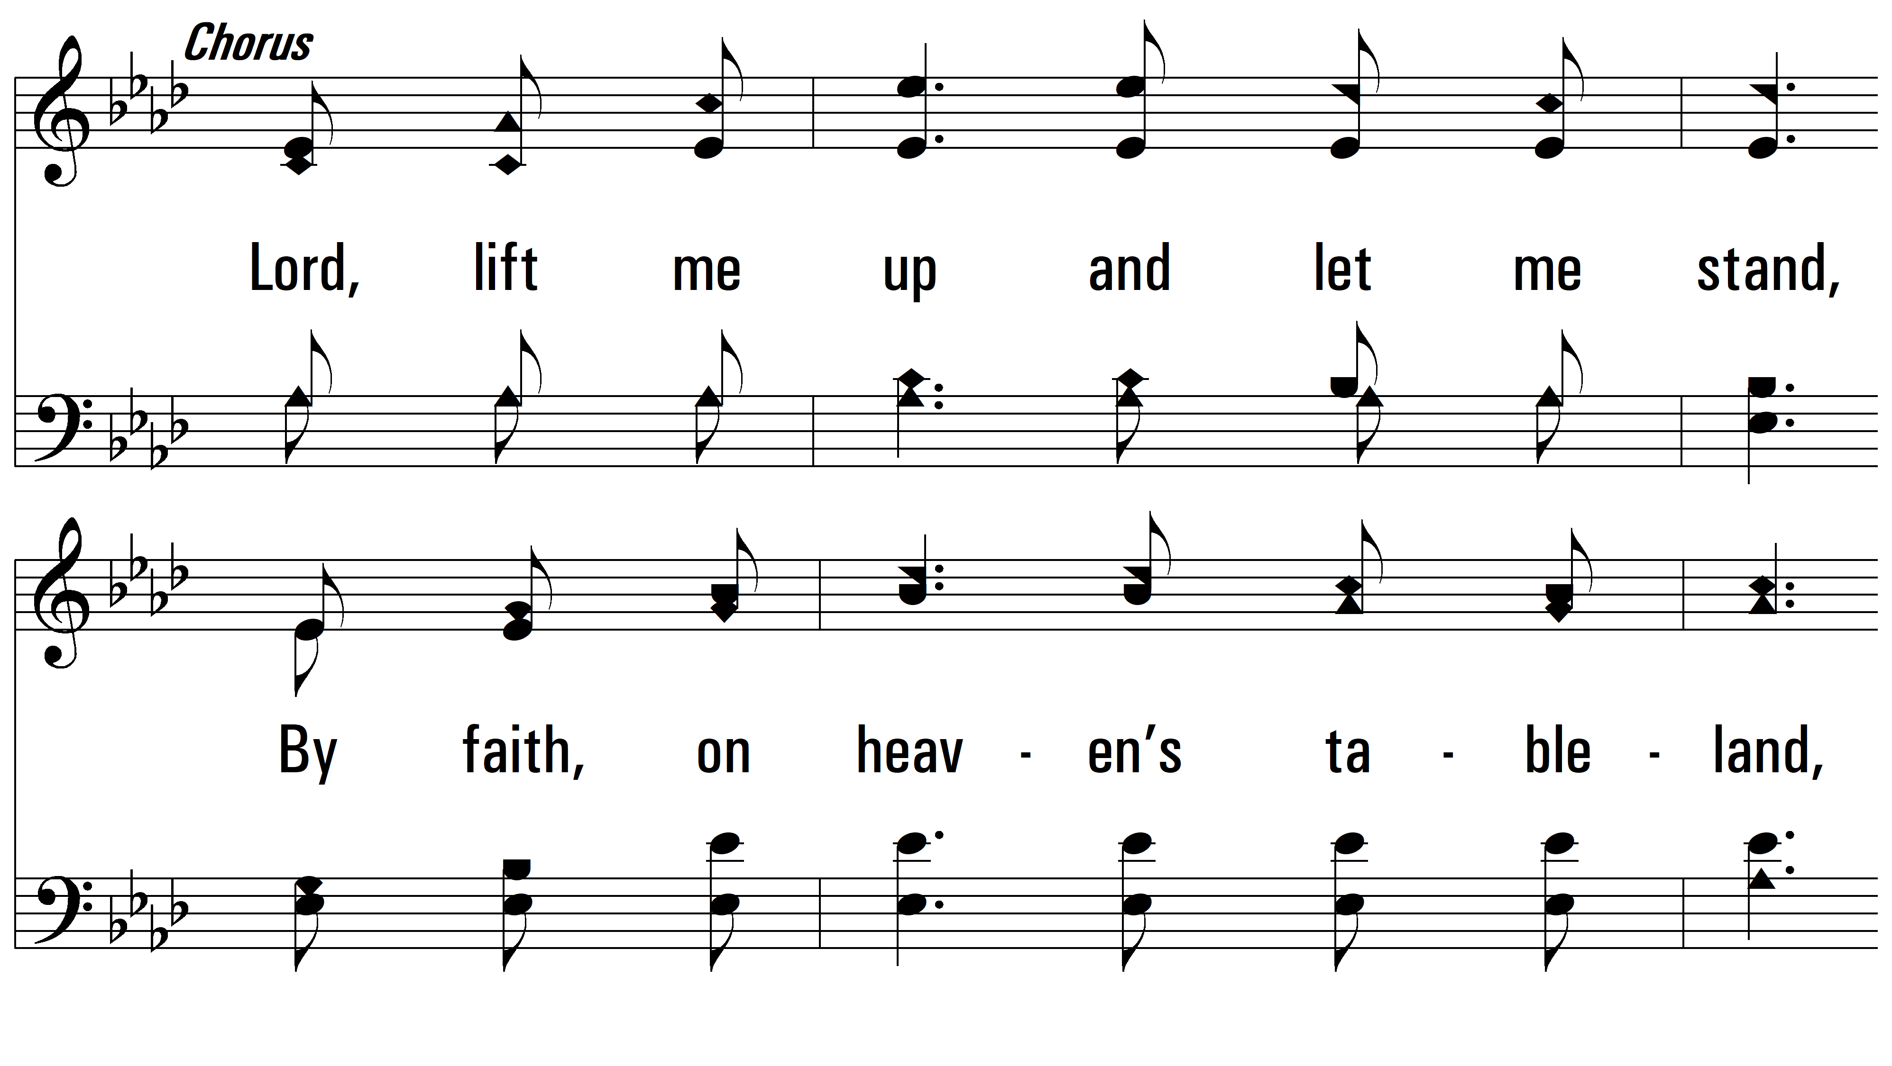
vs. 1

Slide 5
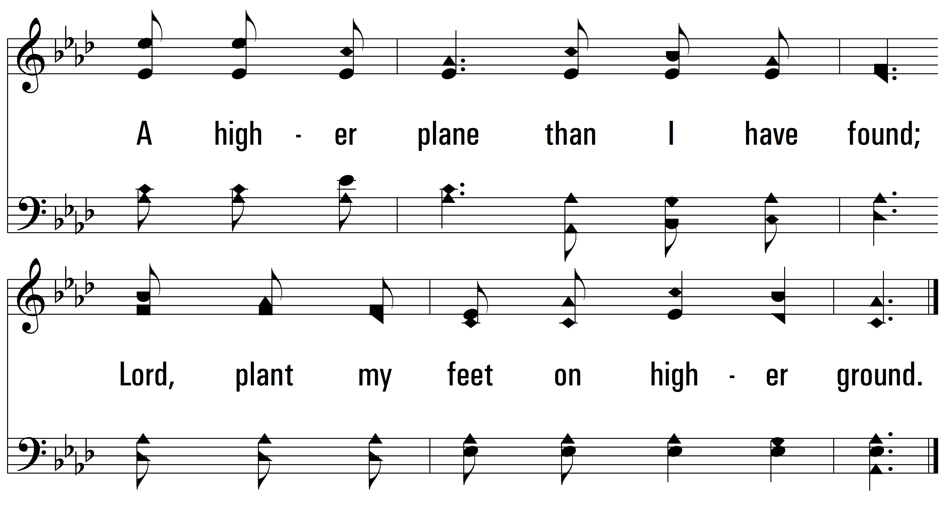
vs. 1

Slide 6
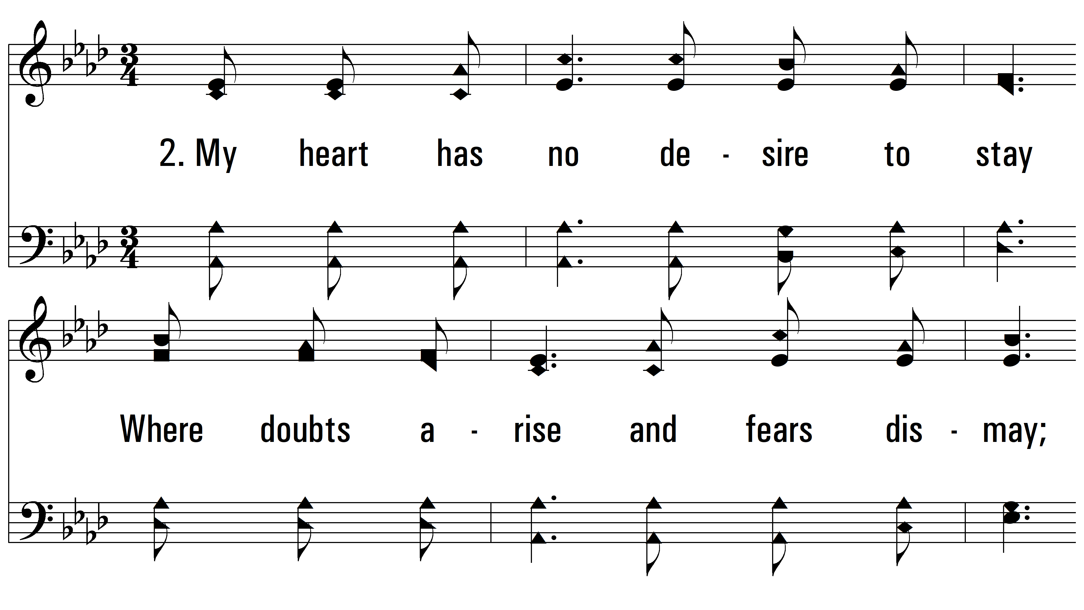
vs. 2 ~ Higher Ground

Slide 7
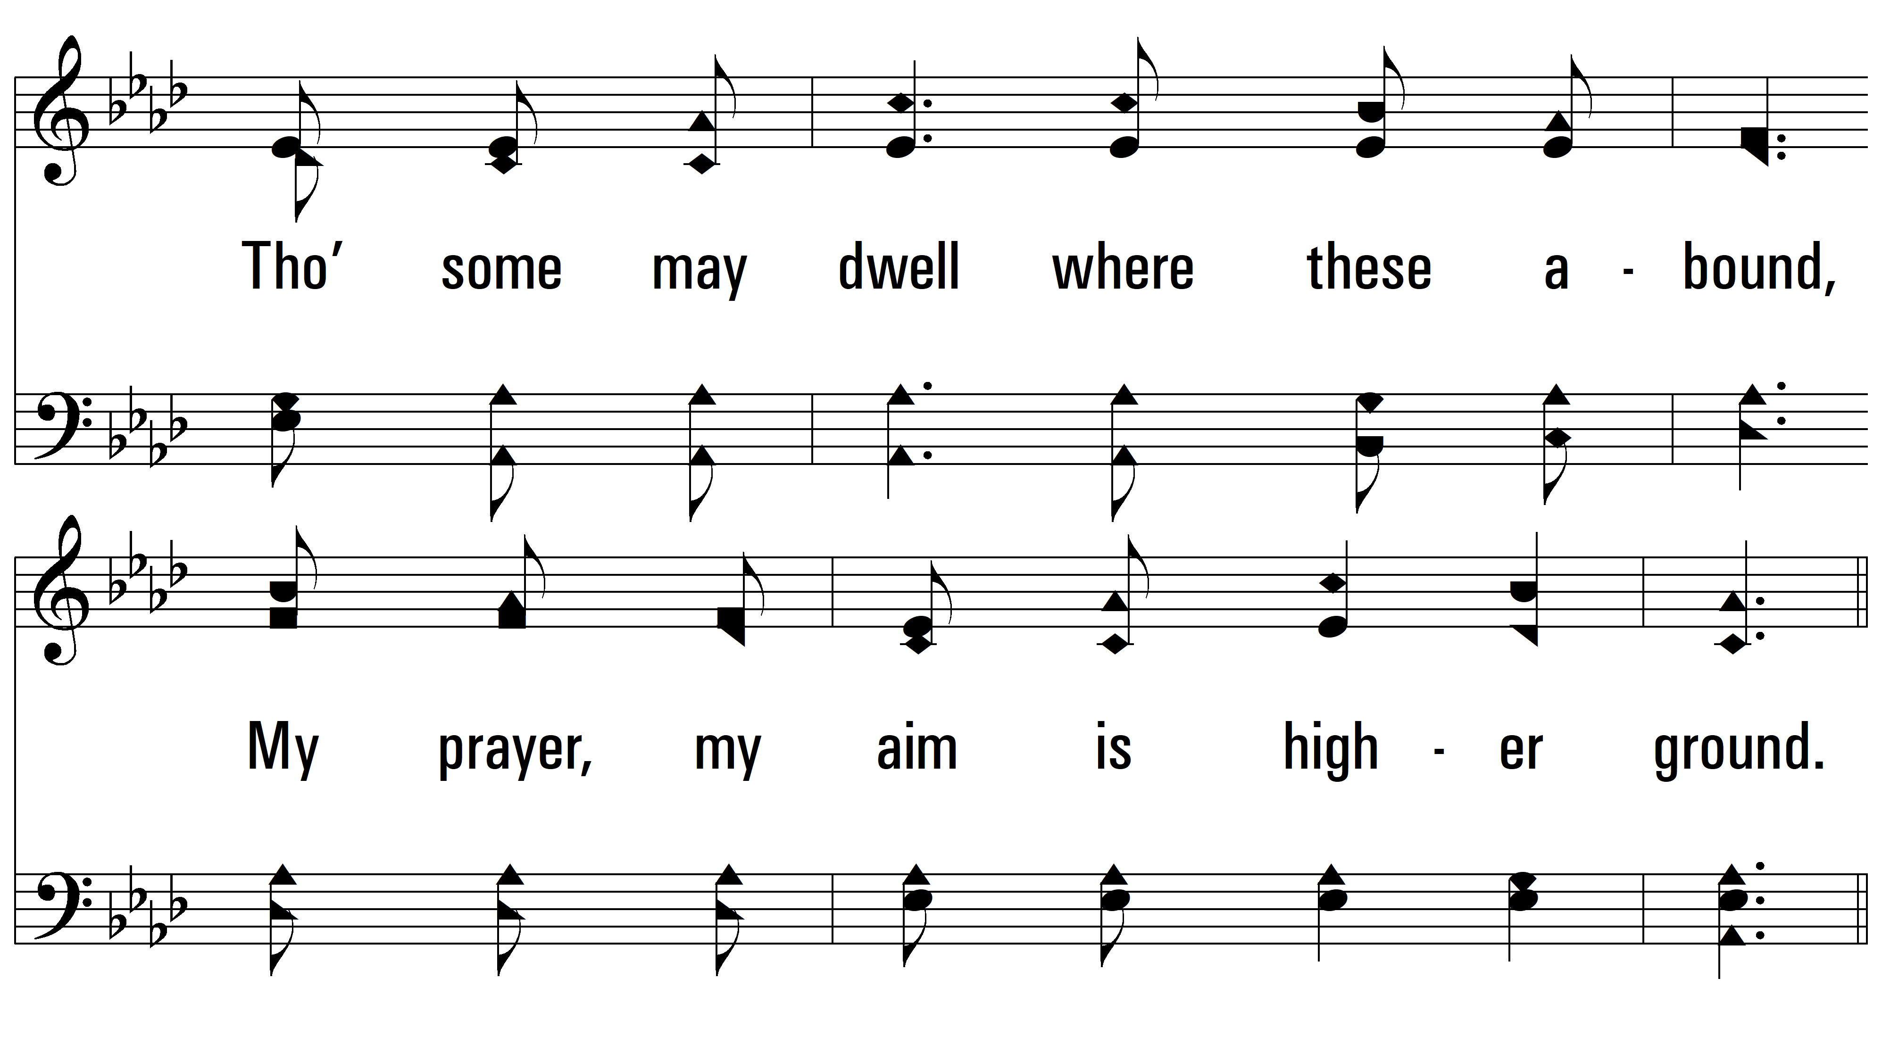
vs. 2

Slide 8
vs. 2

Slide 9
vs. 2

Slide 10
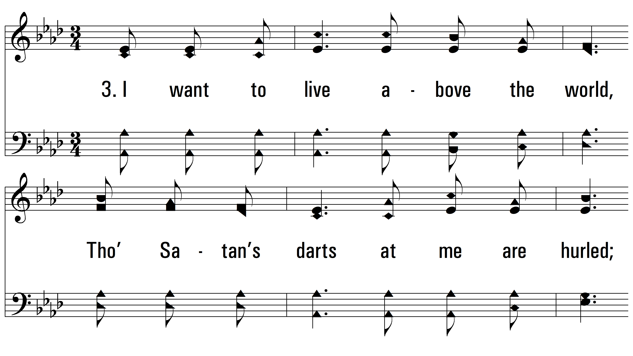
vs. 3 ~ Higher Ground

Slide 11
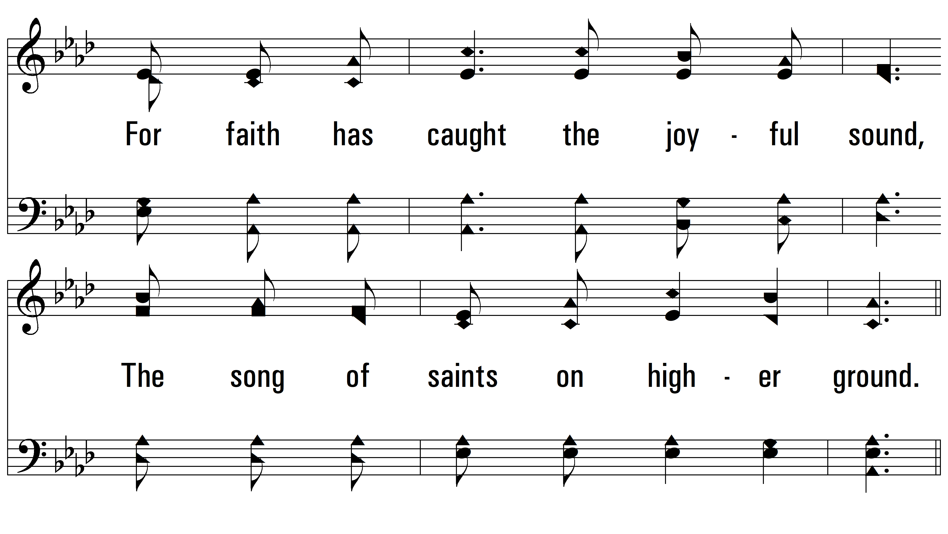
vs. 3

Slide 12
vs. 3

Slide 13
vs. 3

Slide 14
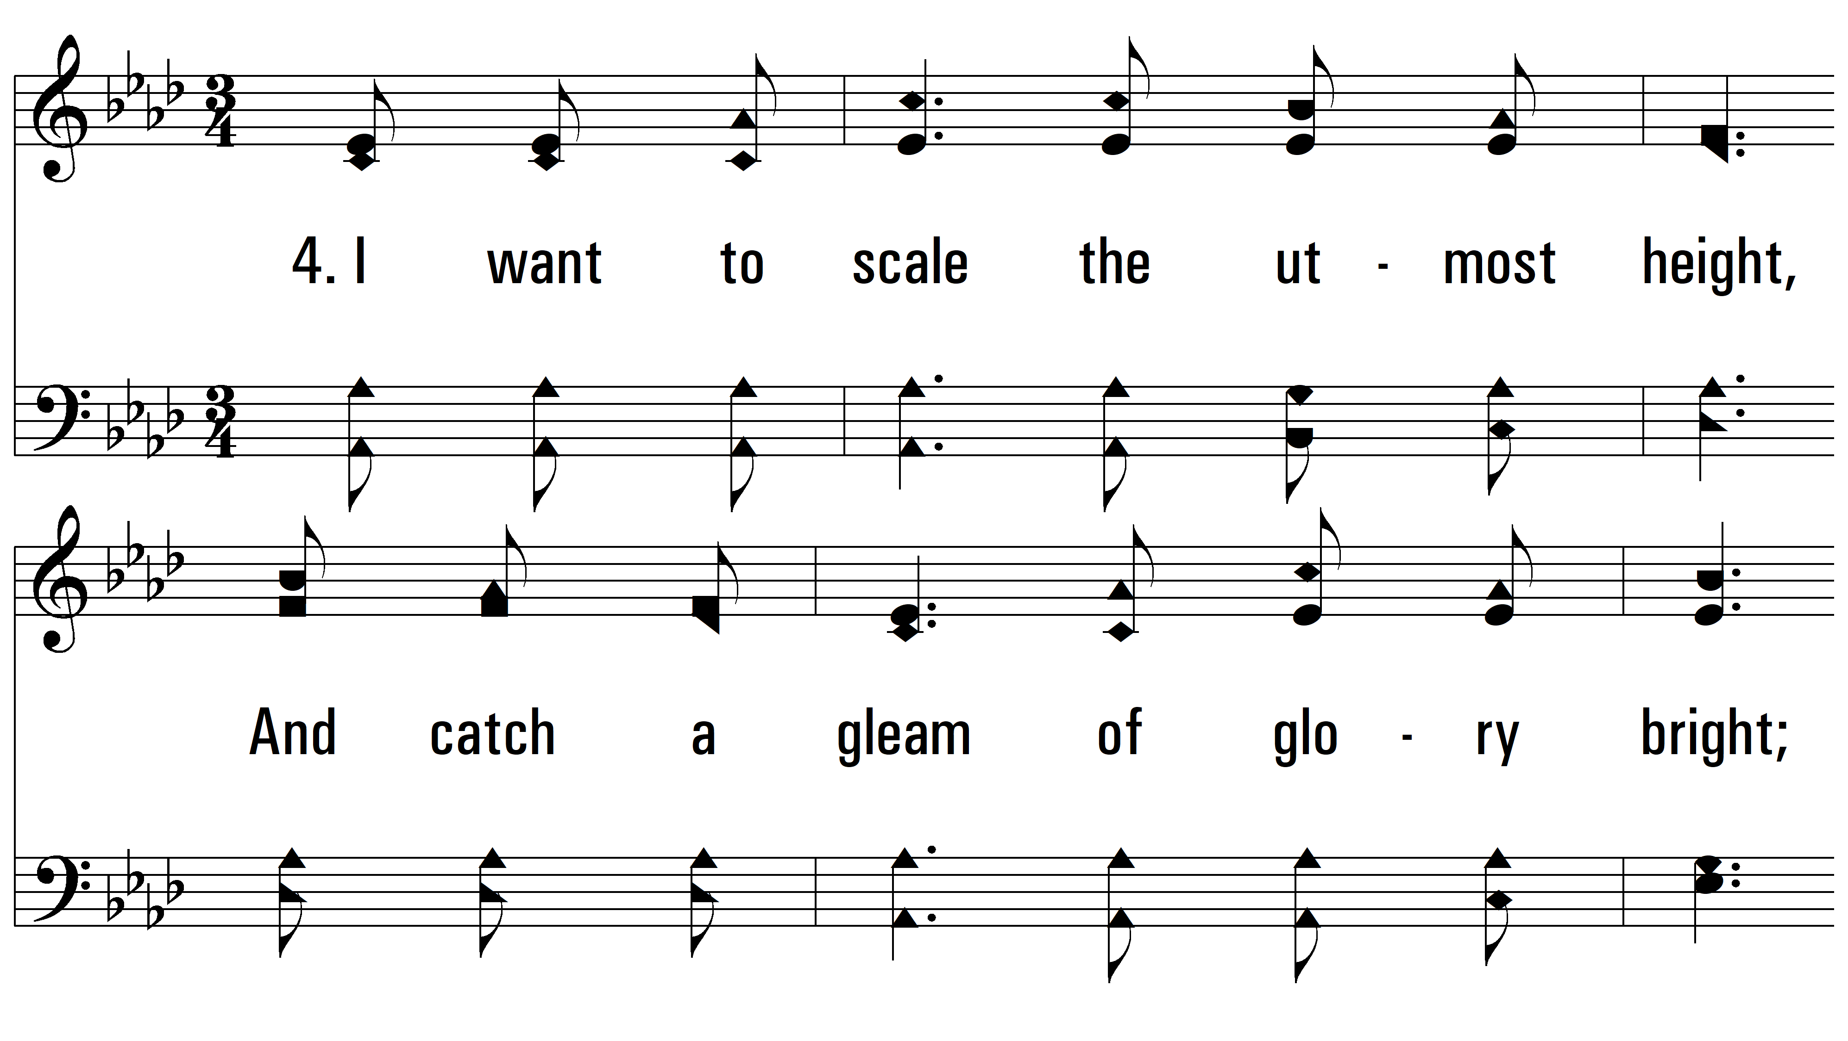
vs. 4 ~ Higher Ground

Slide 15
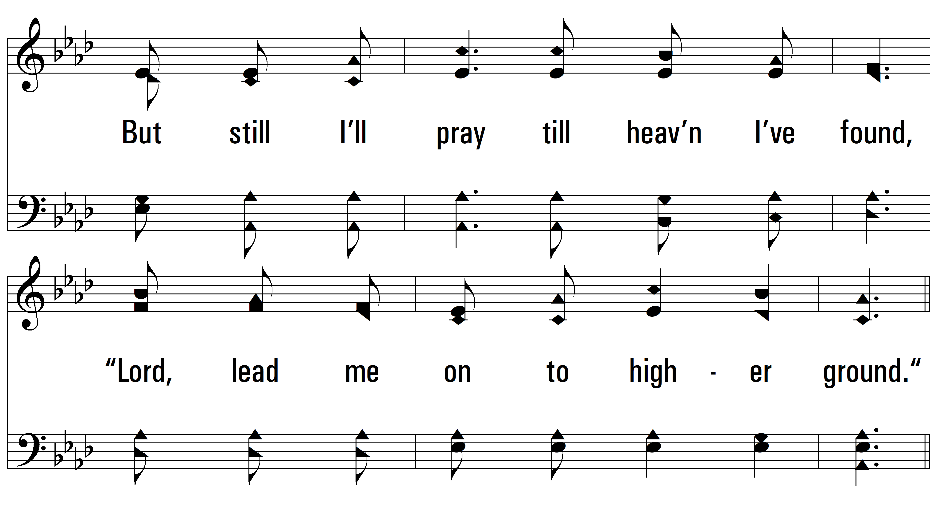
vs. 4

Slide 16
vs. 4

Slide 17
vs. 4
PDHymns.com
END

