Slide 1
Here We Are But Straying Pilgrims
Words: | I. N. Carmen (1854)
Music: | W. O. Perkins (1854)
4/4
G/G - DO
Verses: 3/Chorus
Lead - | DO
Alto - | SOL
Tenor - | MI
Bass - | DO
PDHymns.com

Slide 2
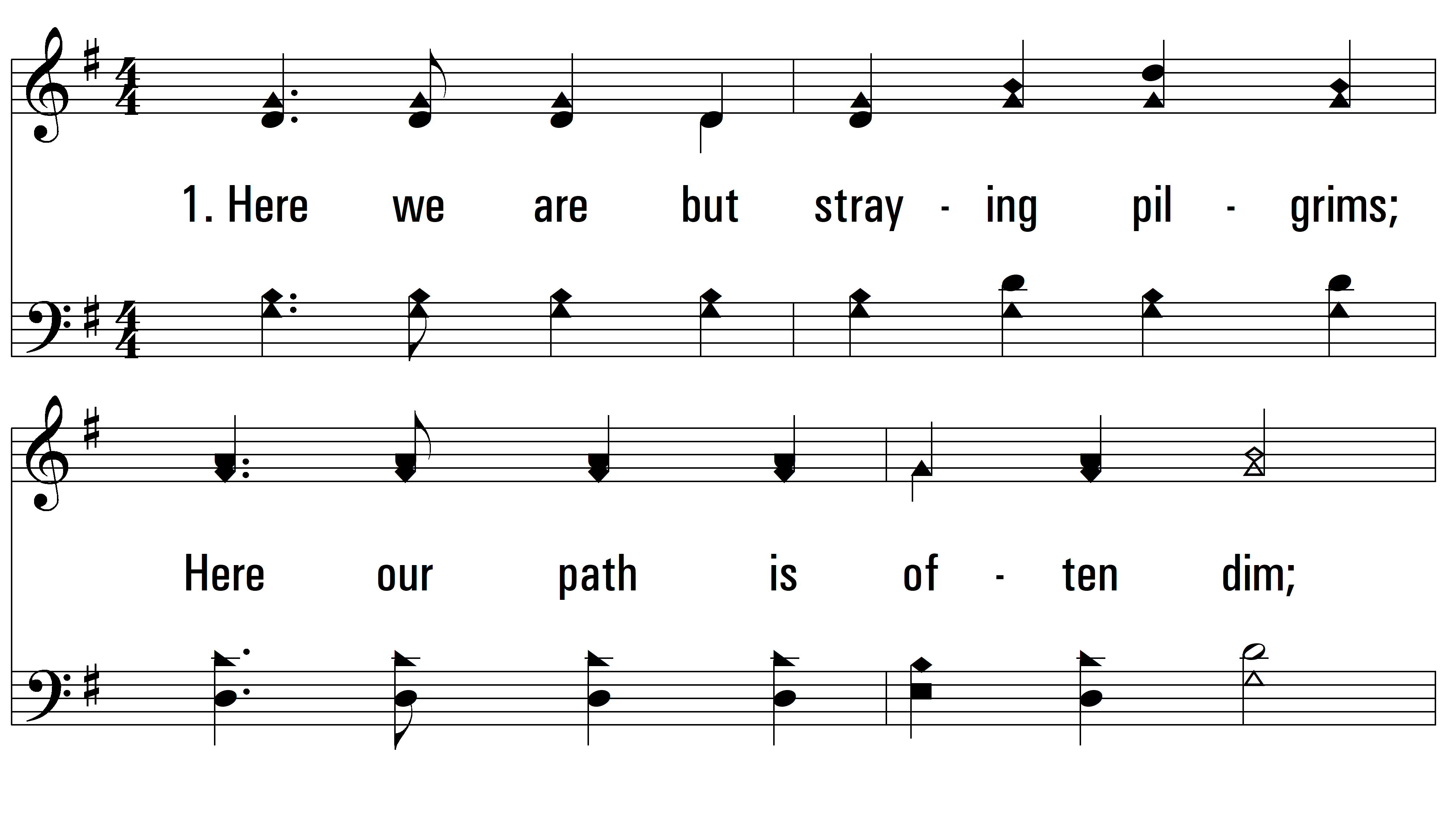
vs. 1 ~ Here We Are But Straying Pilgrims

Slide 3
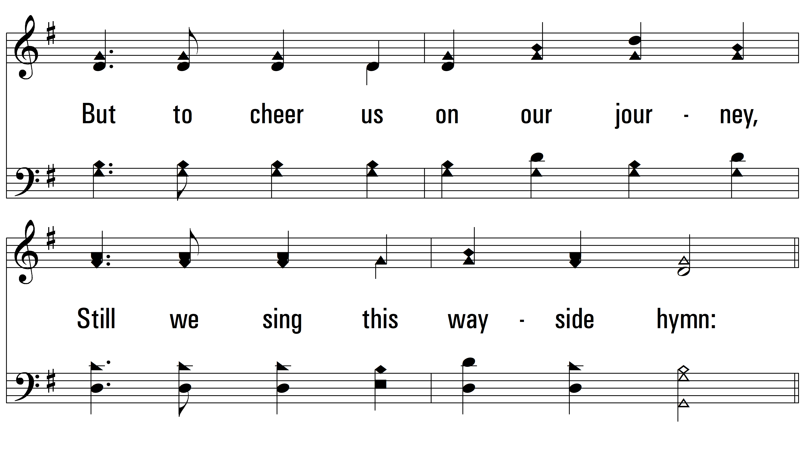
vs. 1

Slide 4
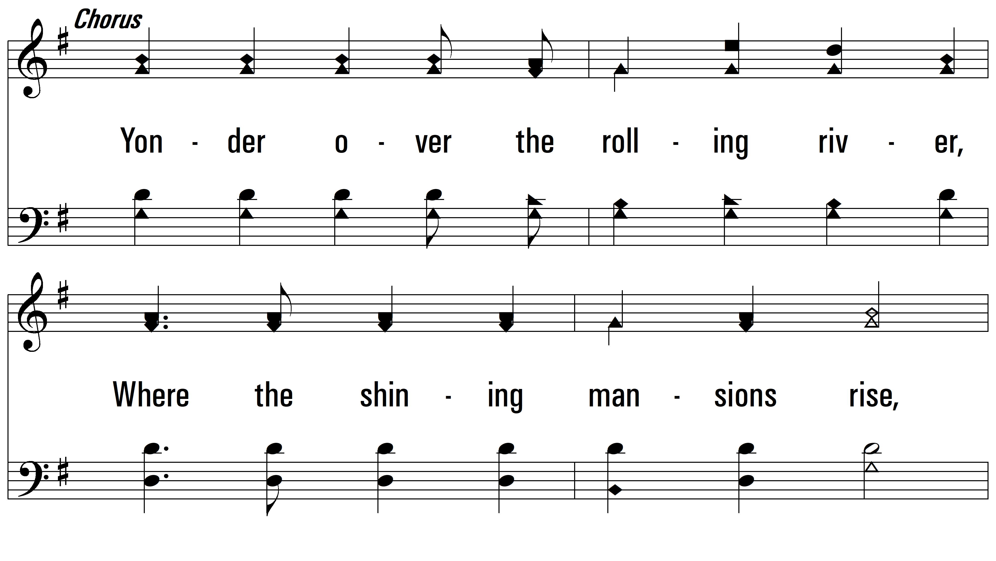
vs. 1

Slide 5
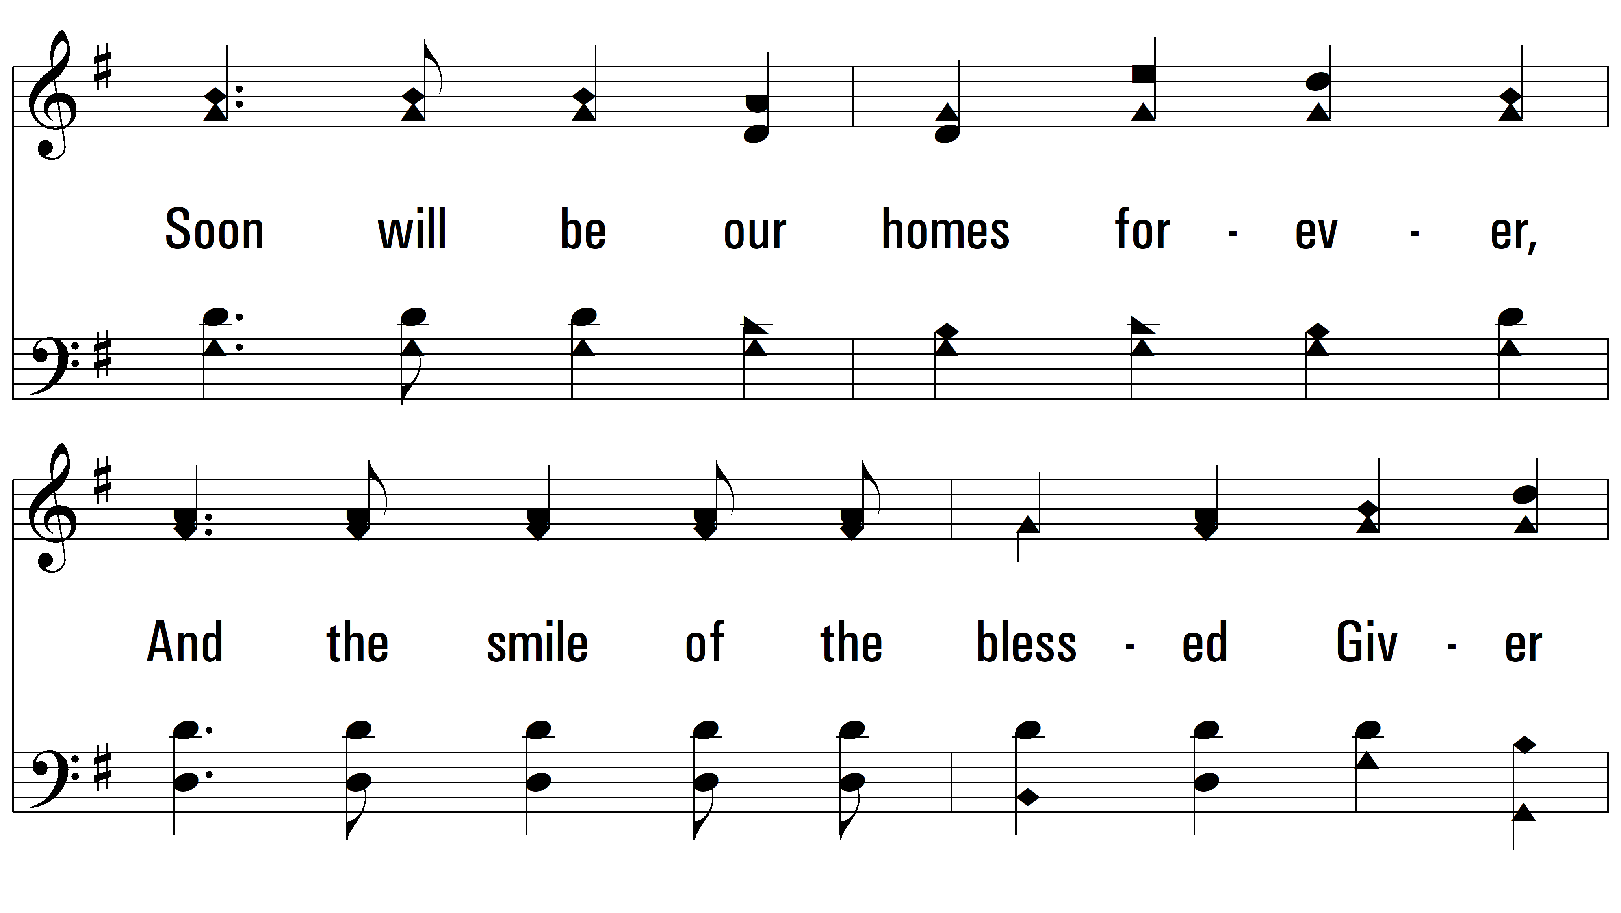
vs. 1

Slide 6
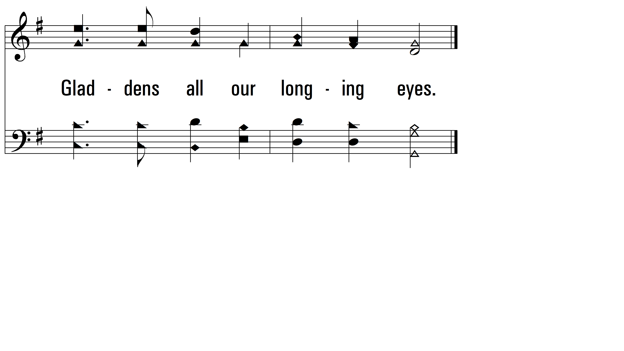
vs. 1

Slide 7
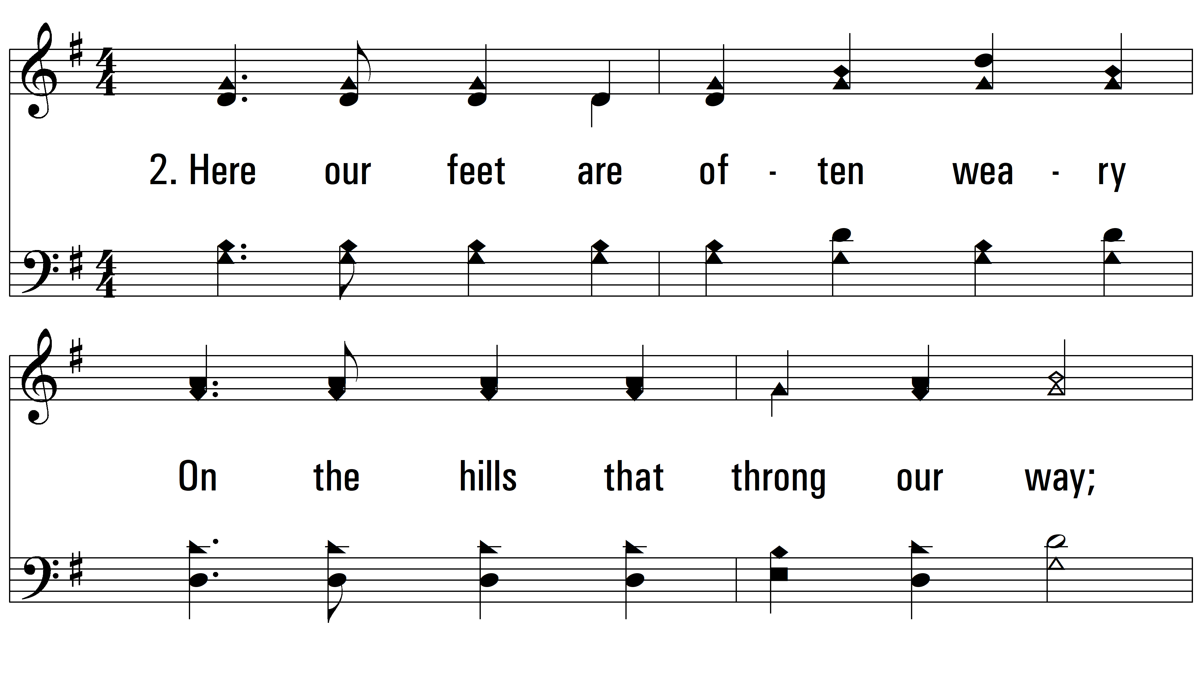
vs. 2 ~ Here We Are But Straying Pilgrims

Slide 8
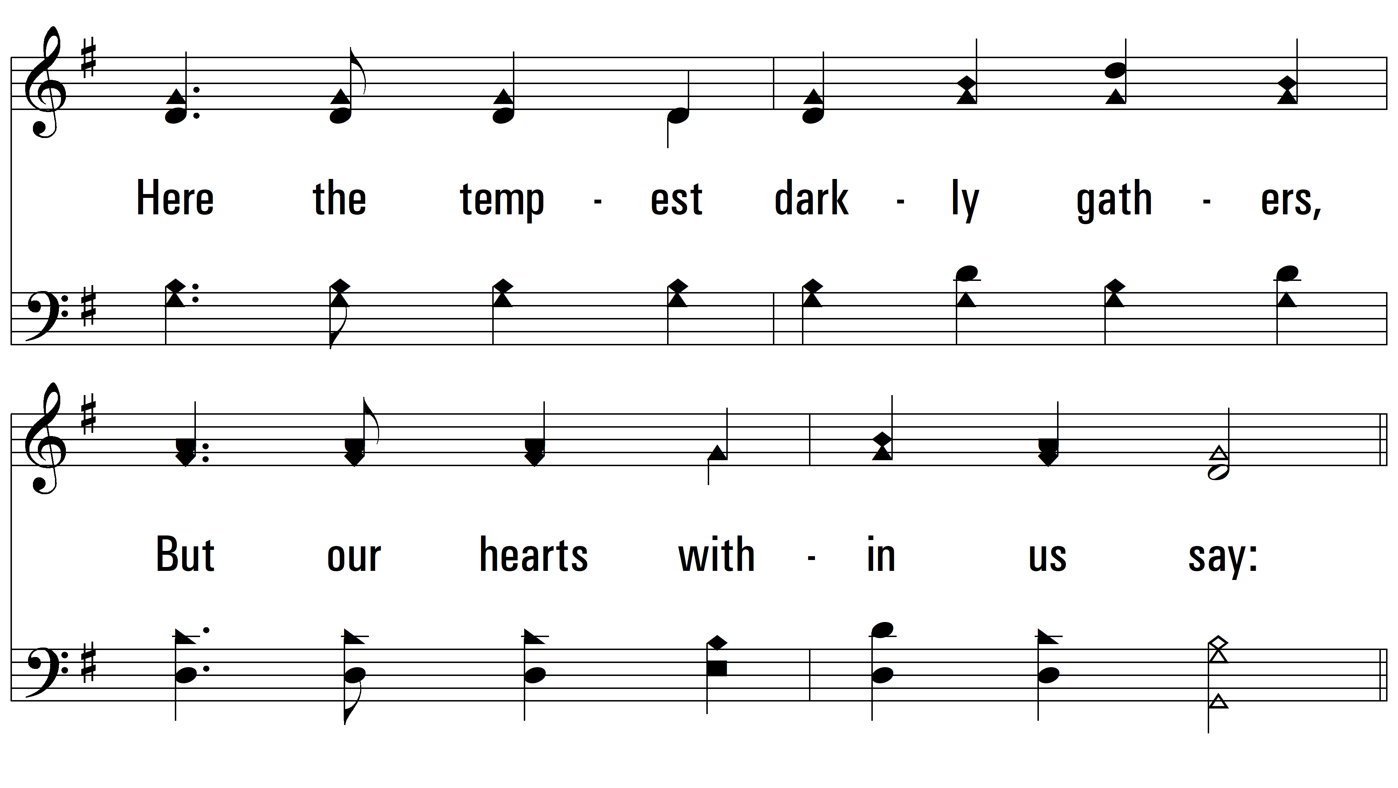
vs. 2

Slide 9
vs. 2

Slide 10
vs. 2

Slide 11
vs. 2

Slide 12
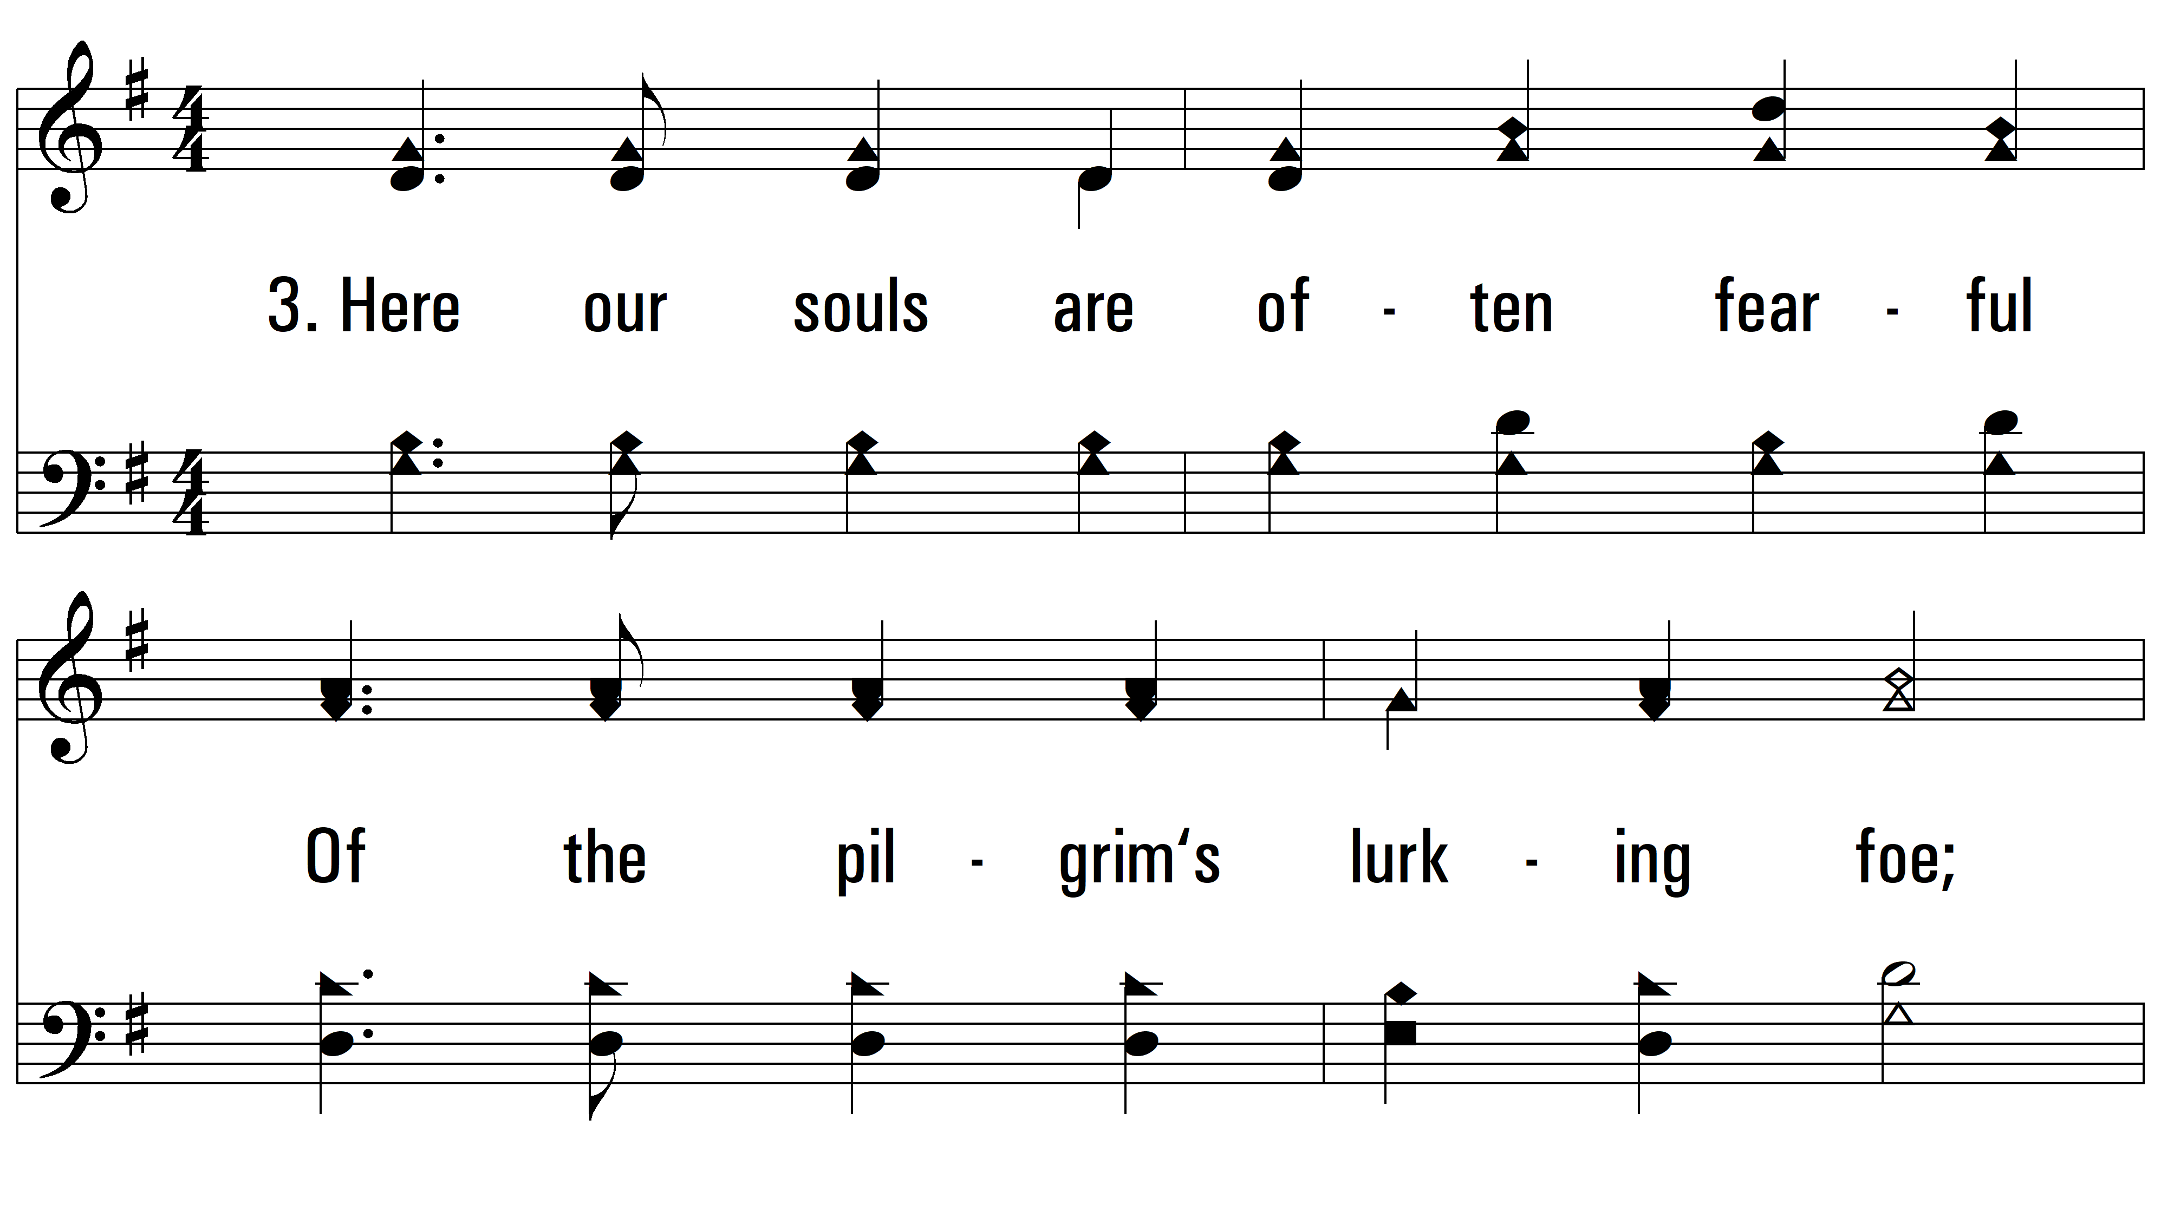
vs. 3 ~ Here We Are But Straying Pilgrims

Slide 13
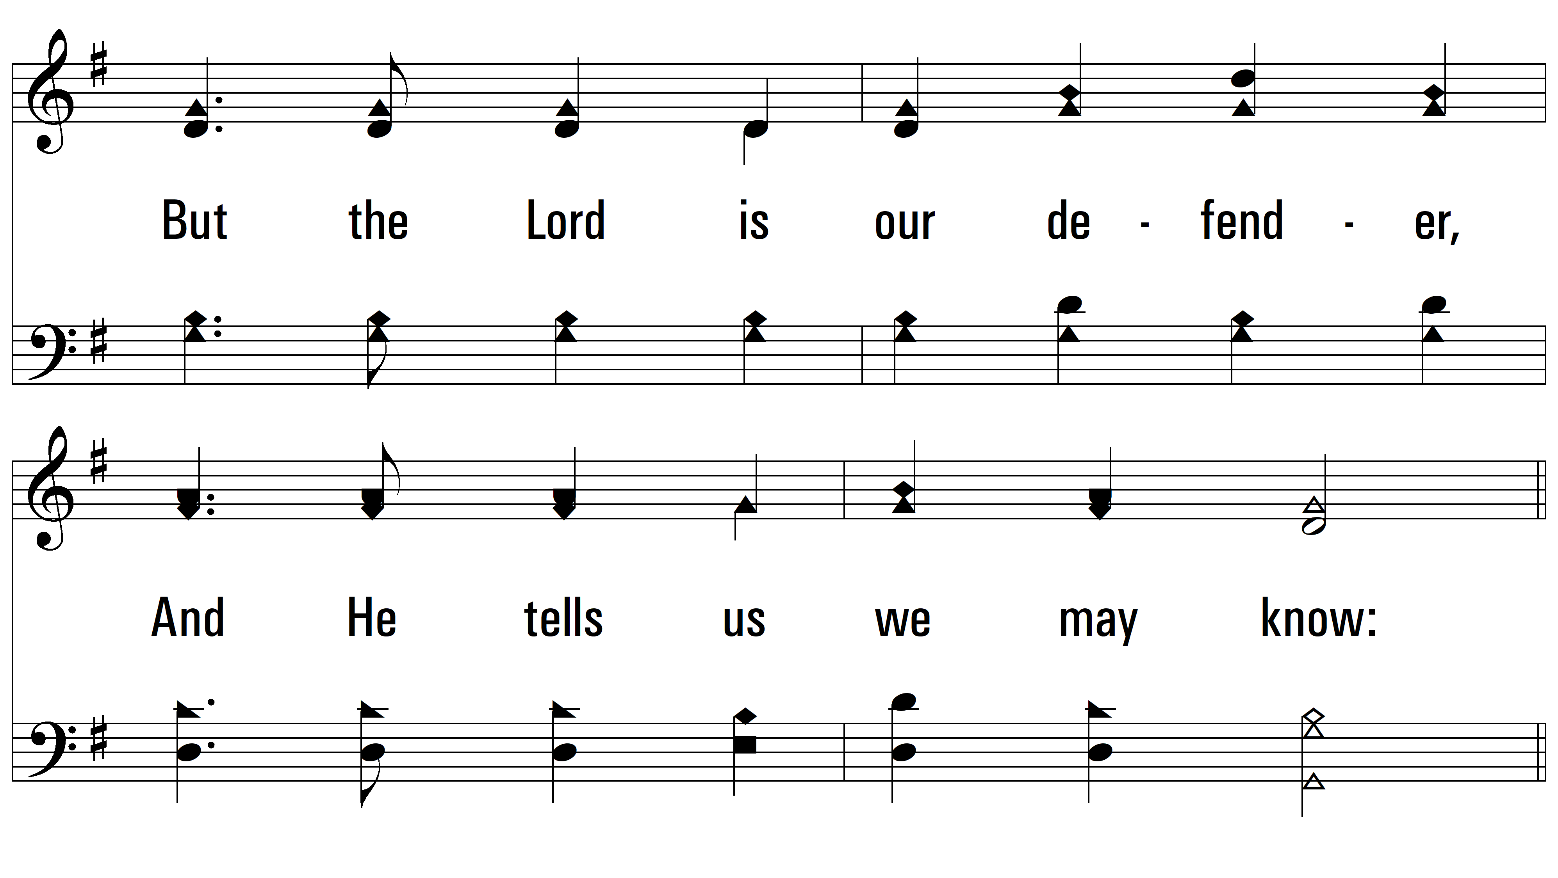
vs. 3

Slide 14
vs. 3

Slide 15
vs. 3

Slide 16
vs. 3
PDHymns.com
END

