Slide 1
Heavenly Father, We Appreciate You
Words: | Traditional
Music: | Traditional
9/8
B^{b}/D - MI
Verses: 3
Lead - | MI
Alto - | MI
Tenor - | SOL
Bass - | DO
PDHymns.com

Slide 2
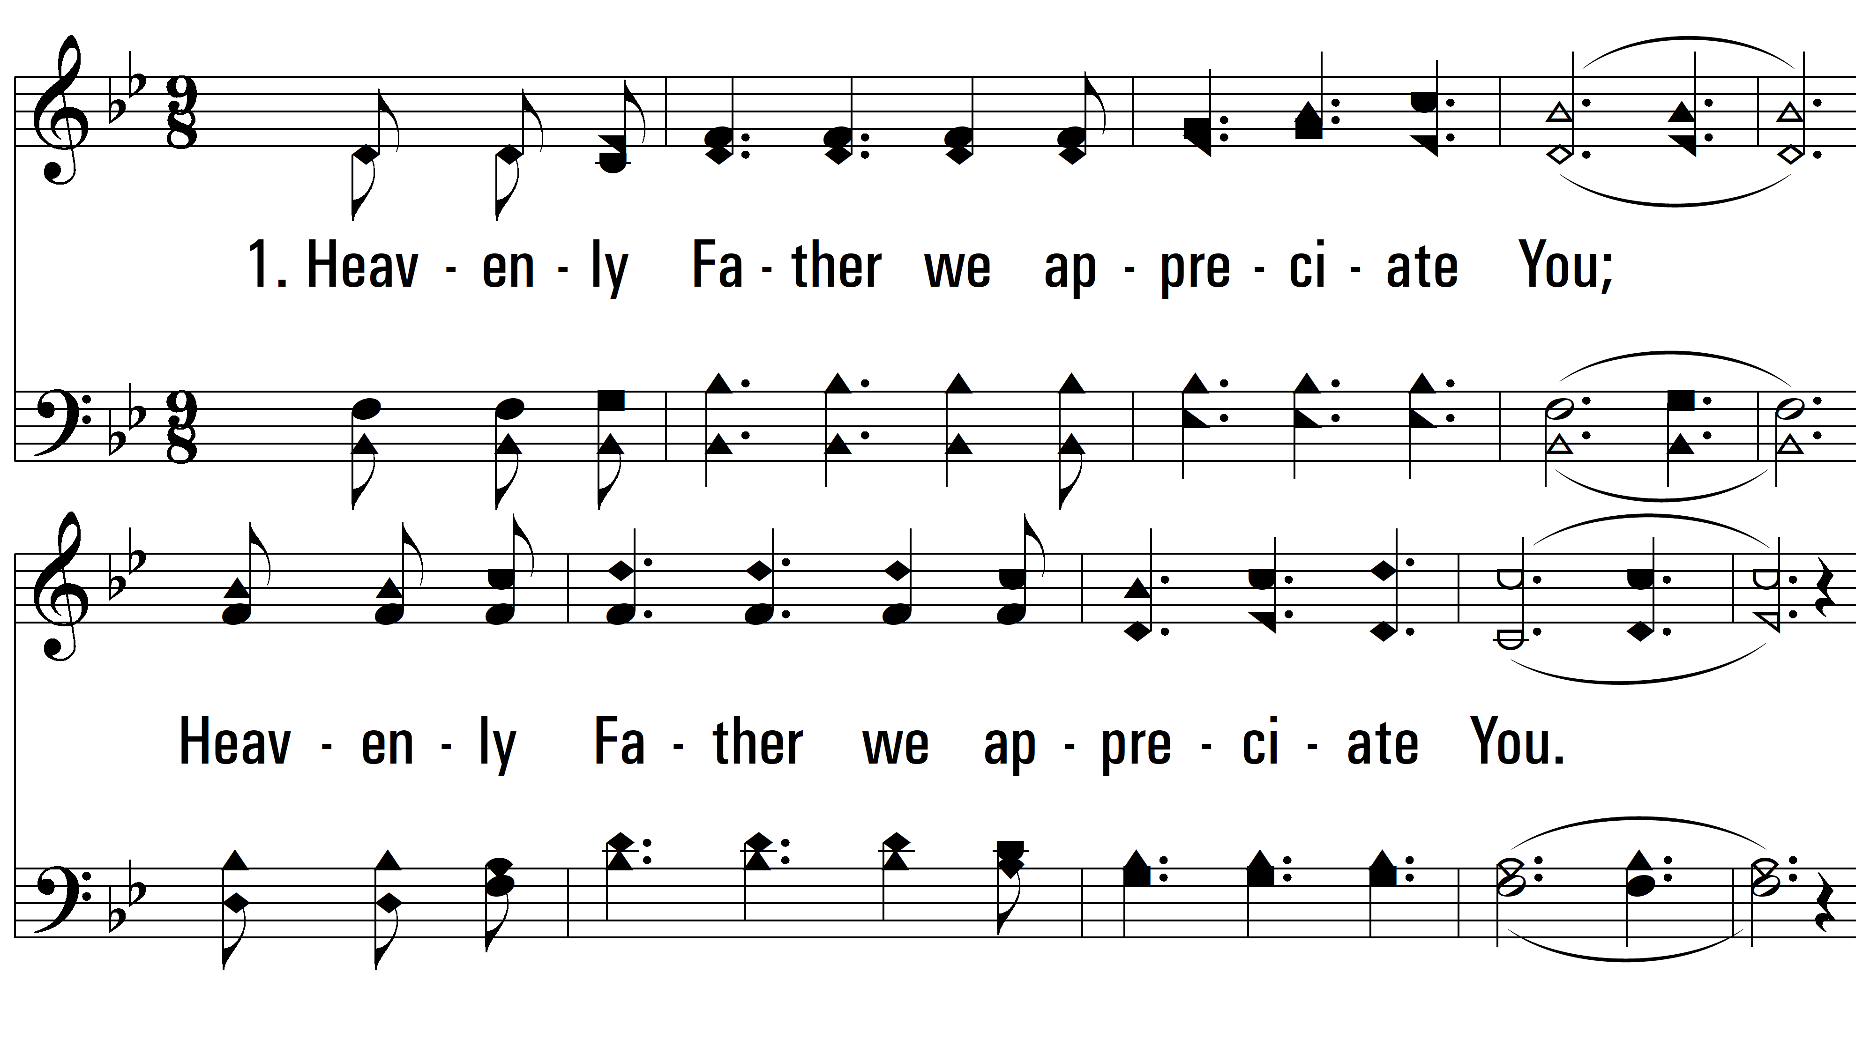
vs. 1 ~ Heavenly Father, We Appreciate You

Slide 3
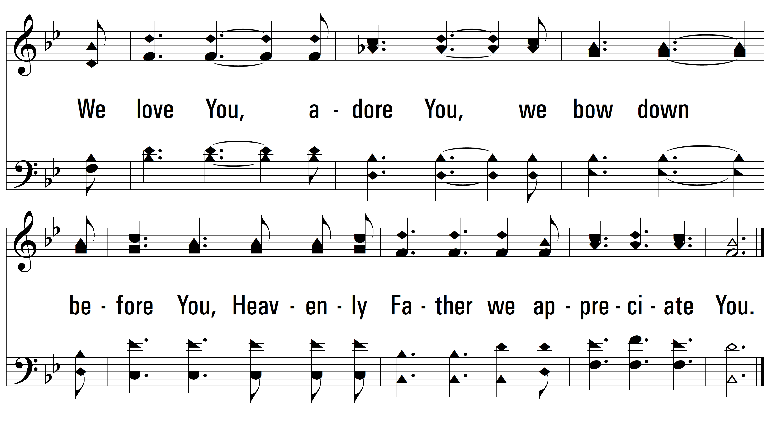
vs. 1

Slide 4
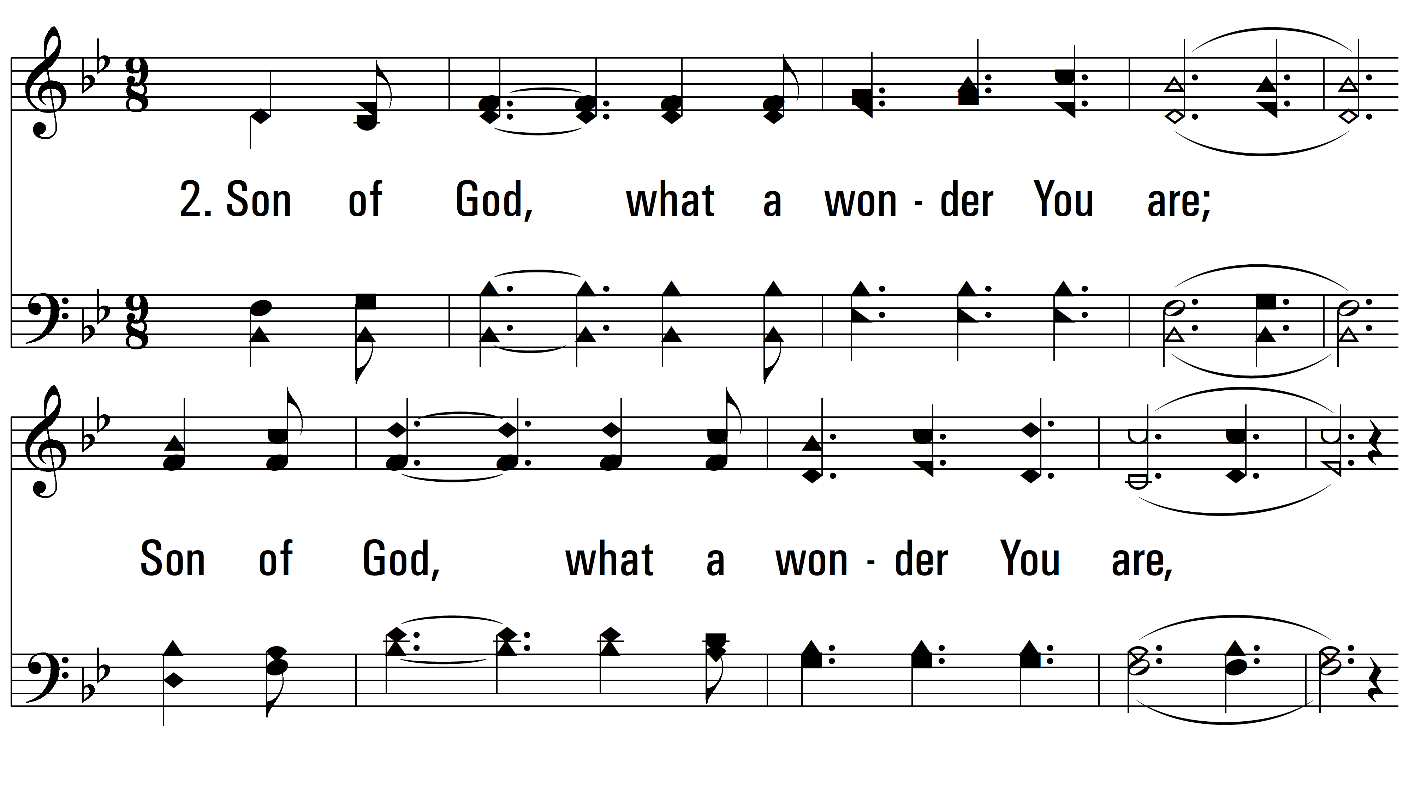
vs. 2 ~ Heavenly Father, We Appreciate You

Slide 5
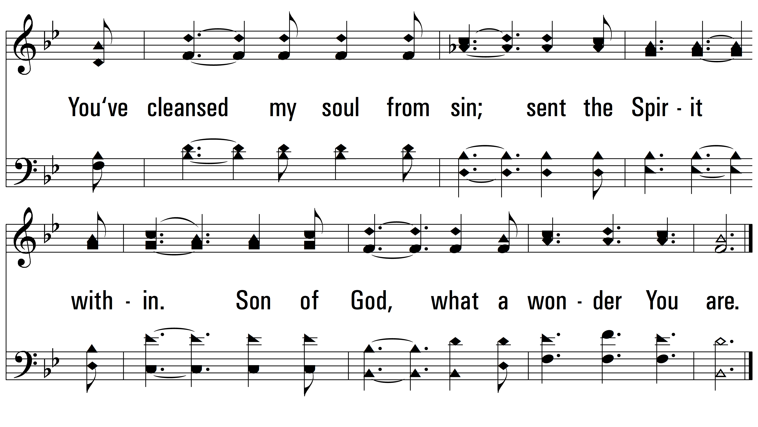
vs. 2

Slide 6
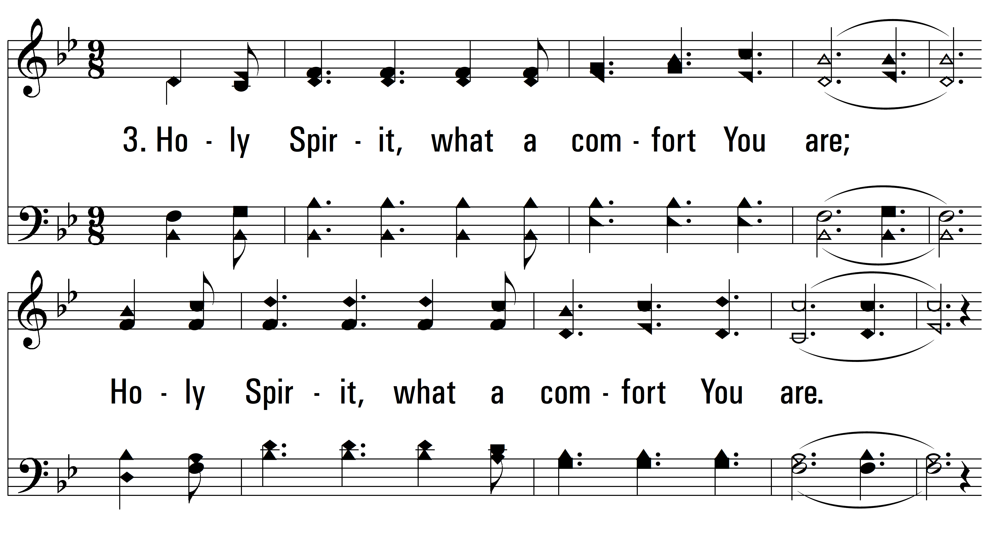
vs. 3 ~ Heavenly Father, We Appreciate You

Slide 7
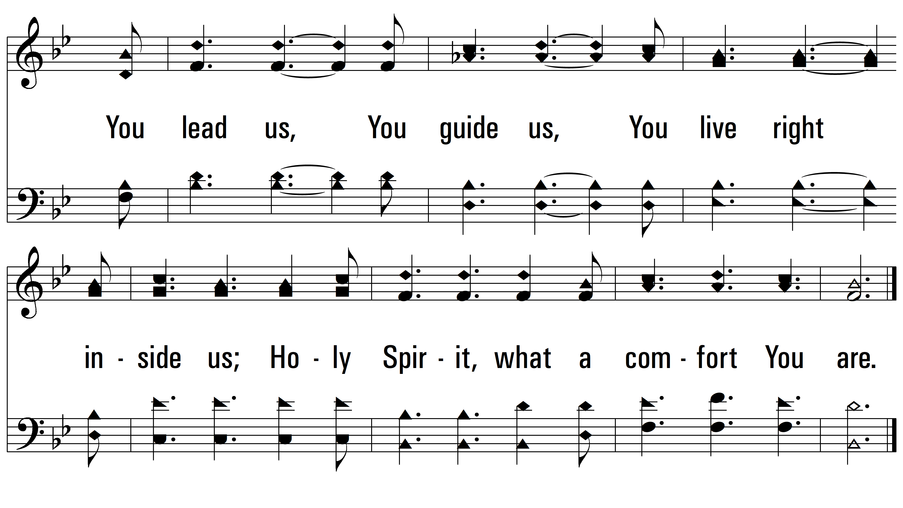
vs. 3
PDHymns.com
END

