Slide 1
He Loves Me
Words: | Isaac Watts (1707), Ref. Ralph E. hudson (1885)
Music: | Showalter’s Song-Land Messenger No. 2 (1898), Arr. by L. O. Sanderson (1948)
4/4
G/D - SOL
Verses: 5/Chorus
Lead - | SOL
Alto - | DO
Tenor - | MI
Bass - | DO
PDHymns.com

Slide 2
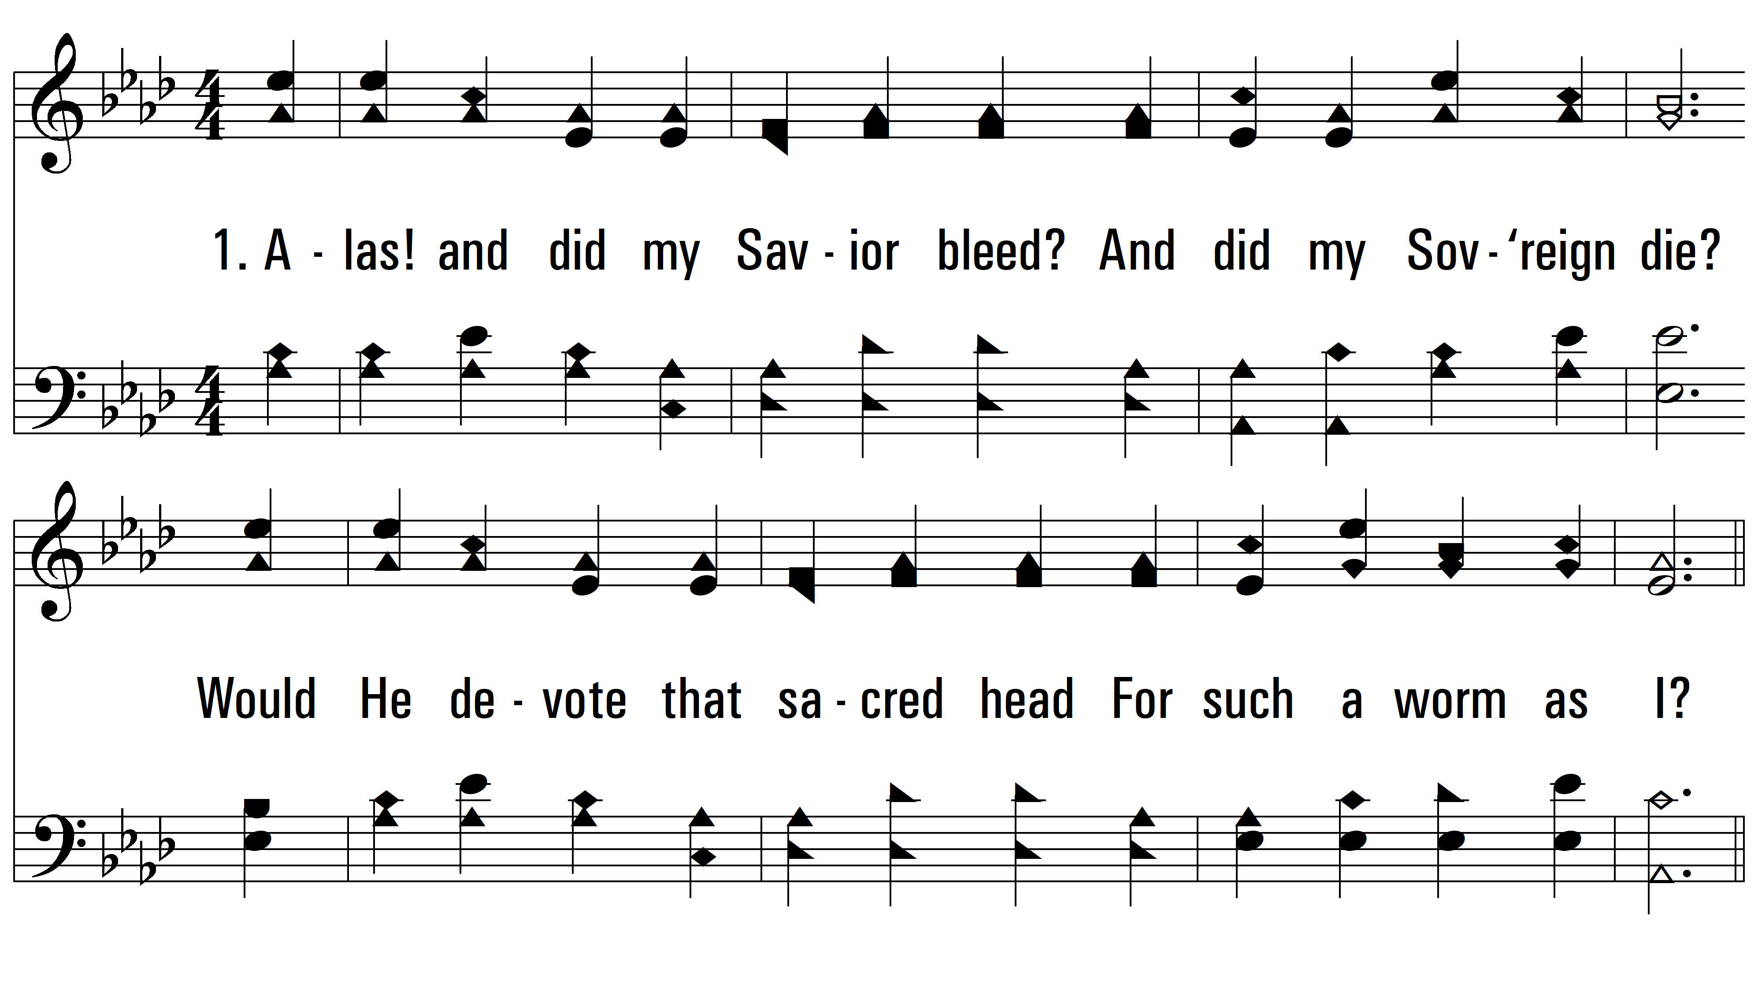
vs. 1 ~ He Loves Me

Slide 3
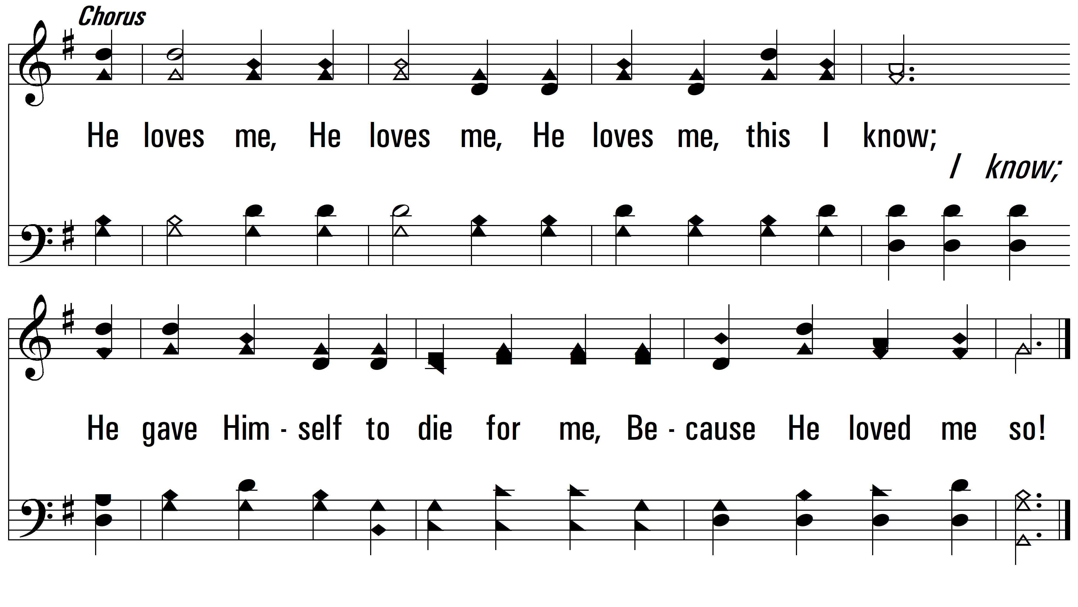
vs. 1

Slide 4
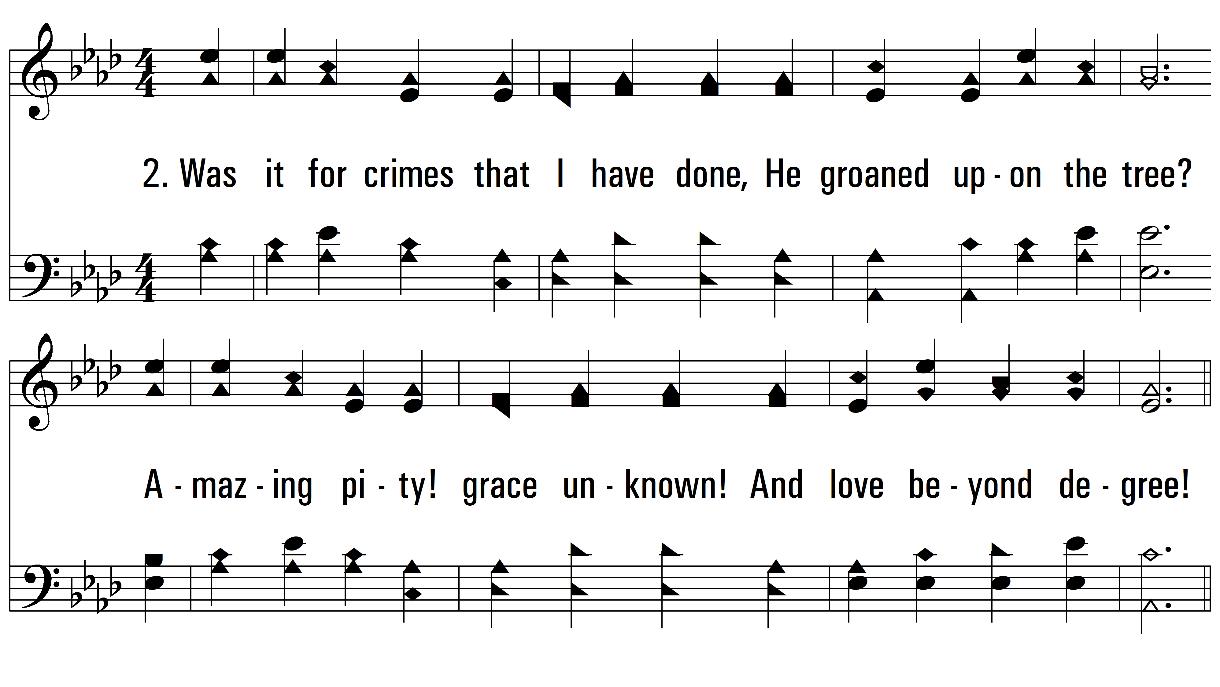
vs. 2 ~ He Loves Me

Slide 5
vs. 2

Slide 6
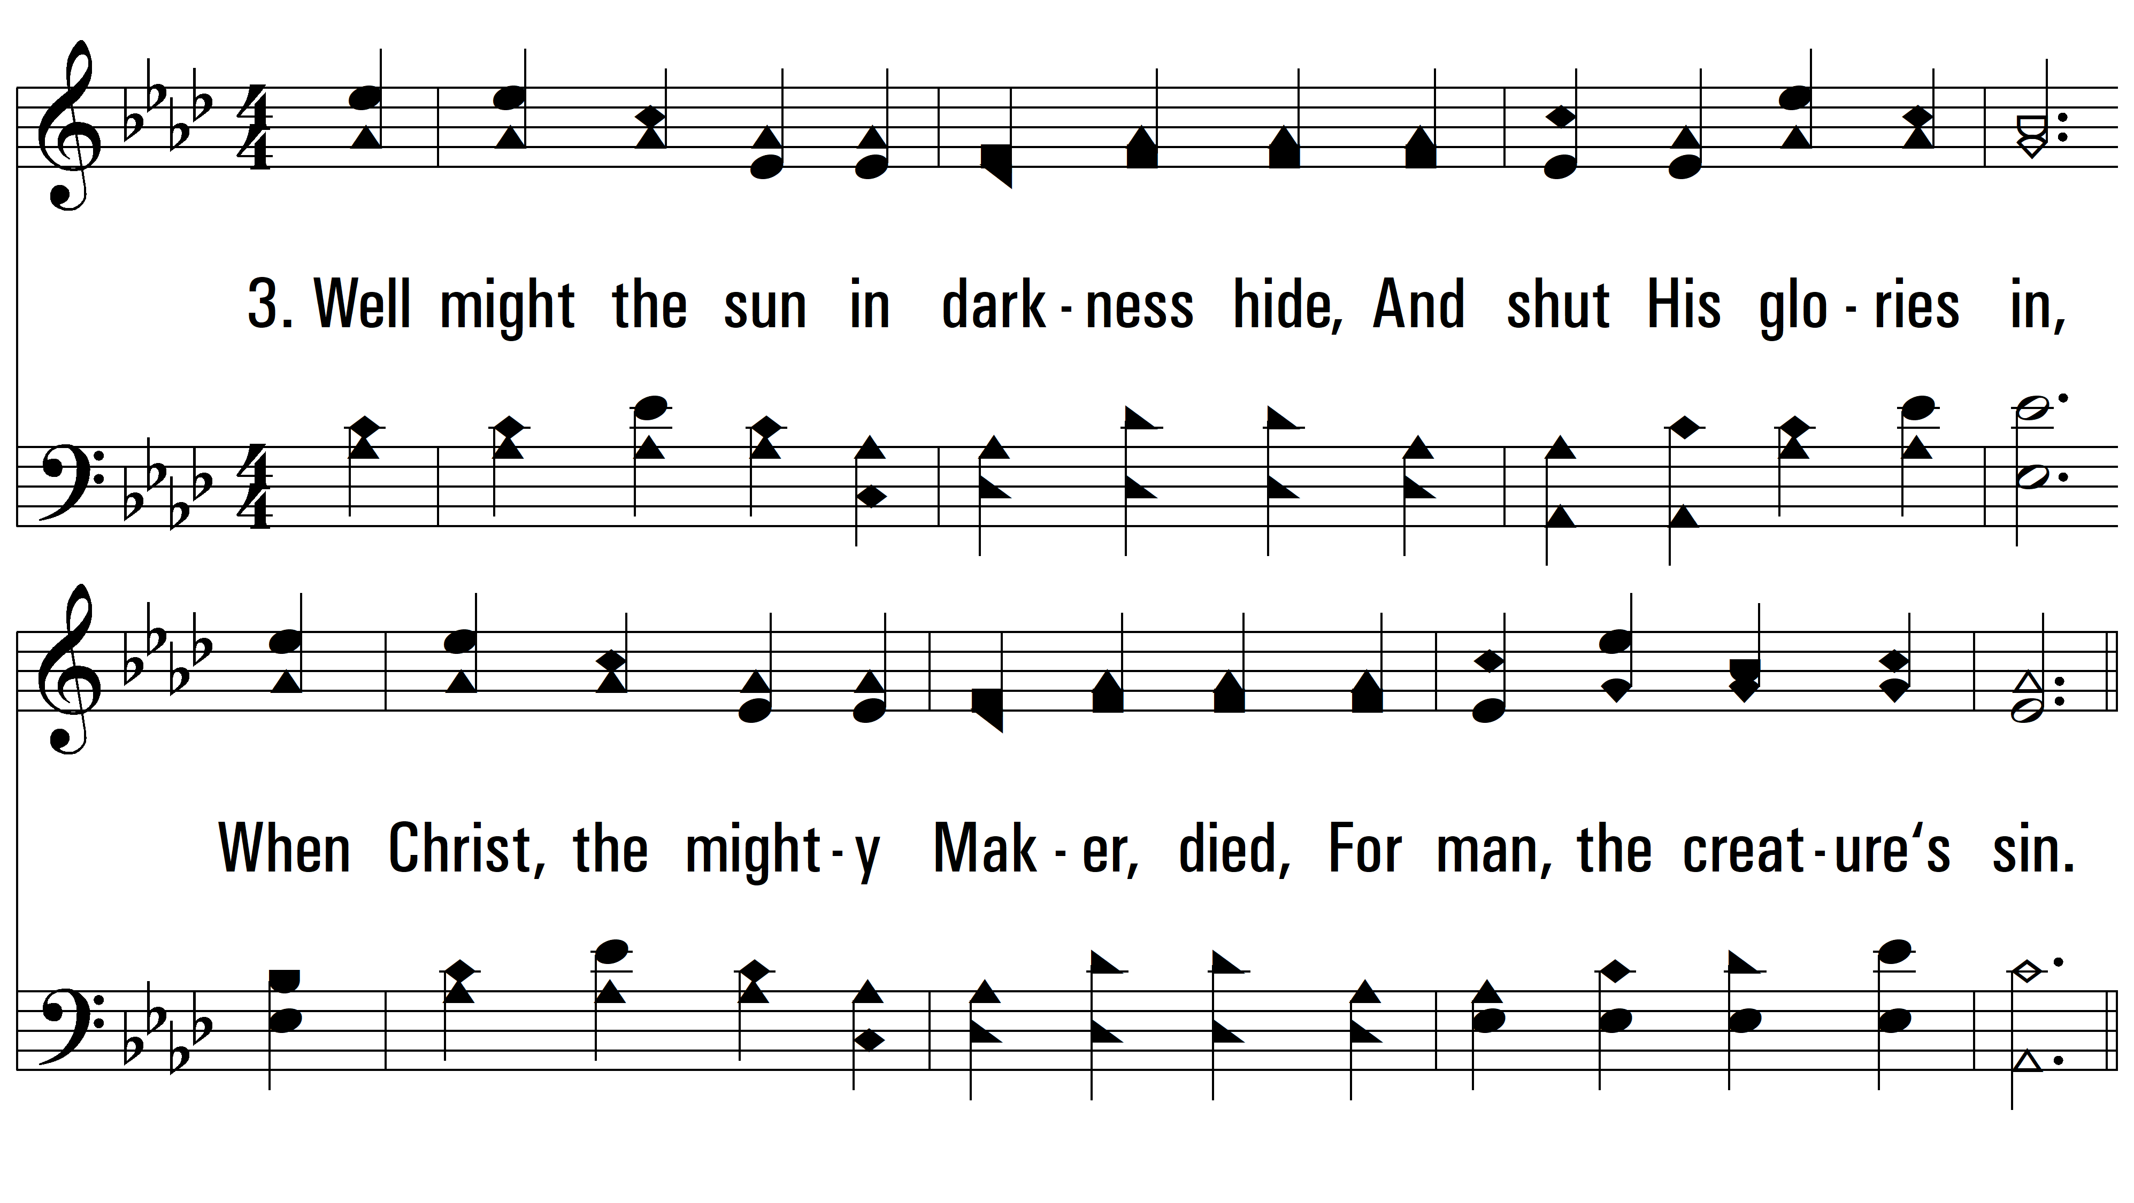
vs. 3 ~ He Loves Me

Slide 7
vs. 3

Slide 8
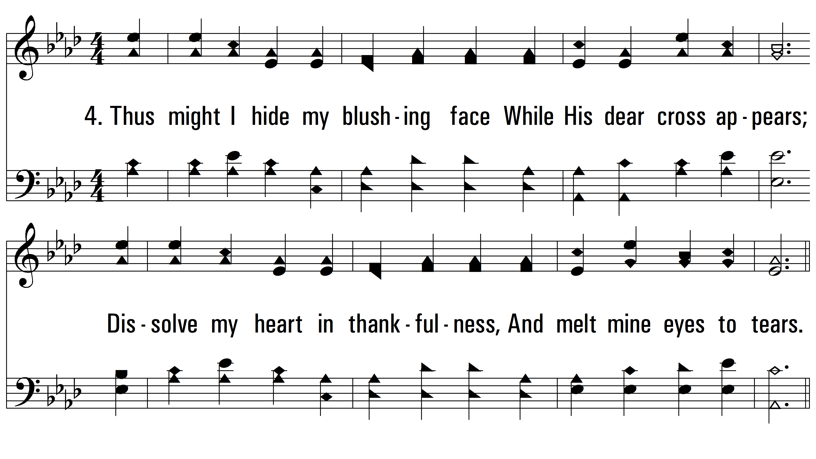
vs. 4 ~ He Loves Me

Slide 9
vs. 4

Slide 10
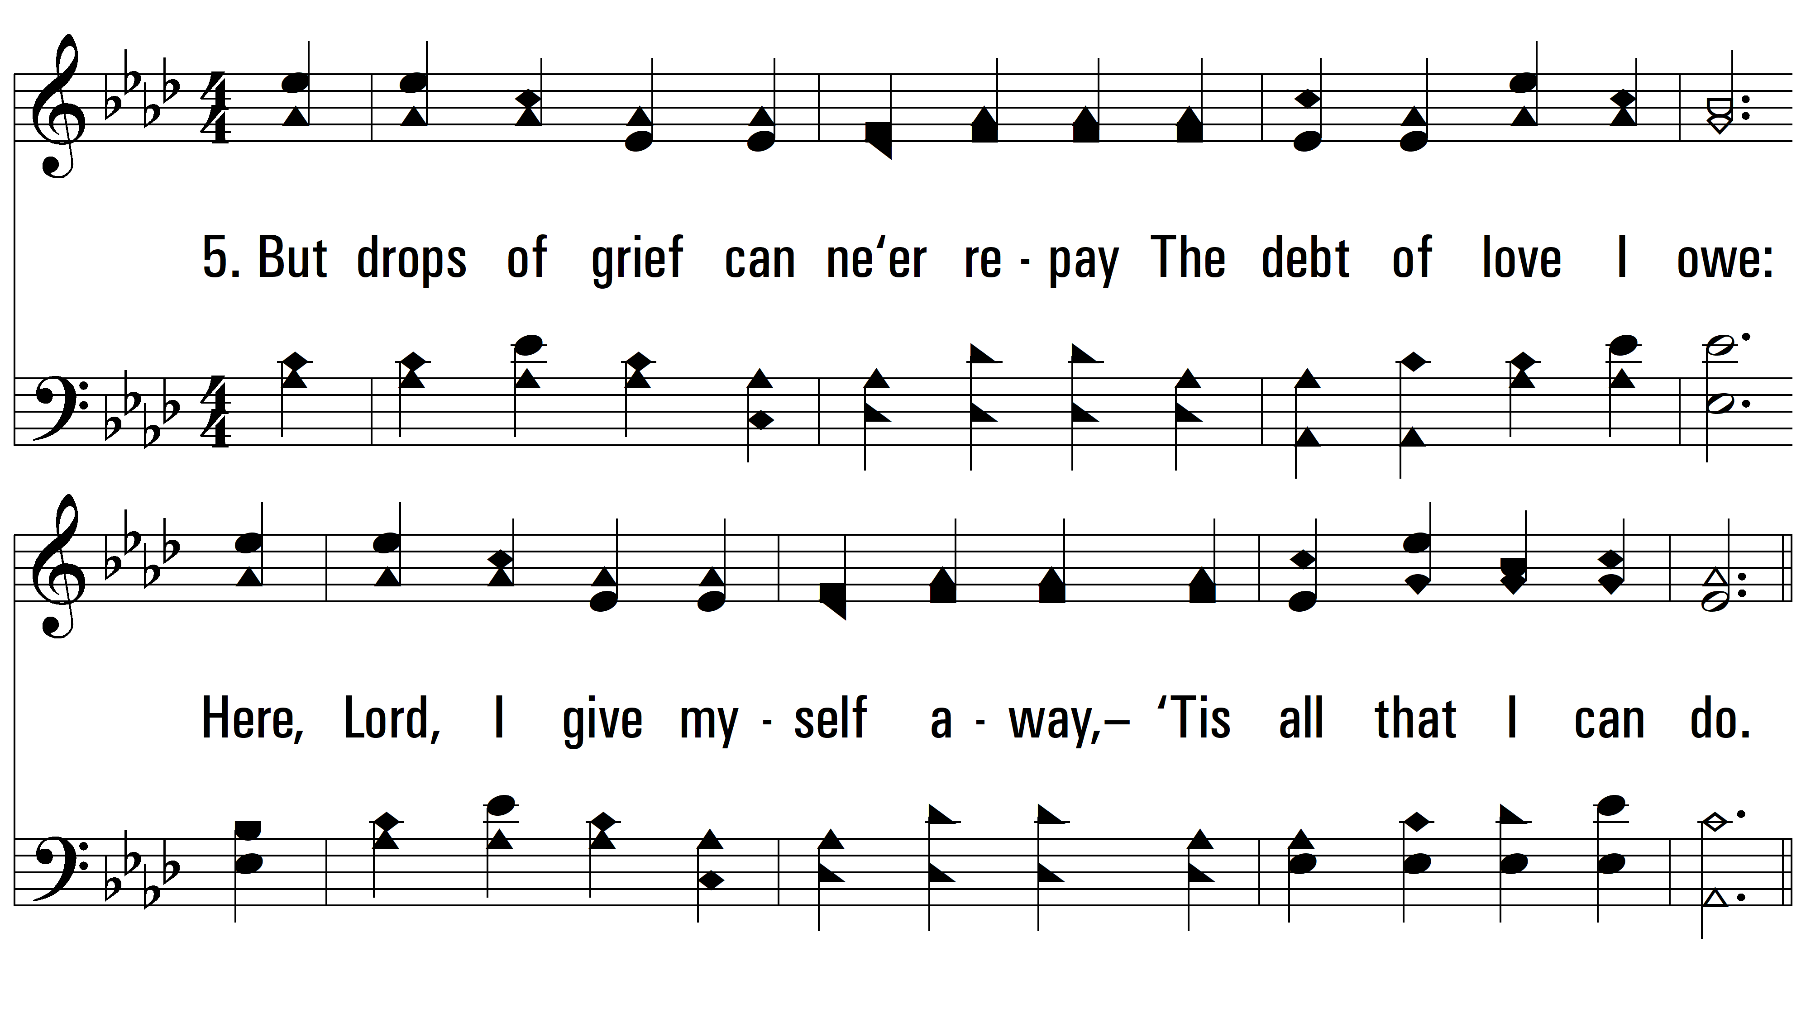
vs. 5 ~ He Loves Me

Slide 11
vs. 5
PDHymns.com
END

