Slide 1
He Loves Me
Words: | Arr. from Showalter’s Song-Land Messenger No. 2 (1898)
Music: | Arr. from Showalter’s Song-Land Messenger No. 2 (1898)
4/4
A^{b}/E^{b} - SOL
Verses: 3/Chorus
Lead - | SOL
Alto - | DO
Tenor - | MI
Bass - | DO
PDHymns.com

Slide 2
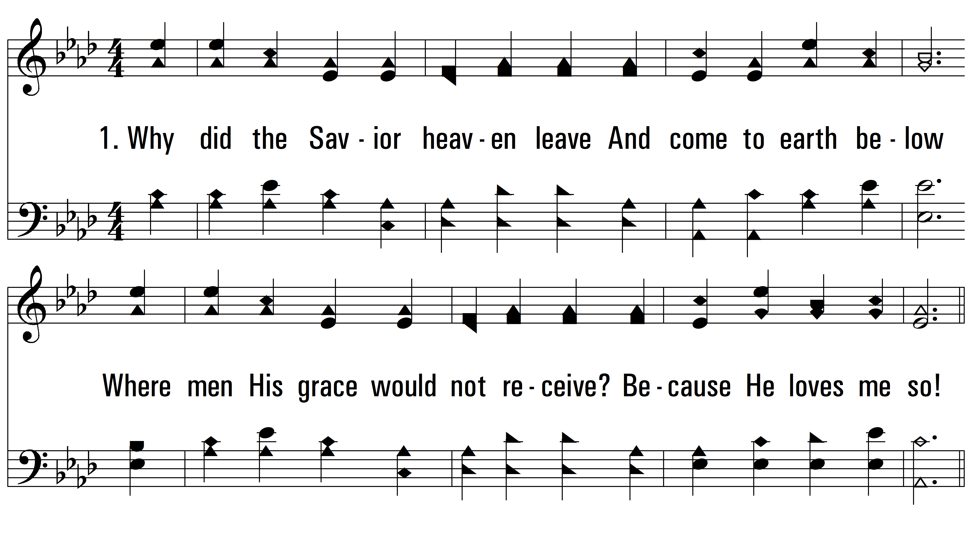
vs. 1 ~ He Loves Me

Slide 3
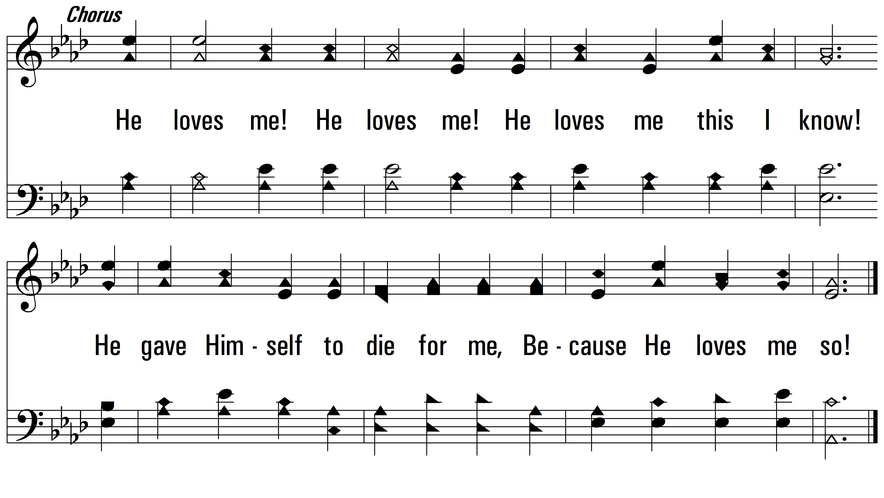
vs. 1

Slide 4
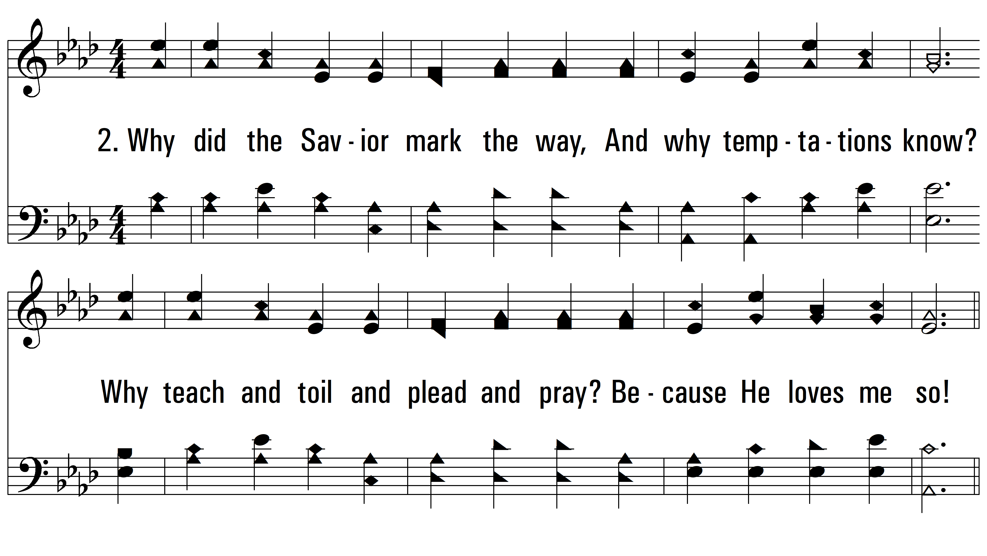
vs. 2 ~ He Loves Me

Slide 5
vs. 2

Slide 6
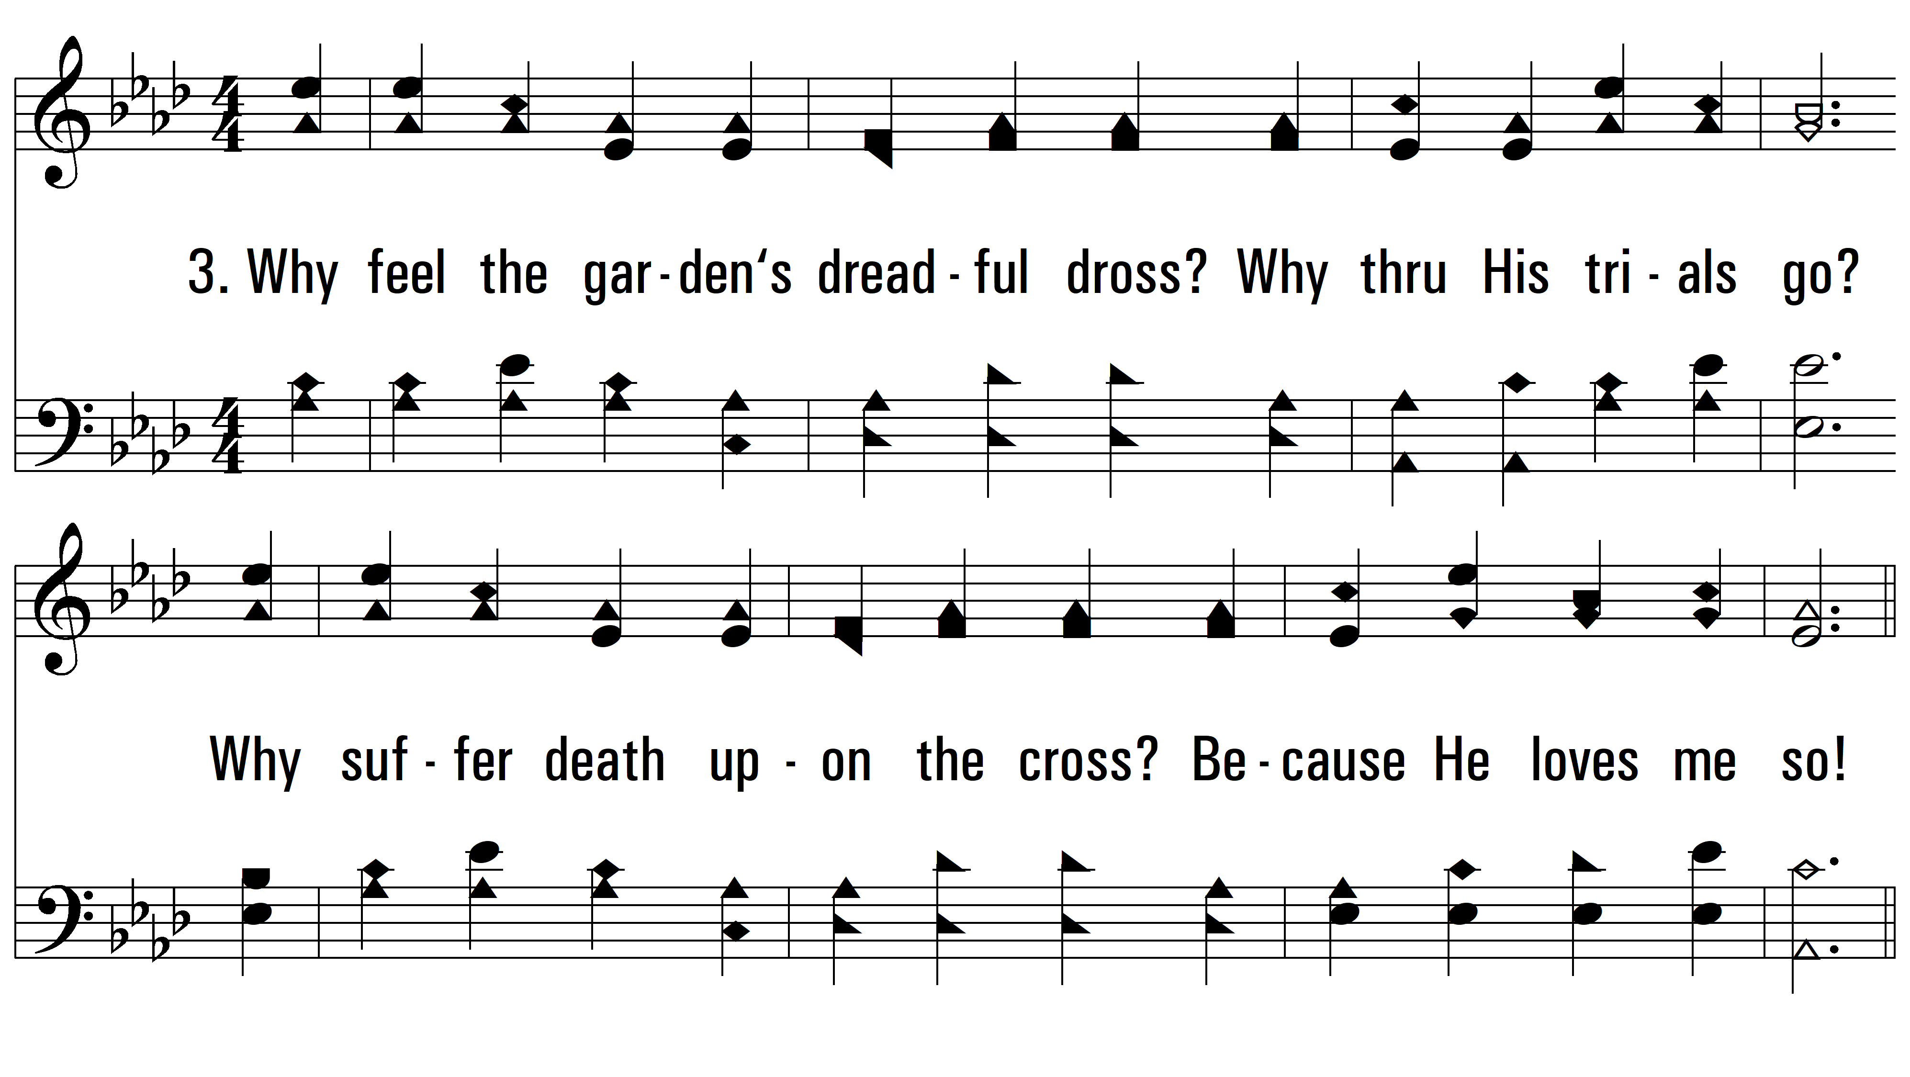
vs. 3 ~ He Loves Me

Slide 7
vs. 3
PDHymns.com
END

