Slide 1
He Keeps Me Singing
(There’s Within My Heart)
Words: | L. B. Bridges (1909)
Music: | L. B. Bridges (1909)
4/4
A^{b}/C - MI
Verses: 3/Chorus
Lead - | MI
Alto - | SOL
Tenor - | DO
Bass - | DO
PDHymns.com

Slide 2
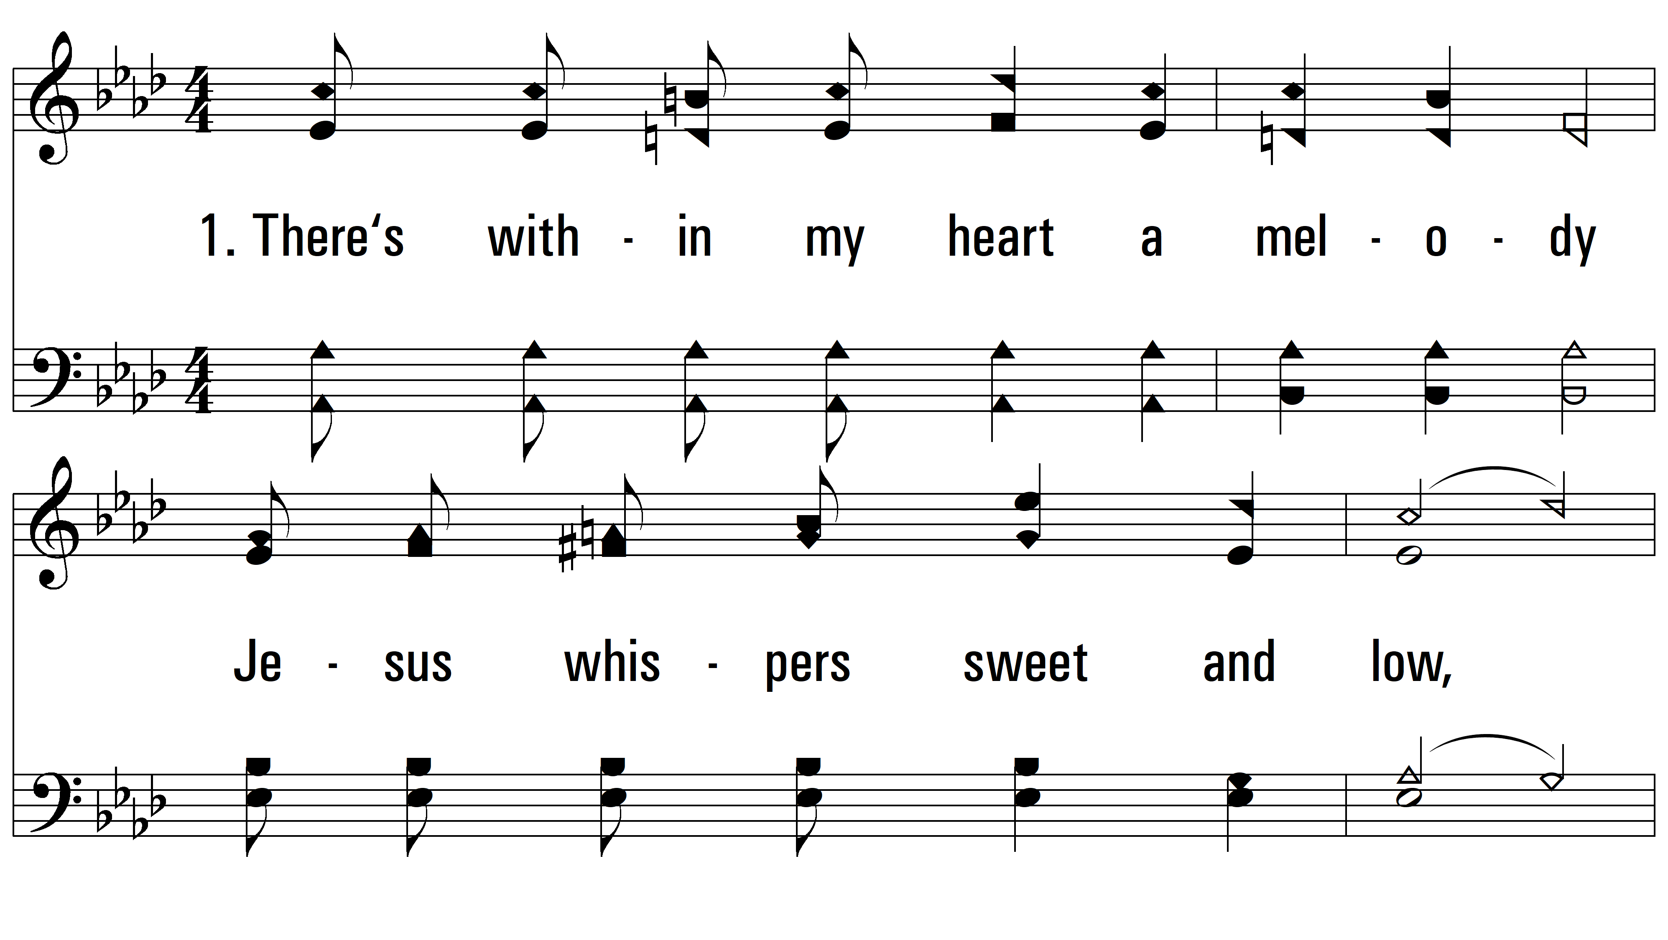
vs. 1 ~ He Keeps Me Singing

Slide 3
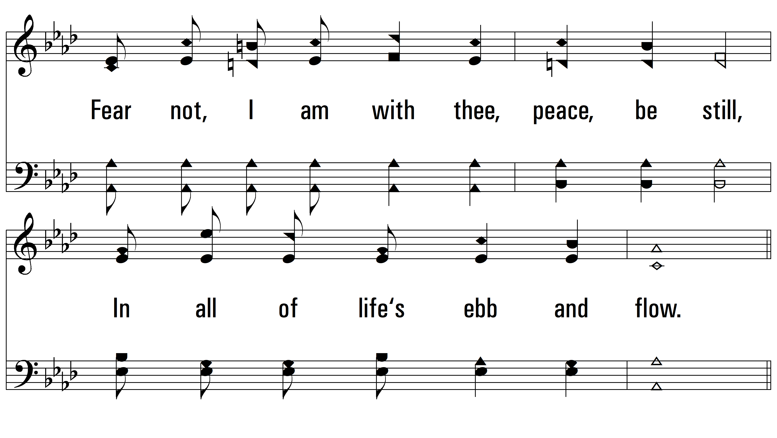
vs. 1

Slide 4
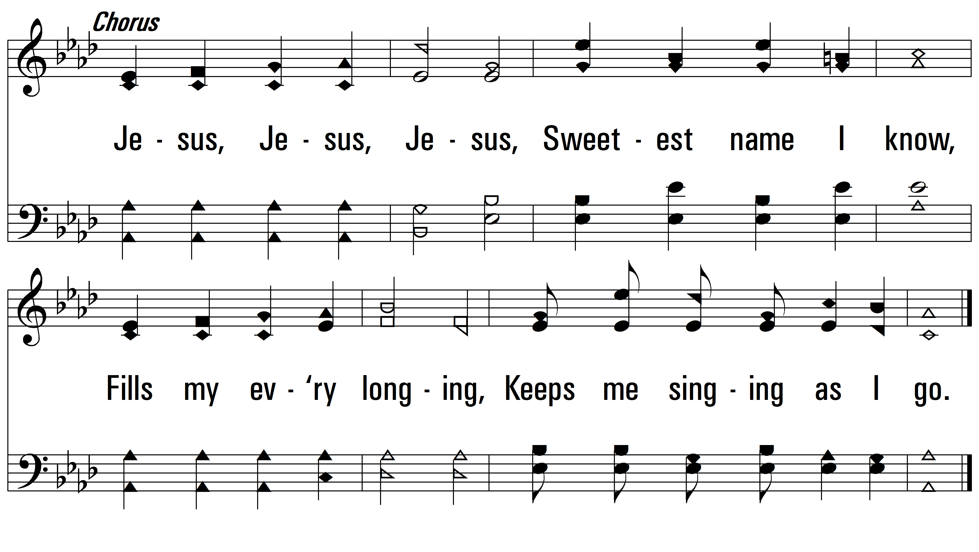
vs. 1

Slide 5
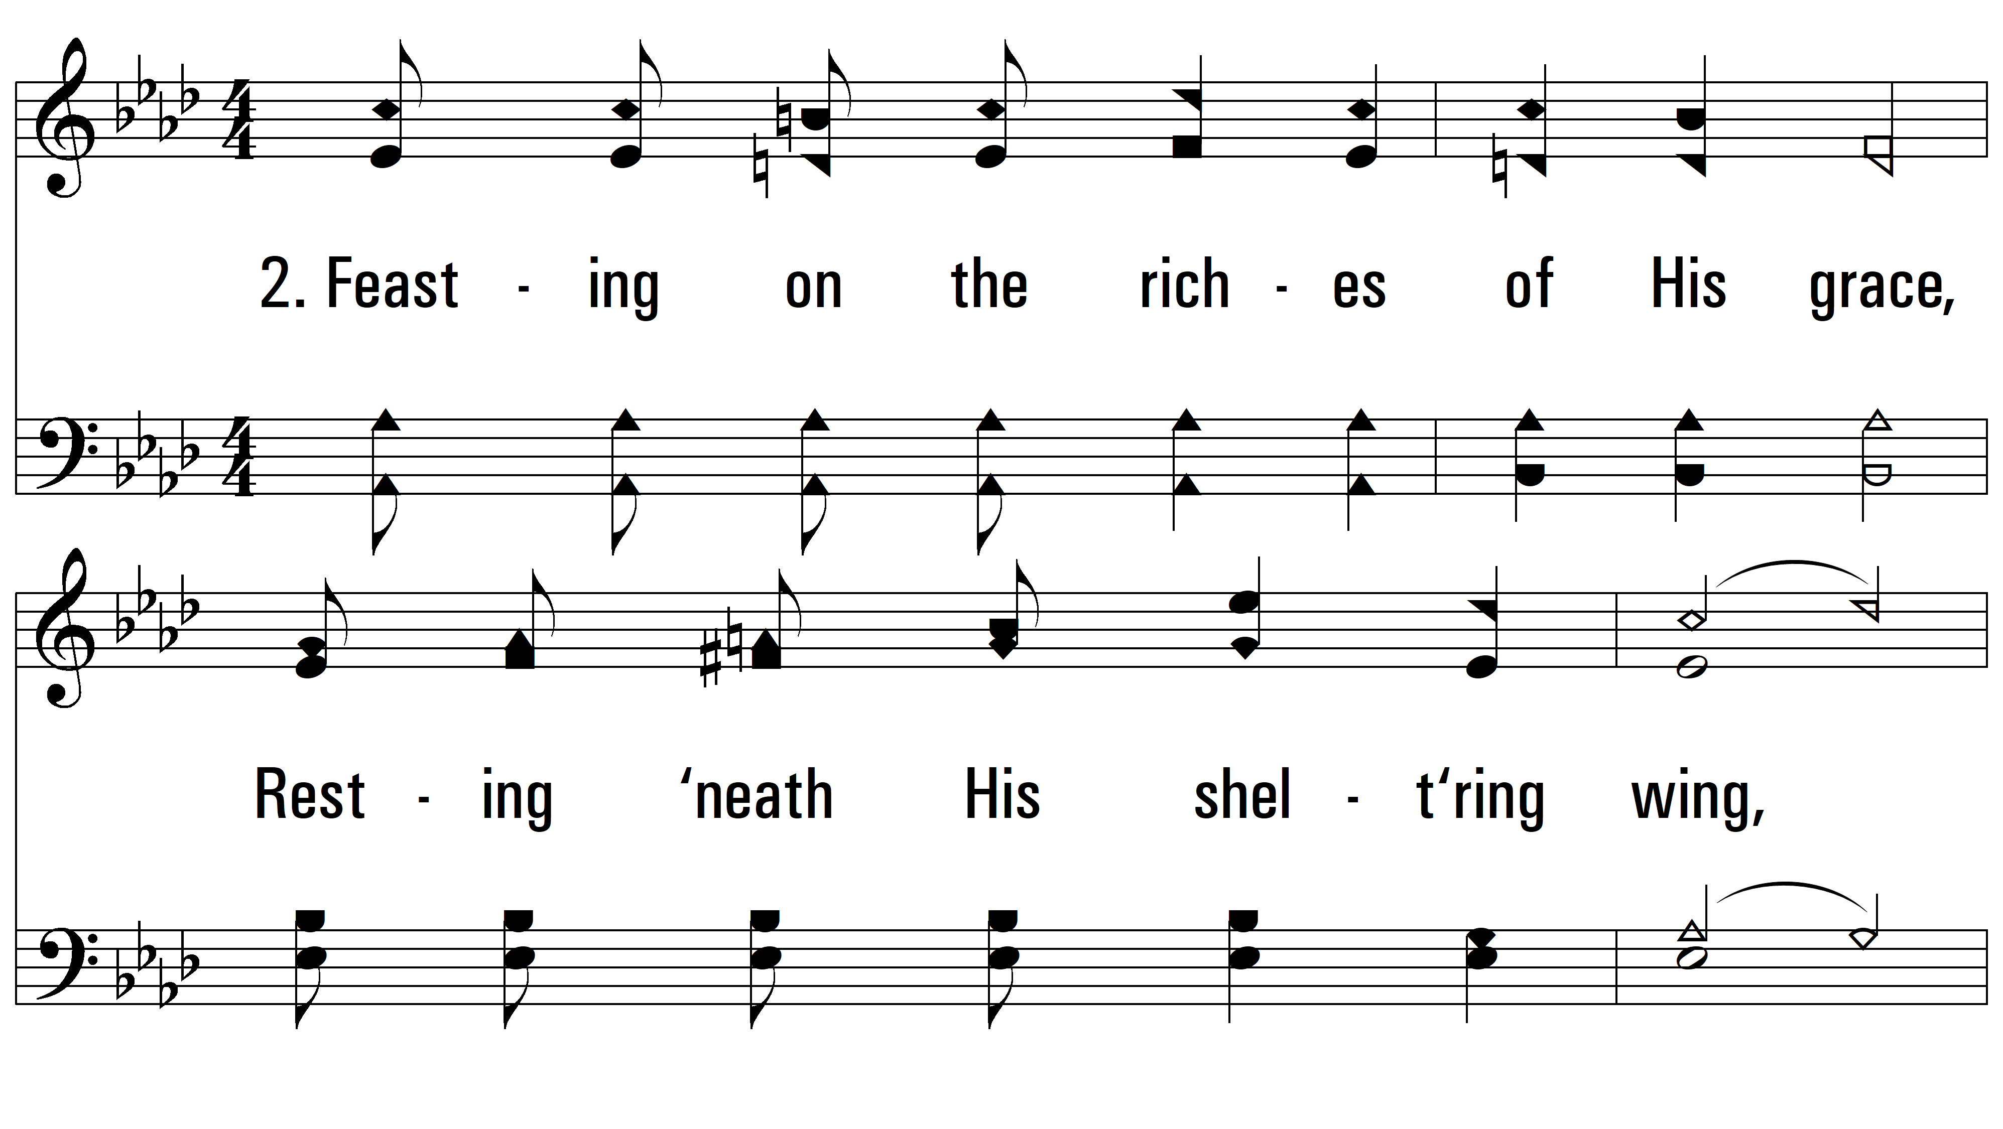
vs. 2 ~ He Keeps Me Singing

Slide 6
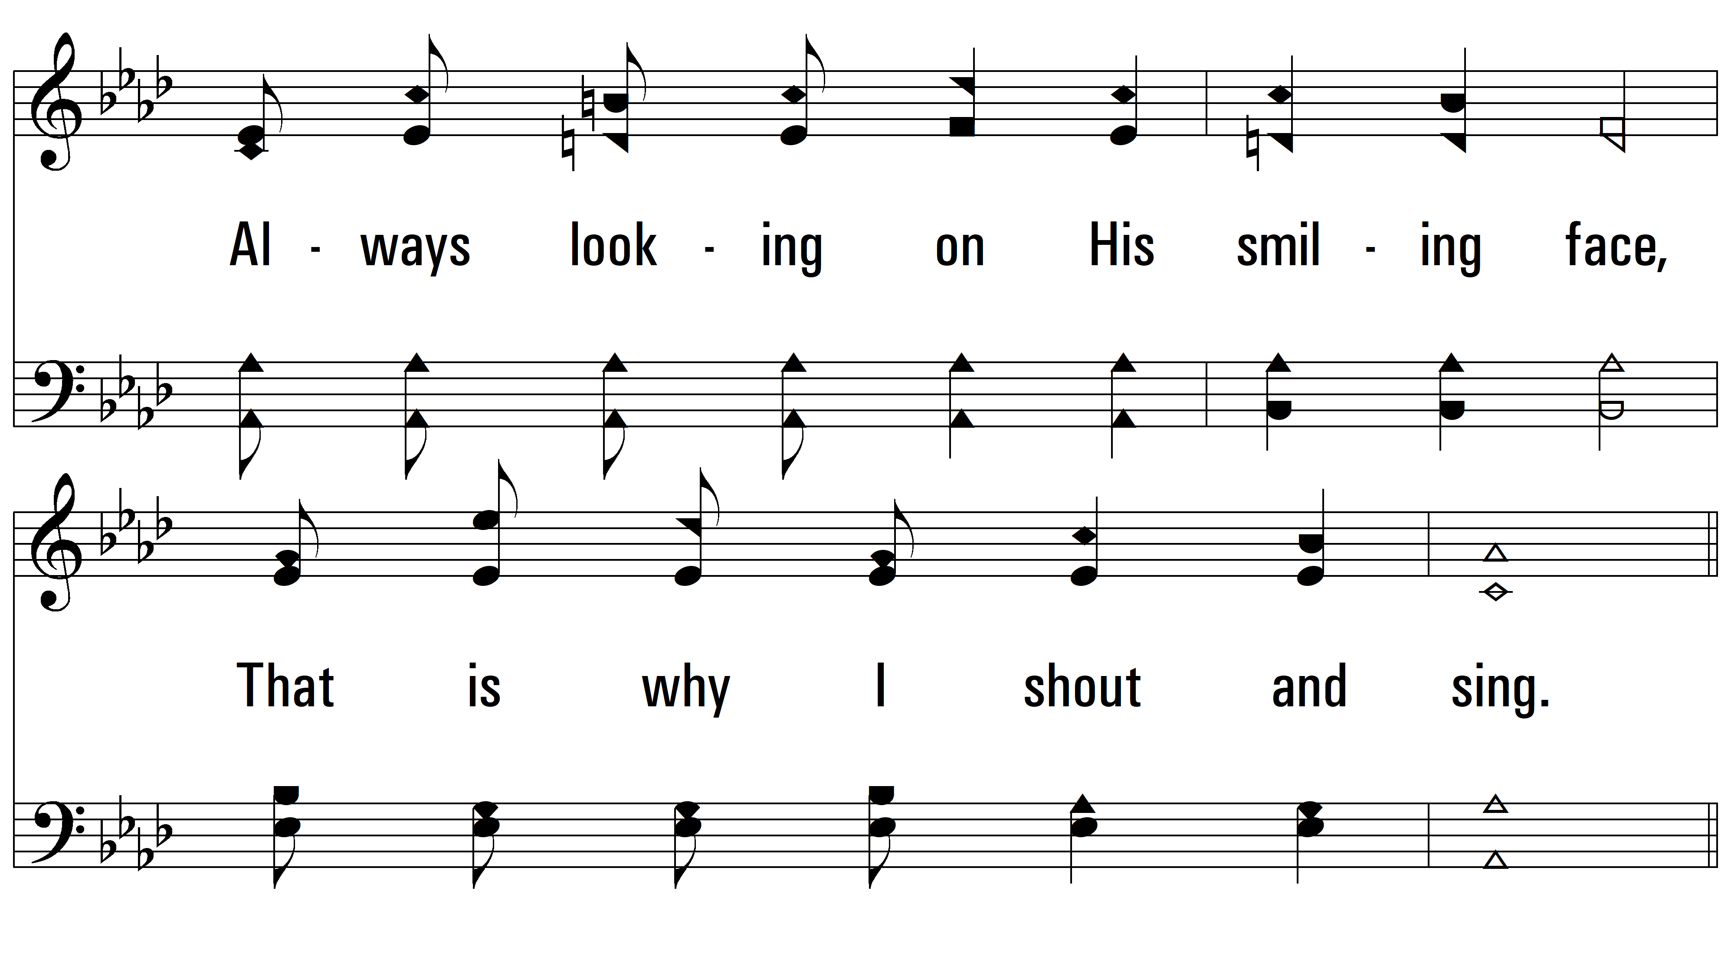
vs. 2

Slide 7
vs. 2

Slide 8
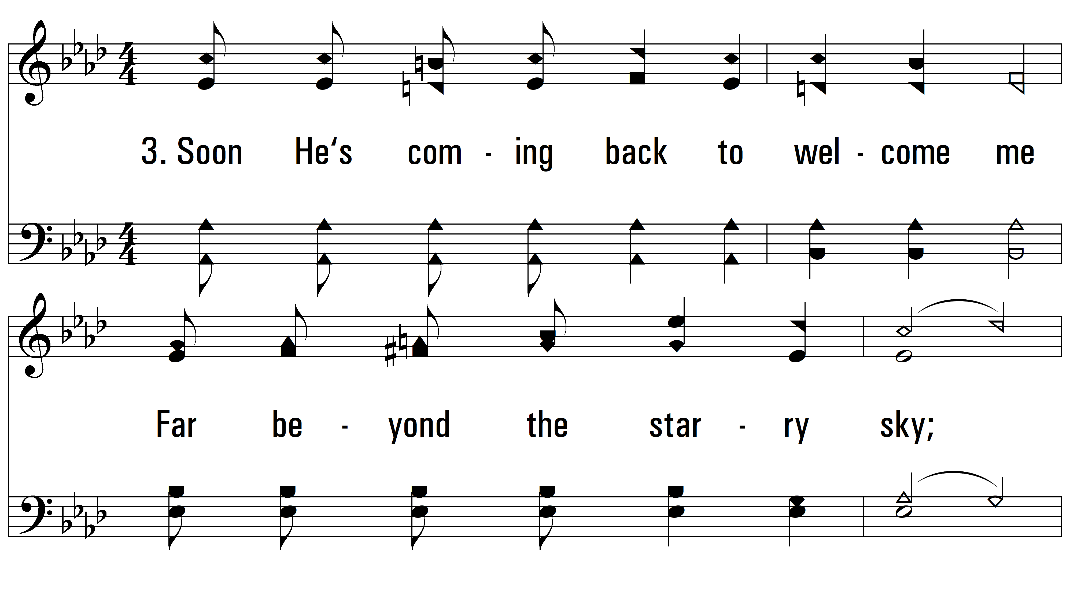
vs. 3 ~ He Keeps Me Singing

Slide 9
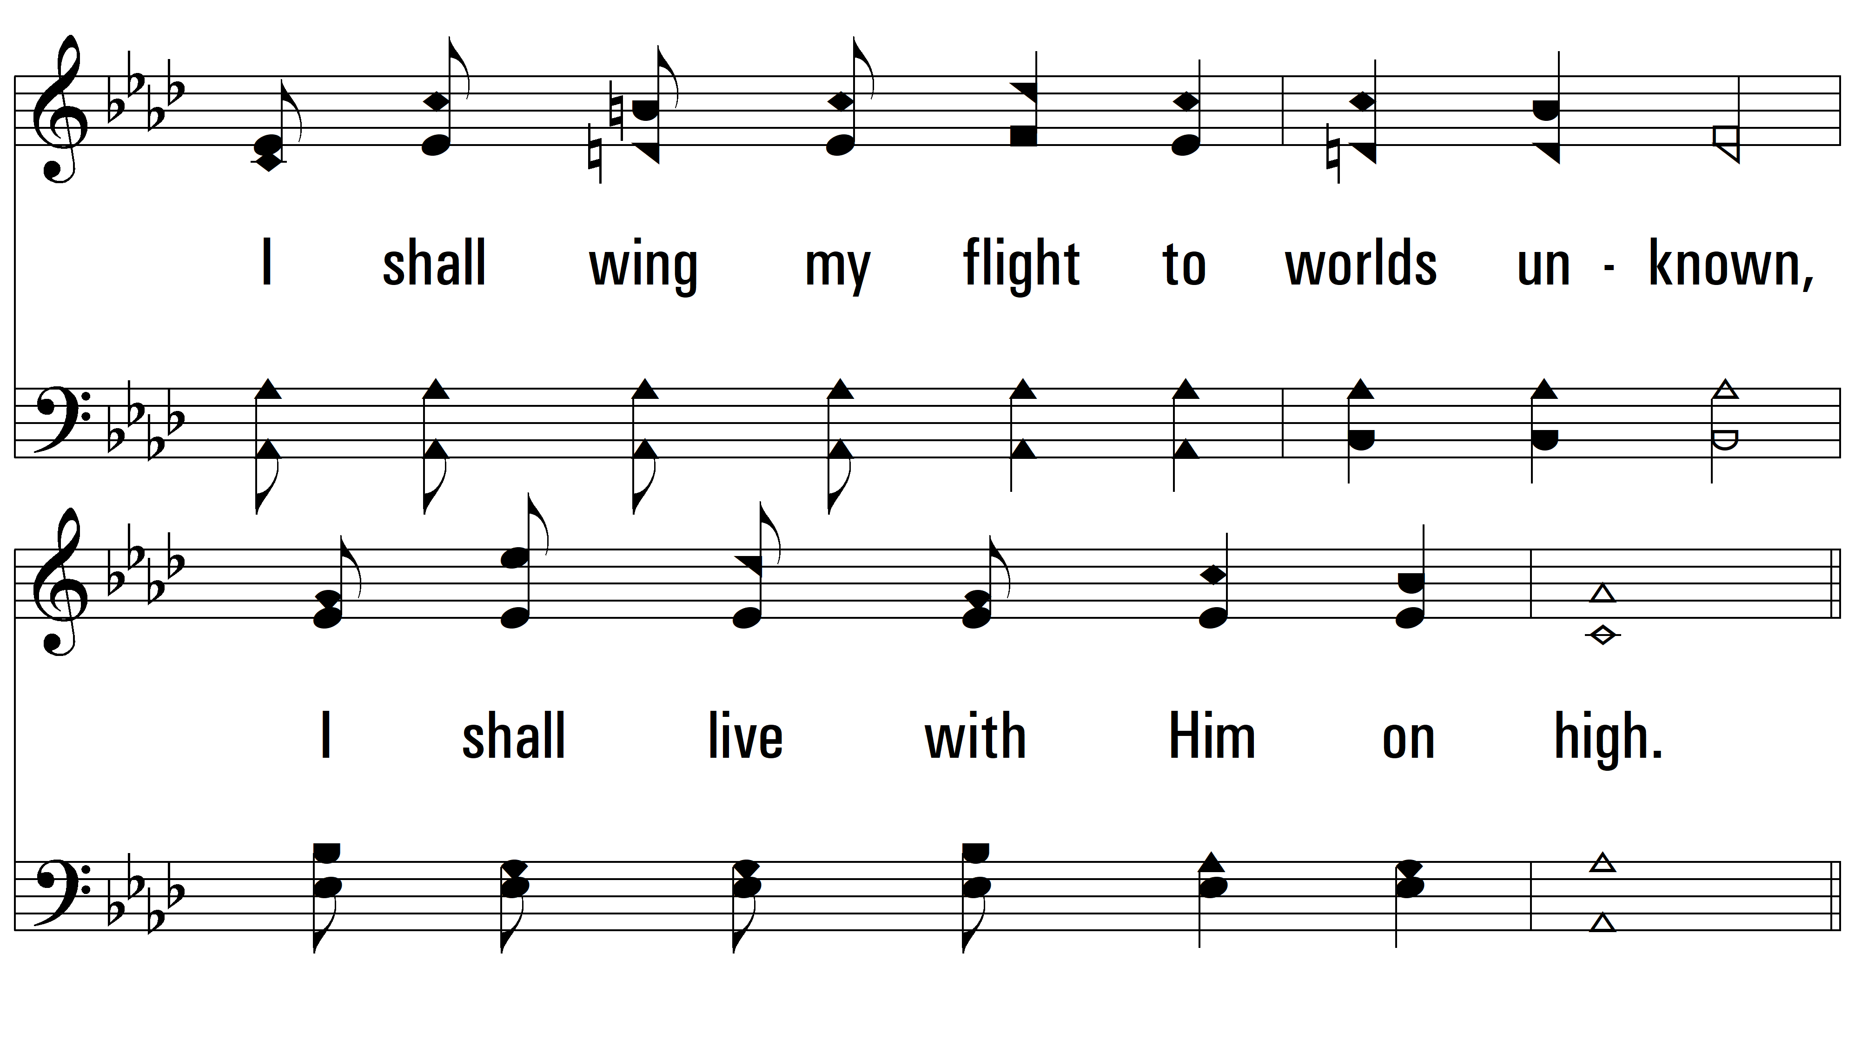
vs. 3

Slide 10
vs. 3
PDHymns.com
END

