Slide 1
He Bore It All
Words: | J. R. Baxter Jr.
Music: | Virgil O. Stamps
4/4
F/C - SOL
Verses: 3/Chorus
Lead - | SOL
Alto - | DO
Tenor - | MI
Bass - | DO
PDHymns.com

Slide 2
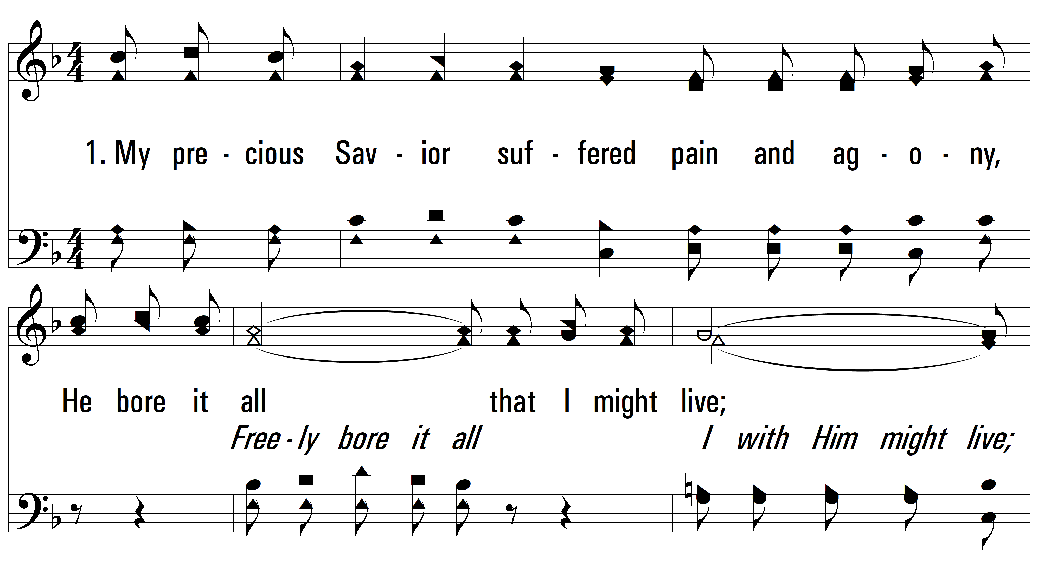
vs. 1 ~ He Bore It All

Slide 3
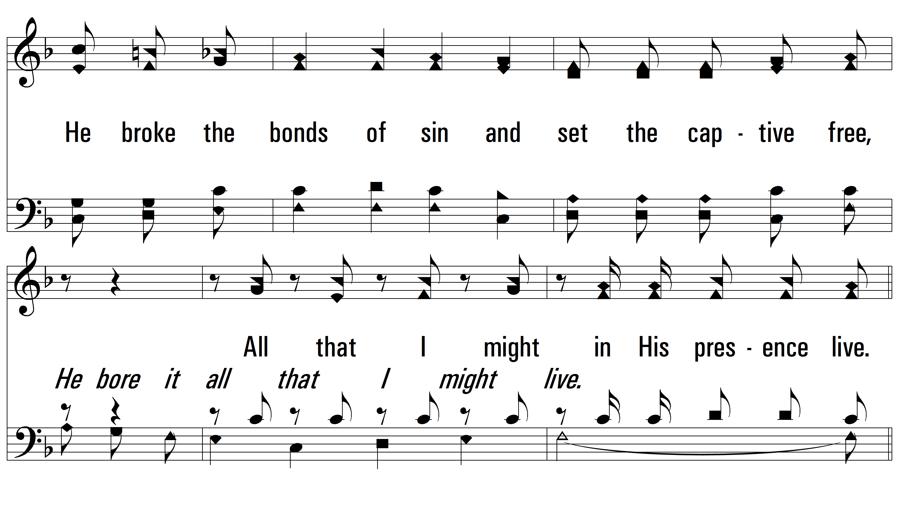
vs. 1

Slide 4
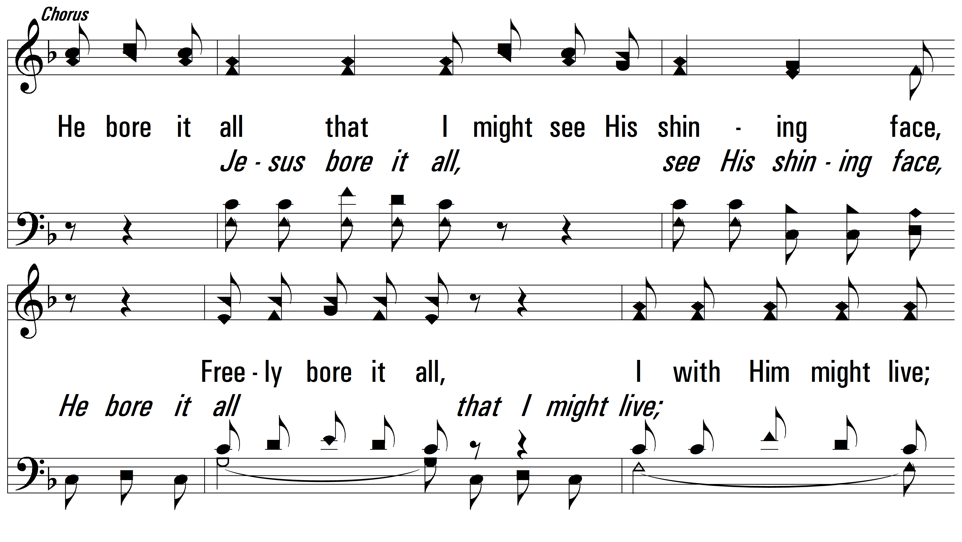
vs. 1

Slide 5
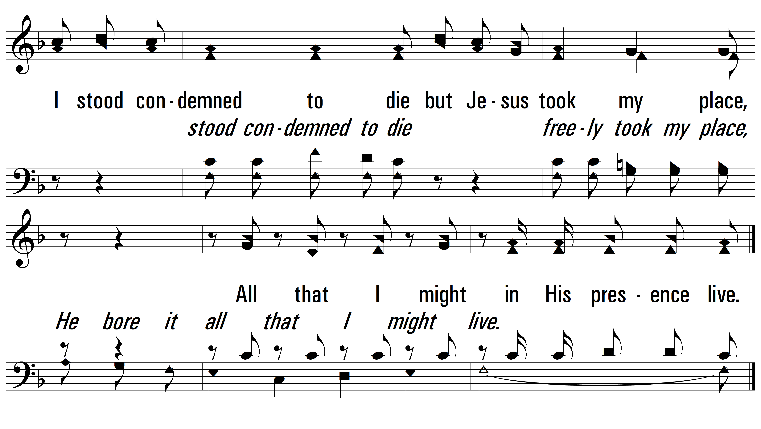
vs. 1

Slide 6
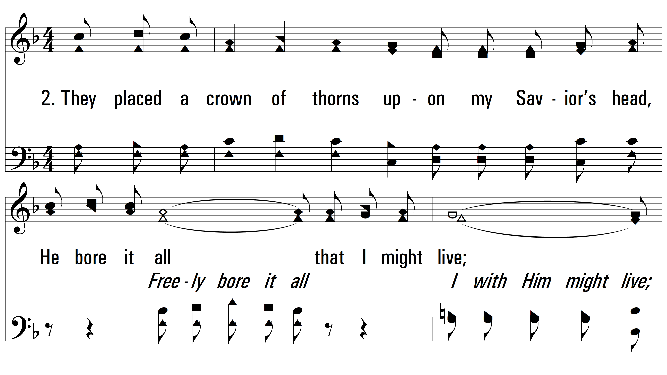
vs. 2 ~ He Bore It All

Slide 7
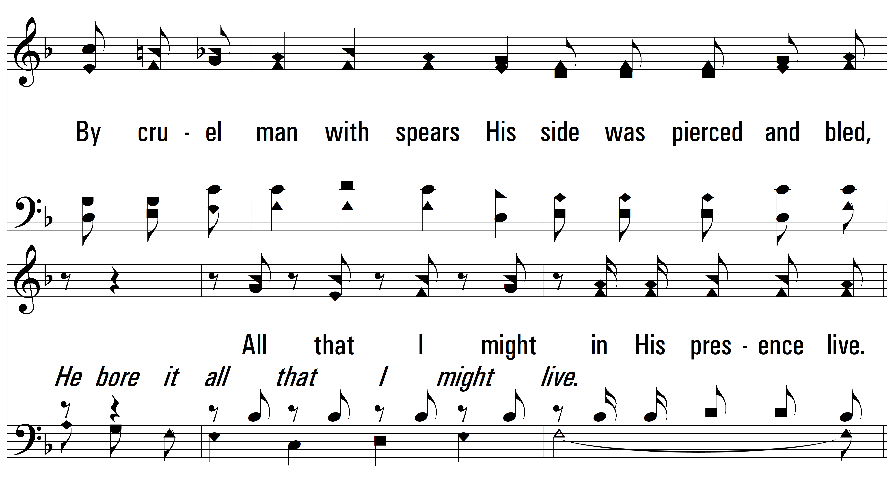
vs. 2

Slide 8
vs. 2

Slide 9
vs. 2

Slide 10
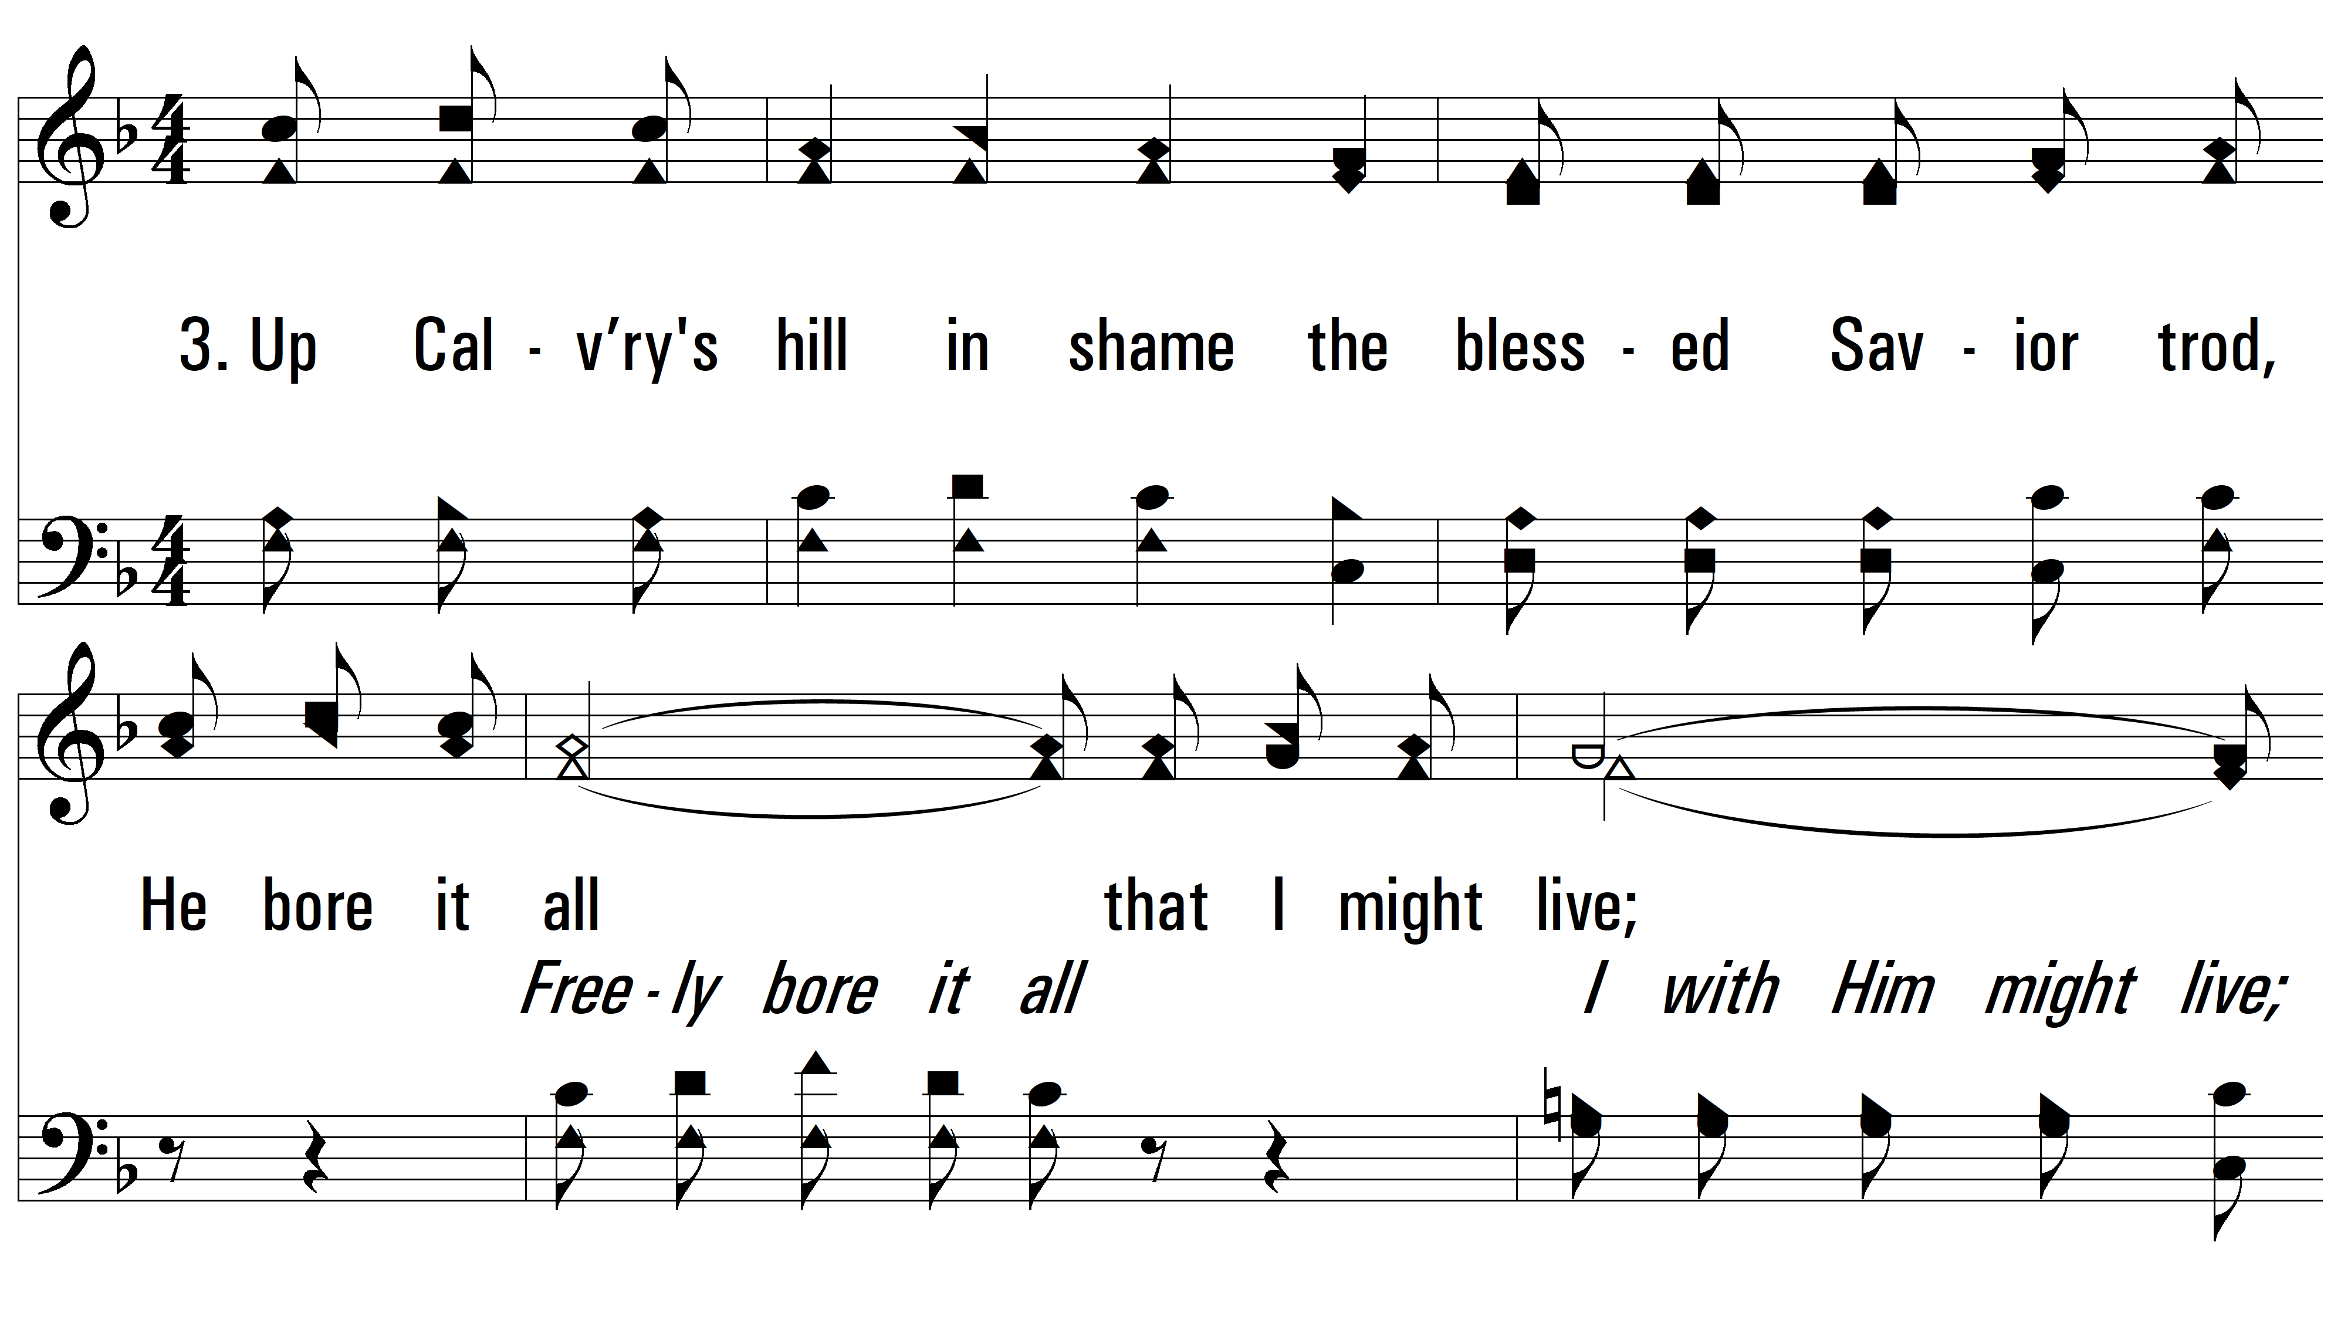
vs. 3 ~ He Bore It All

Slide 11
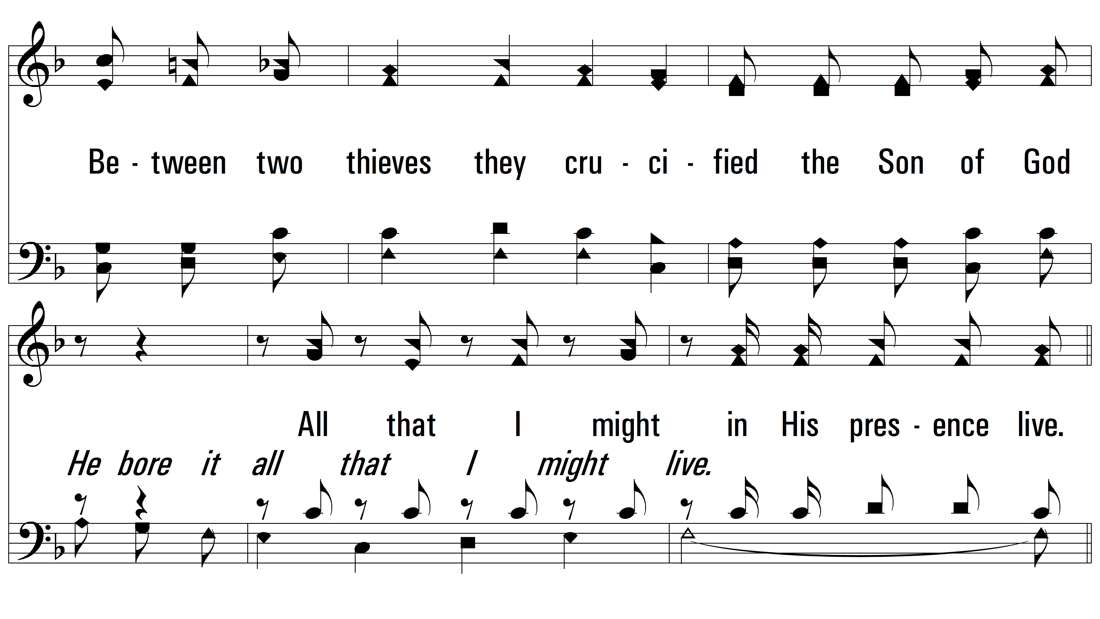
vs. 3

Slide 12
vs. 3

Slide 13
vs. 3
PDHymns.com
END

