Slide 1
Have Thine Own Way
ADELAIDE
5.4.5.4.D
Words: | Adellaide Pollard (1902)
Music: | George C. Stebbins (1907)
9/4
E^{b}/G - MI
Verses: 4
Lead - | MI
Alto - | DO
Tenor - | SOL
Bass - | DO
PDHymns.com

Slide 2
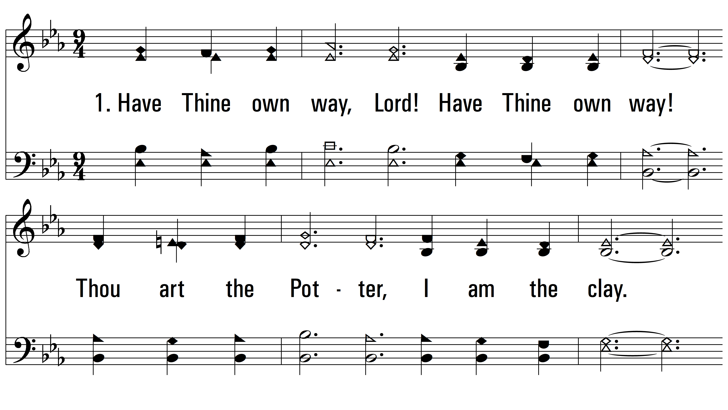
vs. 1 ~ Have Thine Own Way

Slide 3
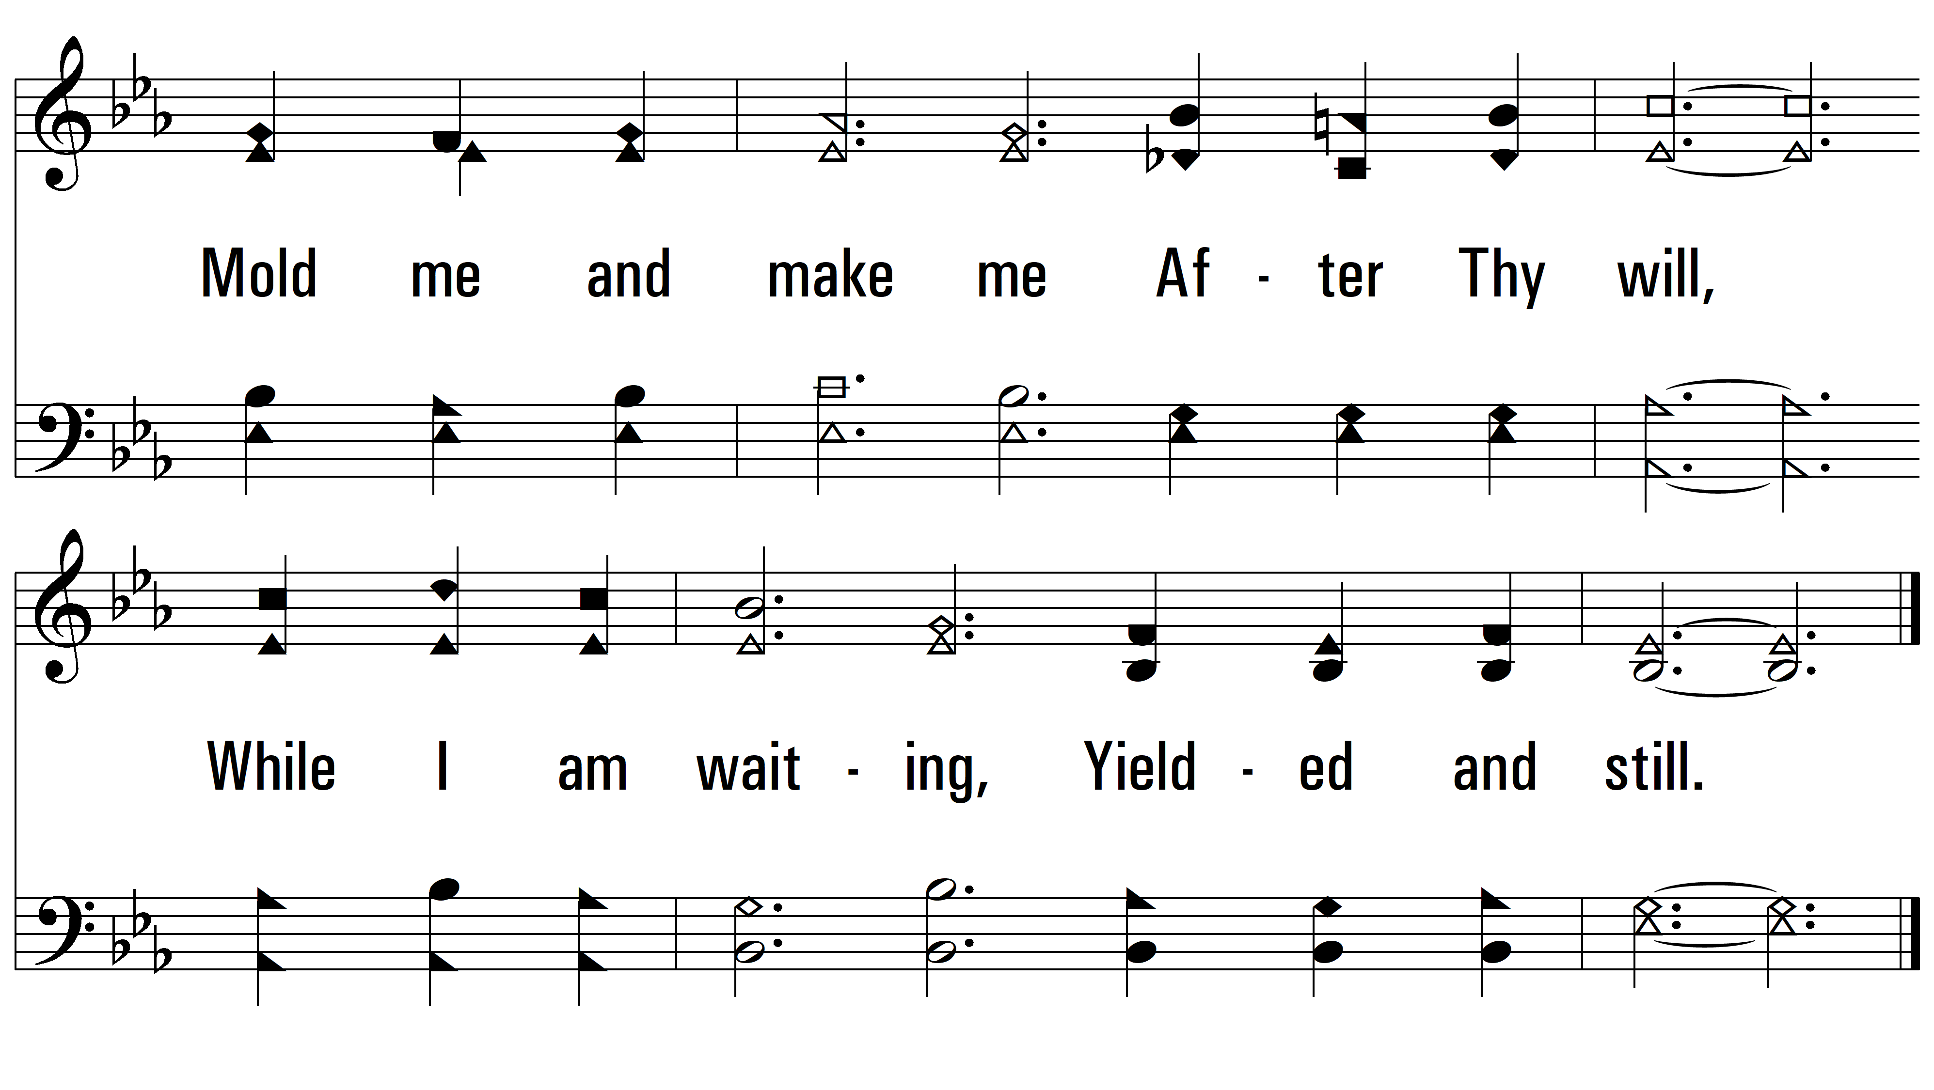
vs. 1

Slide 4
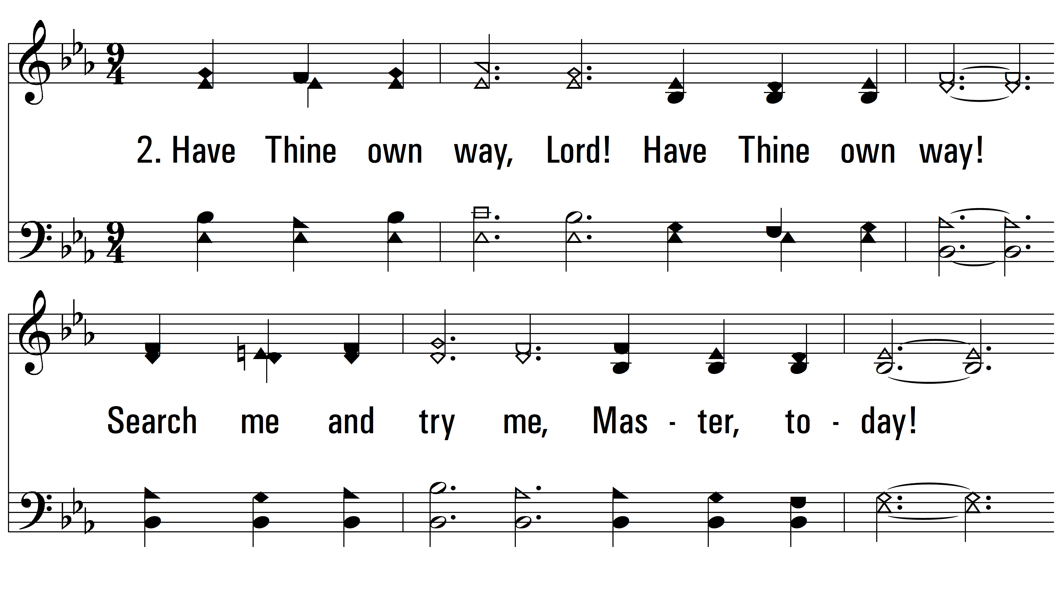
vs. 2 ~ Have Thine Own Way

Slide 5
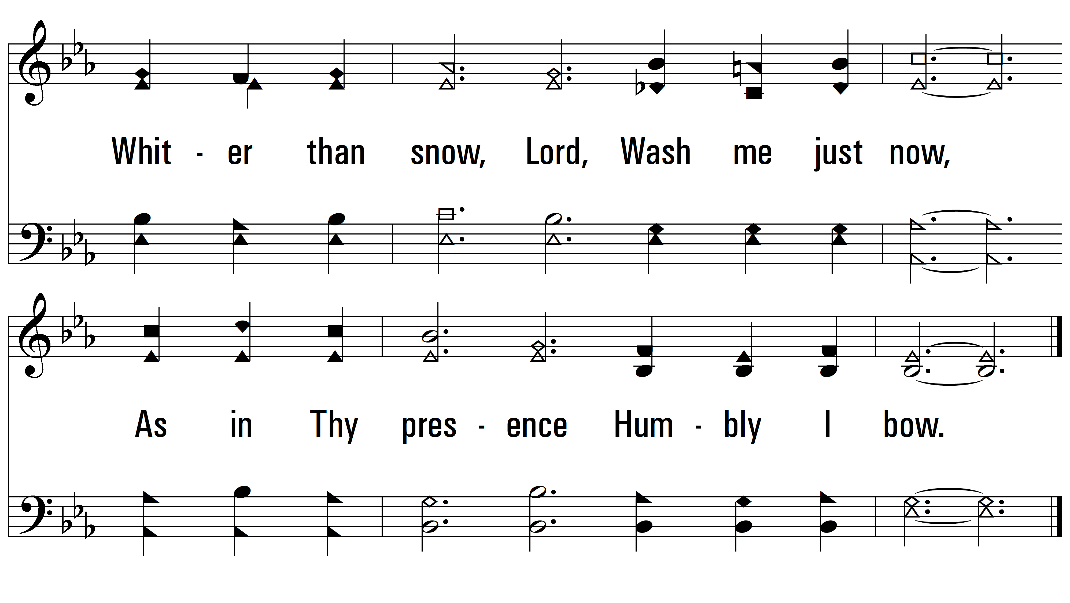
vs. 2

Slide 6
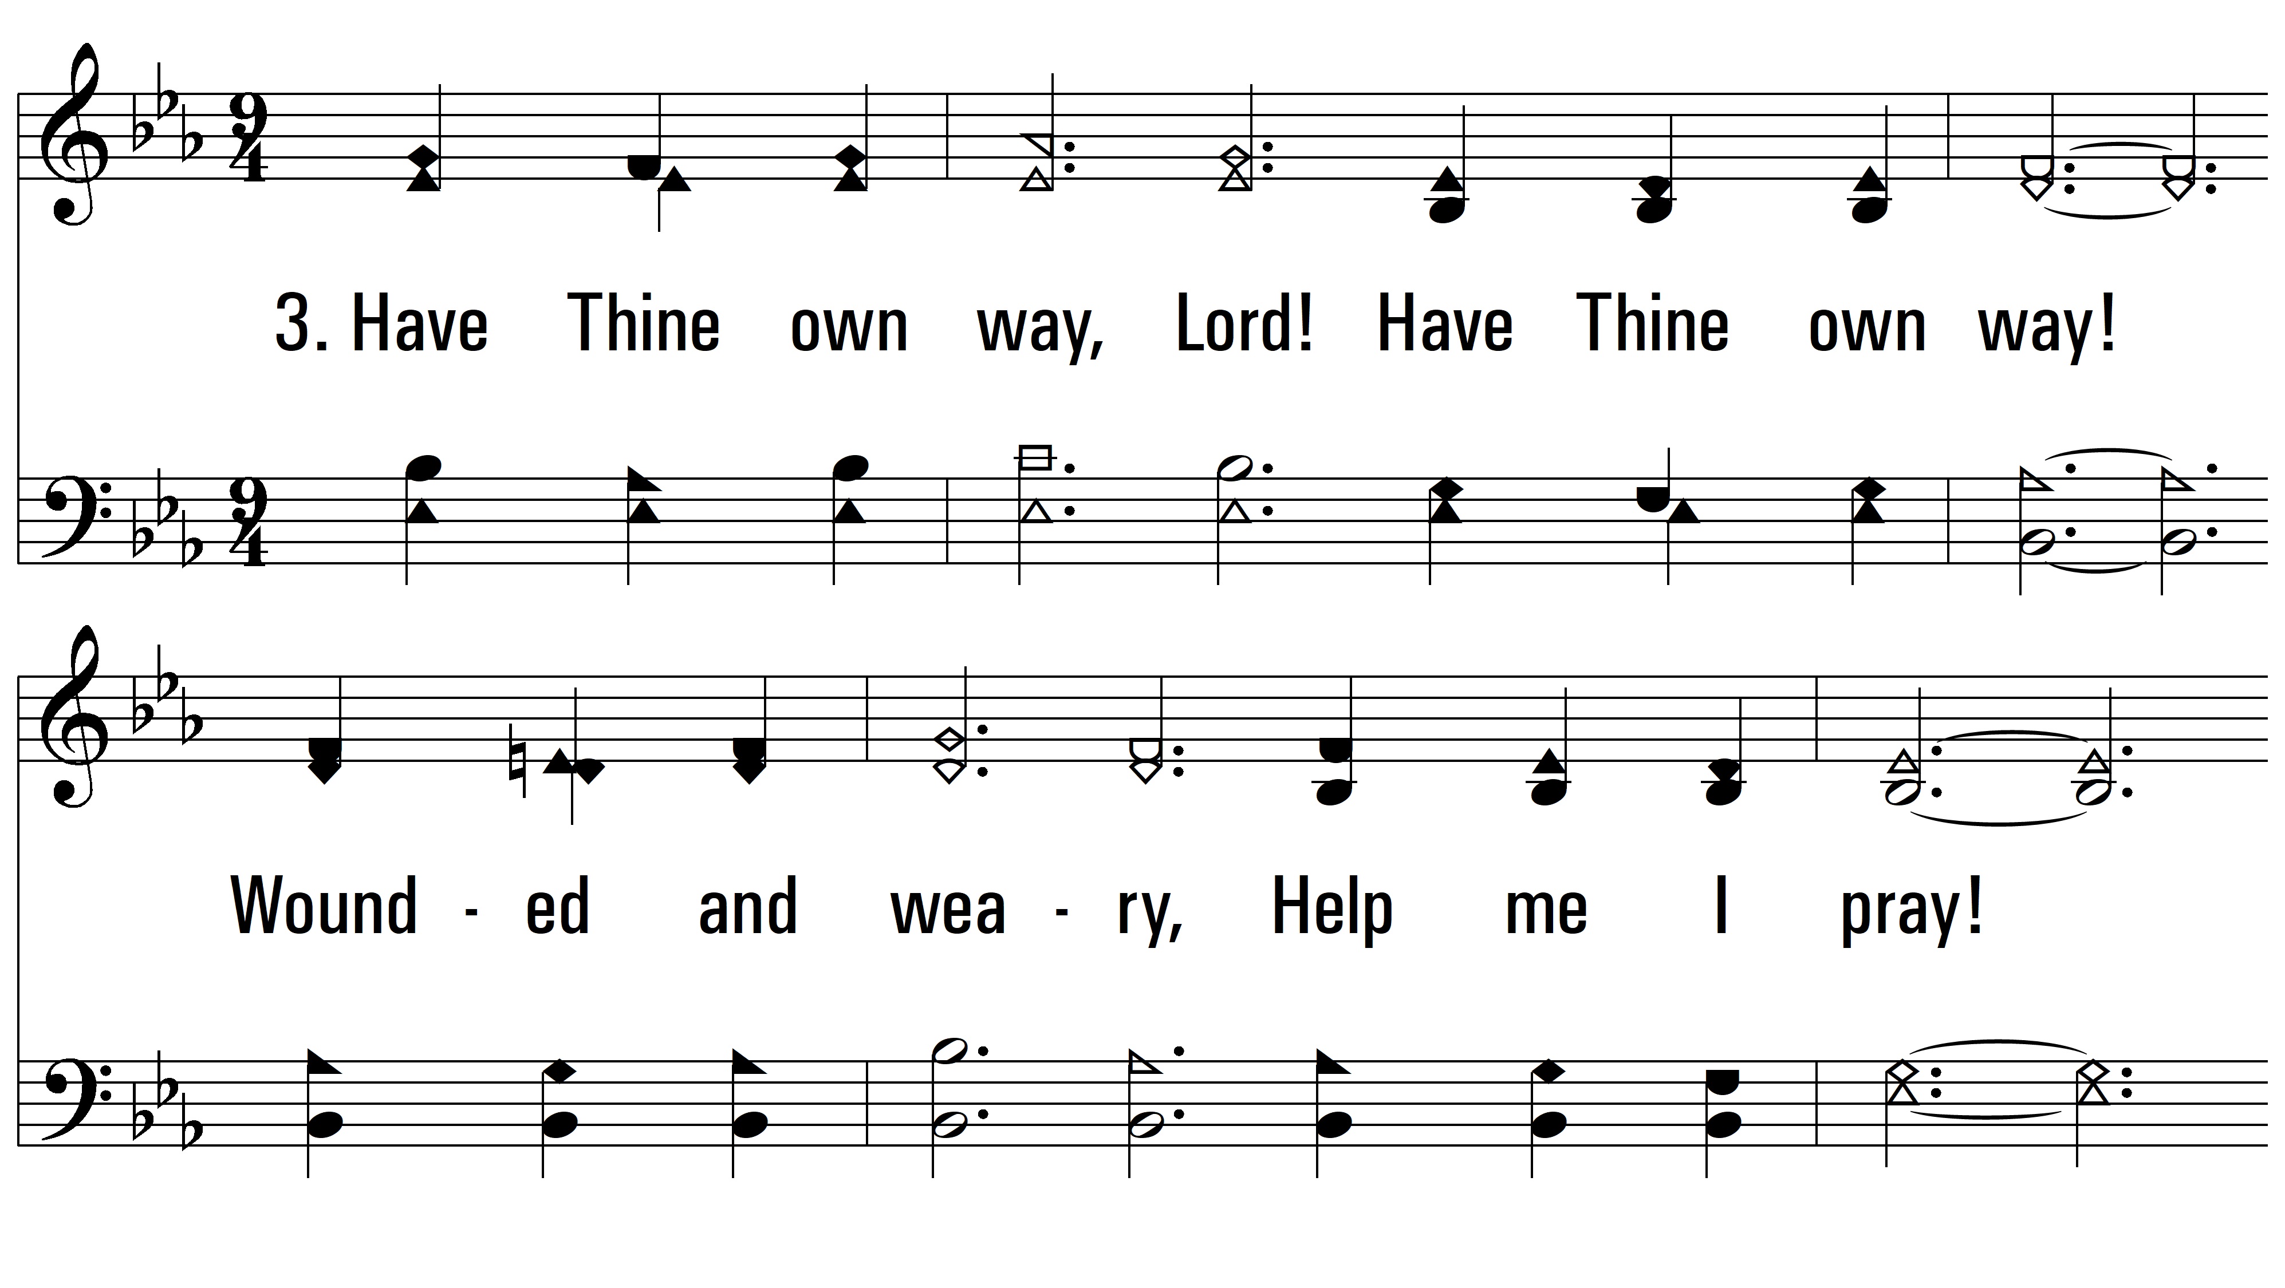
vs. 3 ~ Have Thine Own Way

Slide 7
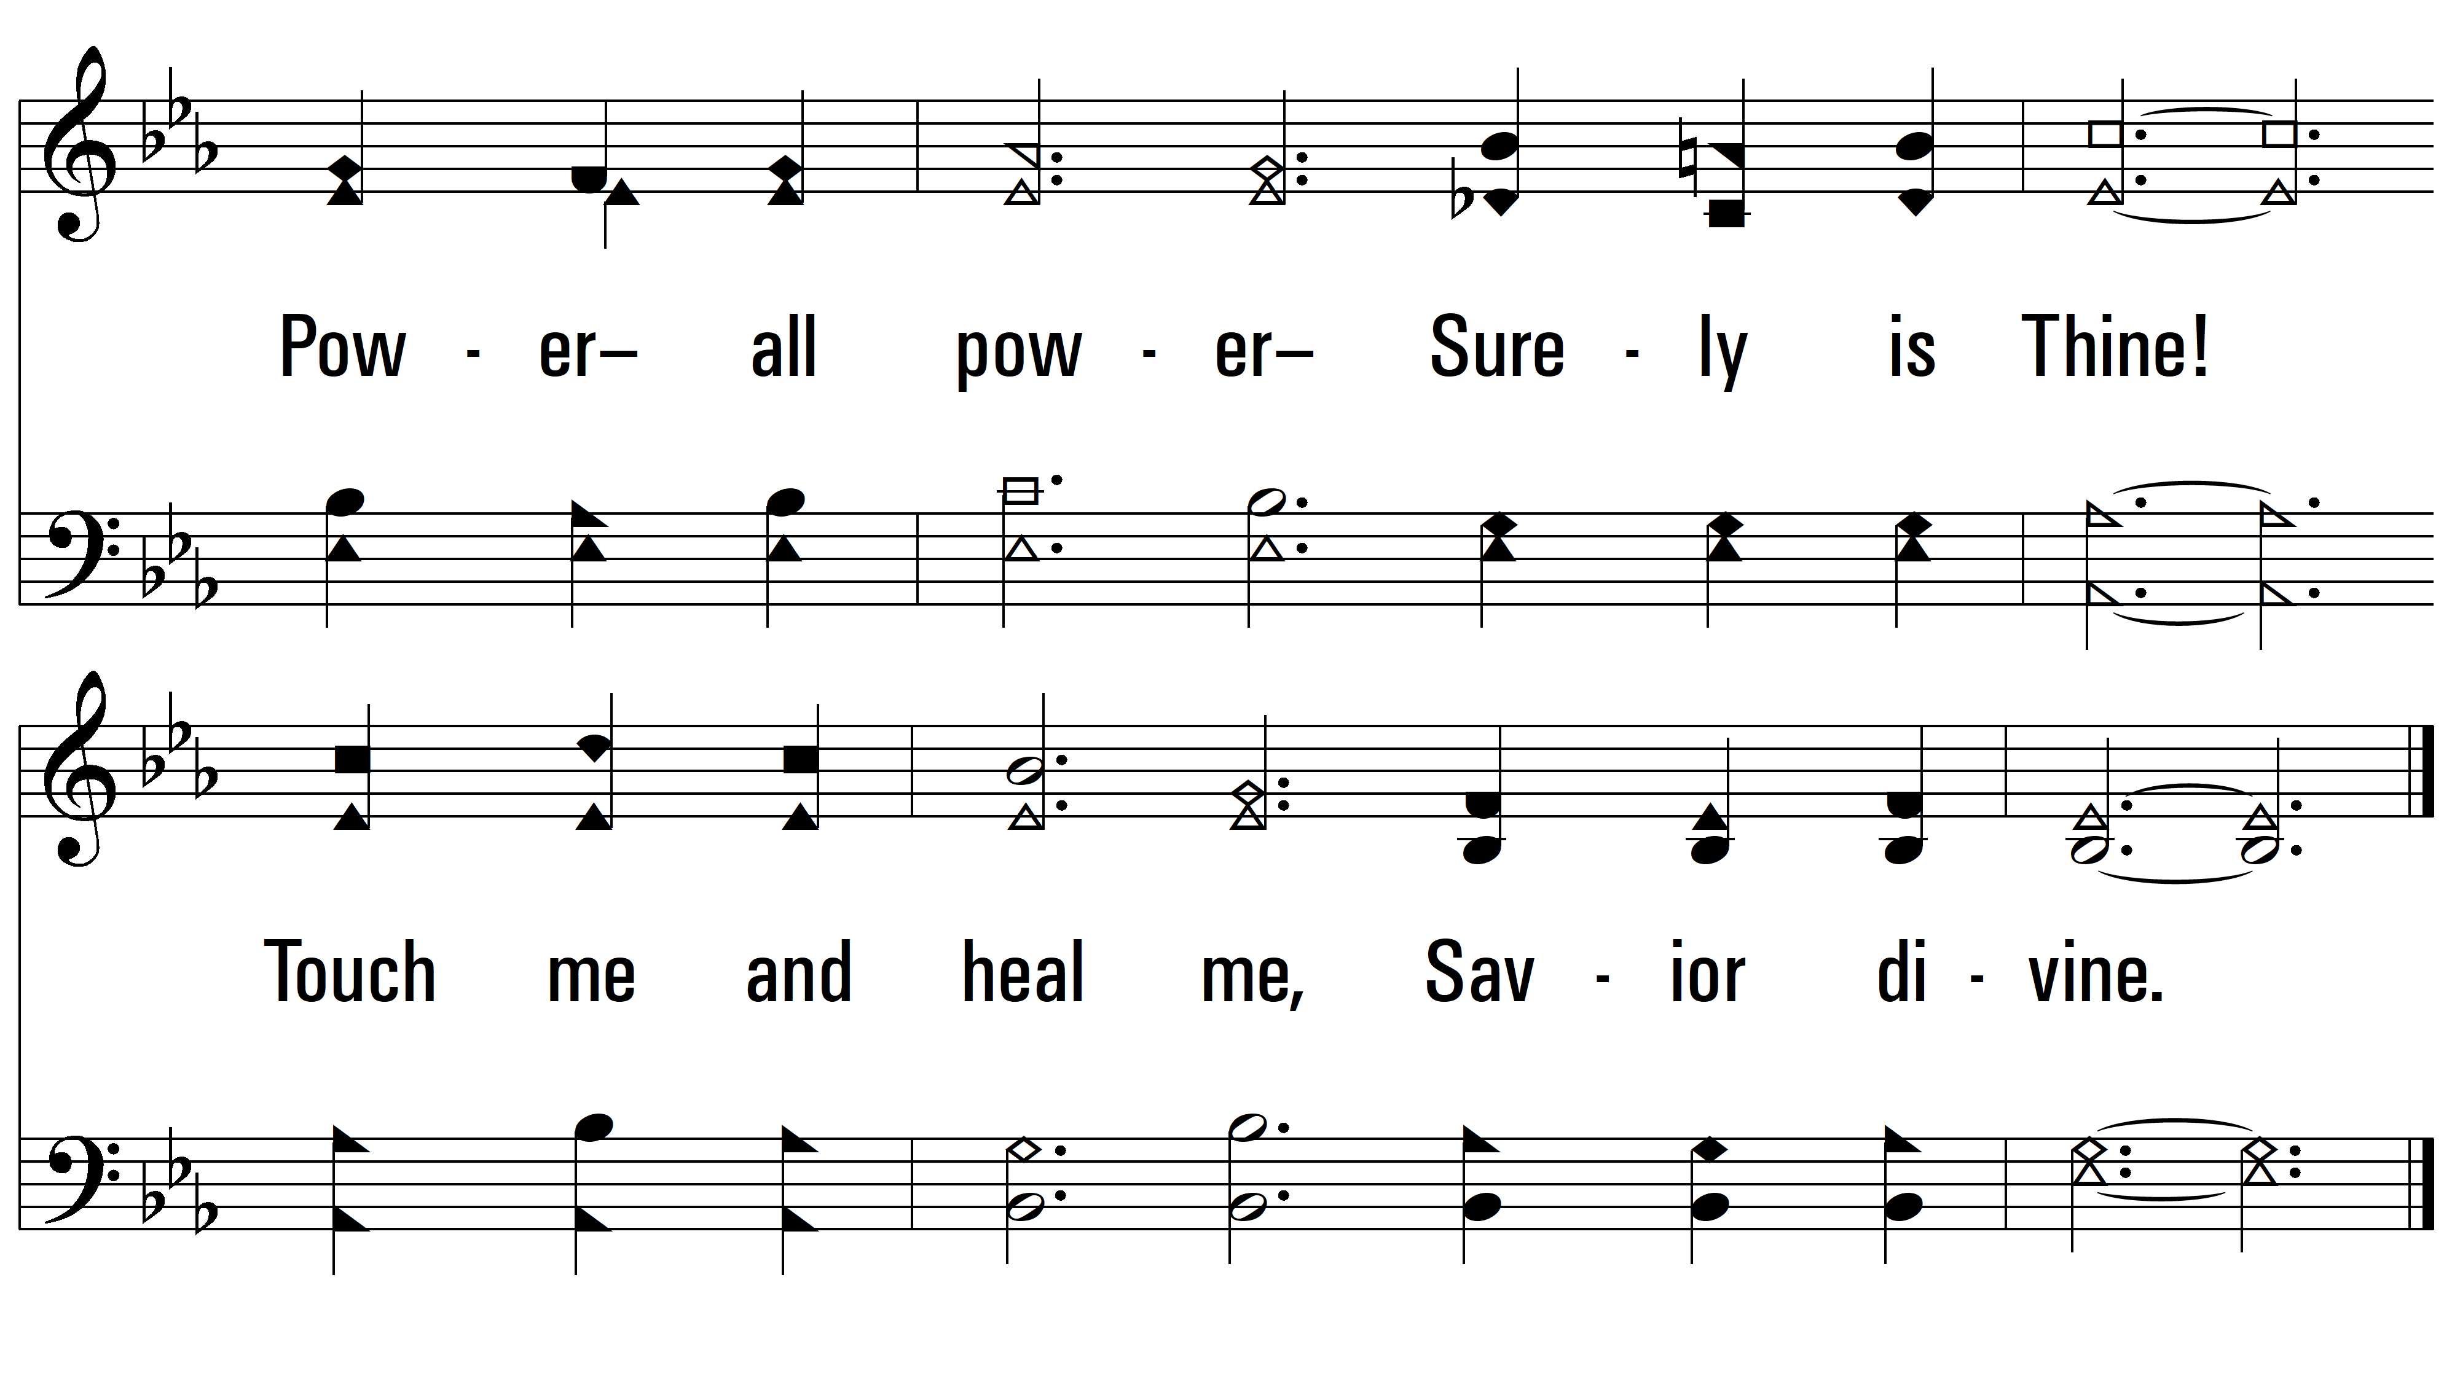
vs. 3

Slide 8
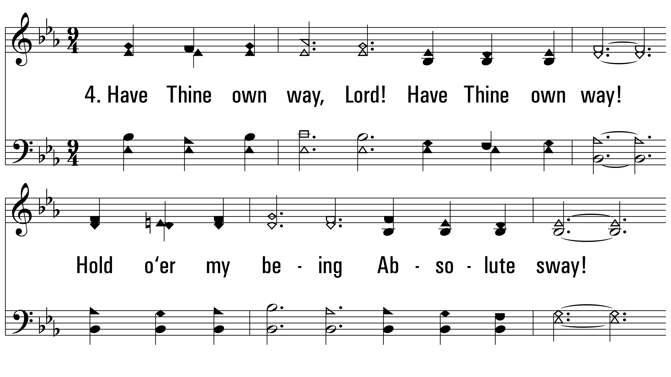
vs. 4 ~ Have Thine Own Way

Slide 9
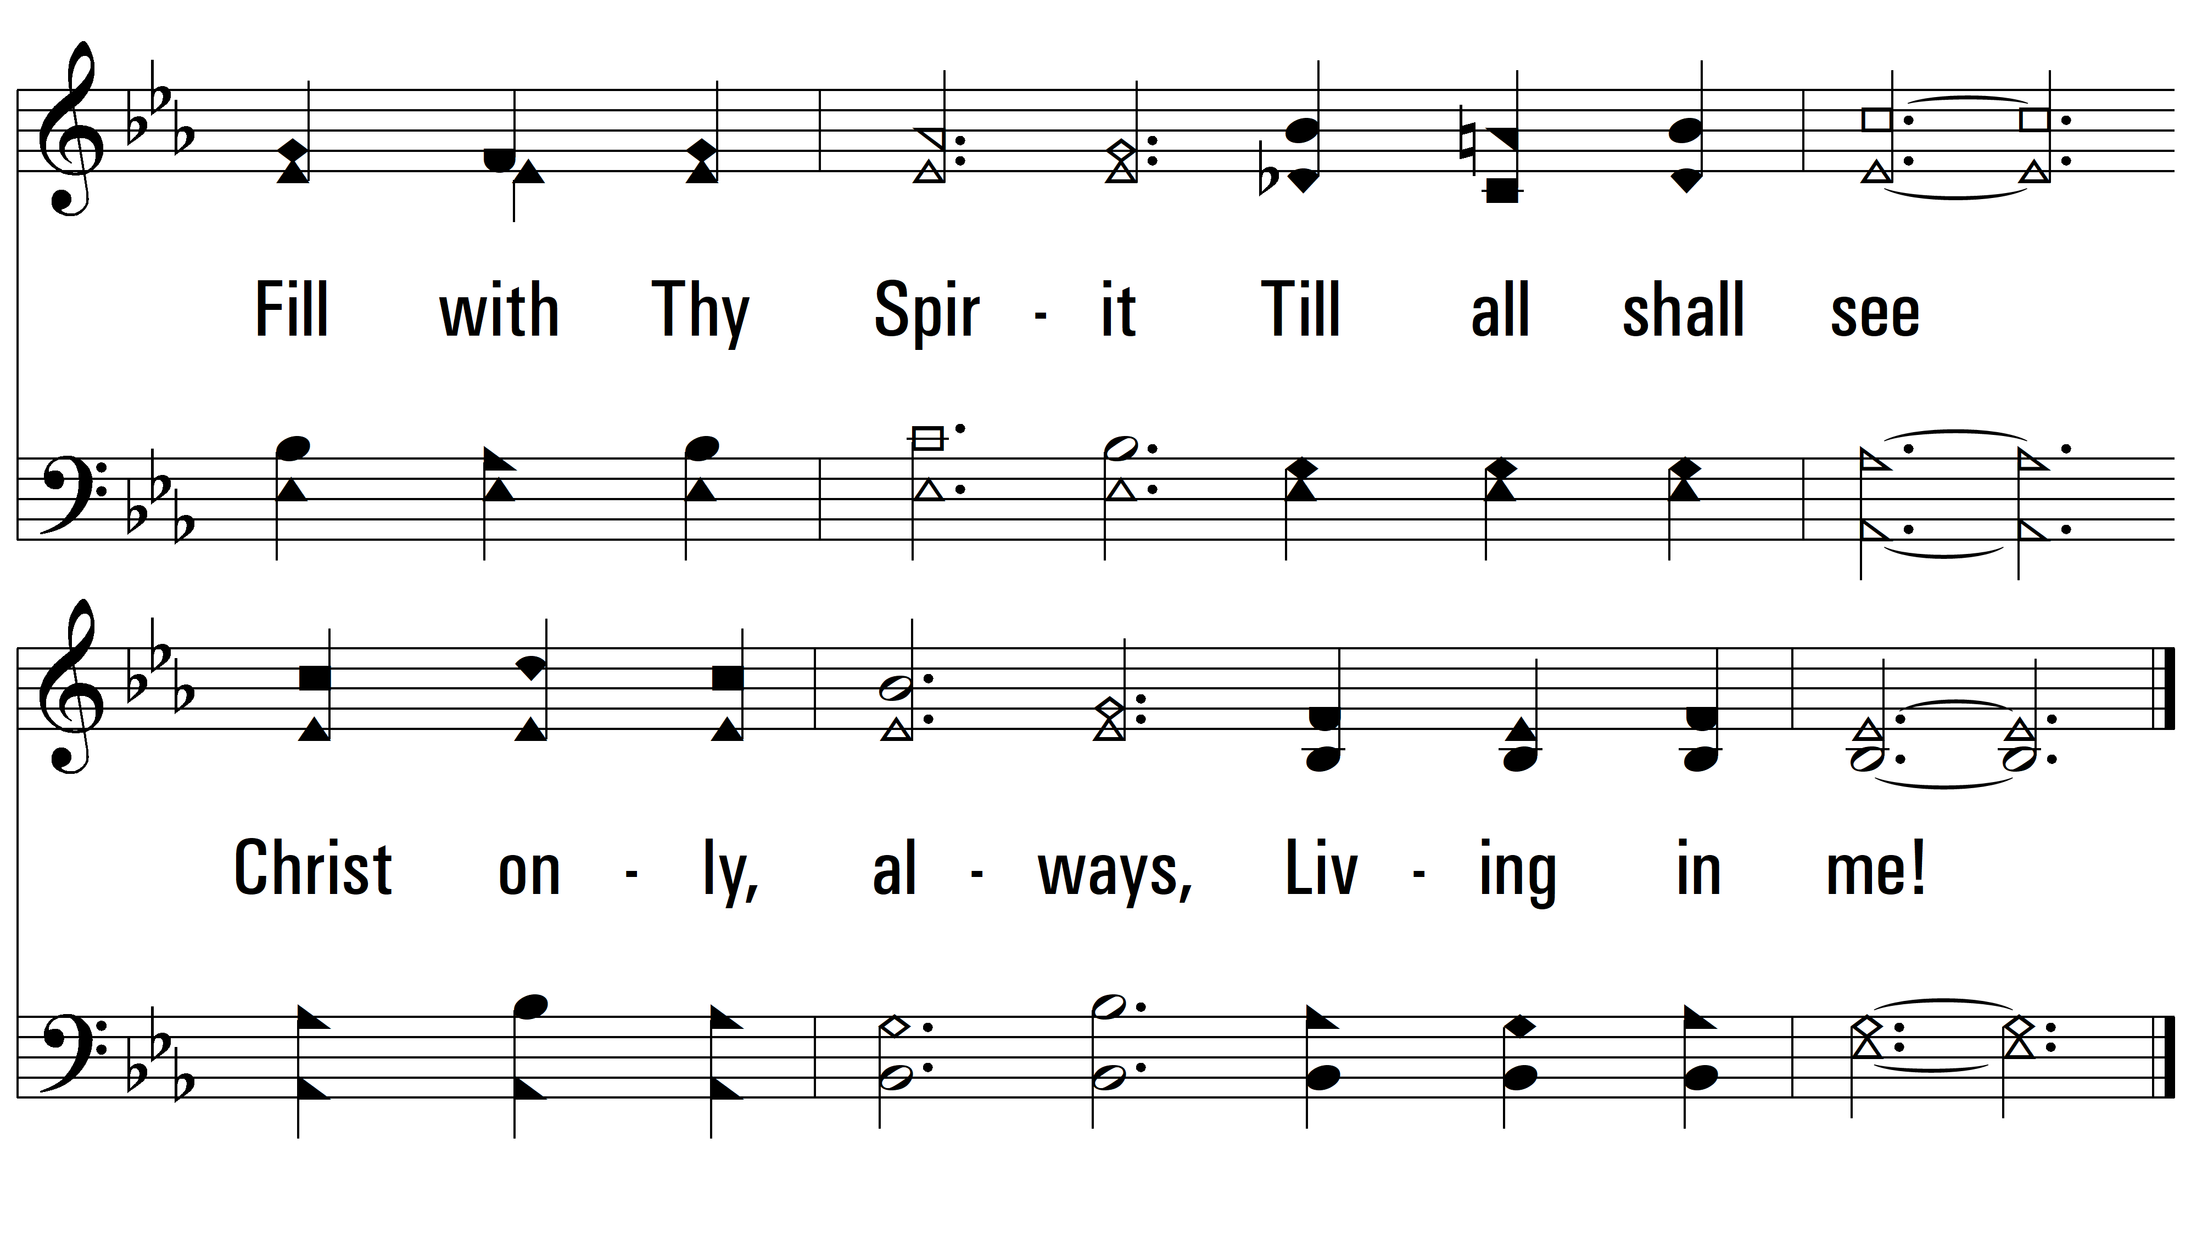
vs. 4
PDHymns.com
END

