Slide 1
Hallelujah! What A Savior
Words: | Phillip P. Bliss (1875)
Music: | Phillip P. Bliss (1875)
4/4
C/G - SOL
Verses: 5
Lead - | SOL
Alto - | MI
Tenor - | DO
Bass - | DO
PDHymns.com

Slide 2
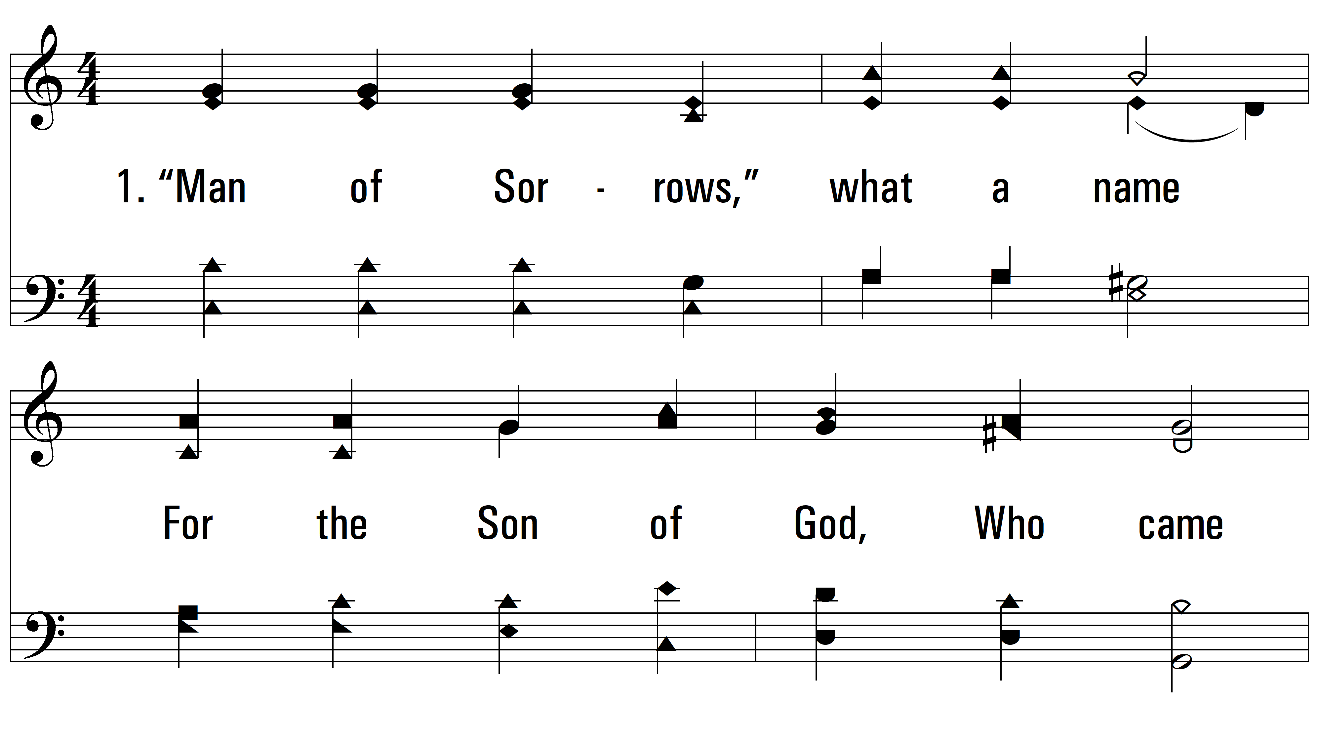
vs. 1 ~ Hallelujah! What A Savior

Slide 3
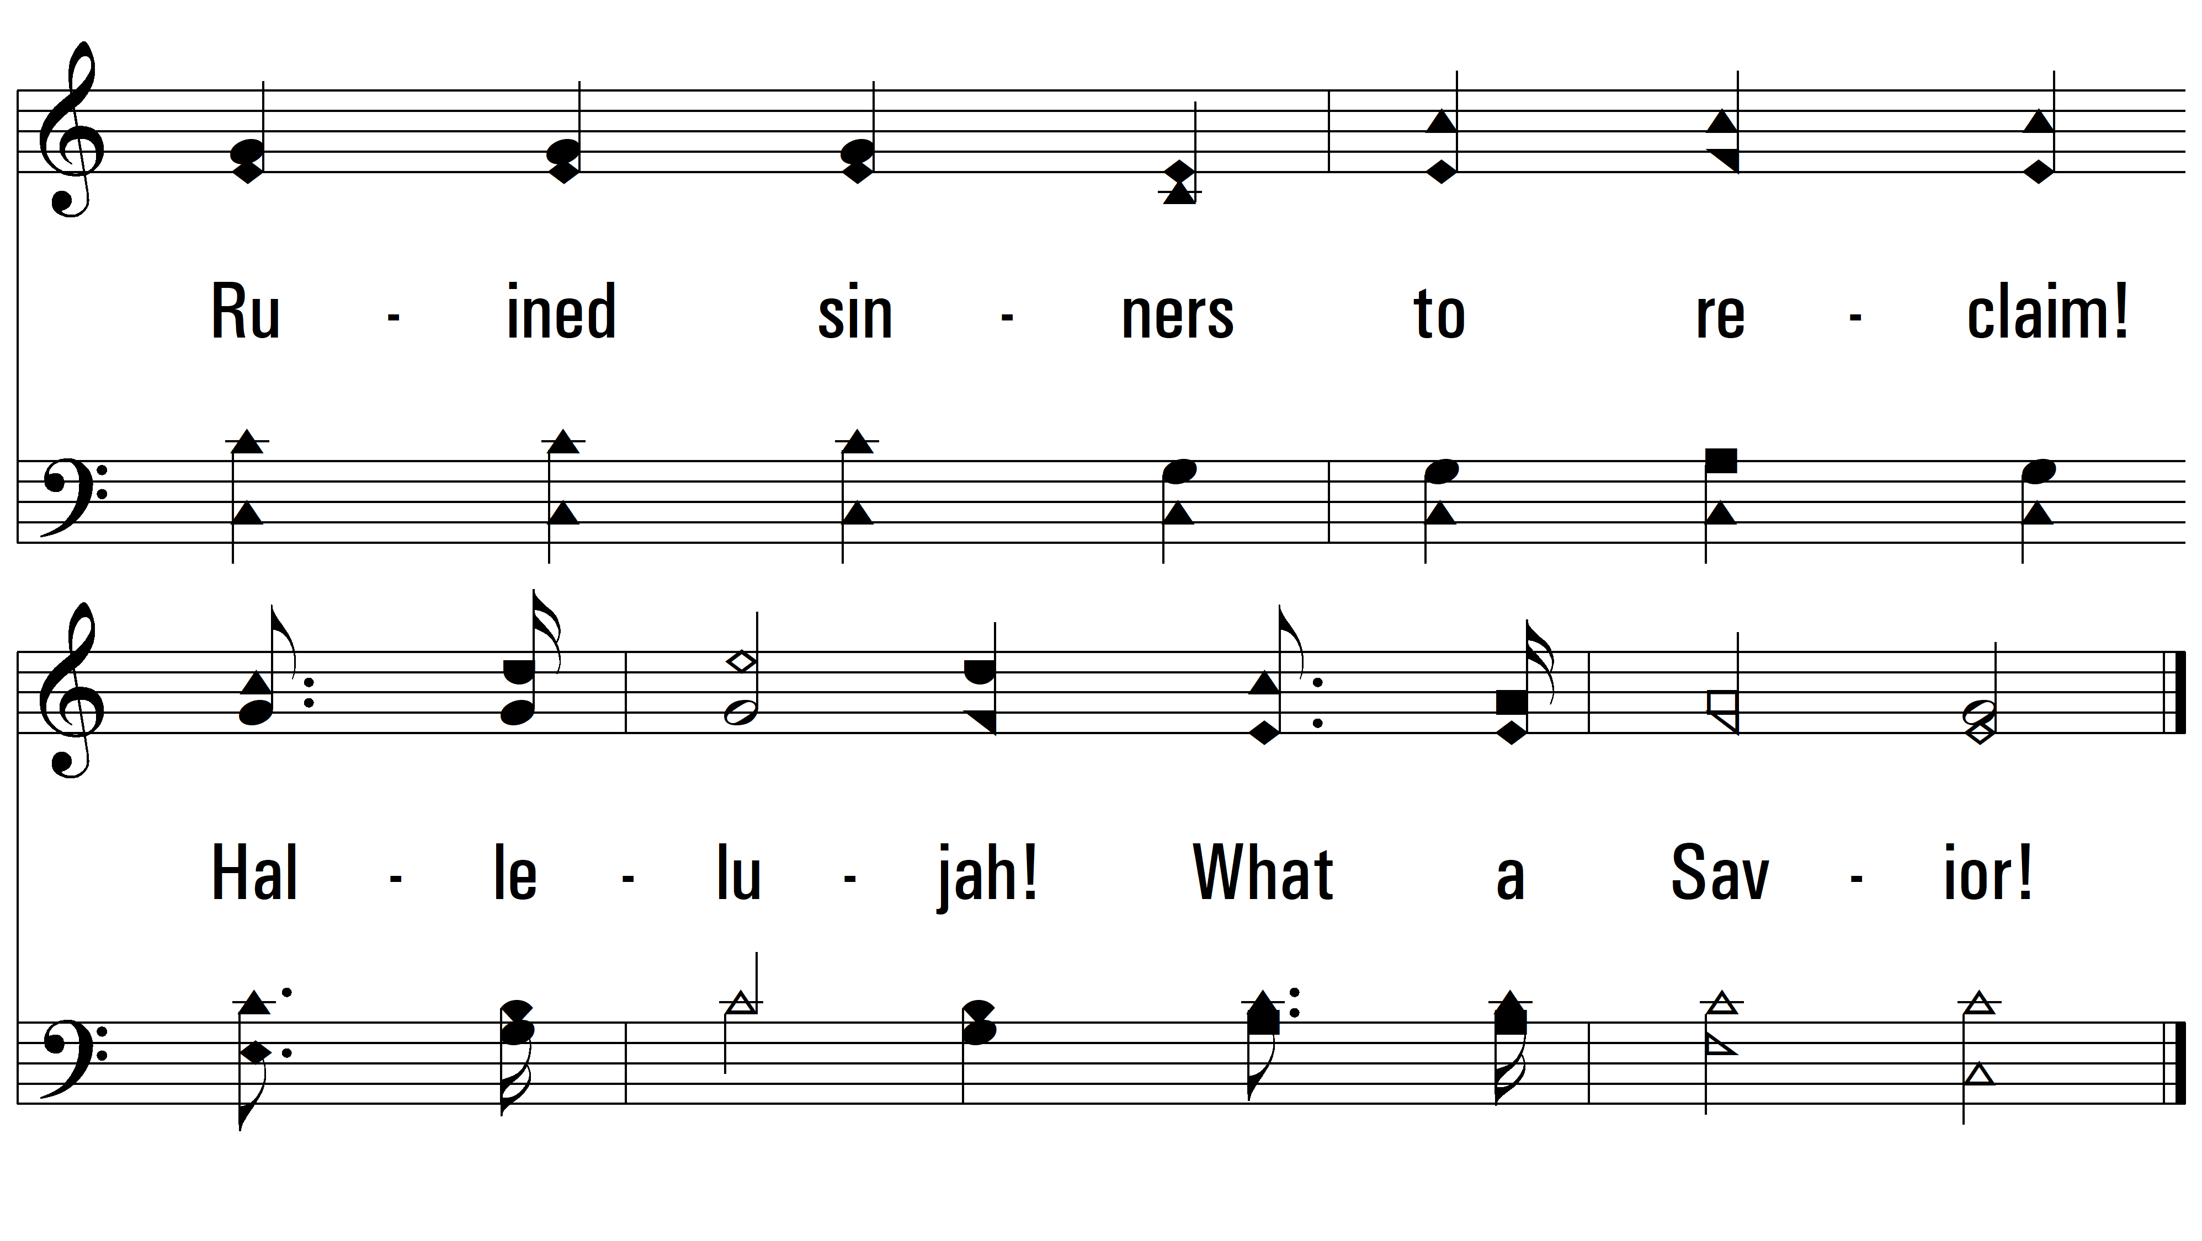
vs. 1

Slide 4
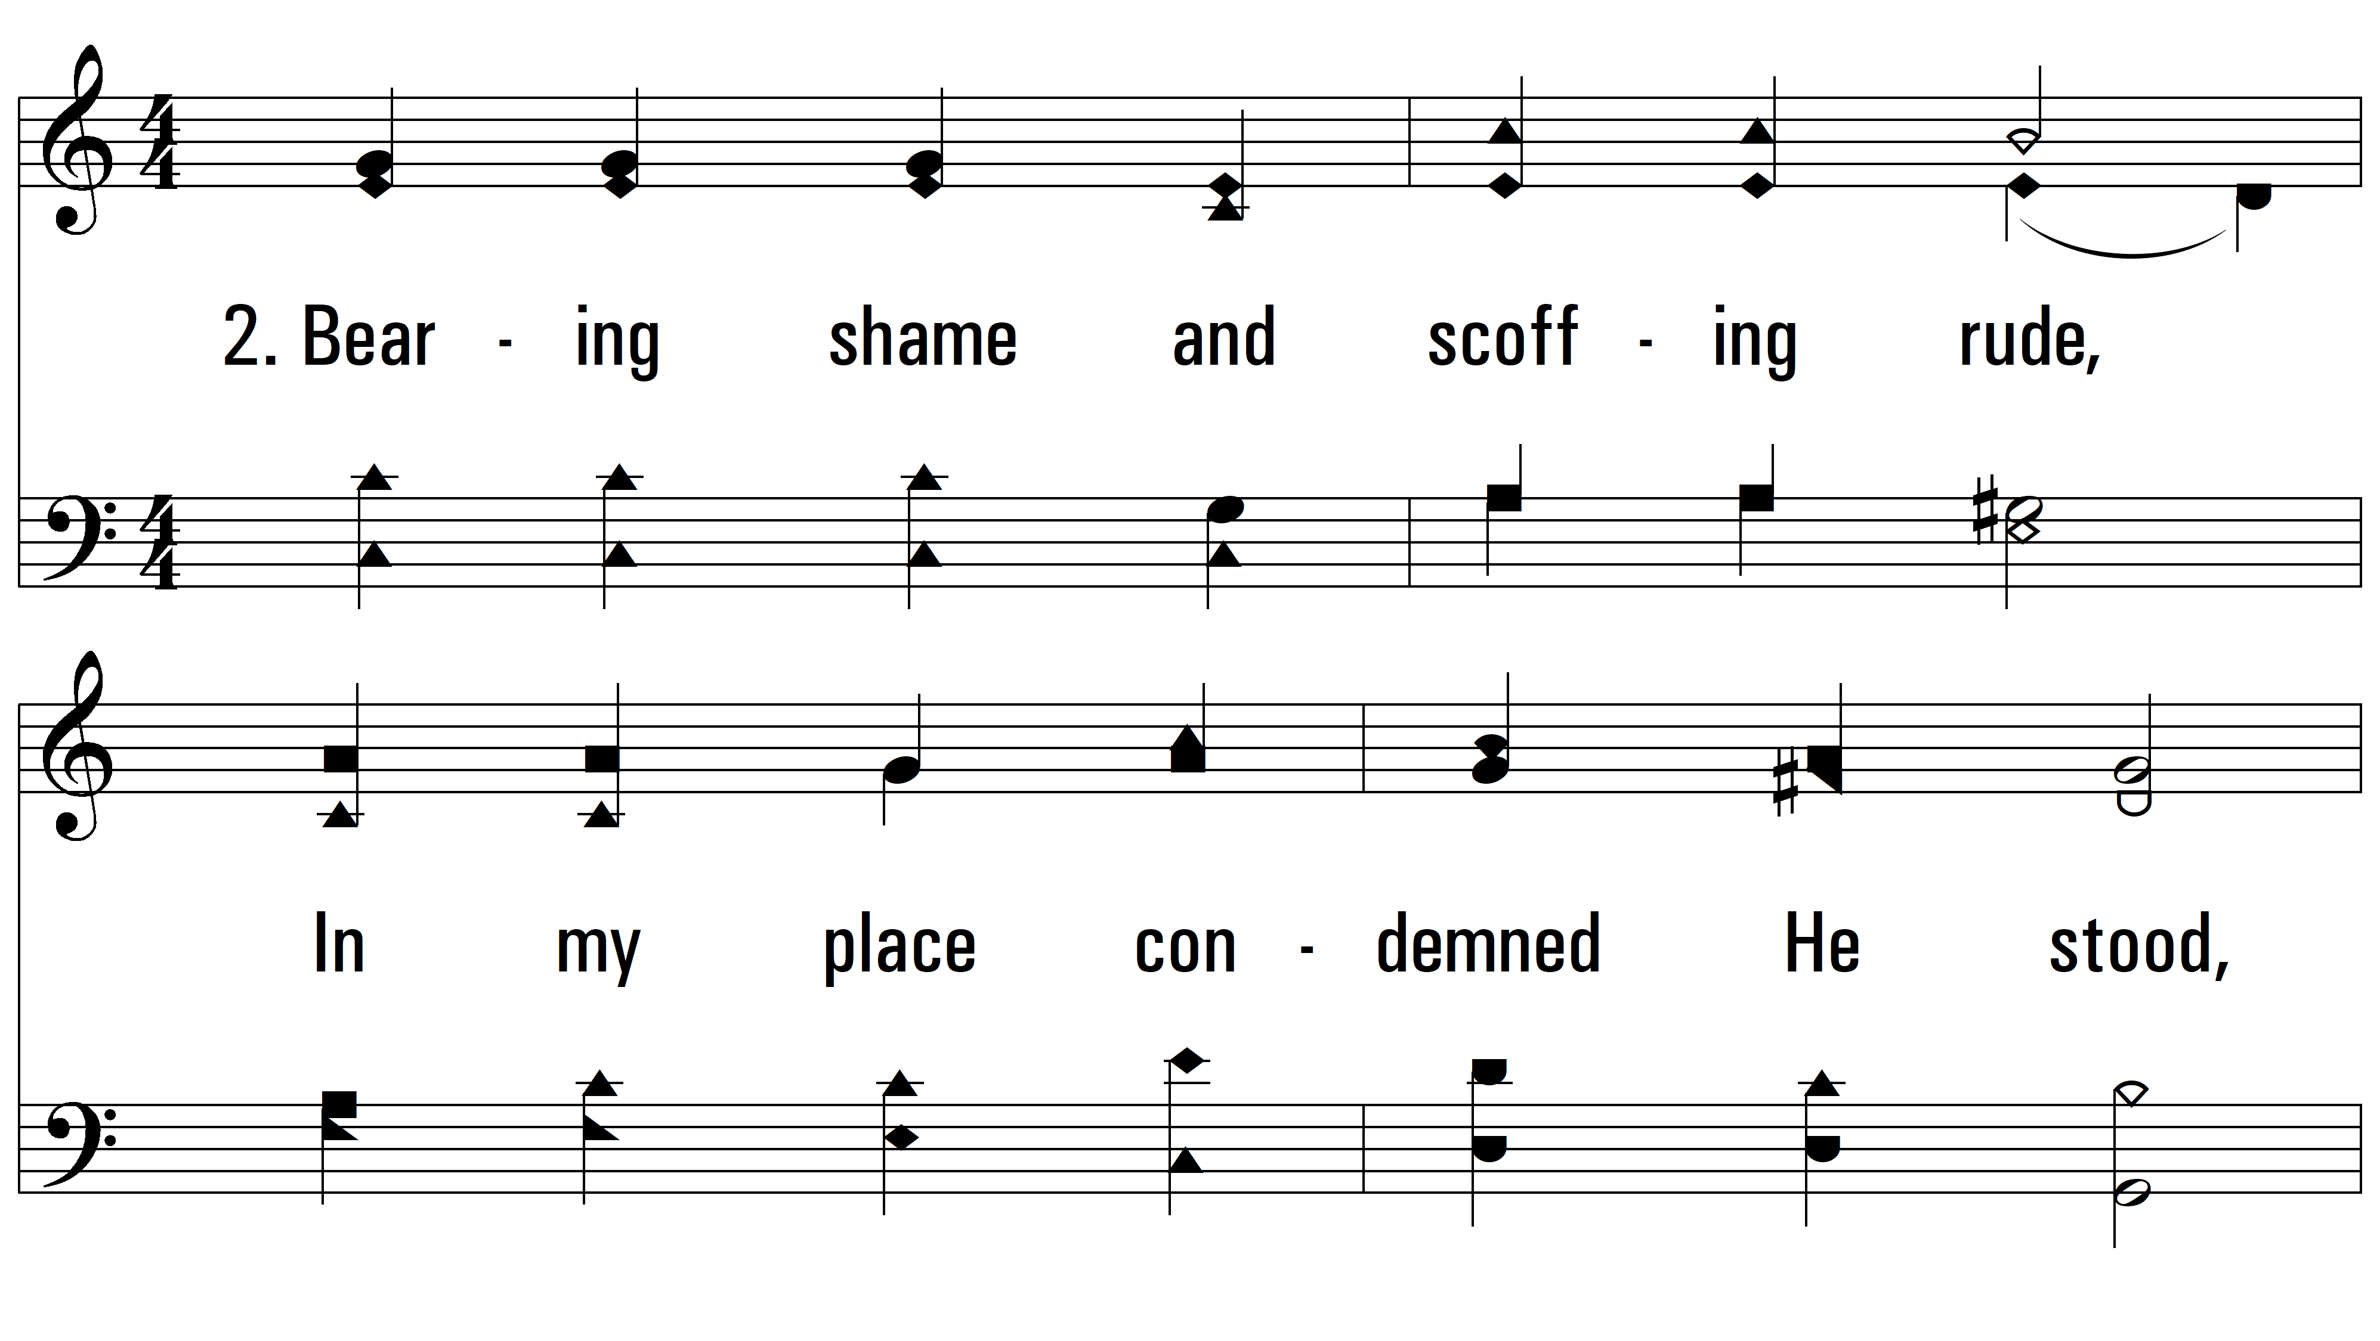
vs. 2 ~ Hallelujah! What A Savior

Slide 5
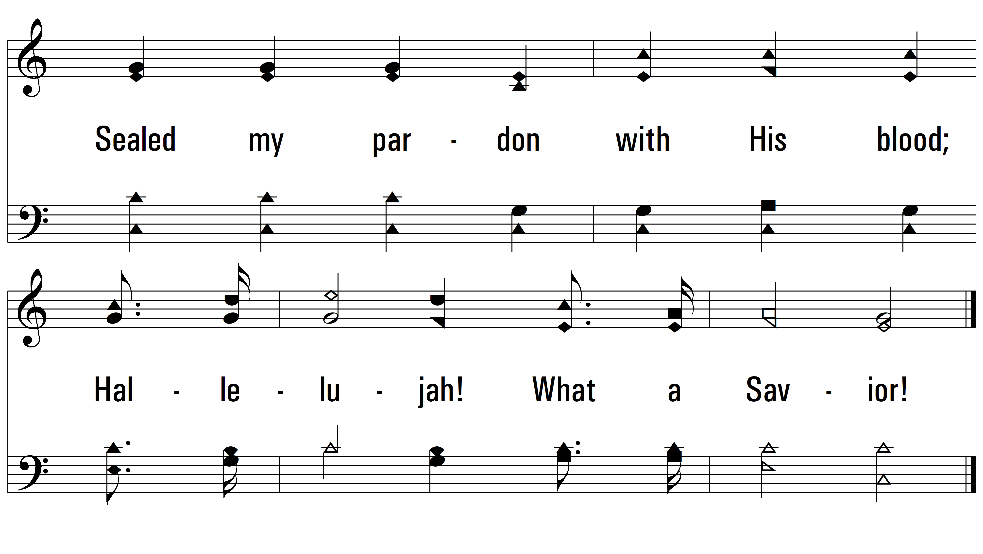
vs. 2

Slide 6
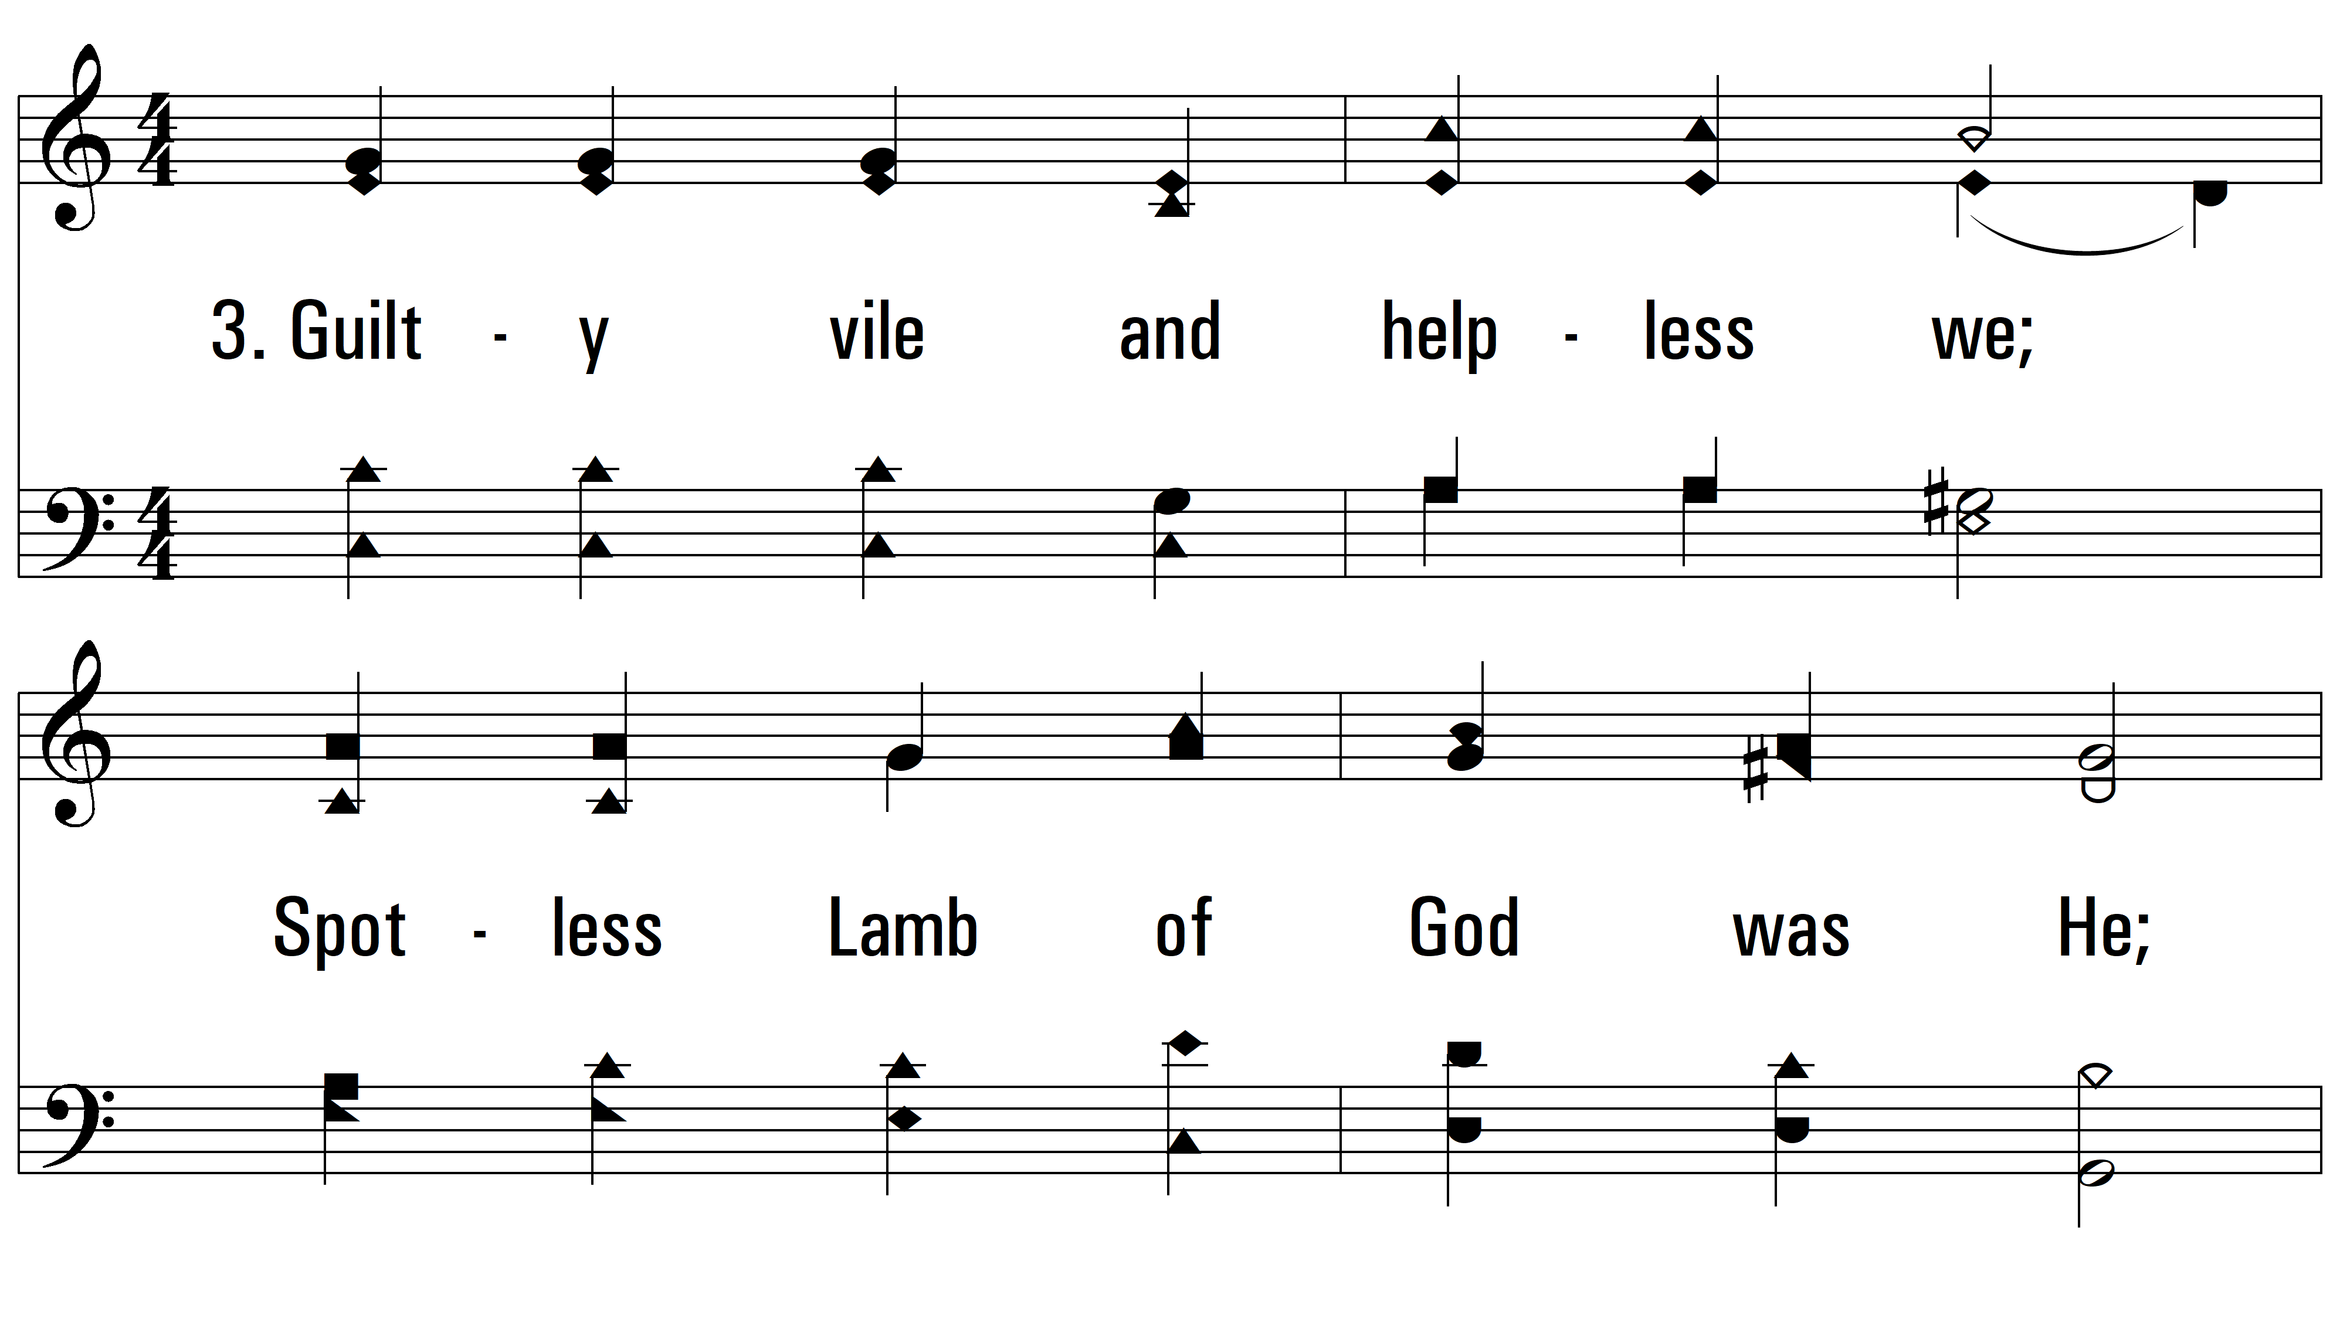
vs. 3 ~ Hallelujah! What A Savior

Slide 7
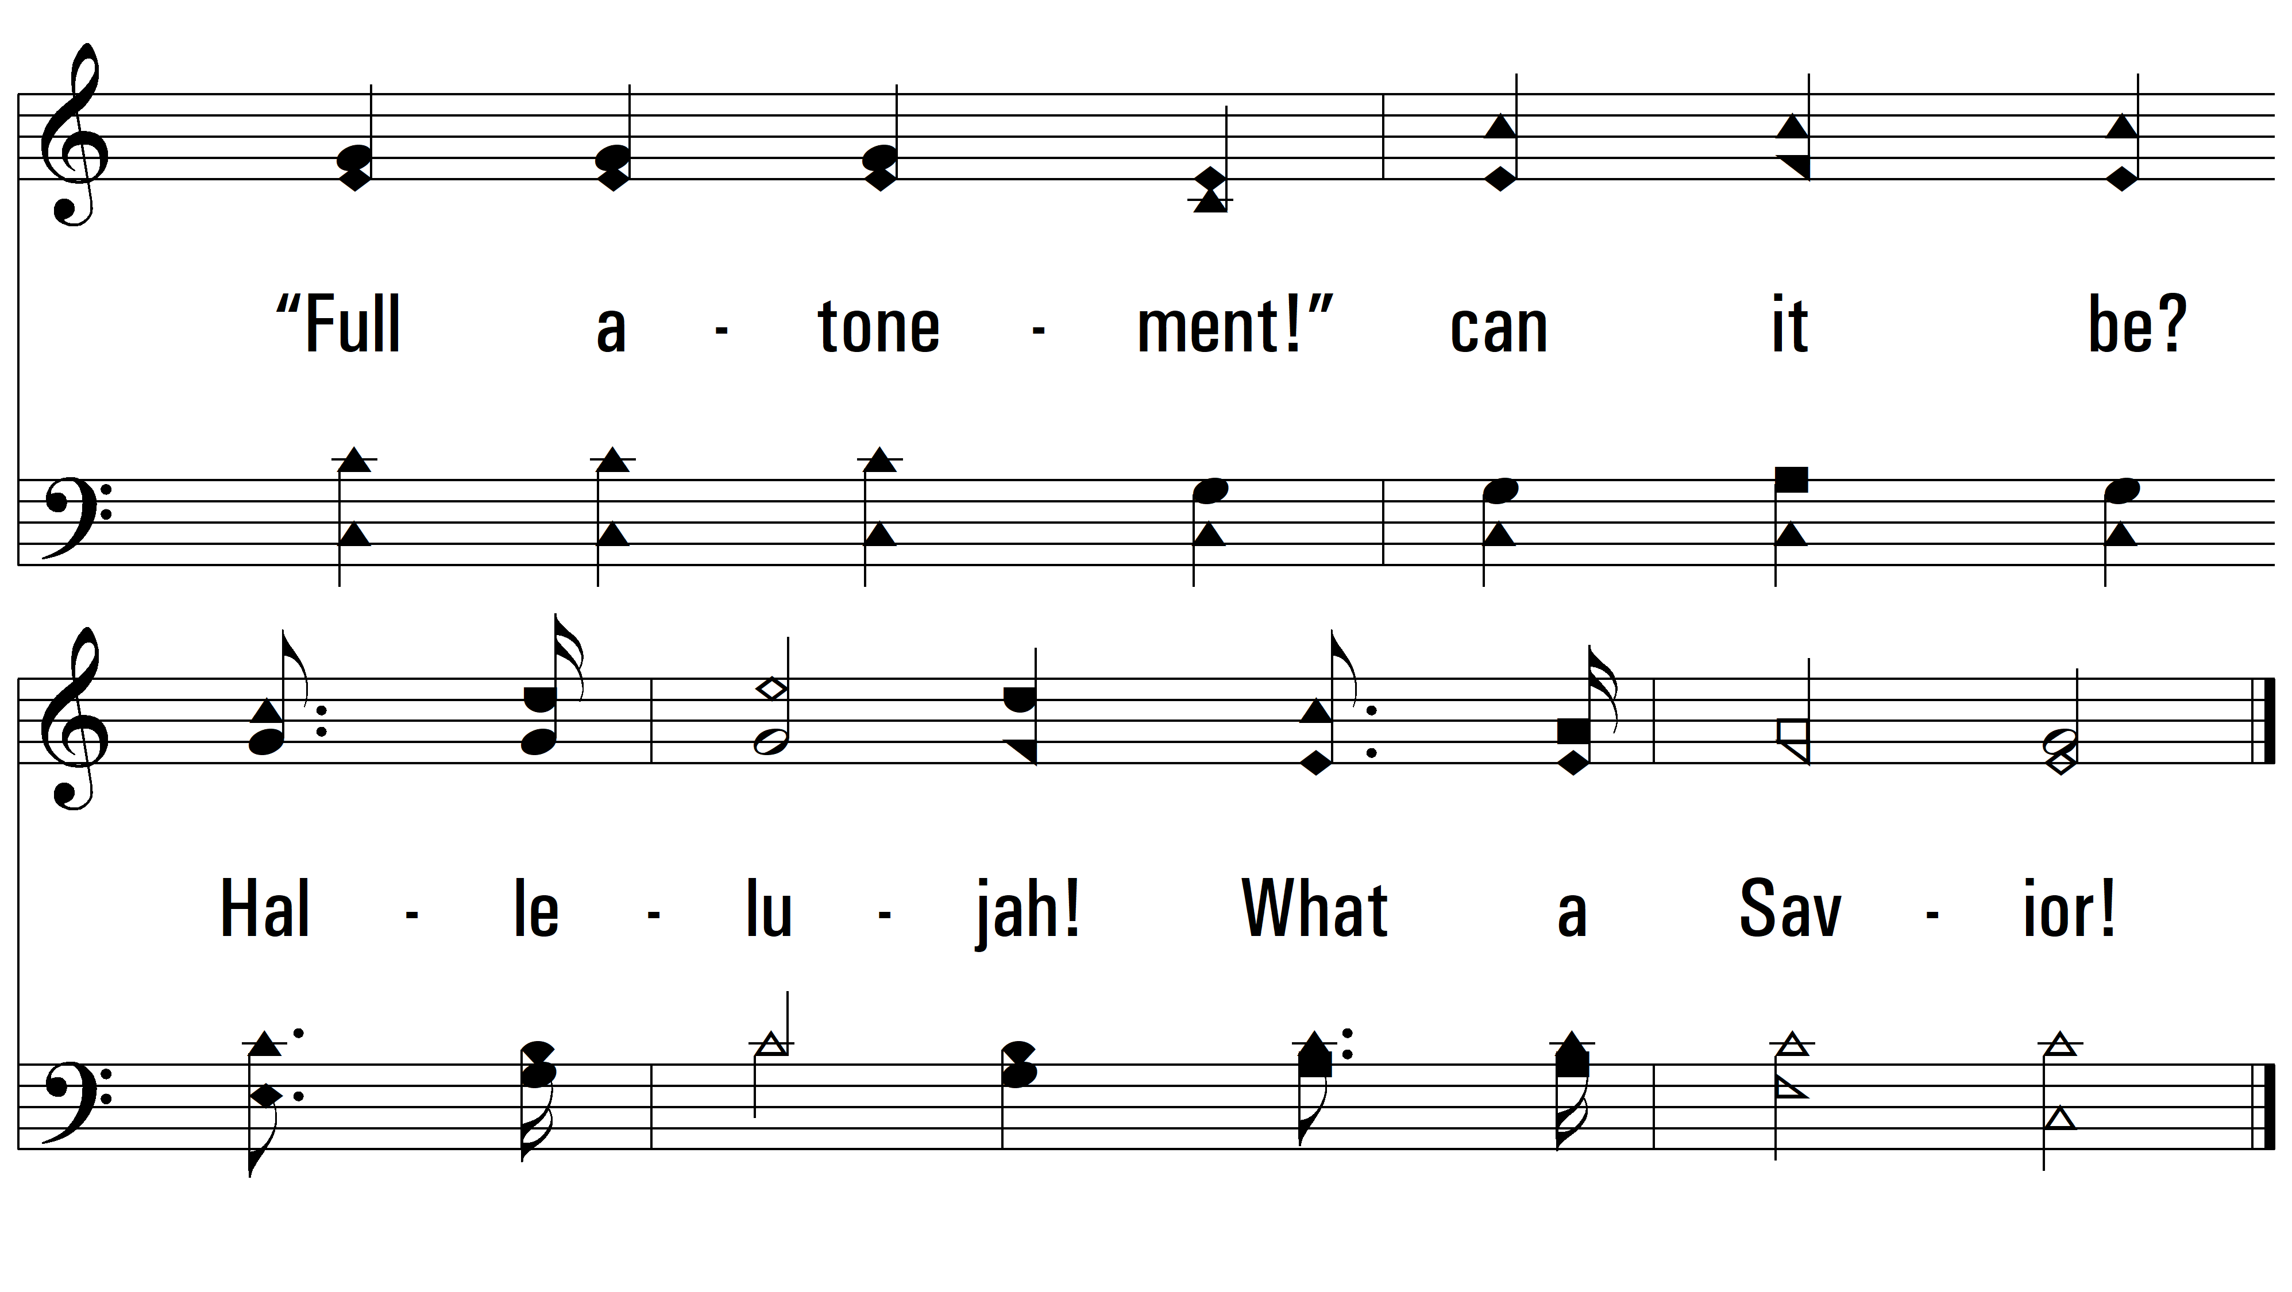
vs. 3

Slide 8
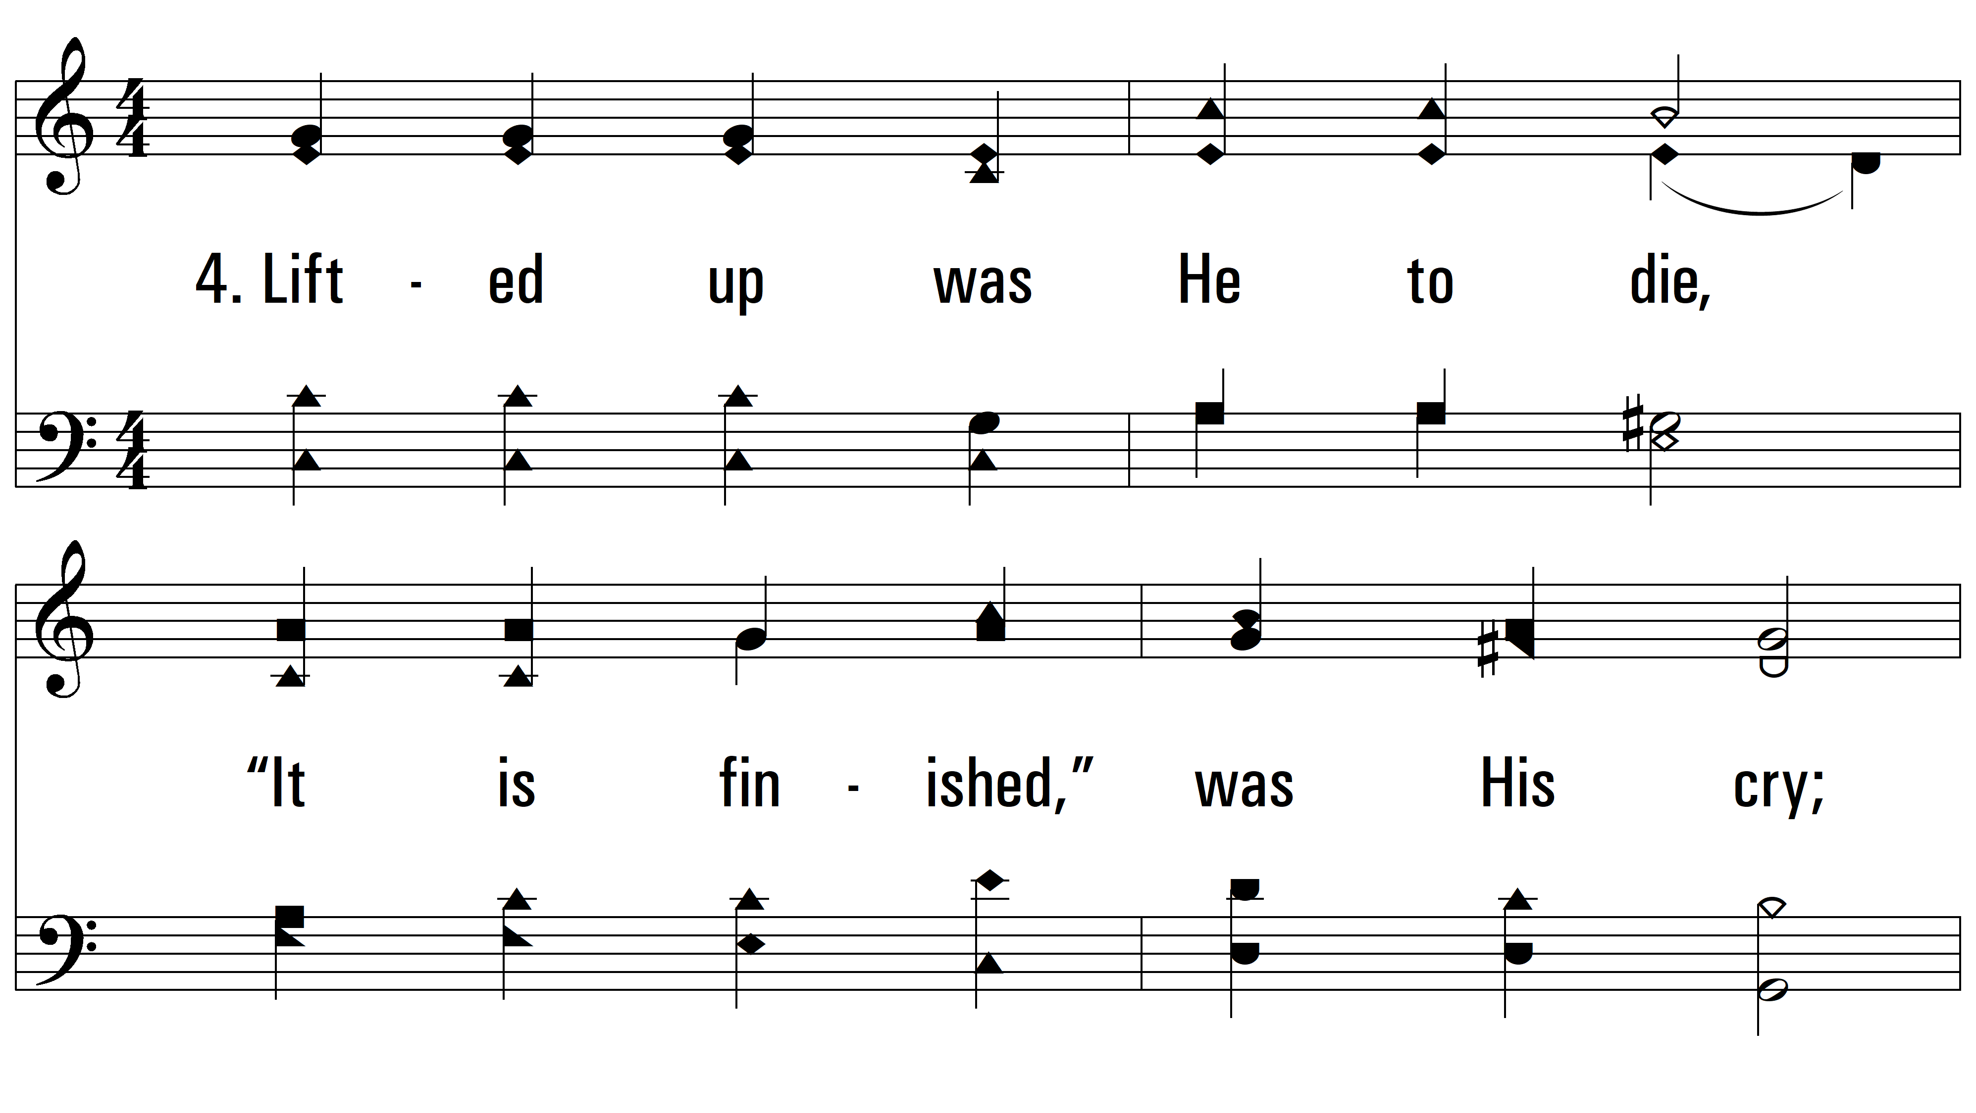
vs. 4 ~ Hallelujah! What A Savior

Slide 9
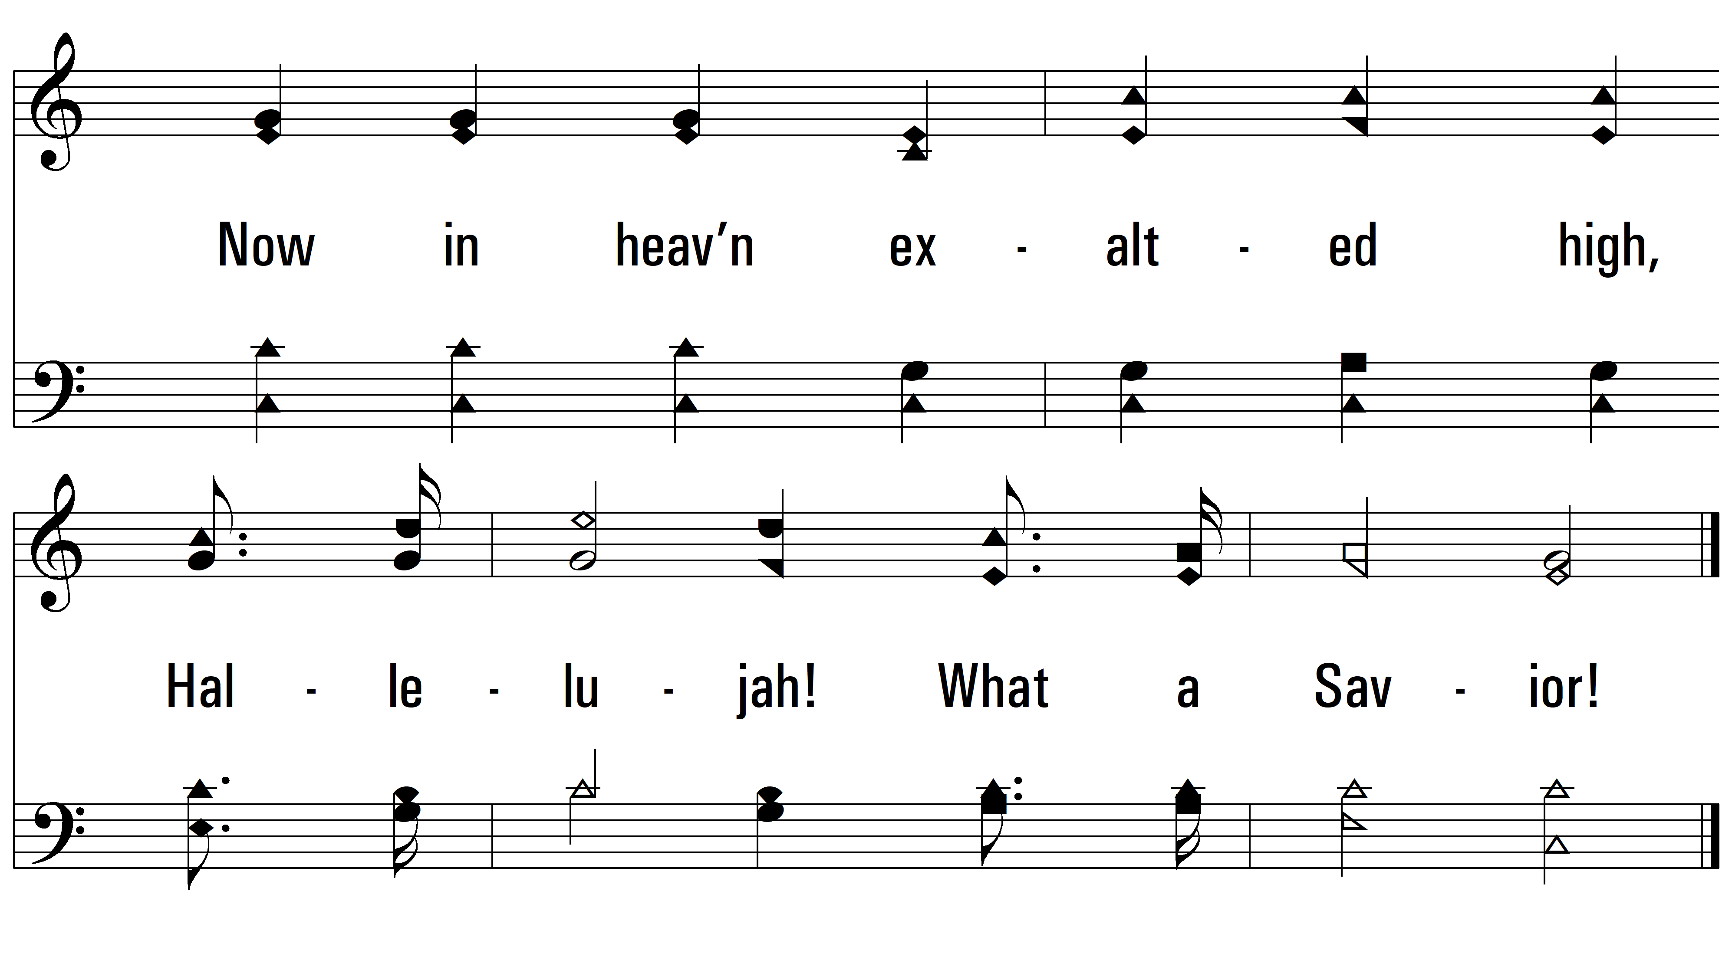
vs. 4

Slide 10
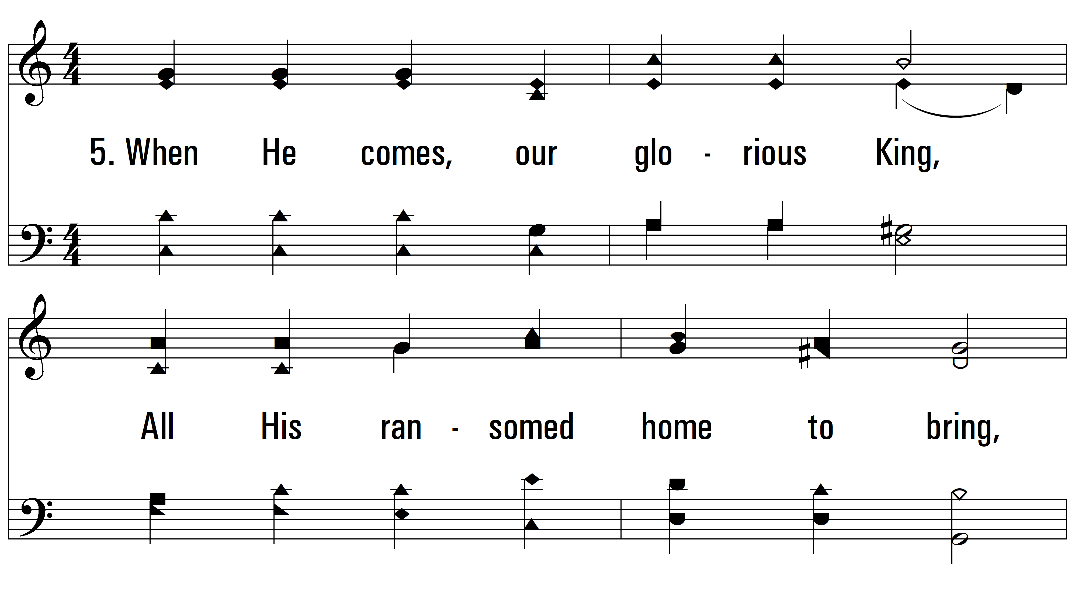
vs. 5 ~ Hallelujah! What A Savior

Slide 11
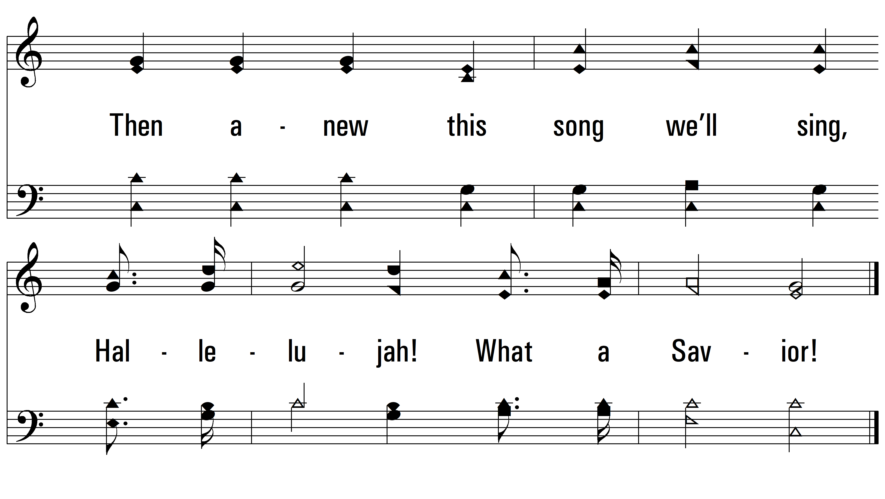
vs. 5
PDHymns.com
END

