Slide 1
Hallelujah! We Shall Rise
Words: | J. E. Thomas (1904)
Music: | J. E. Thomas (1904)
4/4
B^{b}/F - SOL
Verses: 3/Chorus
Lead - | SOL
Alto - | MI
Tenor - | DO
Bass - | DO
PDHymns.com

Slide 2
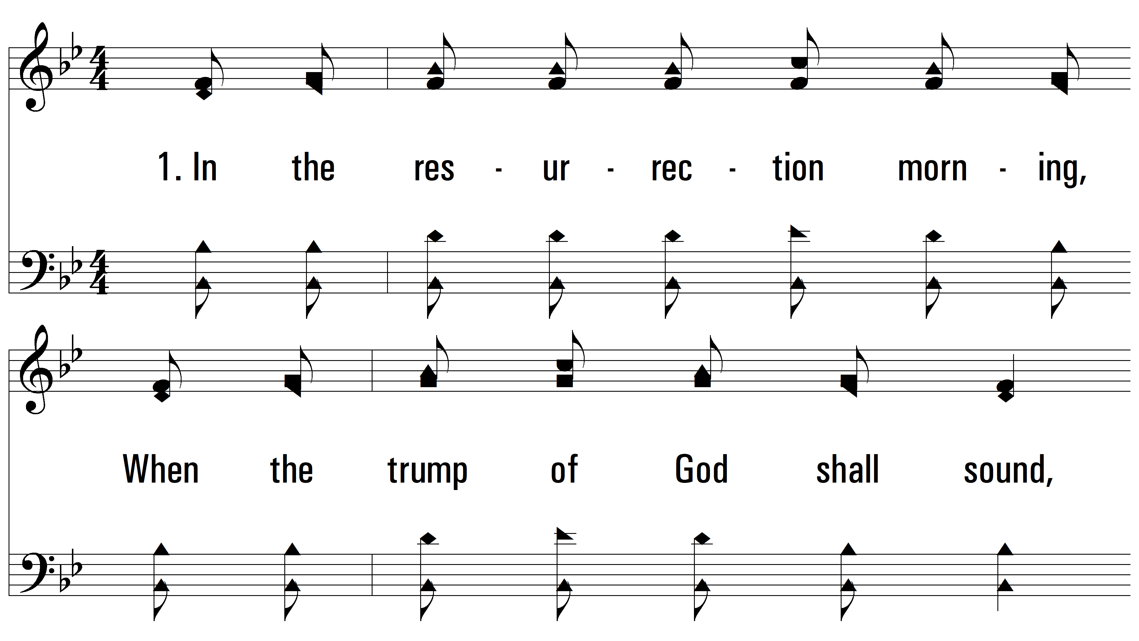
vs. 1 ~ Hallelujah! We Shall Rise

Slide 3
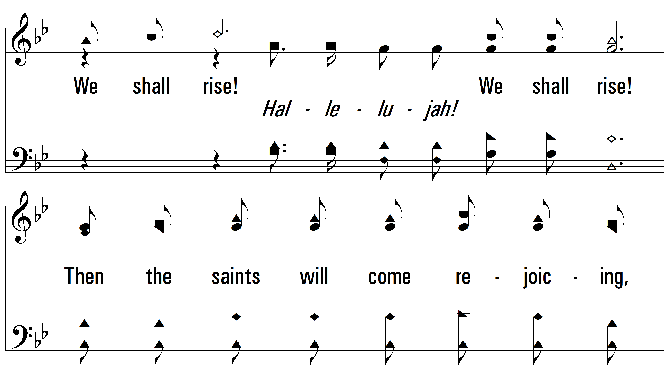
vs. 1

Slide 4
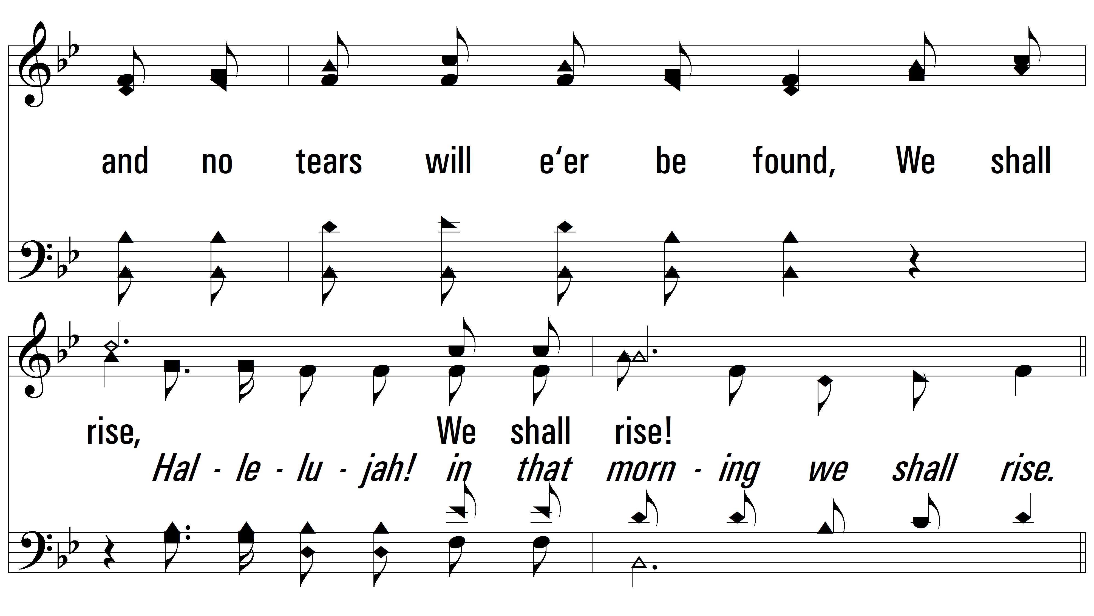
vs. 1

Slide 5
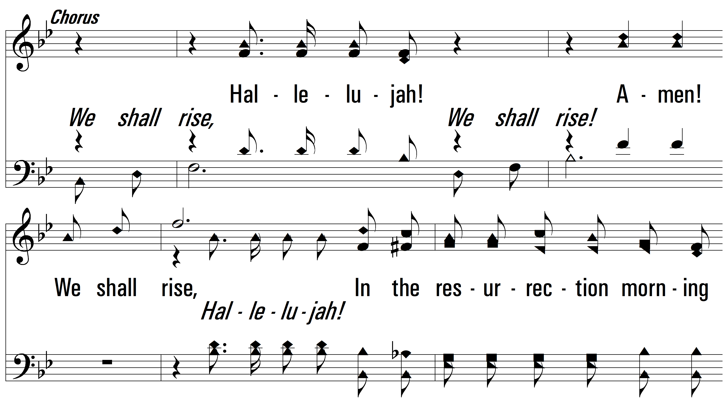
vs. 1

Slide 6
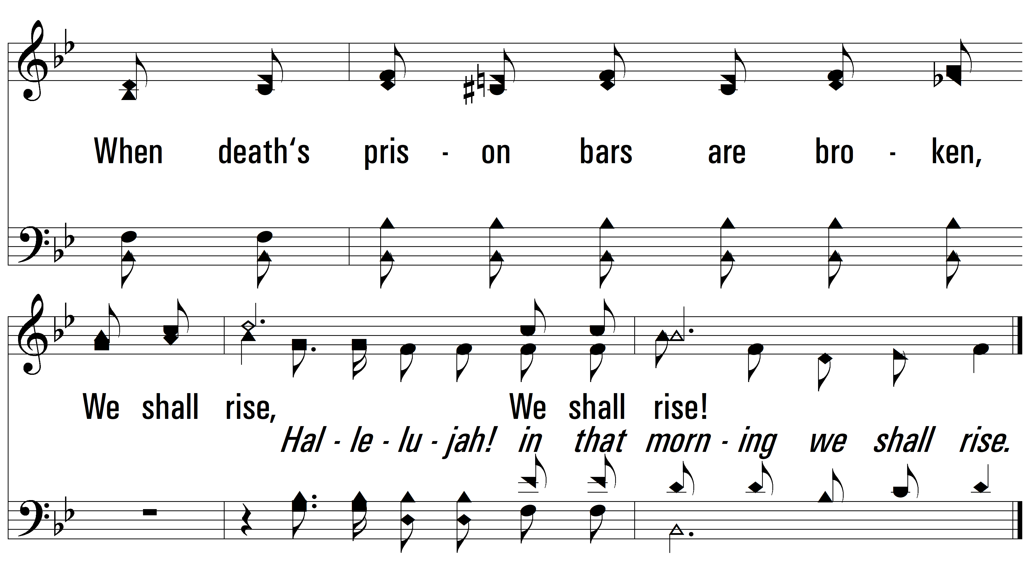
vs. 1

Slide 7
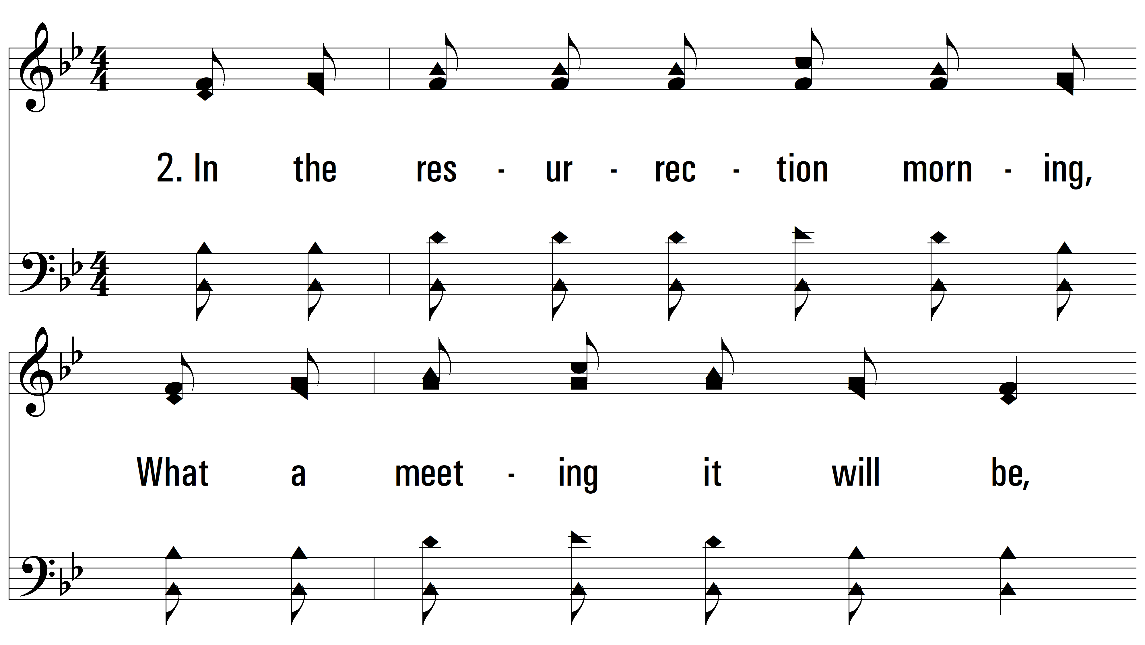
vs. 2 ~ Hallelujah! We Shall Rise

Slide 8
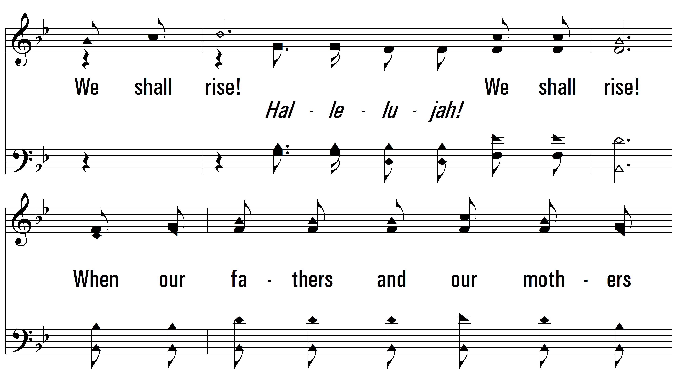
vs. 2

Slide 9
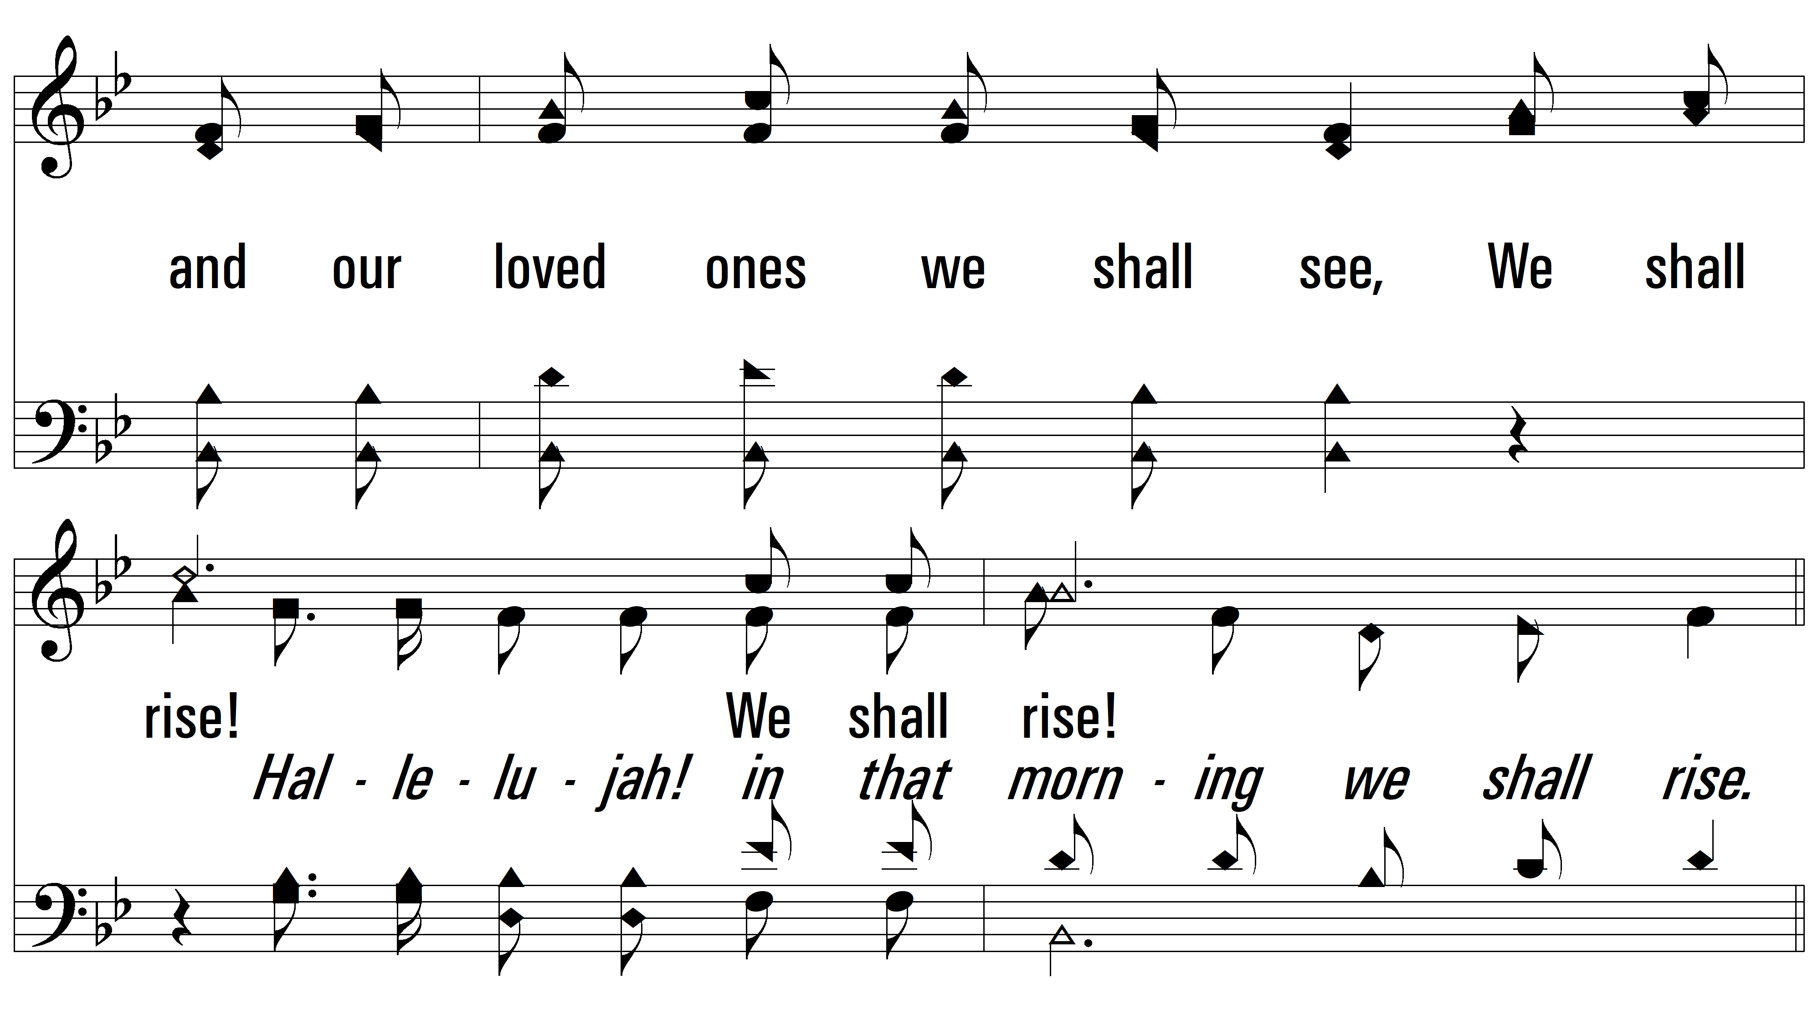
vs. 2

Slide 10
vs. 2

Slide 11
vs. 2

Slide 12
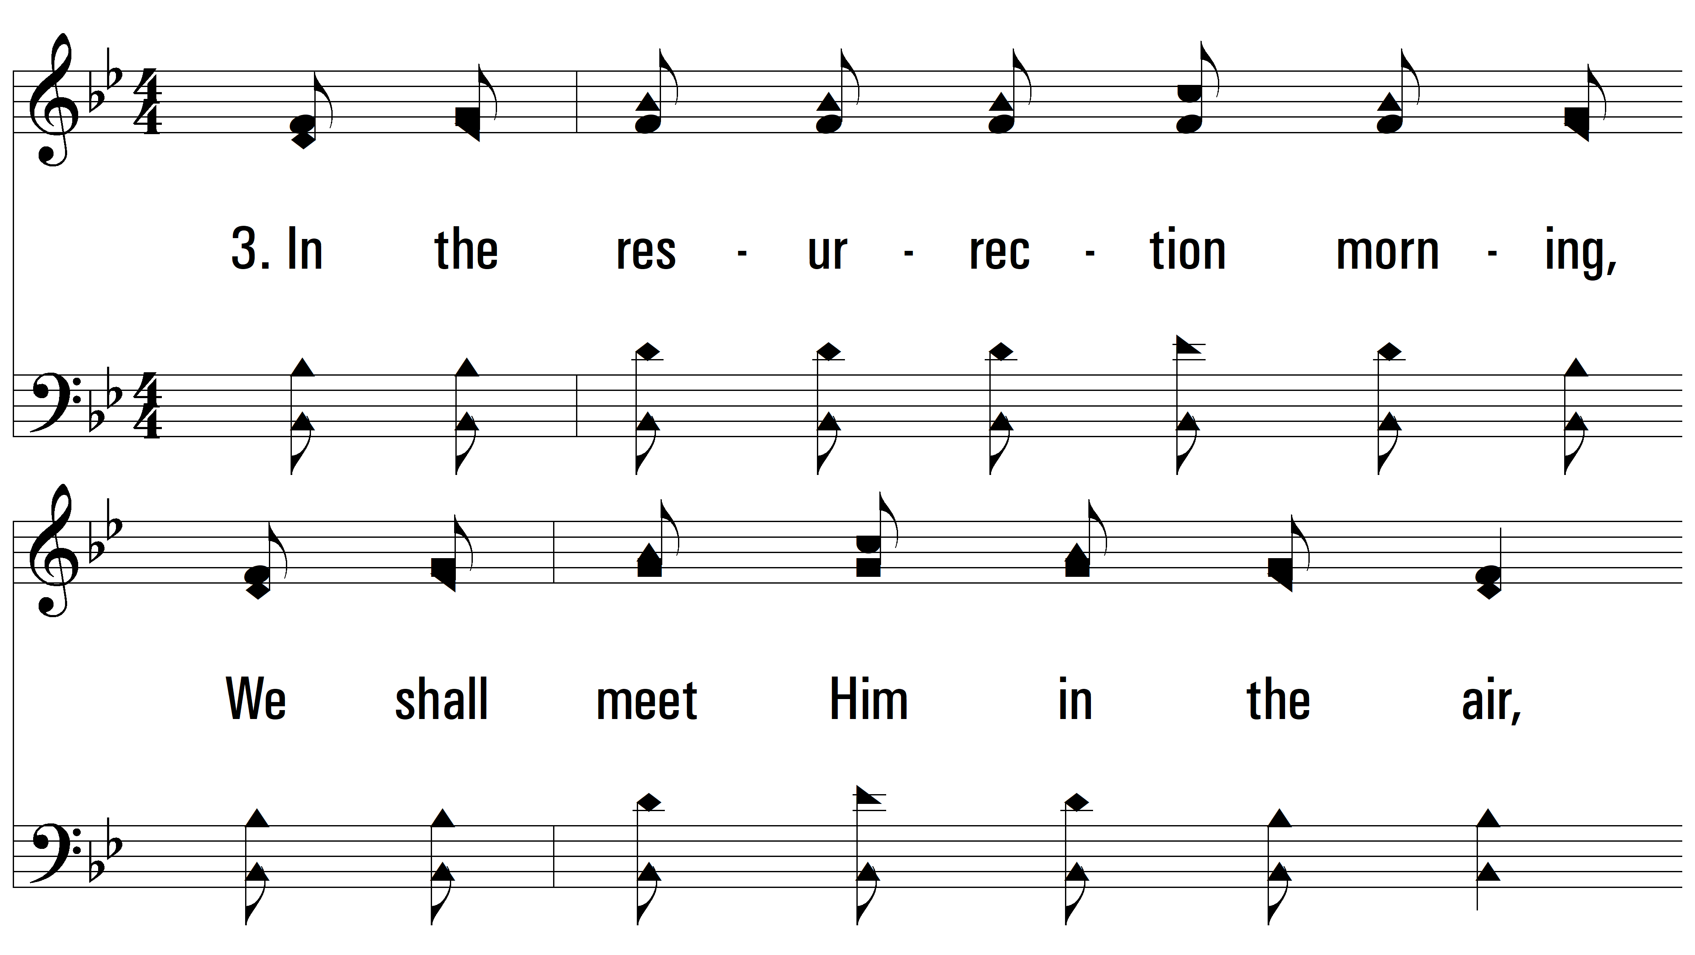
vs. 3 ~ Hallelujah! We Shall Rise

Slide 13
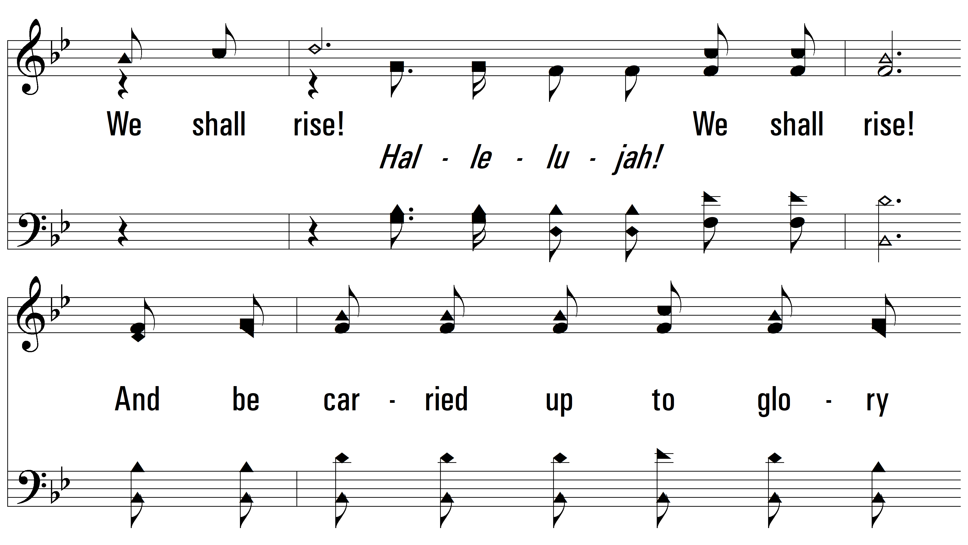
vs. 3

Slide 14
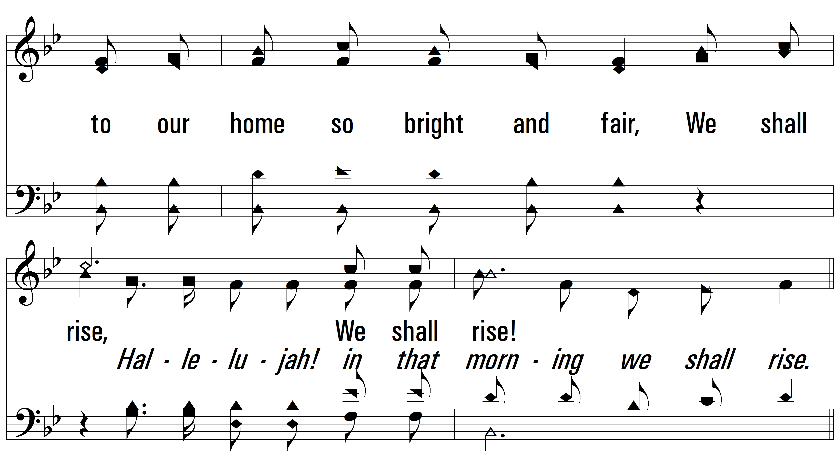
vs. 3

Slide 15
vs. 3

Slide 16
vs. 3
PDHymns.com
END

